Slide 1

Potential Locations for a Microbrewery in Portland, Oregon
April 9, 2020

Slide 2

Portland is attractive to business and residents
Largest city in Oregon.
Second largest metro region in Northwest corner of USA.
Wide variety of outdoor recreational activities within 90 minutee.
Population is growing.
Last 20 years has seen huge growth in property development and rejuvination.

Slide 3
Focus on microbrewery
The population and culture of Portland has a taste for craft beers.
Oregon Craft Beer Association claims Portland has more microbreweries than any other city in the world.
There are several developing areas of Portland where there are few microbreweries.
The climate in the area is ripe for distinctive additions to the microbrewery collection.

Slide 4
Data Acquisition and Preparation
Location data available for free from Foursquare.
50 microbreweries within a 6km radius of downtown Portland.
The data was easily manipulable.
Mapped initial data.

Slide 5
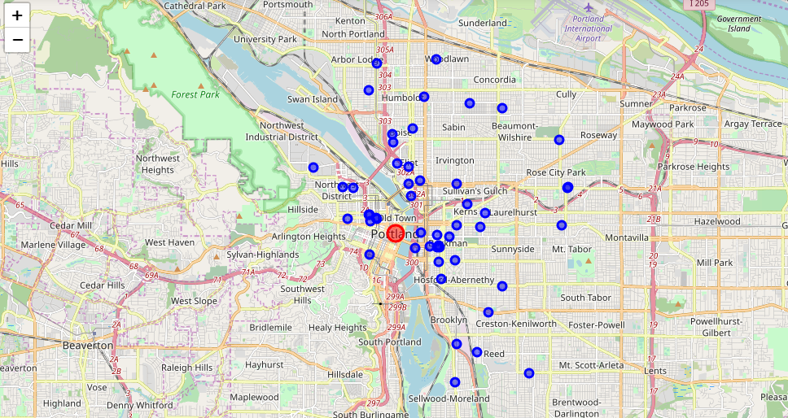
Locations of the Microbreweries
Note density around downtown

Slide 6
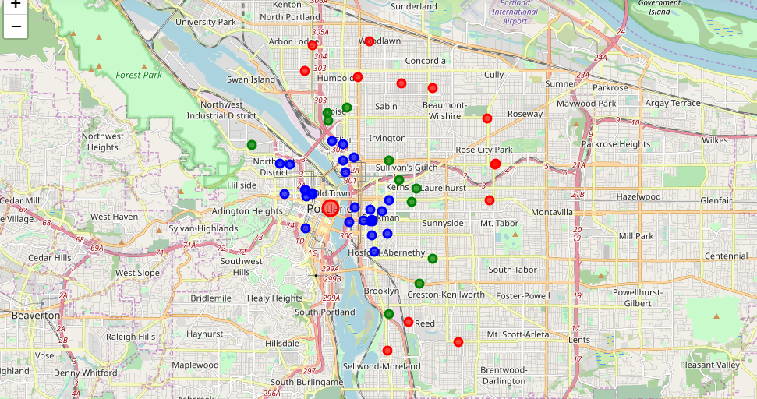
K-means cluster results

Slide 7
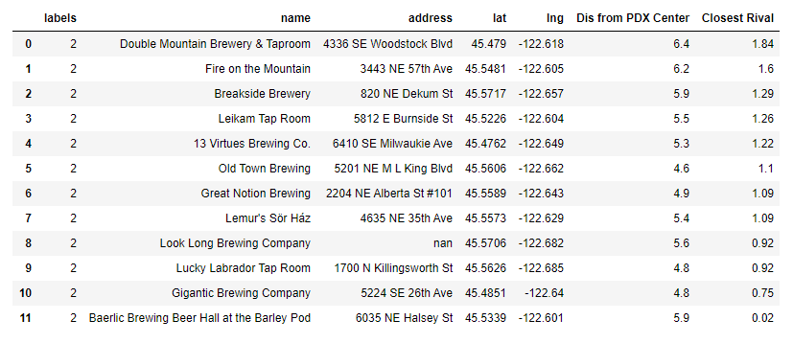
Data on the red cluster microbreweries

Slide 8
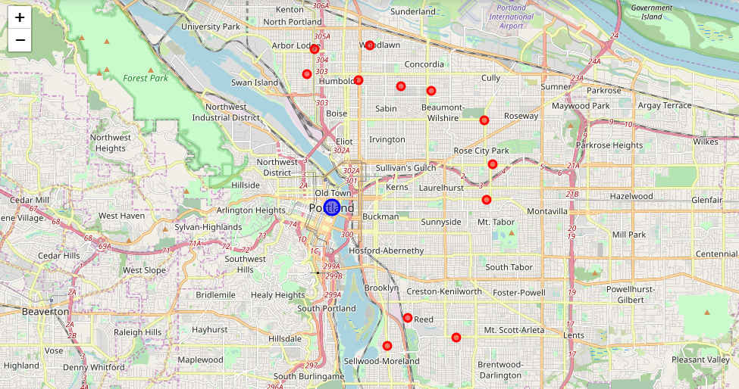
Red cluster: most promising locations

Slide 9
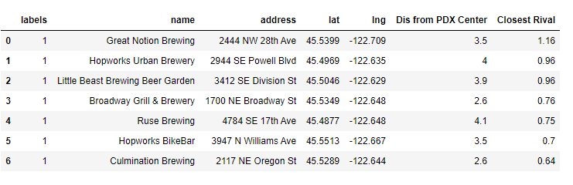
Data on the green cluster microbreweries
Data on microbreweries with a competitor closer than 500 meters has been dropped from this table.

Slide 10
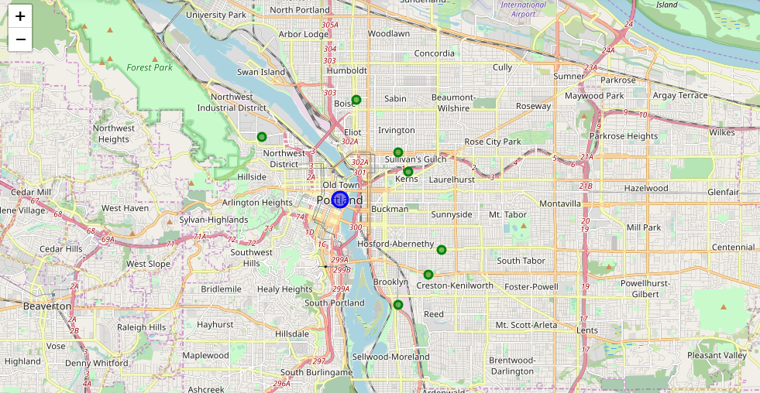
Green cluster: explore locations after red cluster

Slide 11
Conclusions
NE and SE Portland have sufficient space to locate a microbrewery more than 500 meters from a competitor.
The red cluster locations are the prime area for further research.
Additional considerations, such as real estate prices, zoning laws, available parking, etc. should be considered when making a final decision.

Slide 12
The End
Thank you!
Andrew McNall, Ph.D.
Data Scientist
armcnall@gmail.com

