Slide 1
Microsoft and Containers
Andrew Moll
@AskTheData

Slide 2
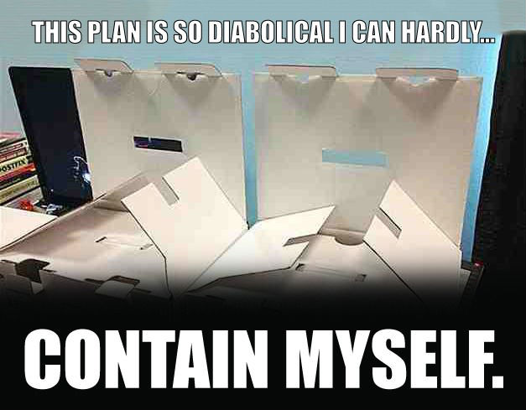

Slide 3
Container 101
What is a Container
Declarative packaging
Unit of deployment
Isolated environment
Isolated resources
Why Containers
Avoid “It works on my machine”
Write once run anywhere
Very lightweight
Massive Scale
Repeatable and reliable execution
Dev Ops
Great for microservices
Notes:
House with Shared Kitchen

Slide 4
Virtual Machine Vs Container
Containers are isolated, but share OS and, where appropriate, bins/libraries
App A
App A’
App B
Bins/Libs
Bins/Libs
Bins/Libs
Guest OS
Guest OS
Guest OS
App A
App A’
App B
App B’
App B
App B’
App B
App B’
Bins/Libs
Bins/Libs
Hypervisor
Docker Engine
Host OS
Host OS
Server
Server

Slide 5
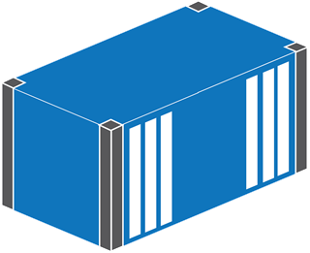
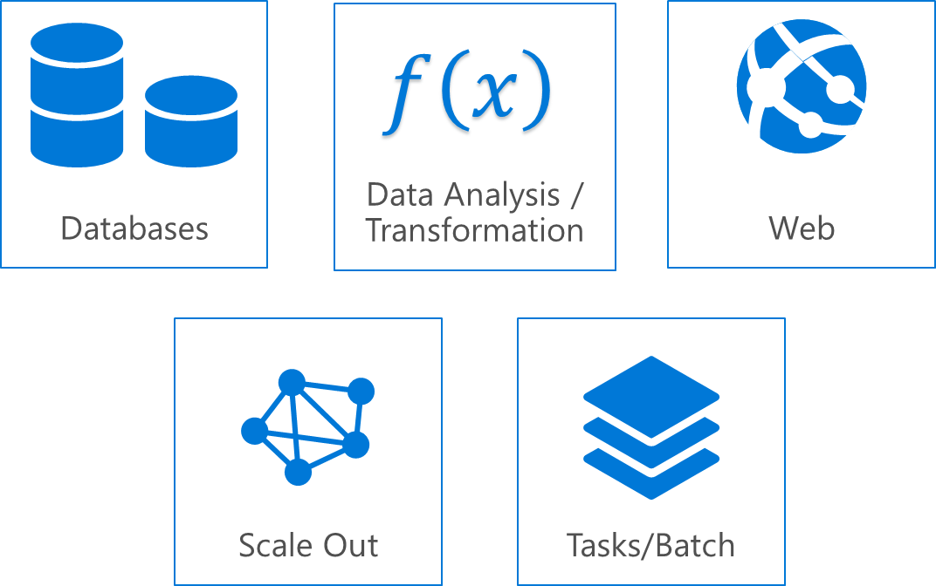
Container Use Cases
Workload Characteristics
Scale out
Distributed
State separated
Rapid (re)start
Deployment Characteristics
Efficient hosting
Multitenancy
Rapid deployment
Highly automatable
Rapid scaling
Notes:
Data Processing/Data Transformation
Web: Stop the webrole until the request comes in and then start it when you begin receiving them
Databases: Data that you care about should not reside in a container. Scale quickly, then each container needs to bring the data with it..
Tasks/Batch: Run and then done. Can save state or just start a new instance

Slide 6

Isolation Technology In Windows
Windows
Process
Job Object
Windows Server Container
Hyper-V Container
Hyper-V Virtual Machine
Faster and more efficient More isolated
Notes:
Use Hyper-V Containers when:
The host doesn’t trust the code it’s hosting in the container
You want a version of Windows different than what’s running in the container host

Slide 7
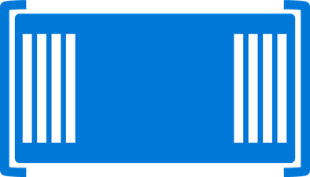

Windows Server Container
Isolated runtime environment for hosted applications
Docker
PS WMI
Container Management stack
User mode
Kernel
Kernel mode
Host OS
Notes:
Management stack allows for our partners to build on top. Provide both Docker and PS
Can’t run a Linux on a windows or a windows on linux

Slide 8

Hyper-V Container
Isolated runtime environment for hosted applications leveraging additional Hyper-V provided isolation boundary
Docker
PS WMI
Hyper-V partition(s)
Container Management stack
User mode
Kernel
Kernel
Kernel
Kernel mode
Host OS
Hypervisor

Slide 9
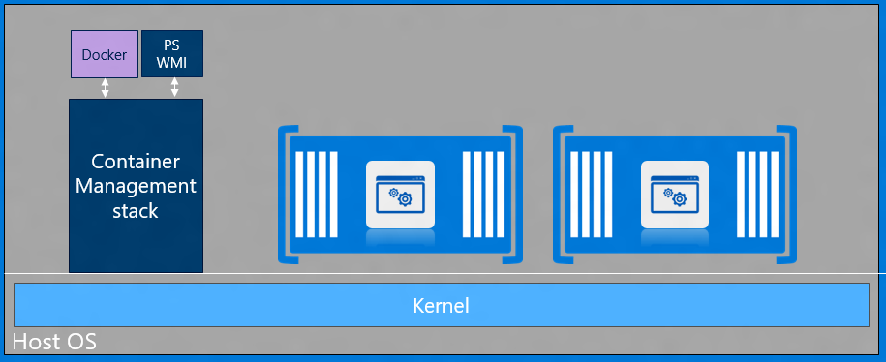
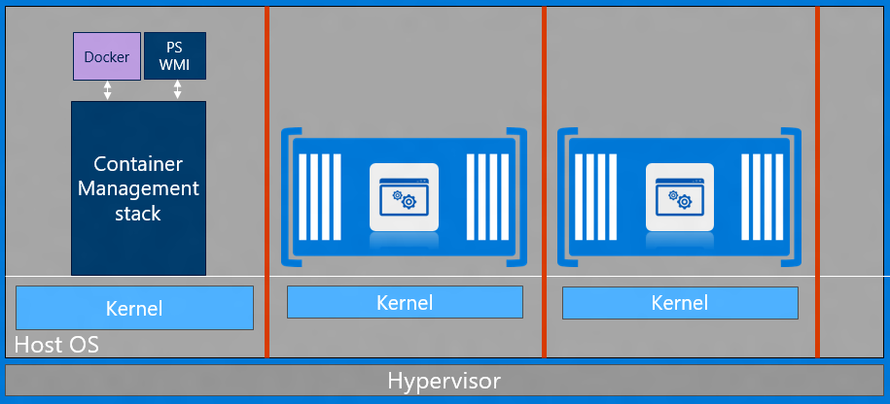
Container Use Cases
Windows Server Container
Trusted multi-tenancy
Highly automatable
Scalable / Elastic
Small footprint / Efficient
Resource Management
Hyper-V Containers
Windows Server Container
Untrusted / hostile multi-tenancy
Regulated workloads
Notes:
Windows two type of containers allow for trusted and non-trusted multitenancy environment.

Slide 10
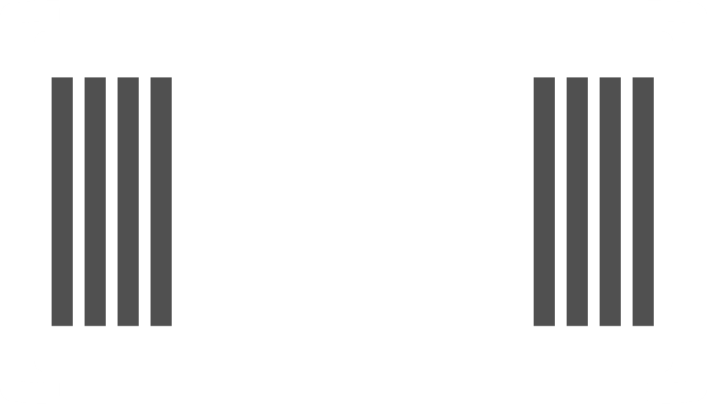


Container Deployment options
Container
Operating System
VM
Operating System
Physical System

Slide 11
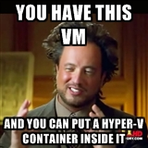

Slide 12
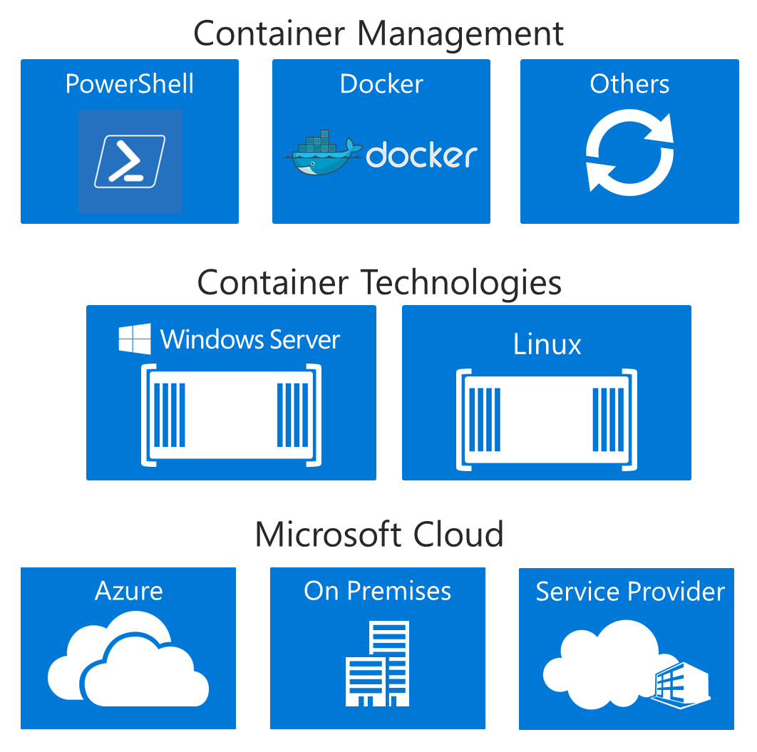
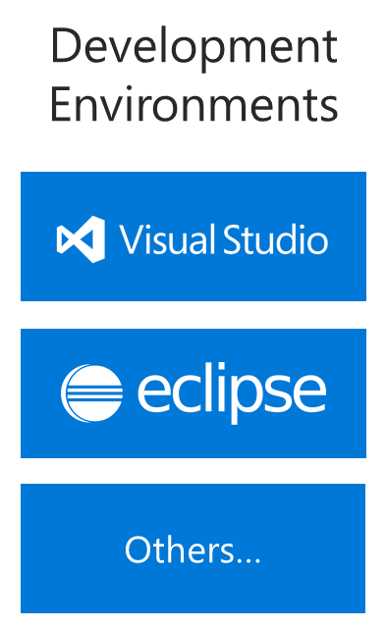
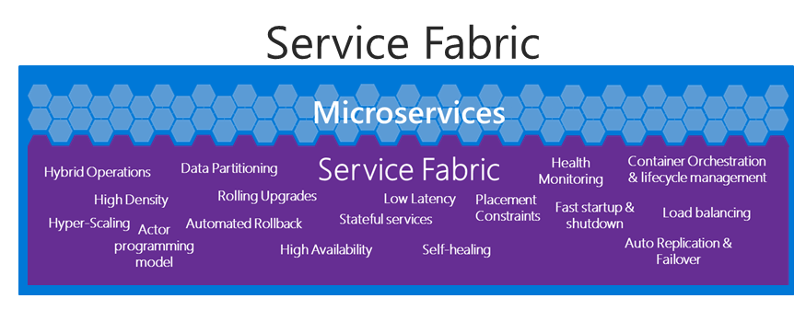
Containers In The Bigger Picture…
Notes:
Service fabric uses containers and we manage the isolation services

Slide 13
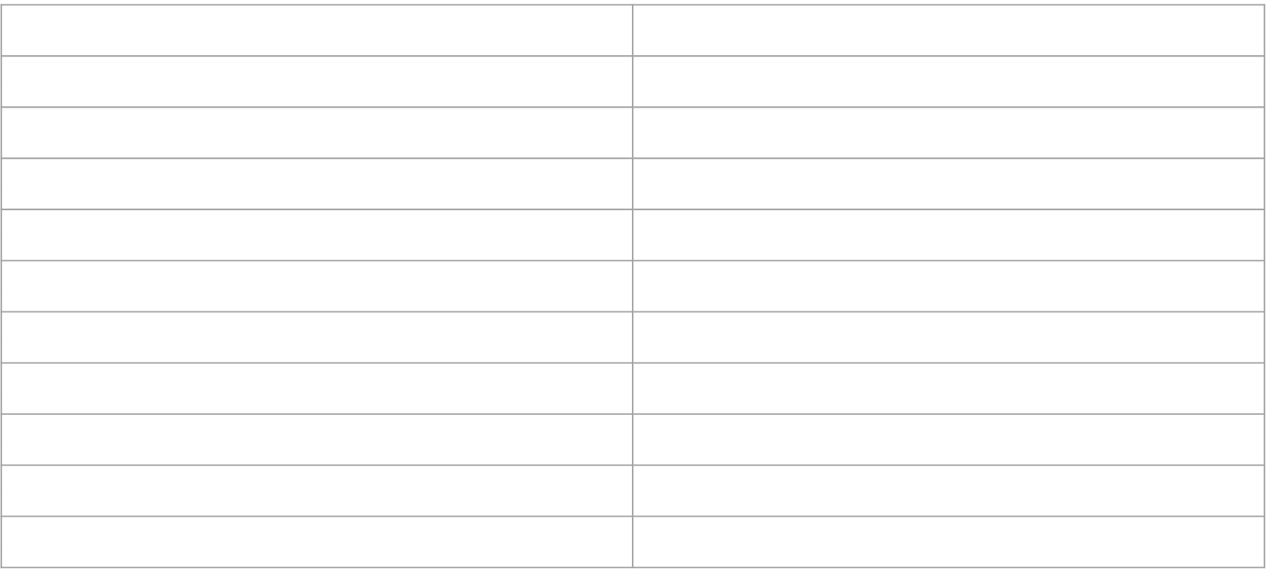
Windows Container Management
PowerShell
In-box management
Local
Highly automatable
Similar to VM cmdlets
Docker
Separate Download
Local
Central Repository
Customers that are familiar with Docker

Slide 14
Demo

Slide 15
Windows Container OS
WindowsServerCore
Highly compatible
Existing Windows Server (Core) applications
NanoServer
Optimized for high density
“Born in the cloud” applications
Distributed applications
Notes:
Distributed applications since tasks are smaller. We’re not backporting this, only windows server 2016

Slide 16
Nano Servers

Slide 17
Nano Server - Next Step in Our Cloud Journey
A new headless, 64-bit only, deployment option for Windows Server
Deep refactoring focused on
CloudOS infrastructure
Born-in-the-cloud applications

Slide 18
Nano Server - Roles & Features
Zero-footprint model
Server Roles and Optional Features live outside of Nano Server
Standalone packages that install like applications
Key Roles & Features
Hyper-V, Storage (SoFS), and Clustering
Core CLR, ASP.NET 5 & PaaS
Full Windows Server driver support
Antimalware optional package
System Center and Apps Insight agents to follow

Slide 19
Nano Server - Cloud Application platform
Born-in-the-cloud application support
Subset of Win32
CoreCLR, PaaS, and ASP.NET 5
Available as OS everywhere
Host OS for physical hardware
Guest OS in a VM
Windows Server containers
Hyper-V containers
Future additions
PowerShell Desired State Configuration (DSC) & PackageManagement
Additional Roles and Application Frameworks

Slide 20
Nano Server - Management
Eliminating the need to ever sit in front of a server
Configuration via PowerShell Desired State Configuration (DSC)
Remote management/automation via Core PowerShell and WMI
Integrate into DevOps toolchains

Slide 21
Roadmap
Nano Server is the future nucleus of Windows Server
Target for cloud components and Born-in-the-Cloud applications
New foundation for all components
Provides a Just Enough OS model for all applications
Not everything will run on Nano Server
Server Core provides compatibility for existing Enterprise applications
Physical, Virtual, Containers
Existing Enterprise Applications
Born-in-the-Cloud
applications
Server Core
Nano Server

Slide 22
Microservices

Slide 23
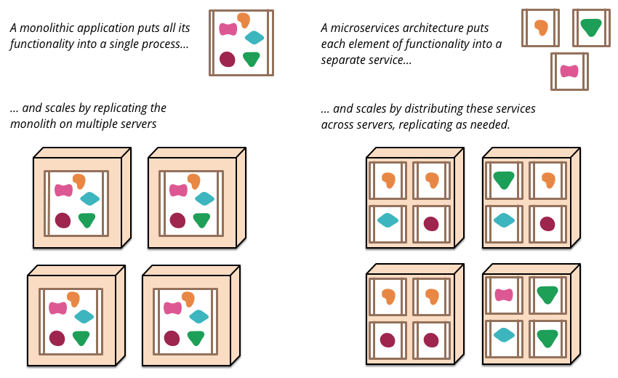
Microservices Architecture
http://martinfowler.com/articles/microservices.html

Slide 24
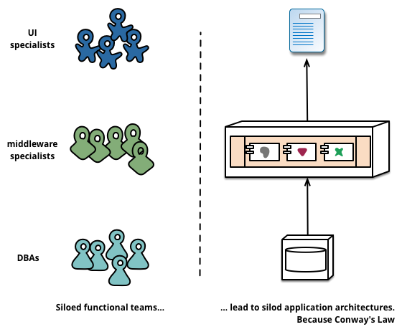
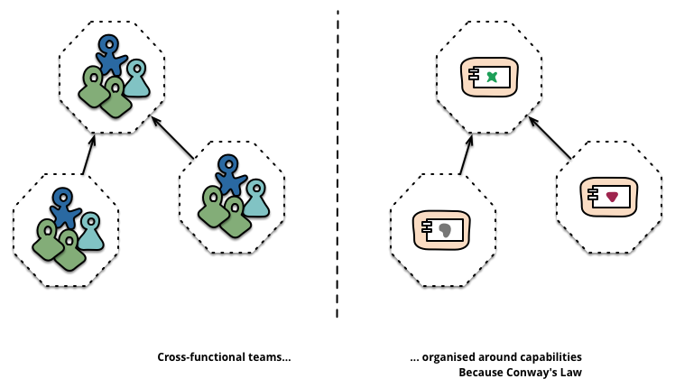
Microservices Architecture
“Any organization that designs a system (defined broadly) will produce a design whose structure is a copy of the organization's communication structure.” -- Melvyn Conway, 1967
Monolithic
Microservices
http://martinfowler.com/articles/microservices.html

Slide 25

Service Fabric Microservice Management
App1
App2
AZR330

Slide 26
Microsoft Azure Service Fabric A platform for reliable, hyperscale, microservice-based applications
Microservices
High Availability
Data Partitioning
Service Fabric
Health Monitoring
Container Orchestration & lifecycle management
Hybrid Operations
Self-healing
Simple programming models
High Density
Rolling Upgrades
Low Latency
Placement Constraints
Replication & Failover
Stateful services
Fast startup & shutdown
Load balancing
Hyper-Scale
Automated Rollback
Windows
Server
Linux
Windows
Server
Linux
Azure
Hosted Clouds
Windows
Server
Linux
Private Clouds
AZR330

Slide 27
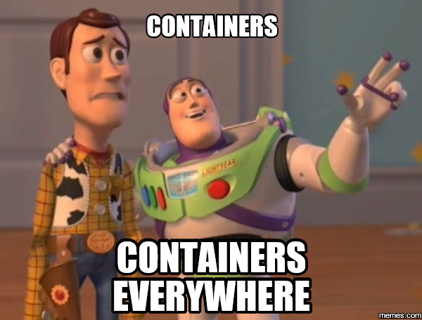

Slide 28
Resources
Aka.ms/windowscontainers

