Slide 1
So you want to be a data scientist?(Day 3)
Andrew Moll | Lauren Tran | Christine Matheney

Slide 2
Recap

Slide 3

Data Set
Clean Up
the general process
Split
Training Algorithm
You have a dataset
Clean up your dataset
Separate dataset into training data and test data
Choose an algorithm
Train your algorithm with the training data
Test your algorithm on your test data
Analyze results
Wash rinse repeat
Training Data Set
Test
Data Set
Score
Evaluate
Notes:
Dataset: everyone in room stands up
Clean up: remove non-students
Split: 15/rest
Training: group by favorite subject; tell them to find what type of movie was most popular in their groups

Slide 4
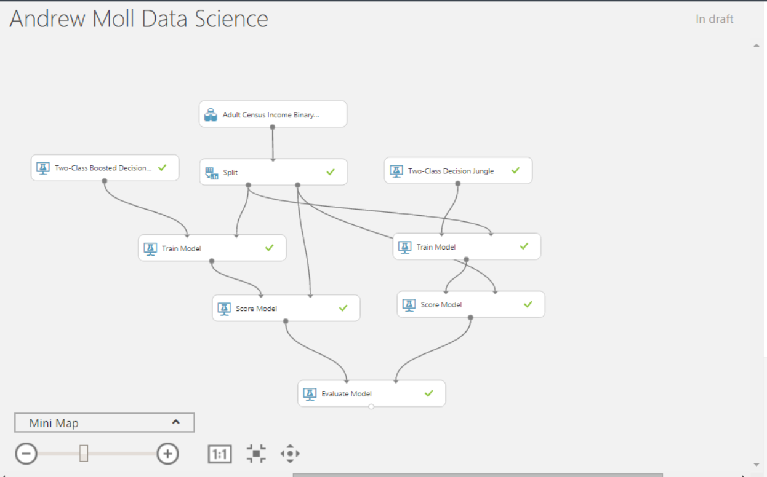

Slide 5
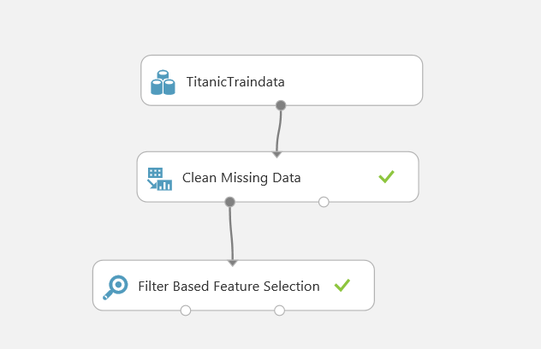
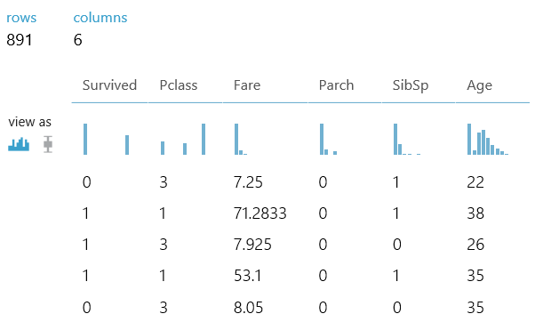

Slide 6
Let’s HACK!

Slide 7
Aka.ms/bullisday3

