Slide 1
So you want to be a data scientist?(Day 2)
Andrew Moll | Lauren Tran

Slide 2
Recap

Slide 3
Who
When
What
Where
Why
Notes:
What is data science
Who is a data scientist
Where do data scientists work
Why should you care?
When to use data Science?

Slide 4
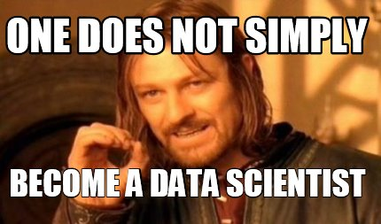

Slide 5
Would you have survived the Titanic?
Class | Name | Age | Ticket # | Fare | Cabin # | Survived
First | Carl A | 25 | 1 | A | 123 | 0
Main | Steven S | 55 | 2 | C | 324 | 1
??????????
???????????
…
…
…
…
…
?????????????

Slide 6
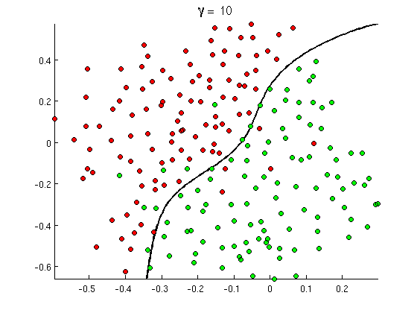
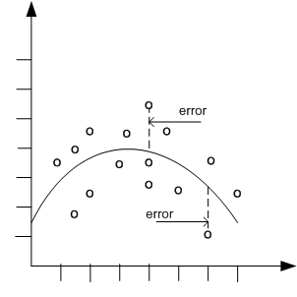

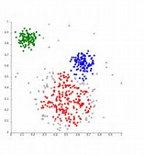
Common Classes of Problems
Classification
Regression
Recommenders
Clustering
Notes:
http://openclassroom.stanford.edu/MainFolder/courses/MachineLearning/exercises/ex8materials/ex8b_10.png
http://docs.oracle.com/cd/B28359_01/datamine.111/b28129/img/scatter_plot_nonlinear.gif
http://spectrum.ieee.org/img/RecommendNEWf1-1348253703748.jpg

Slide 7
the fastest possible intro to machine learning

Slide 8
Machine Learning develops and uses algorithms
to make predictions from data

Slide 9
algorithms
algorithms
Machine Learning develops and uses algorithms
to make predictions from data
predictions
predictions
data
data

Slide 10
Machine Learning develops and uses algorithms
to make predictions from data

Slide 11
algorithms
Machine Learning develops and uses algorithms
to make predictions from data
predictions
data

Slide 12
algorithms
predictions
data

Slide 13
data
predictions
algorithms

Slide 14
data
Think data in a spreadsheet
Age | Occupation | Gender | Hours/Week | Income
35 | Farming-fishing | Male | 40 | <=50K
23 | Adm-clerical | Female | 30 | <=50K
31 | Sales | Male | 38 | >50K
31 | Prof-specialty | Female | 50 | >50K
Rows are “Data points” (person, for example)
Columns represent “Features”
The set of features for a data point is a “Feature Vector”
Notes:
TO DO: add their data and ask them what predictions can we make from this data
-they should come up with the questions they should ask of the data, which of the four types of problems it is, and tell us a feature that is relevant (or multiple)

Slide 15
data
Think data in a spreadsheet
Age | Occupation | Gender | Hours/Week | Income
35 | Farming-fishing | Male | 40 | <=50K
23 | Adm-clerical | Female | 30 | <=50K
31 | Sales | Male | 38 | >50K
31 | Prof-specialty | Female | 50 | >50K
Rows are “Data points” (person, for example)
Columns represent “Features”
The set of features for a data point is a “Feature Vector”
You may have hundreds of millions of Data Points
You may have many features
Two data sets: training and test
Training data set has the answers labeled
Test data set has known answers but is unmarked
Age | Occupation | Gender | Hours/Week | Income
28 | Adm-clerical | Male | 32 | <=50K
32 | Tech-support | Female | 30 | <=50K
31 | Sales | Female | 38 | >50K
49 | Exec-management | Male | 60 | >50K

Slide 16
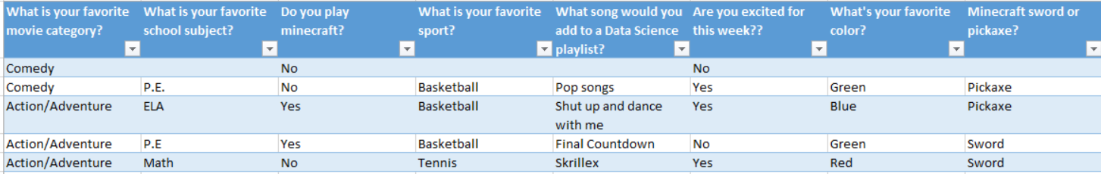
data:features
Features turn a “thing” into a vector
Features are designed specifically for a dataset and desired prediction
Much of the magic of ML is choosing the right feature vectors

Slide 17
prediction
Think generalization, not telling the future
Use a training set to generalize
Use generalizations to perform accurately on new, unseen examples

Slide 18

Data Set
Clean Up
the general process
Split
Training Algorithm
You have a dataset
Clean up your dataset
Separate dataset into training data and test data
Choose an algorithm
Train your algorithm with the training data
Test your algorithm on your test data
Analyze results
Wash rinse repeat
Training Data Set
Test
Data Set
Score
Evaluate
Notes:
Dataset: everyone in room stands up
Clean up: remove non-students
Split: 15/rest
Training: group by favorite subject; tell them to find what type of movie was most popular in their groups

Slide 19
Data Set
Clean Up
the general process: your turn!
Split
Training Algorithm
You have a dataset
Clean up your dataset
Separate dataset into training data and test data
Choose an algorithm
Train your algorithm with the training data
Test your algorithm on your test data
Analyze results
Wash rinse repeat
Training Data Set
Test
Data Set
Score
Evaluate
Notes:
Dataset: everyone in room stands up
Clean up: remove non-students
Split: 15/rest
Training: group by favorite subject; tell them to find what type of movie was most popular in their groups

