Slide 1
Finding the box with an image processing system
Andrew Morris

Slide 2
Overview
Some hurdles in implementing computer vision
Explanation of the Problem
Image Processing
My Implementation

Slide 3
Some hurdles in implementing computer vision
Identifying a 3-D object in a 2-D picture is challenging.
We lose all information about the space
Representing lines

Slide 4
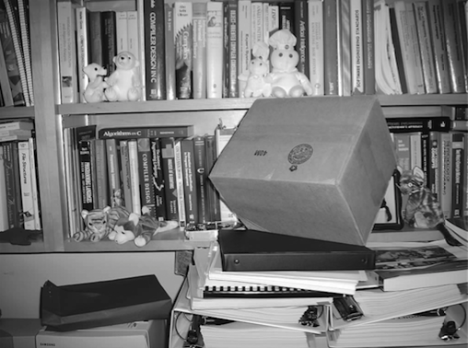
Explanation of the Problem
Our task was to identify a cardboard box in a series of 8-bit image.
The program was to process the image to create a line drawing, and then identify the box in the photograph.

Slide 5
Image Processing
Smoothing
Kirsch Edge Detection
Variable Window Noise Reduction
Line thinning
Hough Transform

Slide 6
Image Processing - Smoothing
Each pixel in the image receives a weighted value from a 3x3 window.
1 | 2 | 1
2 | 4 | 2
1 | 2 | 1

Slide 7
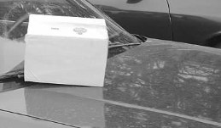
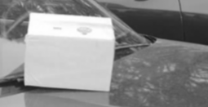
Image Processing - Smoothing
BEFORE
AFTER
An example of an image before and after Smoothing.

Slide 8
Image Processing – Edge Detection
Compare the contrast from left pixels to the right pixels. If this exceeds a threshold, then we count it as a edge.
L1 |  | R1
L2 | K | R2
L3 |  | R3

Slide 9
Image Processing – Noise Reduction
For every pixel in the

Slide 10
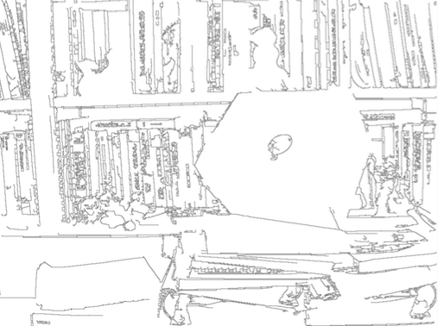
Image Processing - Thinning
Stephanelli & Rosenfeld’s thinning algorithm reduces edges to a single pixel wide line.

Slide 11
Image Processing – Hough Transform
Every pixel ‘votes for a possible line in the image.
If a line gets enough votes, then we count the line.
NEED IMAGE, how to represent?

Slide 12
My Implementation
An example of an image ran through the image recognition program.

Slide 13
Questions?

