Slide 1
Finding the box with an image processing system
Andrew Morris

Slide 2
Overview
Some hurdles in implementing computer vision
Explanation of the Problem
Image Processing
My Implementation

Slide 3
Some hurdles in implementing computer vision
Identifying a 3-D object in a 2-D picture is challenging.
We lose all information about the space
Representing lines

Slide 4
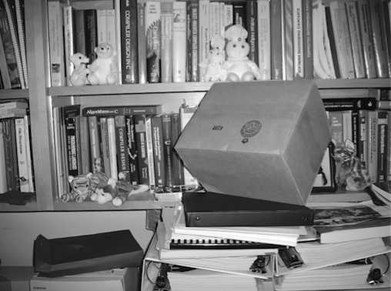
Explanation of the Problem
Our task was to identify a cardboard box in a series of 8-bit image.
The program was to process the image to create a line drawing, and then identify the box in the photograph.

Slide 5
Image Processing
Smoothing
Kirsch Edge Detection
Variable Window Noise Reduction
Line thinning
Hough Transform

Slide 6
Image Processing - Smoothing

Slide 7
Image Processing – Edge Detection

Slide 8
Image Processing – Noise Reduction

Slide 9
Image Processing - Thinning

Slide 10
Image Processing – Hough Transform

Slide 11
My Implementation

