Slide 1
Project 0
Frank Berni
Team Amplifire
Solid-State

Slide 2


Scope of the Project
Inspired from the popular Apps Marketplace and OfferUp
Users should be able to:
Maintain their own profile
Make posts for what they want to sell
Contact the sellers
Report others if they feel unsafe
Send in feedback to us
Notes:
*Edit this slide to make sure it talks about the Business we modeled, what users should be able to do

Slide 3

Welcome to Poke-TradR
One Part
Trading Platform
Trainers can trade Pokémon amongst each other
Trainers can also purchase quality Pokémon from us as well
One Part
Working Pokedex
Continuously updated database
Easily accessible information to help Trainers make informed decisions
Notes:
Introducing PokeTradR

Slide 4
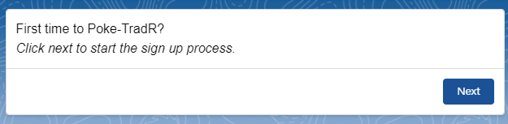
The front end
Sign up Process
New Users can sign up as a Trainer
Paired up with a trusted Associate who will handle their Account and Service Questions
A
Notes:
The Trainer Flow wizard to aid in easy sign up
How Associates play a part

Slide 5

The front end
Trades and Offers
A Trainer makes a Trade
Other Trainers may Offer Pokémon or Money
The owner of the Trade has the final say

Slide 6
The front end
Complaint Process
#$%!
M
We enforce a safe environment
Complaints can be made anonymously to us
Our Moderators work diligently to ensure our platform is safe for everyone
Notes:
Service
Web to Case
Assignment Rules
Escalation Rules

Slide 7
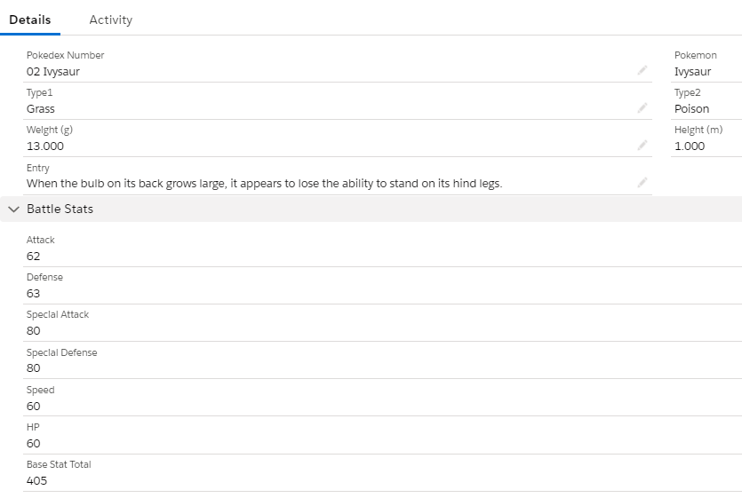
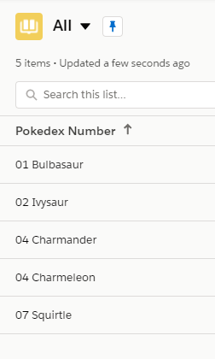
The front end
Pokedex
…!
Trainers have full access to our Pokedex
We want our trainers to be as informed as possible
Look out for more features as we continuously improve it
Notes:
The other spectrum: Pokedex

Slide 8
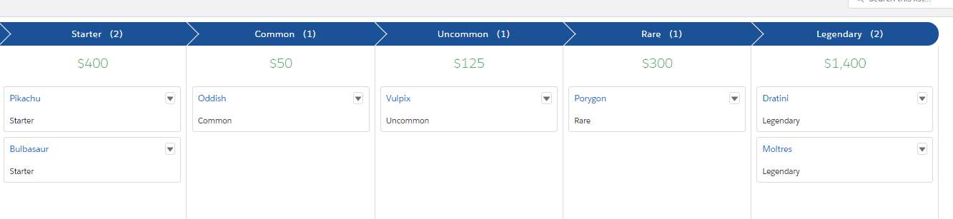


The front enD
What we Offer
We offer Pokémon ranging from Regular, Shiny and Legendary for Purchase
Keep out for ever changing deals
Trainer ranks may affect these prices
Our Sales Team will equipped to answer any questions users ask
Notes:
As a main product we sell, we also provide company special Pokemon bred to be competitive. The available Pokemon always change week to week and we have prices for regular and shiny variants
The more active a Trainer is on our platform the more they rank up which can lead to better deals on these pokemon

Slide 9
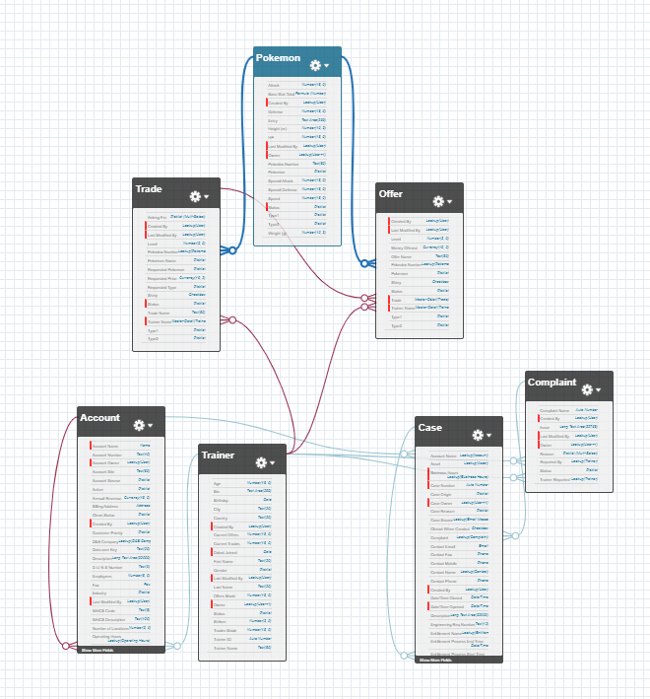
The Back end
The Schema behind the Org
Five Custom Objects made
Master-detail Relationships
Lookup Relationships
Notes:
Discussing each Custom Object: Trainer, Trade, Offer, Pokemon, Complaint
How I designed the Master-detail relationships between Trainer to Trade and Offer & Trade to Offer

Slide 10
The Back end
CEO
Administrators
Assistants
Professors
Moderators
Associates
Sales Associates
The Role Hierarchy
Notes:
Discuss Role Hierarchy and Permissions
CEO and Admins access to everything
Moderators see/edit all trainer, trade, offer and complaints; in charge of Cases and Complaints (No editting Pokemon)
Associates see/edit assigned trainer, trade, offer and complaints (No editting Pokemon)
Sales Associates handle our Products and Price books
Professor access to all Pokemon entries
Assistant see/edit Pokemon entries

Slide 11
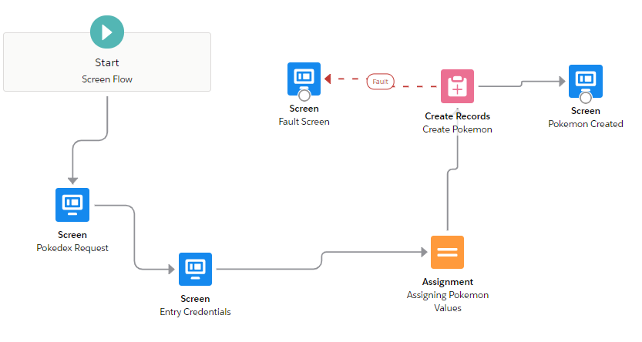
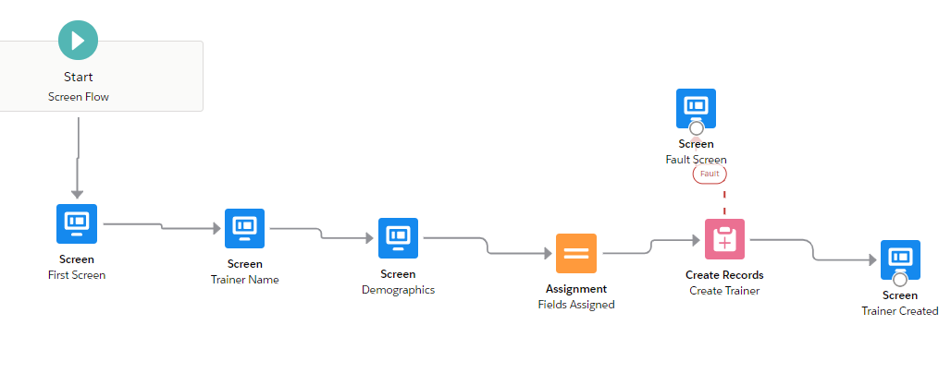
The Back end
New Pokemon Wizard
Flows
New Trainer Wizard
Notes:
Explain the Flow processes
Two Flows were created.
One for Creating a New Trainer to make the profile creation process super accessible
Another for Creating New Pokemon entries, helps streamline some of the process for Assistants

Slide 12
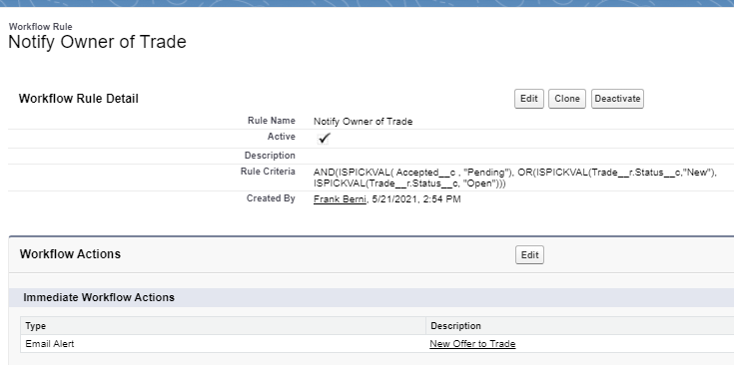
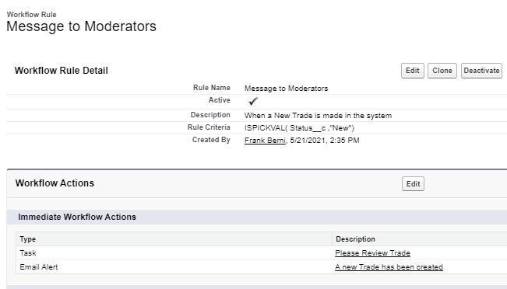
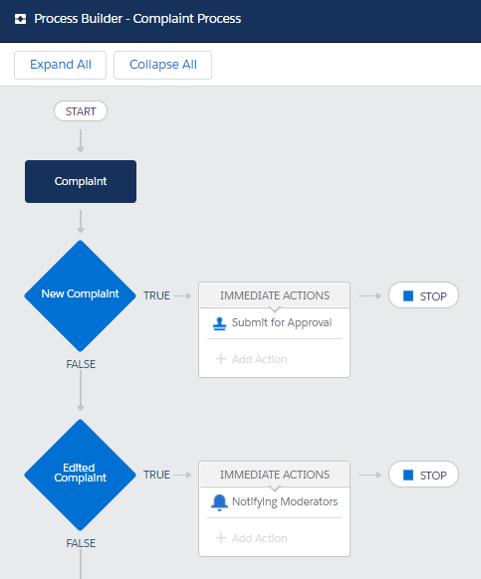
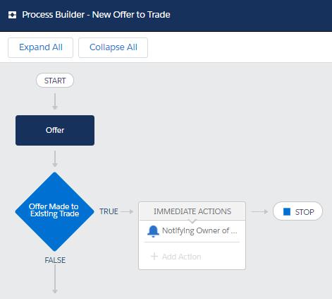
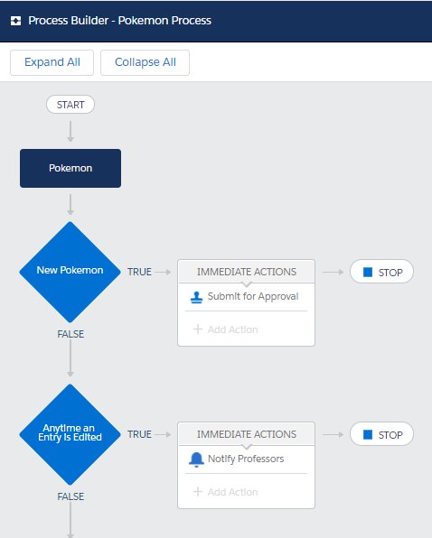
The Back end
Automations
Notes:
Approval Processes:
One for when a Pokemon Entry is created the Professors will get a notified to approve the entry or not to ensure accuracy
One for the Complaint process to ensure that when a complaint is approved it generates a task for Moderators to add a strike to the trainer being reported
A Workflow Rule to notify Moderators and generate a task for when a trade is made to ensure the trade follows proper QA guidelines
Two automations
a Process for notifying the owner of a trade whenever someone makes them an offer on the platform
A Workflow rule to ensure the owner of trade is being emailed when someone offers them a trade.

Slide 13
Live Demo
Notes:
Exit to Live Demo

