Slide 1
Policy Evaluation
Value Function
Policy Iteration
Policy Improvement

Slide 2
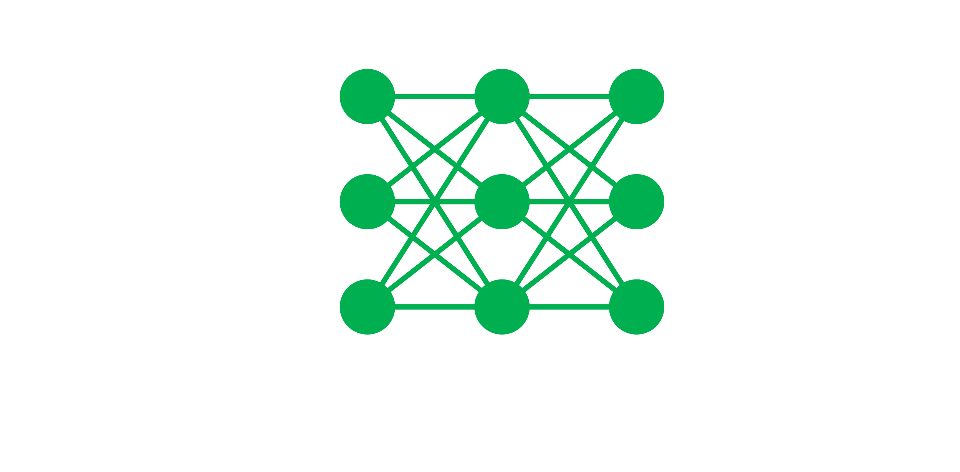
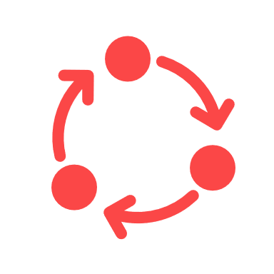
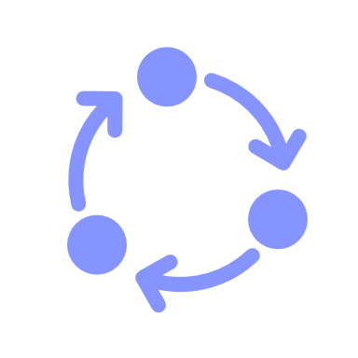
Train neural network
Train data
New model
Iteration done
Self-Play
Self-test-Play

