Slide 1
Policy Evaluation
Value Function
Policy Iteration
Policy Improvement

Slide 2
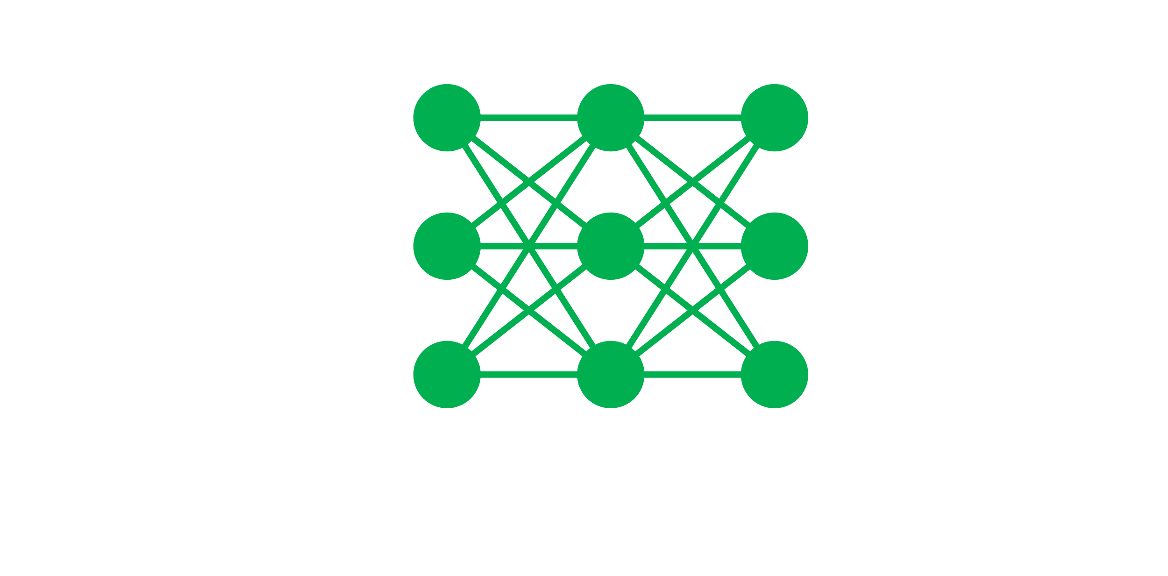
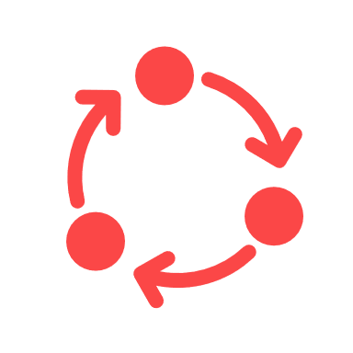
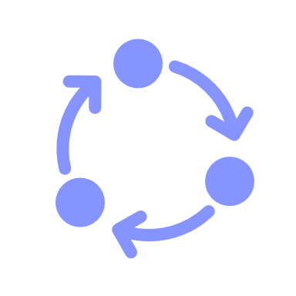
Train neural network
Train data
New model
Iteration done
Self-Play
Self-test-Play

Slide 3
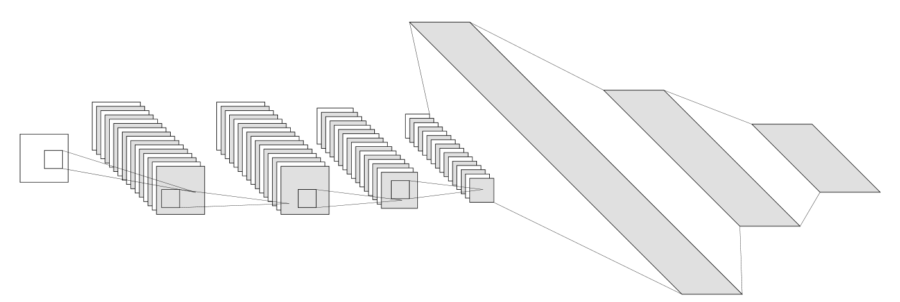
V, 1×1
1@8×8
512×1
512@8×8
512@8×8
512@6×6
512@4×4
1024×1
P, 65×1
8192×1

Slide 4
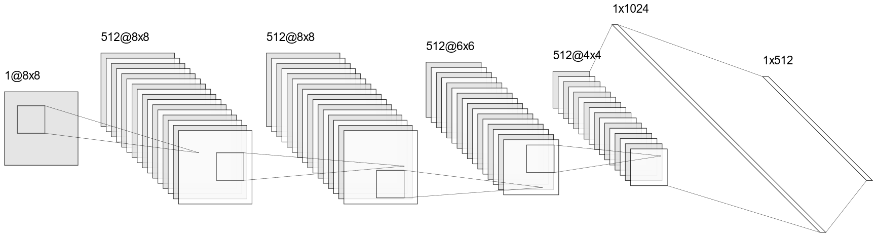
P, 1×65
Stride of 1
Filter size: 3×3
V, 1×1
Padding: same
Padding: valid
Convolutions
Full connection

Slide 5
85.71%
2.04%
12.25%
……
……
……

