Slide 1
JavaScript
A language for the future

Slide 2


Hi, I’m Andrew
Graduated from Cofo 2018
Software Engineer at Cerner
I like
Programming
Being outdoors
Being with people
Learning

Slide 3
Outline
What is JavaScript?
Examples
Pure javascript (vanilla)
React
Angular
Why you should use it

Slide 4
Part 1
What is JavaScript

Slide 5


What JS is NOT
!=
Dynamically typed
Prototype based (until ES6)
Statically typed
“Class-based” language
Notes:
Prototype – All objects are instances. ES6 is making JS more like “Class-based” meaning JS is now even more flexible.

Slide 6
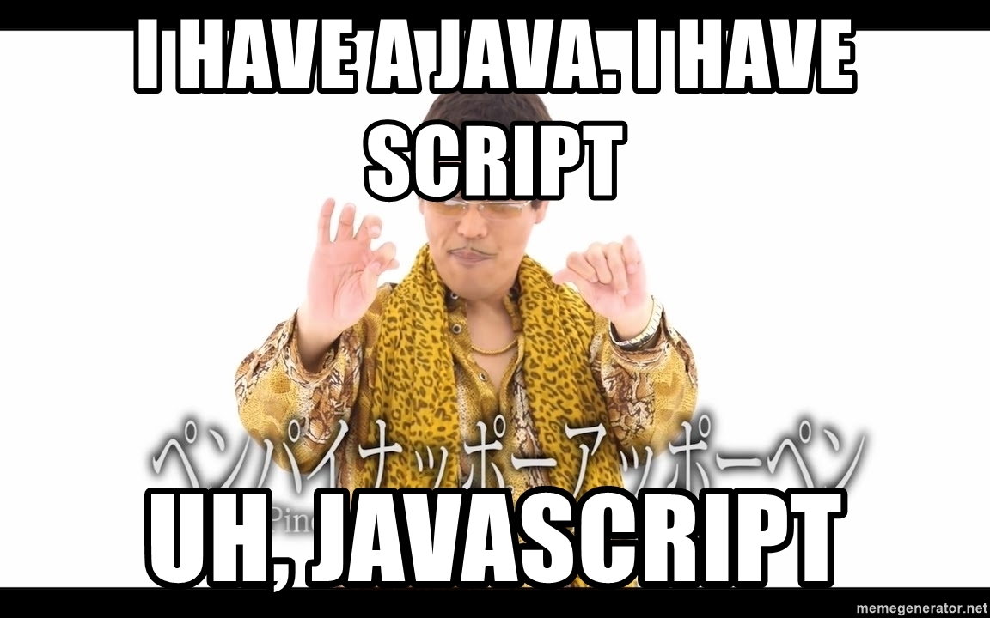


Slide 7
Part 2
Some Examples

Slide 8
Pure JavaScript
.js
.html
.css

Slide 9
Angular
Module
Template (.html)
.scss
List component (.ts)
Template (.html)
ListItem component (.ts)
.scss
Example comparison: https://medium.com/javascript-in-plain-english/i-created-the-exact-same-app-in-react-and-vue-part-2-angular-39b1aa289878

Slide 10
React
.scss
Container.jsx
.scss
List.jsx
.scss
ListItem.jsx
https://reactjs.org/docs/getting-started.html

Slide 11
Three.js
http://mathis-biabiany.fr/
https://threejs.org/examples/webgl_shaders_ocean.html
http://vr.ff.com/us/
http://www.cryptarismission.com/
https://codepen.io/teolitto/pen/KwOVvL
https://codepen.io/enesser/pen/jdenE

Slide 12
Part 3
So?

Slide 13
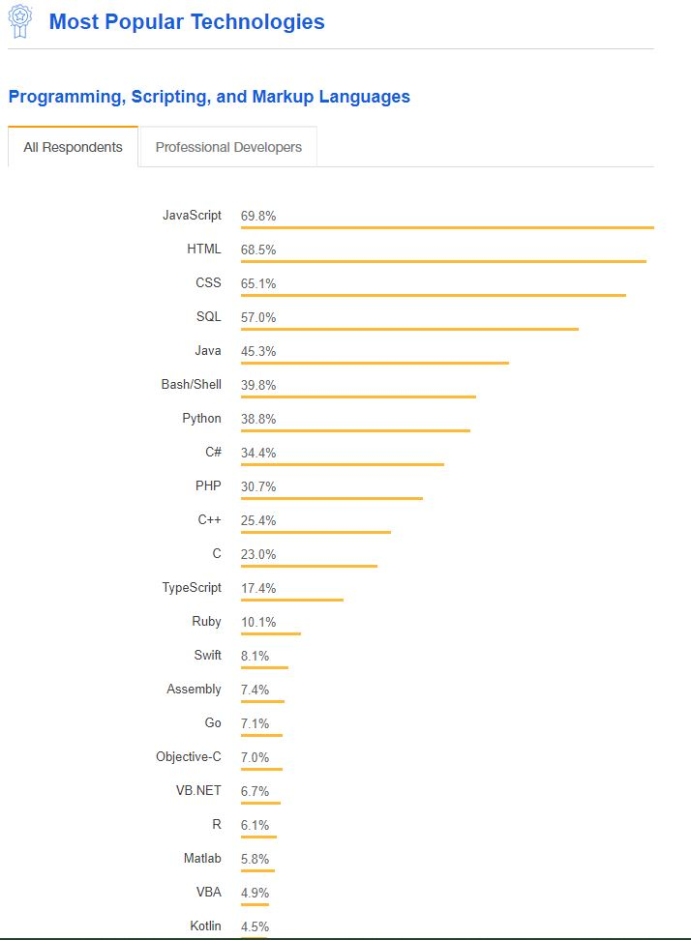
Reason: Stats
Credit: https://insights.stackoverflow.com/survey/2018#technology

Slide 14








There is something for everyone (besides web developers)
Cross Platform Desktop Native (electron)
Three.js
Game Development
Native app development for both platforms (react-native)
Server side (even allows for C bindings)
Jest (unit testing)
Typescript (JS with types)
VR/AR (argon js)
Tensorflow (AI)
Node Package Manager

Slide 15

JAVASCRIPT IS NOT scary. Use JavaScript in youR projects
Personal and school (why not?)

Slide 16
Questions?

