Slide 1
Programming Philosophy, Principles and Practices
Andrew Hunter
Senior Consultant

Slide 2
Agenda for Series
Introduction
Modern Development Environment
Object Oriented Programming Philosophy
Declarative vs Imperative Coding
Programming Patterns and Practices in C#
Refactoring a “realistic” application

Slide 3
Agenda for Today
Introduction
Modern Development Environment
Object Oriented Programming Philosophy
Declarative vs Imperative Coding

Slide 4
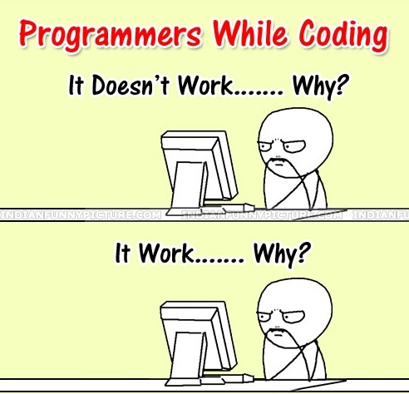
Introduction
What is programming?

Slide 5
Introduction
Programming in its purest sense is problem solving; programmers being the problem solvers.

Slide 6
Introduction
Cynthia Ruden has stated that what allows machines, and humans, to learn is structure which necessarily limits flexibility.
It is creating this structure that we can then learn and effectively solve problems.

Slide 7
Introduction
Functionally then, programming is about managing complexity

Slide 8
Introduction
“The function of good software is to make the complex seem simple”
-Grady Booch

Slide 9
Modern Development Environment
Visual Studio 2017 and Visual Studio Code
https://visualstudio.microsoft.com/downloads/
Git for Source Control
https://git-scm.com/downloads
https://try.github.io
https://learngitbranching.js.org
Node and npm for front end development
https://nodejs.org/en/

Slide 10
Object Oriented Programming
Created as a paradigm to help manage complexity through user defined types and information hiding
Made popular by C++ however the concept of classes was heavily influenced by Simula67
Operator overloading came from Algol68

Slide 11
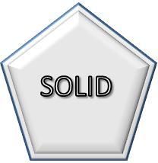
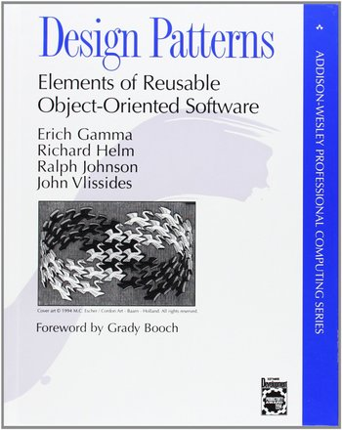

Object Oriented Programming
IS HARD

Slide 12
Object Oriented Programming
Favor composition over inheritance
Classes should sealed by default (declarative)
Favor pure methods over those with side effects
Abide by the single responsibility principle
A class or method should only do one thing and do it well
Minimize or eliminate branching logic
Rule of thumb: more than two branches and refactor
Choose declarative over imperative programming style
A little copying and pasting is often better than a little dependency

Slide 13
Declarative vs Imperative
Imperative programming is the most prevalent style
The program specifies how to do something
Often hard to read and quickly understand
Tough to tell when to refactor
Declarative programming is the preferred .NET style
The program specifies what needs to be done
Often results in easy to read code
When readability decreases you naturally know to refactor

Slide 14
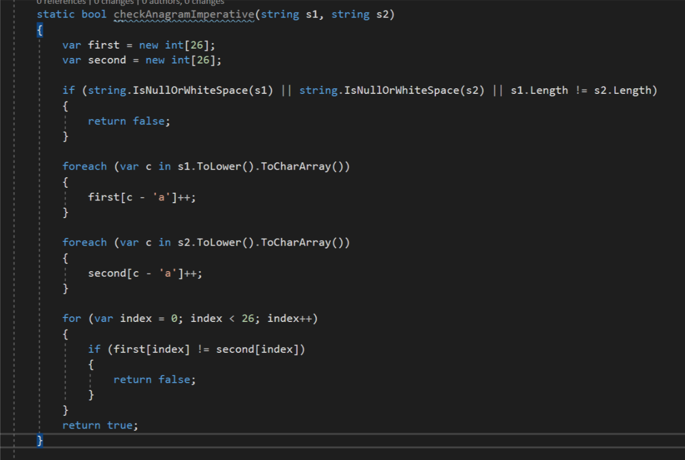

Slide 15
Declarative vs Imperative
DEMO

Slide 16
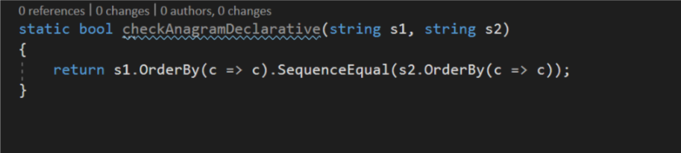

Slide 17

Declarative vs Imperative
Filter
Map
Reduce

Slide 18
Declarative vs Imperative
Extension Methods
“Extends” a type to add additional functionality
Compiler creates IL that is similar to calling a static method on the type
Perfect example of the Open/Close principle
Open for extension / Closed for modification

Slide 19
Declarative vs Imperative
DEMO

Slide 20
Declarative vs Imperative
Filter
Implemented with LINQ extension method Where()
Allows for selecting specific results using predicate logic
Lazily evaluated – must do something to cause the collection to be iterated through to execute the logic

Slide 21
Declarative vs Imperative
DEMO

Slide 22
Declarative vs Imperative
Map
Implemented with LINQ extension method Select()
Allows for transforming data from one shape to another
Lazily evaluated – must do something to cause the collection to be iterated through to execute the logic

Slide 23
Declarative vs Imperative
DEMO

Slide 24
Declarative vs Imperative
Reduce
Implemented with LINQ extension method Aggregate()
Allows accumulating values over a sequence

Slide 25
Declarative vs Imperative
DEMO

Slide 26

Discussion

