Slide 1
Data Collection Experience
By Andrew Plum

Slide 2
Goal and Modes of Collection
Goal:
Explore the correlation between the words in speeches made by Federal Reserve Chair Jerome Powell and the performance of the S&P 500 on the same day.
Mode of Collection:
Obtain initial datasets available online.
Combine the datasets into a joint dataset.

Slide 3
Data Acquirement
S&P 500 Data:
Downloaded from the website fred.stlouisfed.org in .csv file format.
Speech Transcripts:
Manually collected from the website federalreserve.gov by clicking on the relevant web pages where the speech transcripts were contained and copying and pasting the text into its own .txt file for each speech made.

Slide 4

Organization of the Data and Metadata
Physical and Logical Organization of the Data
Metadata
I used elements a part of the Dublin Core metadata standard
I recorded the elements:
Title, creator description, date last updated, date last downloaded, file format, publisher, source, language, rights, URL, and citation.

Slide 5
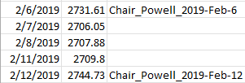
Problems Encountered
Missing Metadata:
The Fed Chair Speeches dataset I compiled did not have much initial metadata so most of the metadata for the dataset was created by me.
Limiting Data:
There were 2608 records of data for the daily close of the S&P 500 but there were only 58 speeches.
This was a part of the dataset with less null values there are still a lot here

Slide 6
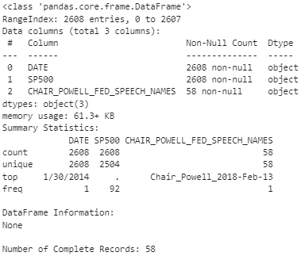

Slide 7
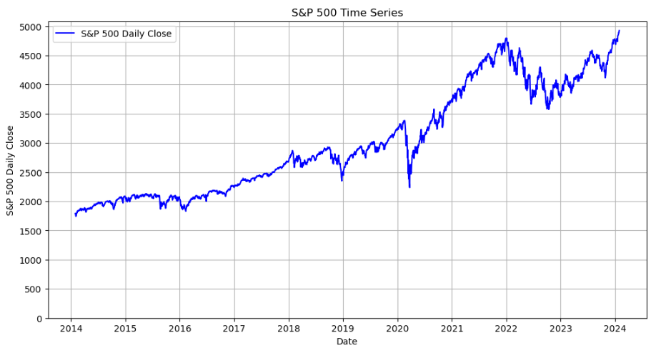

Slide 8
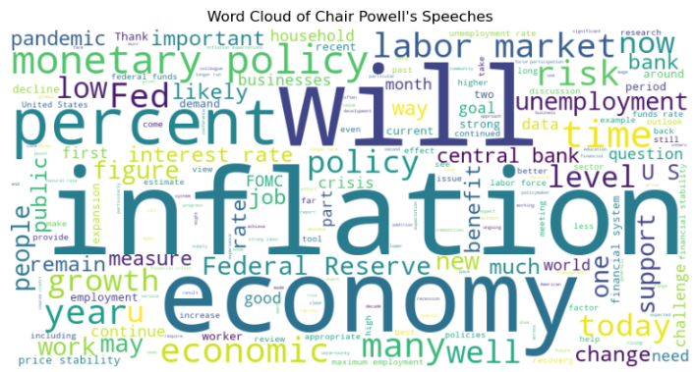

Slide 9
Lessons Learned
Plan Ahead:
Consider how much of the data collected will be useful. Because there were a lot of null values much of the data collected couldn’t be used.
In the Future, Consider Automating the Data Extraction Process
The frequent copying and pasting I did to obtain one of the datasets was tedious and time consuming.
Good Datasets Tend to be Well Documented

Slide 10
Citations
S&P Dow Jones Indices LLC, S&P 500 [SP500], retrieved from FRED, Federal Reserve Bank of St. Louis; https://fred.stlouisfed.org/series/SP500, January 22, 2024.
https://www.federalreserve.gov/newsevents/speeches.htm

