Slide 1
Designing My Ontology
By Andrew Plum
Notes:
Hello, my name is Andrew and here’s an overview of the ontology I made

Slide 2
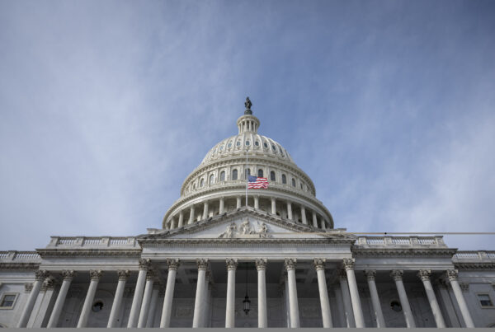
Ontology Topic – US Government
The topic I chose for my ontology’s domain is the United States government.
I decided to narrow the scope of the ontology to being how the US government is classified as a system of government rather than really detailing the internal workings and structure of the government.
Notes:
With my ontology, I decided to focus on the nature of the US government.
And I mainly wanted to characterize how its system of government compares to other systems of government.

Slide 3
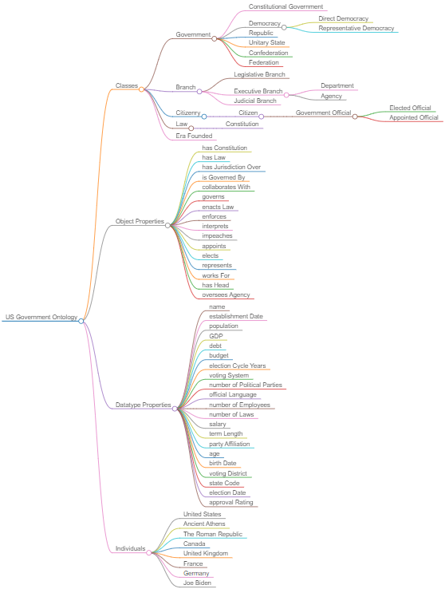
Initial Design Process
I started out by researching my topic extensively to ensure I had a good understanding of it.
I wrote down potential concepts and relationships to include in my ontology during this process.
Mindmap:
Pictured on the right
HTML file
Notes:
During an initial brainstorming phase that I did, I created a list of concepts and relationships related to my topic.
Here is a mind map that I made of the finalized list of concepts that made it into my ontology.
I did make the mind map actually quite a bit later after writing the initial list when it probably would have been more useful to make it earlier.

Slide 4
Iterative Design Process
After writing a list of potential concepts I wanted in my ontology, I identified the central concepts based on how frequently they appeared in my research and defined them in the ontology.
From here I asked myself how each one of the concepts already defined related to the other concepts already defined.
Sometimes during step 2, I branched the ontology out further, defining new concepts that I missed in the 1st step.
I repeated steps 2 through 3 until I thought the breadth and depth of the ontology was adequate for describing the nature of the system under focus.
I finished the process with 27 classes, 27 object properties, 26 datatype properties, and 33 instances in my ontology.
Notes:
After the initial brainstorming:
I branched out from the initial list of concepts I made adding key relationships between the concepts as well as new concepts I missed during the brainstorming.
When finished my ontology, it consisted of 27 classes, 27 object properties, 26 datatype properties, and 33 instances.

Slide 5
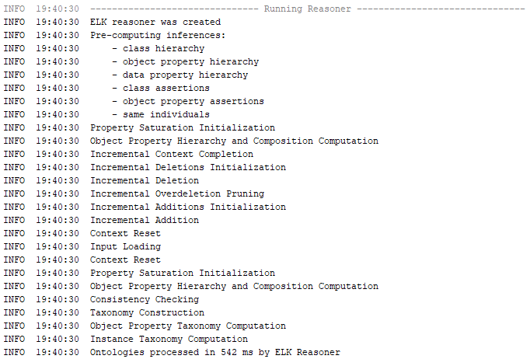
Testing the Ontology
I used reasoners to test my ontology for logical inconsistencies.
ELK 0.6.0
Results:
Notes:
I checked for logical inconsistencies in the ontology using some of the available protégé reasoners.
Here is a picture of the results of the ELK reasoner

Slide 6
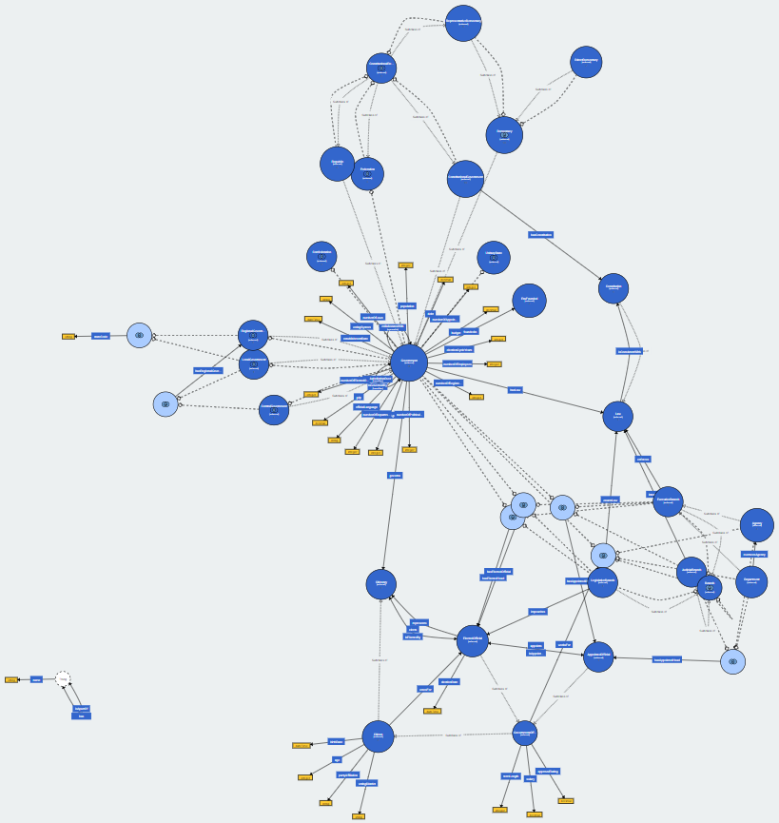
Visualizing the Ontology
Ontology Conceptual Map Visualization:
Interactive HTML conceptual map link:
https://service.tib.eu/webvowl/#opts=doc=0;#file=SWOP_Assignment2_Andrew_Plum.ttl
Interactive file
Notes:
Here is a visualization of the finished ontology.
Let’s look at the interactive version.

Slide 7
Problems Encountered
Cascading Changes
I wanted to change central concepts of my ontology after building the ontology out from them.
This led to cascading changes in order to keep the ontology logically consistent. This was difficult to keep track of at times.
Syntax Errors
I actually wrote the turtle code myself instead of using protégé.
Led to errors like missing periods to end a triple.
Notes:
The two main problems I had during the design were:
Keeping track of cascading changes that were required to keep the ontology logically consistent after changing a foundational axiom.
And there were some small syntax errors because I initially didn’t use protégé.

Slide 8
Lessons Learned
Plan Ahead and Understand the Topic well:
Start out the design process by correctly identifying which concepts and relationships are central to the ontology.
Being correct here will avoid cascading changes that are needed to keep the ontology logically consistent.
The use of protégé made the ontology design process quicker and less error prone.
The available reasoners were useful for catching various errors with the ontology.
Notes:
Some lessons I learned from this exercise were:
To plan ahead better to prevent cascading changes that are needed
And that Protégé made the design process quicker and less error prone
And that is all I have. Thank you.

