Slide 1

An Analysis of Country DBpedia Data
Andrew Plum, Palak Pandey, Leo Bomboy, Carrie Nickel, and Sebastian Fedane

Slide 2

What are we trying to analyze?
Analyze the quality of country-level data by comparing DBpedia to World Bank data as a benchmark.
Use said DBpedia data to determine which factors are most impactful to the rate of happiness of a country.
Notes:
1) Measure the difference in the quality of country data from dbpedia and world bank country data where the world bank country data is used as the gold standard data.
2) To discover which country related factors were most impactful in predicting country happiness rates and then also coming up with a predictive model for it.

Slide 3
Why this Topic was Chosen
There is lots of readily available economic and demographic data to query and parse.
Initial research and surfing DBpedia & World Bank affirmed this.
Global development of economies has several dependent factors.
Such as GDP, External Debt, Population, etc.
To explore and do further research of why countries fall behind in certain categories.
Ex: the country related economic factors for why certain countries have a low rate of happiness while others have a higher rate of happiness.

Slide 4
Investigative Questions
What is the difference in the quality of country data from DBpedia and country data from the World Bank?
Need some standard of country data to benchmark against.
Can map the difference in quality of the data by country to answer second question.
What economic/demographic factors are most influential in predicting country happiness? How well can we predict country happiness rates with this data.
Need to collect rates of happiness of countries by year and relevant country factors for each year.
Can utilize machine learning models.
Can use more interpretable models to answer the first question.
We don’t necessarily care about model interpretability for the second question.

Slide 5
Goals
1) Measure the difference in the country data from DBpedia and World Bank country data where the World Bank country data is used as the ideal standard data and map that difference in quality by country.
2) Discover which country related factors are most impactful in predicting country happiness rates and then also create a model which performs well at predicting country happiness.

Slide 6
SPARQL Query Dataset
2 SPARQL queries
Combining the queries led to timeout errors when running them through the SPARQL endpoint.
Between the two queries, 19 unique attributes were collected. However only 16 were used in the analysis.
['countryName', 'population', 'year', 'populationDensityKm', 'yearsExisted', 'conflictCount', 'governmentType', 'gdpNominal', 'gdpPpp', 'gdpNominalPerCapita', 'giniCoefficient', 'humanDevelopmentIndex', 'inflationRate', 'unemploymentRate', 'grossExternalDebt', 'debt']
Dropped attributes were either duplicate entries, or irrelevant to our investigation

Slide 7
SPARQL Query Dataset (Cont.)
Design Process
Query 1: Extract demographics (eg., population , government structure).
Query 2: Extract economic metrics (e.g., GDP, debt).
Finding relevant properties
Finding and querying attributes that were relevant to the hypothesis.
Handling Missing Data
The Optional keyword was used to retrieve partial data for attributes that were not available for every country.
Splitting the Queries
A single comprehensive query could cause timeouts and unneeded technical difficulties.
Queries were split to prevent these types of issues.
Filtering and Preprocessing
Filters like Regex were used to target specific records such as country names and GDP unites.
Duplicate and irrelevant records were excluded during preprocessing.

Slide 8
SPARQL Query Dataset (Cont.)
Components
GDP in various formats (gdpNominal, gdpPpp) and debt data where gathered for example.
Regex was used to link country names to their economic objects.
Human development indicators and other demographic metrics were matched with economic data via country name and year.
Challenges with this approach came in the form of missing data, such as GDP discrepancies and missing dates, excluding rows of data and were handled via an OPTIONAL clause including the otherwise would be dropped rows.

Slide 9
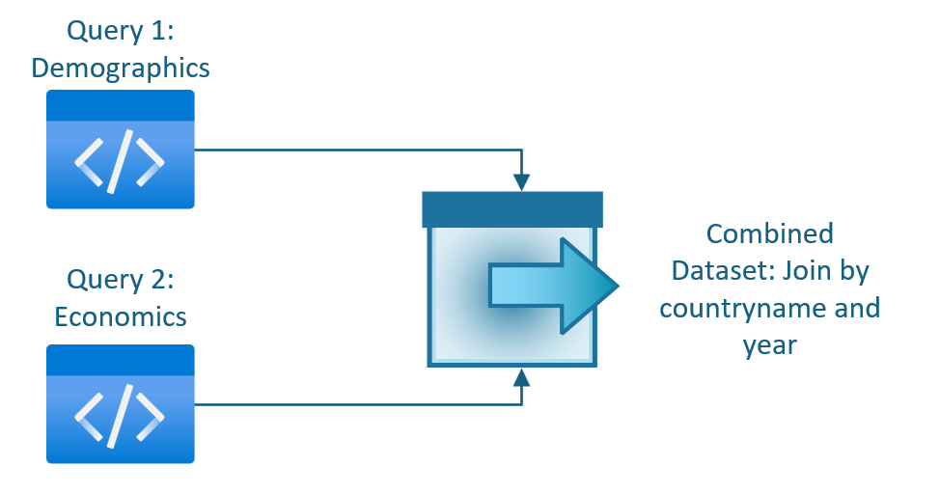
SPARQL Query Data Joined Using Python

Slide 10
World Bank Data
The dataset collected from the World Bank had 17 attributes
['countryName', 'countryCode', 'year', 'inflationRate', 'unemploymentRate', 'debtToGdpRatio', 'foreignDirectInvestment', 'population', 'populationDensityKm', 'yearsExisted', 'homicidesPer100k', 'gdpNominal', 'gdpPppPerCapita', 'gdpNominalPerCapita', 'giniCoefficient', 'humanDevelopmentIndex', 'grossExternalDebt']
Some attributes were dropped because they lacked a column match with the dbpedia data.
Eg. homicides/100k was initially thought to match with conflicts the country had been involved in instead it represents the actual homicide rate per 100,000 people.
Due to the high quality of the data, the World Bank dataset was used as a benchmark for quality comparison.

Slide 11
World Happiness Report Data
Data on country happiness rates by year were acquired from the World Happiness Report.
“Life Ladder”
Used as the primary attribute because it quantifies well-being/happiness rates of a country.
The original dataset contained additional attributes such as: social support, generosity, and perception of corruption.
These attributes were dropped as they do not directly relate to the focus of project.
We used this dataset to compare the country happiness score directly to GDP, inflation, unemployment, and other key metrics.

Slide 12
Combined Datasets
There were two combined datasets for each of the two analyses:
One which combined the comparable columns of the DBpedia dataset and the World Bank dataset
Had 22 attributes
Used in analysis 1
120 Rows
One which combined the DBpedia dataset with the happiness rate by its respective year and country from the World Happiness Report
Had 17 attributes
Used in analysis 2
150 Rows
Key Challenge: Data in the two datasets with no counterparts and missing rows or with name mismatches (eg. Russia and Russian Federation) were dropped.

Slide 13
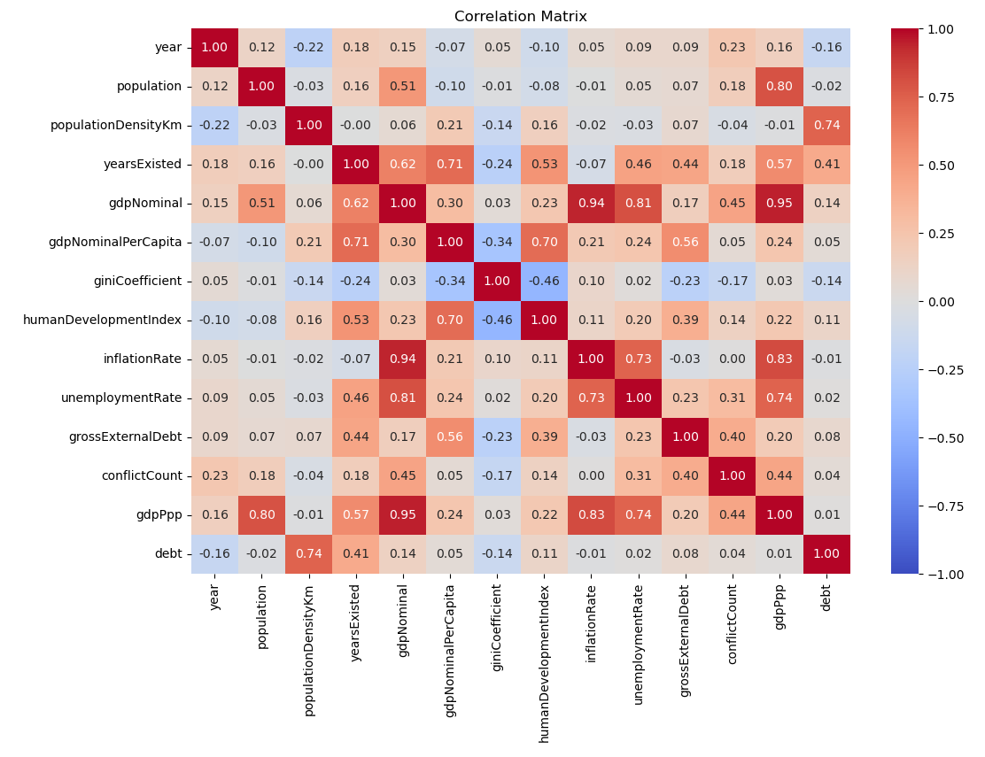
EDA
Direct Correlation
Correlation Heatmap
Only examines correlations between the DBpedia data.
Inverse Correlation
Notes:
Exploratory Data Analysis

Slide 14
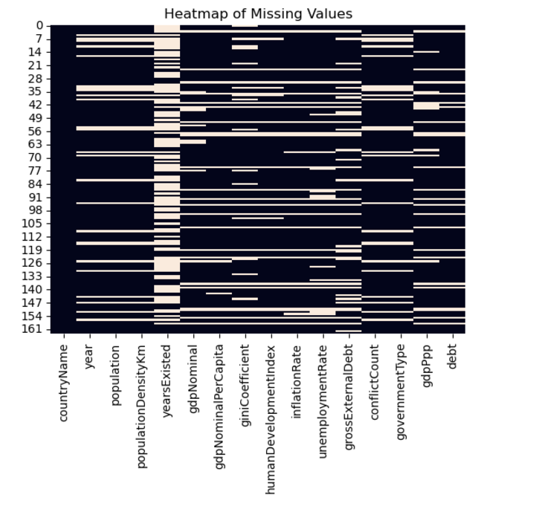
EDA (Cont.)
Missing Values Visualized
A heatmap that visualizes the pattern of missing data across variables. It is important to note large missing attributes, which will cause them to be negated in the final synopsis.
Notes:
Exploratory Data Analysis

Slide 15
Code Analysis I: Data Quality and Alignment
Standardize the Data
Both the DBpedia and World Bank Data were standardized using “StandardScaler” to ensure compatibility across metrics and different ranges and units.
Calculating Average Difference
In each row the following was performed.
- Calculating the element-wise difference between standardized values for each attribute.
- Averaged these differences across all attributes within a row to be a row-wise mean difference.

Slide 16
Code Analysis I (Cont.)
Averaging Across Rows
Took the average of the row-wise mean differences to calculate an overall metric and represent accuracy and alignment of the datasets.
Overarching Purpose
By completing this process in the code, we were able to assess the quality of the DBpedia data compared to the World Bank and create visualizations.

Slide 17
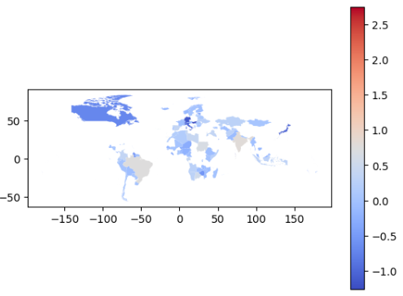
Code Analysis I (Cont.)
Geographic Visualization
The map visualizes the standardized data’s differences across countries by their respective row-wise average. The color gradient from red to blue provides a geographic overview of how metrics vary globally.

Slide 18
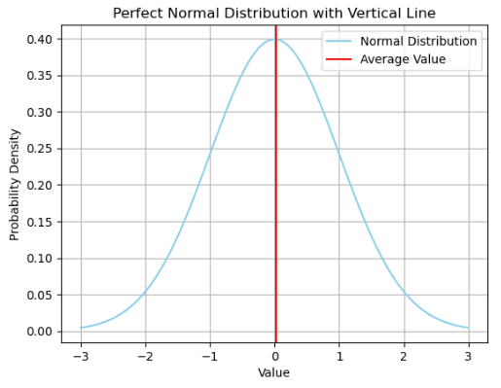
Code Analysis I (Cont.)
Normal Distribution Overview
This plot overlays the standardized data's average differences onto a perfect normal distribution. The red vertical line represents the calculated average, indicating how closely the distances align.

Slide 19
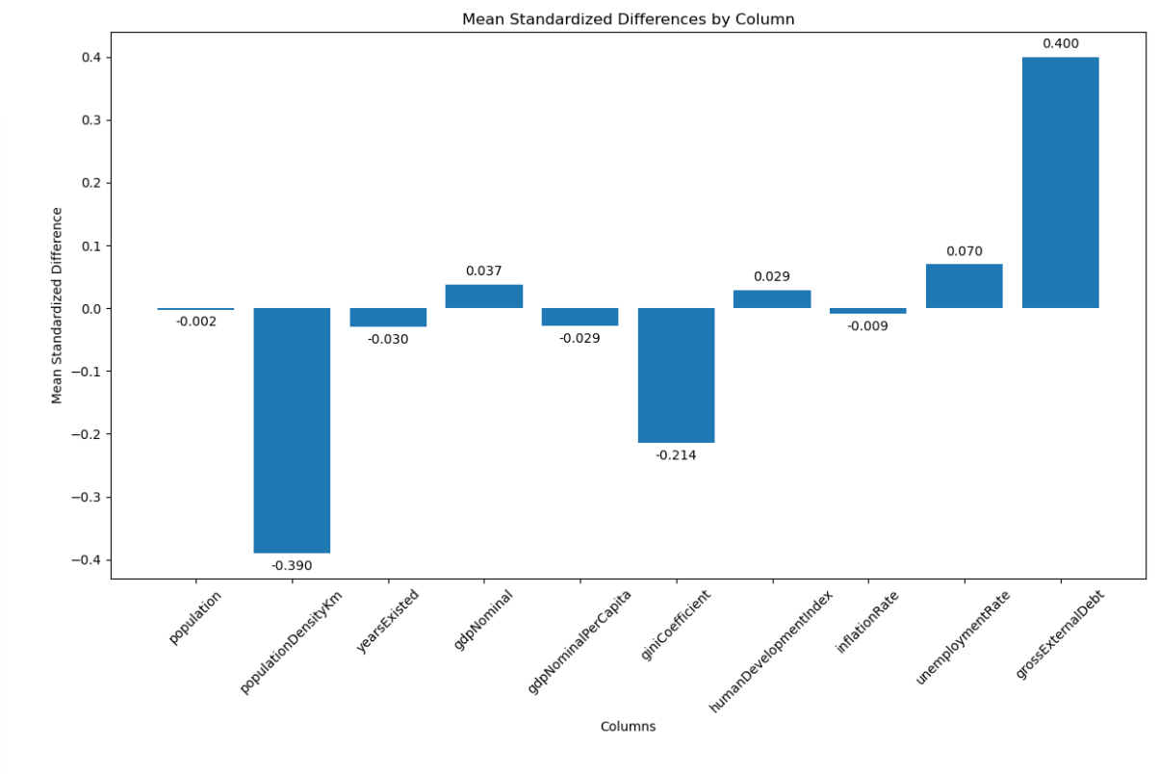
Code Analysis I (Cont.)
By Column Mean Differences of Standardized Values
A visual of standardized differences in various columns across the DBpedia and World Bank datasets.
In this case, the differences are calculated as the average difference from the standardized values, allowing for a direct comparison.
The largest positive difference being grossExternalDebt and the largest negative being populationDensityKm.
Notes:
Exploratory Data Analysis

Slide 20
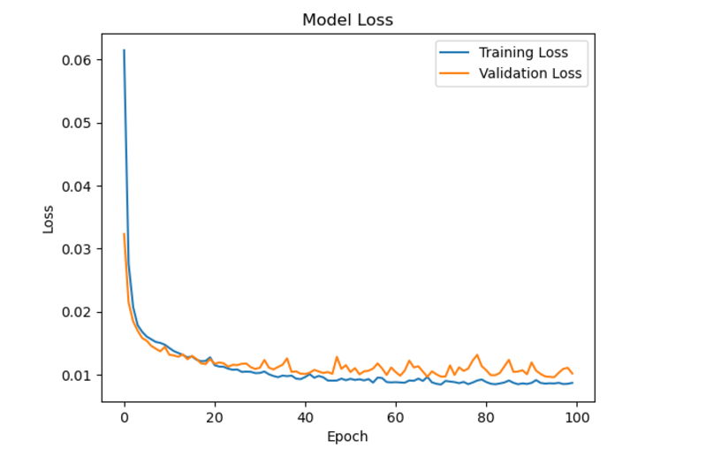

Code Analysis II: Predictive Modeling
Neural Network Loss
Depicted is the training and validation loss across epochs for our neural network model.
The size of the descent as well as minimal overfitting indicates optimal training of the model.
80.05% of the variation in the dependent variable explained by the independent data in the model.

Slide 21
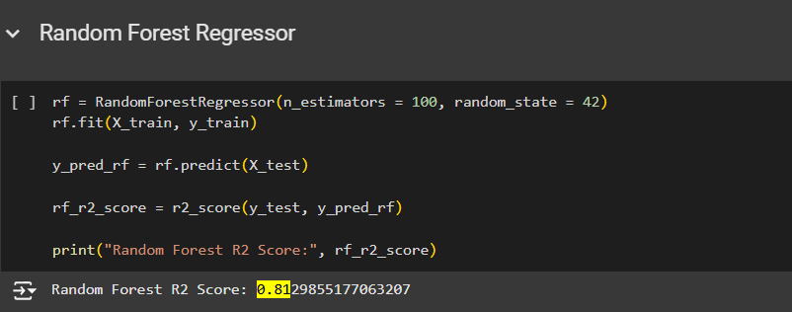
Code Analysis II (Cont.)
Random Forest Performance
81.29% of the variation in the dependent variable explained by the independent data in the model.
Notes:
Exploratory Data Analysis

Slide 22
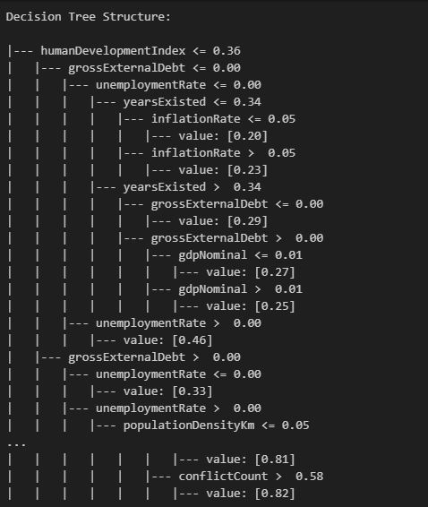
Code Analysis II (Cont.)
Decision Tree Interpretability Advantage
The model’s tree structure shows exactly how it is making its predictions.
Importance of each feature in the model can be gleaned.
*Structure is truncated to fit on slide

Slide 23
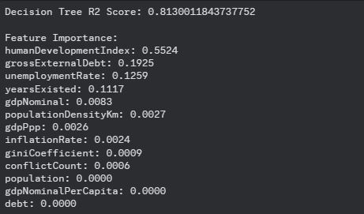
Code Analysis II (Cont.)
R² Score:
81.30% of the variation in the dependent variable explained by the independent data in the model.
Feature Importance
Rating of each model attribute by a combination of its frequency and depth in the model.
humanDevelopmentIndex is most important in the model’s prediction.

Slide 24
Results
Analysis Findings
The difference in quality between the DBpedia and World Bank data was minimal and there was no observable trend in the difference in quality by country.
The best performing models of the ones tried was a decision tree regressor with an R² of 0.8130, and the structure of the model indicated that humanDevlopmentIndex was the most important feature in the model’s prediction by quite some margin (feature importance value of about 52%).

Slide 25
Results (Cont.)
Key Insights:
A low average difference in quality demonstrates that DBpedia can serve as complimentary data source when validated.
However, it may be difficult to produce a large dataset with no initial missing values because of DBpedia’s differences in documenting similar values.
Outliers in the data indicated localized issues in data alignment and need to be handled on a case-by-case basis.

Slide 26
Project Improvements
Handling Missing Values
Ensure missing values were dropped and columns with outliers dropped.
Either collect more data for this, make sure less of it is dropped during the joining of the initial datasets, or employ methods like missing value imputation.
Ensure Unit Consistency
Standardize variables such as GDP to use consistent units across datasets or do on-the-fly conversion.
Statistical Validation
Incorporate statistical tests to verify that differences in quality between datasets are significant and not due to random or coincidental relationships.

Slide 27
Future Work
Improved Data Matching
Develop a method to identify and reconcile data that refers to the same entities under different labels.
Avoid unnecessary data loss due to unmatched country names due to oncincidenties in country names, e.g., “Russia” vs “Russian Federation”.
Reaffirm Conclusions with Further Experimentation

Slide 28
Conclusion
Successful comparison of the quality of data from World Bank and DBpedia allowed us to create predictive models and be confident in their findings.
Gaps and discrepancies were closed between the two datasets to allow for a strong predictive model and accuracy.
Visualization of global demographic and economic trends highlight the utility of the linked data and can be used to address larger scale research questions.
Further focus can be given to expanding possible data sources and using more advanced statistical and analytical techniques.

