Slide 1
datasets and network intrusion detection
Daniel Mesko and Andrew Quijano

Slide 2
Intrusion Detection Systems
Software that monitors a network or system for malicious activity
Network Intrusion Detection Systems (NIDS):
Placed at strategic points within a network to monitor network traffic
Identify malicious (or more generally, anomalous) network behavior
Flag the anomaly, alert system administrators and/or ignore it

Slide 3
Intrusion Detection Systems
Two Detection Methods:
Signature-based: specific patterns (called signatures) are pre-identified as malicious; all network traffic is cross-checked with these patterns to identify attacks
Anomaly-based: taught to distinguish normal network traffic from anomalous (malicious) traffic; new network traffic is compared against the model. Designed to detect unknown attacks. Usually using AI/ML

Slide 4
Anomaly-Based NIDS
Training Phase:
ML Model(s) trained with datasets derived from real network traffic – some records labeled “normal”, others labeled with some anomaly (probe, smurf, etc.)
Datasets (CSV files) contain many records (rows) of data flows/streams or connections
Each row represents a connection, each column a feature of that connection.
Some features directly extracted from packet headers, others derived over time, relative to other connections, etc.
Testing Phase:
Compare current network traffic with the profile created in training phase

Slide 5
The Problem
Datasets must represent normal AND anomalous network traffic accurately and completely.
False positives, uncaught attacks – both common.
Datasets are hard to come by, often very large (high training overhead).
The features of many datasets are difficult/time consuming to derive, so the derivation process is hard to replicate and slow to execute when reading live from wire

Slide 6
Motivation
A handful of datasets exist
The industry standard KDD Cup 1999 dataset (now 20 years old) – many IDS researchers feel that it is bloated (many redundant records), and does not represent modern network traffic accurately and does not contain modern attack variants.
Reparsings of the KDD dataset, most notably NSL-KDD, which removes redundant records to avoid classifier bias, dataset is smaller and thus easier to use for training.
Other datasets, with unique features from KDD, representing specialized different attacks.

Slide 7
Related Work
Data Sets:
KDD Cup ’99 original “white-papers”
W. Lee, “A data mining framework for constructing features and models for intrusion detection systems,” Ph.D. dissertation, Columbia University, 1999.
W. Lee and S. J. Stolfo, “Data mining approaches for intrusion detec- tion,” 1999.
Secondary KDD Cup ‘99 analyses
Shortcomings of KDD, description of NSL-KDD
M. Tavallaee, E. Bagheri, W. Lu, and A. A. Ghorbani, “A detailed analysis of the kdd cup 99 data set,” in 2009 IEEE Symposium on Computational Intelligence for Security and Defense Applications, July 2009, pp. 1–6.
Description of KDD features, relevance
A. A.Olusola., A. S.Oladele., and D. O.Abosede, “Analysis of kdd 99 intrusion detection dataset for selection of relevance features,” in Proceedings of the World Congress on Engineering and Computer Science, vol. I, oct 2010.
Relevance of features, proposal of smaller feature sets
R. C. Staudemeyer and C. W. Omlin, “Extracting salient features for network intrusion detection using machine learning methods,” South African Computer Journal, 2014.
Feature Derivation, Dataset Evaluation
Feature derivation process, IDS testing tools
S. Skjolsvik, “Framework for generating ids benchmarking data sets,” Ph.D. dissertation, 2007.
Properties for evaluating datasets
M. Ring, S. Wunderlich, D. Scheuring, D. Landes, and A. Hotho, “A survey of network-based intrusion detection data sets,” 2019.

Slide 8
Related Work
Machine Learning Models
An overview of neural networks use in anomaly Intrusion Detection Systems
Sani, Y., Mohamedou, A., Ali, K., Farjamfar, A., Azman, M., & Shamsuddin, S. (2009, November). An overview of neural networks use in anomaly intrusion detection systems. In 2009 IEEE Student Conference on Research and Development (SCOReD) (pp. 89-92). IEEE.
Intrusion Detection System Using Bayesian Network and Feature Subset Selection
Jabbar, M. A., Aluvalu, R., & Reddy, S. S. S. (2017, December). Intrusion Detection System Using Bayesian Network and Feature Subset Selection. In 2017 IEEE International Conference on Computational Intelligence and Computing Research (ICCIC) (pp. 1-5). IEEE.
PHAD: Packet header anomaly detection for identifying hostile network traffic.
Mahoney, M. V., & Chan, P. K. (2001). PHAD: Packet header anomaly detection for identifying hostile network traffic..

Slide 9
Our Goals
Analyze KDD Cup ’99 dataset
Examine the distinct values for each feature in the dataset.
Distribution of values across normal v. anomalous behavior.
Features with highest variation across normal v. anomalous behavior.
Use it to train an IDS, generate our own attacks against the system, observe success/false-positivity rates.
Analyze NSL-KDD dataset
Examine the values for each feature.
Difference in frequencies of values from those of KDD Cup ’99
Ratio of normal to attack records as opposed to KDD Cup ‘00
Use it to train an IDS, generate our own attacks against the system, observe success/false-positivity rates.

Slide 10
Some Features/Values Compared
Protocol, Status Flag, and Land features
Normal vs. Anomalous Behavior
KDD Cup ‘99 vs. NSL-KDD

Slide 11
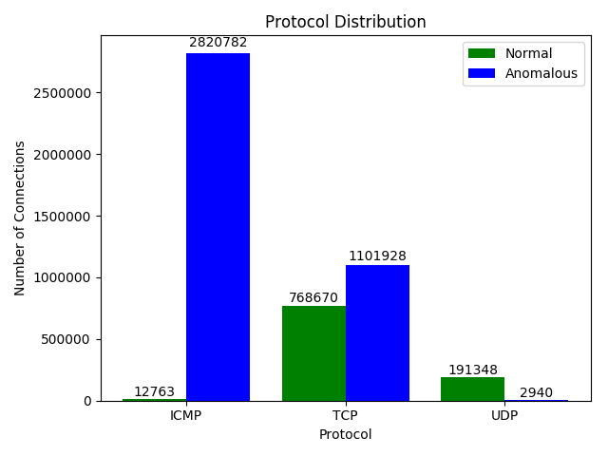
KDD Cup ’99 Protocol Distribution

Slide 12
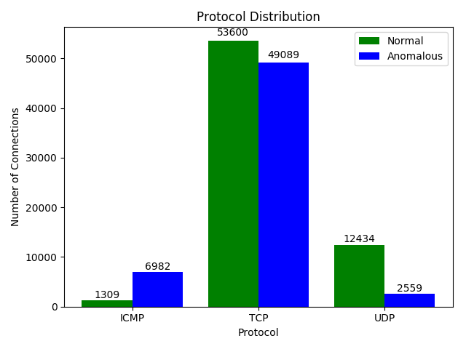
NSL-KDD Protocol Distribution

Slide 13
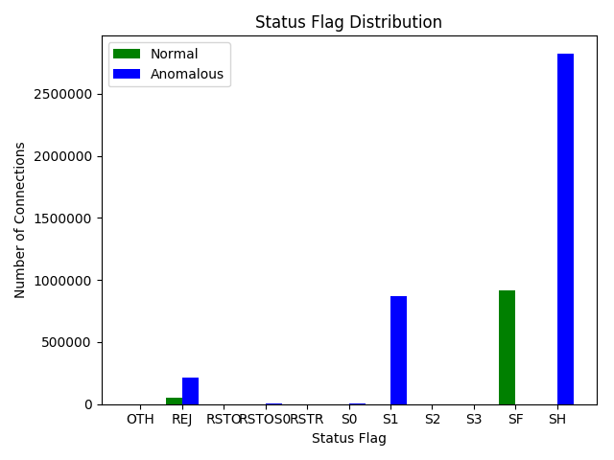
KDD Cup ’99 Status Flag Distribution

Slide 14
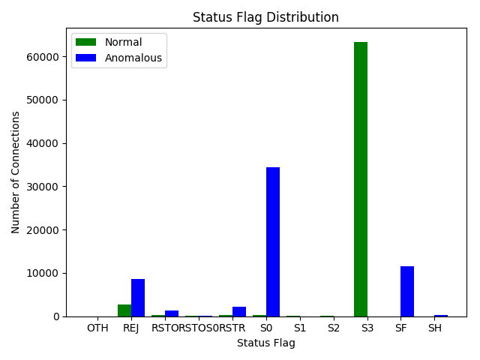
NSL-KDD Status Flag Distribution

Slide 15
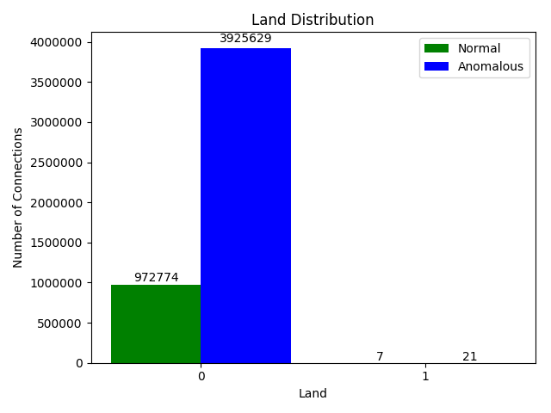
KDD Cup ’99 Land Distribution

Slide 16
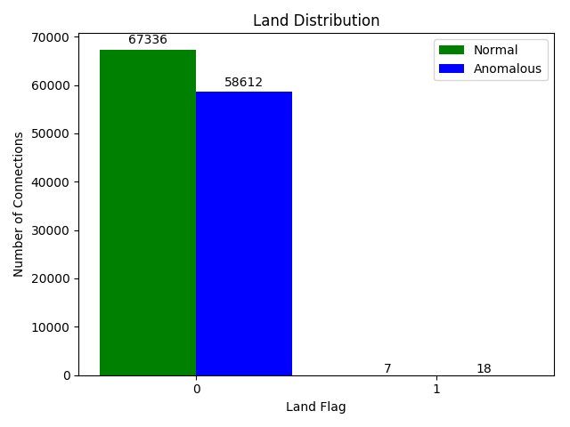
NSL-KDD Land Distribution

Slide 17
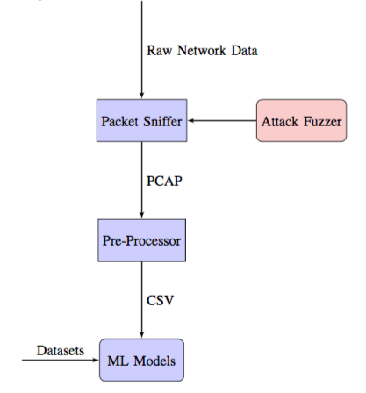
System Design
Four Components
Packet Sniffer
Data Pre-Processor
ML Models
Attack Fuzzer

Slide 18
System Implementation
Packet Sniffer
Reads raw network data from live interface using Linux command line application tcpdump
After reading a pre-defined number of packets, it outputs a Packet Capture (PCAP) File
Data Pre-Processor
Reads PCAP files and outputs a CSV file of features identical to those of KDD/NSL-KDD datasets.
Some features extracted directly from packet headers, some derived from higher-level relationships between connections and time windows.
We used the open-source KDD preprocessor written in C++ by a group of researchers at the University of Bergen.
https://github.com/AI-IDS/kdd99_feature_extractor

Slide 19
System Implementation
Machine Learning Models
Currently working: Naïve Bayes, LDA, QDA
Classifiers to tune: KDD, Decision Tree, Random Forest, SVM, Logistic Regression
Incremental Learning: Consult Verma for tuning paramters
Attack Fuzzer
Denial of Service
Port Scanning
User to Root and Remote to Root contains mostly outdated attacks so they are ignored.

Slide 20
Experimental Setup
On a Google Cloud VM:
IDS trained from the datasets (stored locally).
tcpdump reads from network interface while we:
Browse the web
Execute attacks
Data pre-processor analyzes traffic, generates CSV file, passes it to the IDS
IDS tests CSV file against machine learning models, prints testing score, classification report, and confusion matrix.

Slide 21
Performance Evaluation of KDD Cup’99
Youtube browsing
Naïve Bayes Train/Test Score: 94%/
QDA Train/Test Score: 98.6%/
LDA Train/Test Score: 98.7%/
SYN Flood Attack
Naïve Bayes Test Score:
QDA Test Score:
LDA Test Score:

Slide 22
Final Steps
Repeat tests for NSL-KDD
Determine whether errors in KDD are from lack of tuning (need more time for computation) or perhaps the models are too old for modern traffic
Test the Adversarial ML model. Determine how to modify attacks such that different pre-processing results are achieved.
Attempt to defeat Adversarial ML by changing the time frame from 2 second to another value.

Slide 23
Expected Conclusions
NSL-KDD has fewer records -> easier to train/tune
NSL-KDD ratio of normal to attack records more balanced -> fewer false positives
NSL-KDD redundant records are removed -> less classifier bias towards frequent values

Slide 24
Future Work/Extensions
Build/find pre-processors for non-KDD-based datasets, so that they can be evaluated against KDD
Further attempt to doctor packets to subvert IDS
Identify weaknesses in certain datasets
Make our own dataset with relevant features that can detect these kinds of attacks

