Slide 1
Department of Computer Science
Columbia University
Indoor Localization Privacy
using
Homomorphic Encryption
REU Student: Andrew Quijano
Mentor: Kemal Akkaya

Slide 2
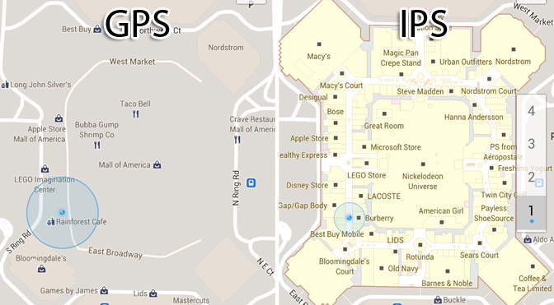
Introduction
Indoor localization is widely used in shopping malls, airports, office buildings, etc. where GPS falters in accuracy.
There are various techniques to achieve it.
Triangulation, beacons, additional sensors, fingerprinting, etc.

Slide 3
Fingerprint-based Localization Approach
Fingerprint-based Localization has been widely used for accurate indoor localization.
The idea is based on two steps
Step 1: Training by collecting fingerprints from various locations and storing them in a database
Step 2: Using the training data to do a distance computation to your location
Distance is your signal’s distance to the ones stored in the database on the first step
Needs training but if enough fingerprints are created, the localization will be very accurate and straightforward

Slide 4
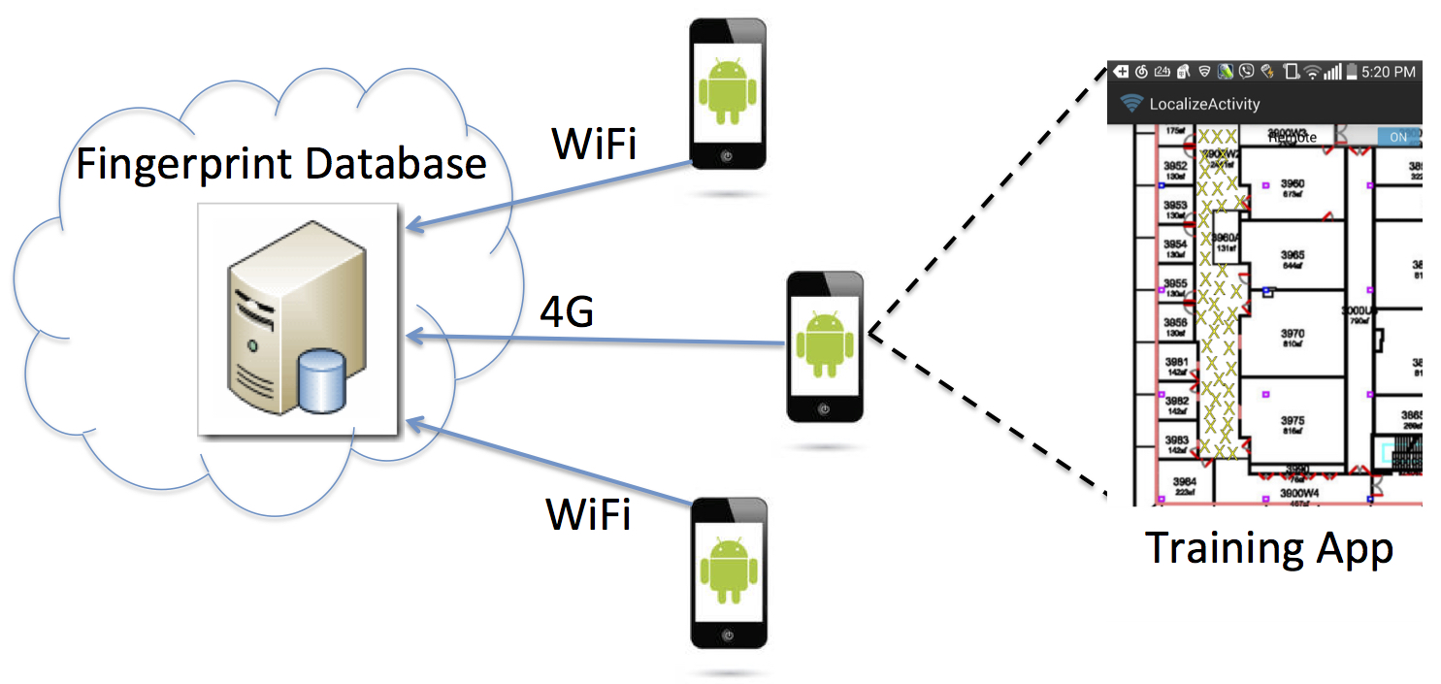
Our Wi-Fi Localization Implementation
We developed a Fingerprint-based localization system to find/track a user’s position in a building.
It has two phases:
1) Client measures signal strength values (RSSI) for APs from various locations within a building.
Stores RSSI values to a remote database via mobile crowdsourcing
2) Location is determined by comparing RSSI measurements of a client to fingerprints in the database
Notes:
The main contribution is building an Indoor location system using Wi-FI RSS signals. As you can see on the image, this relies on needing the floor map loaded onto the application. To begin training the database, you should go into each room and conduct a scan of RSSI/APs detected within the floor. The information is stored within a remote database. The benefit of this system is it allows for easy crowdsourcing for multiple fingerprints for multiple devices. The location of a user is determined by using Euclidean distance computation to figure out which fingerprints the user is closest to.

Slide 5
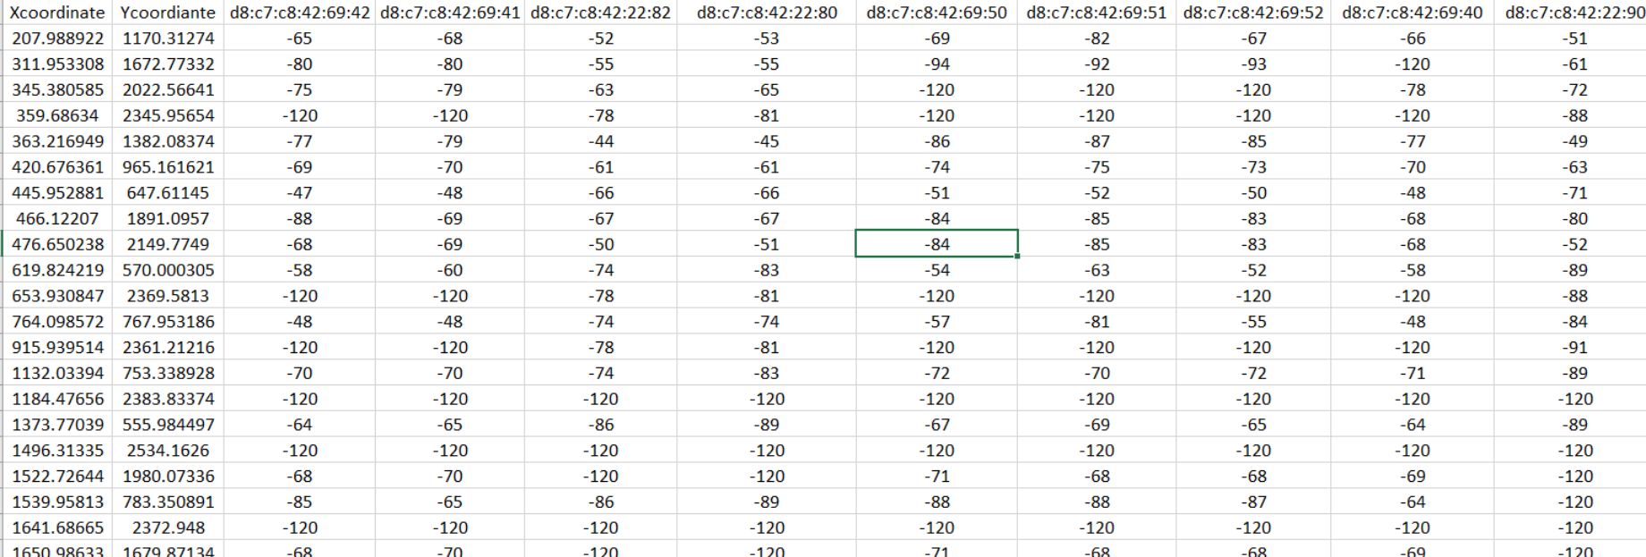
Lookup Table Creation
Upon completing the training phase, create a lookup table from which distance computations are used and filter APs as needed.
If the specific AP on the column is not found at that fingerprint, place a miss-constant of -120 as this value increases the distance without accidentally giving a wrong answer.
Notes:
Upon completing the training, it is critical to create a lookup table from which you can standardize the Euclidean distance computation. Ideally you would filter out APs that are known within your building/filter out temporary APs (e. g. hotspots). Each row contains the coordinates of the fingerprint on the floor map and RSSI reading of the AP within the fingerprint. If the AP is not found at that finger-print we assign it a value of -120. This value is determined to be the most idea “miss constant” as it is large enough to not confuse the distance computation but not too large as in it would skew it too much.

Slide 6
Our Problem: Privacy Concerns
Client queries carrying a scan fingerprint can be collected by outside parties or the service provider
Information about the client’s location history can be determined.
Responses to malicious queries can also leak the contents of the fingerprint database.
Need to hide client’s scan fingerprint
MAC address cannot be changed since this would disconnect the user from AP
Notes:
The reason why we conducted research on this topic is because Indoor location is a burgeoning field, but there has been no major focus on attempting to provide any security to the user. This information could be used to track users by a malicious actor to determine where they work, live, etc.
Therefore, it is urgent that we conceal the most information either MAC address of RSSI signals detected.

Slide 7
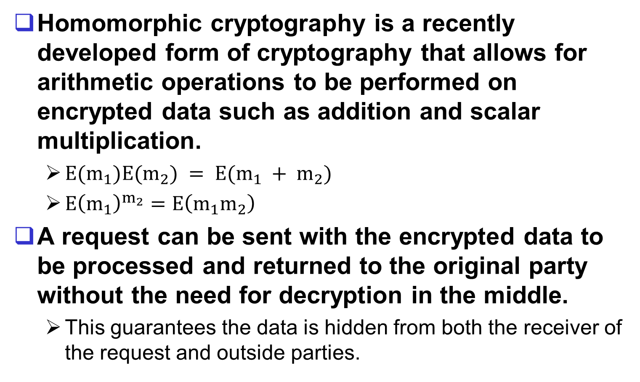
Solution: Homomorphic Cryptography
Homomorphic cryptography is a recently developed form of cryptography that allows for arithmetic operations to be performed on encrypted data such as addition and scalar multiplication.
$E(m_{1})E(m_{2}) = E(m_{1} + m_{2})$
$E{\left(m_{1}\right)}^{m_{2}}=E\left(m_{1}m_{2}\right)$
A request can be sent with the encrypted data to be processed and returned to the original party without the need for decryption in the middle.
This guarantees the data is hidden from both the receiver of the request and outside parties.
Notes:
The solution is to encrypt the RSS values using homomorphic encryption. As seen on the slide, it allows for some computations on the encrypted values such as addition and scalar multiplication. Therefore, the server can compute distance without ever knowing which fingerprints the user is closet too and provides a protection against man in the middle attacks.

Slide 8
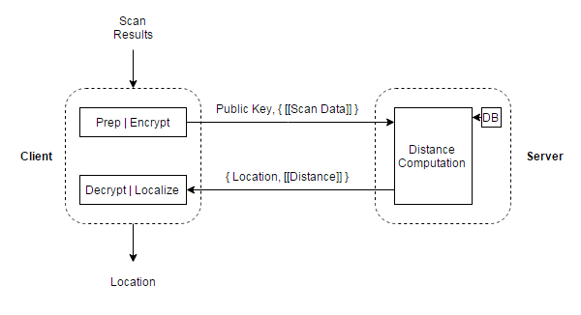
Client-side Localization via Homomorphic Cryptography

Slide 9
What is the problem with Client-side Approach
Since server is not trusted, then the results (top k results) of distance computations which are encrypted are not exposed to it
They are sent back to client
It decrypts them and finds the minimum one/Compute centroid location
Sending these results back to the phone is not efficient
The phone battery will consume more power each time
It will also do more computations on the phone
Finally, transmission of these values may take some time
In this paper, we offer an alternative approach to perform the computations at the server but still maintain privacy

Slide 10
The Approach
The idea is based on still using Homomorphic computations
However, we also perform the sorting operation at the server side
This was possible due to recent implementations of comparisons of two encrypted numbers
Socialist Millionaire Problem
DGK algorithm enabled such computations on the encrypted distance values
We devised a sorting algorithm and found the top value
This value is sent to the client
Not the list of all values as in the case of client-based approach

Slide 11
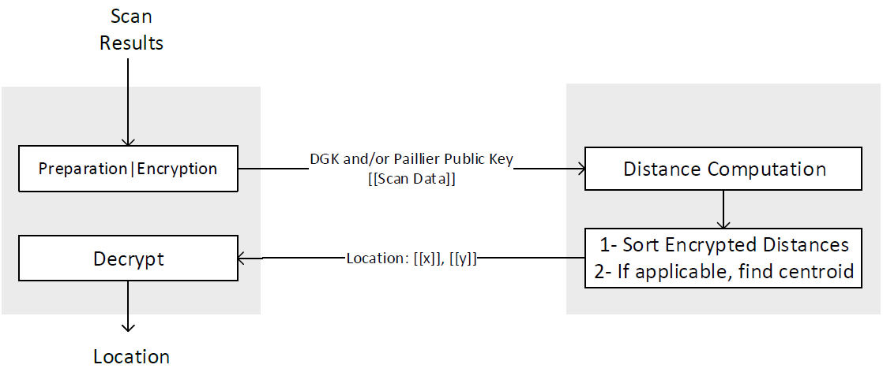
Server-side Localization via Homomorphic Cryptography

Slide 12
Details
Paillier and DGK homomorphic cryptosystem is used.
Client sends request with public key and scan fingerprint containing encrypted signal strength (RSS) values for each AP.
Service provider receives encrypted request data, retrieves and encrypts data from database, then performs the distance computation on the data set

Slide 13

Distance Computation
The cost associated with the distance computation is large because we are performing the Euclidean distance algorithm on large encrypted values.
The distance $d_{i}$ between the localization scan and a fingerprint can described by the equation below.
𝑉′ = client scan data, 𝑉_{𝑖} = remote fingerprint, N = number of APs (matched or constant)

Slide 14
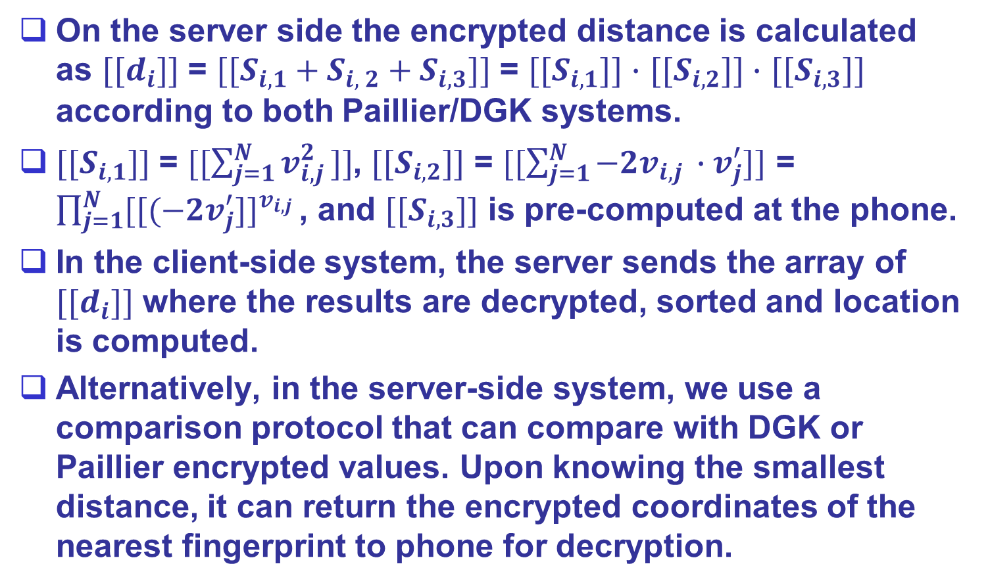
Computational Overhead
On the server side the encrypted distance is calculated as $[[d_{i}]]$ = $[[S_{i, 1}+S_{i, 2}+S_{i, 3}]]$ = $[[S_{i, 1}]]$ $∙$ $[[S_{i, 2}]]$ $∙$ $[[S_{i, 3}]]$ according to both Paillier/DGK systems.
$[[S_{i, 1}]]$ = $[[\sum_{j=1}^{N}{v_{i,j }^{2}}]]$, $[[S_{i, 2}]]$ = $[[\sum_{j=1}^{N}{−2v_{i,j }∙v_{j}^{′}}]]$ = $\prod_{j=1}^{N}{{[[(−2v_{j}^{′}]]}^{v_{i,j} }}$, and $[[S_{i, 3}]]$ is pre-computed at the phone.
In the client-side system, the server sends the array of $[[d_{i}]]$ where the results are decrypted, sorted and location is computed.
Alternatively, in the server-side system, we use a comparison protocol that can compare with DGK or Paillier encrypted values. Upon knowing the smallest distance, it can return the encrypted coordinates of the nearest fingerprint to phone for decryption.

Slide 15
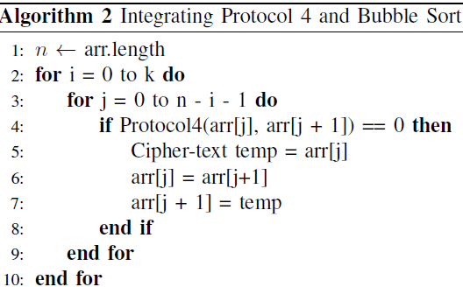
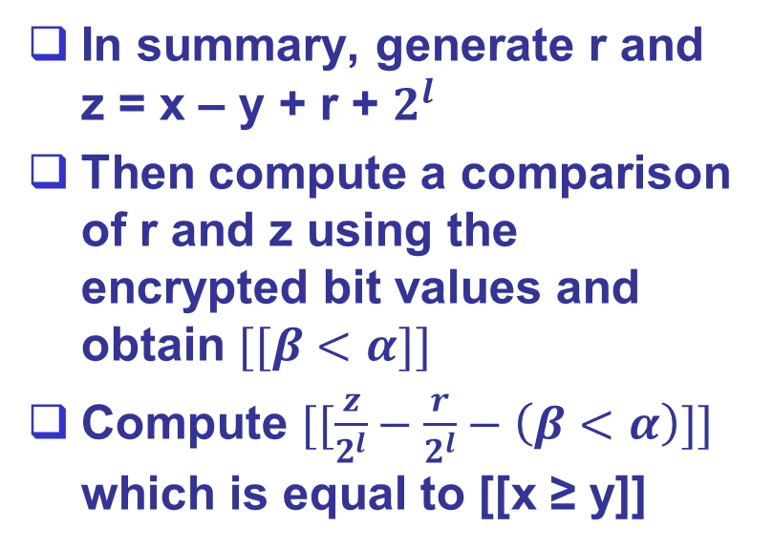
Encrypted Sorting
DGK was originally designed for auctions, so it has a built-in comparison protocol from which to compare encrypted numbers and return [[x ≥ y]], given [[x]] and [[y]].
Using the protocol below, incorporate it with Bubble sort to be able to sort the array by smallest encrypted distance.
In summary, generate r and z = x – y + r + $2^{l}$
Then compute a comparison of r and z using the encrypted bit values and obtain $[[β<α]]$
Compute $[[\frac{z}{2^{l}}−\frac{r}{2^{l}}−\left(β<α\right)]]$ which is equal to [[x ≥ y]]

Slide 16
Results
Also, we discovered that DGK while is supports smaller plain-text space than Paillier, it is much faster in encryption and decryption time, which allows it to be useful in Indoor Location applications.
We used 2048-bit keys as 1024-bit keys are no longer deemed secure.
Server-side approach saves battery life, otherwise Client-side approach supports computing centroids.
Approach | Time (Paillier) | Time (DGK) | Energy (Paillier/DGK)
Client Side | 11.3 | 6.71 | 4%
Server Side | 27.93 | 16.65 | 3%

Slide 17
Conclusion
Fingerprint-based localization is accurate but raises concerns regarding privacy
Server will have access to all fingerprints
Homomorphic computations can address this issue
However, it brings computation overhead to the client and adds transmission overhead.
In this paper, we utilized encrypted sorting to perform homomorphic operations at the server side to address these issues
The implementation demonstrated that battery consumption can be reduced while the latency is increased slightly.

Slide 18
Acknowledgements and Code
Funding
National Science Foundation (NSF)
Cisco Silicon Valley Foundation
Mentors and Friends
Professor Kemal Akkaya for his support and mentorship during the REU program
Dr. Samet Tonyali for assistance in implementing DGK Crypto Library
Alice Niu for testing the Indoor Localization System
Homomorphic Encryption Library:
https://github.com/AndrewQuijano/Homomorphic_Encryption
REU Project Code:
https://github.com/AndrewQuijano/SSTREU2017

