Slide 1


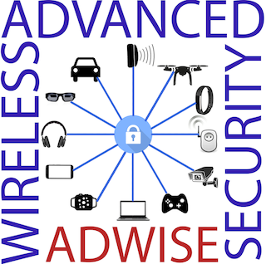

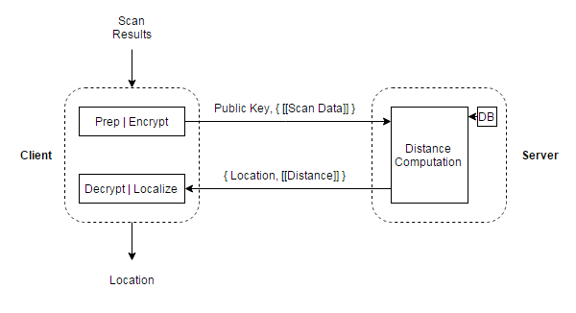
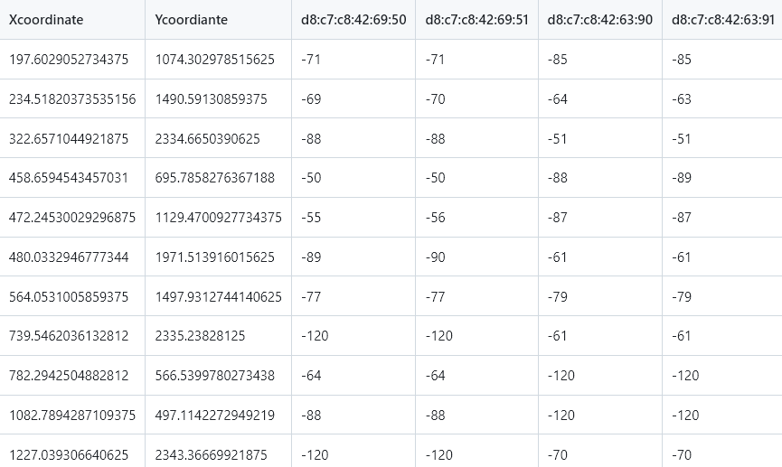
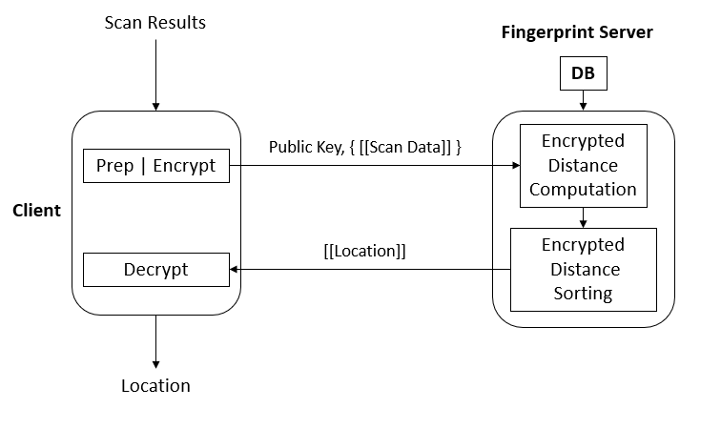
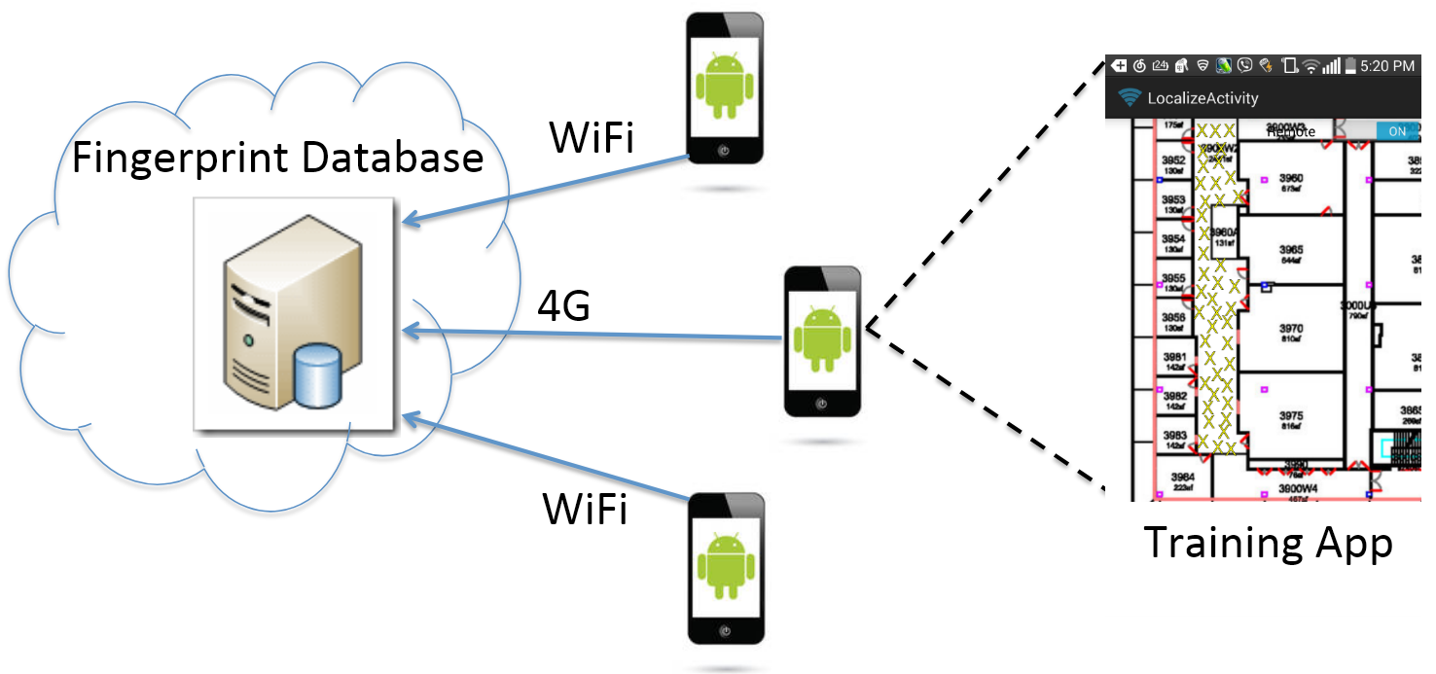
Server-side Fingerprint-Based Indoor Localization Using Encrypted Sorting
Andrew Quijano†, Kemal Akkaya*
†New York University & *Advanced Wireless and Security Lab, VCU
Electrical & Computer Engineering Department
andrew.quijano@nyu.edu, akkayak@vcu.edu
INTRODUCTION
EXPERIMENT SETUP
RESULTS
GPS is unusable for indoor localization in large buildings, e.g., malls, hospitals, and airports.
Users are concerned about their location data being compromised and/or privacy concerns
This research is to implement a homomorphic encryption system that both provides privacy and minimizes phone battery usage.
Training/Data Collection Phase
Obtain a floor map of where to localize a user
The user marks coordinates on a floor map with the results of an RSSI scan (Mac Address, RSSI tuples)
Generating the Lookup Table
Use this table to compute the Euclidean distance between the user’s location and the trained points
Reduce columns by filtering out rarely seen Access Points
We compare our approach with a prior work (Parmengol et al. 2017), where rather than sorting encrypted numbers, the values are decrypted in the client.
EXISTING METHODS
Other fingerprint server models exist, where all information is on the phone but can use excessive battery, and a user would have unusually detailed information about a network.
Utilize differential privacy, a technique to inject noise to make it more difficult to identify a specific user. The noise can be added to the fingerprint data and user data, but this noise can decrease the accuracy of the results.
Our approach is slower, but it uses less phone battery as more work is done on the fingerprint server
We also utilized DGK, a homomorphic encryption scheme with a smaller plaintext space, but faster than Paillier
The results compute the average time of 20 localizations with 2048-bit keys
We used a Samsung Galaxy S6 Edge, with more modern phones, the time should be much faster
FINGERPRINT LOCALIZATION FRAMEWORK
Crowdsourced Training: the fingerprint server data is crowdsourced, coming from various users owning multiple different phones
It uses DGK and/or Paillier homomorphic encryption on the RSSI values
Application: Compute distance squared without decrypting the client input, hence preserving the user’s privacy
For localization, the phone scans Access Points, encrypts RSSI, and sends it to the fingerprint server
The server, utilizing encrypted integer sorting, can find the smallest distance and return the correct coordinates
Approach | Time (Paillier) | Time (DGK) | Energy (Paillier/DGK)
Client-Side | 11.13 s | 6.71 | 3%
Server-Side | 27.93 s | 16.65 s | 4%
CONCLUSION
Homomorphic encryption can be used to securely localize a user inside a building.
To save battery life, outsourcing more computations to the server is feasible option, at the trade-off for more compute
Future Work: Utilize more sensors, e.g. barometers, CSI, or Bluetooth

