Slide 1
Homomorphic Encryption for Practical Secure Computation
Case Studies in Drone Navigation and Decision Tree Inference
PRESENTED BY: Andrew Quijano
08/21/2025

Slide 2
Homomorphic Encryption
Motivation & Background

Slide 3
Motivation & Problem Statement
The enduring importance of cryptography in securing sensitive information is undeniable, with its history traced back to ancient ciphers such as the Caesar Cipher and evolving into modern robust algorithms such as AES and RSA. In the contemporary digital age, where the Internet underpins critical services such as financial transactions and healthcare data exchange, encrypting communications is paramount to protecting user privacy and ensuring data integrity.
However, a fundamental challenge persists with traditional encryption schemes: For any computation or analysis to occur on encrypted data, it must first be decrypted. This necessity introduces significant security vulnerabilities. Decryption creates moments of exposure in which sensitive data, now in plaintext, become susceptible to various attacks, such as malware designed to intercept data post-decryption

Slide 4
What is Homomorphic Encryption? Why use it?
Homomorphic Encryption (HE) uniquely allows computations, such as addition or multiplication, to be performed directly on ciphertext, without requiring prior decryption
While AES and RSA are strong cryptographically strong, their security is intrinsically tied to robust key management. HE mitigates the following:
Third Party improper Key Management
Third Party insecure environment issues

Slide 5
Contributions
Using the JAR file for the following research projects
Create a drone collision avoidance algorithm that is 30% faster than state of the art and 90% less bandwidth
Create an improved enhanced privacy-preserving decision tree evaluation that is on average 30% - 50% faster than other alternatives
Andrew Quijano created a secure indoor localization system using homomorphic encryption. The following was completed:
Extract the homomorphic encryption code into a JAR file
Extend the functionality of the library

Slide 6
Background
Paillier natively supports ONLY addition and subtraction of two ciphertexts by multiplying them, [x] [y] = [ x + y ], where the brackets denote encryption
To multiply two Paillier ciphertexts, we utilize a two-party protocol – x and y are encrypted operands while a and b are plaintext noise Alice introduces to preserve privacy. (Mau et al.)
([x] + a)([y] + b) = xy + xb + ya + ab
[xy] = ([x] + a)([y] + b) - xb - ya – ab
To compare two Paillier ciphertexts, we use encrypted comparison which allows for usable results without decryption, returning an encrypted bit [X >= Y] given [X] and [Y] (Joye and Salehi)
There also is an encrypted equality check [X == Y], used to compare categorial values

Slide 7
Privacy-Preserving Drone Navigation Through Homomorphic Encryption for Collision Avoidance
Presented at IEEE LCN 2024

Slide 8
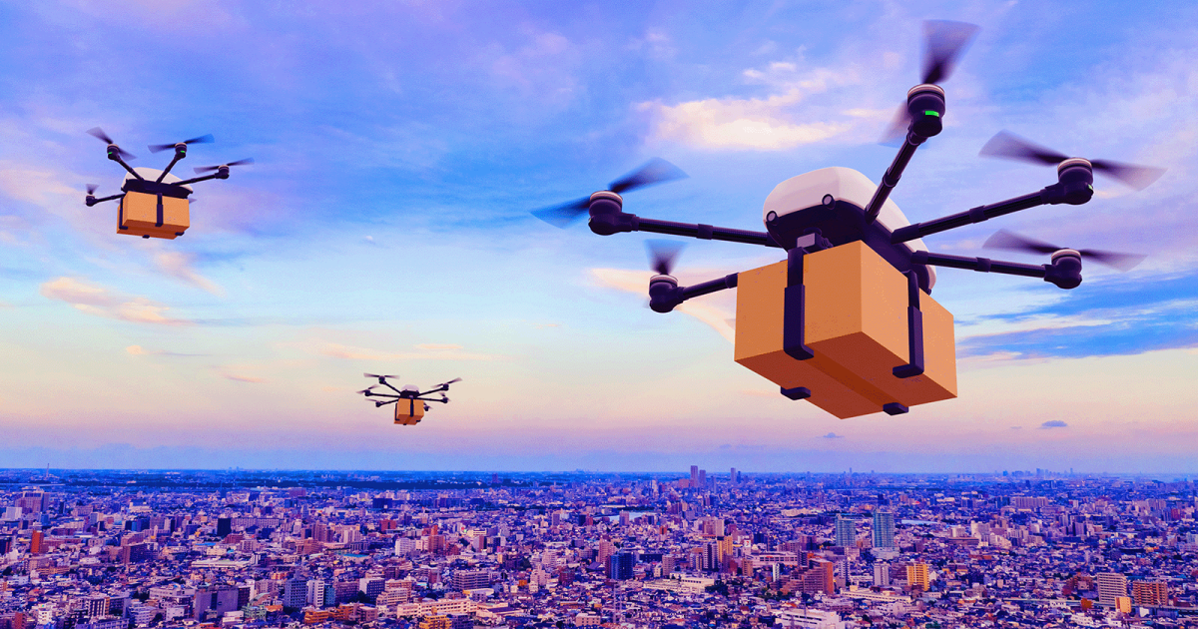
Introduction
With rapid increase of drone technology in various industries, ensuring collision avoidance is paramount to guarantee safety and efficiency.
Drone traffic is increasing in areas like package delivery and search and rescue.
In the case of package delivery, multiple different companies may be operating in a geographic area.
Problem Statement: Companies want to avoid drone collision without the exchanging detailed flight paths that would compromise privacy and security in many cases that may involve sensitive information.
Online retailers – i.e., customers' personal information, such as addresses
Government agencies – i.e., the location of a surveillance target or confidential mission

Slide 9
Literature Review
"Coordinated multi-robot planning while preserving individual privacy“
By Li et al.
Emphasis on robots in a two-dimensional geometric plane, using garbled circuits and homomorphic encryption to preserve path privacy. Specifically avoids reporting locations of intersections.
"Privacy-Preserving Trajectory Matching on Autonomous Unmanned Aerial Vehicles"
By Sciancalepore et al.
Employs Incremental Capsule Matching and privacy-preserving proximity testing to achieve collision detection
Fast, but some accuracy is sacrificed, with a 10.3% false positive rate
"Privacy-Preserving Collision Detection for Drone-based Aerial Package Delivery using Secure Multi-Party Computation"
By Desai et al.
Proposes Secure Multiparty Computation (MPC) for trajectory planning among drones, ensuring collision detection without disclosing sensitive information
Uses a grid-based approach to compare trajectories, requiring a mutual agreement on potential flight paths.
We utilize homomorphic encryption without losing accuracy or requiring pre-processing

Slide 10
Approach and Assumptions
We propose a method of drone collision avoidance via the use of encrypted paths to preserve the confidentiality of flight routes.
Our method specifically makes use of homomorphic encryption, which allows computations on encrypted values.
The original plaintext data need not be decrypted to carry out these computations or utilize their results.
The protocol is run between two drones, assumed to be owned by different companies.
One drone, Alice, is about to take off and the other, Bob, is either in flight or also about to take off.

Slide 11
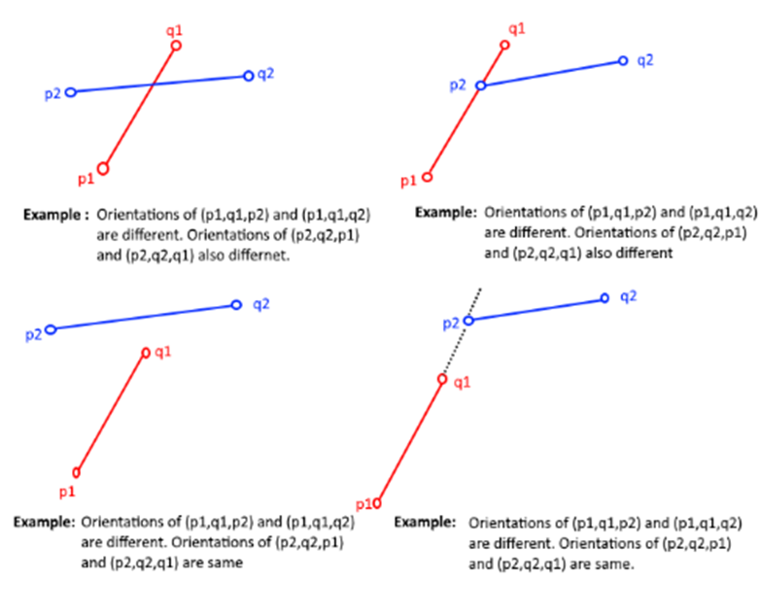
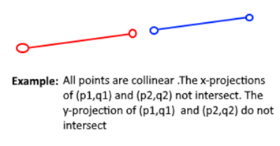
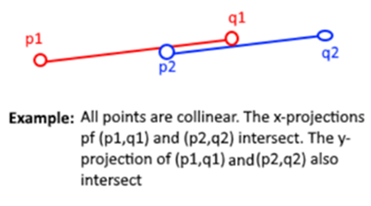
Intersection Algorithm
Intersection primitive relies on orientation of points
Colinear
Not Colinear

Slide 12
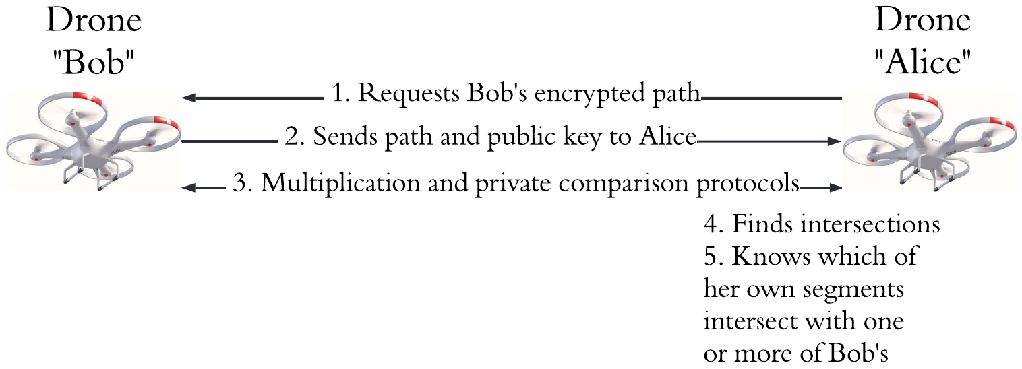
Proposed Protocol
The path comparison algorithm runs between the drones, with communication required for encrypted multiplication and encrypted number comparison.
Only Alice has the intersection output, if Bob wants the outputs, the roles must switch

Slide 13
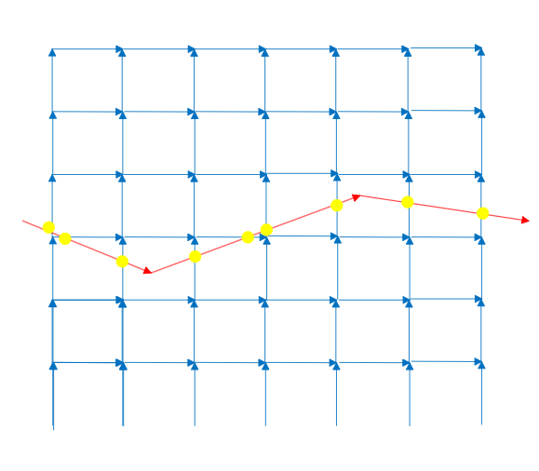
Security Analysis
For third parties, eavesdropping is infeasible since everything is encrypted
Primary threat is a brute force attack against Bobs path by a malicious Alice to reverse engineer Bob’s path
Alice defines her own as a grid of segments to recreate Bobs path through intersections
Time is the primary defense here, as Alice has many times the number of segments that a properly honest path would have.
Drones have limited range to be able to both complete its mission and attempt to follow other drones
Algorithm scales at O(mn) where m and n are the number of segments in Alices and Bobs paths.
Bob will not be in flight long enough to perform this attack and drones are relatively fast.
Comparisons cannot be run once Bob stops complying, as his private key is needed for the multiplication protocol.

Slide 14
Experiment Setup
Two identical Debian 12 virtual machines with 2 CPUs and 4GB of RAM were chosen to emulate a theoretical drone’s resources.
Two sets of 30 random x-y plane segments with values from –99 to 99 were generated.
The two sets of thirty segments were compared for intersections, with one segment from each set compared and timed individually.
The average time and network traffic was collected and calculated.
Average time is defined as the time to complete the protocol
Network traffic is the number of bytes written to the sockets

Slide 15
Results – Comparison with Li et al.
We ran the algorithm by Li et al on the same virtual machines and the same sets of segments, collecting computation and network traffic
Results indicate our approach is 30% faster and sends less network traffic than Li et al.
Approach | Time (seconds) | Network Traffic (bytes)
Our Approach | 4.407 s | 4634
Li et al. | 6.092 s | 39221

Slide 16
Results – Comparison with Desai et al.
We used two Raspberry Pi 4's (as done in their work) to compare with Desai et al.
Speed comparisons were similar when Desai et al's algorithm was using a matrix size of 96 and a secret share size of 64 bits.
This means our approach is similar in speed but relatively unlimited in x-y plane and resolution to Desai's approach when using a matrix size of 96.
Desai's approach scales with matrix size, slowing down considerably when x-y plane or resolution grow.

Slide 17
Conclusion
Our method demonstrates the ability to detect intersections in paths defined by line segments that are homomorphically encrypted in a secure way.
Work is as fast or faster than other totally accurate approaches, with significant advantages in scalability.
Future work on parallelizing the computations on a drone that has multiple CPU cores could cut computation time down significantly.

Slide 18
Enhanced Outsourced and Secure Inference for Tall Sparse Decision Trees.
Presented in IEEE IPCCC 2024

Slide 19
Decision Trees
Decision Tree (DT) an easy-to-understand tool that has been widely used for classification tasks.
A DT consists of internal nodes with a threshold value that determines which node to go to next.
All classes are on the leaf nodes of the DT.
DTs are useful as you can audit why a classification was made
DTs are used managing student data, health data, and fraud detection

Slide 20
Sparse Decision Trees
In a sparse DT, most of the leaves in it are not at the maximum depth of the tree
To analyze if a DT is sparse, we can analyze the level of the output classifications from the training dataset
Dataset | Average | Median | 3rd Quartile | Max | Size
Hypothyroid | 2.78 | 2 | 2 | 9 | 3372
Spambase | 9.60 | 9 | 11 | 22 | 4601
Nursery | 5.99 | 7 | 8 | 14 | 12960

Slide 21
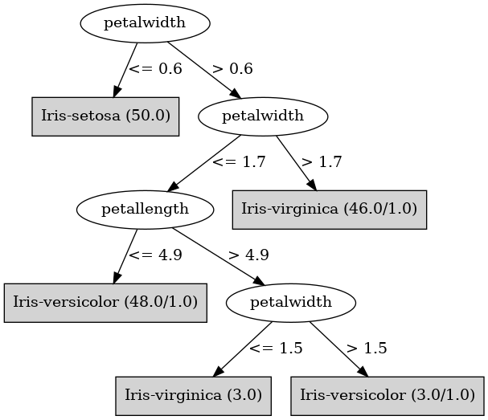
Spare Decision Tree Example - Iris

Slide 22
Secure Inference
A Privacy-Preserving Decision (PPDT) should satisfy the following:
We want to be able to have a client provide an input to evaluate the DT without revealing the input.
The DT owner would want to have clients evaluate it but not have their model reverse engineered by the client
PPDTs also enables compliance with privacy regulations such as
Health Insurance Portability and Accountability Act (HIPAA) in the U.S.
General Data Protection Regulation (GDPR) in the E.U.

Slide 23
Problem Motivation
Prior research used techniques such as homomorphic encryption to create PPDTs
One approach is by Joye and Salehi, in which they implement a new timing attack resistant encrypted integer comparison protocol, and they convert the DT to a complete binary tree so the PPDT has strong timing attack resistance since there will always be the same number of encrypted comparisons.
Issues: Joye and Salehi's approach performs poorly in classification time for sparse DTs. Also, it has no good redundancy as the model is stored on one server.

Slide 24
Related Work - Liu et al.
Utilize the Distributed Two Trapdoors Public Key Cryptosystem (DT-PKC), allowing comparisons between ciphertexts encrypted using different public key pairs.
Liu et al. created new protocols, such as the ability to securely count the frequency of attributes in the data set, used to train the DT on encrypted data.
Our PPDT uses Joye and Salehi's timing attack resistant comparison protocol and has faster evaluations than Liu et al. despite using a larger key size.

Slide 25
Related Work - Yuan et al.
Yuan et al. utilize gradient-boosting decision trees (GBDT) to train DTs
They introduce the privacy preserving distributed GBDT (PPD-GBDT), which uses differential privacy, polynomial approximation and fully homomorphic encryption.
For evaluation, the client encrypts their input and sends the ciphertext and the public key. The client obtains and decrypts the classification result.
Our PPDT has generally faster PPDT evaluation times as we already encrypt everything before evaluation. Also, no noise is added, which could potentially cause classification inaccuracies.

Slide 26
Our Approach
We assume the DT exists on a server and wants to outsource the DT model to the cloud.
We split the DT model into level-sites, which has all the nodes for each specific level
The level-sites will use a comparison protocol and track which nodes are in-scope for the next level-site
The client will run the comparison protocol with each level-site, until a leaf is reached and the level-site returns the classification

Slide 27
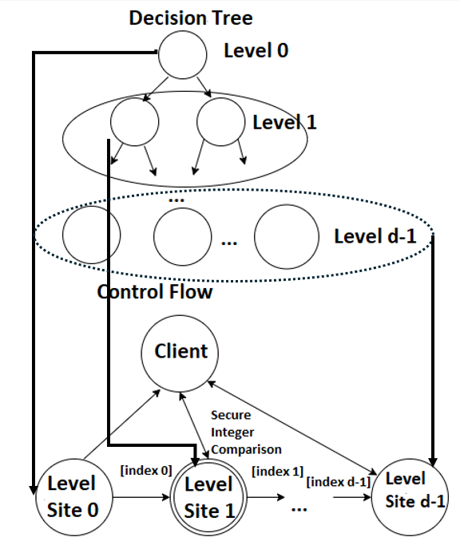
Our Approach - Visualized

Slide 28
Threat Model
Threat Model: We assume that the server is trusted but the client and level-sites are "honest-but-curious" (HBC), specifically
We assume the client will attempt to learn the thresholds of the PPDT from the level-sites
We assume the level-sites will attempt to learn both the input vector and classification
We also consider a passive adversary attempting to learn the client's input, classification and PPDT thresholds
We also assume that the level-sites will attempt to use power-based side channel attacks and timing attacks

Slide 29
PPDT Initialization
Client creates key pair and gives public key to the server
Server trains DT model and encrypts thresholds and leaves
Server distributes encrypted data to the level-sites
Server provides the client with a label encoder for encrypted equality checking for comparing categorical data

Slide 30
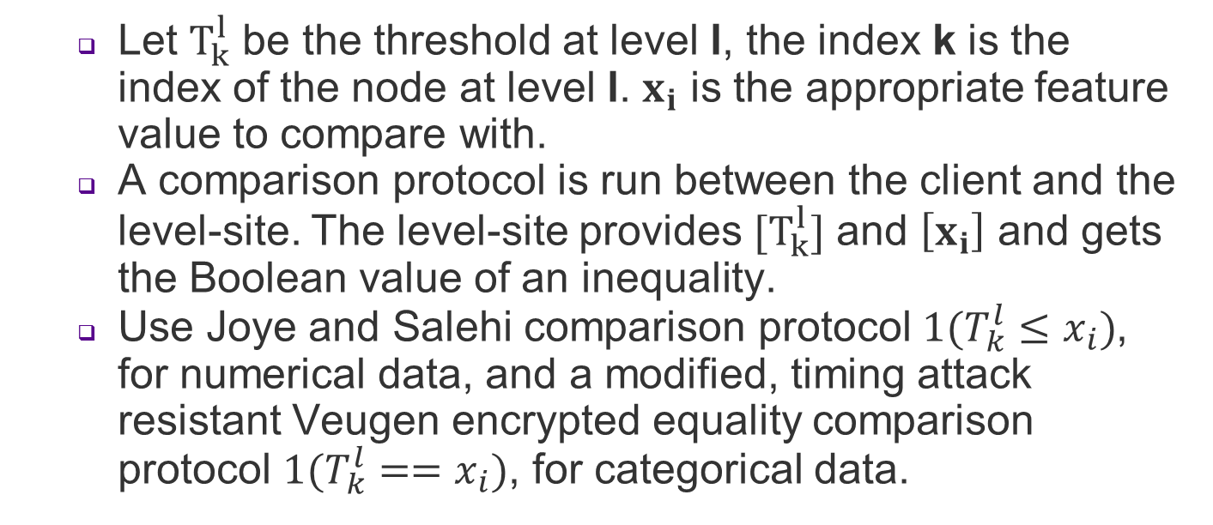
Level-Site Evaluation
Let $T_{k}^{l}$ be the threshold at level l, the index k is the index of the node at level l. $x_{i}$ is the appropriate feature value to compare with.
A comparison protocol is run between the client and the level-site. The level-site provides $[T_{k}^{l}]$ and $\left[x_{i}\right]$ and gets the Boolean value of an inequality.
Use Joye and Salehi comparison protocol $1(T_{k}^{l}≤x_{i})$, for numerical data, and a modified, timing attack resistant Veugen encrypted equality comparison protocol $1(T_{k}^{l}==x_{i})$, for categorical data.

Slide 31
Security Analysis
Security analysis is performed by assuming HBC
Security against an HBC client
Client throttling
The level-sites can limit number of client requests to prevent thresholds being reverse engineered
The level-site returning classification can add extra delay, so the client won't know if the classification was at level-site l or l + 1
The input vector is secure due to HE
Security against an HBC level-site l
Level-site has access only to encrypted data
Index has no relation to encrypted
Security against side-channel attacks.
Can split level-sites between two non-colluding providers
Containers offer strong power-based attack mitigations and make key rotation easier
All level-sites only complete 1 encrypted comparison, and they use a timing attack resistant comparison protocol

Slide 32
Experiment Setup
We implemented and tested the proposed approach using Amazon Elastic Kubernetes Service (EKS). We used t2.medium EC2 instances, which have 2 vCPUs and 4 GB RAM.
Our open-source code implementation used a homomorphic encryption library implemented in Java that implements Joye and Salehi's encrypted integer protocol and Veugen's encrypted equality comparison.
We used Docker containers and Kubernetes, as it allows the creation of replicas and supports horizontal scaling.

Slide 33
Experimental Results compared with Joye and Salehi
The average depth for the hypothyroid set is 2.78, which corresponds to a value between 0.807 and 1.772 seconds. This is significantly faster than the Joye and Salehi approach.
Similarly, the average depth for Nursery data is 5.99 which corresponds to a value between 2.041 and 2.950 seconds, again much less than 4.140 of Joye and Salehi.
Levels | Hypothyroid Our Approach | Hypothyroid Joye & Salehi | Nursery Our Approach | Nursery Joye & Salehi
2 | 0.807 s | 3.279 s | 0.656 s | 4.140 s
4 | 1.772 s | 3.279 s | 2.401 s | 4.140 s
9 | 4.418 s | 3.279 | 2.950 s | 4.140 s
12 | N/A | N/A | 5.648 s | 4.140 s

Slide 34
Experimental Results compared with Yuan et al.
Our approach is faster at almost all levels due to Yuan et al.'s need to encrypt data for each evaluation and the computational overhead of traversing the PPD-GBDT.
In general, our PPDT is roughly 30% faster than Yuan et al.
Levels | Our Approach | Yuan et al.
2 | 1.927 s | 0.49 s
3 | 2.736 s | 7.58 s
4 | 3.937 s | 8.35 s
5 | 4.638 s | 17.33 s
6 | 5.783 s | 19.37 s

Slide 35
Conclusion
We present a new secure decision tree inference protocol by splitting the DT model into level-site constructs. Our PPDT exhibits optimal performance in sparse trees because of fewer encrypted integer comparisons, resulting in faster performance compared to other PPDTs.
It resists timing attacks through timing attack resistant comparison protocols.
Our PPDT also offers strong mitigations against power-based side channel attacks, as we use containers that offer power-based side channel protections, key replacement.
Our approach can be used to split our PPDT with two non-colluding cloud providers.
Finally, our PPDT protocols allow us to support load balancing to more evenly distribute more computing resources to higher levels of the PPDT, which would experience more usage and redundancy in case a level-site experiences an outage.

Slide 36
Potential Future Work
A potential future conference paper(s) for the PhD dissertation

Slide 37
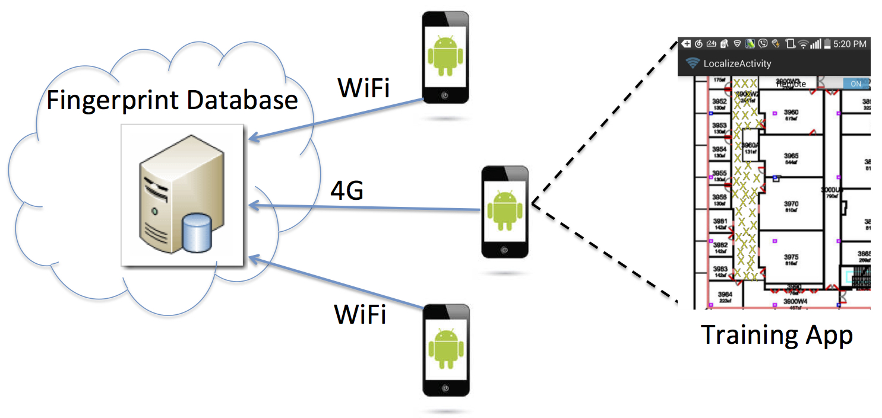
Indoor Localization v2
The encryption library was originally built for secure indoor localization (Quijano & Akkaya, 2019)
Possible extensions for work could be:
Comparing using Fully Homomorphic Encryption vs. Partially Homomorphic Encryption
Utilizing encrypted Euclidean distance computation on Bluetooth RSSI to improve localization accuracy
Utilize CPU cycles as a key performance metric is essential for evaluating and designing efficient solutions for resource-limited IoT applications.

