Slide 1
Deep Fake Revenge Porn
Domestic Violence of the Future

Slide 2
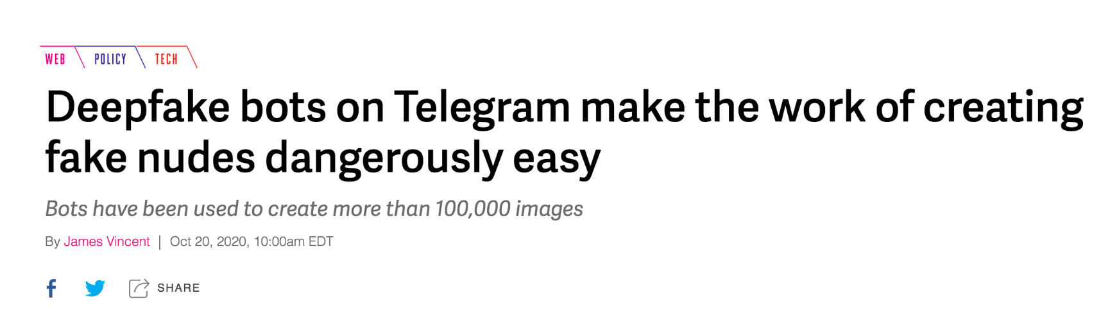
The Deep Fake NCP Problem
In 2018, between 90% to 95% of online deep fake videos were nonconsensual porn
90% of that is non-consensual porn of women specifically.
“Sensity's report is a grim reminder that deepfakes are not, as some feared, being weaponized at scale to distort news information — they are overwhelmingly being used to harass, humiliate, and even extort women.”
Notes:
Nonconsensual pornagraphy (or ncp), often referred to as revenge porn, is defined as the distribution of sexually explicit images or videos of individuals without their consent. Deep fake ncp is when a user creates synthetic content by stitching usually a person’s likeness onto already existing pornagraphic content. Though some form of nonconsensual porn has been around since the 1980s, recently the rise in power and ubiquity of deep fake technology has allowed this form of harassment to proliferate at an alarming rate. In 2018, a study by Sensity AI found that 90% to 95% of online deep fake videos were nonconsensual porn, and 90% of that porn was of women specifically. Women who suffer from this form of harrasment undergo devastating mental health effects-Helen Mort, a poet and broadcaster who was harassed with deep fake NCP described the experience saying ““It really makes you feel powerless, like you’re being put in your place,” she says. “Punished for being a woman with a public voice of any kind.”
Despite many news outlets reporting that deepfakes are being weaponized to distort news information, the reality is that an overwhelming portion of deepfakes are being used to harass, humiliate and even extort women.
https://www.businessinsider.com/deepfake-nude-revenge-porn-telegram-bot-2020-10

Slide 3

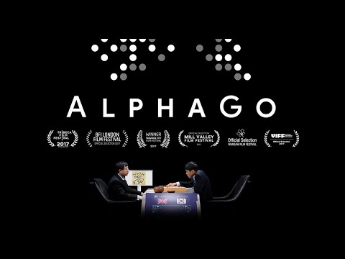
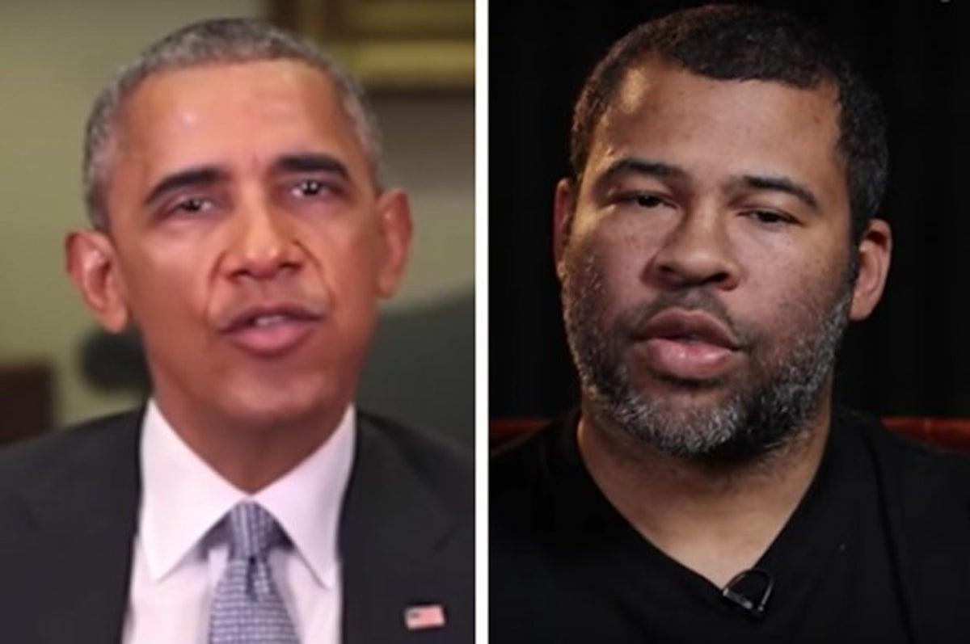
History of Deep Fakes
1944 - Neural Networks are first proposed, but do not gain widespread popularity
1999 - Nvidia releases the GeForce 256, which they bill as the “world’s first GPU”
2018 - Reddit user “deepfakes” started posting celebrities’ faces swapped onto porn
2 core technologies power deep fakes: Autoencoders + GANs
Notes:
Deep Fakes are based on a field of machine learning called Deep Learning. In deep learning, algorithms called neural networks, which are designed to imitate the neurons inside of a human brain, are able to learn important features from input data quickly and often without supervision. They were first proposed in 1944, but because they were very computationally expensive, they did not achieve widespread popularity until around the 2000’s, when GPU chips became more widely available. This type of machine learning has been used by car companies like Tesla to power their autodriving capabilities, by Google to defeat a human for the first time ever in a game of go, and now by companies like Buzzfeed who created a viral deep fake video of Barack Obama using Jordan peele’s facial movements.
Deep fakes started in 2018, when a reddit user who went by the name “deepfakes” started posting celebrities faces swapped onto porn. SInce then, the technology to create and dissemenate these videos has only become more powerful thanks to two key technologies behind deep fakes: the autoencoder and the GAN, or generative adversarial networks

Slide 4



Slide 5


Slide 6
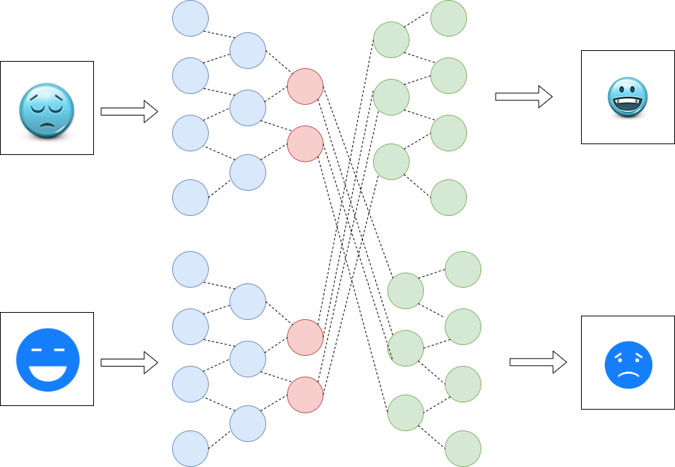
Autoencoder
Notes:
So this diagram shows how an autoencoder creates the face swap between two images. An autoencoder is an unsupervised neural network whose purpose is to reconstruct the given data. Because of this, autoencoder’s input layer has the same number of neurons as their output layer. The encoder portion of the autoencoder analyzes the training images its given for essential “features,” and then the decoder portion reconstructs a face it is trained on based on new data. So essentially you will have two encoders trained on two sets of images, and two decoders trained on two sets of images, but then when you run the system you switch the encoder/decoder set, so you end up generating a face you’ve seen before in training based on data from another face you have not seen before in training.
While in the past facial manipulations required careful manual editing to ensure everything moved together flawlessly, the autoencoder can achieve all these blending and stitching skills automatically.

Slide 7
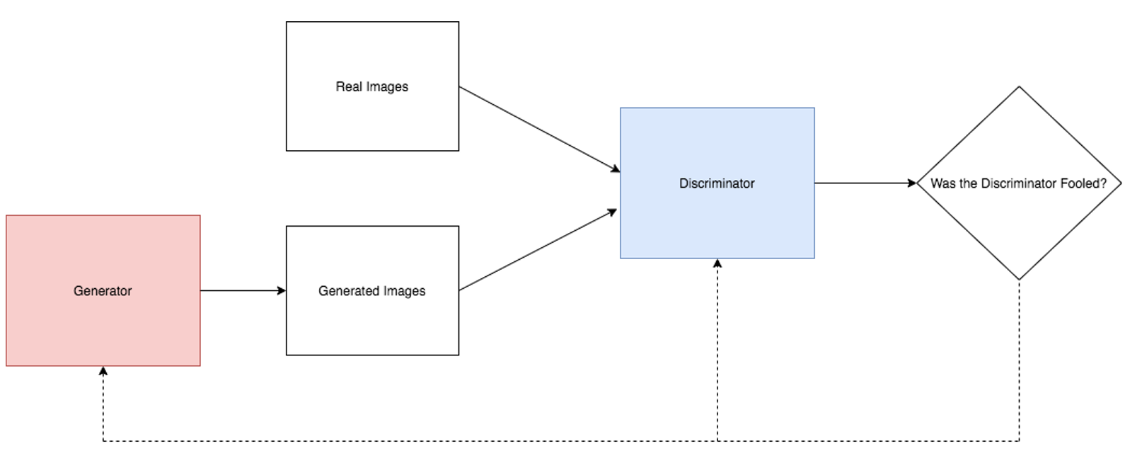
Generative Adversarial Network (GAN) - Andrew
A GAN, creates a generator and discriminator model.
The discriminator receives training data and data from generator.
The discriminator attempts to figure out where data came from
The generator tries to have its data output look like training data based on discriminator output
GANs are particularly useful in creating deep fake images
Goodfellow, I. J., Pouget-Abadie, J., Mirza, M., Xu, B., Warde-Farley, D., Ozair, S., ... & Bengio, Y. (2014). Generative adversarial networks. arXiv preprint arXiv:1406.2661.

Slide 8
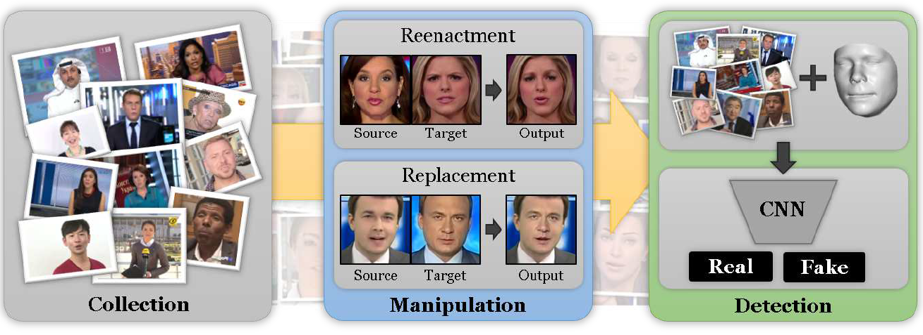
Deep Fake Detection Systems - Andrew
Rossler et al. in 2019 created a deep fake detection system. They used the Faceforensics++ dataset. This is a labeled dataset has authentic images, and images created from various deep fake software.
As shown on rightmost image, the preprocessing step crops specifically only the face. They pass it into a Convolutional Neural Network that can determine whether the image was a deep fake or not
This detection system had a high performance 90%+ on high resolution images and 80%+ accuracy on low pixel images. The dataset is comprehensive as it has millions of images of men/women
Rossler, A., Cozzolino, D., Verdoliva, L., Riess, C., Thies, J., & Nießner, M. (2019). Faceforensics++: Learning to detect manipulated facial images. In Proceedings of the IEEE/CVF International Conference on Computer Vision (pp. 1-11)
Notes:
Well, thankfully there has been some work
So problem finished, presentation over. Right…????

Slide 9
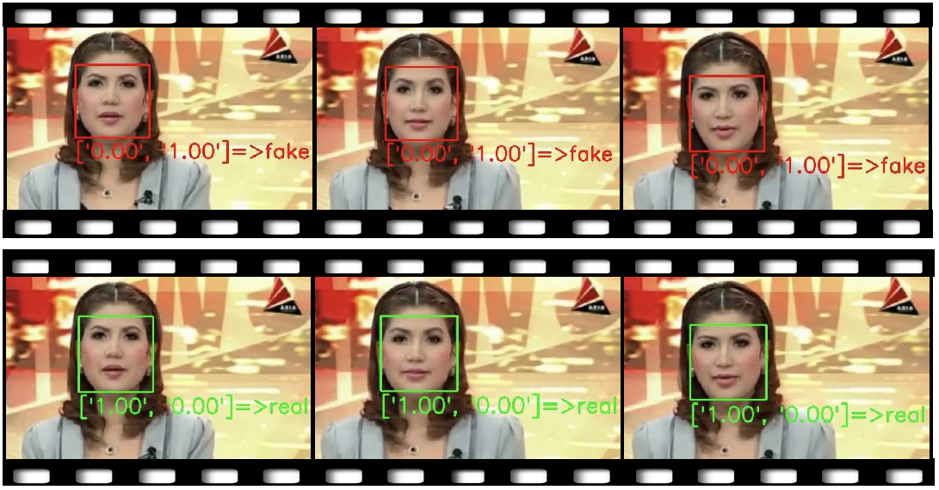
Adversarial Deep Learning - Andrew
Top row - Original Deep Fake detector output
Bottom row - Change pixels randomly until detector outputs the probability is likely authentic
Key Point: This was model was created in 2021, only 2 years after Rossler et al.’s model. It is therefore unlikely there will ever be a foolproof deepfake detection model that can last
Hussain, S., Neekhara, P., Jere, M., Koushanfar, F., & McAuley, J. (2021). Adversarial deepfakes: Evaluating vulnerability of deepfake detectors to adversarial examples. In Proceedings of the IEEE/CVF Winter Conference on Applications of Computer Vision (pp. 3348-3357).
Notes:
Literally, two years later another paper was published on how to circumvent the deep fake detection system created in 2019.

Slide 10
Deep Fake NCP causes the same harms as traditional NCP
Ashcroft v. Free Speech Coalition (2002)
Virtual Child Pornography is protected, non-obscene speech because it has artistic value
United States v. Hotaling (2011)
Morphed computer-generated images are essentially child pornography

Slide 11
Section 230 does not protect common cases of NCP
Barnes v. Yahoo! (2009)
Yahoo is not a content provider and not a publisher
Yahoo’s responsibility in their lack of “good faith” restricting
The protections would be the same for deep fake NCP

Slide 12
Section 230 does not apply to Content Providers
Fair Housing Council v. Roommates.com (2008)
Roommates.com used registration information to filter roommate preferences
Roommates.com affirmatively solicited content that contributed to discrimination
Roommates.com is a content provider and a publisher

Slide 13
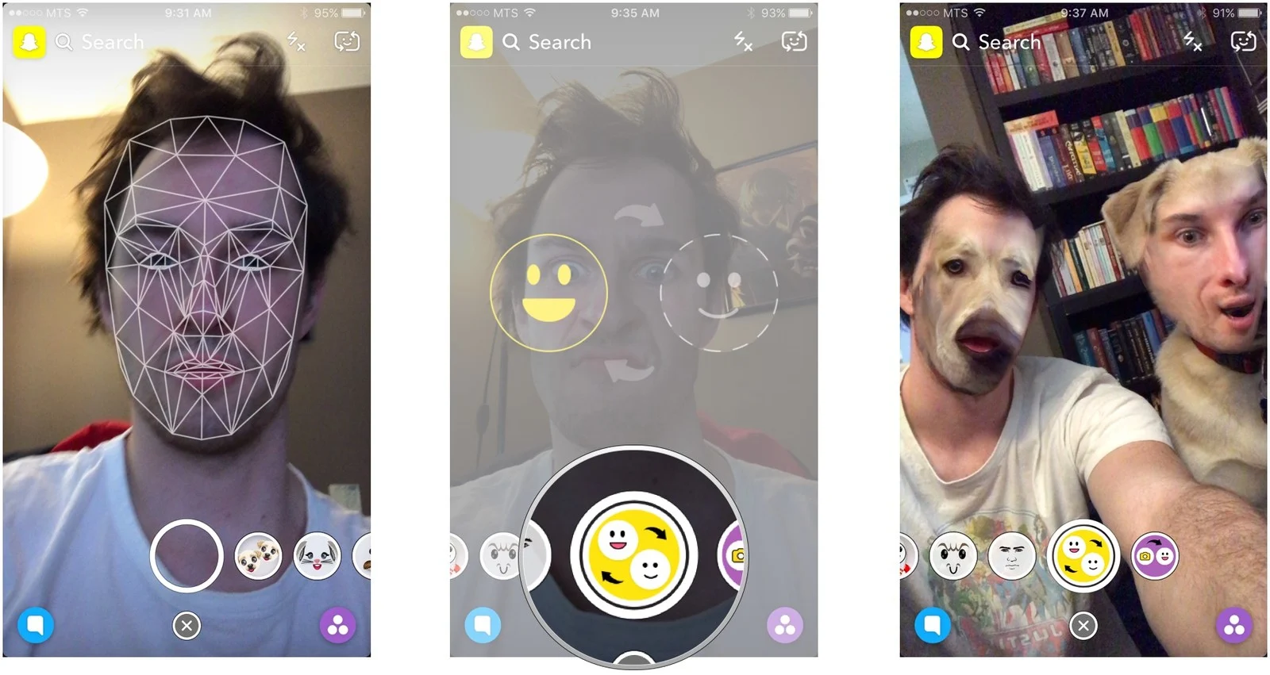
What counts as a Content Provider of Deep Fake NCP
Lemmon v. Snap
Speed Filter is a “content-neutral” tool
Snapchat’s Deep Fake Filters
Face Swap
What is not a “content-neutral” tool?
Face Swap into pornographic scenarios only
Undressing clothed bodies (DeepNude)

Slide 14
Pursuing a Copyright Claim
An often hinted-at alternative to tort claims
Cause of action and remedies arise under the Digital Millennium Copyright Act
High level requirements:
Claimant is the “author” of the image
Claimant is aware of the image’s unauthorized distribution
Claimant registered the copyright
Claimant finds representation and files a legal claim against the distributor
Directly tied to lack of financial remedies

Slide 15
Copyright Infringement Remedies May Suit Victims’ Needs
Mirrors tort remedies
Distributor must remove the copyrighted material from their platform
Prevents future harms
Goes beyond a tort against deep fake NCP creator, which does not result in comprehensive takedown
Victim may be entitled to money damages
Addresses psychological harms (expensive healthcare), employment ramifications
BUT requires actual knowledge of the copyright infringement, notice to the platform, and a refusal to act expeditiously
Sense that “justice has been served”
No carceral outcome as with criminal cases, but imprisoning corporate distributors does not directly serve victim’s interests--criminal outcome would be punitive, not protective
But, no remedy can make a victim “whole”
Social repercussions
Content is never truly gone

Slide 16
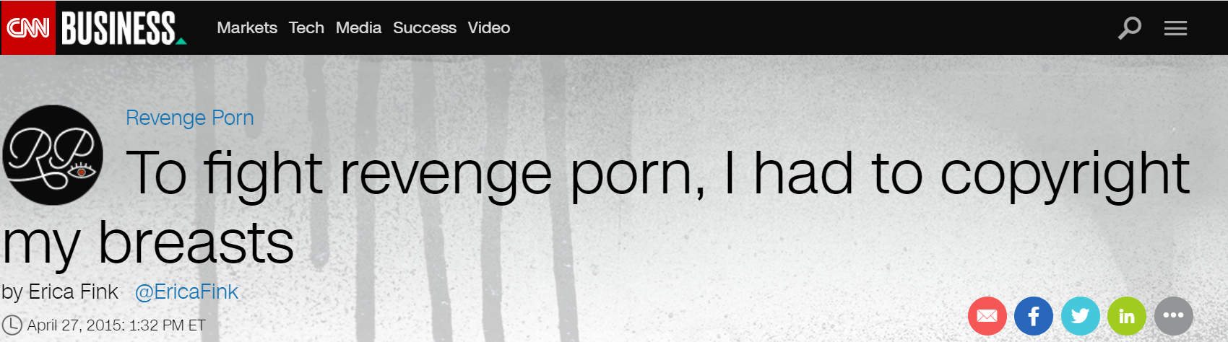
Registering a Copyright is Not Appropriate for All Victims
Victim must “voluntarily” share sensitive information
Copyright owners may suppress images from the Library of Congress public catalog in some cases
Retraumatizes victim by forcing complicity in distribution
Victim must be the author
Victims do not always take the photo themselves
Deep fakes make it difficult to identify the source material, since the Autoencoder replicates facial features that would be present in all photos of the victim and puts them into a new context

Slide 17
Fair Use Doctrine May Preclude Copyright Infringement Claims for Deep Fake NCP
Because the Autoencoder makes such significant alterations to the source images, distributors may find a defense in fair use
Copyright Act of 1976 sets out four factors that courts assess:
the purpose and character of the use, including whether such use is of a commercial nature or is for nonprofit educational purposes;
the nature of the copyrighted work;
the amount and substantiality of the portion used in relation to the copyrighted work as a whole; and
the effect of the use upon the potential market for or value of the copyrighted work.

Slide 18
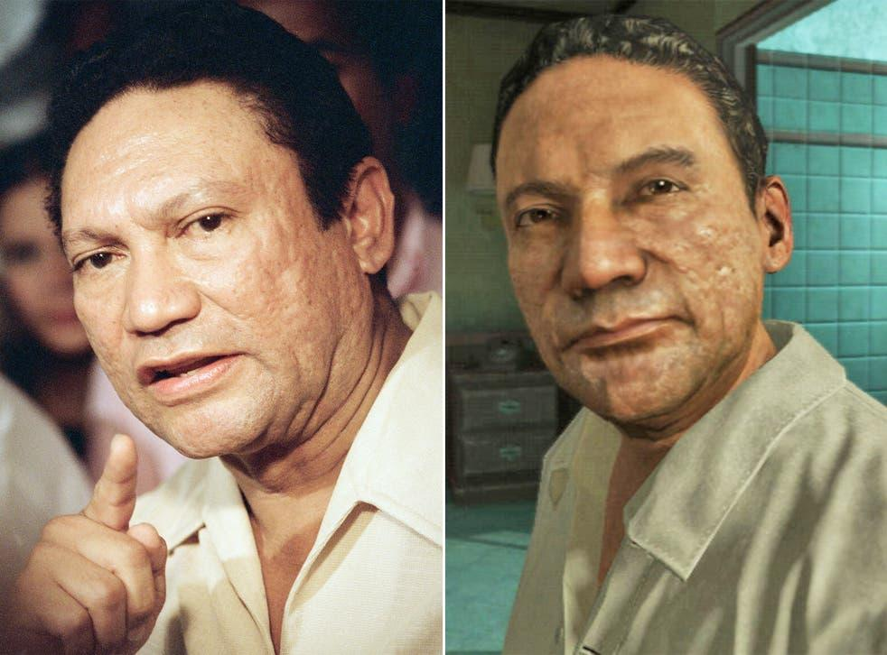
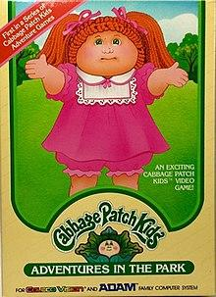

Fair Use Factors
Noriega v. Activision/Blizzard
Original Appalachian Artworks, Inc. v.
Topps Chewing Gum, Inc
Notes:
Though deep fake NCP is created to look as convincing as possible and because the person whose likeness they use is often even explicitly named, there is no question that the content is created to confuse users into thinking it is the real thing, an act that would normally violate fair use. However, we believe fair use arguments will ultimately fail because the most important factor in determining fair use is often the effect on market. For example in Noriega v. Activision, former Panama dictator Manuel Noriega’s likeness was used in a call of duty game, but partly because it was not used in any marketing of the video game, it was ruled as fair use. In another case, Rogers v. Koons, when artist Jeff Koons used a picture owned by Rogers to sell sculptures, the courts ruled that this undermined Rogers’s own ability to sell his art in the same art market. Because perpetrators of deep fake ncp often do not gain monterey value from creating these videos and because victims are often uninterested in similarly selling such pornographic content of themselves, it would be hard for them to argue and win a copyright infringement case.

Slide 19
Copyright Claims Cannot Eradicate Deep Fake NCP
Deep fakes are rapidly reposted and platforms are slow to fight the spread
Ex. Nancy Pelosi’s 2020 deep fake--viewed more than 2 million times in a matter of days; TikTok, Twitter, and YouTube all removed the footage after CNN inquired about it
Ex. Barnes v. Yahoo! (2009)--platform did not remove NCP until news media planned to broadcast about it
Individuals can download or screenshot NCP and reupload it months or years later
Actual eradication of a particular victim’s deep fake NCP would require constant vigilance
Complicated by deep web, inaccessible to the average user attempting takedown

Slide 20
Conclusion
Advances in technology permitted the creation of deep fake content, but do not afford means of tracking or combatting it
Legal remedies are equally limited:
Deep fake distributors escape responsibility for their complicity through CDA Section 230
Copyright infringement suits will rarely work for victims of deep fake NCP
As more states take action against NCP on an individual level, Congress should take advantage of momentum in the movement and amend CDA Section 230 to allow increased liability in deep fake NCP distributors

