Slide 1
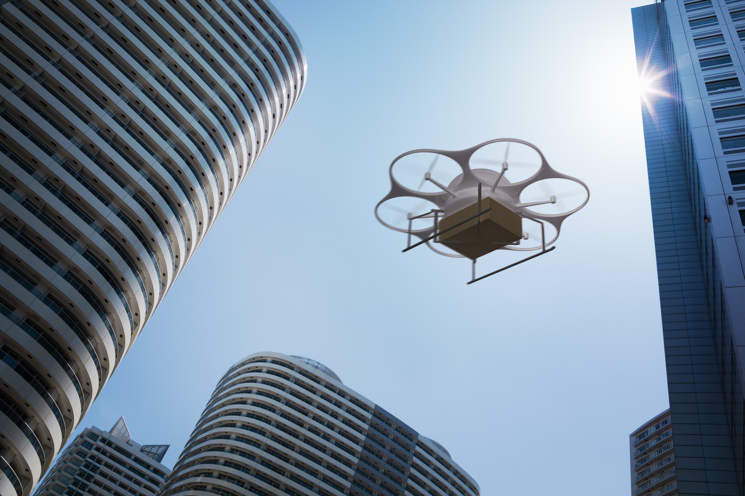
Privacy-Preserving Drone Navigation through Homomorphic Encryption for Collision Avoidance
Allan Luedeman, Florida International University
Nicholas Baum, Florida International University
Andrew Quijano, New York University, Amazon*
Dr. Kemal Akkaya, Florida International University
*This paper was completed outside of his job responsibilities at Amazon. The views expressed in this paper are those of the author and do not necessarily reflect the official policy or position of Amazon.

Slide 2
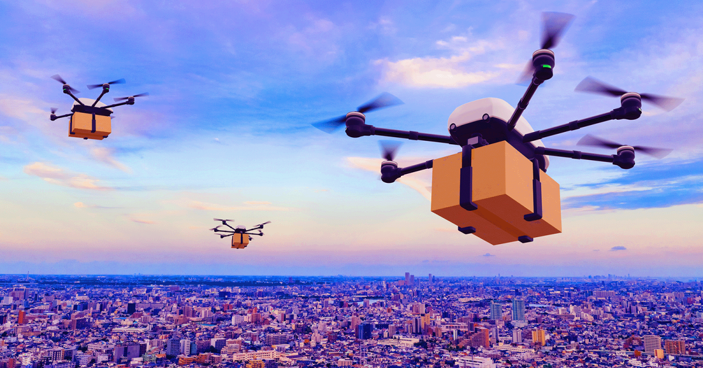
Introduction
With rapid increase of drone technology in various industries, ensuring collision avoidance is paramount to guarantee safety and efficiency.
Drone traffic is increasing in areas like package delivery and search and rescue.
In the case of package delivery, multiple different companies may be operating in a geographic area.
Problem Statement: Companies want to avoid drone collision without the exchanging detailed flight paths that would compromise privacy and security in many cases that may involve sensitive information.
Online retailers – i.e., customers' personal information, such as addresses
Government agencies – i.e., the location of a surveillance target or confidential mission
Notes:
https://builtin.com/sites/www.builtin.com/files/styles/og/public/2022-09/delivery-horizon-drone-delivery.png

Slide 3
Background
Partially homomorphic cryptosystems securely add, subtract, multiply, divide, and compare numbers without decryption.
Paillier natively supports ONLY addition and subtraction of two ciphertexts by multiplying them, [x] [y] = [ x + y ], where the brackets denote encryption
To multiply two Paillier ciphertexts, we utilize a two-party protocol – x and y are encrypted operands while a and b are plaintext noise Alice introduces to preserve privacy.
([x] + a)([y] + b) = xy + xb + ya + ab
xy = ([x] + a)([y] + b) - xb - ya – ab
To compare two Paillier ciphertexts, we use encrypted comparison which allows for usable results without decryption, returning an encrypted bit [X >= Y] given [X] and [Y]

Slide 4
Literature Review
"Coordinated multi-robot planning while preserving individual privacy"
By Li et al.
Emphasis on robots in a two-dimensional geometric plane, using garbled circuits and homomorphic encryption to preserve path privacy. Specifically avoids reporting locations of intersections.
"Privacy-Preserving Trajectory Matching on Autonomous Unmanned Aerial Vehicles"
By Sciancalepore et al.
Employs Incremental Capsule Matching and privacy-preserving proximity testing to achieve collision detection
Fast, but some accuracy is sacrificed, with a 10.3% false positive rate
"Privacy-Preserving Collision Detection for Drone-based Aerial Package Delivery using Secure Multi-Party Computation"
By Desai et al.
Proposes Secure Multiparty Computation (MPC) for trajectory planning among drones, ensuring collision detection without disclosing sensitive information
Uses a grid-based approach to compare trajectories, requiring a mutual agreement on potential flight paths.
We utilize homomorphic encryption without losing accuracy or requiring pre-processing

Slide 5
Approach And Assumptions
We propose a method of drone collision avoidance via the use of encrypted paths to preserve the confidentiality of flight routes.
Our method specifically makes use of homomorphic encryption, which allows computations on encrypted values.
The original plaintext data need not be decrypted to carry out these computations or utilize their results.
The protocol is run between two drones, assumed to be owned by different companies.
One drone, Alice, is about to take off and the other, Bob, is either in flight or also about to take off.

Slide 6
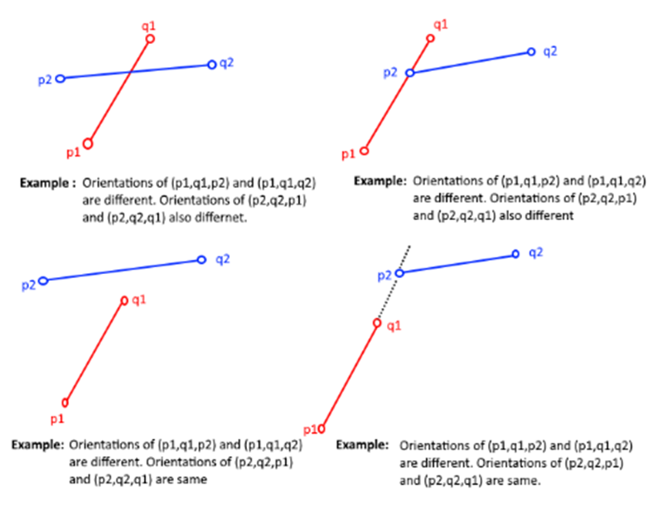
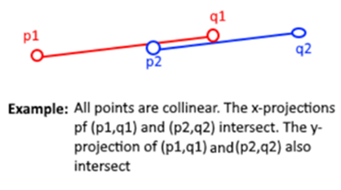
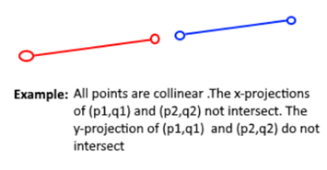
Intersection Algorithm
Intersection primitive relies on orientation of points
Colinear
Not Colinear

Slide 7
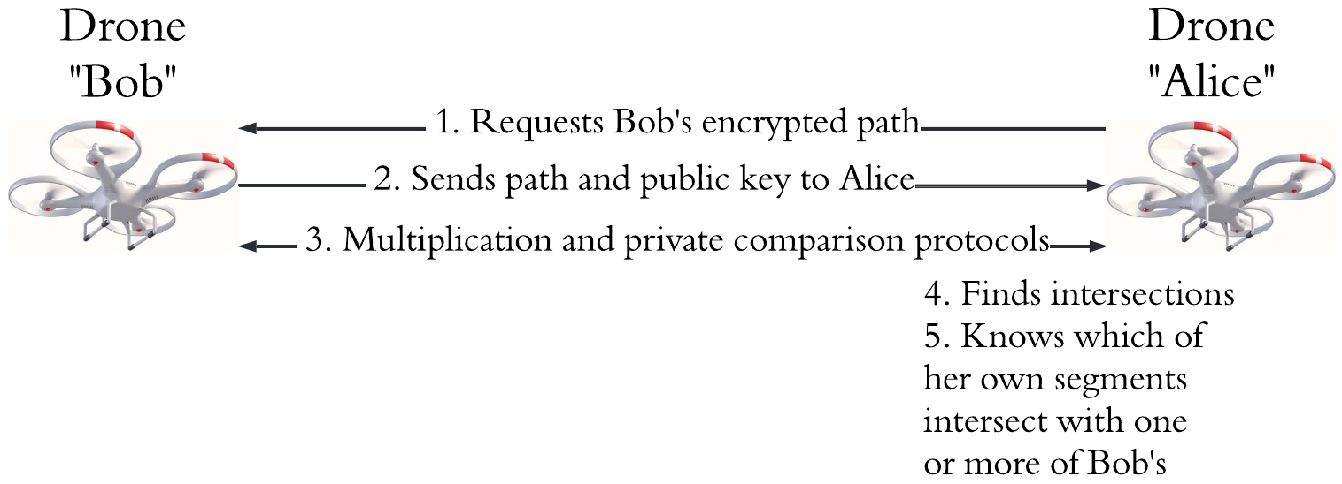
Proposed Protocol
The path comparison algorithm runs between the drones, with communication required for encrypted multiplication and encrypted number comparison.
Only Alice has the intersection output, if Bob wants the outputs, the roles must switch

Slide 8
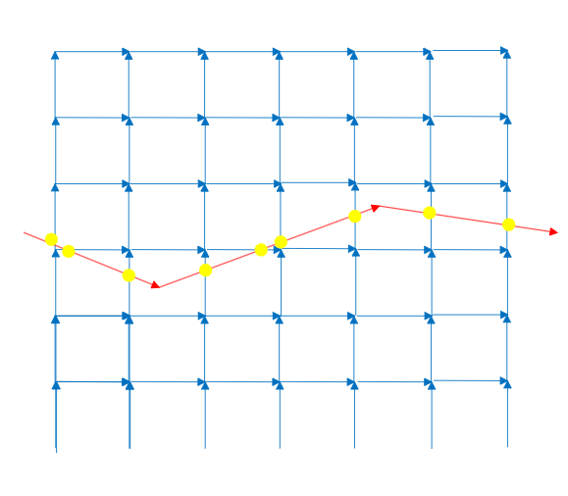
Security Analysis
For third parties, eavesdropping is infeasible since everything is encrypted
Primary threat is a brute force attack against Bobs path by a malicious Alice to reverse engineer Bob’s path
Alice defines her own as a grid of segments to recreate Bobs path through intersections
Time is the primary defense here, as Alice has many times the number of segments that a properly honest path would have.
Drones have limited range to be able to both complete its mission and attempt to follow other drones
Algorithm scales at O(mn) where m and n are the number of segments in Alices and Bobs paths.
Bob will not be in flight long enough to perform this attack and drones are relatively fast.
Comparisons cannot be run once Bob stops complying, as his private key is needed for the multiplication protocol.

Slide 9
Experiment Setup
We implemented the protocol using our Java library, available at https://github.com/adwise-fiu/Homomorphic_Encryption
Two identical Debian 12 virtual machines with 2 CPUs and 4GB of RAM were chosen to emulate a theoretical drones resources.
Two sets of 30 random x-y plane segments with values from –99 to 99 were generated.
The two sets of thirty segments were compared for intersections, with one segment from each set compared and timed individually.
The average time and network traffic was collected and calculated.
Average time is defined as the time to complete the protocol
Network traffic is the number of bytes written to the sockets

Slide 10
Results – Comparison with Li et al.
We ran the algorithm by Li et al on the same virtual machines and the same sets of segments, collecting computation and network traffic
Results indicate our approach is 30% faster and sends less network traffic than Li et al.
Approach | Time (seconds) | Network Traffic (bytes)
Our Approach | 4.407 s | 4634
Li et al. | 6.092 s | 39221

Slide 11
Results – Comparison with Desai et al.
We used two Raspberry Pi 4's (as done in their work) to compare with Desai et al.
Speed comparisons were similar when Desai et al's algorithim was using a matrix size of 96 and a secret share size of 64 bits.
This means our approach is similar in speed but relatively unlimited in x-y plane and resolution to Desai's approach when using a matrix size of 96.
Desai's approach scales with matrix size, slowing down considerably when x-y plane or resolution grow.

Slide 12
Conclusion
Our method demonstrates the ability to detect intersections in paths defined by line segments that are homomorphically encrypted in a secure way.
Time complexity is O(mn), scaling linearly as a single path grows but experiences polynomial growth as both paths expand.
Work is as fast or faster than other totally accurate approaches, with significant advantages in scalability.
Future work on parallelizing the computations on a drone that has multiple CPU cores could cut computation time down significantly.

Slide 13
Acknowledgements
This work was supported by the Griffis Institute (Award Number SA10012022020481). The content of this paper is solely the responsibility of the authors and does not necessarily represent the official views of the sponsor.
We thank Alfredo Bayuelo for this assistance in comparing our work with the work of Li et al.
Andrew Quijano is open to collaborate on any research projects interested in making use of the Homomorphic Encryption library.

