Slide 1
Reliable Concurrency Without the Actor Model
An exploration of Software Transactional Memory

Slide 2
Who am I?
Andrew Rademacher
@AndRademacher
https://github.com/AndrewRademacher

Slide 3
Talks on the actor model.
Erlang, or How I Learned to Stop Worrying and Let Things Fail
John Daily
https://youtu.be/E18shi1qIHU
Using Project Orleans to Build & Scale Halo
Hoop Somuah
https://youtu.be/I91ZU8tEJkU
Designing a Real Time Game Engine in Erlang
Mark Allen
https://youtu.be/sla-t0ZNlMU

Slide 4
What does the actor model mean by concurrency?

Slide 5
System
Message
Actor
Actor
Event Loop
+
Memory
Event Loop
+
Memory
Mailbox
Mailbox

Slide 6
System
URI Cache
Does a URI exist?
Actor
Add a URI.
Does a URI exist?
Actor
Actor

Slide 7
Actor
URI Cache
Actor
Actor
FIFO
Request
Request
Request
Actor

Slide 8
Actor model is concurrent with regard to a system of actions.
Actor model is NOT concurrent with regard to data.

Slide 9
What do I mean by concurrency?

Slide 10
System
Thread
URI Cache
Thread
Thread

Slide 11
Rules of the game.
A player can join the game by submitting a fortune.
A player can trade fortunes with any other player.

Slide 12
Web API
POST /player
{ “email”, “p1@gmail.com” , “fortune”: “A good way to keep healthy is to eat more Chinese food.”}
Empty Response
GET /fortune/trade/p1@gmail.com/p2@gmail.com
No request body.
{ “fortune_given”: { … } , “fortune_received”: { … } }

Slide 13
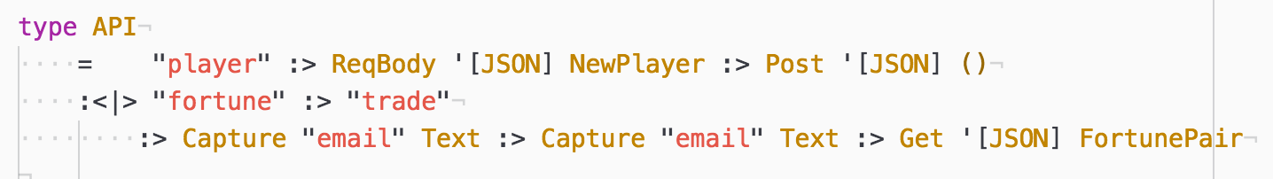
Types

Slide 14
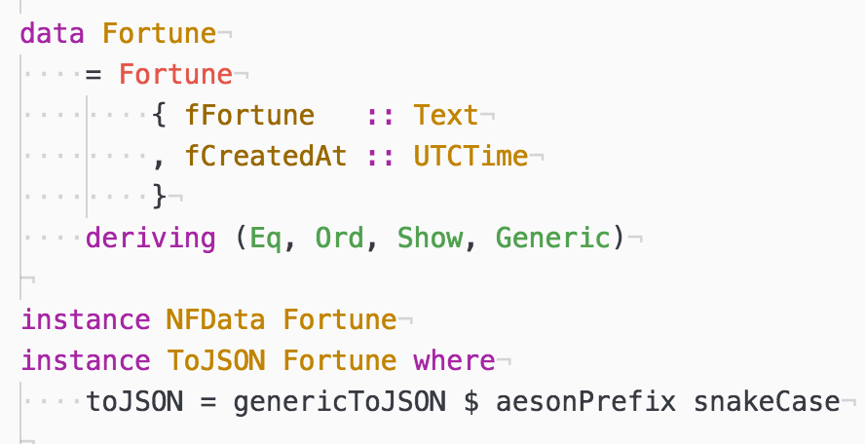
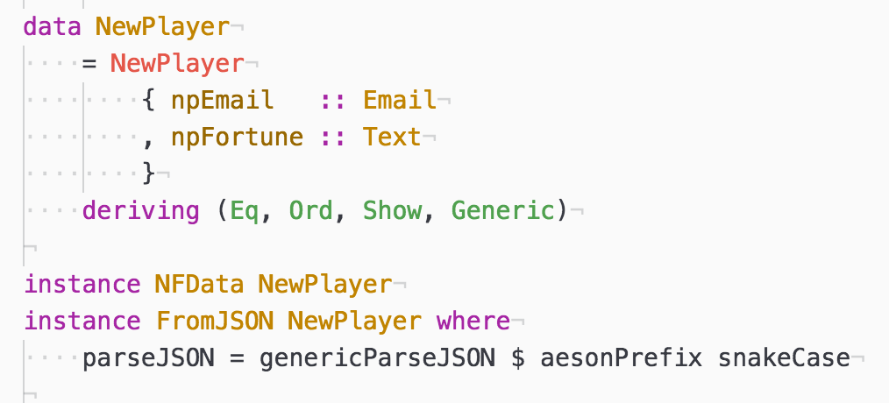
Types

Slide 15
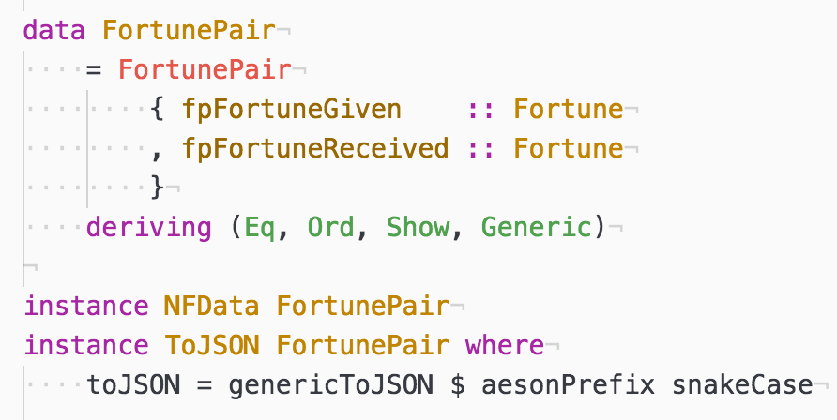
Types

Slide 16
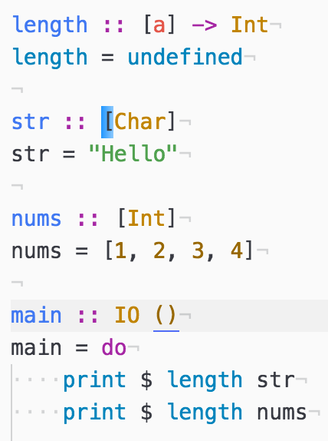
Detour (Parametric Polymorphism)
Java Generics
C++ Templates
etc

Slide 17
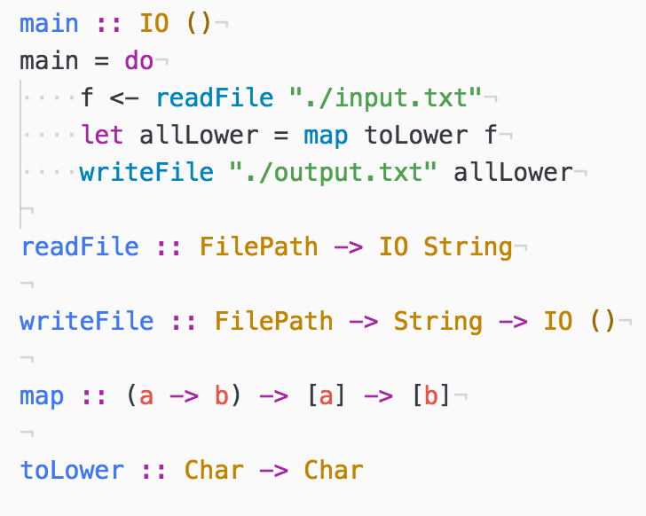
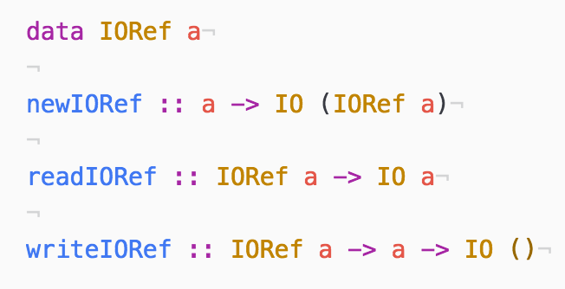
Detour (IO & IORef)

Slide 18
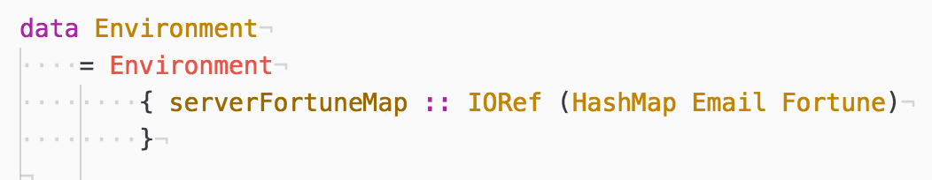
First attempt (i.e. IORef-2)

Slide 19
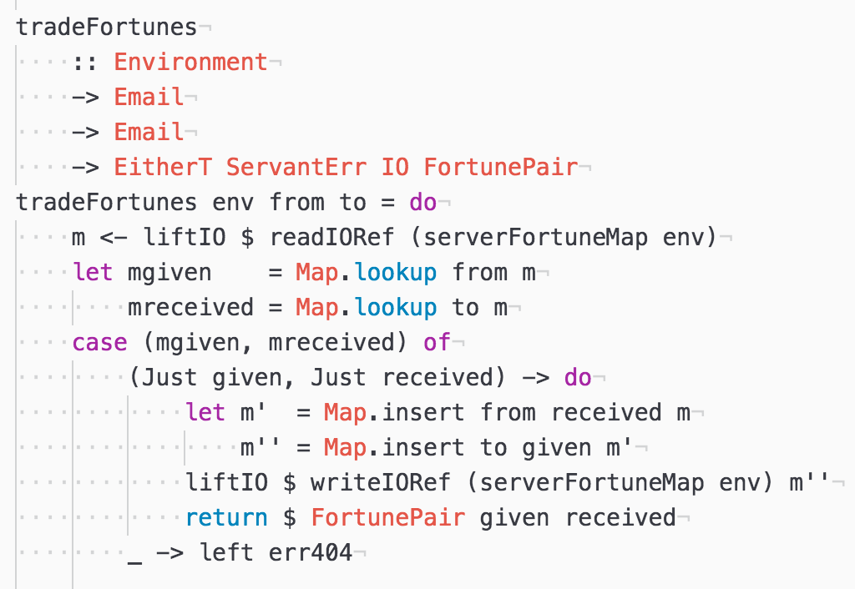
Read IORef
Lookup fortunes
Update fortunes
Write new map to IORef

Slide 20
Time
Thread A
Map v1
Map v2
Shared Memory
IORef
IORef
IORef
IORef
v2 and v3 never merged!
Thread B
Map v1
Map v3

Slide 21
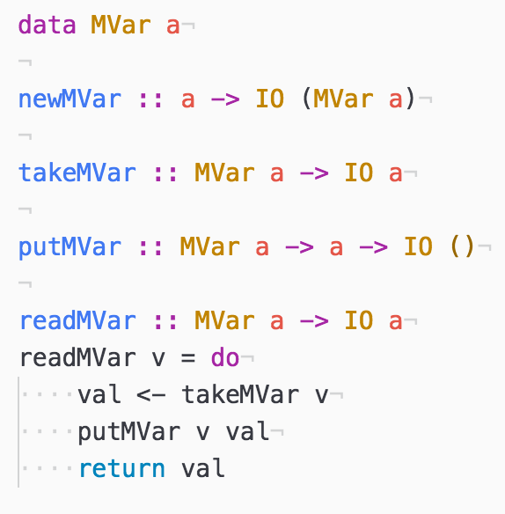
Detour (MVar)

Slide 22
box = MVar Int
putMVar box
42
takeMVar box

Slide 23
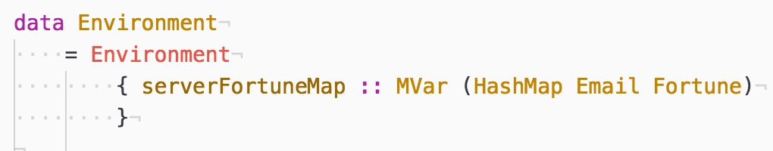
Second Attempt (i.e. MVar-1)

Slide 24
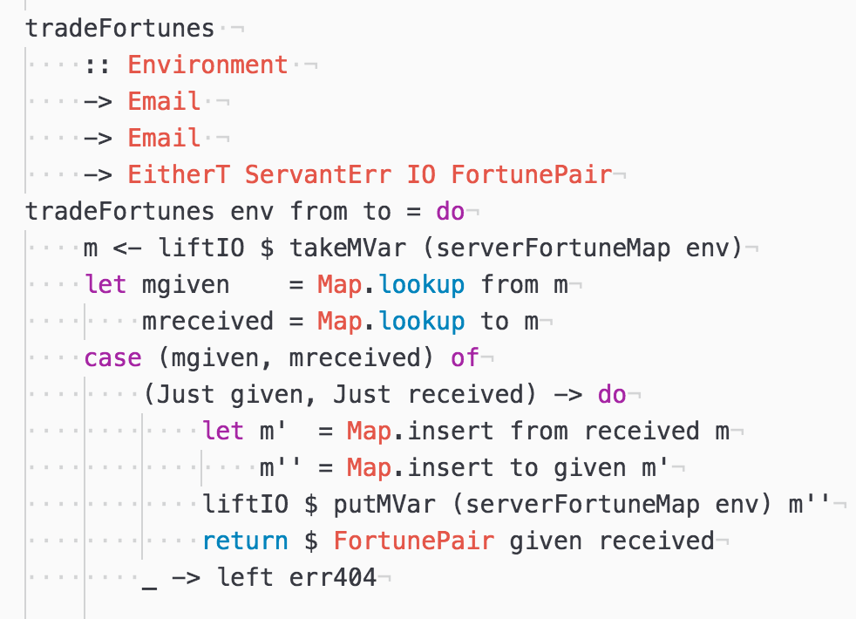
Reading IORef is replaced with “taking” an Mvar
Writing IORef is replaced with “putting” an MVar

Slide 25
Time
Thread A
Map v1
Map v2
Shared Memory
MVar
Empty
MVar
Empty
MVar
Thread B
Blocked
Map v2
Map v3

Slide 27
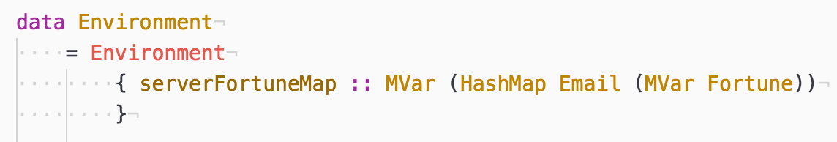
Third Attempt (i.e. Mvar-2)

Slide 28
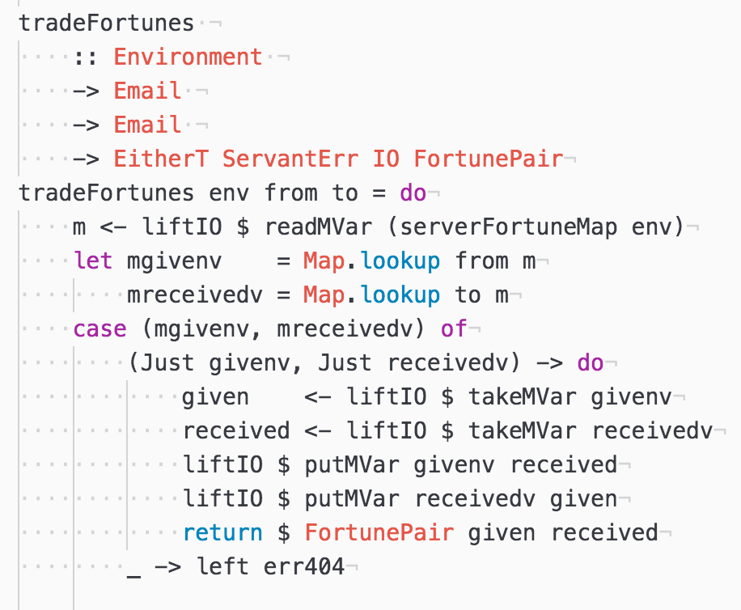
Read top MVar; take followed immediately by put.
Take both the “from” and “to” MVars.
Put both MVars with reverse values.

Slide 29
This is a problem.

Slide 30
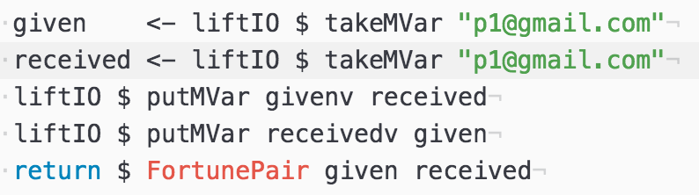
GET /fortune/trade/p1@gmail.com/p1@gmail.com

Slide 31
p1@gmail.com
takeMVar p1@gmail.com
“A good way to keep healthy is to eat more Chinese food.”
takeMVar p1@gmail.com

Slide 32
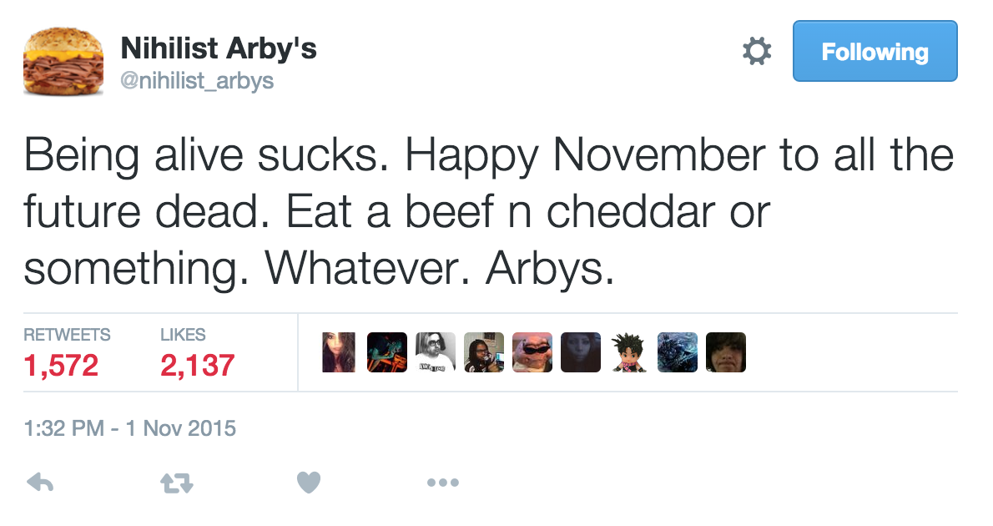

Slide 34
Software Transactional Memory

Slide 35
Shared Memory
Access Log
READ: A1
A1
READ: G0
B5
READ: B5
WIRTE: F8
F8
G0

Slide 36
Thread A Log
Thread B Log
READ: A4
READ: A1
READ: I3
READ: G0
WRITE: G0
READ: B5
WIRTE: M3
WIRTE: F8
COMMIT
ROLLBACK
RETRY

Slide 37
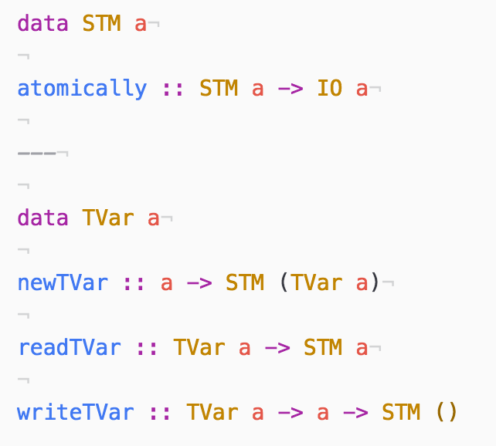

Slide 38
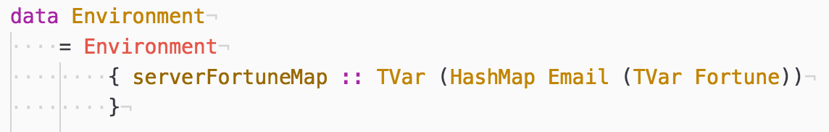
One last try (i.e. TVar-1)

Slide 39
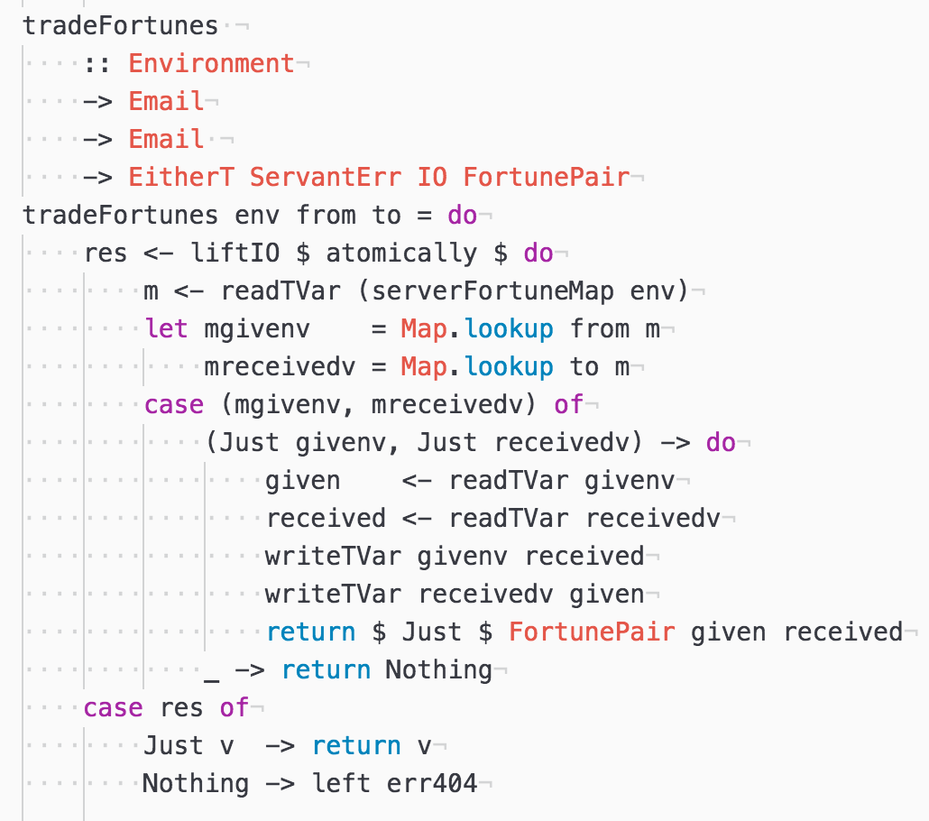
Call inside atomically
Read top level TVar
Lookup players
Read “to” and “from” player TVars
Write “to” and “from” player TVars in reverse

Slide 40
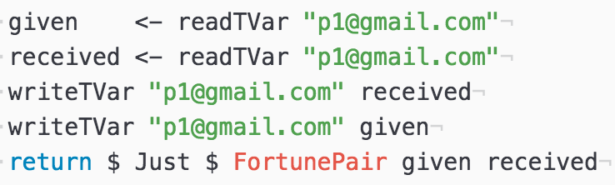
GET /fortune/trade/p1@gmail.com/p1@gmail.com
Thread Log
READ: p1@gmail.com
READ: p1@gmail.com
WRITE: p1@gmail.com
WRITE: p1@gmail.com
COMMIT

Slide 42
STM Implementations
https://github.com/jbakic/Shielded (.NET)
http://clojure.org/refs (Clojure)
https://nbronson.github.io/scala-stm/ (Scala)
http://hackage.haskell.org/package/stm (Haskell)
https://github.com/AndrewRademacher/whimsy (Talk Project Files)

