Slide 1
Open Science Framework
Enabling open practices and
increasing organization

Slide 2
Schedule
3:00-3:30 Introductions
What’s the problem?
How do we address it?
3:30-4:15 OSF examples and use cases
4:15-4:30 Break
4:30-5:00 Hands on use of the OSF
5:00-5:30 Breakout session
5:30-5:45 Upcoming Features
5:45-6:00 Q&A

Slide 3

Notes:
Talking points:
1) Personal introductions (Andrew: background, role; and Johanna: background, role),
2) what COS does in the broadest sense: promoting openness, integrity, transparency, and reproducibility in scientific research.
nothing about center mission at this point
go through slides/photos as we talk

Slide 4
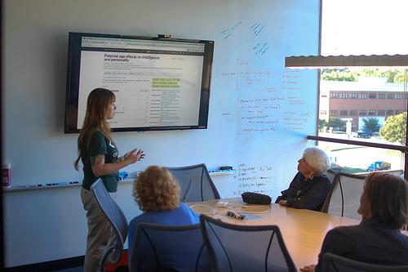
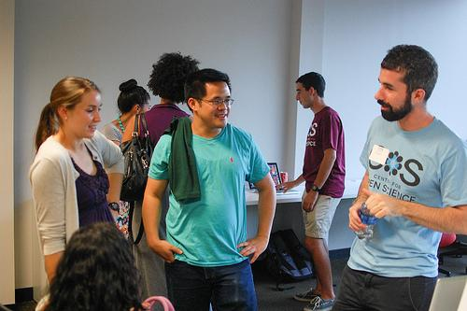
Notes:
Talking points:
1) when we were founded,
2) how we’re funded (L&J Arnold Foundation, Sloan, grants, etc.)

Slide 5
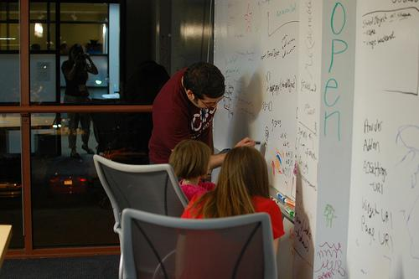
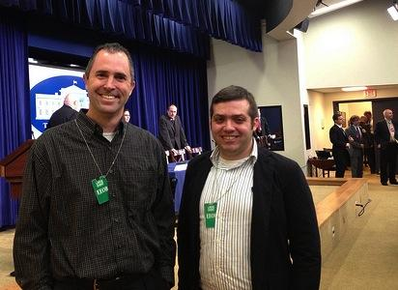
Notes:
Talking points:
1) note our co-founders, Brian and Jeff, at the White House “Open Science Champions of Change” event

Slide 6
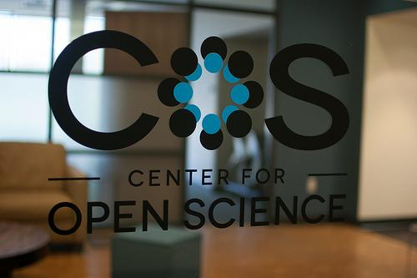
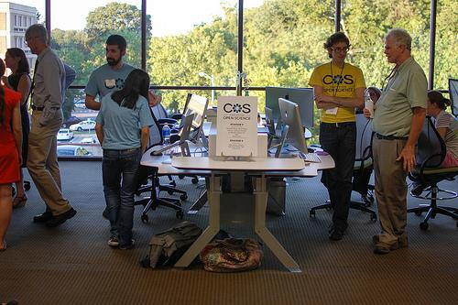
Notes:
Talking points:
1) we function like a tech start-up, with many of our resources going towards software development
2) today we are going to talk about how we are applying that approach to enable open science

Slide 7
Scientific Ideals
- Innovative ideas
- Reproducible results
- Accumulation of knowledge
Notes:
Talking points:
1) I hope it is fair to say that we are all here because we share the same ideals and are invested in increasing transparency in social sciences
2) Main goals in scientific research are simple and what we list above: innovative ideas, reproducible results, accumulation of knowledge
3) This isn’t really anything new, and has been the case for hundreds of years.

Slide 8
What’s the problem?
- Low power
- Questionable research practices
- Overabundance of positive results
- Ignoring null results
- Lack of replication
- Limitations of NHST
Sterling, 1959; Cohen, 1962; Lykken, 1968; Tukey, 1969; Greenwald, 1975; Meehl, 1978; Rosenthal, 1979
Notes:
Talking points:
1) So what’s the problem? There are some problems with the methods...for decades we’ve realized some parts of the scientific process aren’t functioning properly, like the items listed here: low power, questionable research practices, overabundance of positive results, ignoring null results, lack of replication, limitations of null hypothesis statistical testing.
2) This has been talked about for decades and is not new for anyone in the room here. The citations at the bottom show a few samples of notable works looking at these issues over the past 50+ years. (point out the dates in the citations).

Slide 9
What’s the problem?
Incentive structure
- null results and replications are hard to publish
Personal barriers
- motivated reasoning, getting it right isn’t as concrete as getting it published
(Nosek, Spies, Motyl, 2012; Kunda, 1990; Trope & Liberman, 2010)
Notes:
Talking points:
1) But, it’s more than just a methods problem….We presume that almost everybody wants to do the right thing and do science the right way, but there simply certain barriers and disincentives in doing so.
2) Some of it is a matter of incentives….Good careers are built on good publishing which is built on novel and positive results, thus the literature is biased and unchallenged.
3) And some is a matter of personal barriers...subconscious biases make it easier to accept confirmations and harshly judge null results. Hindsight affects reporting practices.

Slide 10
What’s the solution?
- Transparency
- Distinguishing confirmatory v. exploratory
- Replication
- Aggregation of evidence
- Narrow use of NHST
Sterling, 1959; Cohen, 1962; Lykken, 1968; Tukey, 1969; Greenwald, 1975; Meehl, 1978; Rosenthal, 1979
Notes:
Talking points:
1) To complement the noting of problems, there have been many solutions proposed. Examples include approaches in increasing transparency, distinguishing confirmatory vs. exploratory research, replication, aggregation of evidence, and narrow use of NHST.
2) These aren’t new ideas either...again see the same list of citations from the past 50+ years..

Slide 11
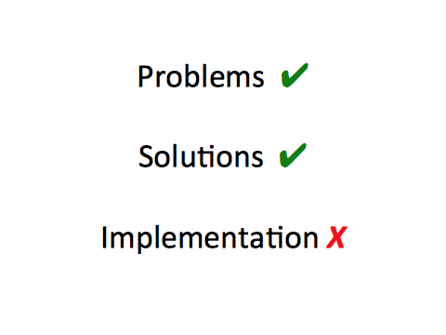
Notes:
Talking points:
So...why are we here?
1) We’ve all identified problems
2) We’ve all identified solutions
3) We haven’t connected these very well in the implementation.
Major takeaway: we’re here to talk about the strategy that we are taking to try and address this implementation issue, and tomorrow’s BITSS meeting will be full of discussions on the various pieces of this implementation and how it all might fit together.

Slide 12
How can we solve this?
INFRASTRUCTURE
COMMUNITY
METASCIENCE
Notes:
Talking points:
1) We’re a non-profit tech start-up, with the main mission of increasing the openness, integrity, transparency, and the reproducibility of scientific research.
2) We have three main areas of activity to address the problems with incentives and personal barriers which we mentioned previously: 1) enabling metascience research, 2) building community, and 3) developing infrastructure in the form of OSF.
details to have on hand
Change the incentive structure without creating more hurdles
Increase accountability to self and others
Increase discoverability of materials, data, and workflow
Respect existing workflow
infrastructure - OSF
major arm of COS
Workflow software to help researchers organize, archive, and connect
Built flexibly so nothing is mandated: tools to support your individual workflow
provides altmetrics
community: transparent practices
Offer a place to use and improve programming skills while making an important impact
Designed badges to recognize open practices: indicates that they are valued; offer these freely to any journal or organization that wants to sign on
Idea is to foster a diverse and inclusive community that discusses and improves its own practices
we will provide the technical support and venue: we will connect you and you do whatever you’re best at
metascience
collaborative projects investigating the replicability of current scientific research: What is the problem, exactly? (RP:P, RP:CB, Wysktra-replicability in social science)

Slide 13
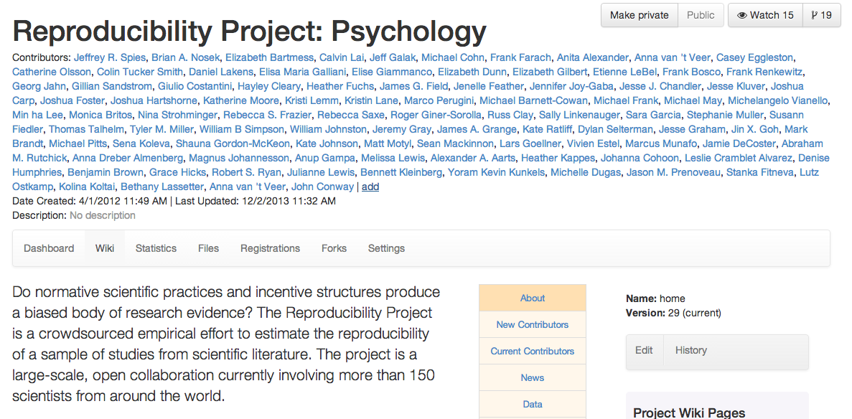
Metascience
- Conduct research to better understand the problem
- Reproducibility Project, Archival Project
Notes:
Talking points:
1) In our enabling of metascience research we aim to conduct science about scientific practices, evaluate the state of the community, and inform the rest of our behaviors.
2) Examples of work in this area include the Reproducibility Project and Archival Project, which you may have heard and some of you may be involved in.

Slide 14
Community
- Unite technological initiatives
- Unite researchers
- Enable common standards and rewards
Notes:
Talking points:
1) In our building of community we aim to unite initiatives and researchers so that there is a more engaged, helpful community and greater use and access to open science practices.
2) Better services and new rewards will lead to a more active scientific community.

Slide 15



Community
Endorsements and adoptions:
Bio, Tech & Beyond, Databrary, DataOne, Dataverse Network Project, Duraspace, EAPP, Fetzer Franklin Fund, Figshare, LJAF, Mozilla Science Lab, Network for Open Scientific Innovation, Open Science Federation, OpenfMRI, Prometheus Research, Psi Chi, PsychoPy, Reproducibility Initiative, Science Exchange, Cortex, European Journal of Personality, Journal of Research in Personality, Psi Chi Journal, Psychological Science, Journal of Social Psychology, Human Computation, Journal of Vision
Notes:
Talking points:
1) As an example of a community project, we are working with a diverse group of organizations to promote the adoption of badges for open practices. Early examples include open data, open materials, and preregistration.
2) These are not domain specific, organizations don’t have to pay to use them, organizations don’t have to use them all. They might be used by journals.
3) This a very low cost, low effort, low risk incentive for promoting good open science practices.

Slide 16
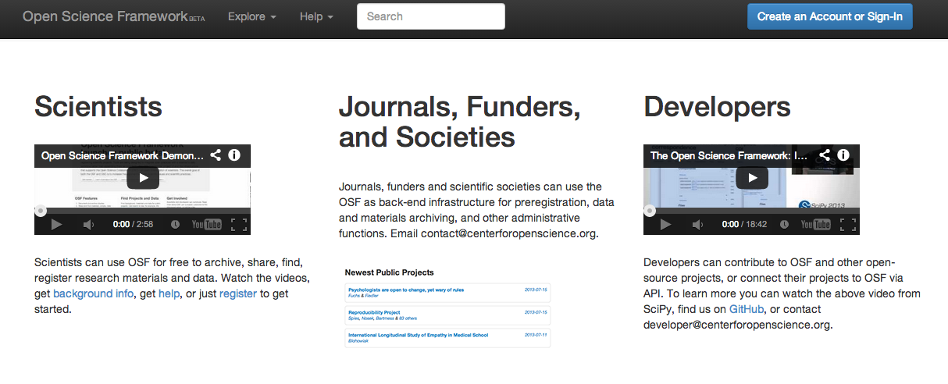
Infrastructure
Support the way researchers work right now
Enable: open materials, data; registration of hypotheses; pre/post data collection reports; tools to connect projects and initiatives and to increase their audiences; easy, online publishing of any results and simple distribution of those ideas
Notes:
Talking points:
1) In our developing of infrastructure we aim to create an environment that simply enables researchers to improve their practices, and invested parties to easily employ open science.
2) This approach changes the incentive structure and creates an environment where personal barriers are lessened
Main takeway: we are going to where researchers presently are, rather than expecting them to come to us. This means researchers are able to follow their own workflow. We nudge open practices through tools being available.

Slide 17
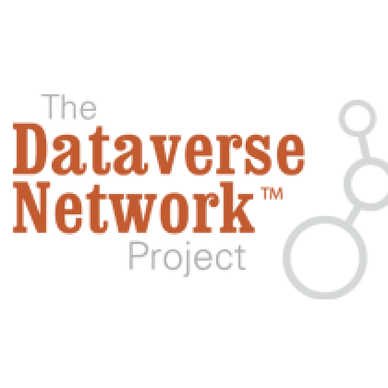
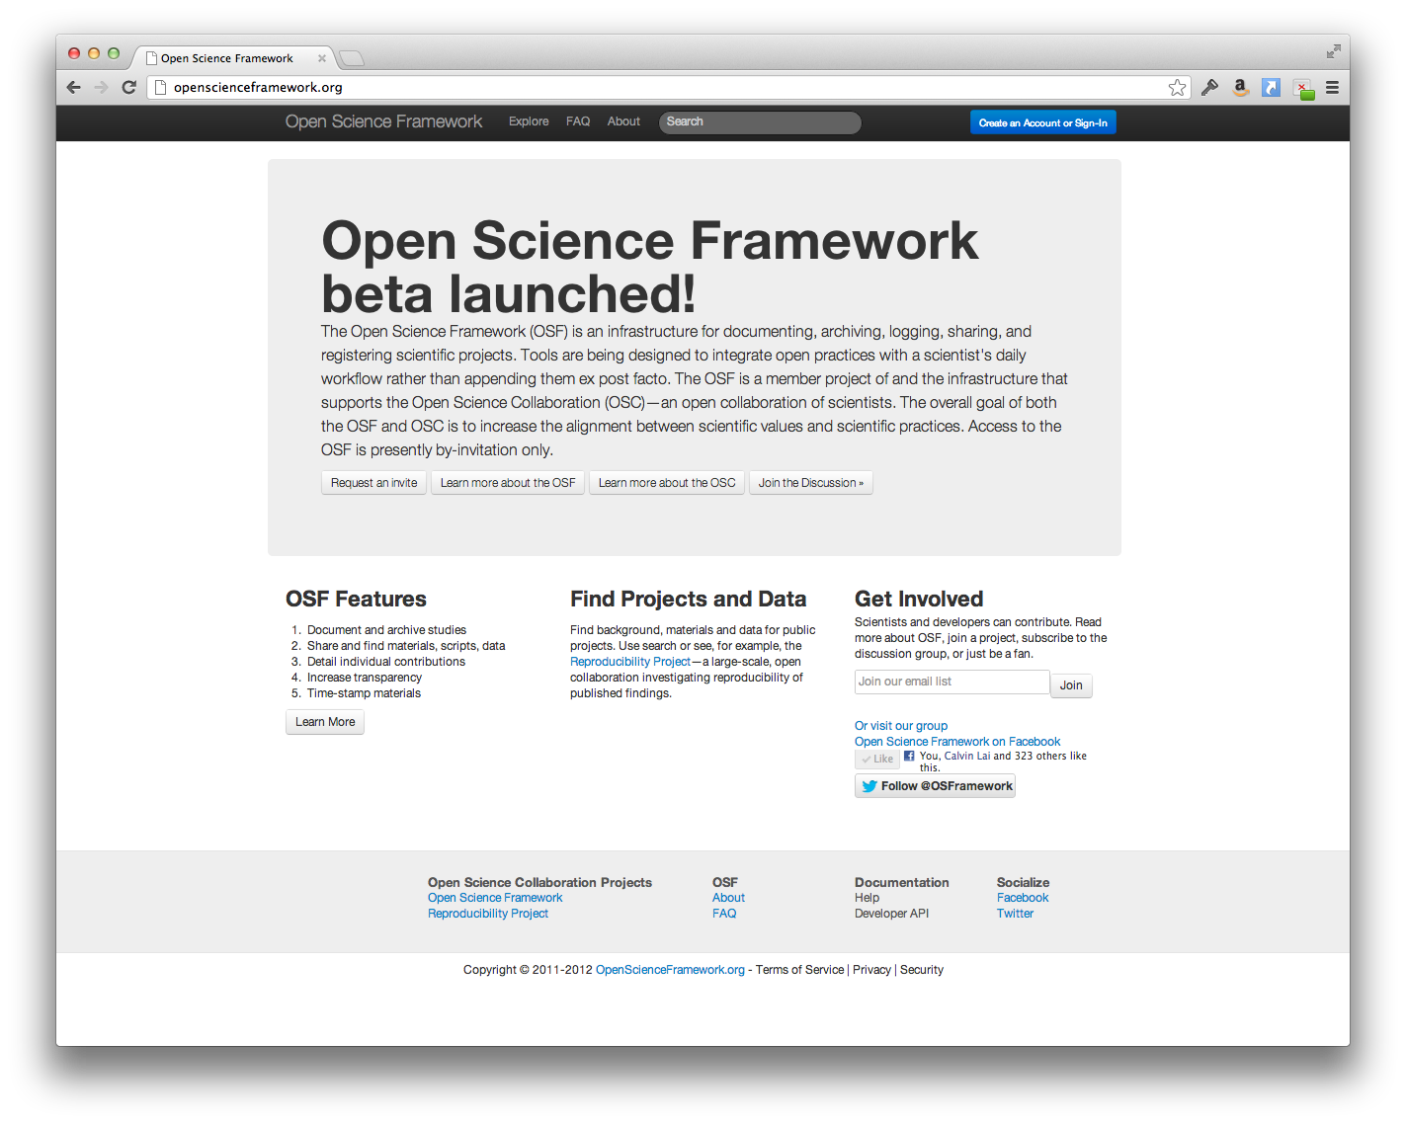




Infrastructure
Notes:
Talking points:
1) We connect OSF to the workflow through APIs and add-ons to the already common and popular tools that people in this room use, develop, and manage.
2) Connecting services both improves user experience and, in providing choice, we increase the service’s use and the value for all parties.
3) We are not trying to interfere with workflow, so there are options and nothing proscriptive or mandated.

Slide 18
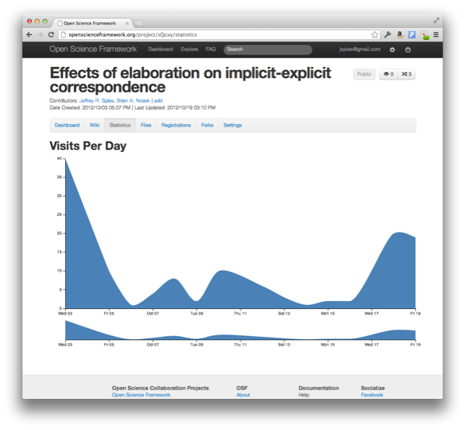
Infrastructure
Notes:
Talking points:
1) Additionally, this approach allows for more ways of measuring value and impact across the scientific process - altmetrics.

