Slide 1

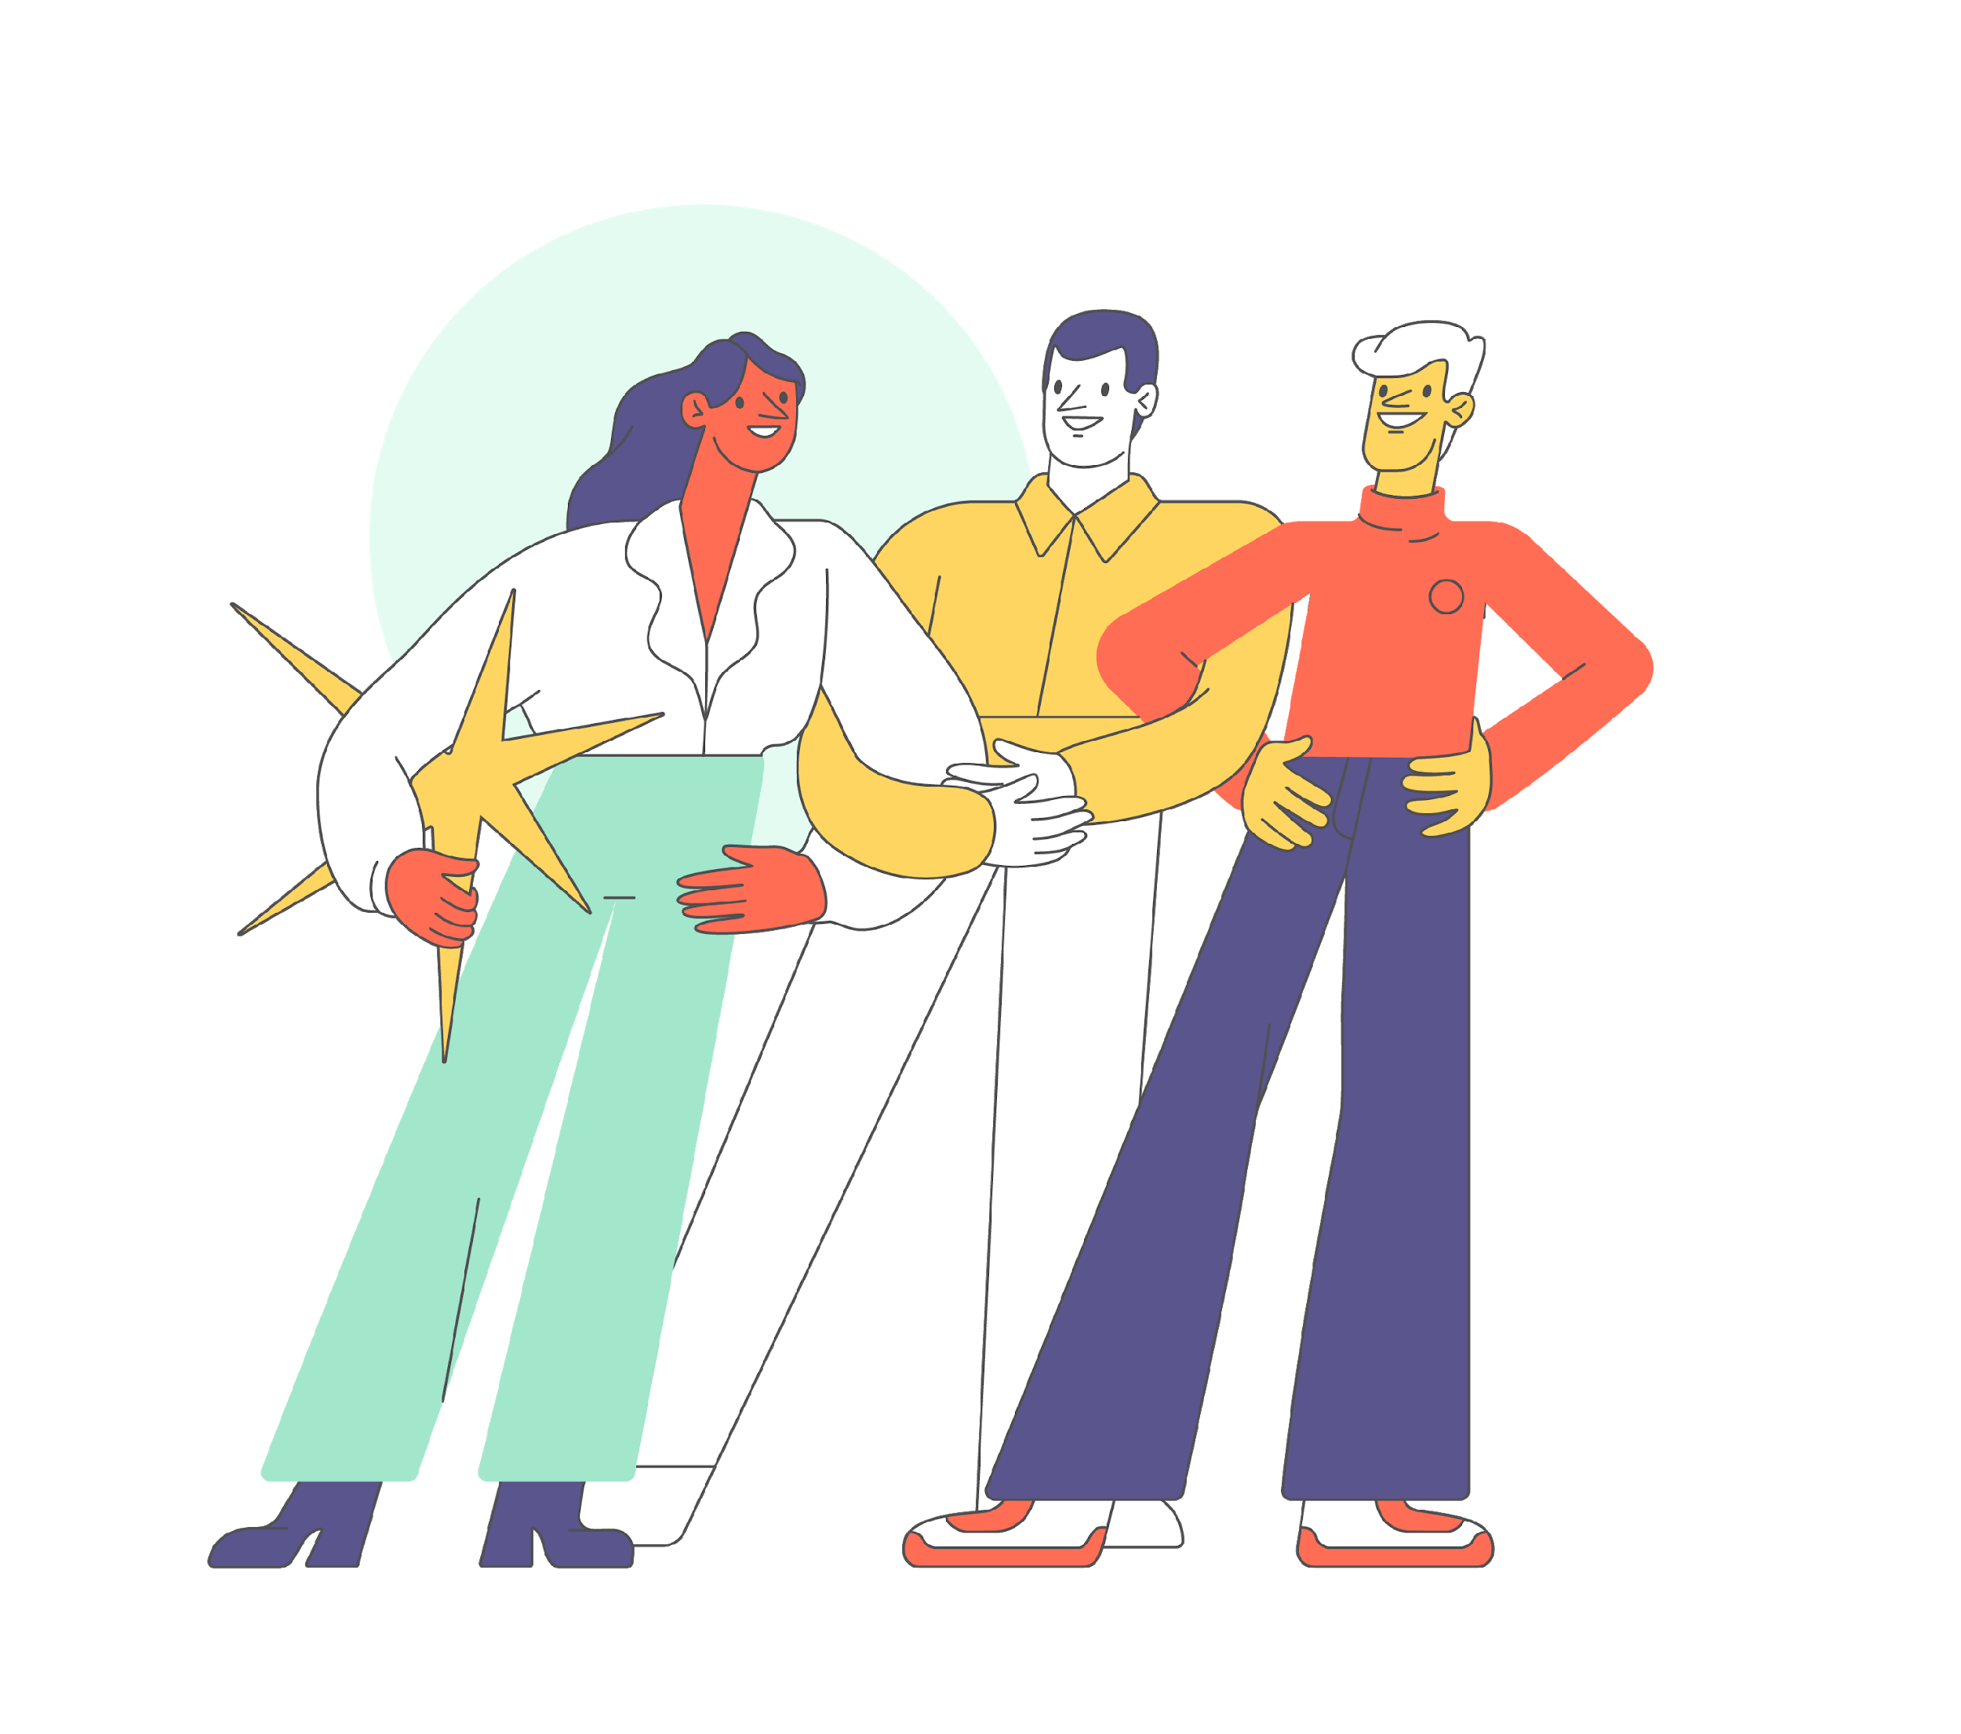

2 Lesson
First steps
Viktoriia Dvornyk
Date: 27-10-2022

Slide 2

Let's get it started

Slide 3

Content
Python interpreter
print()
git
PyCharm

Slide 4

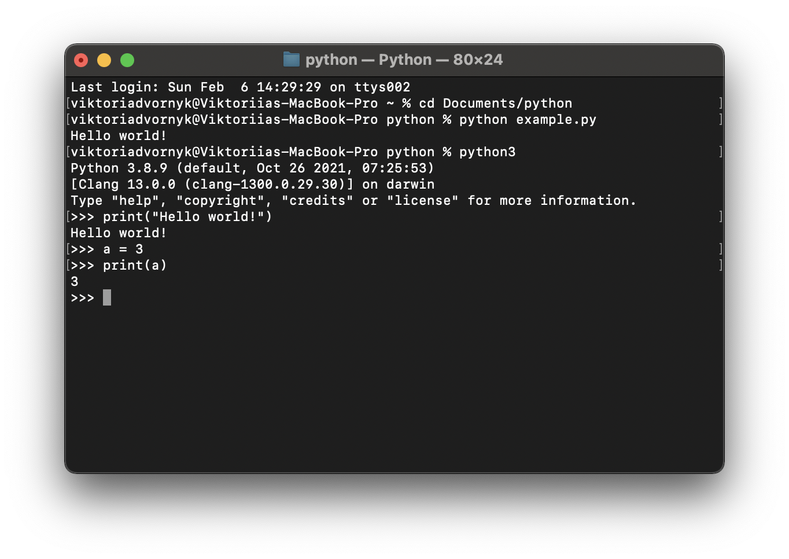
Python interpreter

Slide 5

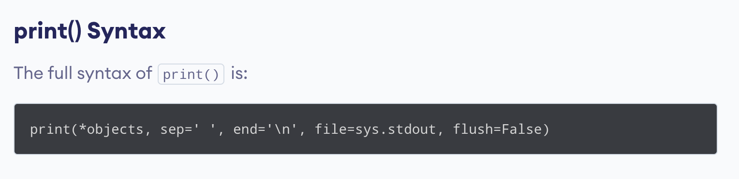
print() function
print() Parameters
objects - object to the printed. * indicates that there may be more than one object
sep - objects are separated by sep. Default value: ' '
end - end is printed at last
file - must be an object with write(string) method. If omitted, sys.stdout will be used which prints objects on the screen.
flush - If True, the stream is forcibly flushed. Default value: False

Slide 6
print() function
print() Parameters
objects - object to the printed. * indicates that there may be more than one object
sep - objects are separated by sep. Default value: ' '
end - end is printed at last
file - must be an object with write(string) method. If omitted, sys.stdout will be used which prints objects on the screen.
flush - If True, the stream is forcibly flushed. Default value: False
Note: sep, end, file, and flush are keyword arguments. If you want to use sep argument, you have to use:
print(*objects, sep = 'separator’)
not print(*objects, 'separator')

Slide 7

print() Return Value
It doesn't return any value; returns None.
flush = True
Output from print() goes into a buffer. If you want to avoid this, you can use flash = True.
This argument is also used if you use the file argument, which allows you to specify a file object to write the output to. By default (with flush=False), the file will be written to after exiting the loop, and if flush=True, the file will be written immediately
print() with file parameter
In Python, you can print objects to the file by specifying the file parameter

Slide 8

Git
Git cribs:
https://training.github.com/downloads/ua/github-git-cheat-sheet/
https://proglib.io/p/git-cheatsheet

Slide 9


Let’s test your knowledge
https://www.menti.com/ap7sp3xb2b
https://www.menti.com/rx1w98g165

Slide 10
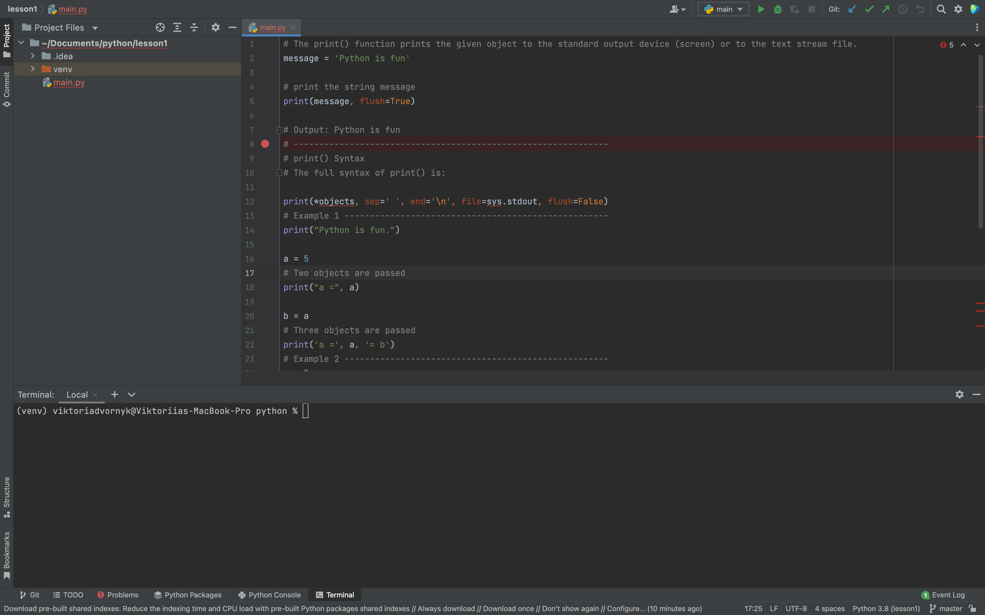
PyCharm

Slide 11



+380982759822 viktoriia-dvornyk
VikaDvornyk
Viktoriia Dvornyk
Github:

Slide 12


Thank you!
beetroot.academy

