Slide 1



3 Lesson
Variables and primitive data types
Viktoriia Dvornyk
Date: 29-10-2022

Slide 2

Let's get it started

Slide 3

Content
Variables
Data types
Operators
Integers, Floats, Strings
Type convertions

Slide 4

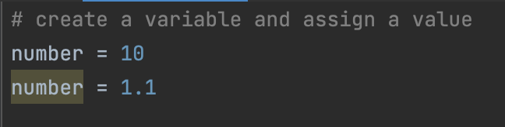
Variables
A variable is a named location used to store data in the memory. It is helpful to think of variables as a container that holds data that can be changed later in the program
For example,
Note: In Python, we don't actually assign values to the variables. Instead, Python gives the reference of the object (value) to the variable
Note: Python is a type-inferred language, so you don't have to explicitly define the variable type. It automatically knows what is a string or integer.

Slide 5

Rules and Naming Convention for Variables and constants
4. Use capital letters possible to declare a constant. For example:
PI
G
MASS
SPEED_OF_LIGHT
TEMP
4. Never use special symbols like !, @, #, $, %, etc.
5. Don't start a variable name with a digit
1. Constant and variable names should have a combination of letters in lowercase (a to z) or uppercase (A to Z) or digits (0 to 9) or an underscore (_). For example:
snake_case
MACRO_CASE
camelCase
CapWords
2. Create a name that makes sense. For example, age makes more sense than a
3. If you want to create a variable name having two words, use underscore to separate them. For example:
my_name
current_salary

Slide 6

Data types in Python
Python Numbers
Integers, floating point numbers and complex numbers fall under Python numbers category. They are defined as int, float and complex classes in Python
We can use the type() function to know which class a variable or a value belongs to
Python Strings
String is sequence of Unicode characters
We can use single quotes or double quotes to represent strings Multi-line strings can be denoted using triple quotes, ''' or """

Slide 7

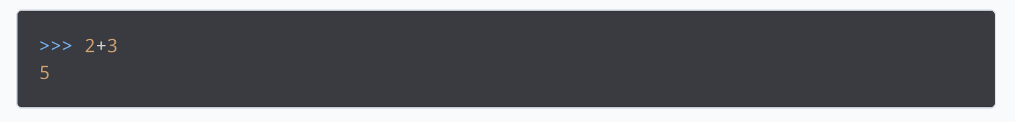
Python Operators
Operators are special symbols in Python that carry out arithmetic or logical computation. The value that the operator operates on is called the operand.
For example:

Slide 8
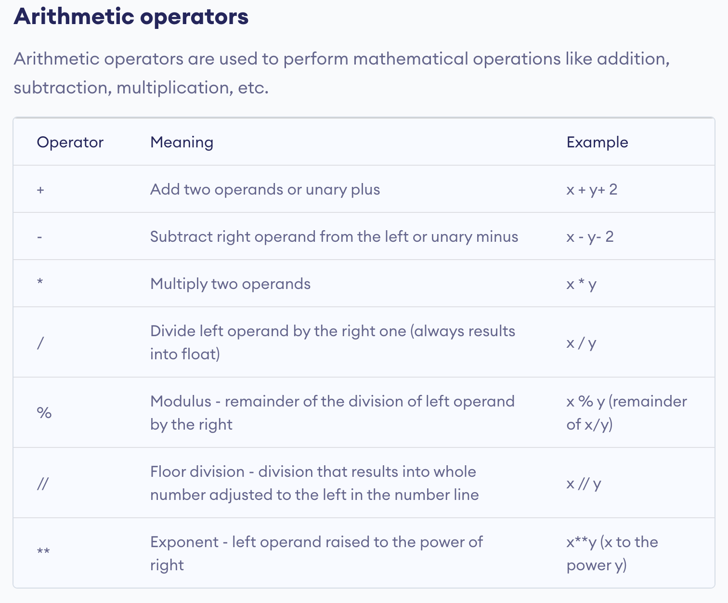

Slide 9
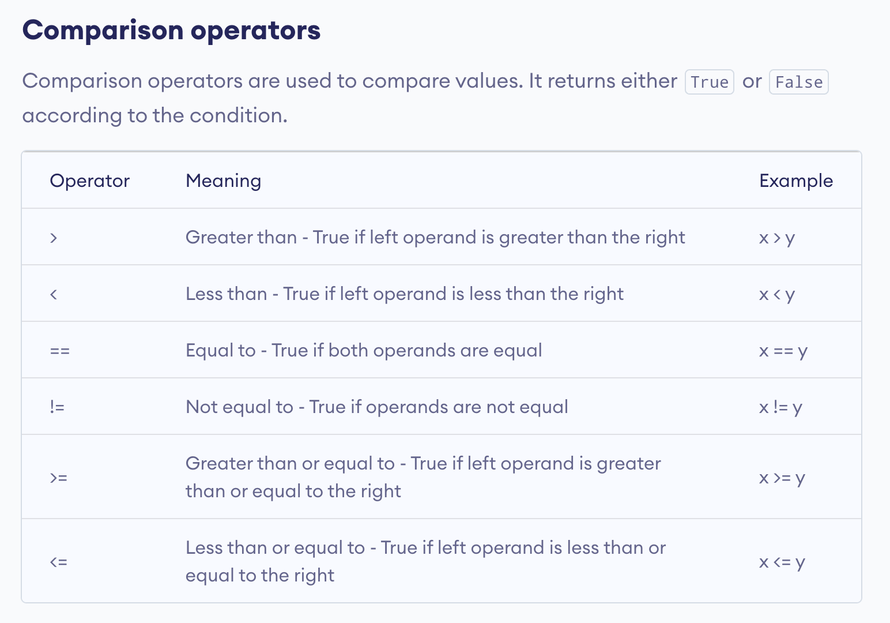

Slide 10
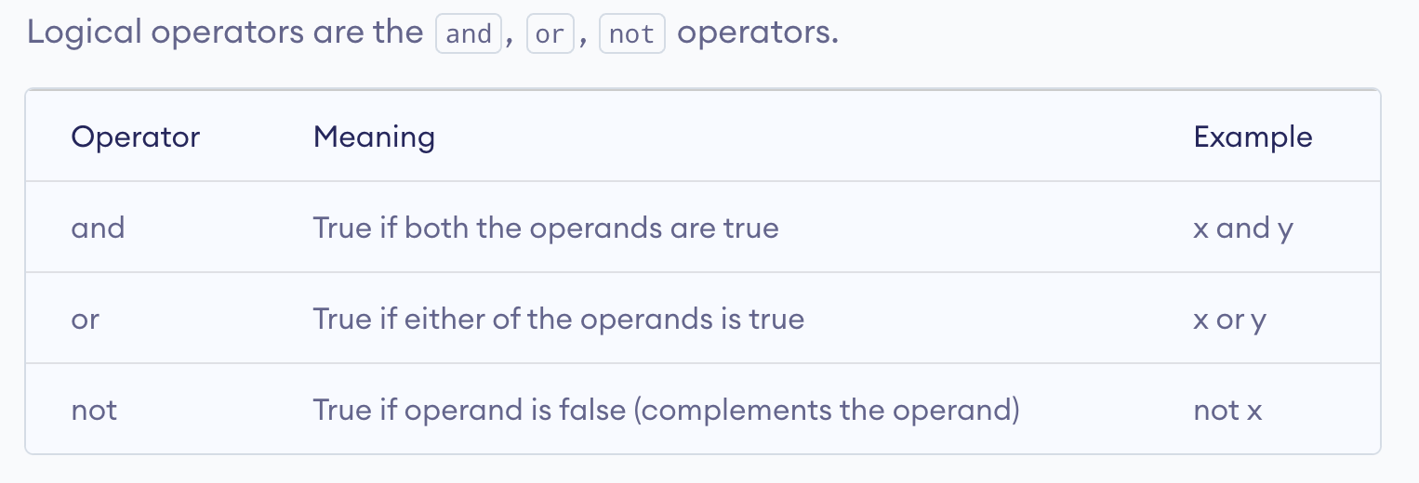

Slide 11
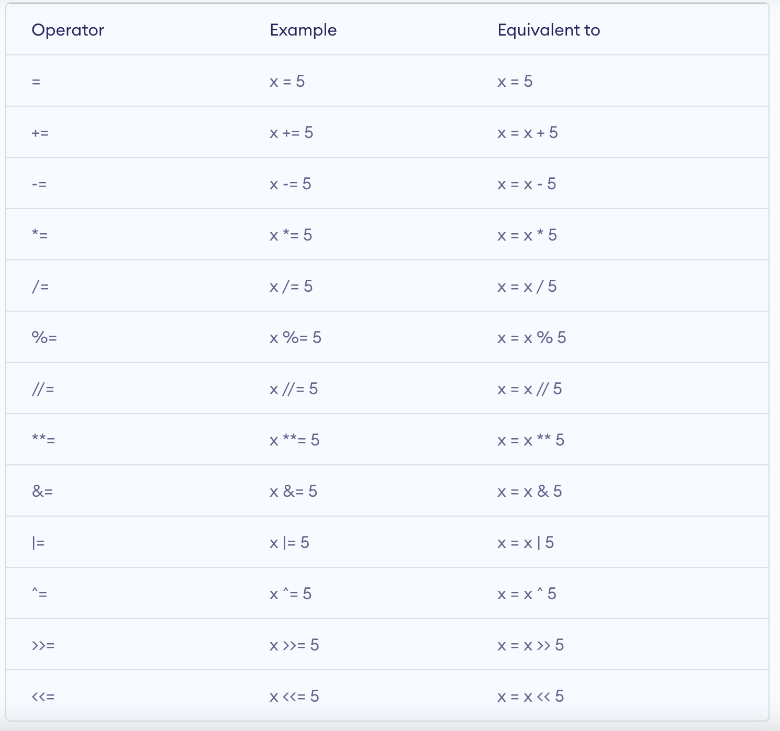
Assignment operators

Slide 12
Type Conversion
The process of converting the value of one data type (integer, string, float, etc.) to another data type is called type conversion. Python has two types of type conversion.
1. Implicit Type Conversion
2. Explicit Type Conversion

Slide 13



+380982759822 viktoriia-dvornyk
VikaDvornyk
Viktoriia Dvornyk
Github:

Slide 14


Thank you!
beetroot.academy

