Slide 1
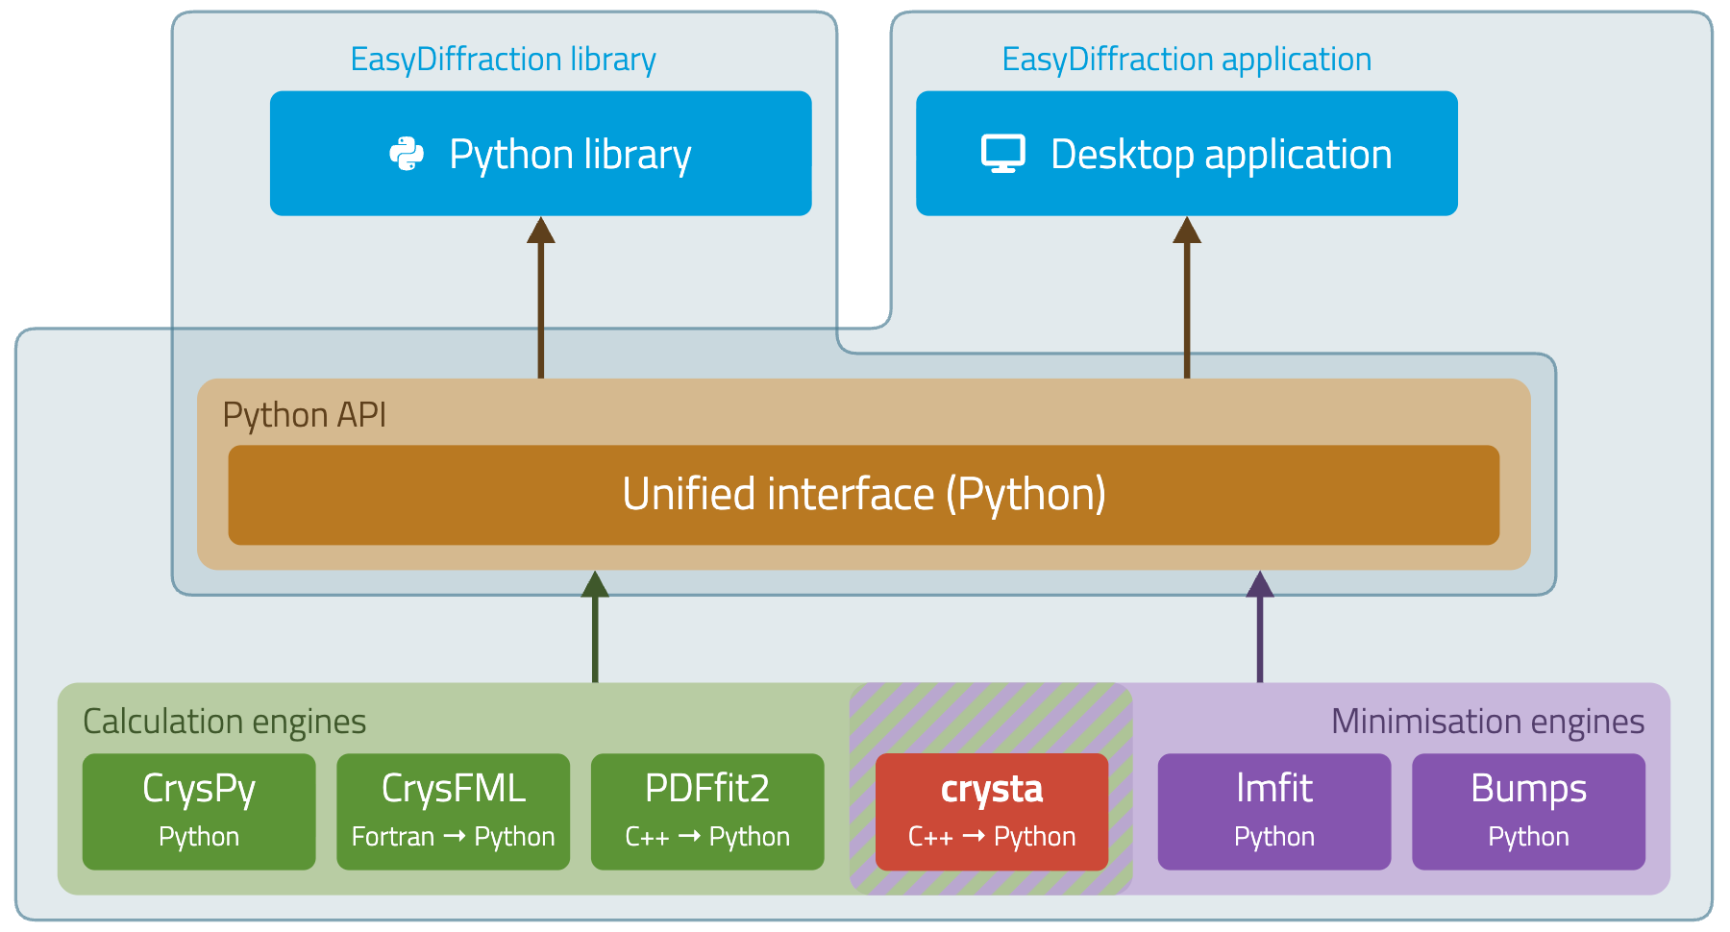
crysta – a new engine for EasyDiffraction
Built in-house for high performance: 5–10 times faster than FullProf

Slide 2
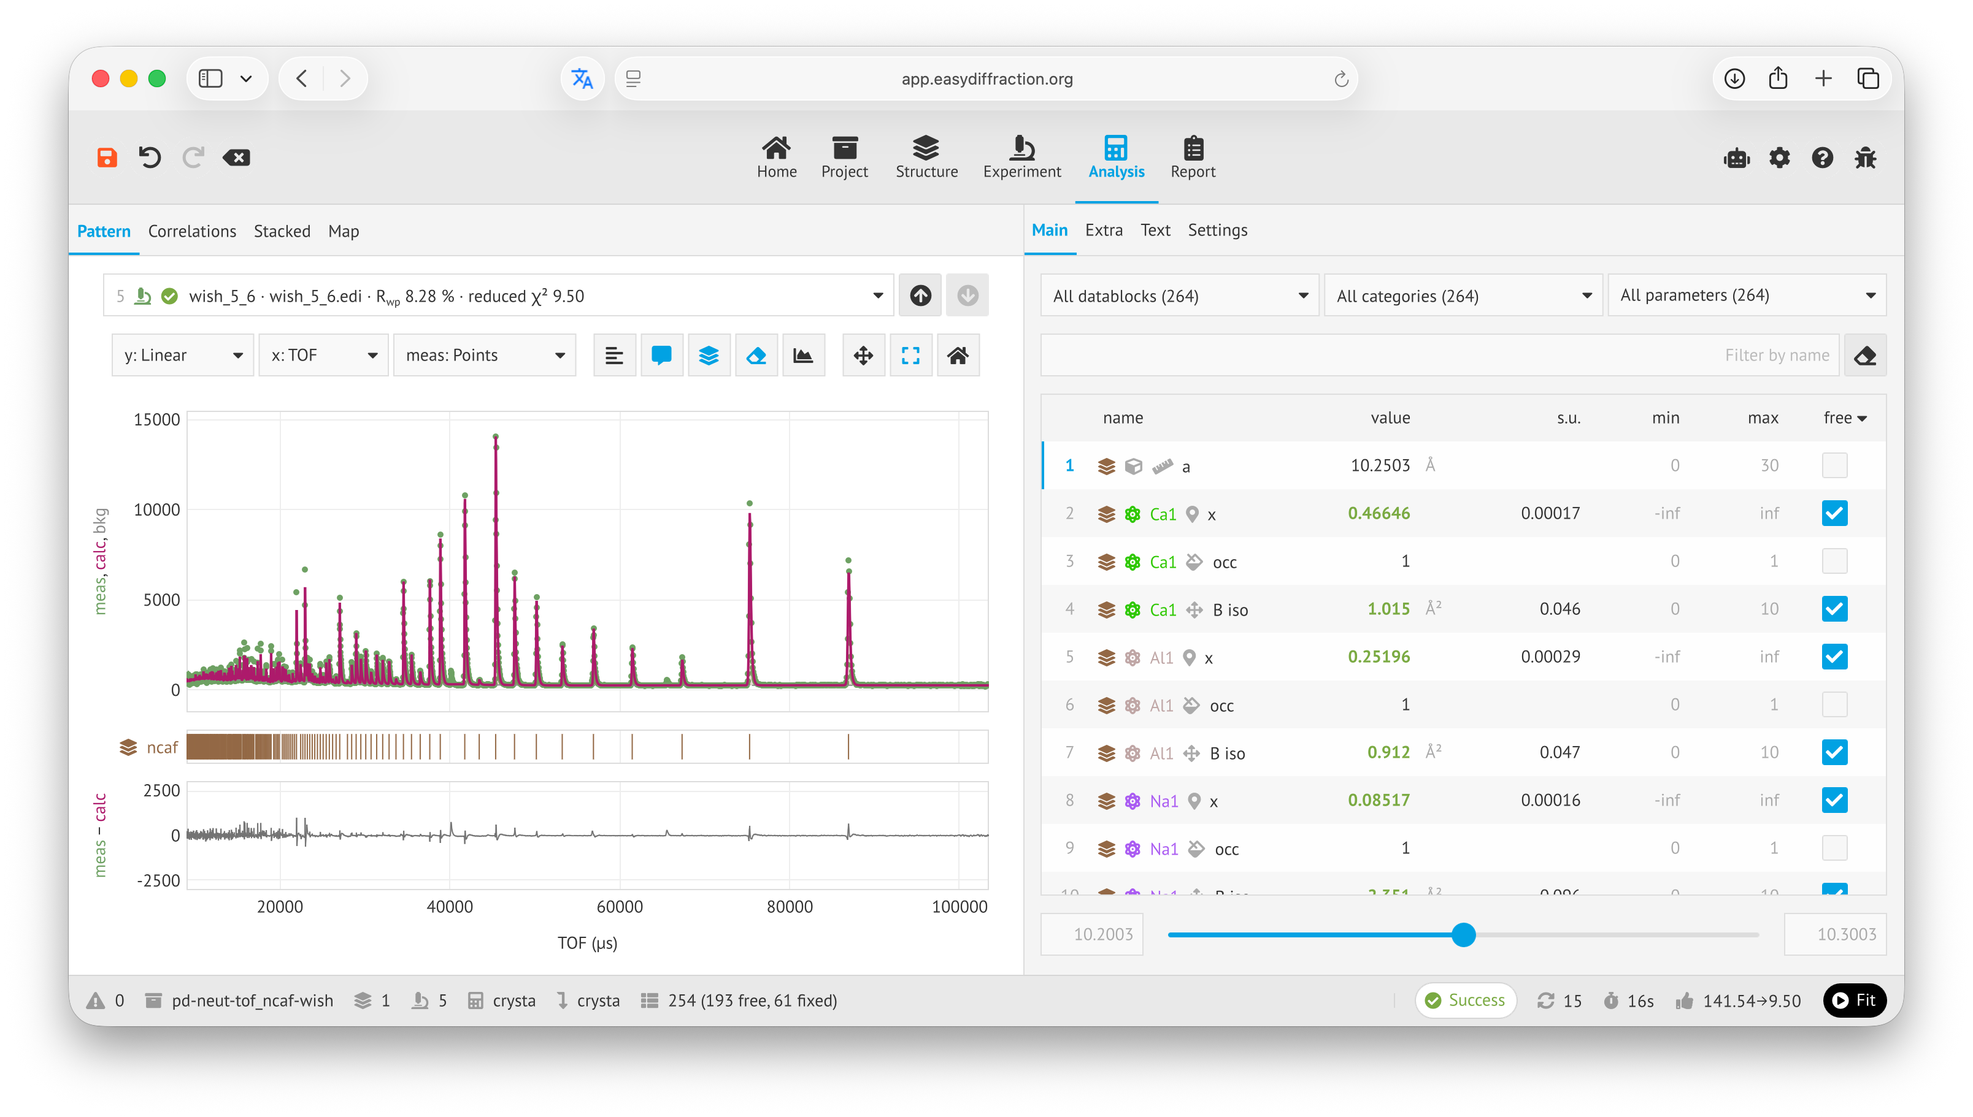
EasyDiffraction web application
Try it out at https://easydiffraction.org

