Slide 1
8
Pointers and
Pointer-Based
Strings

Slide 2
8.10 Arrays of Pointers
Arrays can contain pointers
  Commonly used to store array of strings (string array)
    Array does not store strings, only pointers to strings
    Example
      const char *suit[ 4 ] =
      { "Hearts", "Diamonds", "Clubs", "Spades" };
        Each element of suit points to a char * (string)
    suit array has fixed size (4), but strings can be of any size
    Commonly used with command-line arguments to function main

Slide 3
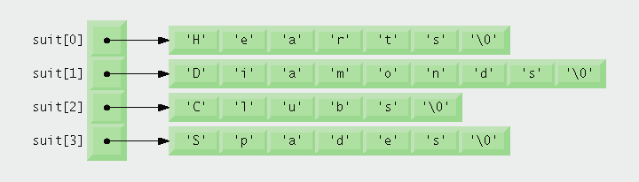
Fig. 8.22 | Graphical representation of the suit array.

Slide 4
8.11 Case Study: Card Shuffling and Dealing Simulation
Card shuffling program
  Use an array of pointers to strings, to store suit names
  Use a double scripted array (suit-by-value)
  Place 1-52 into the array to specify the order in which the cards are dealt
Indefinite postponement (starvation)
  An algorithm executing for an indefinitely long period
    Due to randomness

Slide 5
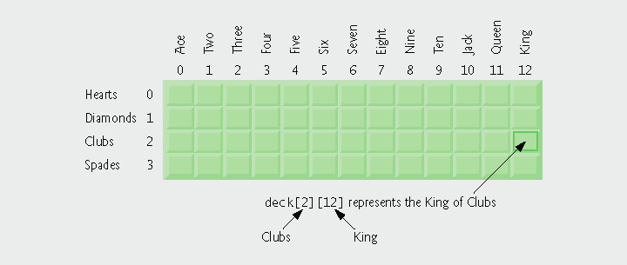
Fig. 8.23 | Two-dimensional array representation of a deck of cards.

Slide 6
Performance Tip 8.3
Sometimes algorithms that emerge in a “natural” way can contain subtle performance problems such as indefinite postponement. Seek algorithms that avoid indefinite postponement.

Slide 7
8.11 Case Study: Card Shuffling and Dealing Simulation (Cont.)
Pseudocode for shuffling and dealing
simulation
First refinement
Second refinement
Third refinement
Initialize the suit array
Initialize the face array
Initialize the deck array
Shuffle the deck
Deal 52 cards
For each of the 52 cards
  Place card number in randomly selected unoccupied slot of deck
Choose slot of deck randomly
While chosen slot of deck has
been previously chosen
Choose slot of deck randomly
  Place card number in chosen slot of deck
For each of the 52 cards
  Find card number in deck array and print face and suit of card
For each slot of the deck array
If slot contains card number
Print the face and suit of the
card

Slide 8
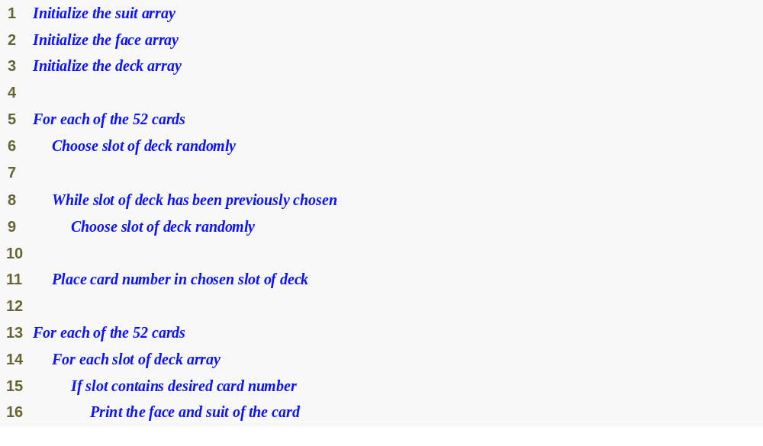
Outline
fig08_24.cpp
(1 of 1)

Slide 9
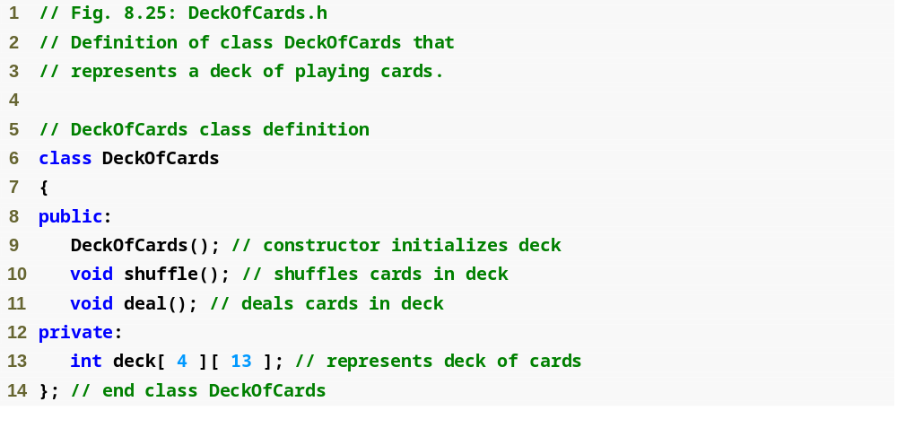
Outline
fig08_25.cpp
(1 of 1)

Slide 10
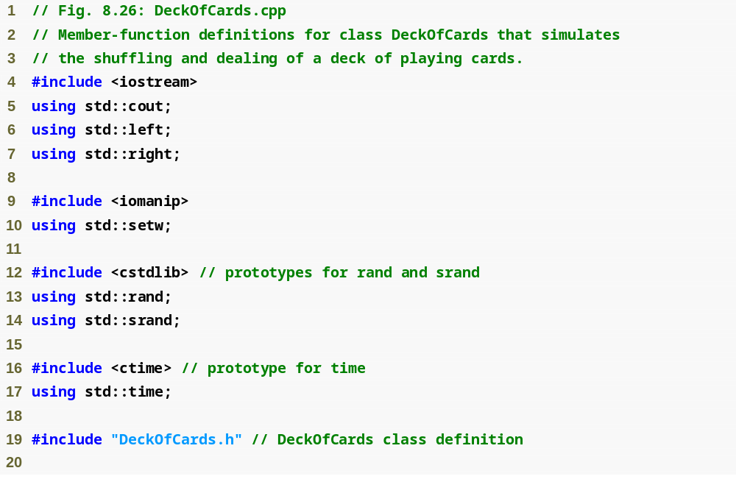
Outline
fig08_26.cpp
(1 of 4)

Slide 11
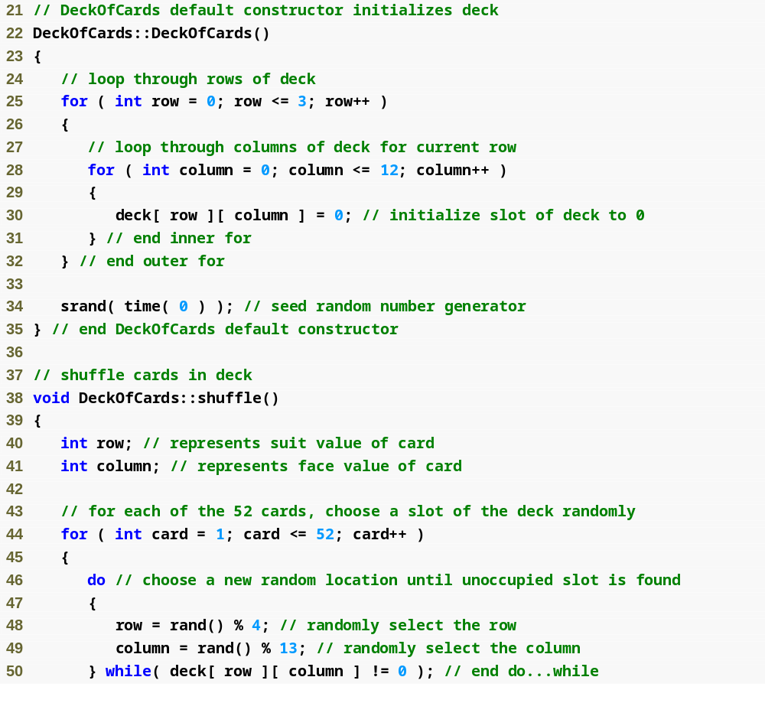
Outline
fig08_26.cpp
(2 of 4)
Current position is at randomly selected row and column

Slide 12
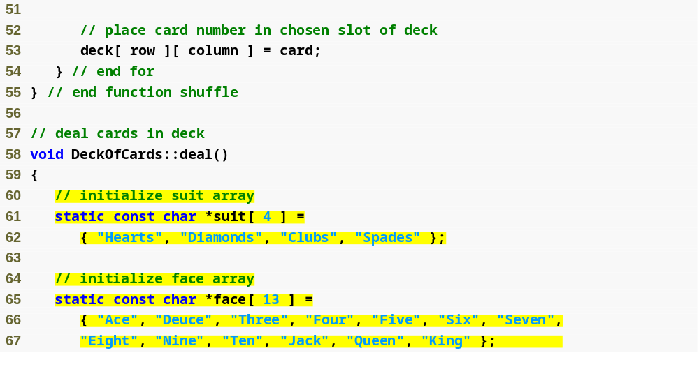
Outline
fig08_26.cpp
(3 of 4)
suit array contains pointers to char arrays
face array contains pointers to char arrays

Slide 13
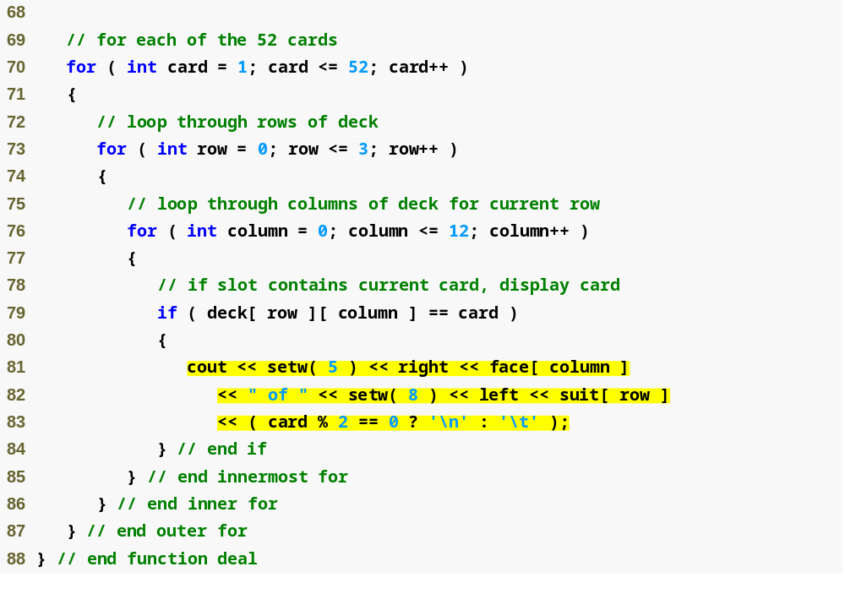
Outline
fig08_26.cpp
(4 of 4)
Cause face to be output right justified in field of 5 characters
Cause suit to be output left justified in field of 8 characters

Slide 14
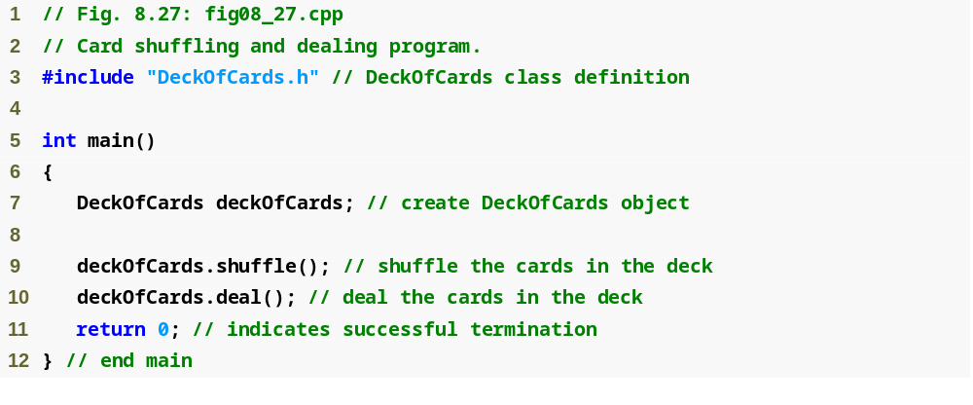
Outline
fig08_27.cpp
(1 of 2)

Slide 15
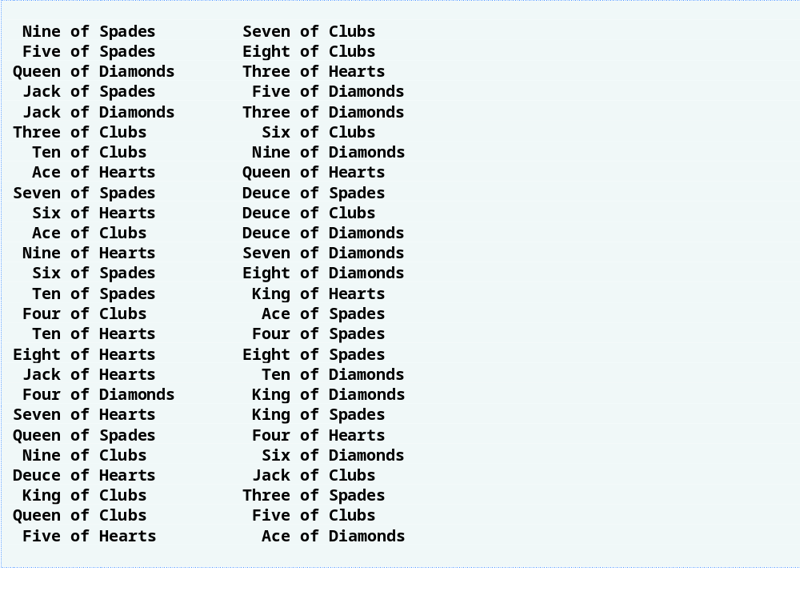
Outline
fig08_27.cpp
(2 of 2)

