Slide 1
Ljubljana/RINSC Fluence Cross Calibration
Andrew Kent

Slide 2
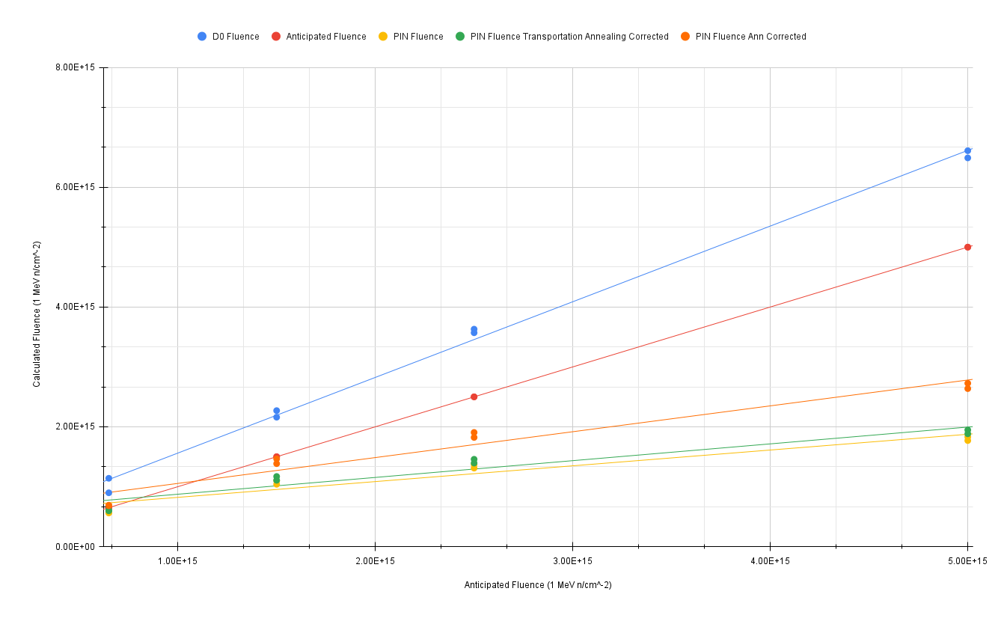
Anticipated Fluence vs. Calculated fluence for PIN and D0 diodes
D0 Diodes fluence estimates run higher than the predicted fluence though they seem to follow a linear trend
D0’s in the 1.5e15, 2.5e15 and 5e15 fluence batches did not deplete before our highest voltage (1100V), depletion voltages were therefore taken at the highest voltage as a “lower bound”
Pin fluence estimates run lower than anticipated values, though corrections due to transportation annealing (green) and reactor annealing (orange) bring it closer to anticipated
Saturation of pin fluence estimates still occurs as it did for RINSC irradiation runs

Slide 3
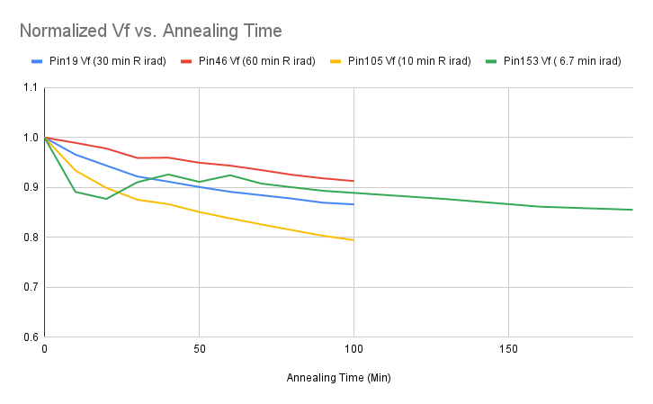
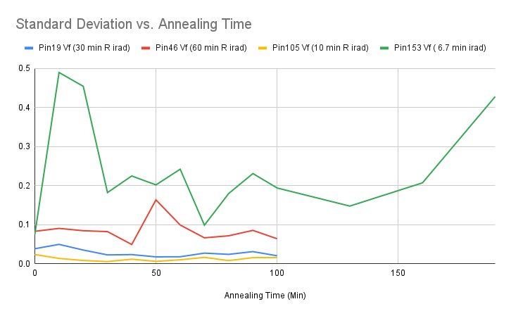
Ljubljana Pin Diode Annealing at 60C
Pin diode from Ljubljana (Pin 153) annealed at 60C for a total of 200 minutes, results normalized and plotted with pin diodes irradiated at RINSC and annealed via the same process
Pin Forward voltage of the pin diodes were measured at 1mA 30 times

Slide 4
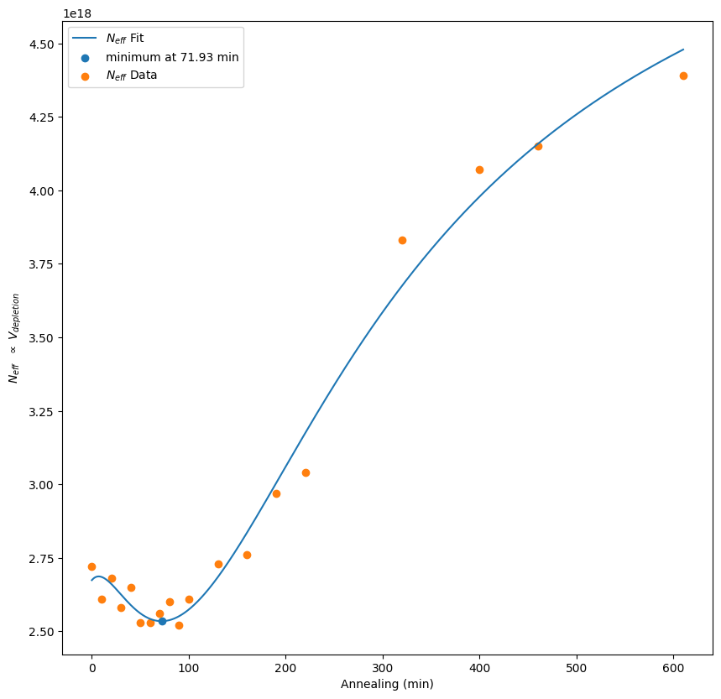
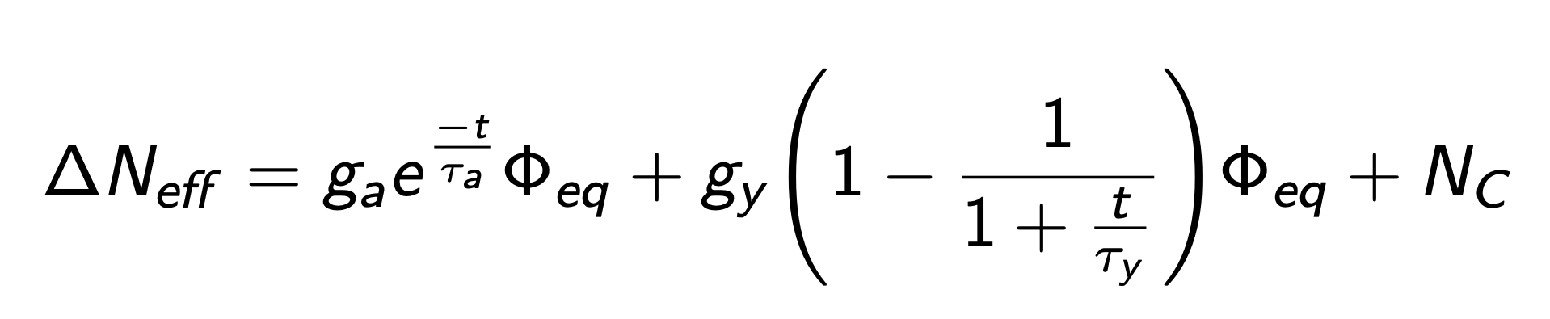
D0_CO138 Hamburg Model Fit
Based on the minimum calculated from the Hamburg model fit, we estimate ~8 minutes of annealing at 60C occurring during transportation from Ljubljana to Brown University
8 Minutes of annealing at 60C is equivalent to ~33 hours of annealing at 20C
Cargo holds of most planes kept at ~7C: estimation for annealing during travel is reasonable though data still has uncertainty

Slide 5
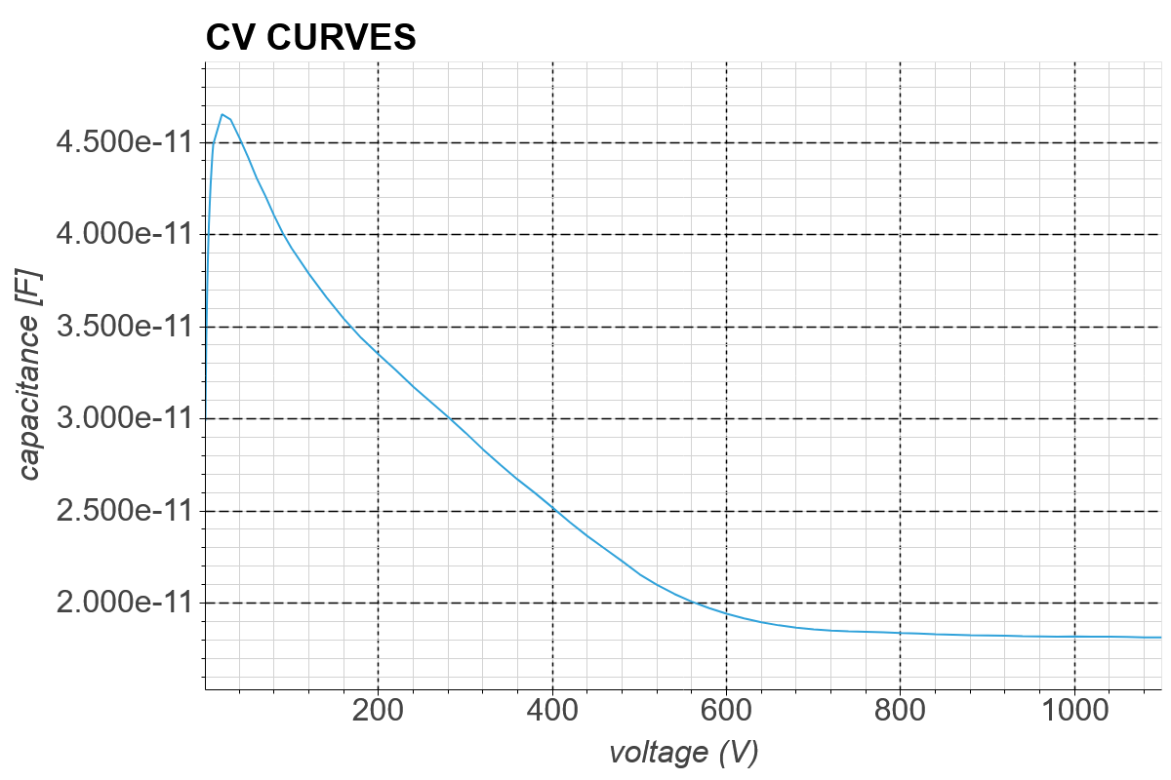
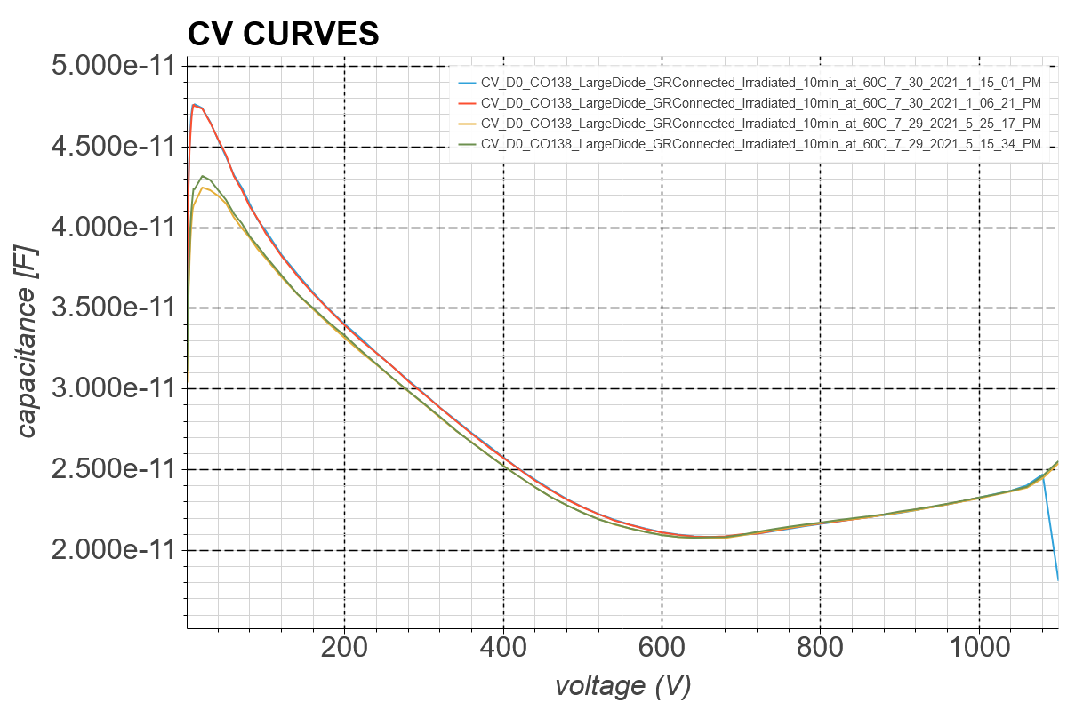
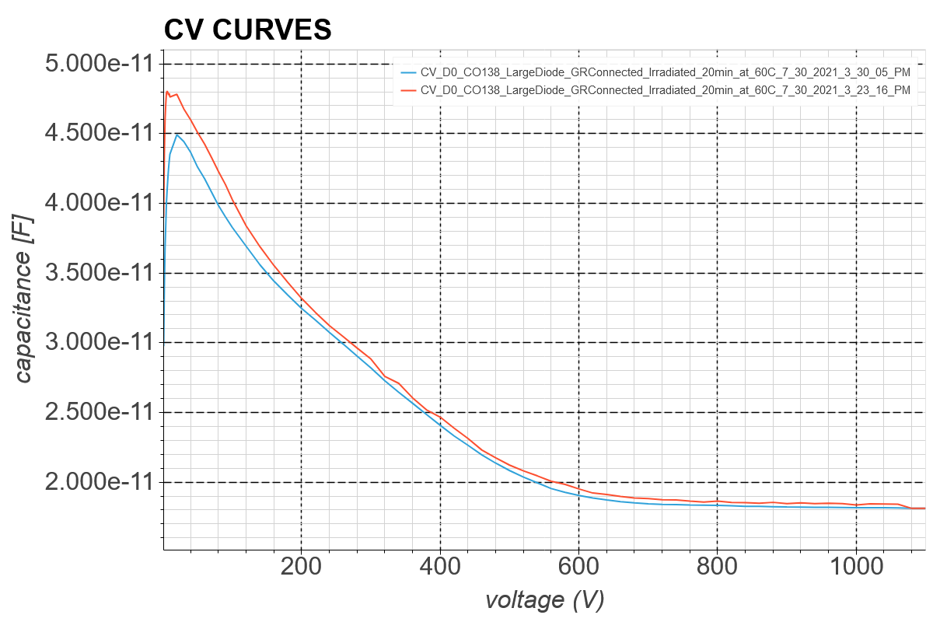
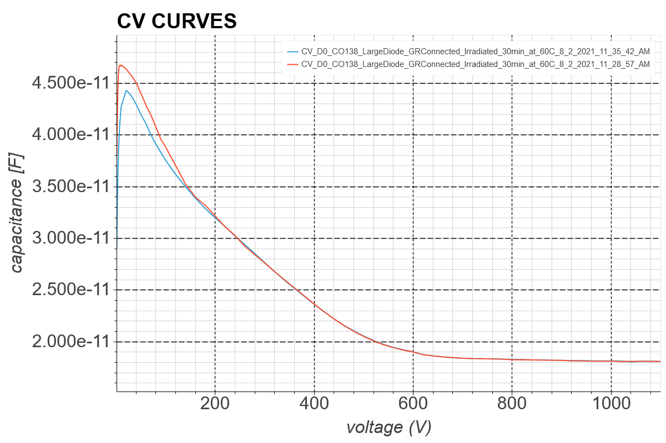
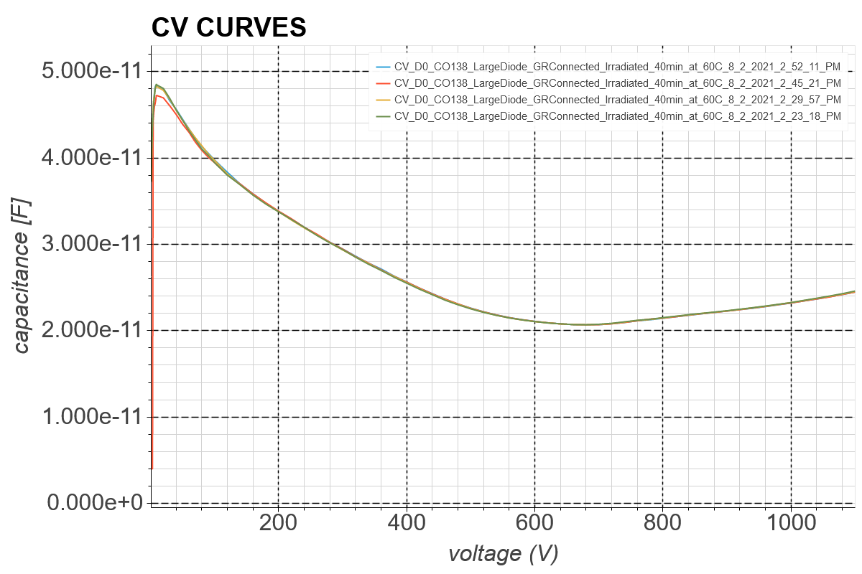
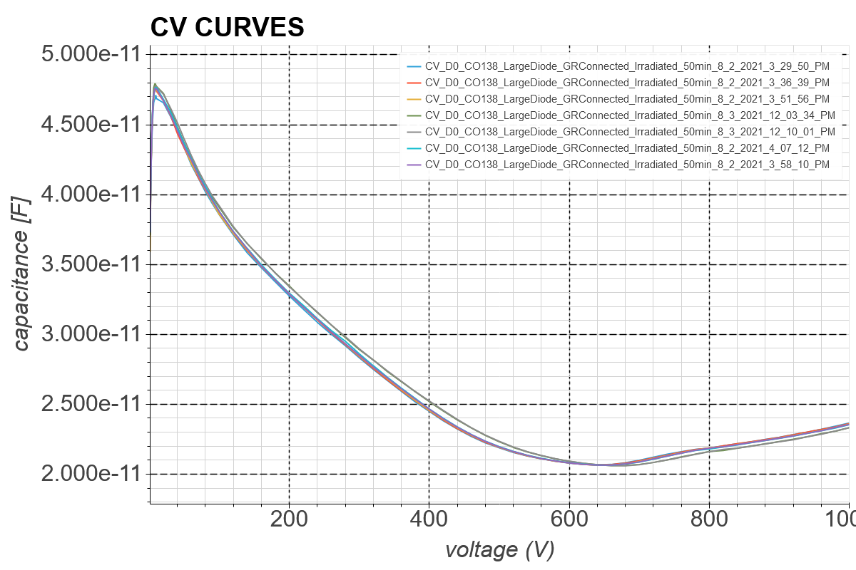
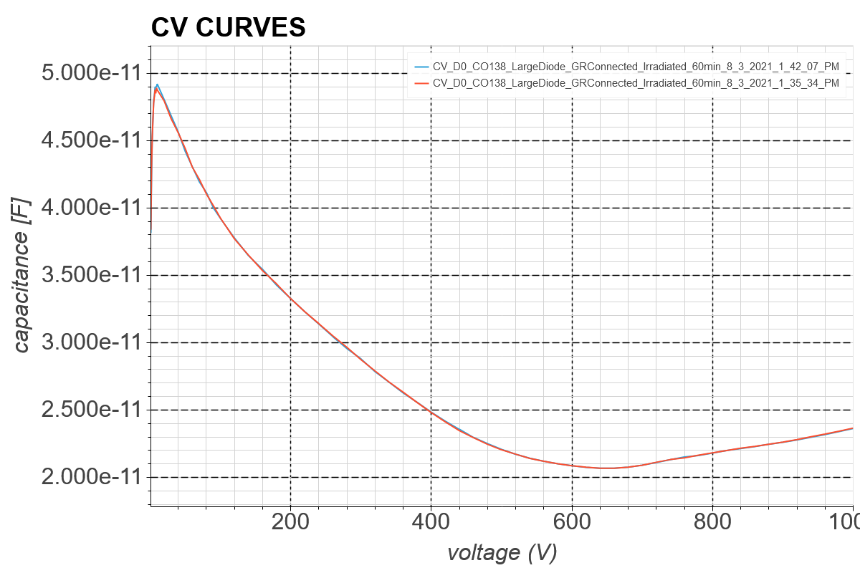
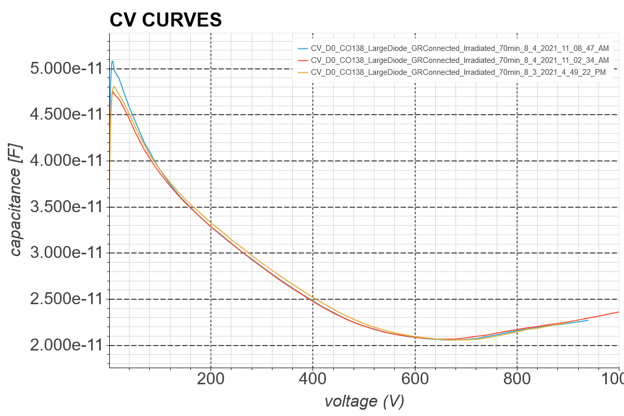
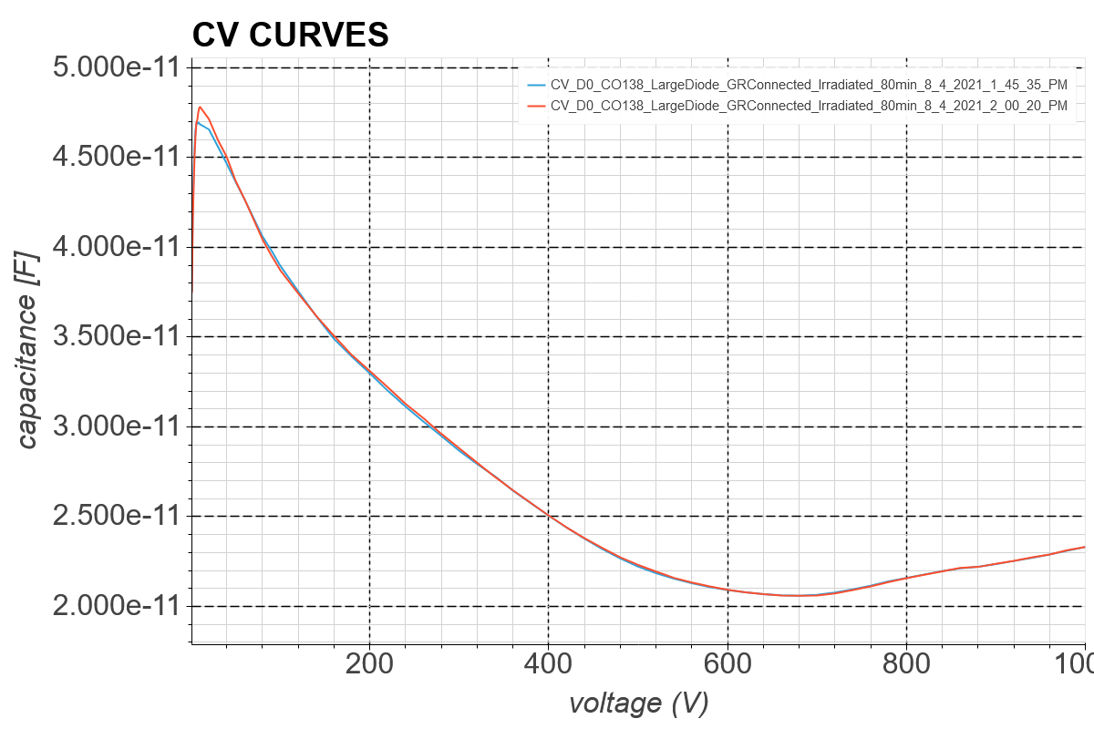
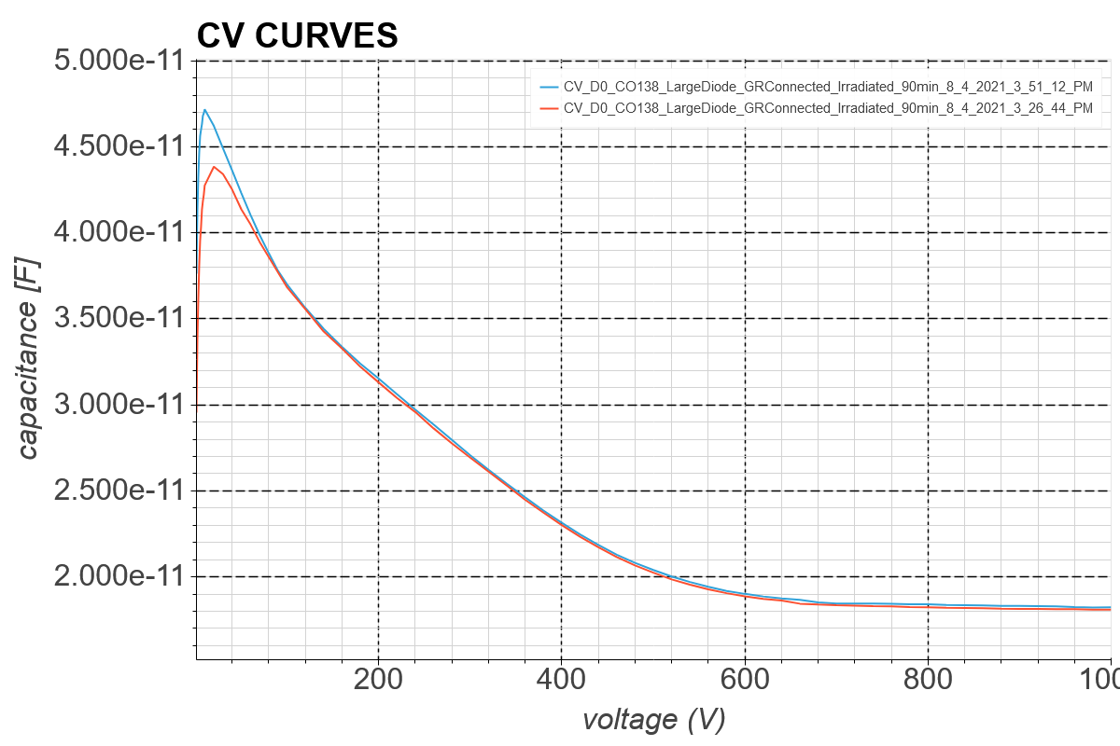
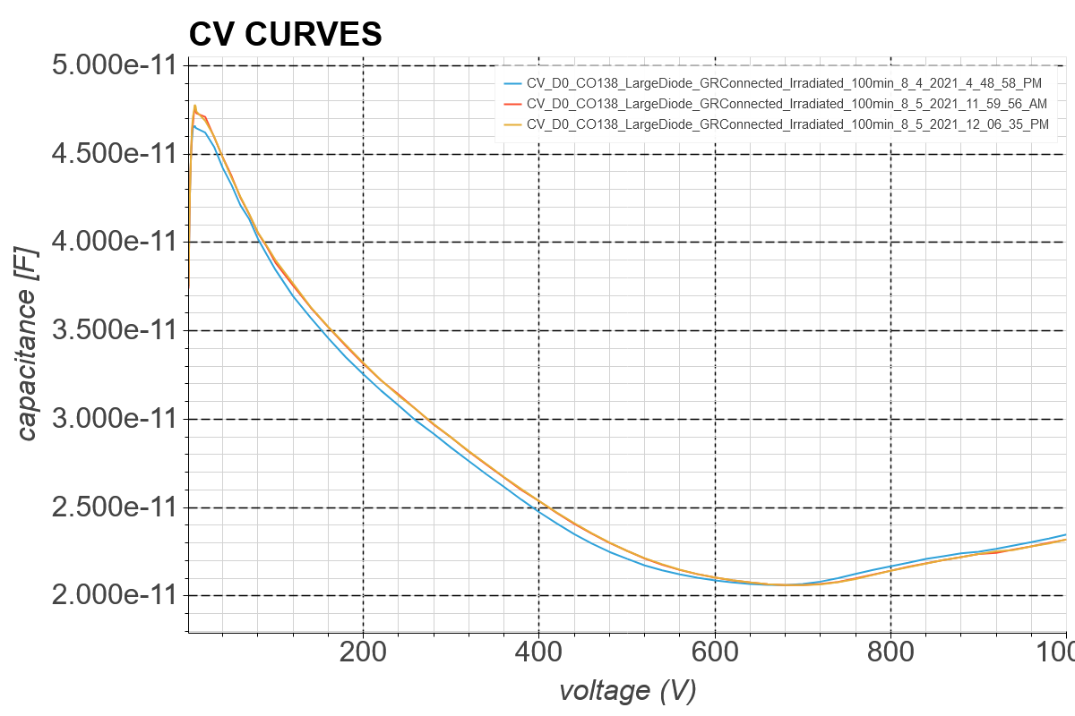
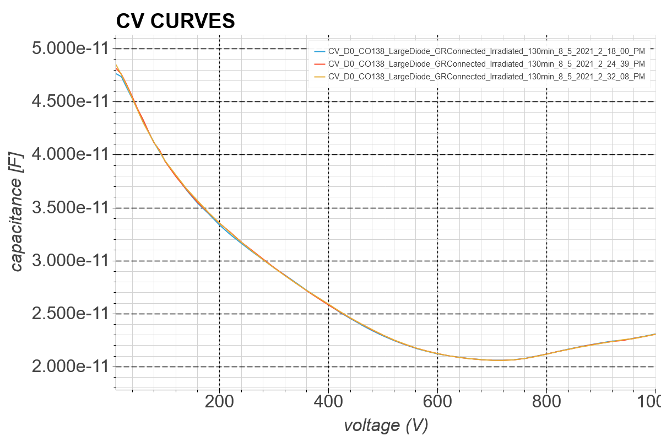
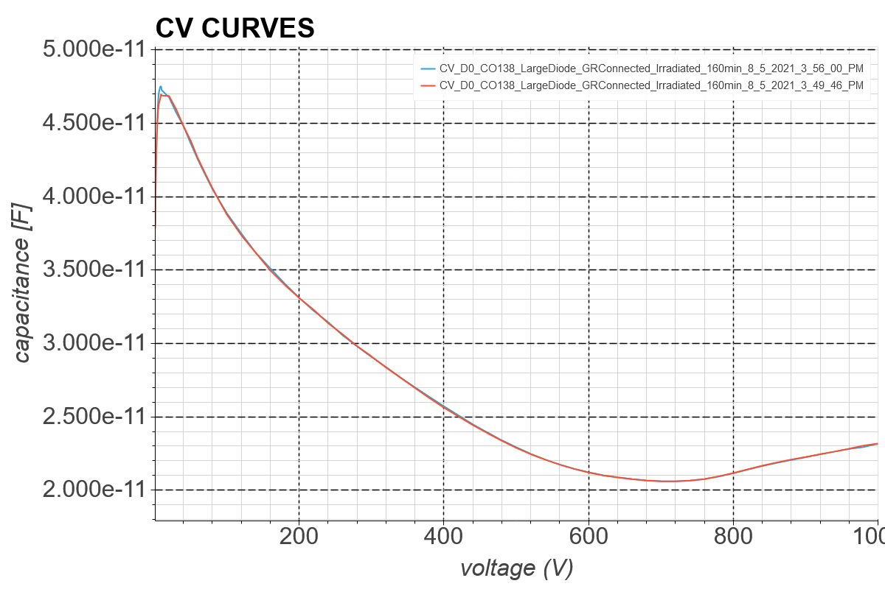
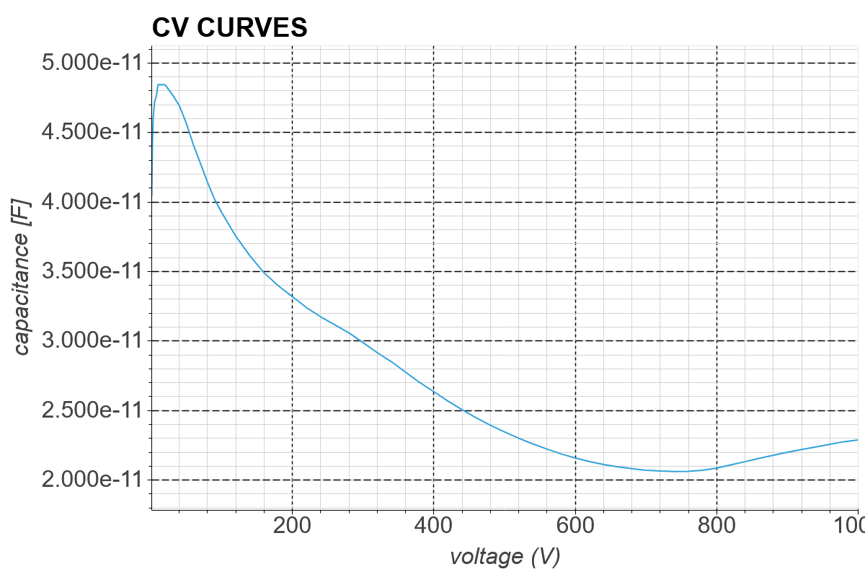
Ljubljana D0 CV Curves
0 Min
10 Min
20 Min
30 Min
40 Min
50 Min
60 Min
70 Min
80 Min
90 Min
100 Min
130 Min
160 Min
190 Min

Slide 6
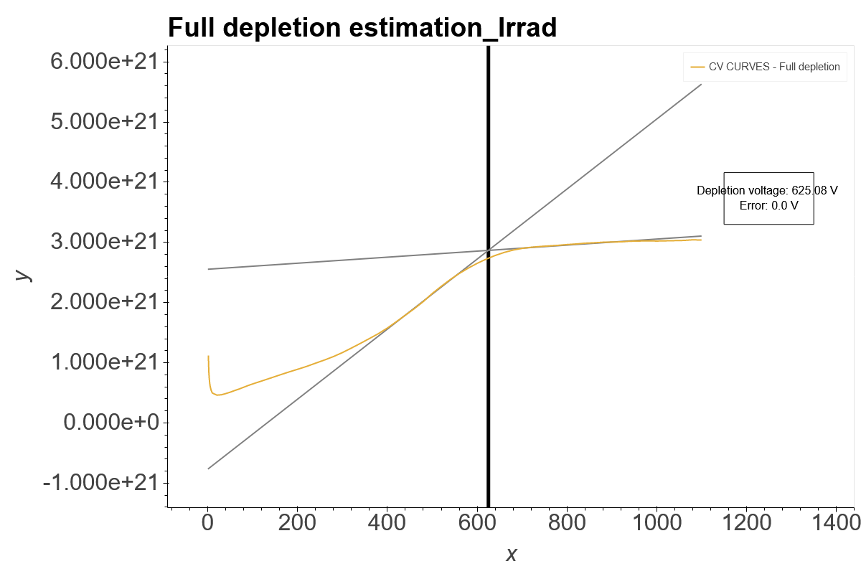
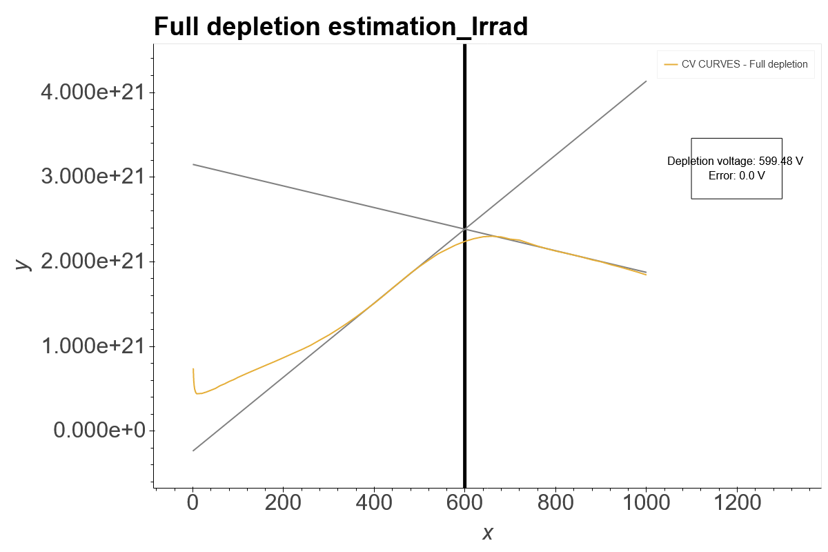
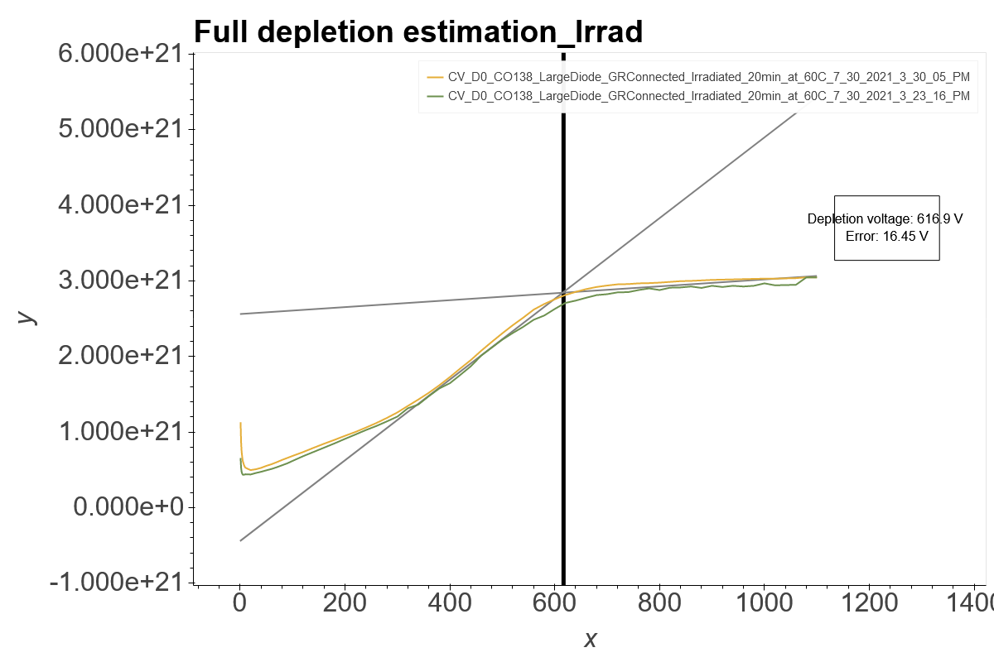
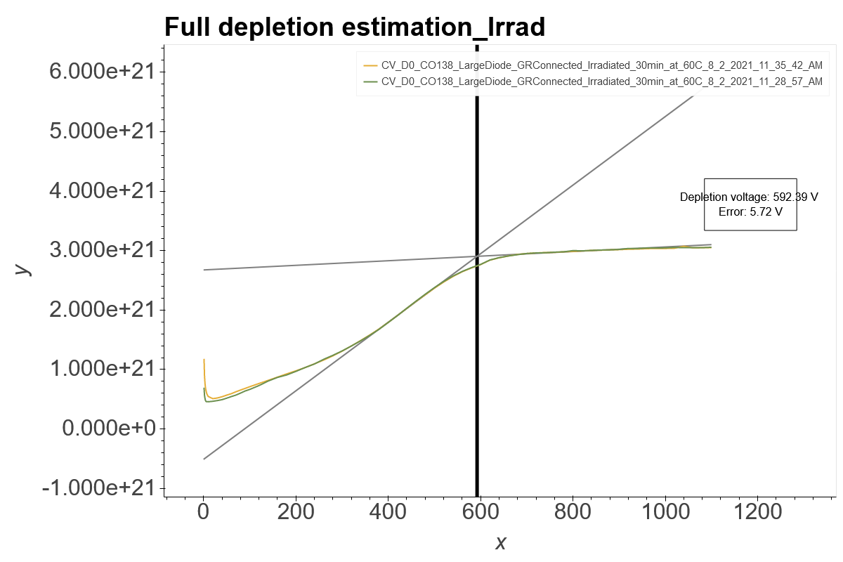
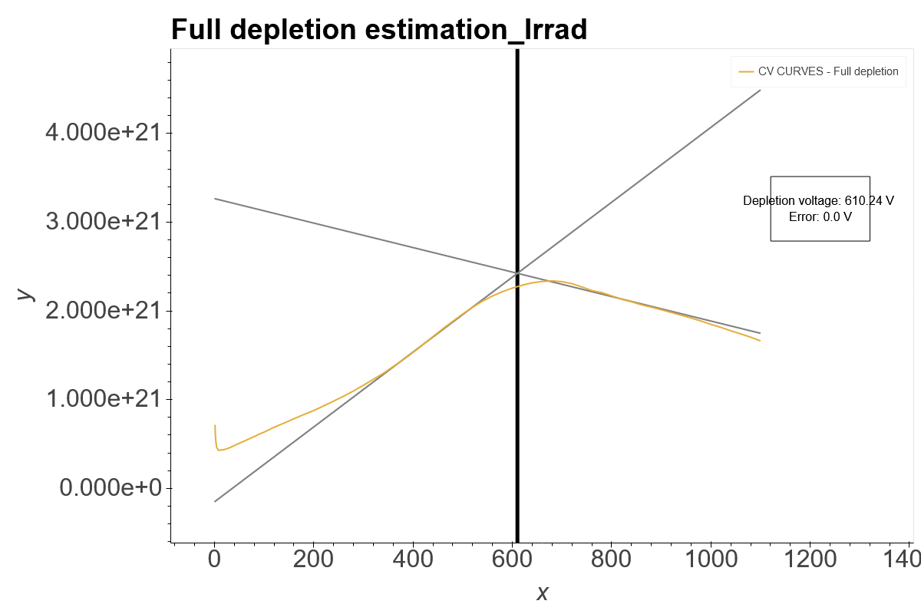
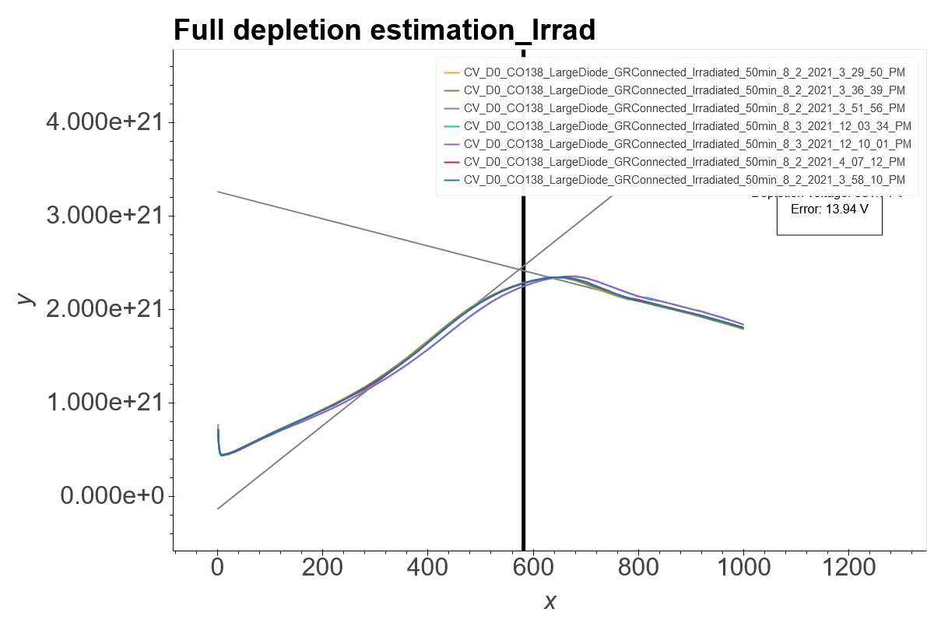
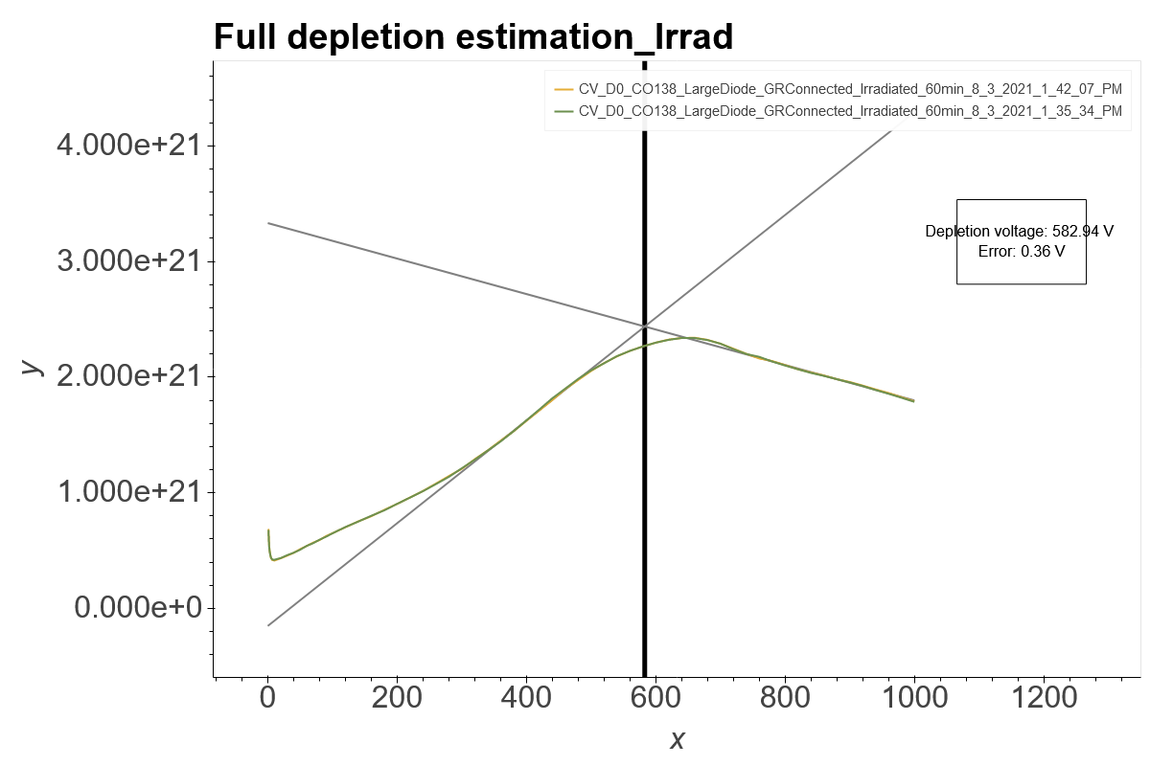
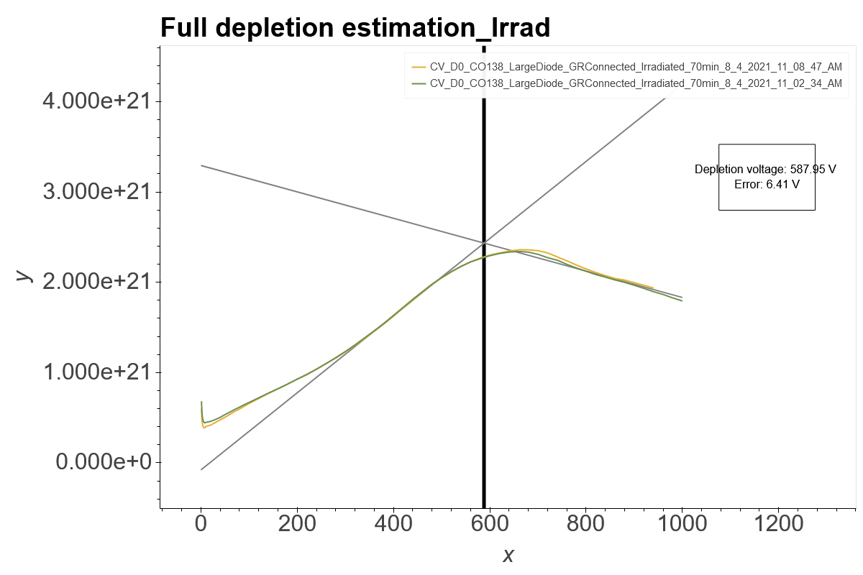
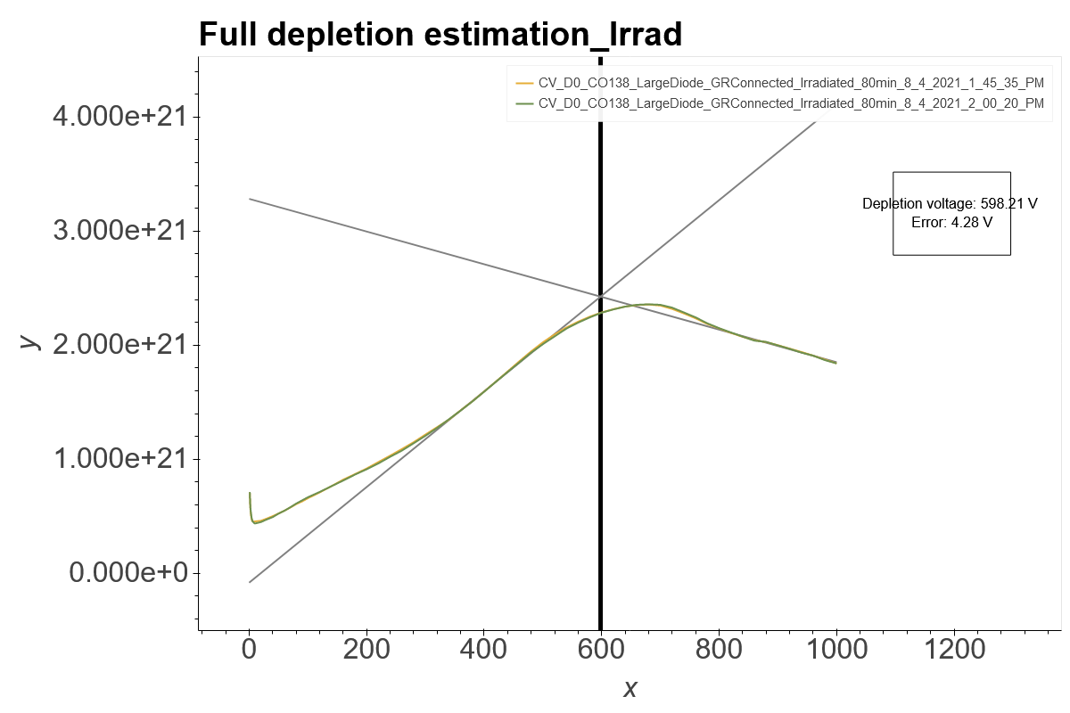
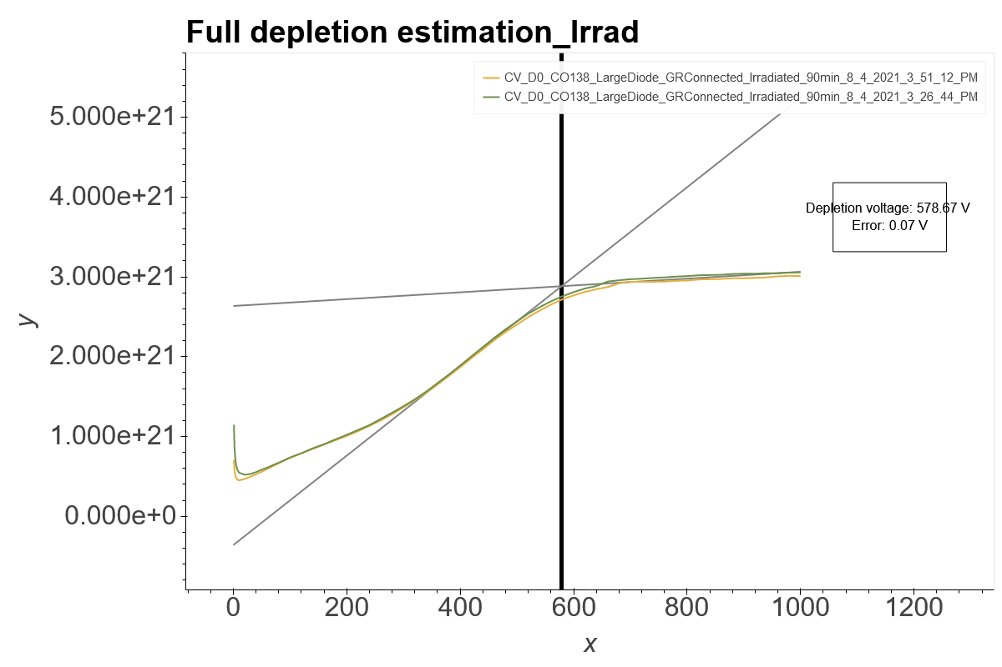
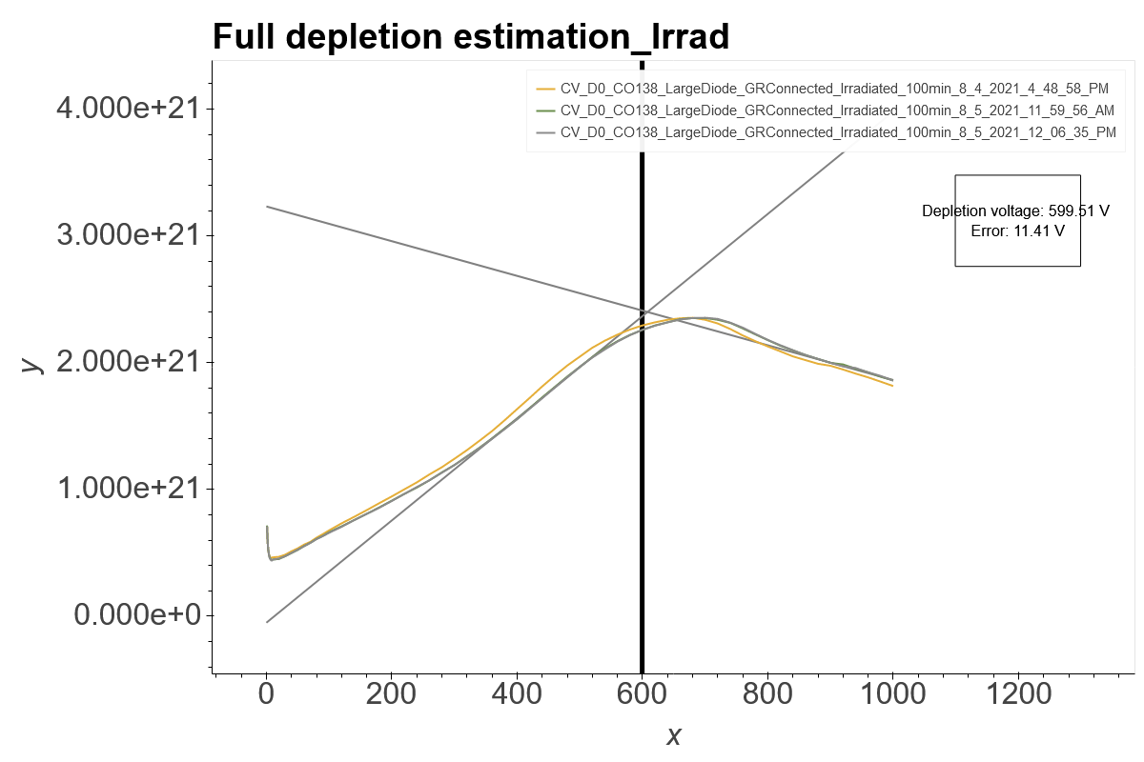
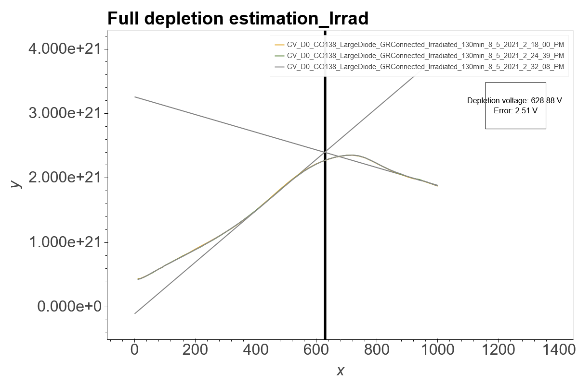
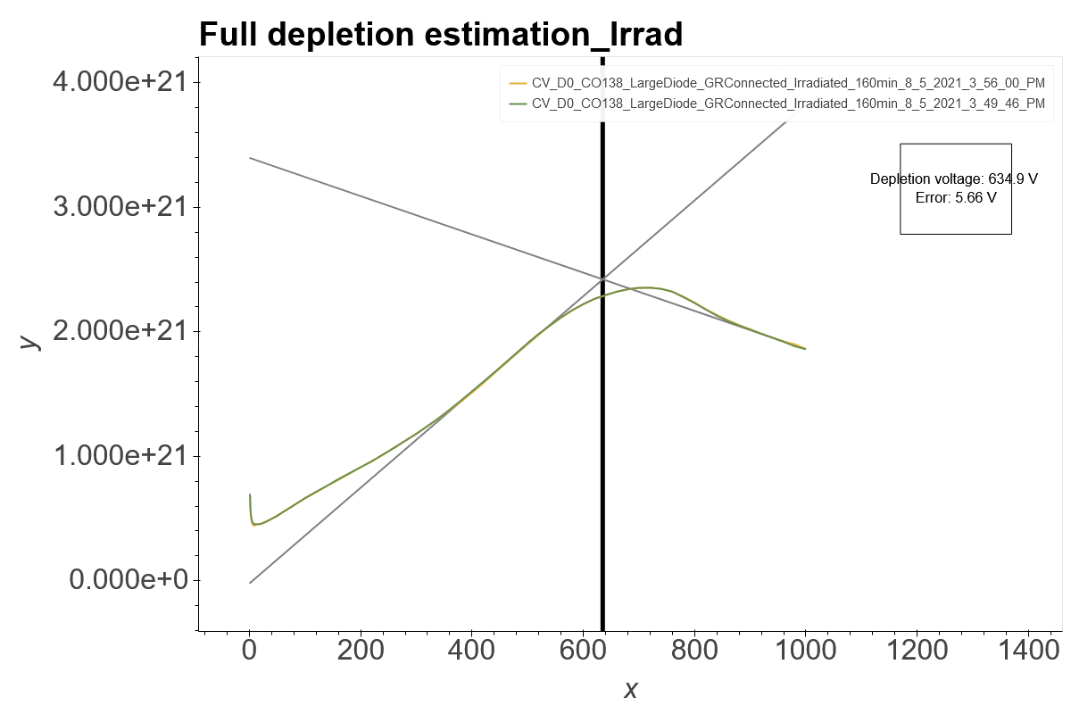
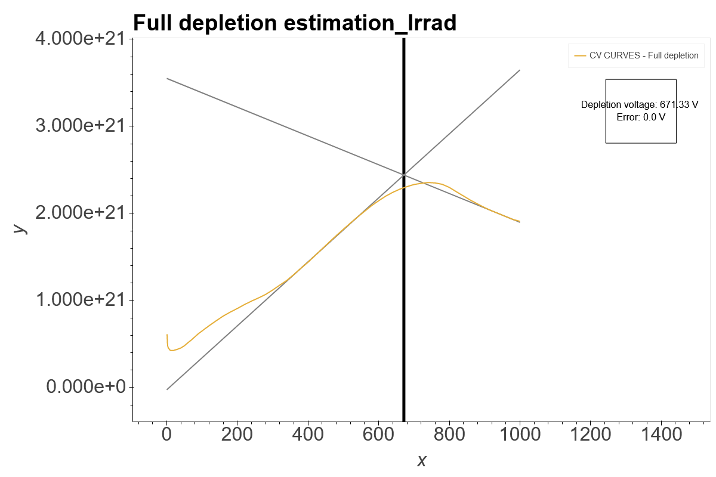
Ljubljana D0 1/C^2 Curves
0 Min
10 Min
20 Min
30 Min
40 Min
50 Min
60 Min
70 Min
80 Min
90 Min
100 Min
130 Min
160 Min
190 Min

