Slide 1
Shifting and Scaling Annealing Data
Rabbit runs only
Reactor assumed to be ~80C based on temperature stickers
Shifted based on time in reactor (should also be shifted based on 80C to ~C conversion)
Scaled/Normalized to 80C 10-minute Rabbits
The pin diodes which spent the least time in the reactor
Annealed at the temperature all pins we assume all pins would have experienced in the reactor

Slide 2
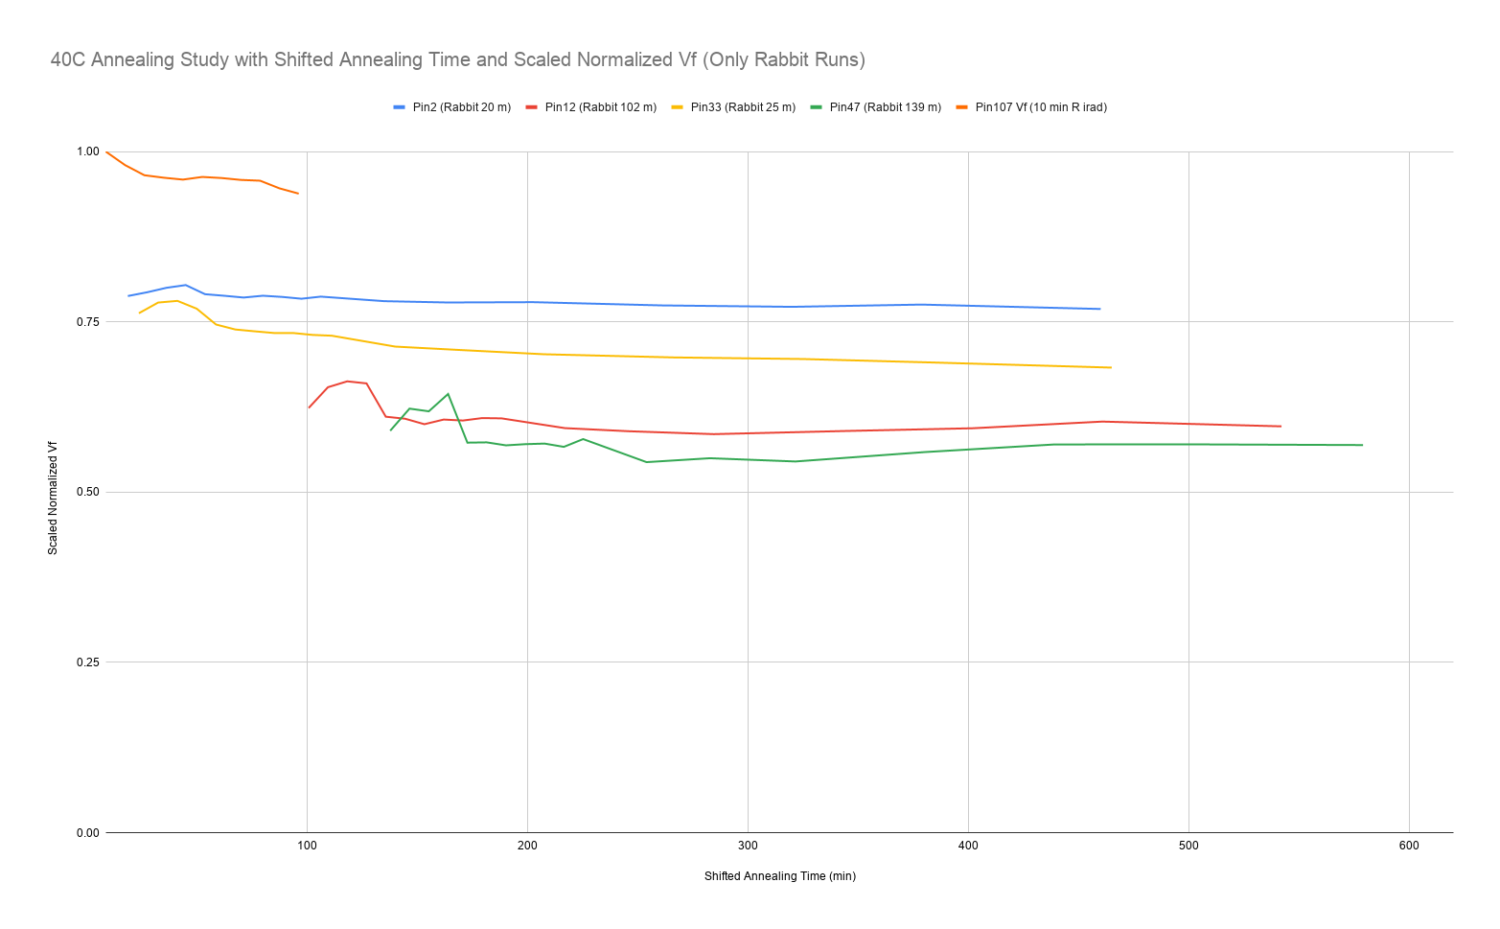
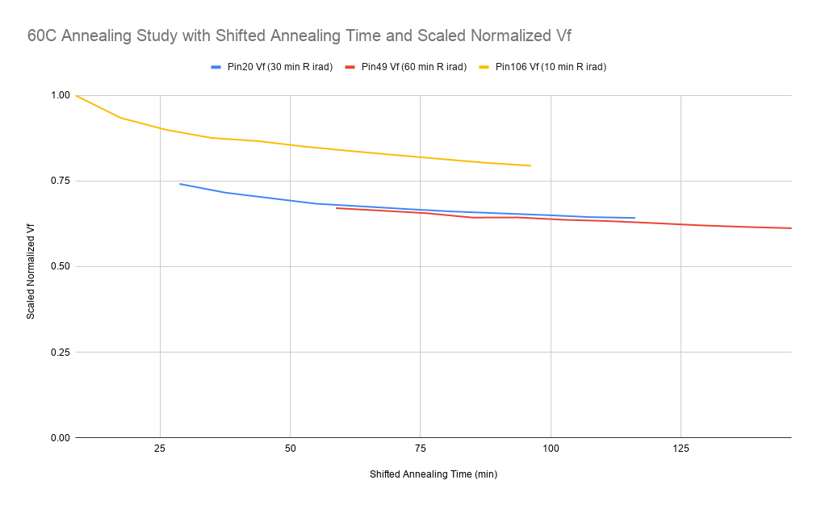
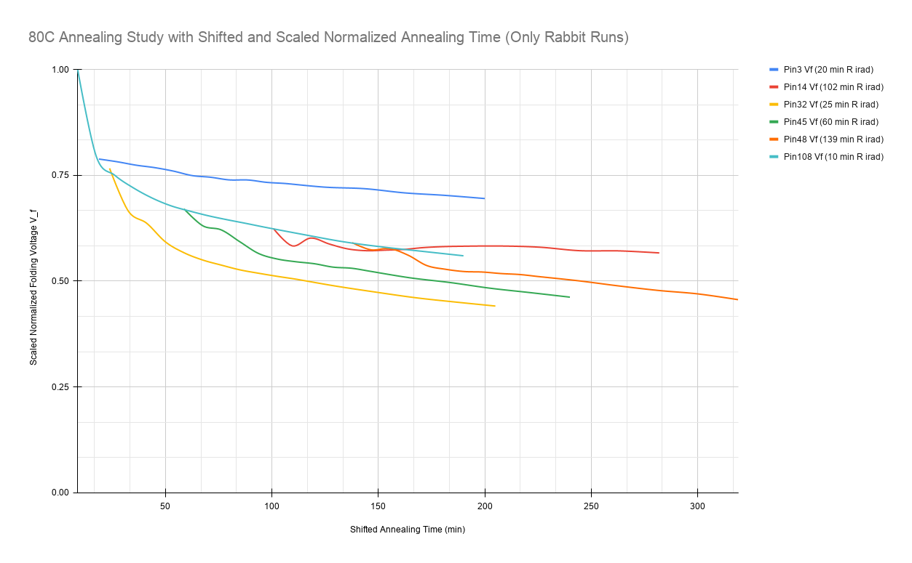
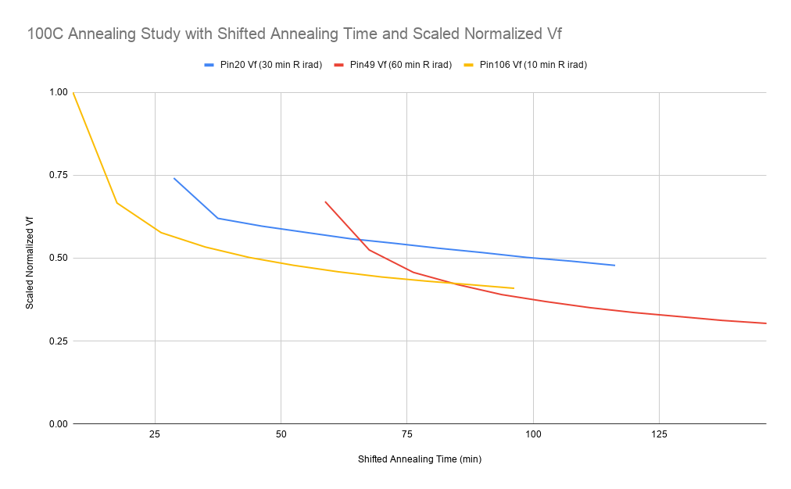

Slide 3
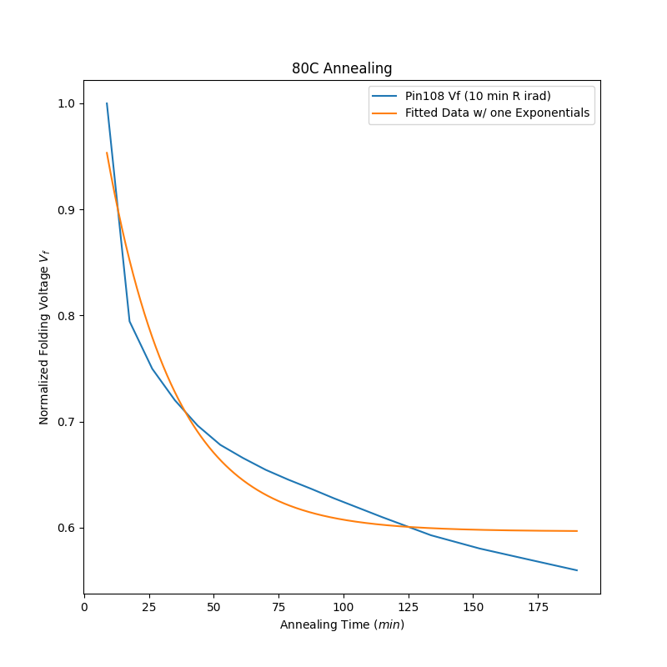
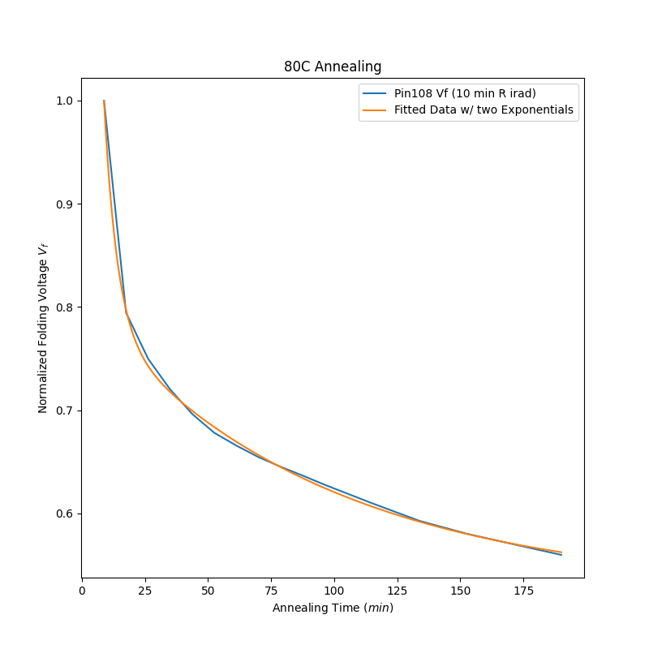
Fitting with One vs. Two Exponentials

Slide 4
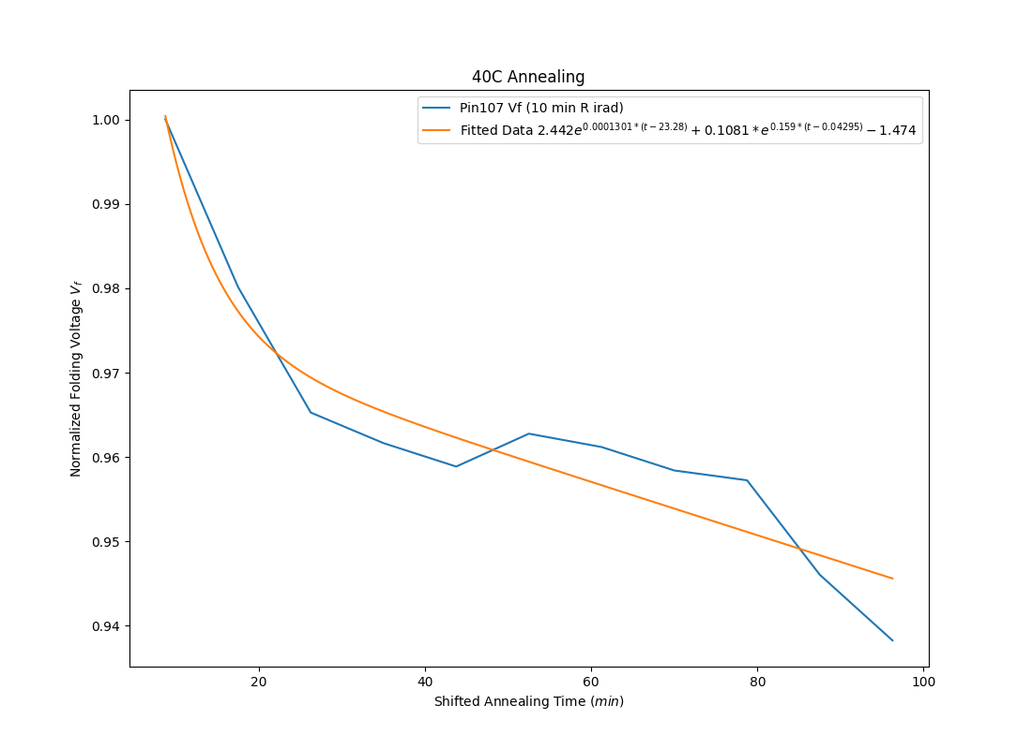
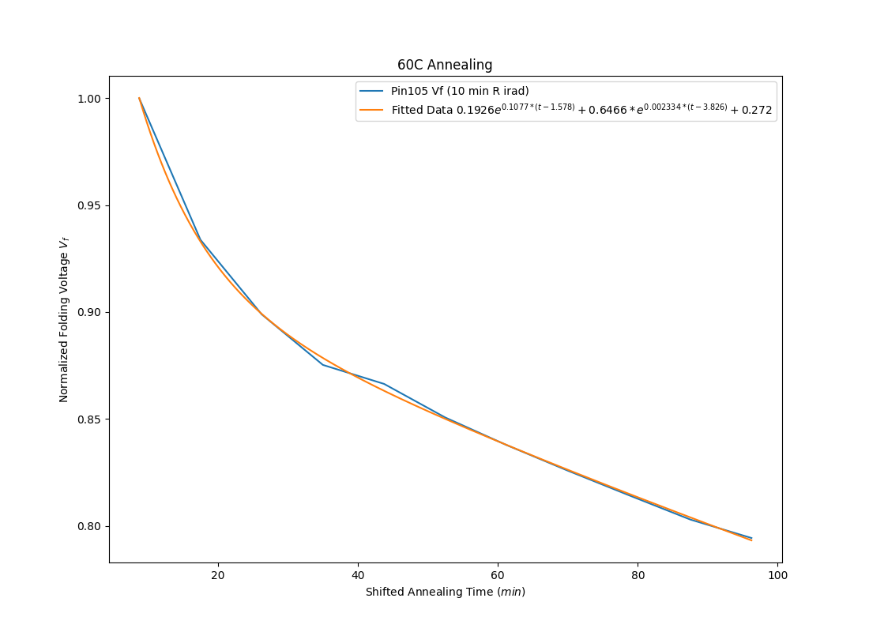
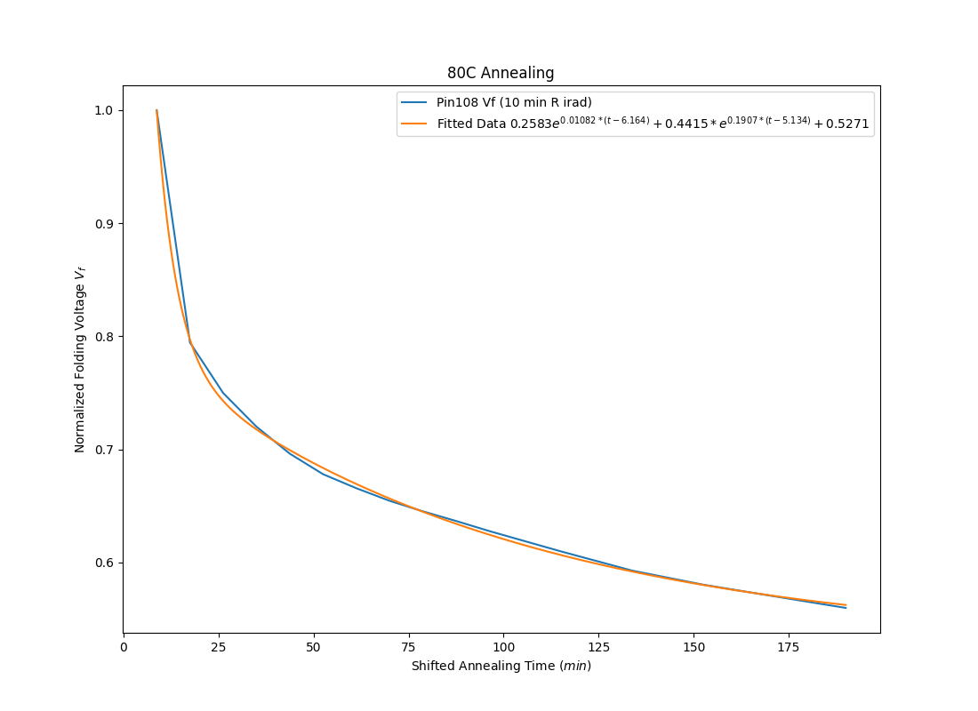
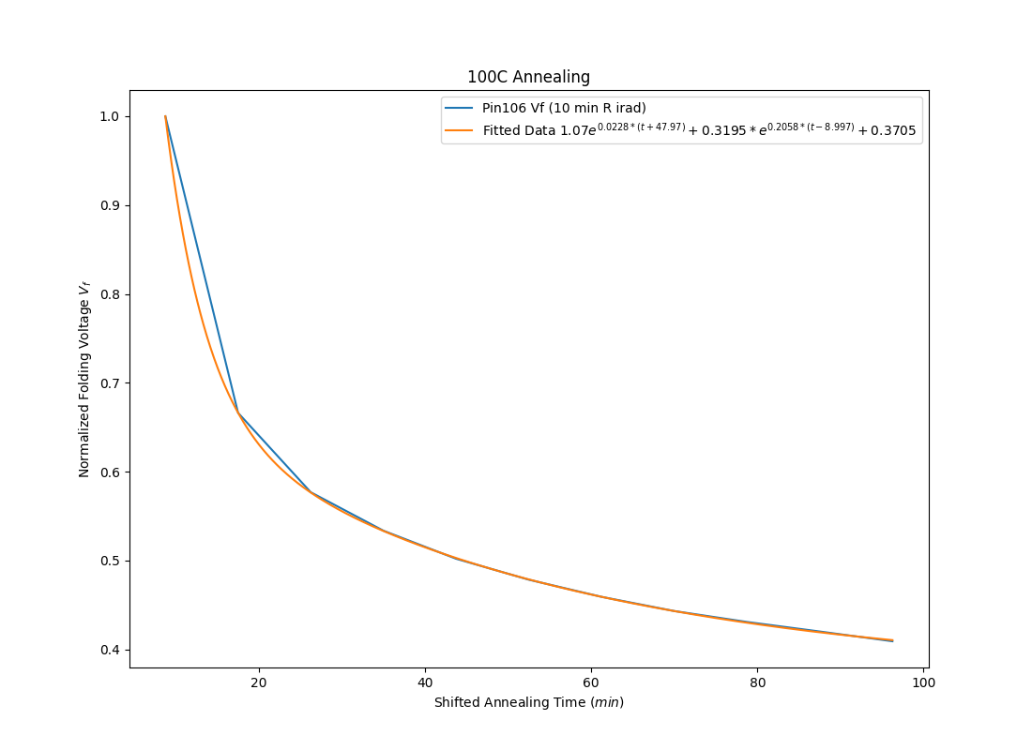

Slide 5
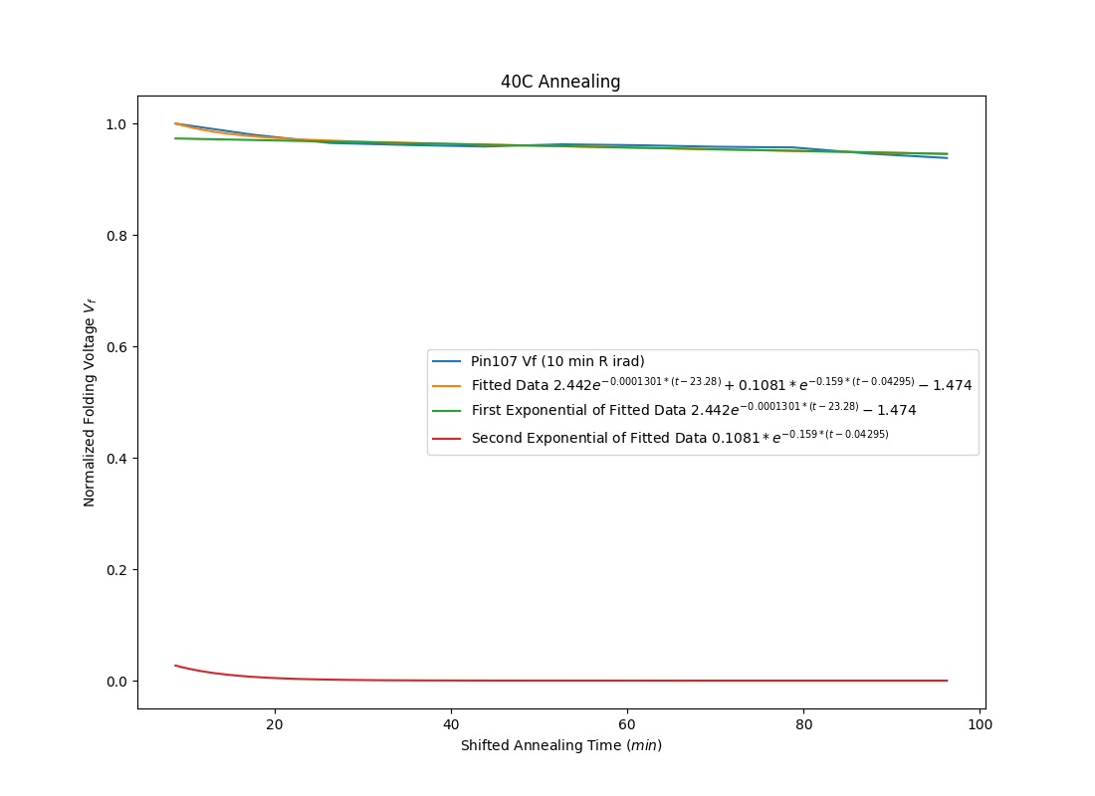
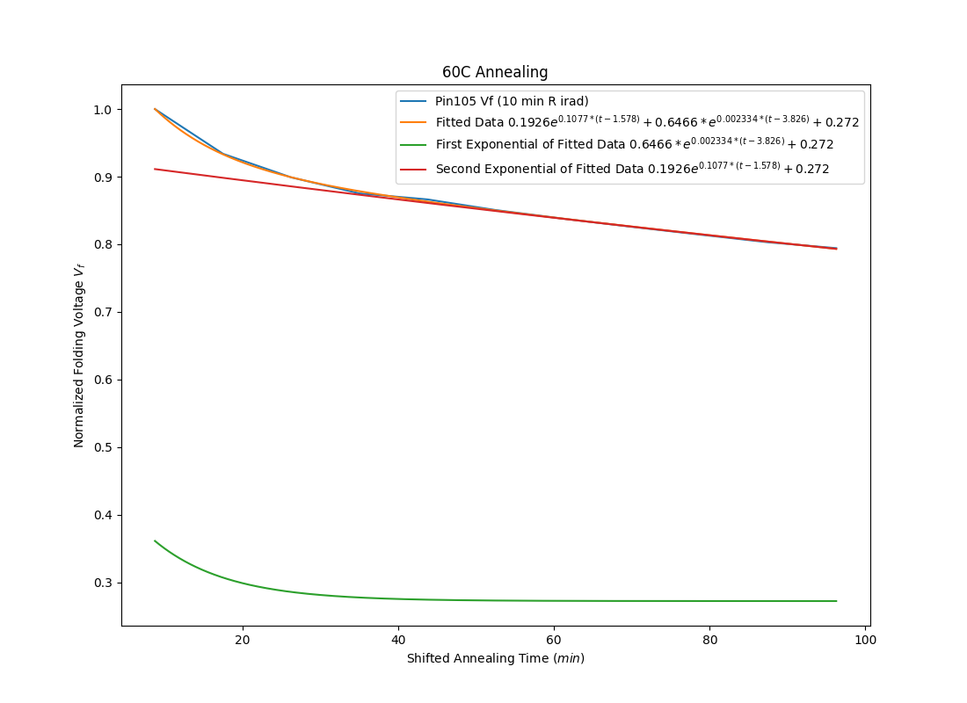
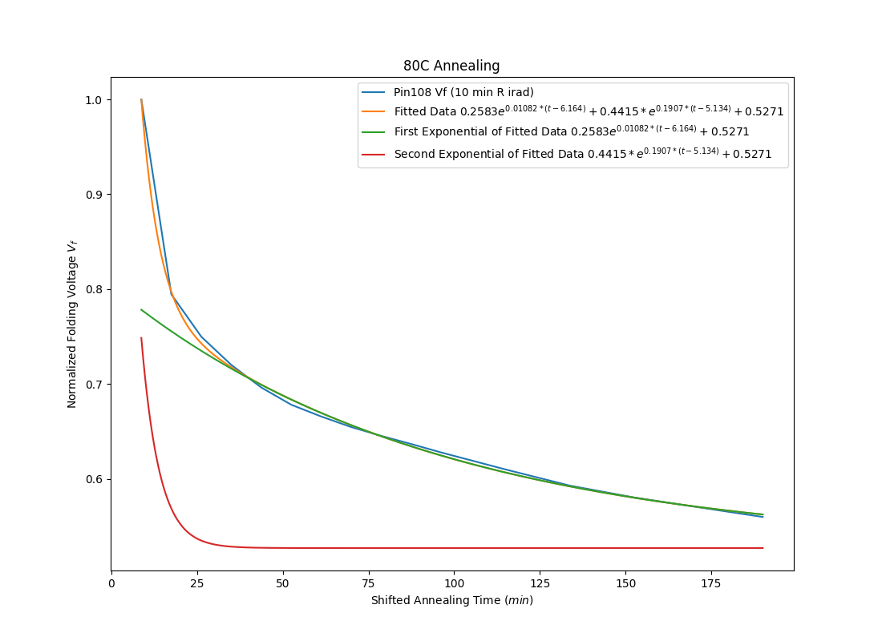
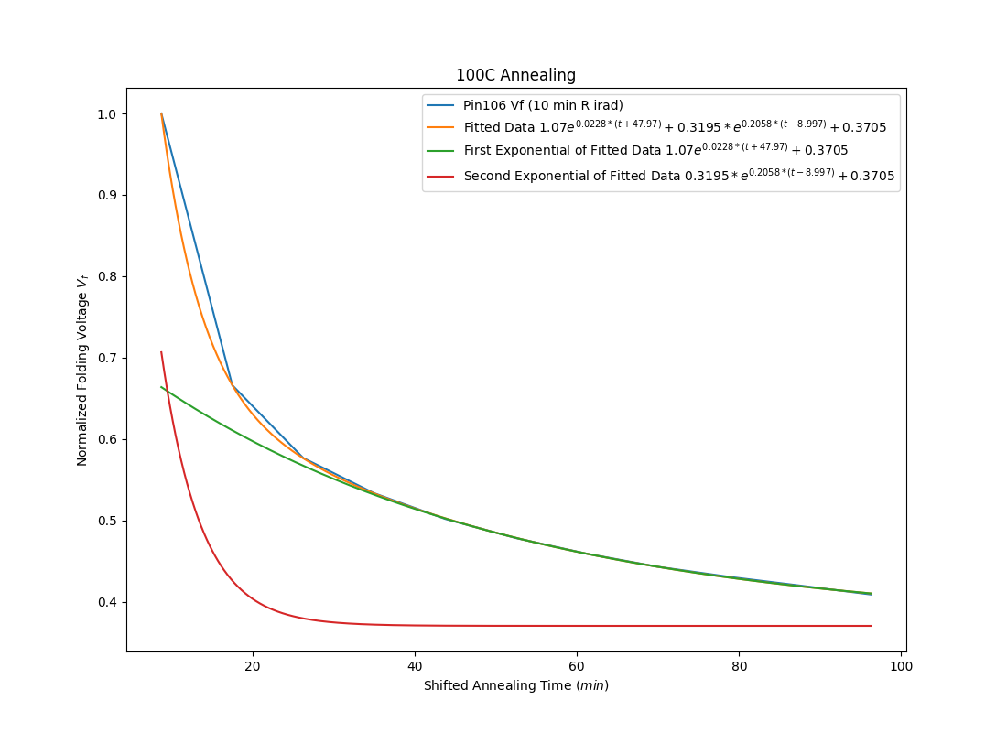
Splitting the Exponentials

Slide 6
Scaling 100C Fitted Function to Other Annealing Runs
t -> a(t-b)
Assumptions:
Regardless of annealing temperature, diodes irradiated to the same amount will converge to same folding voltage at infinite time
Shifting in ”b” allows for slightly lower or higher initial Vf
Scaled to 100C because it was the most “matured”, i.e. reached the greatest % decrease
Resulting issues due to “not ideal” fitting likely due to not annealing long enough for 40C & 60C (?)

Slide 7
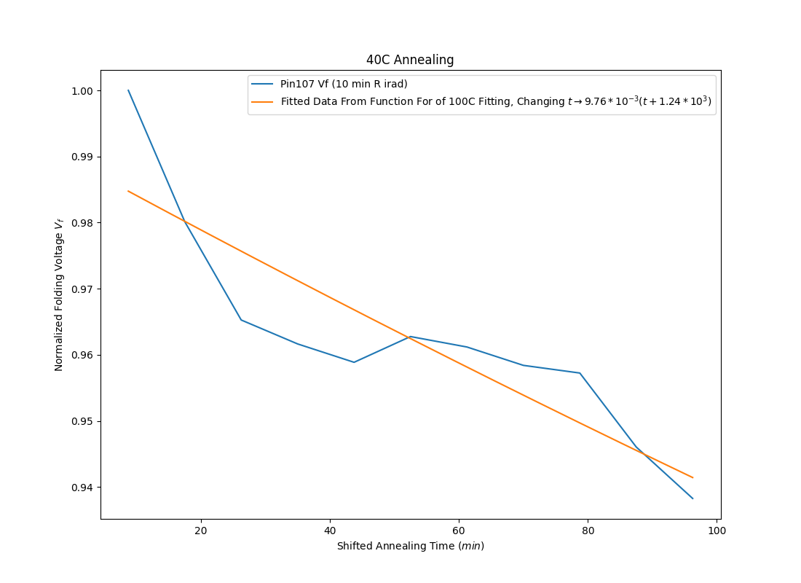
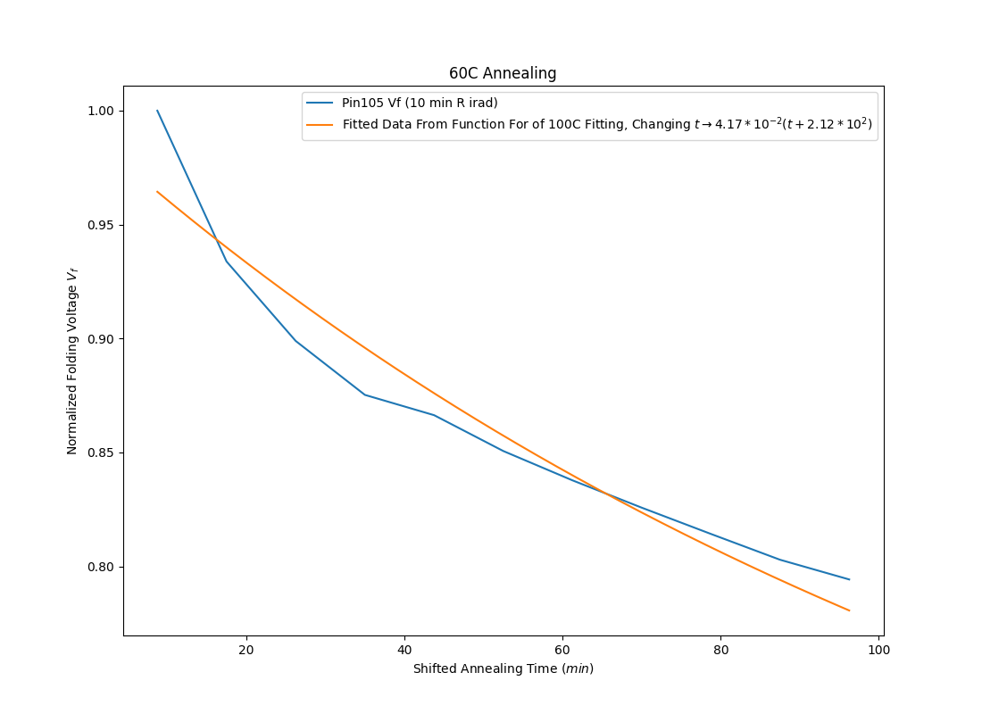
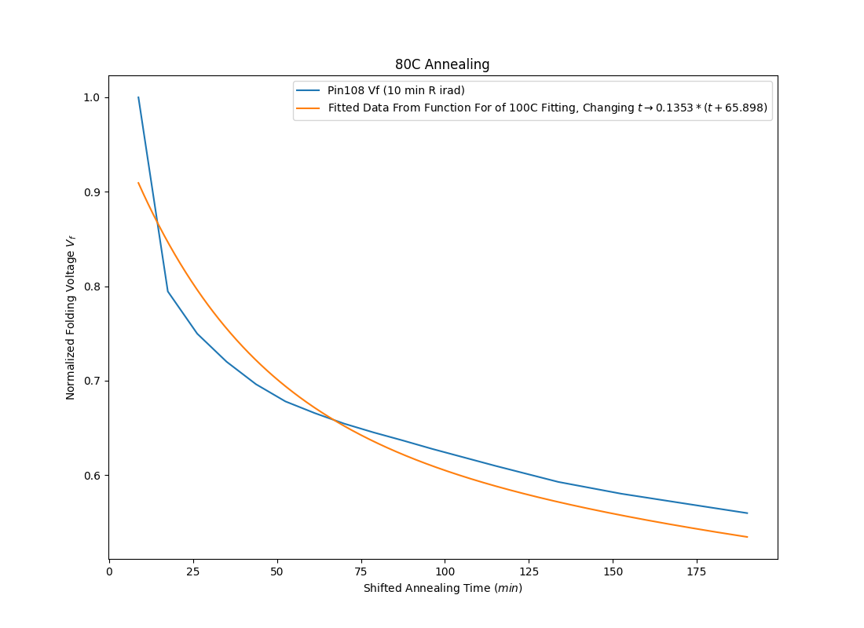
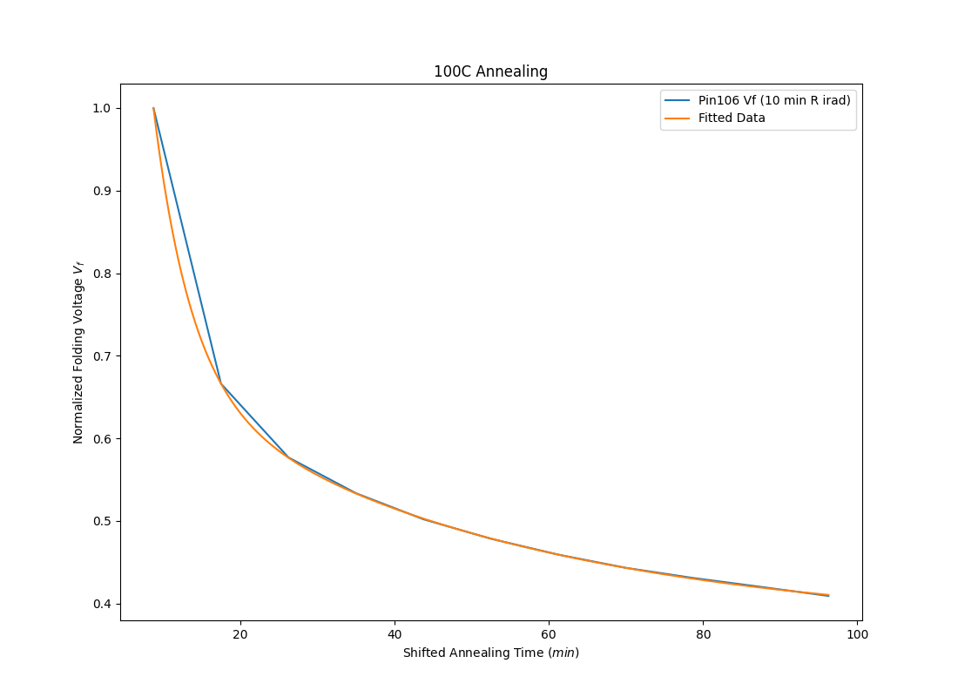

Slide 8
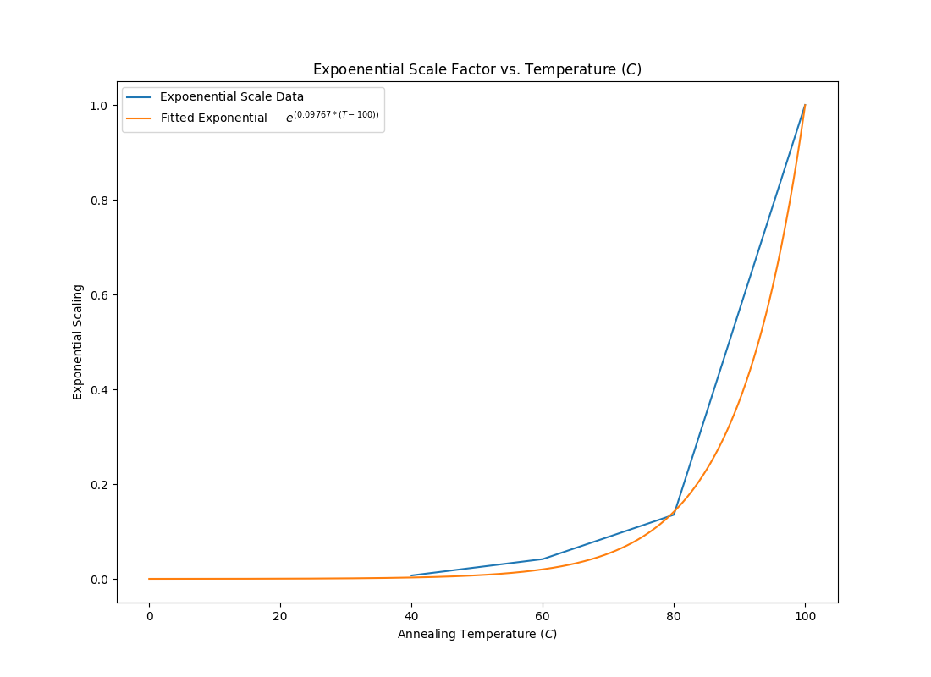
Plotting Exponential Scaling vs. Annealing Temperature
Ideas:
Further fill in annealing temperature with 50C, 70C, 90C
Extend 40C and 60C annealing to longer durations with larger step sizes
Maybe only considering the “long tail”

