Slide 1
OT Irradiated Sensors Round 1 1.1e15 Target
Item | Z-Dist (mm) | Face 1 | Face 2 | Face 3 | Face 4
Pin 121, 123, 125, 127 | (27.5, 27, 24, 26) | 6.38E+14 | 6.75E+14 | 8.67E+14 | 7.15E+14
Foil G (0.1337g) | 42
D0 129, 128 | 80 | 1.07E+15 |  | 1.64E+15
Strip 34254_025 | 80
Strip 34253_037 | 80
Pin 120, 122, 124, 126 | (129, 128, 129, 130) | 5.56E+14 | 5.22E+14 | 6.46E+14 | 5.69E+14

Slide 2
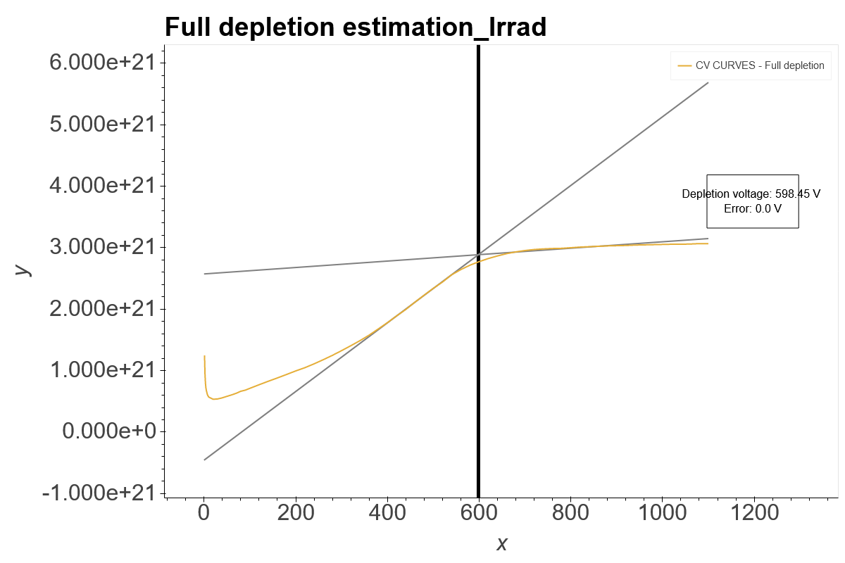
D0 128

Slide 3
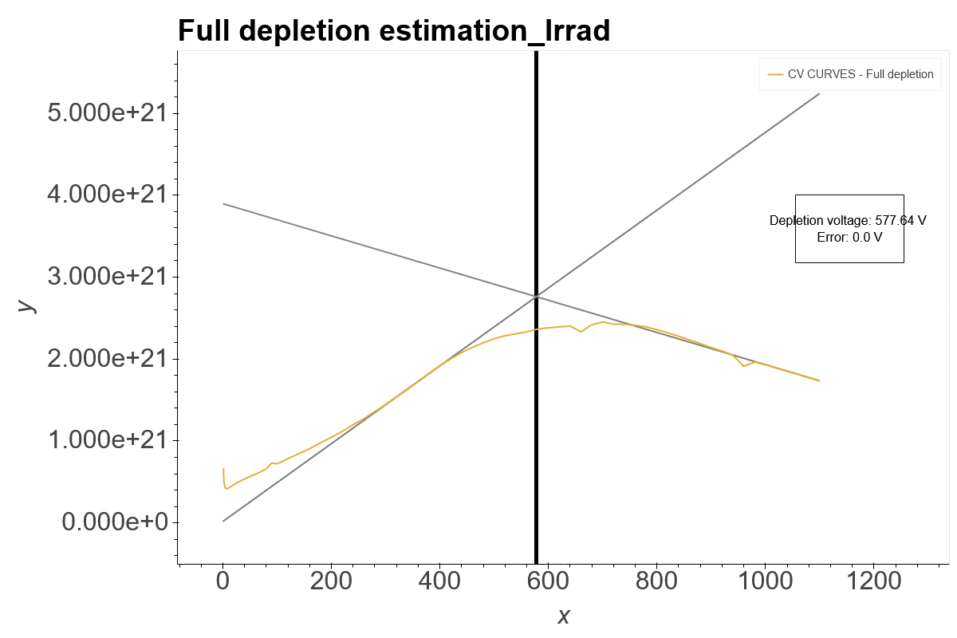
D0 129

