Slide 1
5/13/2021 IT Irradiated Sensors Round 2 1.1e15 Target
Item | Z-Dist (mm) | Face 1 | Face 2 | Face 3 | Face 4
Pin 133, 134 | (29, 26.5)
D0 131 | 33 |  | 3.82E+15
Foil E (0.1255g) | 35
Pin 132 | 78
D0 130 | 80 |  | 1.5E+15
Strip 34252_008 | 94
Strip 34252_018 | 94
Pin 129, 131 | (121, 119)

Slide 2
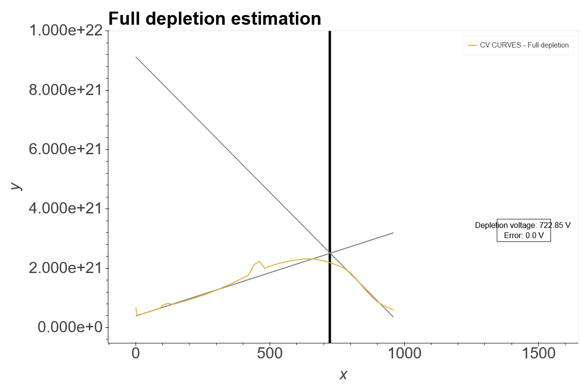
D0 130

Slide 3
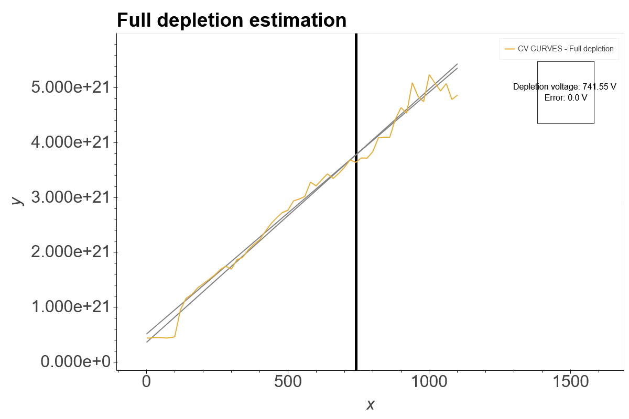
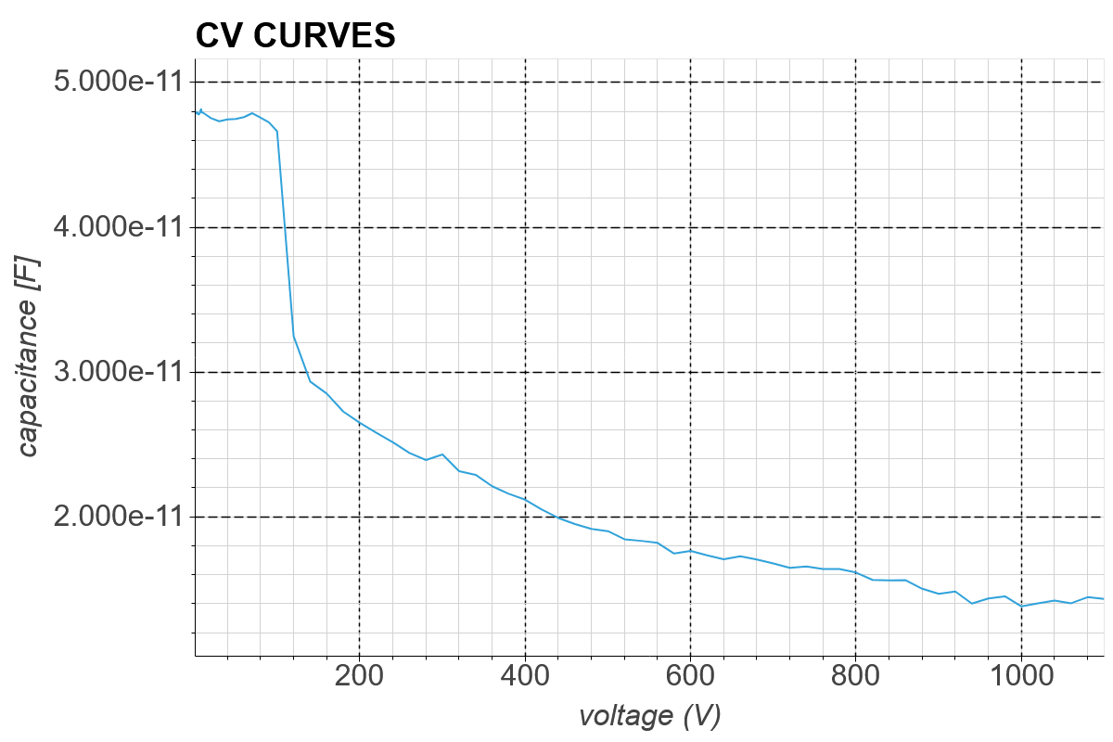
D0 131

