Slide 1
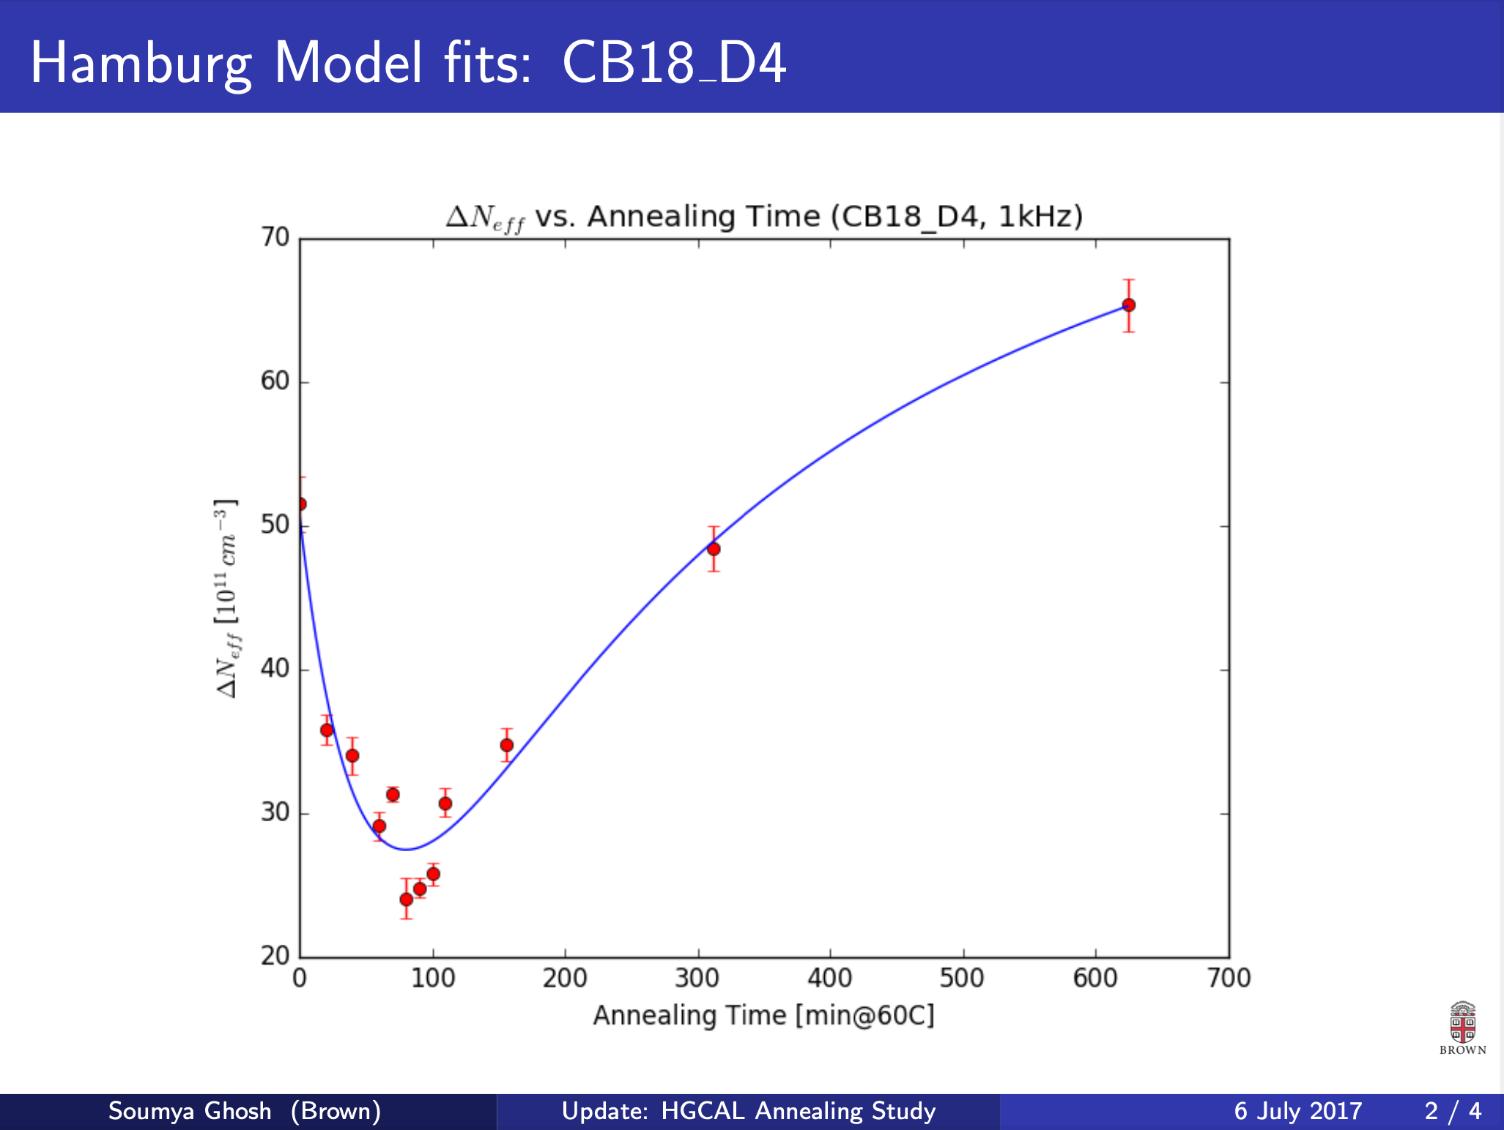
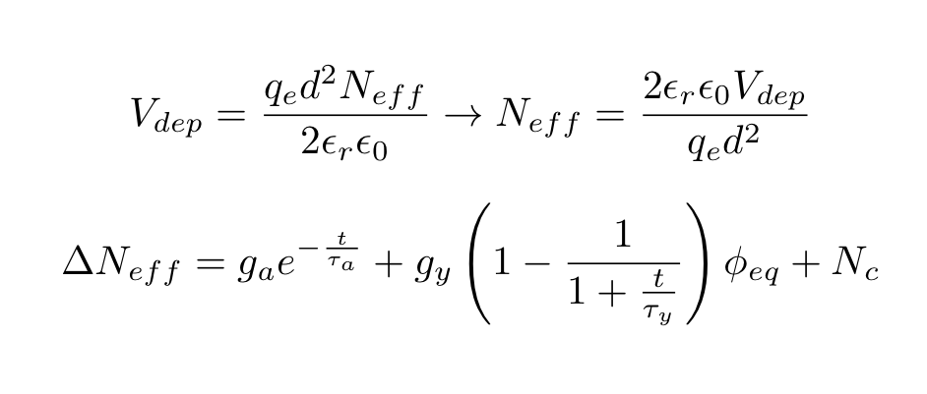
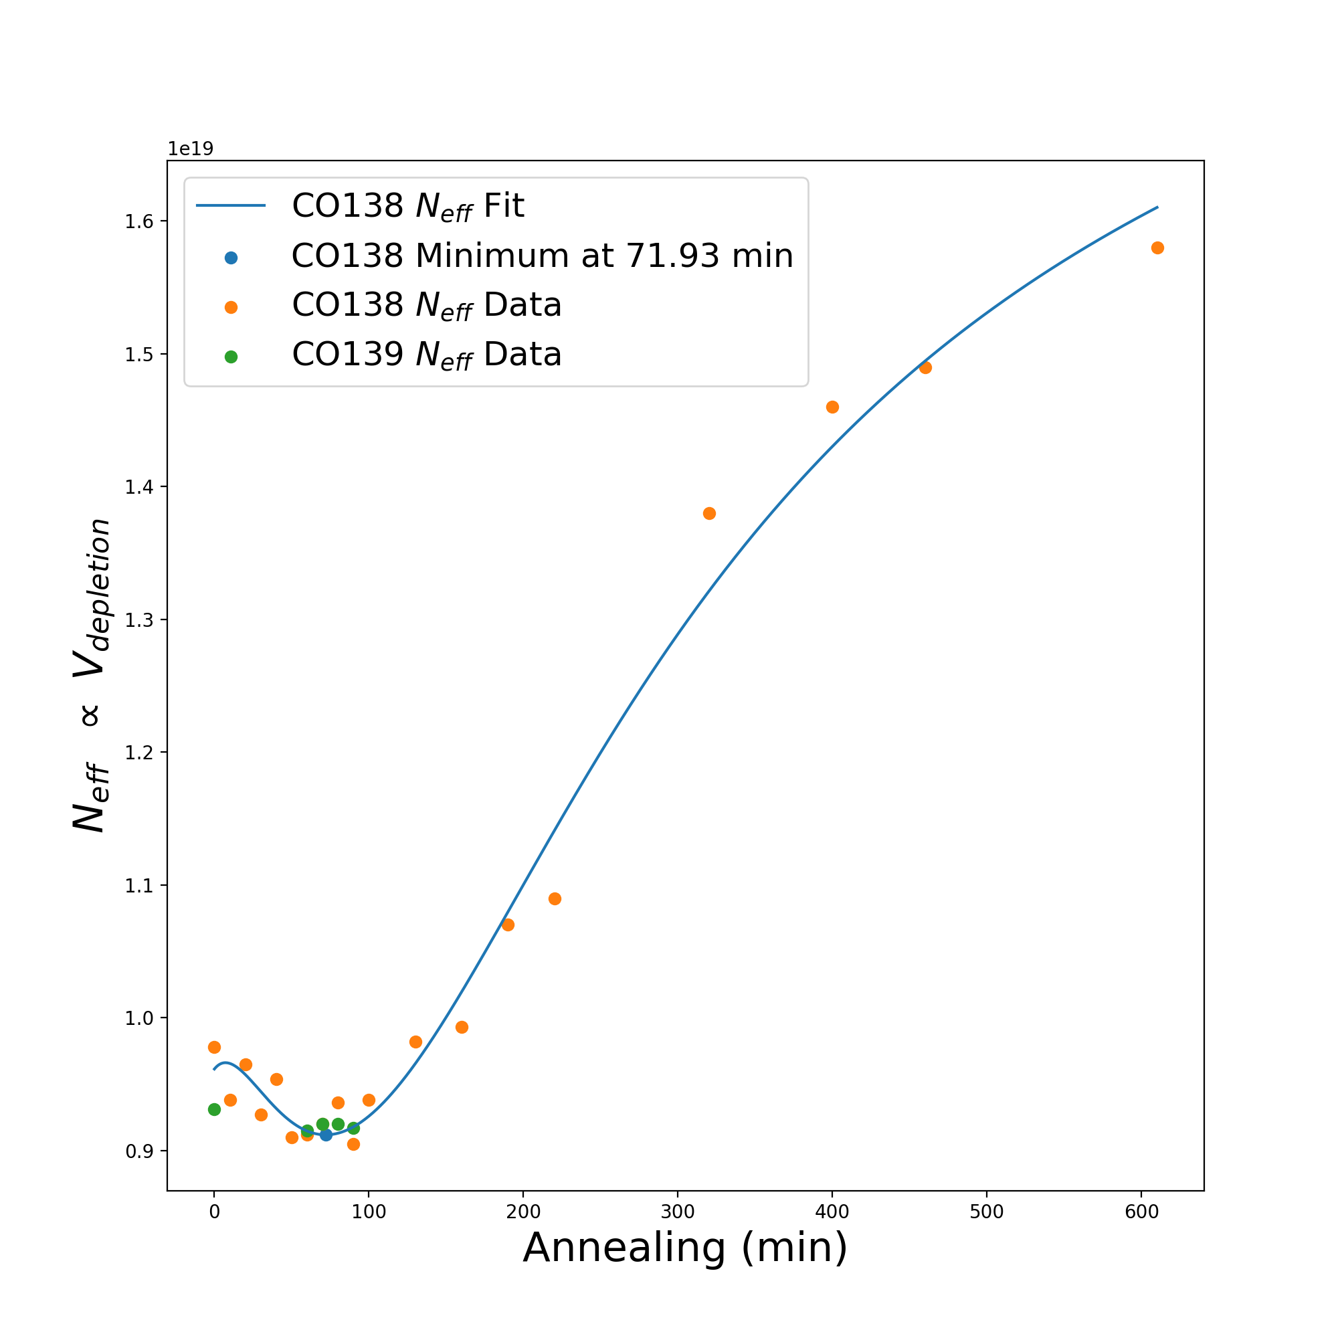

HGCAl Hamburg Model Fit
Fitted parameters include $g_{a}$ (beneficial annealing introduction rate), $g_{y}$(reverse annealing introduction rate), $τ_{a}$ (beneficial annealing time constant), $τ_{y}$ (reverse annealing time constant), $N_{C}$ (stable damage)
Planning on annealing up to ~ 600 minutes, but in larger steps of 30 – 60 minutes

