Slide 1
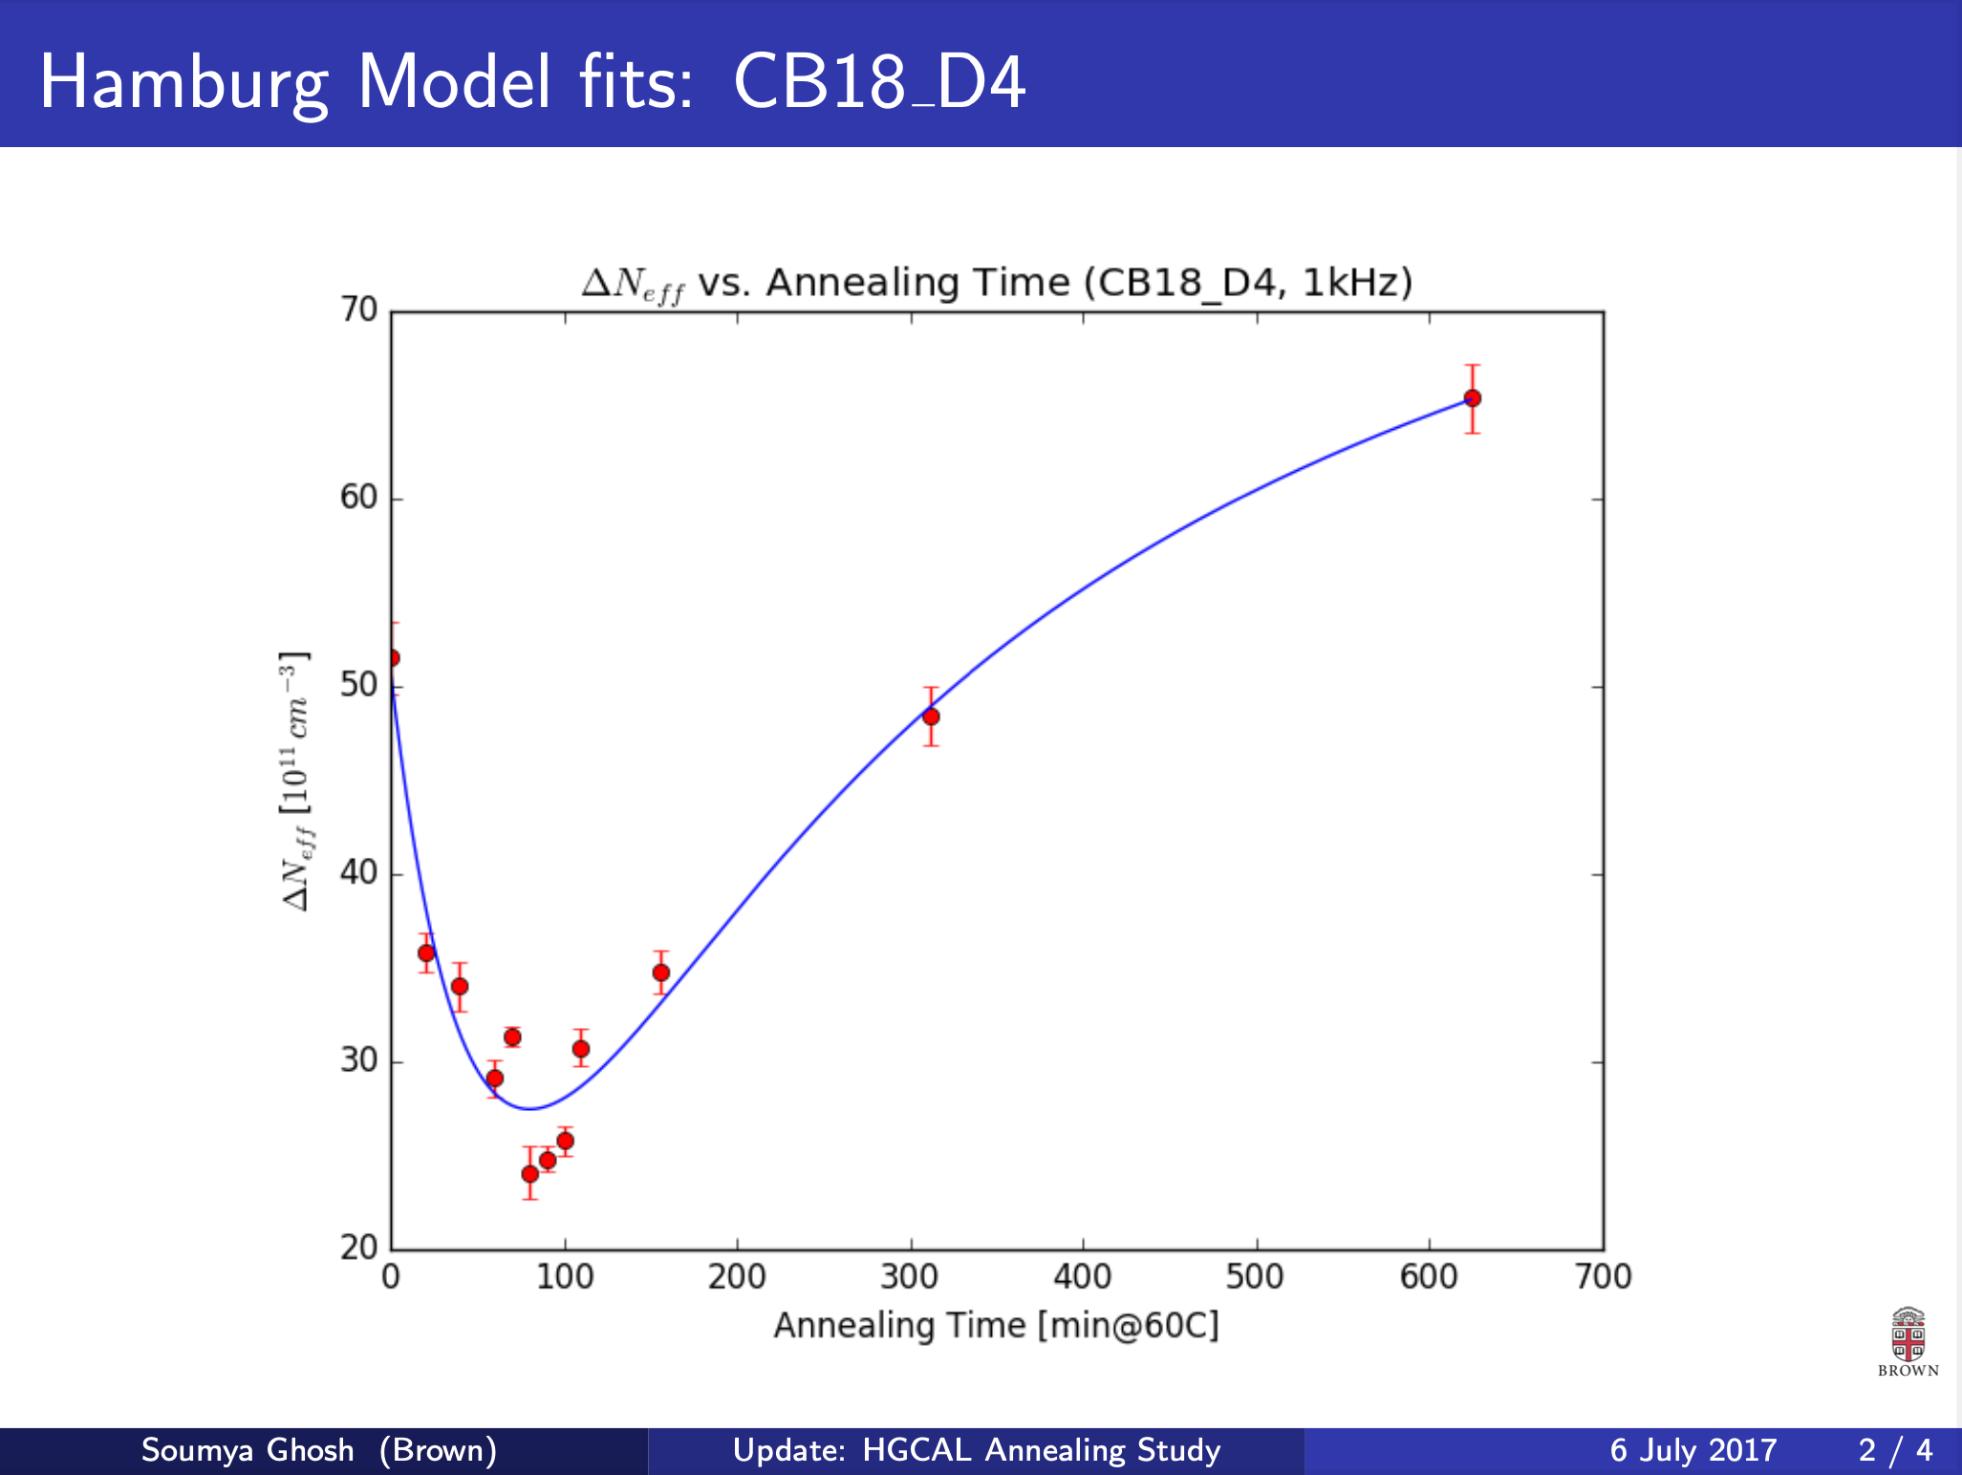
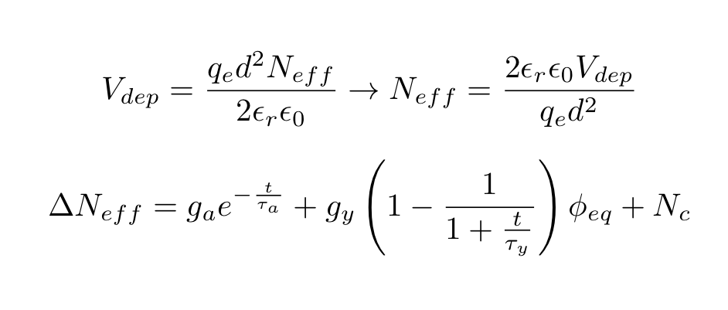
HGCAL Hamburg Model Analysis

Slide 2
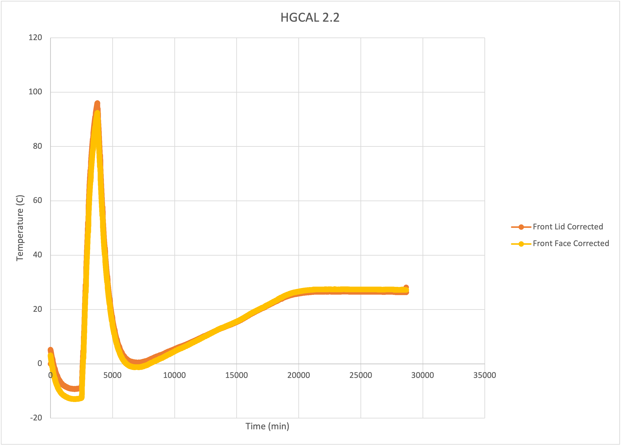
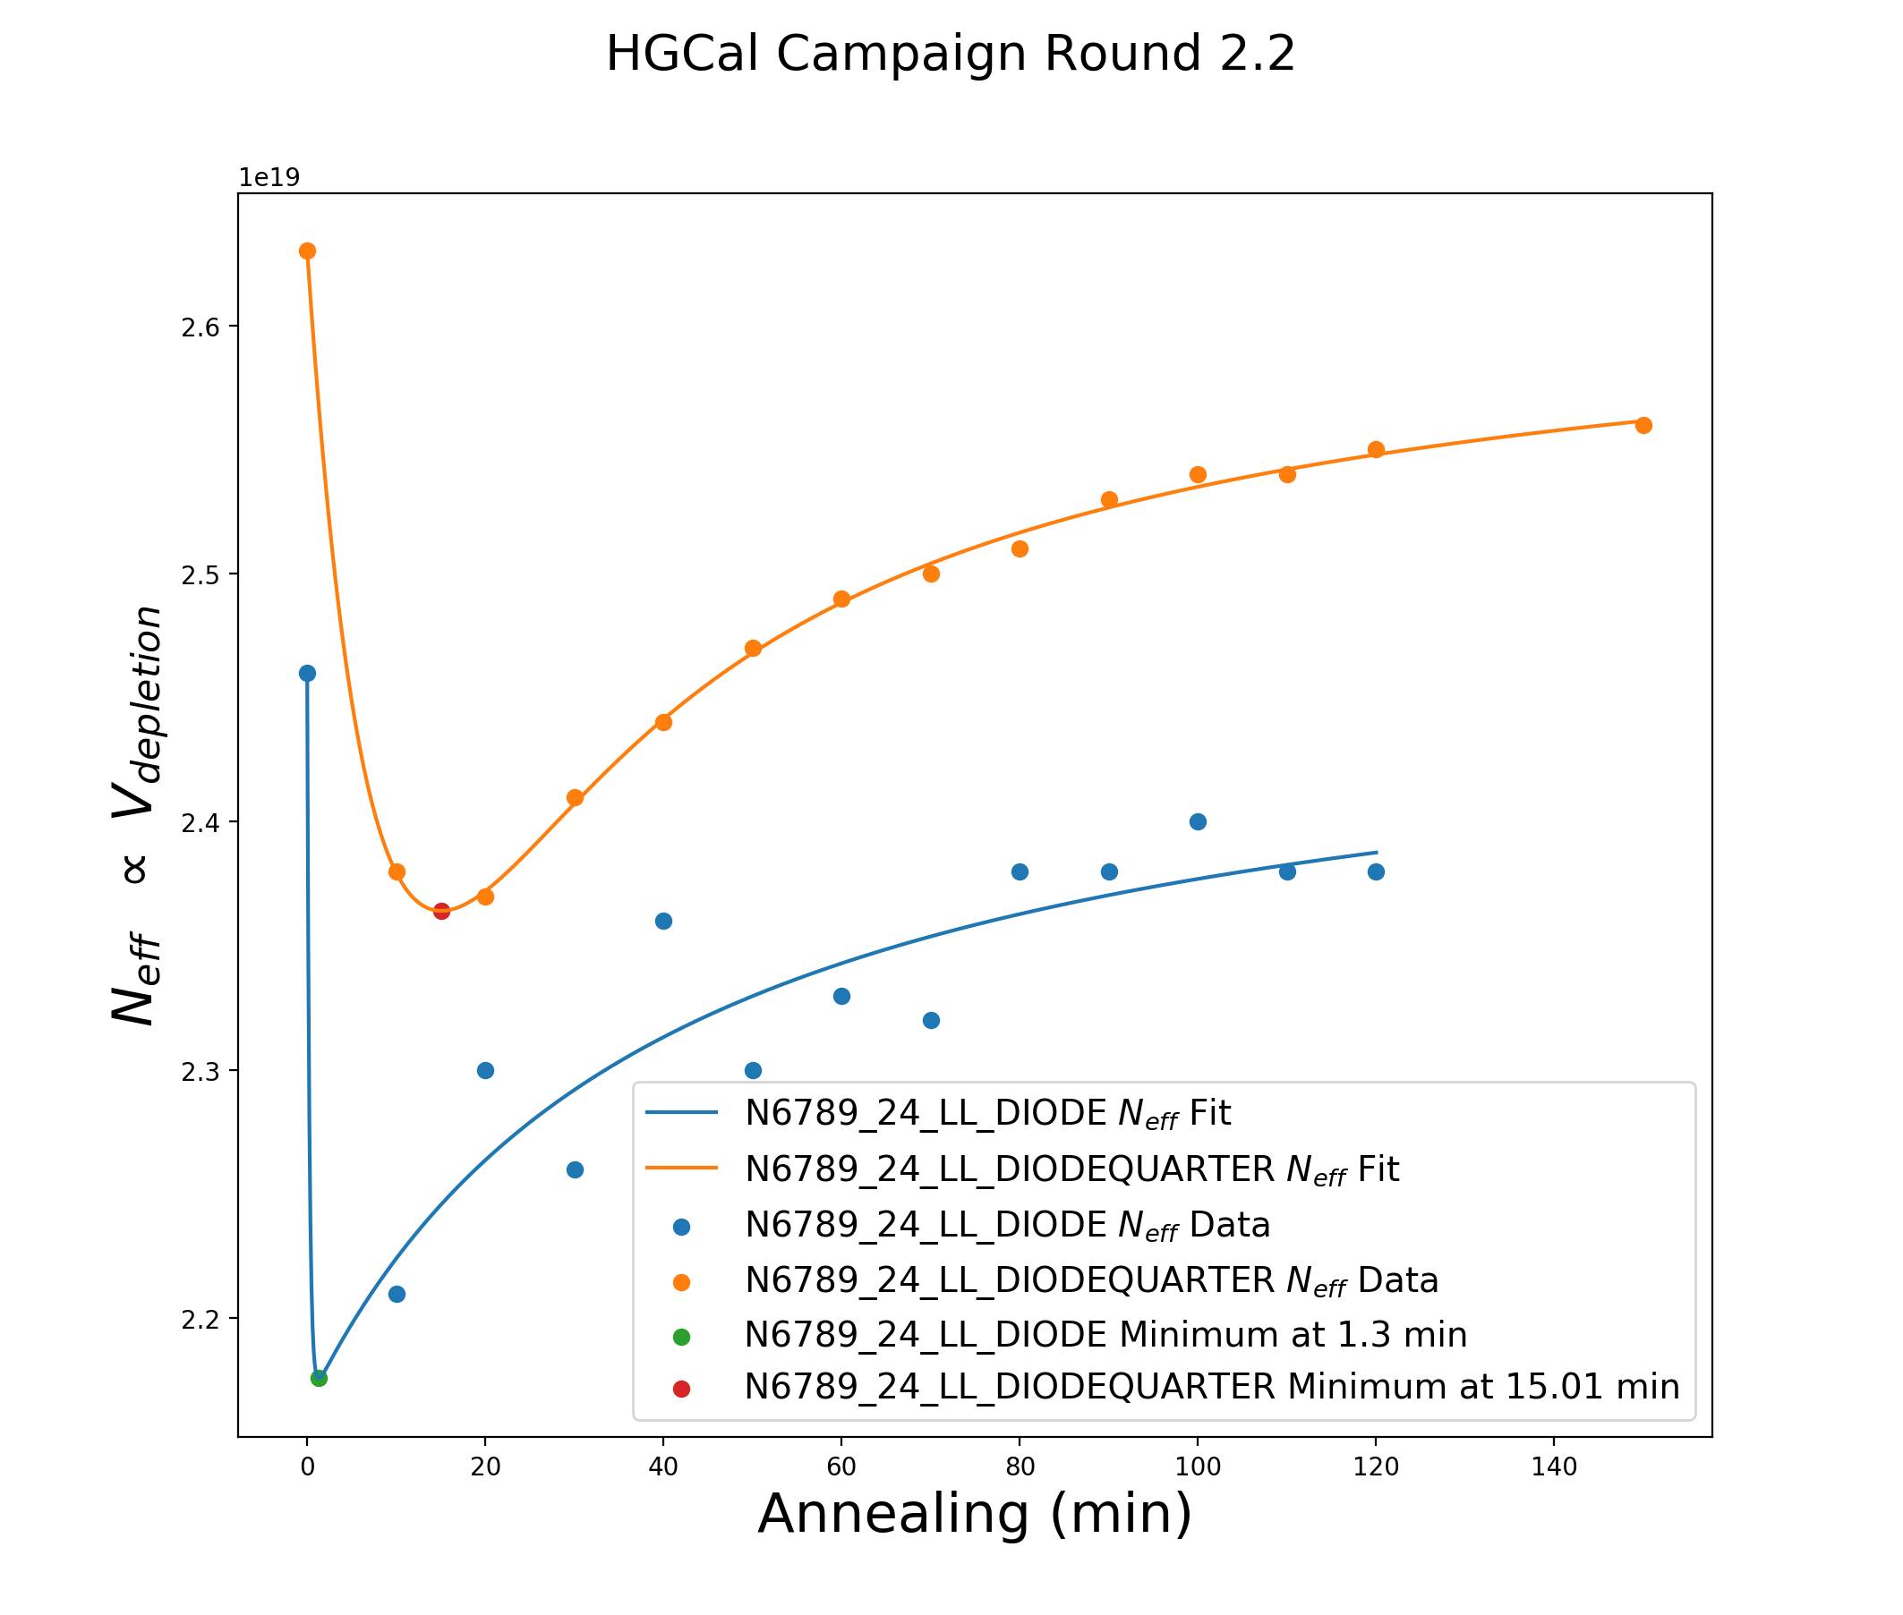
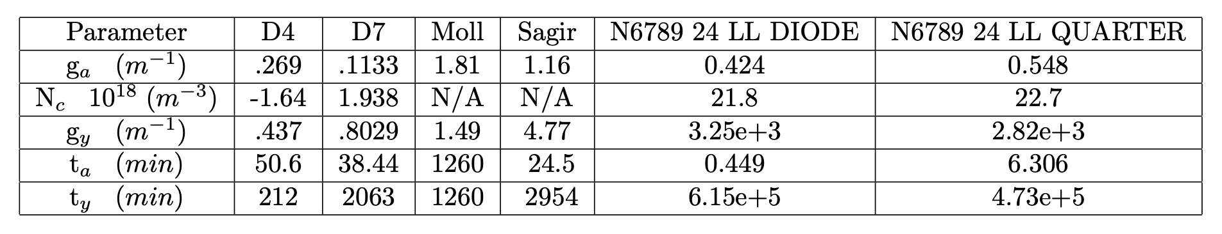
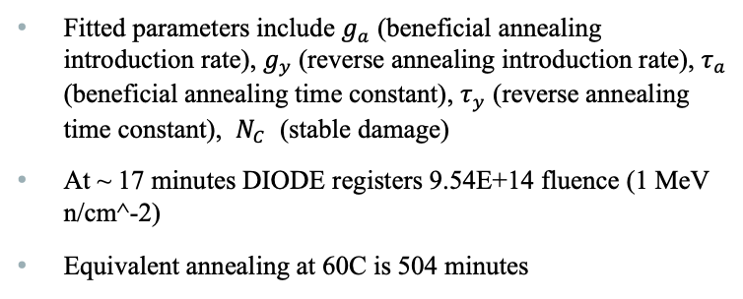
HGCAl 2.2 Hamburg Model Fit (43 min)
Fitted parameters include $g_{a}$ (beneficial annealing introduction rate), $g_{y}$(reverse annealing introduction rate), $τ_{a}$ (beneficial annealing time constant), $τ_{y}$ (reverse annealing time constant), $N_{C}$ (stable damage)
At ~ 17 minutes DIODE registers 9.54E+14 fluence (1 MeV n/cm^-2)
Equivalent annealing at 60C is 504 minutes

Slide 3
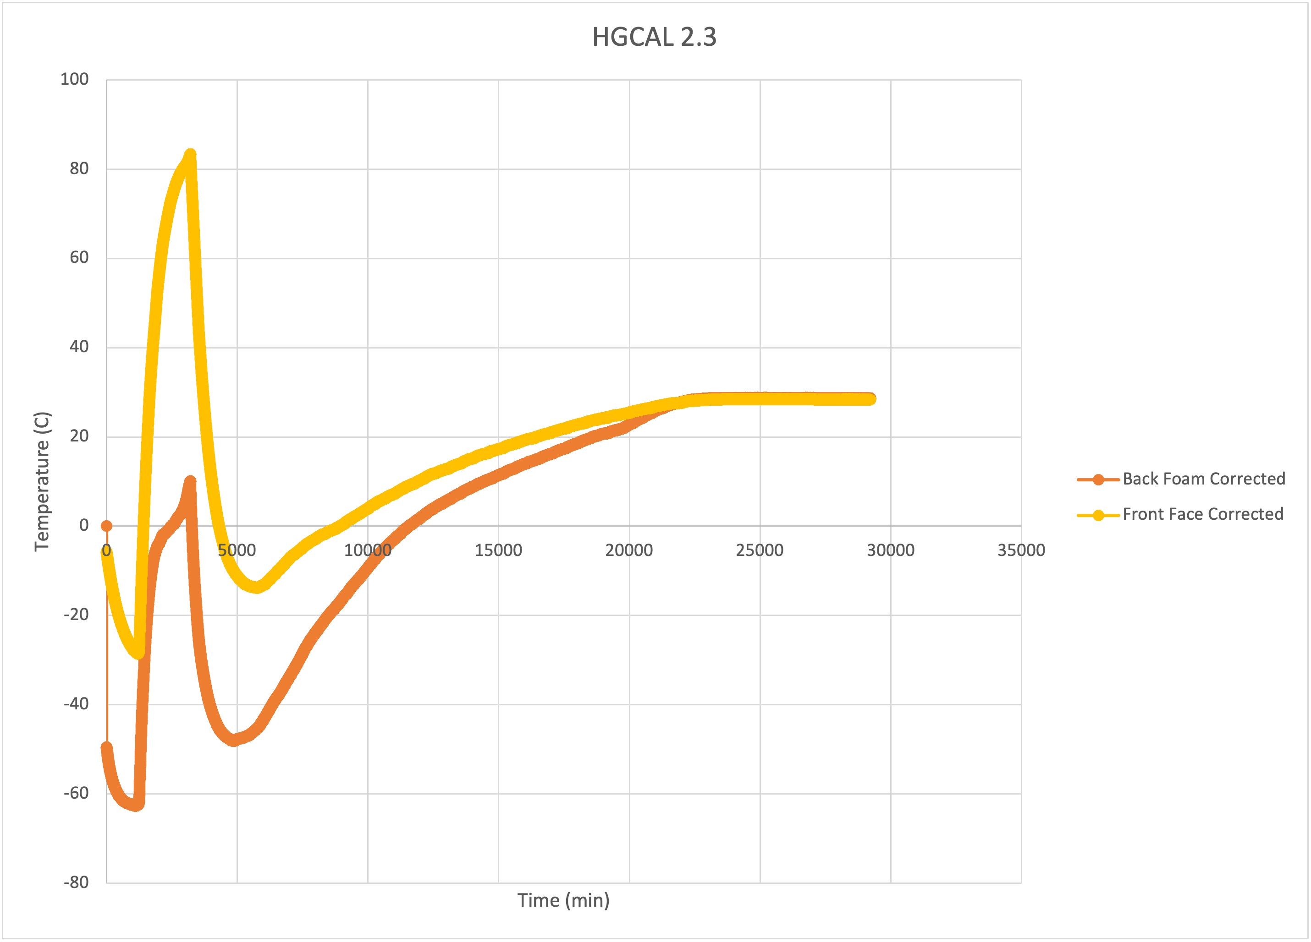
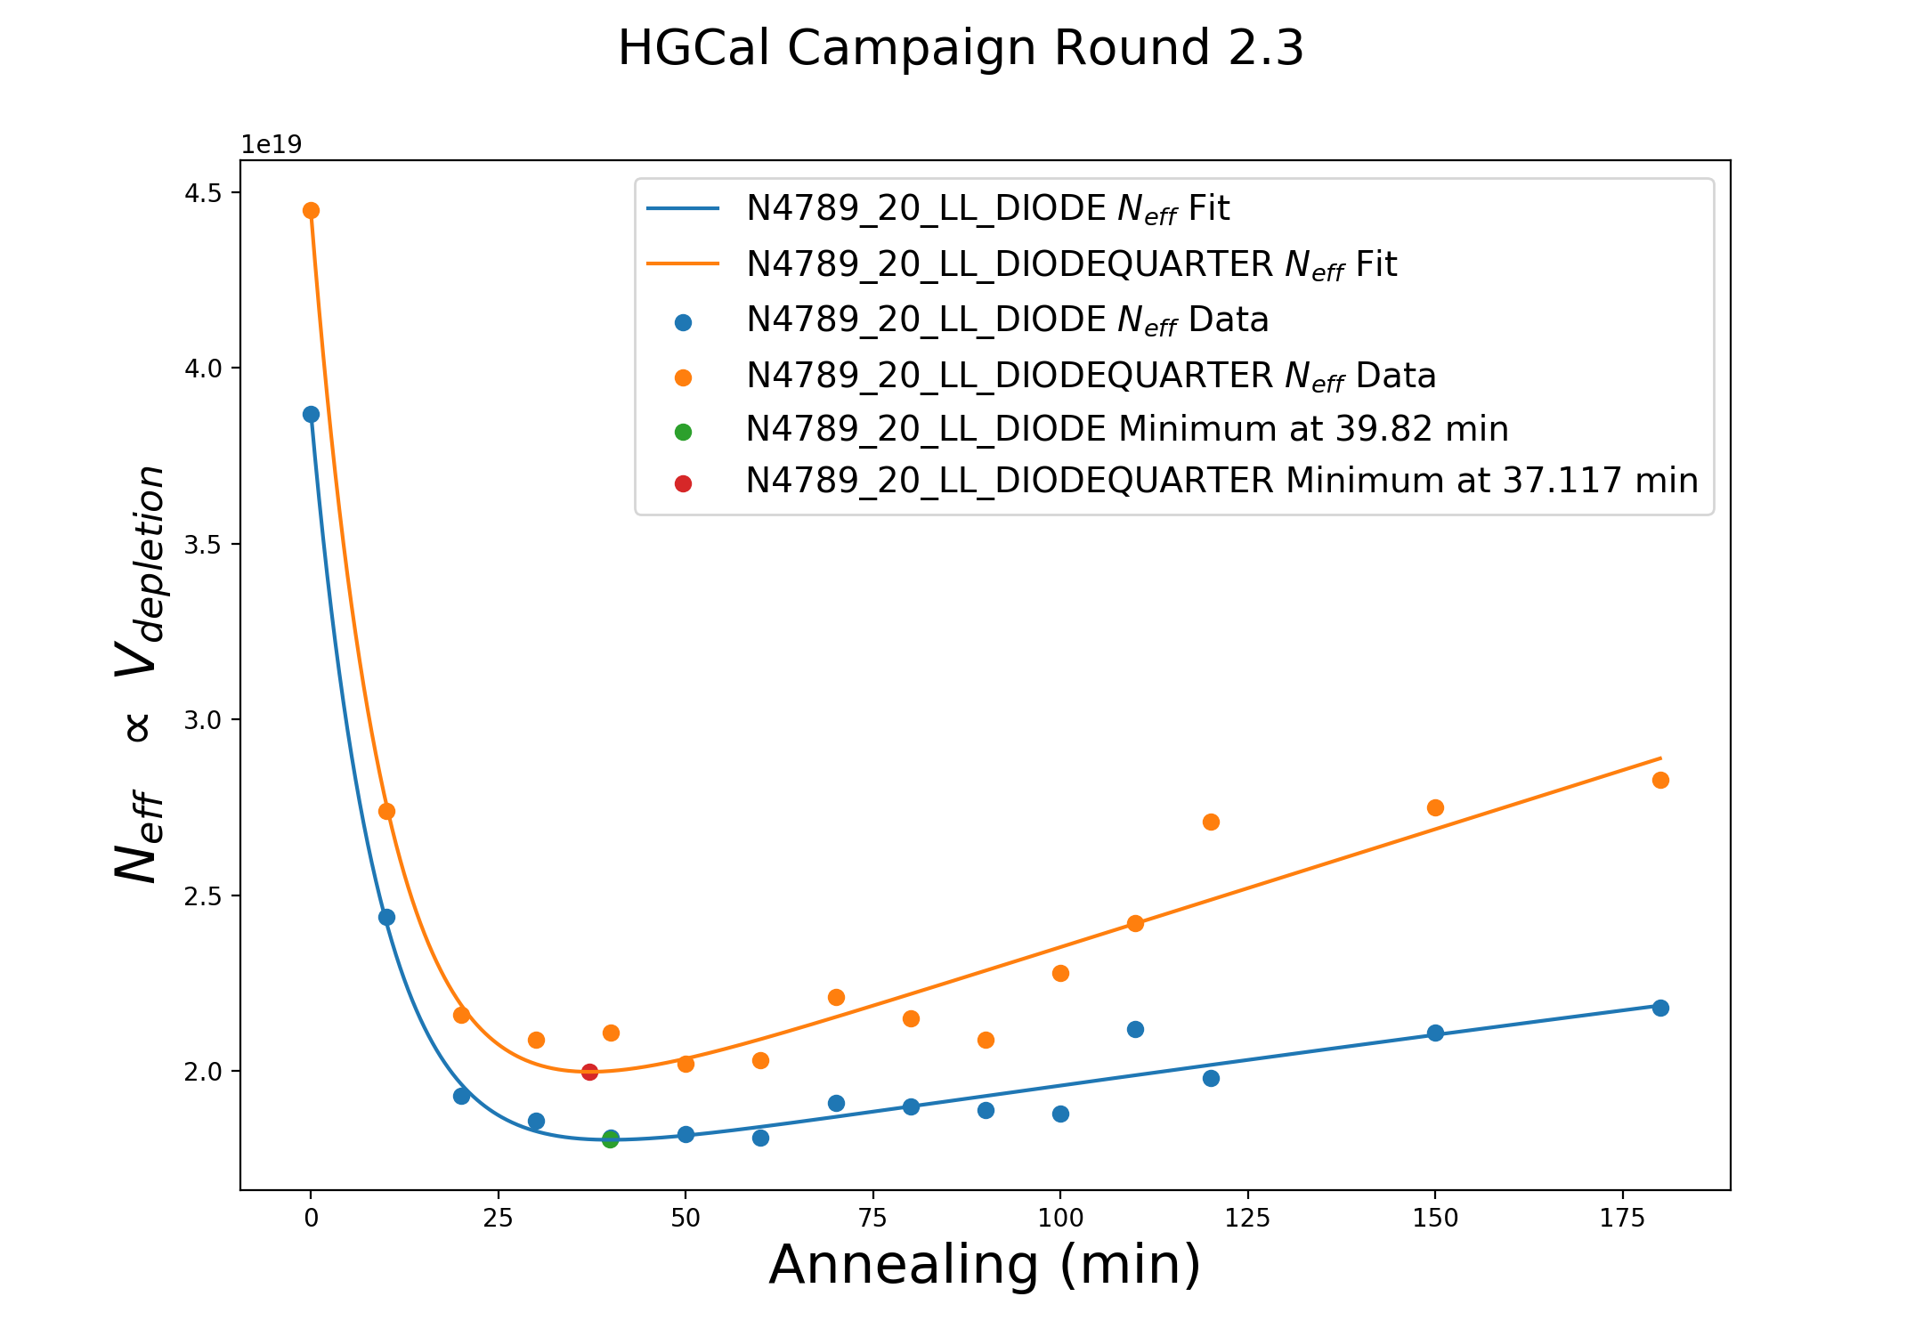
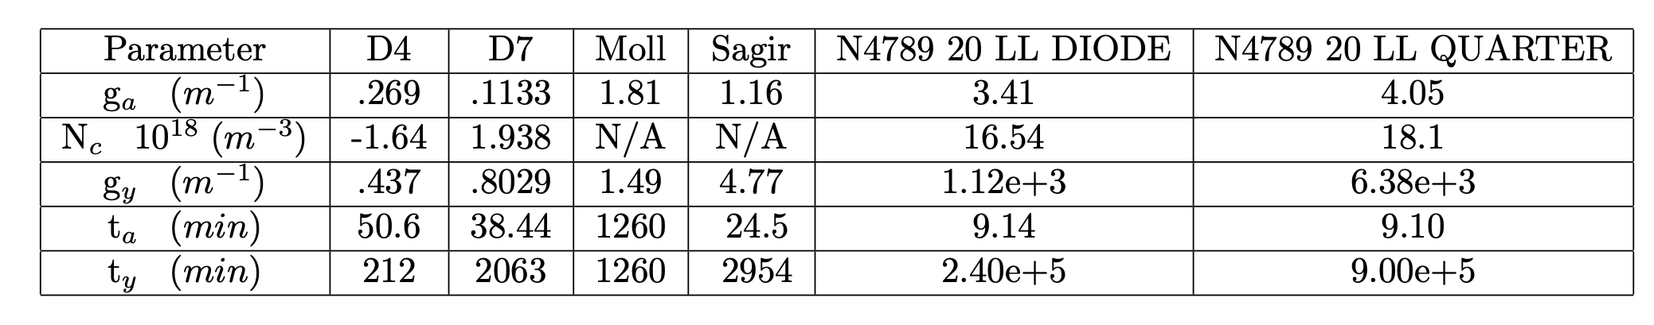
HGCAl 2.3 Hamburg Model Fit (86 min)
At ~ 40 minutes DIODE registers 2.78E+15 fluence (1 MeV n/cm^-2)
Equivalent annealing at 60C:
Back: 5.62 min
Front: 374 min

Slide 4
Comments
Does seem that concurrent annealing while irradiating does affect minimum in N_eff, though unsure of how to model to effect
Difference between maximum and minimum estimated fluence for DIODE during Hamburg analysis:
2.2: 1.04E+15 vs. 9.28E+14
2.3: 3.99E+15 vs. 2.30E+15
Excellent Dep V estimates throughout analysis
Have initial estimates for DIODEHALF and DIODEQUARTER area, fluence estimates for same cutout are ~15% off for HALF and ~50% off for QUARTER
How should I anneal future HGCAL diodes?

