Slide 1
SecurePass
Andrew Sipes

Slide 2
SecurePass
A secure terminal based password generator and storage program powered by Ruby

Slide 3
Why Ruby?
Ruby is a good compromise between readability and writability
Ruby is a good choice for command line programs
Ruby has built in tools for encryption and storage
Ruby was covered extensively in class and it was a new language for me

Slide 4
Project Files
main.rb
user_manager.rb
vault_manager.rb
vault_entry.rb
password_generator.rb
encryption_service.rb
users.json
Vault (containing encrypted files)

Slide 5
main.rb
Controls the entire program. Handles login, account creation, menus, and connects all other components together.

Slide 6
user_manager.rb
Manages user accounts. Stores usernames and hashed passwords in users.json, and handles sign‑in and registration.

Slide 7
vault_manager.rb
Loads and saves each user’s encrypted vault file inside the vaults/ folder. Stores password entries and writes them securely.

Slide 8
vault_entry.rb
Represents a single saved password entry.
Account name, username, email, and password.

Slide 9
password_generator.rb
Creates passwords based on user‑selected rules.
Length of the password.
Toggles and minimum characters for uppercase chars, numbers, and symbols.

Slide 10
encryption_service.rb
Encrypts and decrypts vault data using OpenSSL.
Uses the user’s password as the encryption key.

Slide 11
users.json
Stores all registered usernames and their password hashes.

Slide 12
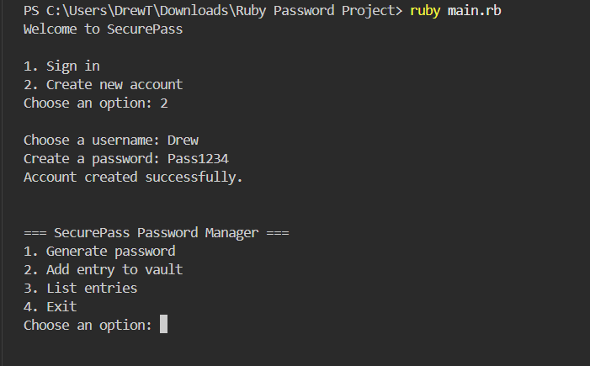
Create New Account

Slide 13
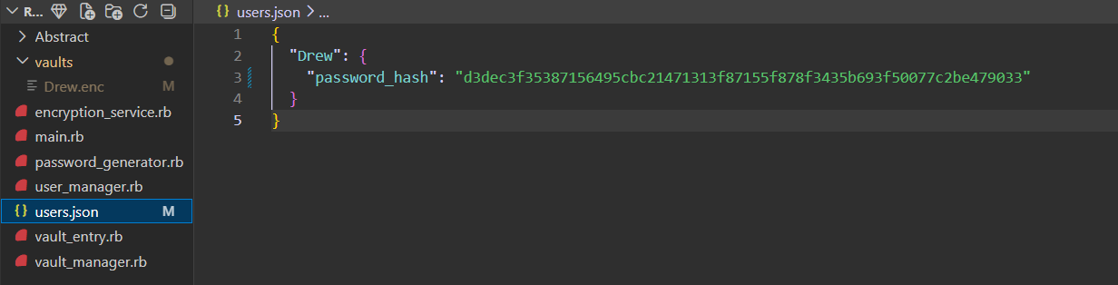
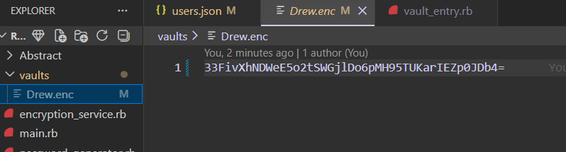
Create New Account Added to Database

Slide 14
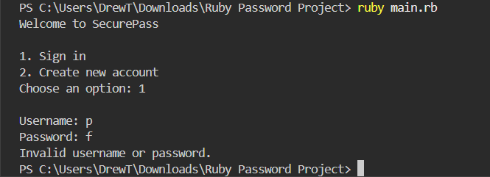
Incorrect Login

Slide 15
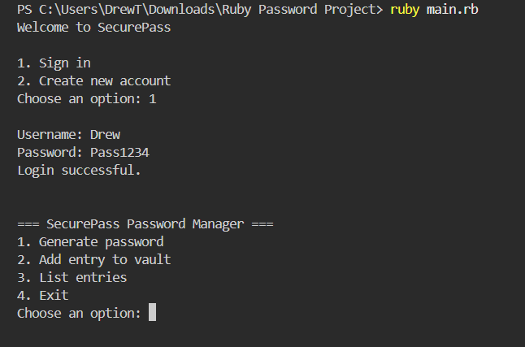
Sign In

Slide 16
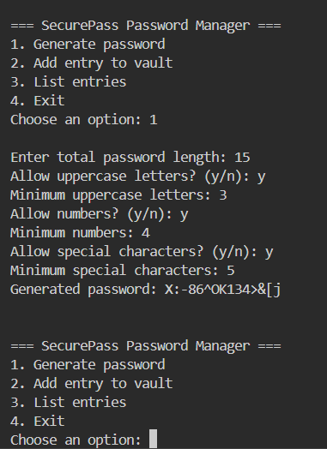
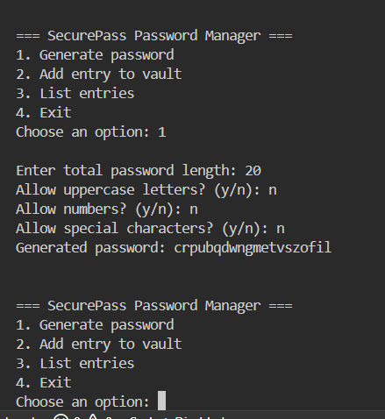
Generate Password
Note: Generate password does NOT save it to the vault

Slide 17
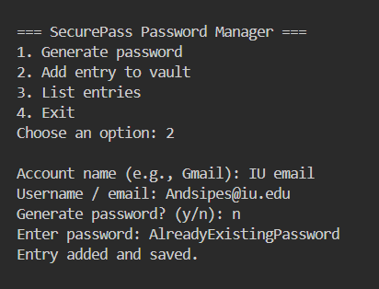
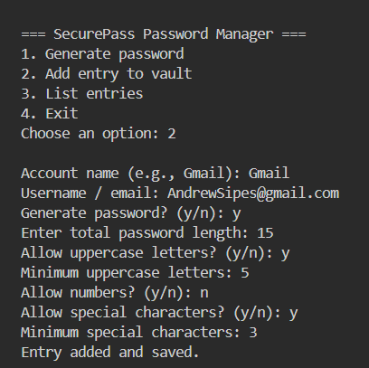
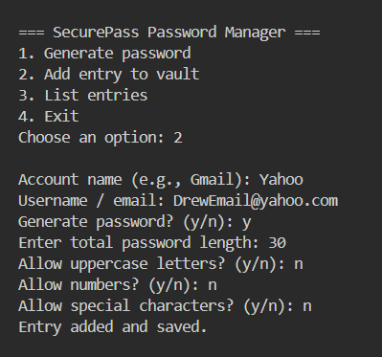
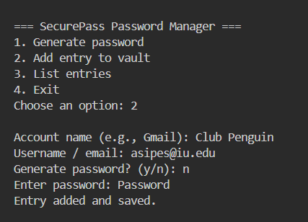
Add Entry to Vault
This is how we add passwords to the vault
There are options to type in passwords manually or have it generated by the program

Slide 18
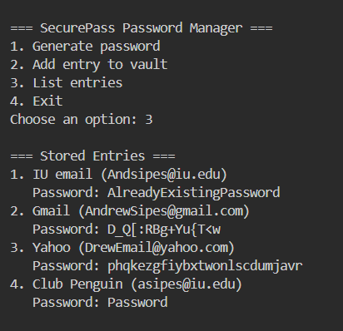
List Entries

Slide 19
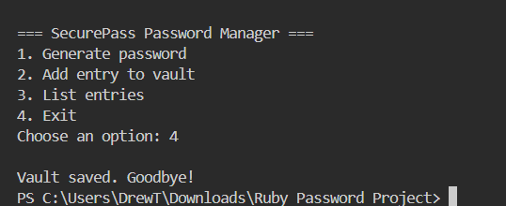
Exit

Slide 20
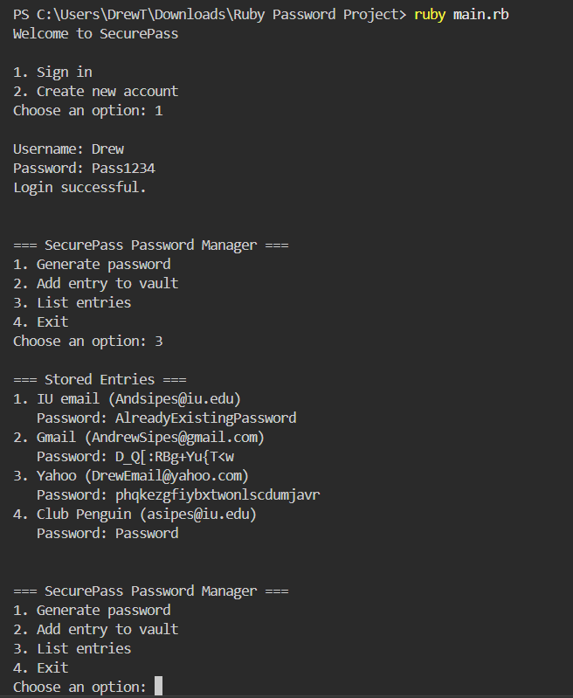
Sign In (Showing vault saves even when program is reset)

Slide 21
Thank you

