Slide 1
Incorporating AVs in Ohio 3C CT-RAMP2 Model
Peter Vovsha, Gaurav Vyas (WSP)
September 14, 2018

Slide 2
General approach to incorporate AVs
Expected impacts and affected sub-models

Slide 3
AV implications for transportation/urban planning
Earlier focuses:
Congestion reduction due to a better use of road capacity
VMT growth due to ZOV and higher trip rates
Replacement for transit (especially with MAAS/TNCs)
Recent recognition:
Parking demand, regulations, and tradeoffs with ZOV repositioning; possibility to remove parking from the city centers and replace it with AV staging areas
Integration with mass rapid transit and reshaping stations & services
Impacts on car ownership and interplay between privately owned AVs and shared AVs in TNCs
Mobility equity and special population groups (elderly, disable)
Far-reaching concept of a “smart city” (how the land-use could/should be reshaped with AVs)

Slide 4
AV impacts reflected in travel model

Slide 5
Requirements for consistent modeling of AVs
One generic approach that can handle regular vehicles and AVs in a single modeling framework:
Not a special AV model or post-processing!
AV penetration rate as a scenario parameter:
If 0% - standard 3C ABM for all HHs
If 100% - AV version for all HHs
If between 0% and 100% - HHs are split into 2 groups
Other essential parameters / AV assumptions:
Listed in the global control file
Due to many factors of uncertainty multiple scenario analysis is essential

Slide 6
AV impacts on travel demand
How AVs affect travel demand

Slide 7
How vehicles are used
Elderly, youth, disable, and other people without a driver license will have access to AVs; auto driver mode availability should not be constrained by age of 16 but extended to age of 12, 8, or even 5:
Mode choice
Escorting needs reduced or completely eliminated
Cars become available at any location any time, including non-home locations even if not used earlier in tour, and not necessarily from home for the entire tour:
Mode choice and multi-modal tour mode combinations
Empty repositioning trips made by AVs facilitate intra-household sharing of cars (and TNC):
carTrack
Ease to order a shared AV from TNC:
Mode choice (cheap ubiquitous driverless taxi/TNC that can increase the currently negligible share)
Accessibility impact on car ownership

Slide 8

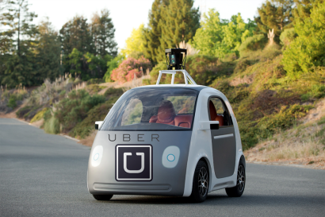
Cars available at any location any time, not necessarily from home for entire tour
ABM: Trip mode combinations on the tour less restrictive with any sequence of auto (AV) and transit
Home
Work
Shop
Shop

Slide 9
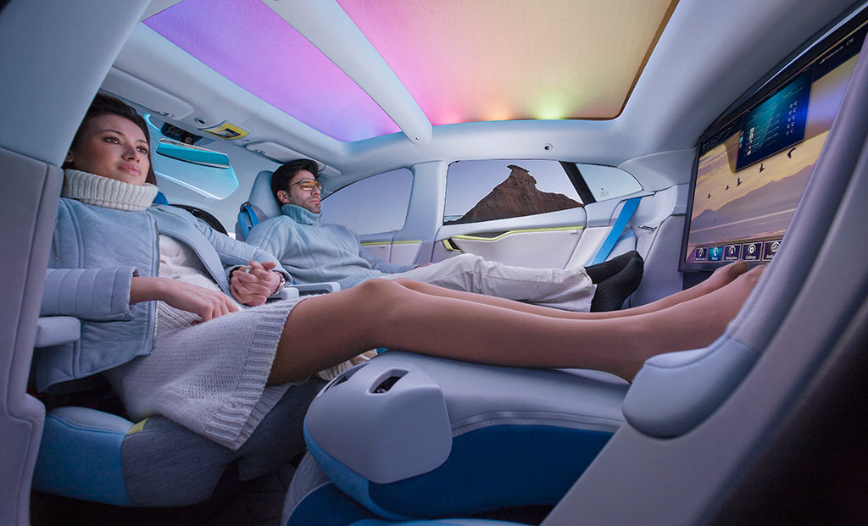
How people view travel
In-Vehicle Time Productivity; AVs offer a significant advantage over conventional vehicles (working, reading, texting, etc):
Mode choice: reductions in in-vehicle time coefficient for AVs can range from 15% to 50%; a dimension for scenario analysis.
Accessibility measures: Effects of convenient and productive travel time are not bound to mode choice only but also should be incorporated in the destination choicel. If people can do other things in the car, they might be willing to travel more or further.
AV as an access mode to transit; AVs create a new mode of transportation K_{r}NR that combined advantages of Park-and-Ride (PNR) and Kiss-and-Ride (KNR) modes:
Mode choice (can work in favor of rapid transit)

Slide 10
General convenience of AV-K_{R}NR vs. PNR KNR & walk access/egress
3 plagues of transit access today:
Walk too long
PNR needs parking and extra car
KNR needs driver
AV solves all 3!
ABM: K_{R}NR convenience parameters equalized to auto
Home
K_{R}NR
Work

Slide 11
Impacts of AV on travel demand (Summary)

Slide 12
carTrack
New sub-model that predicts intra-household car allocation and use (routing and parking details)

Slide 13
HH car allocation and tracking (carTrack)
What is does:
Allocated HH cars to trips taking into account time-space constraints
Reports car trips that cannot be served by HH cars (feedback to mode choice)
Generates complete daily car routes including:
AV repositioning (ZOVs) for traffic assignment
Parking choices for AVs
Graphical output to analyze individual HH (time-space car-tracking diagram)
Discrete LP:
Assumes HH schedule, trips, and modes are given but allows for schedule relaxations (and consequently extra “wait” or “early departure”)
Optimizes HH objective function that combines weighted components:
Penalty for schedule adjustment
Usual driver for each car
Cost for unsatisfied car demand (assumes taxi/Uber used for the trip)
Car repositioning cost
Car parking cost

Slide 14
HH car allocation conflict
Occurs when number of car driver trips in the same time interval exceeds number of cars:
Mode choice does not have a “hard” constraint, only a “soft” probabilistic one
Ways to resolve:
Adjust /relax/stretch individual activity schedules:
Especially effective with AV repositioning
Rescheduling feasibility and penalties compared to cost of unsatisfied demand
Generic MaaS service available (Uber, etc) for unsatisfied auto demand:
Part of mode choice
Not fully processed for traffic assignment since there is no yet routing for them
Feedback to:
Car ownership
Mode choice
Joint travel arrangements

Slide 15
AV parking trade-off with empty trips
Regular vehicle:
Parked at the trip destination for activity duration (or tour duration for PNR)
Taken from parking by the same driver
Drivers can switch only at home
AV:
Has multiple parking options for location, duration and switching of drivers by means of vehicle repositioning (ZOVs)

Slide 16
AV parking and repositioning options

Slide 17
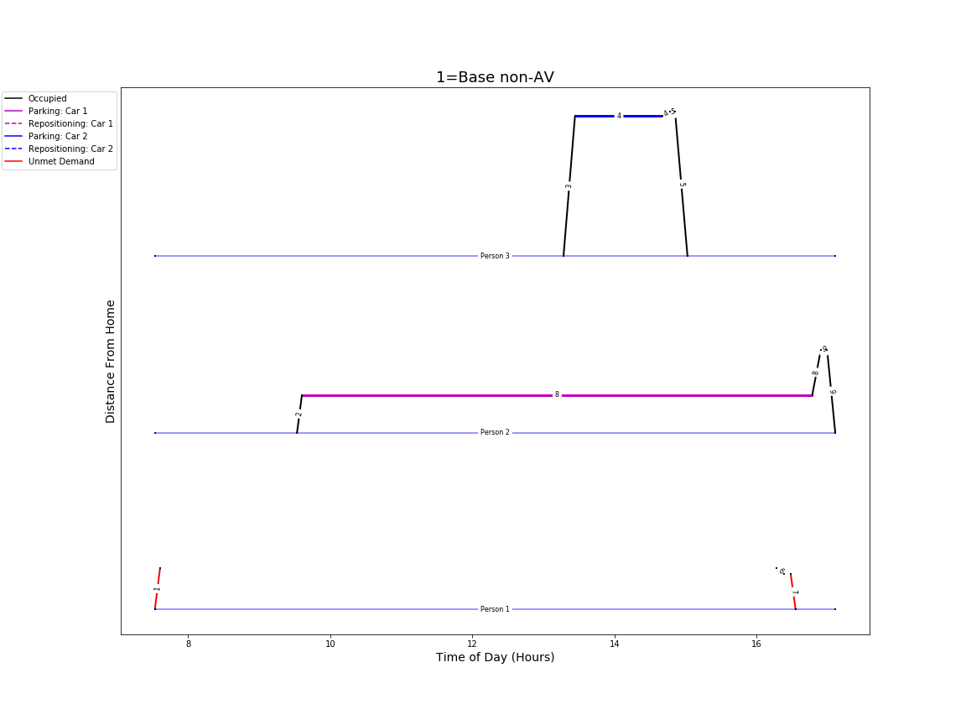
Time-space car-person diagram for a single non-AV HH (from ABM but can be from HTS)
3 persons
2 cars
Car driver trips:
Black – satisfied
Red – unsatisfied
ABM can have them due to “soft” probabilistic impact of car ownership on mode choice
Feedback to mode choice is possible
CarTrack minimizes unsatisfied demand

Slide 18
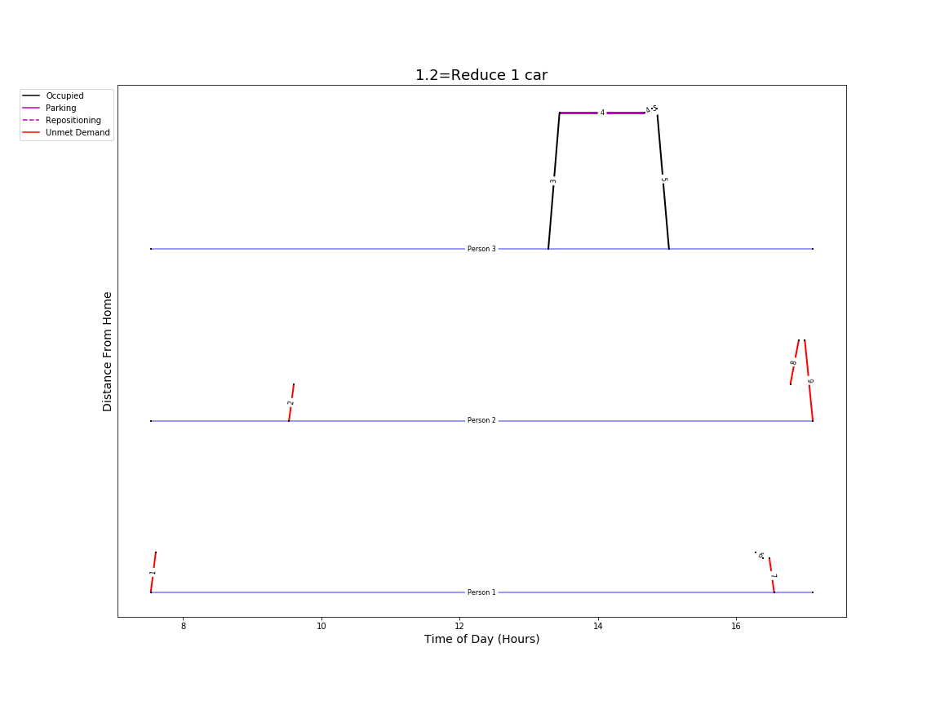
Impact of car ownership (non-AV)
Less cars means unsatisfied demand for activities with lower priorities

Slide 19
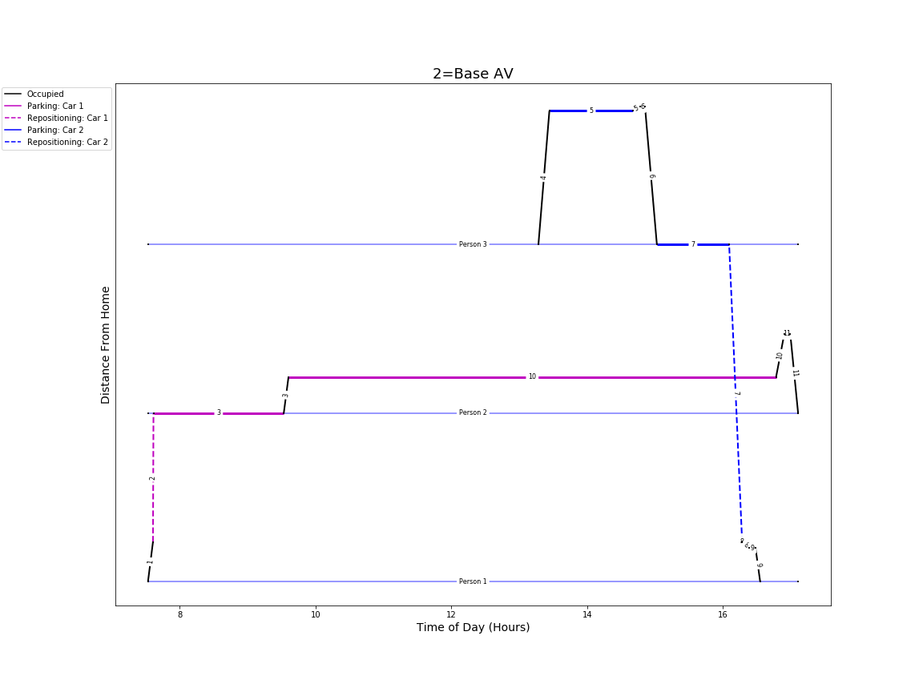
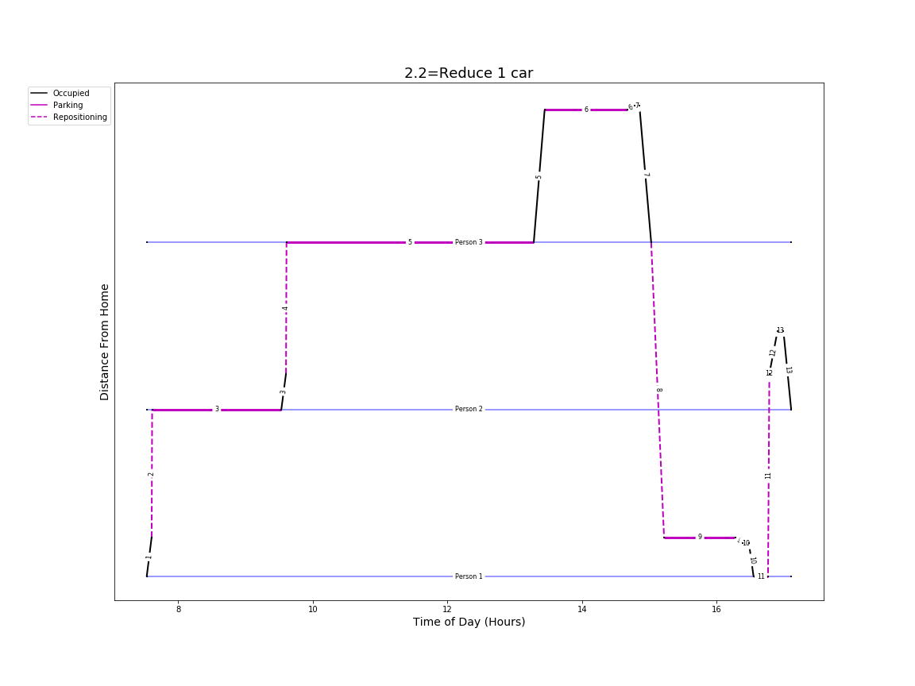
Mitigated impact of car ownership (HH-owned AV)
One AV can serve all trips by repositioning

Slide 20
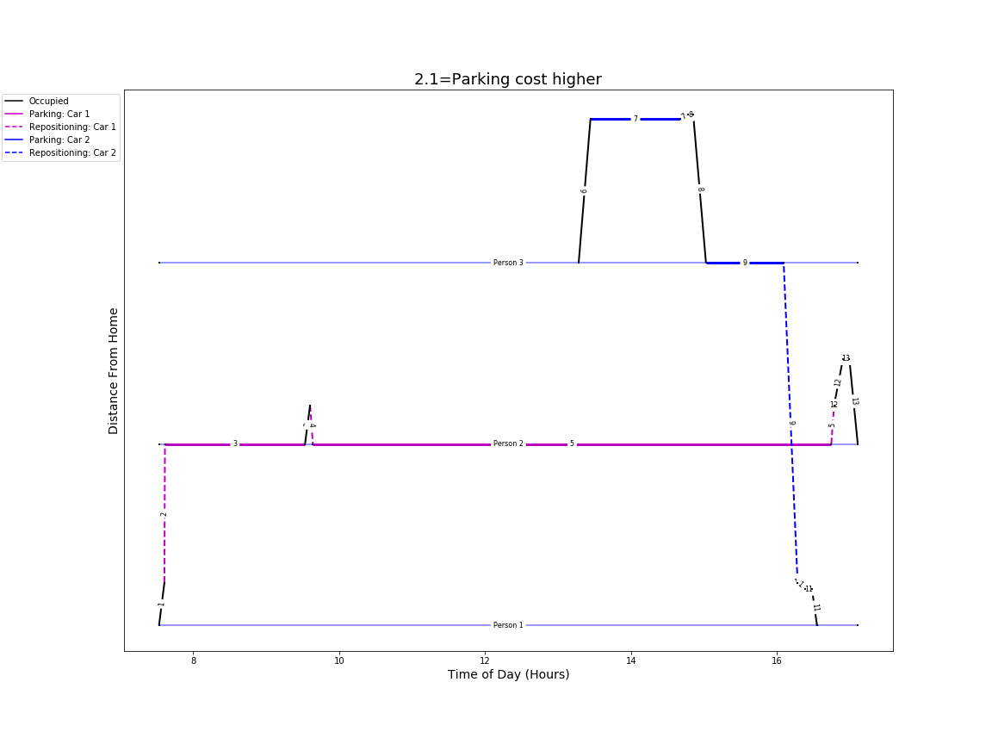
Impact of parking cost and trade-off with empty trips (HH-owned AV)
Parking cost $12 for work trips of person 2
Results in car repositioning home
AVs reduce demand for parking
AV base case with no parking cost

Slide 21
Adjustments of network capacity and speed for AVs
How to adjust network capacities an speeds for different AV penetration rates

Slide 22
3 fundamental parameters
Speed, mph × 5,280
= Spacing_between_vehicles, ft/veh
Lane_throughput, veh/h
2 parameters should be defined and the 3rd one derived
The derived parameter is useful as a sanity check
Shorter spacing between vehicles is the main advantage of AVs/CVs
How to translate (dynamic) throughput to capacity for a (static) VDF?
How to account for a mix of regular vehicles and AVs?

Slide 23
Possible approaches / assumptions
(Le Vine) For each (free-flow) speed:
Define the minimum required spacing
Calculate the resulted throughput (capacity)
Optimal speed for throughput maximization can be defined
Not readily useful for VDF or partial penetration of AVs
(Mahmassani): For each AV penetration rate:
Calculate potential reduction of spacing
Adjust capacity proportionately
No specific consideration of speed
Can be used for VDF with partial penetration of AVs but may overstate speeds at high congestion levels
(Adopted): For each AV penetration rate:
Apply an empirical curve for capacity increase
Apply an empirical curve for speed increase (free-flow and congested proportionately)
Analyze the resulted spacing for consistency (should decrease with a growing penetration rate)
Limitations:
All this currently w/o detailed analysis/revision of VDF parameters
Applied for freeways only, arterials and local roads not revised yet
AVs impacts on intersection delays not clear, especially for partial penetration scenarios

Slide 24
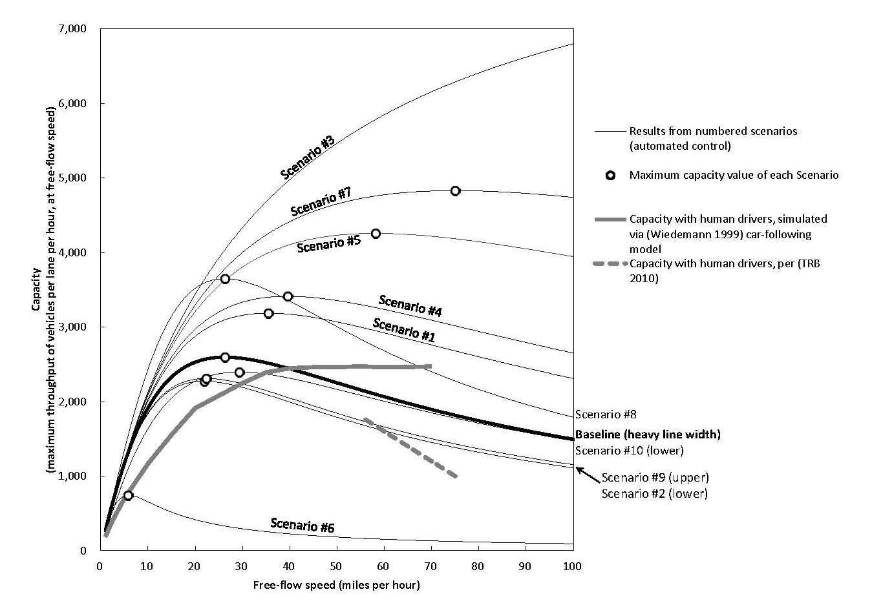
Le Vine et al, 2017
1
Scenarios based on assumptions on upper limit of vehicle deceleration and reaction time

Slide 25
AVs freeway capacity improvements (Mahmassani, 2016)
2
Leader | Follower | Spacing
Connected | Connected | S_{c} (73 feet)
 | Autonomous | S_{a} (73 feet)
 | Regular | S_{r} (146 feet)
Autonomous | Connected | S_{r} (146 feet)
 | Autonomous | S_{a} (73 feet)
 | Regular | S_{r} (146 feet)
Regular | Connected | S_{r} (146 feet)
 | Autonomous | S_{a} (73 feet)
 | Regular | S_{r} (146 feet)

Slide 26
AVs freeway capacity improvements: Spacing as function of penetration (Mahmassani, 2016)
2
Event | Probability | Spacing
Connected vehicle (CV) | P_{c}
Autonomous vehicle (AV) | P_{a}
Regular vehicle (RV) | P_{r}
CV follows CV | (P_{c})² | S_{c} (73 feet)
AV follows any vehicle | P_{a} | S_{a} (73 feet)
RV follows any vehicle or CV follows AV | 1- P_{a} - (P_{c})² | S_{r} (146 feet)
Mix |  | S_{c}(P_{c})² + S_{a}P_{a} + S_{r}[1-P_{a}-(P_{c})² ]

Slide 27
AVs freeway capacity improvements (Mahmassani, 2016)
2
Regular vehicles | Connected vehicles | Autonomous vehicles | Average lane capacity, veh/h
100% | 0% | 0% | 1,800
50% | 50% | 0% | 2,057
50% | 0% | 50% | 2,400
0% | 50% | 50% | 2,880
0% | 100% | 0% | 3,600
0% | 0% | 100% | 3,600

Slide 28
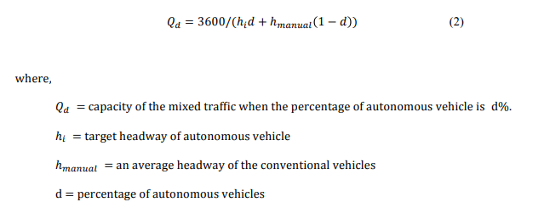

From Yokota et al. Evaluation of AHS effect on mean speed by static method (1998)
3
From Bernhard Friedrich. The Effect of Autonomous Vehicles on Traffic (2016)
Where,
Cm = Capacity
n = Percentage of Avs
Ta = Headway AV
Th = Average Headway
v = Average Speed (80km/hr)
L = Average Car Length (7.5m)
*Note: Average Headway = 1.15s
AV Headway = 0.5s

Slide 29
Adopted capacity factor as function of AV penetration rate
3

Slide 30
Adopted speed factor as function of AV penetration rate
3

Slide 31
Vehicle spacing factor as a sanity check
3
%AV | Capacity (v/h) 80% increase for 100% AV | If 50% increase in speed is assumed for 100% AV |  | If 50% vehicle spacing reduction is assumed
 |  | Speed based on curve (mph) | Derived vehicle spacing | Derived Speed (mph) | Vehicle spacing for mix
0% | 1,800 | 55 | 161 | 55 | 161
5% | 1,841 | 55 | 158 | 55 | 157
10% | 1,884 | 55 | 155 | 55 | 153
15% | 1,929 | 55 | 152 | 55 | 149
20% | 1,976 | 56 | 149 | 54 | 145
25% | 2,025 | 56 | 147 | 54 | 141
30% | 2,077 | 57 | 144 | 54 | 137
35% | 2,132 | 57 | 142 | 54 | 133
40% | 2,189 | 58 | 140 | 54 | 129
45% | 2,250 | 59 | 139 | 53 | 125
50% | 2,314 | 60 | 137 | 53 | 121
55% | 2,382 | 61 | 136 | 53 | 117
60% | 2,455 | 63 | 135 | 53 | 113
65% | 2,531 | 64 | 134 | 52 | 109
70% | 2,613 | 66 | 134 | 52 | 105
75% | 2,700 | 68 | 133 | 52 | 101
80% | 2,793 | 70 | 133 | 51 | 97
85% | 2,893 | 73 | 133 | 51 | 93
90% | 3,000 | 76 | 133 | 50 | 89
95% | 3,115 | 79 | 134 | 50 | 85
100% | 3,240 | 83 | 134 | 50 | 81

Slide 32
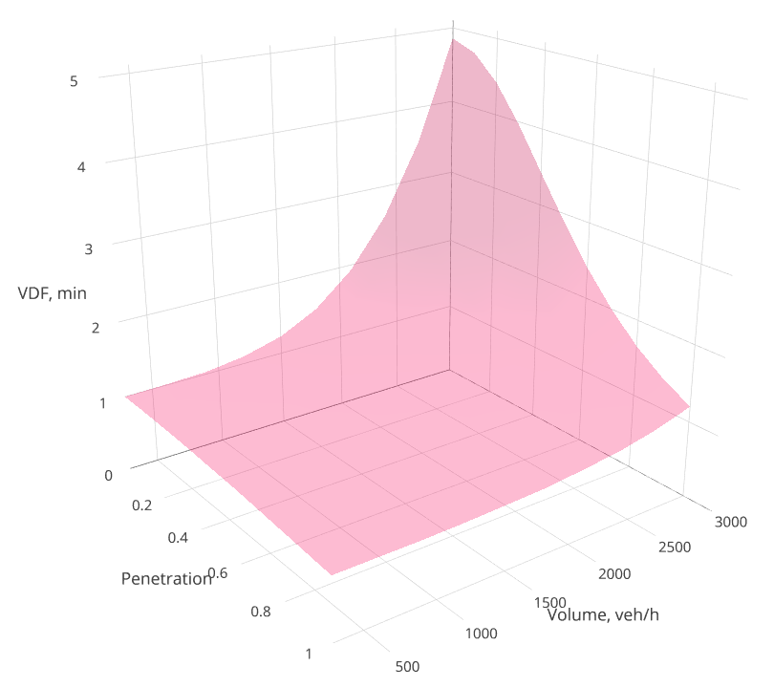
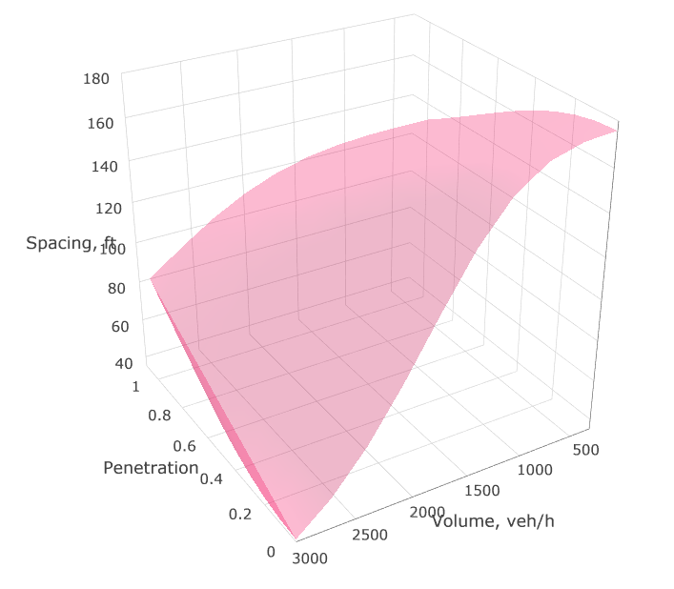
Building “ideal” VDF
Parameter | Formula | Desired property
Capacity as function of penetration rate | C(P) | Monotonically increasing w.r.t. P
Speed as function of penetration rate and volume-over-capacity ratio | S[P,V/C(P)] | Monotonically increasing w.r.t. P Monotonically decreasing w.r.t. V
Spacing (headway) between the vehicles as function of penetration rate and speed | H{P,S[P,V(C(P)]} = S[P,V/C(P)]/C(P) | Monotonically decreasing w.r.t. P Monotonically decreasing w.r.t. V

Slide 33
AV scenario controls
Switches to toggle to manage scenarios

Slide 34
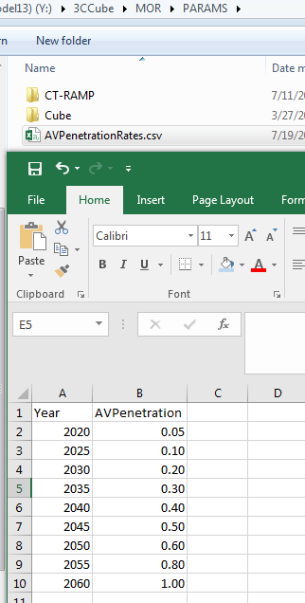
Market penetration rates by year
Specified in AVPenetrationRates.csv:
Interpolation for scenario year
For mixed scenario (AV share < 100%) :
Household level AV Adoption model
Auto calibrate to match AV share
Separate set of rules by AV and Non-AV households

Slide 35
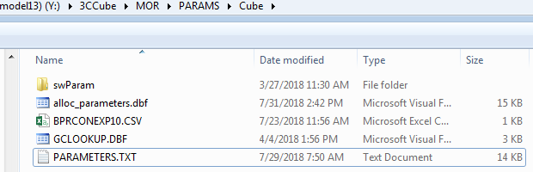
Other scenario controls
Specified in PARAMETERS.TXT file

Slide 36
Other scenario controls
avIVTTBonus: Auto in-vehicle productivity bonus:
Accessibility calculator
Mode choice
minAgeAuto: Minimum age at which a child is allowed to travel in AV without any adult in the car:
School escorting
Mode choice

Slide 37

Other scenario controls
avCapFacFreeway, avCapFacArterial: Ratio of road capacity for 100% AV to 0% AV scenarios
Highway assignment and skimming
avSpeedFacFreeway, avSpeedFacArterial: Ratio of speed for 100% AV to 0% AV scenarios
Highway assignment and skimming
tncDiscount: Crude surrogate for cheap driverless taxi
Mode choice

Slide 38
Other AV Parameters
K_{R}NR bonus: Constant to nullify the inconvenience of KNR
“No escort” bonus: Constant to cancel out the effect of constants for escorting
Not scenario specific

Slide 39
Results for modeled scenarios
Summary of first results

Slide 40
Scenarios
Scenario | Scenario name | AV proportion | Capacity improvement factor |  | Speed improvement factor |  | Zero resulting intersection delay | Auto IVTT Discount | Minimum age travel alone | TNC Discount
 |  |  | Highway | Arterial | Highway | Arterial
1 | Base | 0% | 1 | 1 | 1 | 1 | No | 0% | 16 | 0%
2 | High capacity | 100% | 2 | 1.5 | 1.25 | 1 | No | 0% | 16 | 0%
3 | Med capacity | 100% | 1.5 | 1.25 | 1.25 | 1 | No | 0% | 16 | 0%
4 | Low capacity | 100% | 1.3 | 1.15 | 1.25 | 1 | No | 0% | 16 | 0%
5 | Car use impact | 100% | 1 | 1 | 1 | 1 | No | 0% | 10 | 0%
6 | High IVTT discount | 100% | 1 | 1 | 1 | 1 | No | 50% | 16 | 0%
7 | Moderate IVTT discount | 100% | 1 | 1 | 1 | 1 | No | 25% | 16 | 0%
8 | Moderate travel age threshold | 100% | 1 | 1 | 1 | 1 | No | 50% | 10 | 0%
9 | Moderate travel age threshold, TNC discount | 100% | 1 | 1 | 1 | 1 | No | 50% | 10 | 50%
10 | Low travel age threshold | 100% | 1 | 1 | 1 | 1 | No | 50% | 6 | 0%
11 | High capacity, high IVTT discount | 100% | 2 | 1.5 | 1.25 | 1 | No | 50% | 10 | 0%
12 | Cheap Taxi | 100% | 1 | 1 | 1 | 1 | No | 0% | 16 | 50%
13 | Cheap Taxi, moderate travel age threshold | 100% | 1 | 1 | 1 | 1 | No | 0% | 10 | 50%

Slide 41
Scenarios
Scenario | Scenario name | AV proportion | Capacity improvement factor |  | Speed improvement factor |  | Zero resulting intersection delay | Auto IVTT Discount | Minimum age travel alone | TNC Discount
 |  |  | Highway | Arterial | Highway | Arterial
14 | Cheap Taxi, high productivity bonus | 100% | 1 | 1 | 1 | 1 | No | 50% | 10 | 50%
15 | 25% AV, med capacity, high IVTT discount | 25% | 1.5 | 1.25 | 1.25 | 1 | No | 50% | 10 | 0%
16 | 25% AV, med capacity, low IVTT discount | 25% | 1.5 | 1.25 | 1.25 | 1 | No | 50% | 10 | 50%
17 | 50% AV, med capacity, high IVTT discount | 50% | 1.5 | 1.25 | 1.25 | 1 | No | 50% | 10 | 0%
18 | 50% AV, med capacity, low IVTT discount | 50% | 1.5 | 1.25 | 1.25 | 1 | No | 50% | 10 | 50%
19 | 75% AV, med capacity, high IVTT discount | 75% | 1.5 | 1.25 | 1.25 | 1 | No | 50% | 10 | 0%
20 | 75% AV, med capacity, low IVTT discount | 75% | 1.5 | 1.25 | 1.25 | 1 | No | 50% | 10 | 50%
21 | High capacity, high speed, zero resulting intersection delays | 100% | 2 | 1.5 | 1.25 | 1 | Yes | 0% | 16 | 0%
22 | High capacity, high speed, zero resulting intersection delays | 100% | 2 | 1.5 | 1.25 | 1 | Yes | 50% | 10 | 50%

Slide 42
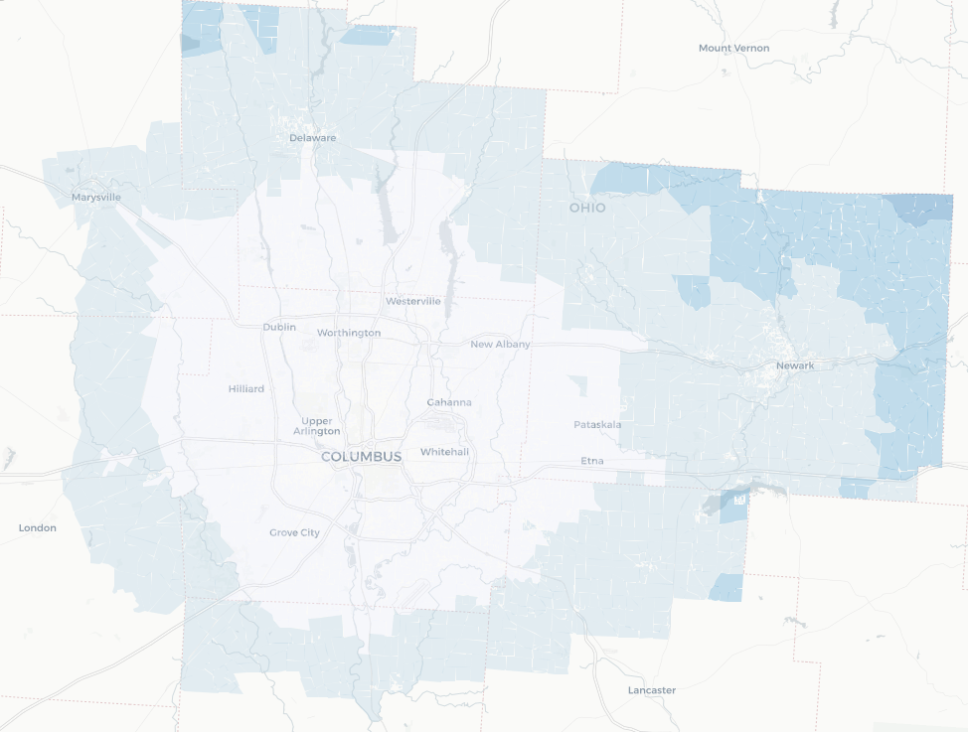
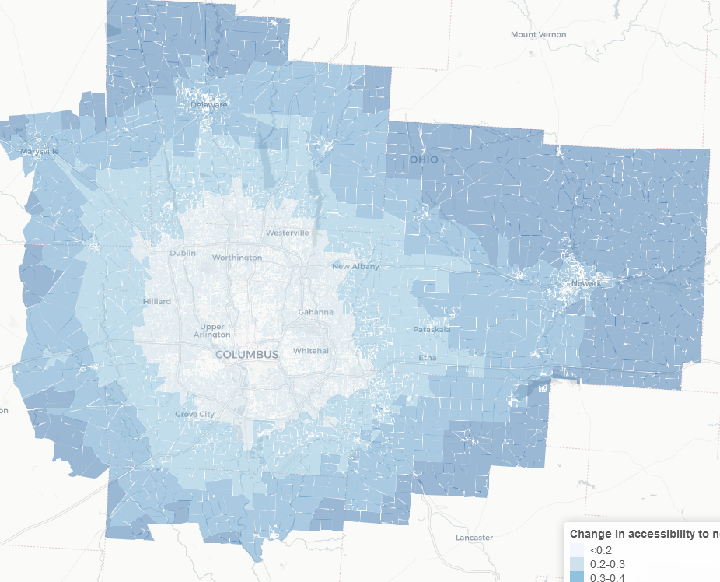
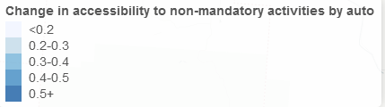
Impact of IVTT bonus on accessibility
25% IVTT Bonus
50% IVTT Bonus

Slide 43
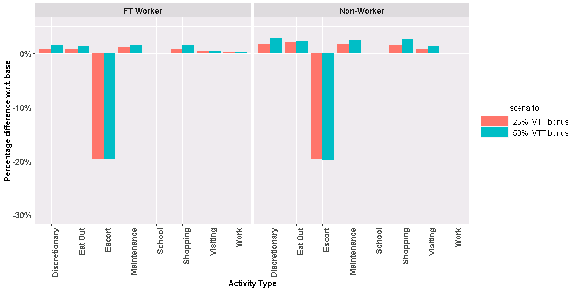
Impact on Activity Participation

Slide 44
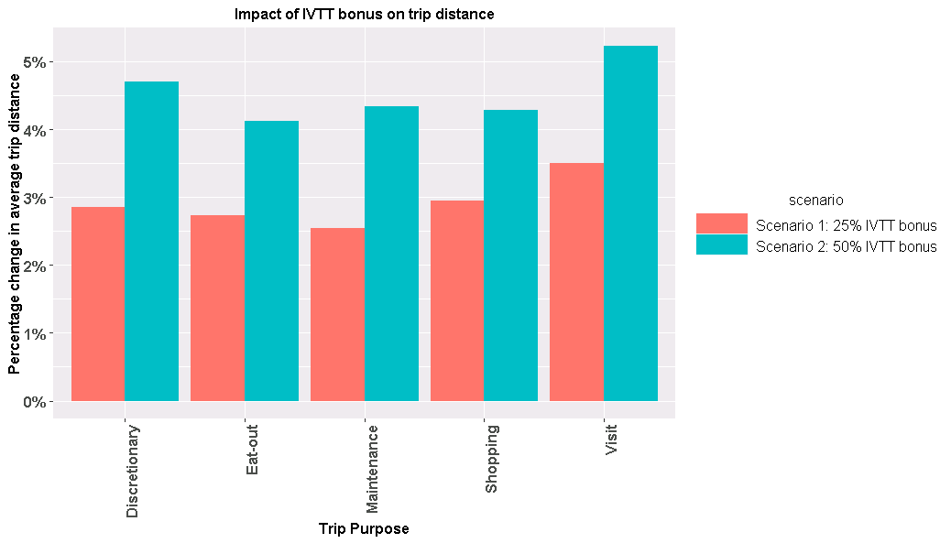
Impact on Average Trip Distance

Slide 45
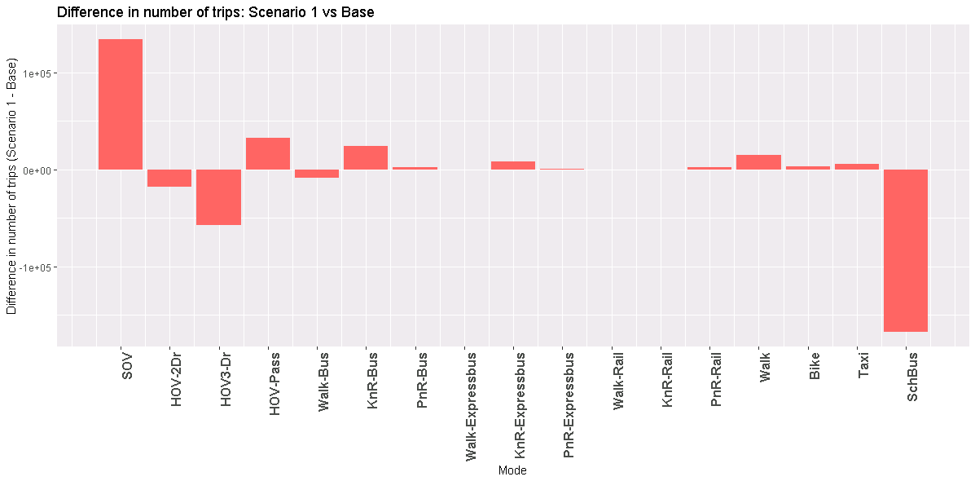
Impact on Mode Choice

Slide 46
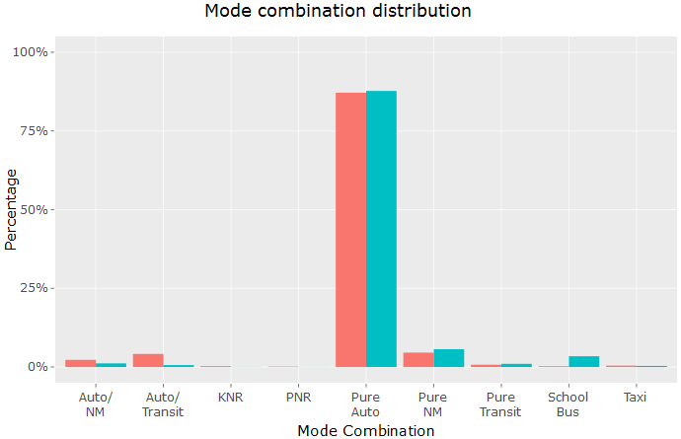

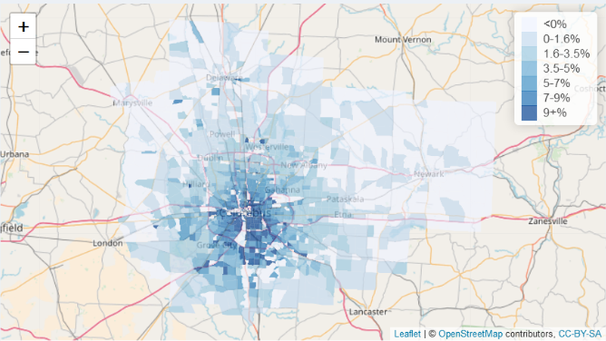
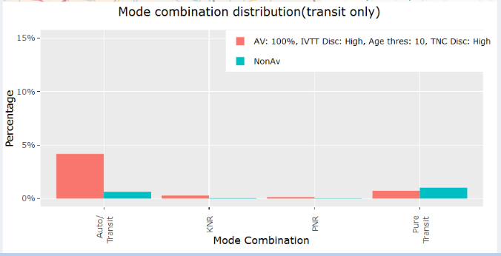
Impact on Mode Choice
Spatial distribution of change in share of Auto/Transit tours

Slide 47
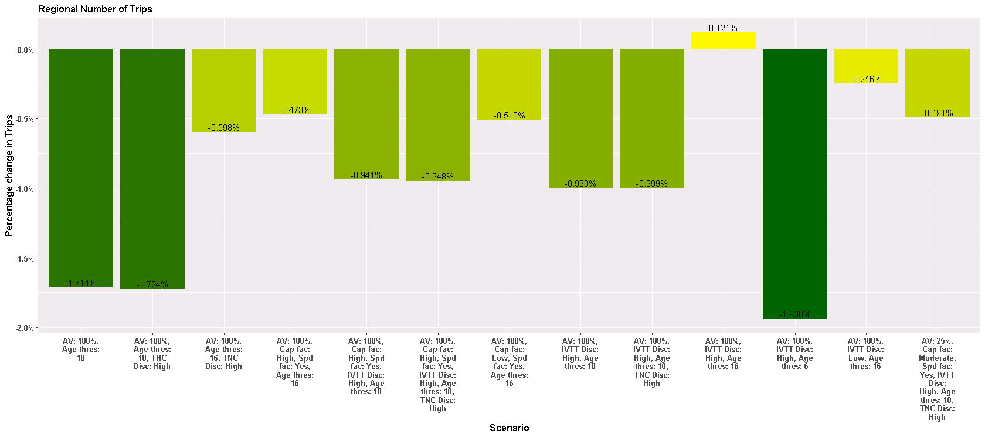
Impact on regional number of trips

Slide 48
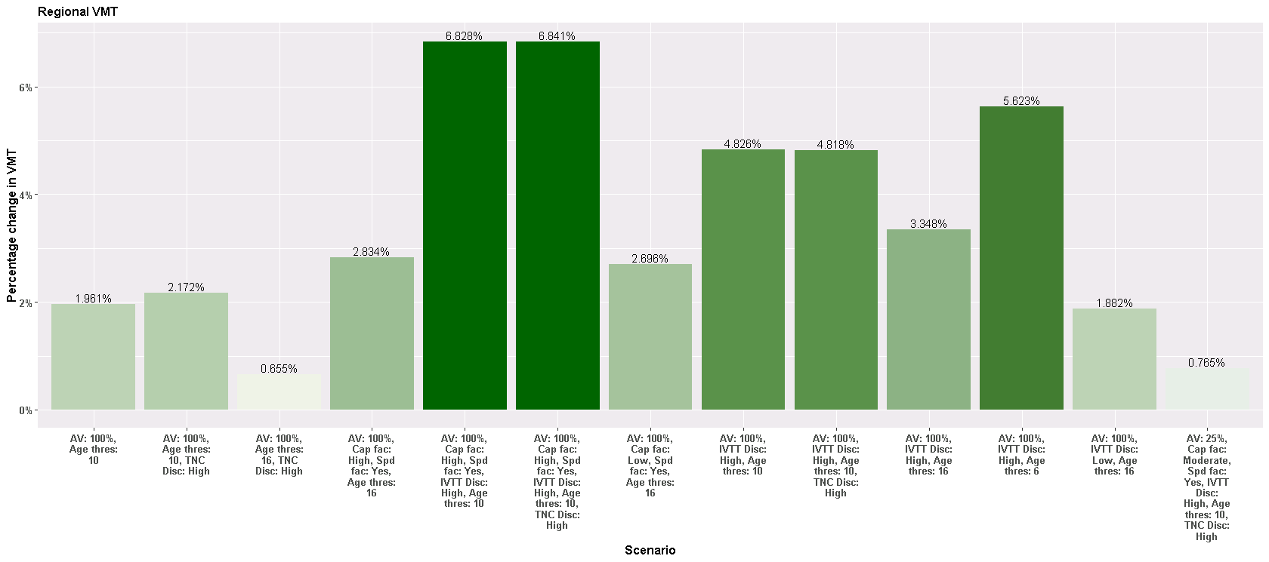
Impact on regional VMT

Slide 49
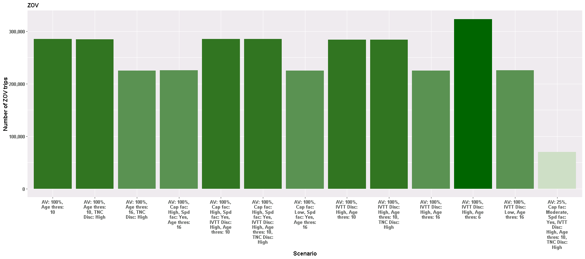
ZOV trips

Slide 50
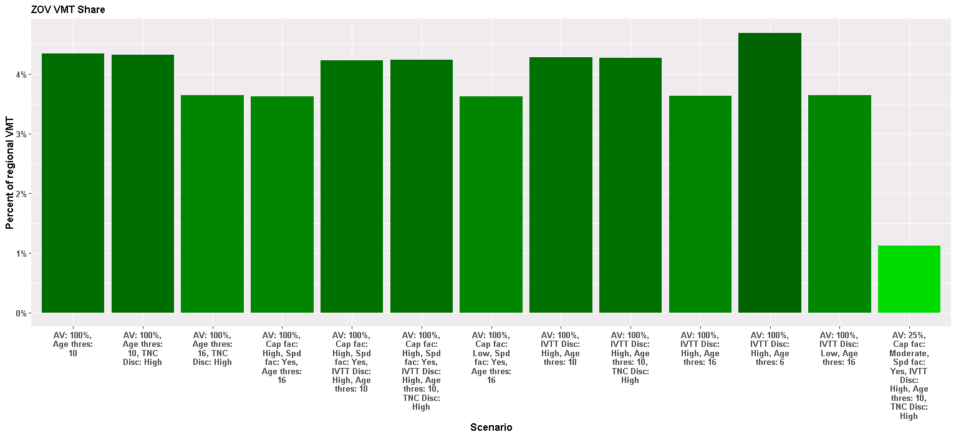
ZOV VMT

Slide 51
Impact on network delay
Delay = ∑(Congested time – free flow time)×link flow

Slide 52
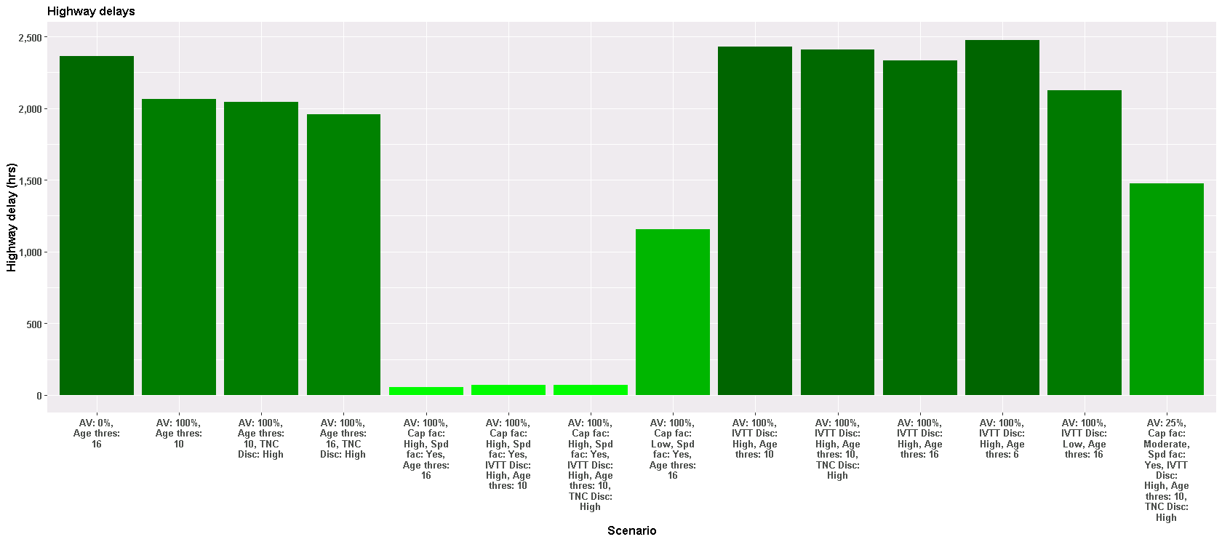
Impact on network delay

Slide 53
Next steps
Possible further improvements

Slide 54
General directions for model improvements that relate to AVs
Moving towards AgBM:
Identify additional model components to replace or complement probabilistic models with Agent-Based simulation to allow more enforcement of absolute time-space constraints on locations of people/vehicles
Integration with advanced network models:
ABM-DTA integration and eventually a complete AgBM
AV simulation in DTA instead of tweaking capacity/speed/VDF
Substitution between in-home and out-of-home activities:
E-shopping/delivery substitution for shopping trips

Slide 55
Sub-model | Private vehicles |  | For-Hire-Vehicles (TNCs)
 | Regular | Autonomous | Regular (taxi, Uber) | Autonomous
Penetration rate | HHs non-adopters | HHs adopters | Cost per mile assumption
Car ownership | Driven by accessibility improvements | Driven by accessibility improvements | Currently direct impact is missing, can be added through accessibility extension
Travel demand | Regular auto in-vehicle time coefficient | AV in-vehicle time coefficient reflecting convenience & productivity | Same in-vehicle time coefficient shared with regular autos
 | Common auto availability rules | Relaxed auto availability rules | Common availability rules
 | Limited KNR availability | Kriss-and-Ride high availability |  | Kriss-and-Ride high availability
 | Escorting children to school require a HH adult | AVs escort children to school |  | AVs escort children to school
Vehicle allocation to drivers or passengers & routing | Intra-household CarTrack | Intra-household CarTrack accounting for ZOV and parking choices | Passenger trips are directly translated into vehicle loaded trips, ZOVs ignored, TNC fleet operation model is needed
 | Feedback to mode choice (unsatisfied demand for cars)
 | Feedback to car ownership (unused cars, unsatisfied demand for cars)
Traffic assignment | Vehicle trips from CarTrack including ZOVs |  | Loaded trips only, ZOVs ignored

Slide 56
Loose ends and short-term improvements
Auto ownership model:
Currently not affected by AVs directly
For owned AVs:
(“Unused cars”) Potential for a decrease in the private auto ownership due to the ease in sharing vehicles among household members
(“Unsatisfied demand”) Potential for growth due to the replacement of escorting and overall AV attractiveness
For shared AVs:
(“Unused cars”) Potential for a decrease in the private auto ownership due to the ease in sharing vehicles among household members
Consistent owned car availability and parking consideration in mode choice and carTrack:
Currently two standalone components that are applied sequentially
More lines for the model system equilibration:
Inform mode choice that car is not available for a certain trip
Inform mode choice that parking cost can be avoided by repositioning

Slide 57
AV impact on car ownership (aggregate)
Mode-specific accessibilities
Private AVs
Auto
Transit
Non-Motorized
Taxi/TNC
Shared AVs
Current car ownership model is driven by “Car need” index:
Auto accessibility against transit & non-motorized accessibility
(taxi/TNC role is negligible)
Revised car ownership model is driven by “Private car need” index:
Auto accessibility against transit, non-motorized, and TNC accessibility
(taxi/TNC role is substantial)

Slide 58
AV impact on car ownership & mode choice (disaggregate Agent-Based outline)
Probabilistically add 1 car
Initial HH car ownership
Probabilistically remove 1 car
Activity & travel generation choices
Probabilistically adopt TNC or rerun mode choice with constrained HH car availability
Mode choice
Unsatisfied demand for HH car trips
Car allocation (carTrack)
Unused HH cars during the day

Slide 59
Strategic directions
Driver’s license sub-model and constraints beyond just age 16:
Broader impacts of AVs on mobility equity and special population groups
Segmentation by vehicle type:
Currently generic vehicle types equally available for each trip:
Coordinated extension of car ownership, mode choice, and car allocation models:
Car ownership by size, age, and make
Mode choice sensitive to operating cost
Policies that differentiate tolls, managed lanes, and/or parking cost by car type
Car allocation constraint by travel party and car size
Join travel and activity participation:
AVs can affect propensity to share rides between the household members as well as for inter-household carpooling
AV can eliminate necessity of joint travel like escorting children
AV can facilitate collection and distribution of the members of the travel party
Randomness in CarTrack:
People do not always make optimal decisions
Unobserved factors affecting decisions that the modeler does not know
Randomization of the coefficients of the objective function (car allocation priorities by trip purpose)
Behavioral and statistical substantiation of schedule adjustments:
Integration with iSAM penalties for trip departure time changes, trip arrival time changes, and activity duration changes with a possible refinement of simple linear penalty functions.
Inter-household car sharing and TNCs simulation:
Much bigger problem than intra-household CarTrack
Heuristics to handle real-time requests for shared AVs instead of predetermine schedule assumed for household-owned AVs
More possibilities to share trips

Slide 60
Possible short-term surrogate for taxi/TNC ZOV trips
Aggregate NHB-trip-type ZOV model by time slice:
Use modeled loaded taxi/TNC trips as the basis for ZOV trip generation
Productions are potential passenger (earlier) drop-off places:
Zonal totals for taxi/TNC loaded trip destinations for the (previous+given)/2 time slice
Attractions are potential passenger (later) pick-up places
Zonal totals for loaded trip origins for the (given+next)/2 time slice
ZOV trips should obey a strong gravity principle:
Cost per mile equal to the ZOV revenue loss vs. loaded trip fare

Slide 61
First conclusions
Advanced ABM is the most appropriate tool to incorporate a wide range of AV impacts and effects:
More fundamental activity participation changes
More fluid travel arrangements, tour structure, and car use,
The impacts are less significant compared to many previous studies:
Many previous studies were based on a priori assumptions
Not that much growth in trip rates, trip length, and VMT
AVs changes the perception of travel but not the physical time available
ZOV trips are not significant (but can be if parking is constrained)
Not that much modal shift overall:
Transit mode redistribution is favor of rapid transit and K_{R}NR
AV-TNC can come into play if cost is substantially reduced
Most substantial changes:
Less escorting and joint travel
More multi-modal combinations
Substantial congestion reduction with optimistic road capacity scenarios

