Slide 1
Problems & Solutions for Large-Scale Models
Andrew Rohne
March 15, 2019

Slide 2
Introduction
Based on TRB Session
Eight Presentations

Slide 3
New ideas for demand estimation: Can we characterize travelers and locations based on movement traces?

Slide 4
Methodology
Clean Data (a year of cellphone data)
Identify attributes
Time between points, if device is moving
Start and end locations with DBSCAN algorithm
Identify trips
Characterize Travelers
K-medoids approach
Background: gravity model inadequate

Slide 5
DBSCAN
Density-Based Spatial Clustering of Applications with Noise
Groups points with a lot of neighbors
GPS Trace Data – ATRI, GPS Household Survey
Unsupervised Algorithm

Slide 6
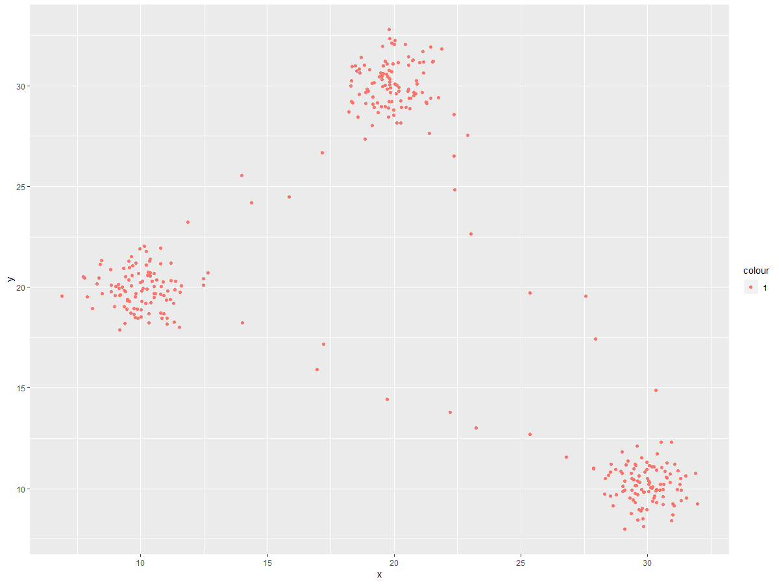
DBSCAN Example

Slide 7
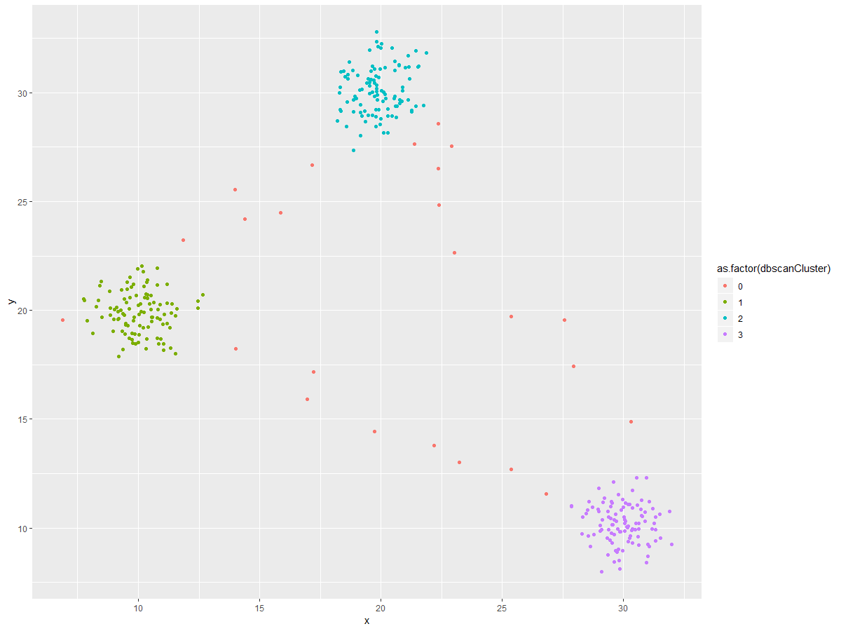
DBSCAN Example

Slide 8
K-medoids
Unsupervised Algorithm for Clustering Data
Similar to k-means clustering
Not really meant for spatial data
User provides number of centers
Algorithm returns medoids
Medoids ~~ Centroids (“Median Centroids”)
Actual datapoints as centers
All points assigned a Medoid

Slide 9
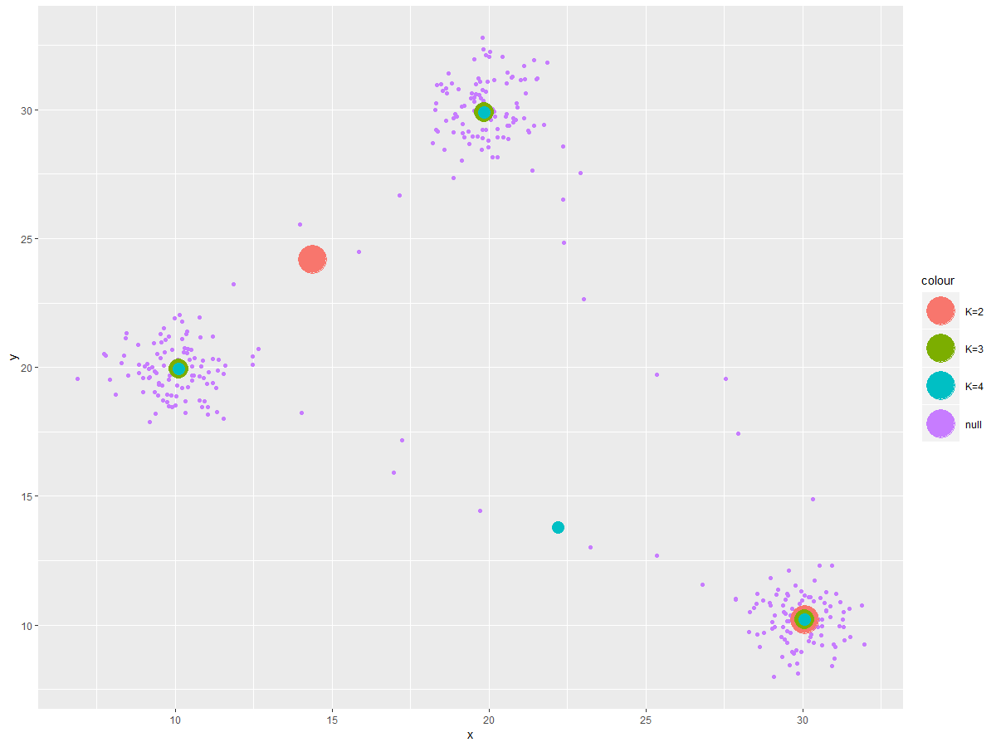
K-medoids Example - Medoids

Slide 10
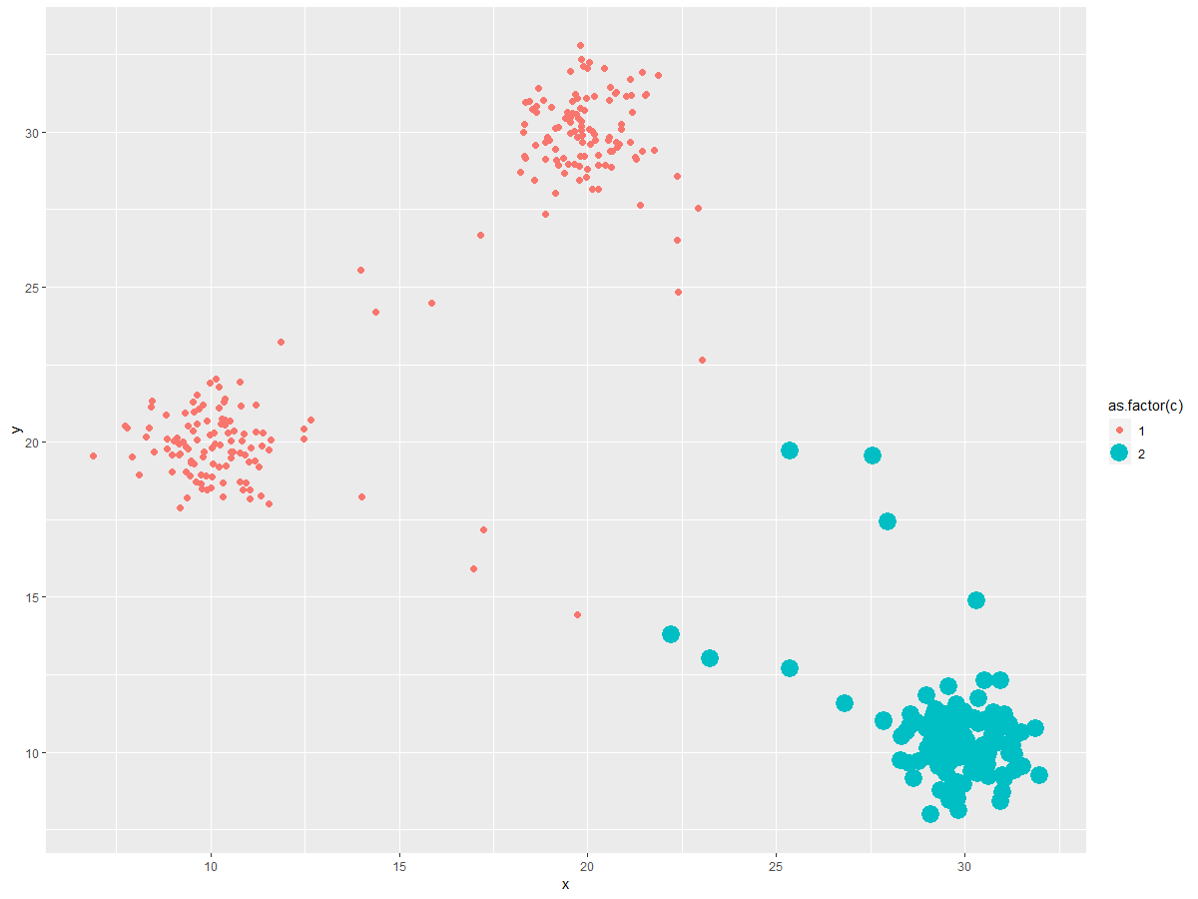
K-medoids Assigned Clusters (k = 2)

Slide 11
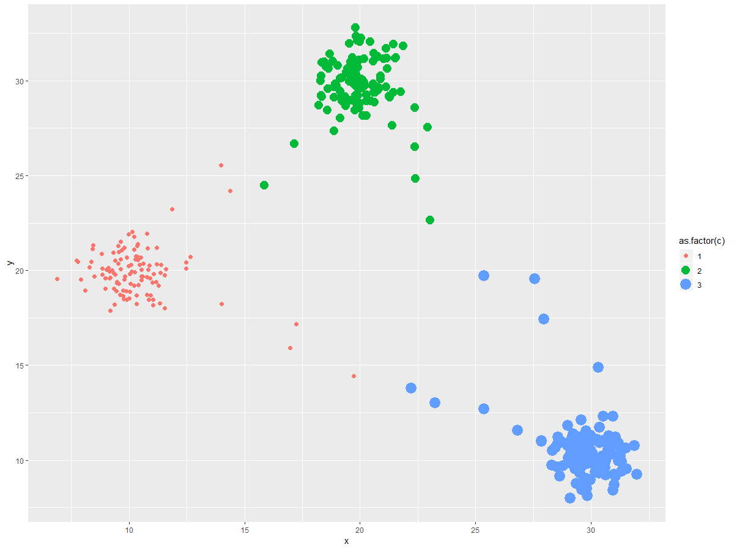
K-medoids Assigned Clusters (k = 3)

Slide 12
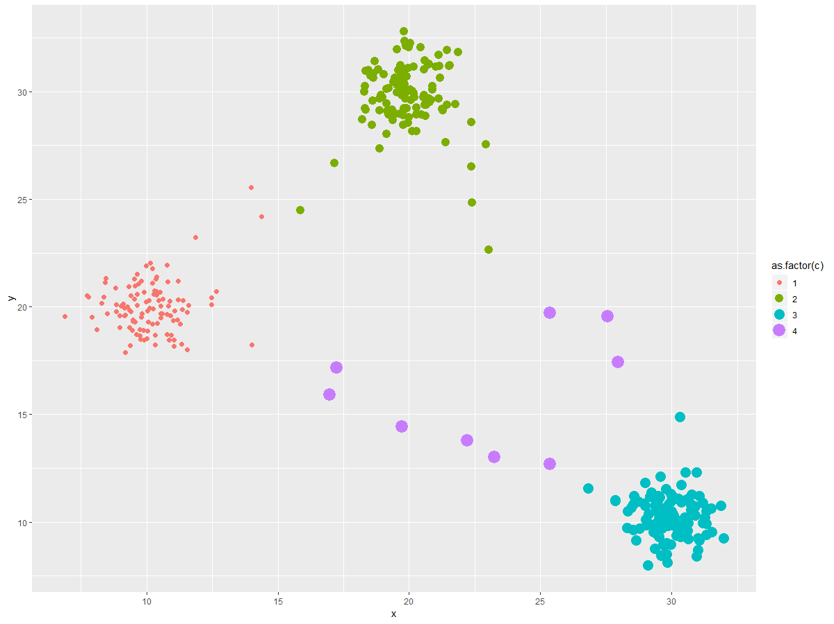
K-medoids Assigned Clusters (k = 4)

Slide 13

K-medoids Assigned Clusters (k = 4)

Slide 14
Traveler Clusters

Slide 15
Synthesizing Household and Person-Level Attributes Jointly for Individual Geographies Using Hidden Markov Model

Slide 16
Methodology
Uses HMM to perform multi-level (person and household) synthesis
HMM = Hidden Markov Model

Slide 17
Hidden Markov Model
Markov Process with Unobserved States
Markov Process
Selection depends on prior state

Slide 18
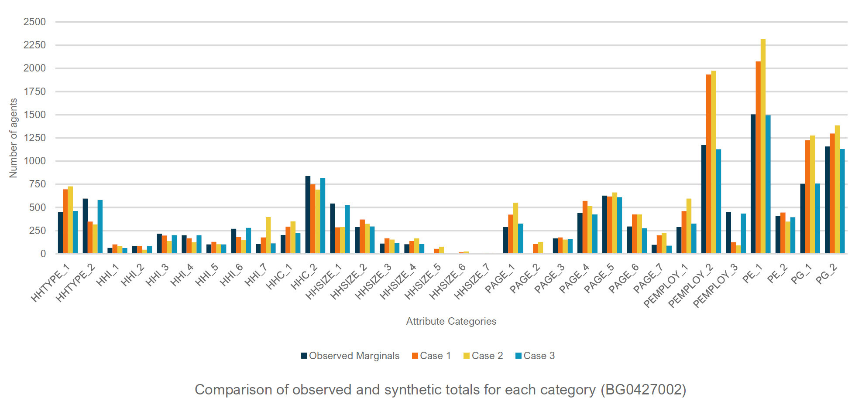
Case Study 1

Slide 19
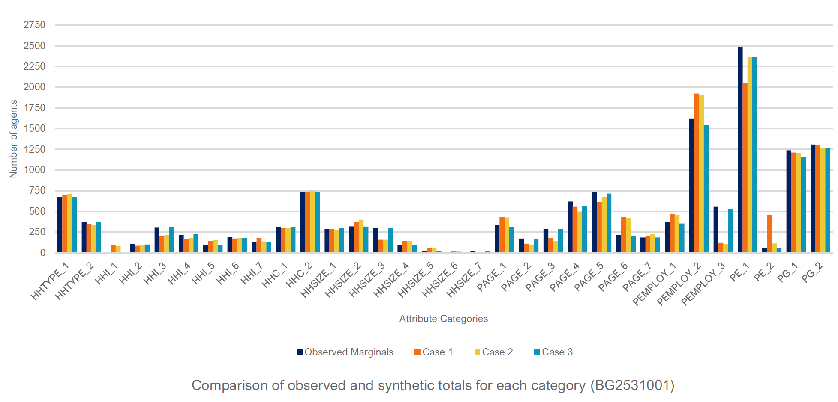
Case Study 2

Slide 20
Synthesizing Household and Person-Level Attributes Jointly for Individual Geographies Using Hidden Markov Model

Slide 21
Methodology
Uses Response Surface Methodology to iteratively adjust parameters
Response Surface Methodology:
A sequence of designed experiments to obtain an optimal response¹
1: Wikipedia, https://en.wikipedia.org/wiki/Response_surface_methodology, accessed 3/12/19

Slide 22
Methodology – Model Structure
TPMS calibration
TPMS validation
Parameters evaluation
Parameter adjustments
Adjustment solution selection
Evaluating the parameters
Doing RSM experiment
Evaluating the non-dominated adjusting solutions
Selecting the candidate parameters
Calculating non-dominated adjusting solutions
Evaluating the validity of each adjusting solution
Choosing the deviation range
Selecting some non-dominated adjusting solutions
Choosing the best adjusting solution
Proposed model structure for the calibration process
Notes:
In the TPMS calibration stage, the objective is to find a set of non-dominated solutions that can improve reproduction of the base-year statistics.
In the TPMS validation stage, the best fitted solution, in terms of reproducing the base year and validity, that at the same time is superior in term of model system’s prediction capabilities. can be obtained.

Slide 23
Pairing Discrete Mode Choice Models and Agent-Based Transport Simulation with MATSim

Slide 24
Methodology
Simulate Mode Choice
Score Against Data
Re-plan Mode Choice

Slide 25
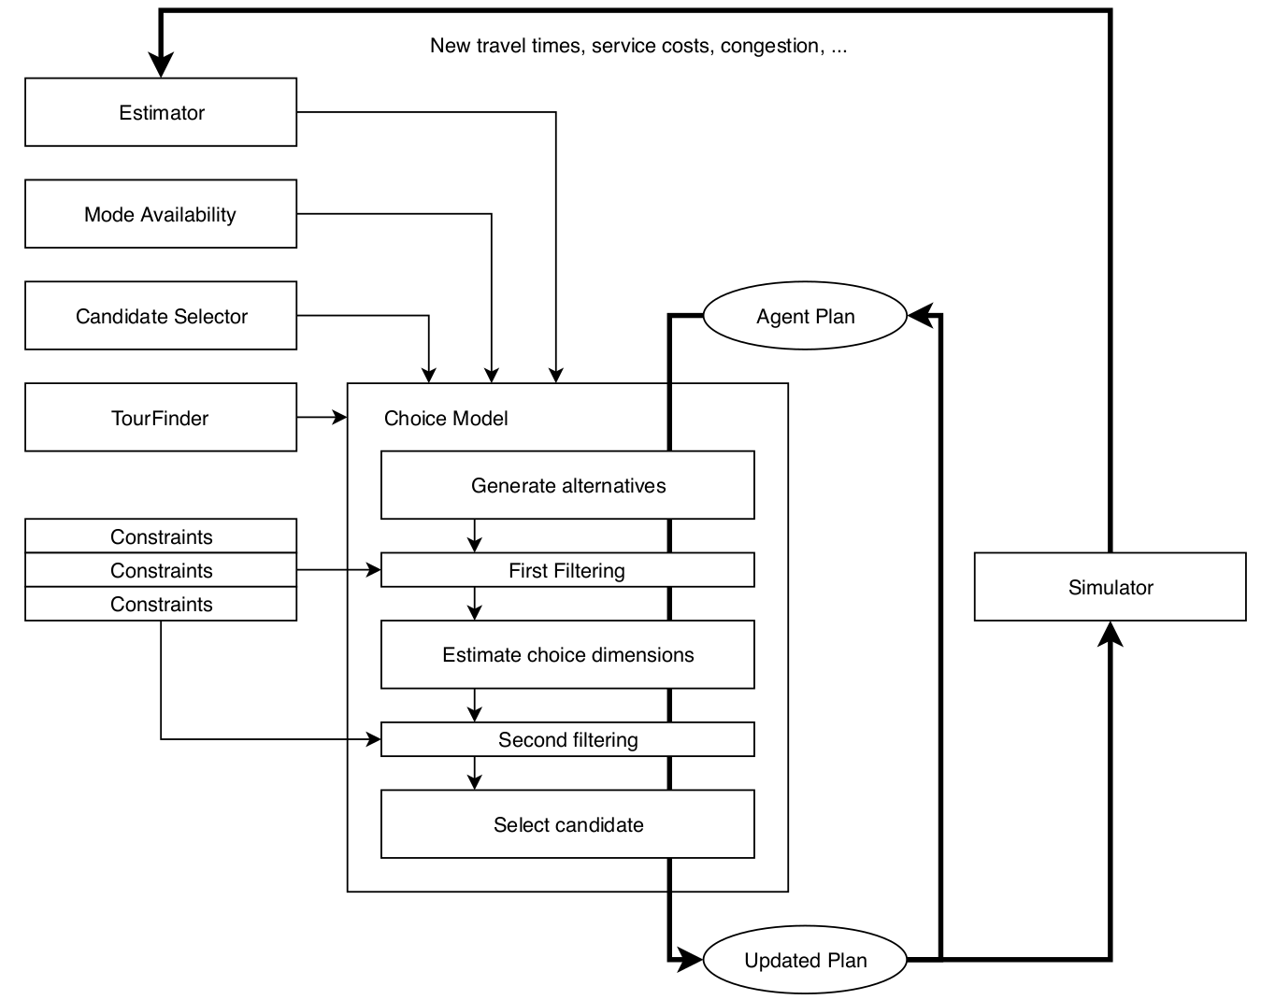
Methodology

Slide 26
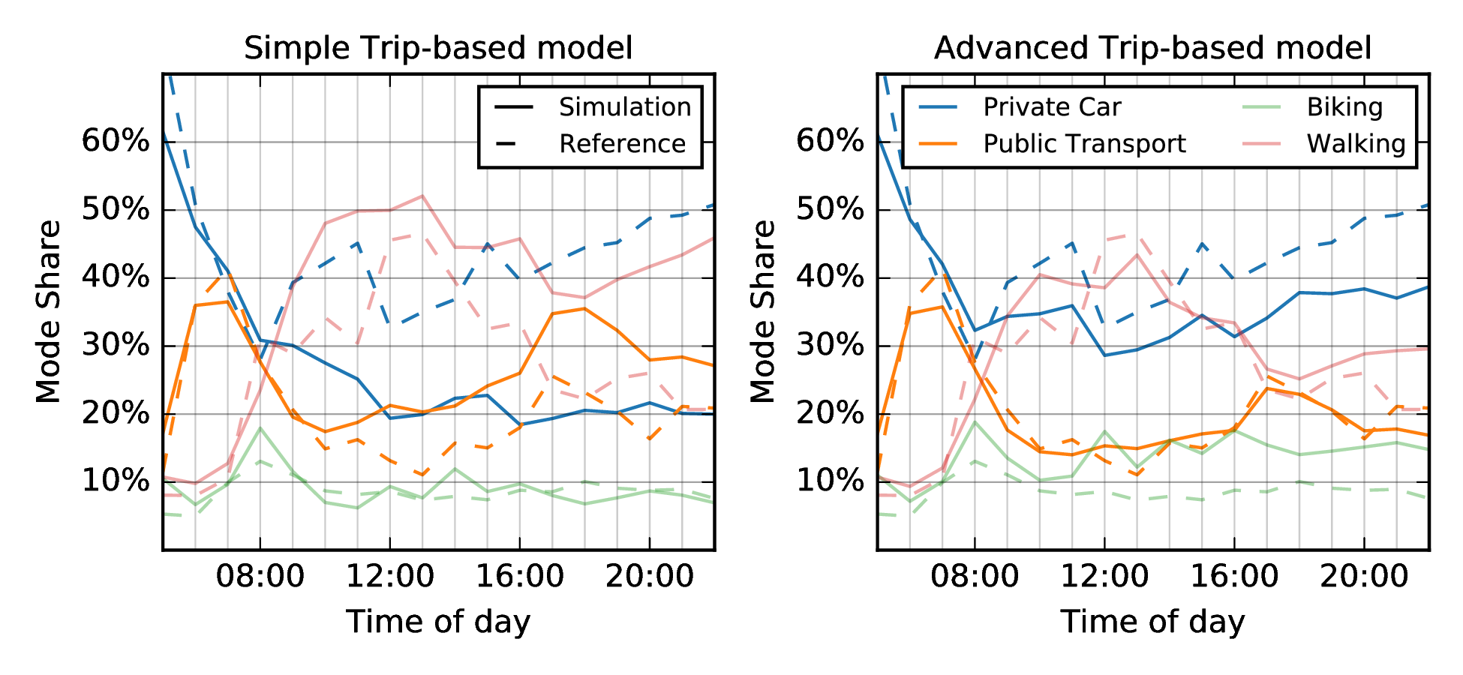
Case Study: Zurich
“Car cannot be used if it has not been moved to the current location.”
”Additionally, the car must arrive back at home.”
TRB 2019, 16 January 2019

Slide 27
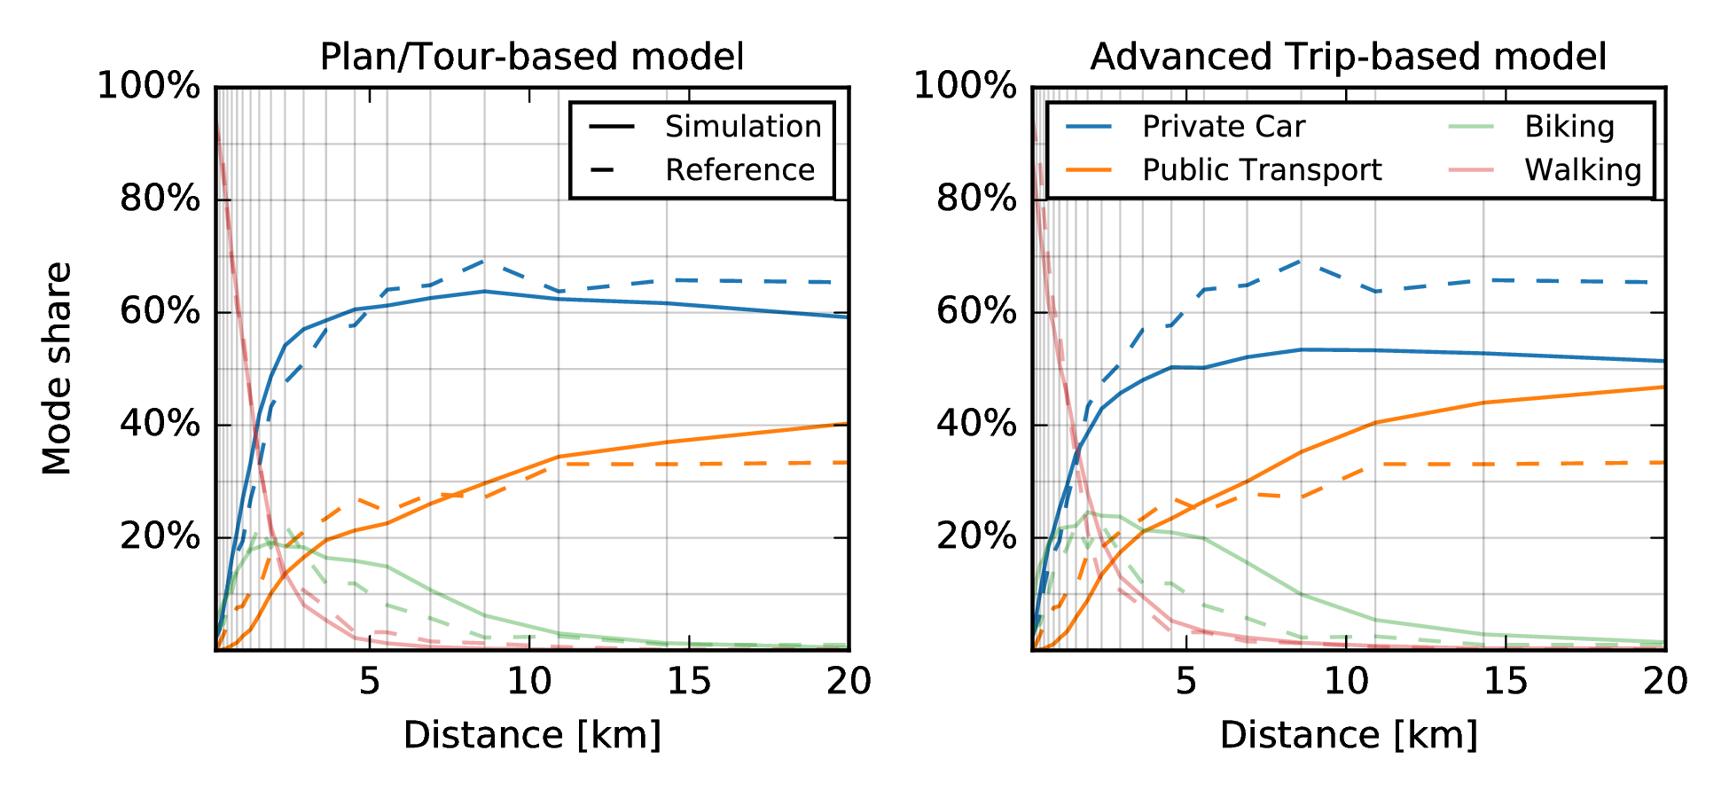
Case Study: Zurich
“I may need a car later on, although not on the first trip.”
TRB 2019, 16 January 2019

Slide 28
Bayesian Optimization for Transportation Simulators

Slide 29
Bayesian Optimization
Design Strategy for global optimization
Strategy…
Global Optimization: attempt to find the global minima or maxima

Slide 30
Bayesian Optimization Strategy
Objective Function (function to maximize or minimize) Unknown
Treat it as random + prior (probability distribution based on beliefs)
Function evaluations treated as data
Prior updated to form posterior distribution
Posterior distribution determines next query point

Slide 31
Global Maxima/Minima

Slide 32
Microscopic Travel Demand Modeling: Using the Agility of Agent-Based Modeling W/o the Complexity of ABMs

Slide 33
MITO Model
Agent-Based
Trip-Based
Accounts for travel time budgets
(and it’s open source)

Slide 34
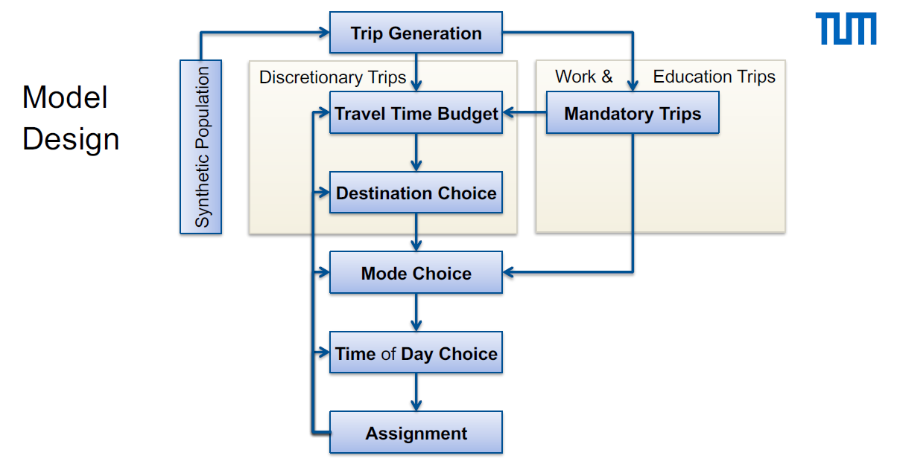
MITO Model Design

Slide 35
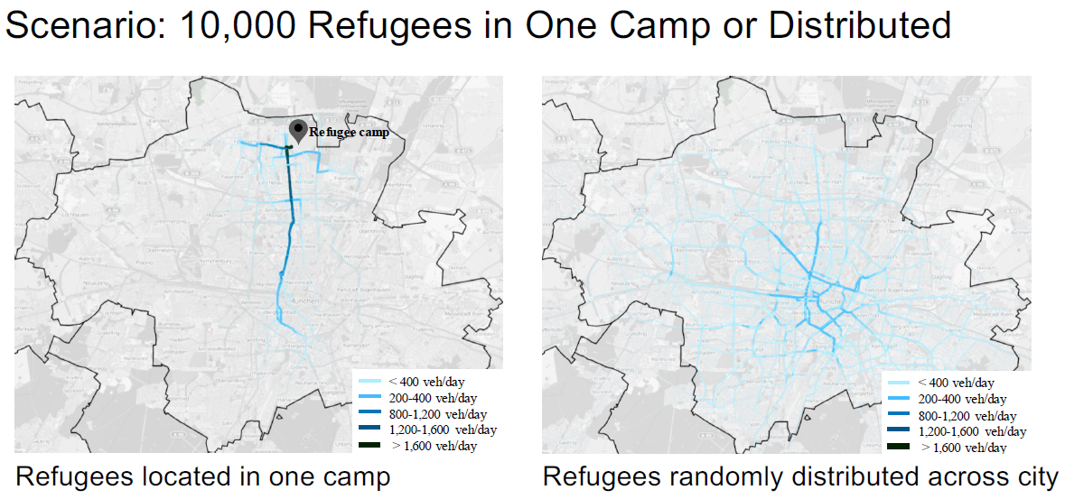
MITO Case Study

Slide 36
Model Averaging: Revisiting Our Approach to Decision Rule Heterogeneity and Improving Our Travel Behavior Models

Slide 37
Background
Random Utility Model vs. Random Regret Minimization vs. Decision Field Theory
Random Utility Model: “normal” models
Utility towards alternative varies across individuals
Utility randomness assumed normal
Random Regret Minimization models
Individuals’ urge to minimize regret after choice
Decision Field Theory
Preferences for alternatives update over time

Slide 38
Methodology
Estimated Models (RUM, RRN, DFT)
Weighted candidate models
Based on performance, e.g. Log-likelihood
Average Models
Provided better fit over one model

Slide 39
Calibrating Activity-Based Travel Demand Model Systems via Microsimulation

Slide 40
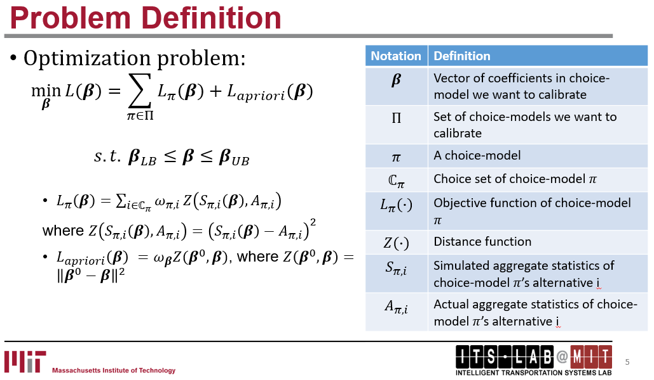
Methodology

Slide 41
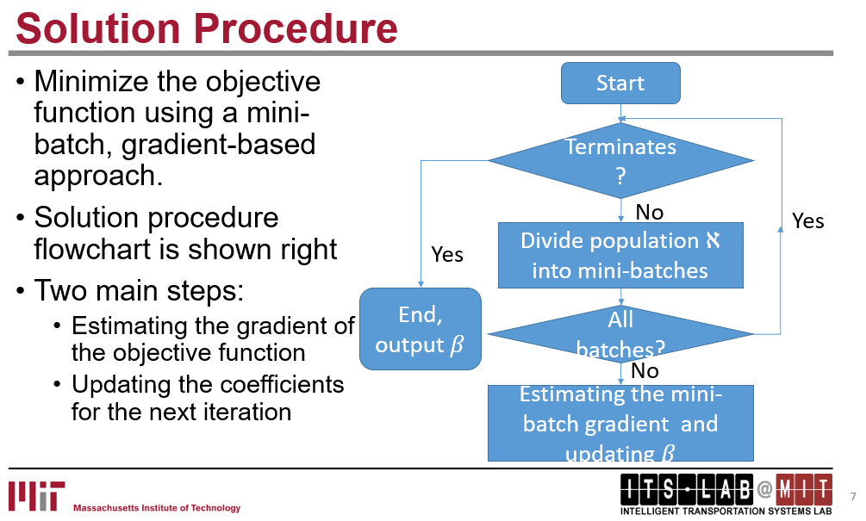
Methodology

Slide 42
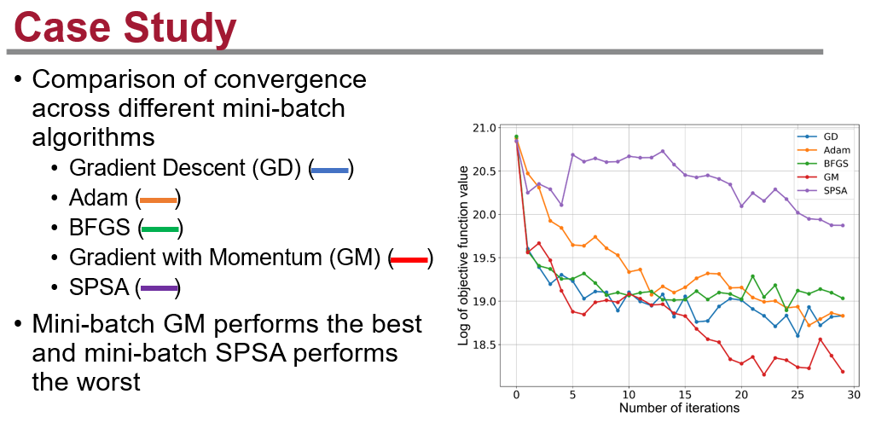
Case Study

Slide 43
Contacts
Andrew Rohne
Senior Consultant
andrew.rohne@rsginc.com
513-314-9901
www.rsginc.com

