Slide 1
Michigan Statewide Summer Weekday and Weekend Models
December 14, 2018
Vince Bernardin, PhD
Steve Tuttle
Nancy McGuckin

Slide 2

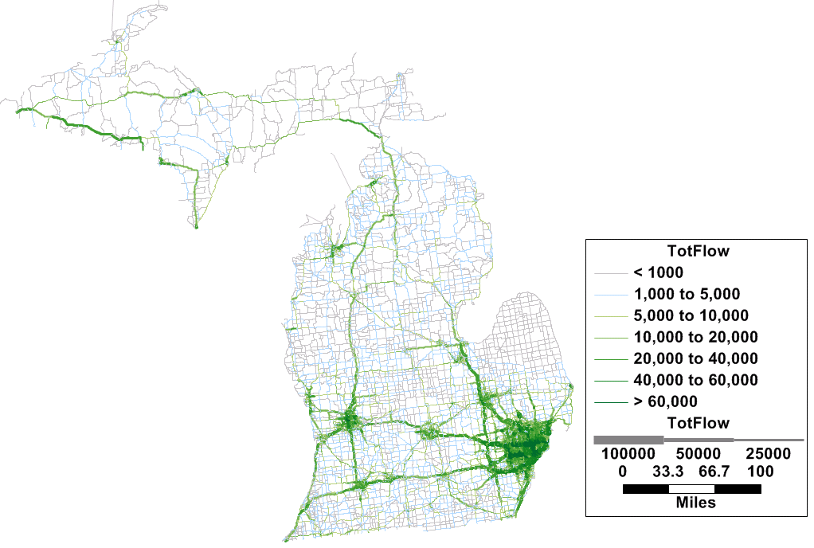
The New Michigan Statewide Model
One of the longest traditions of statewide modeling in the country since early 1970’s
Last major update was mid 1990’s
New model complete early 2019
Special Models:
CAVs
Summer (tourism)

Slide 3
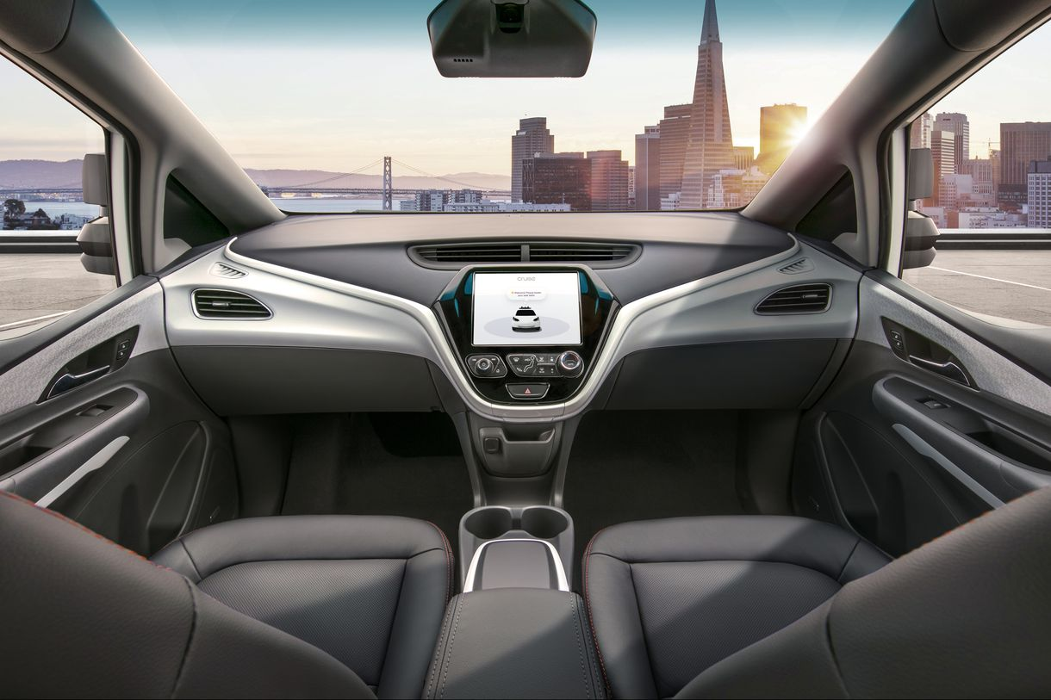

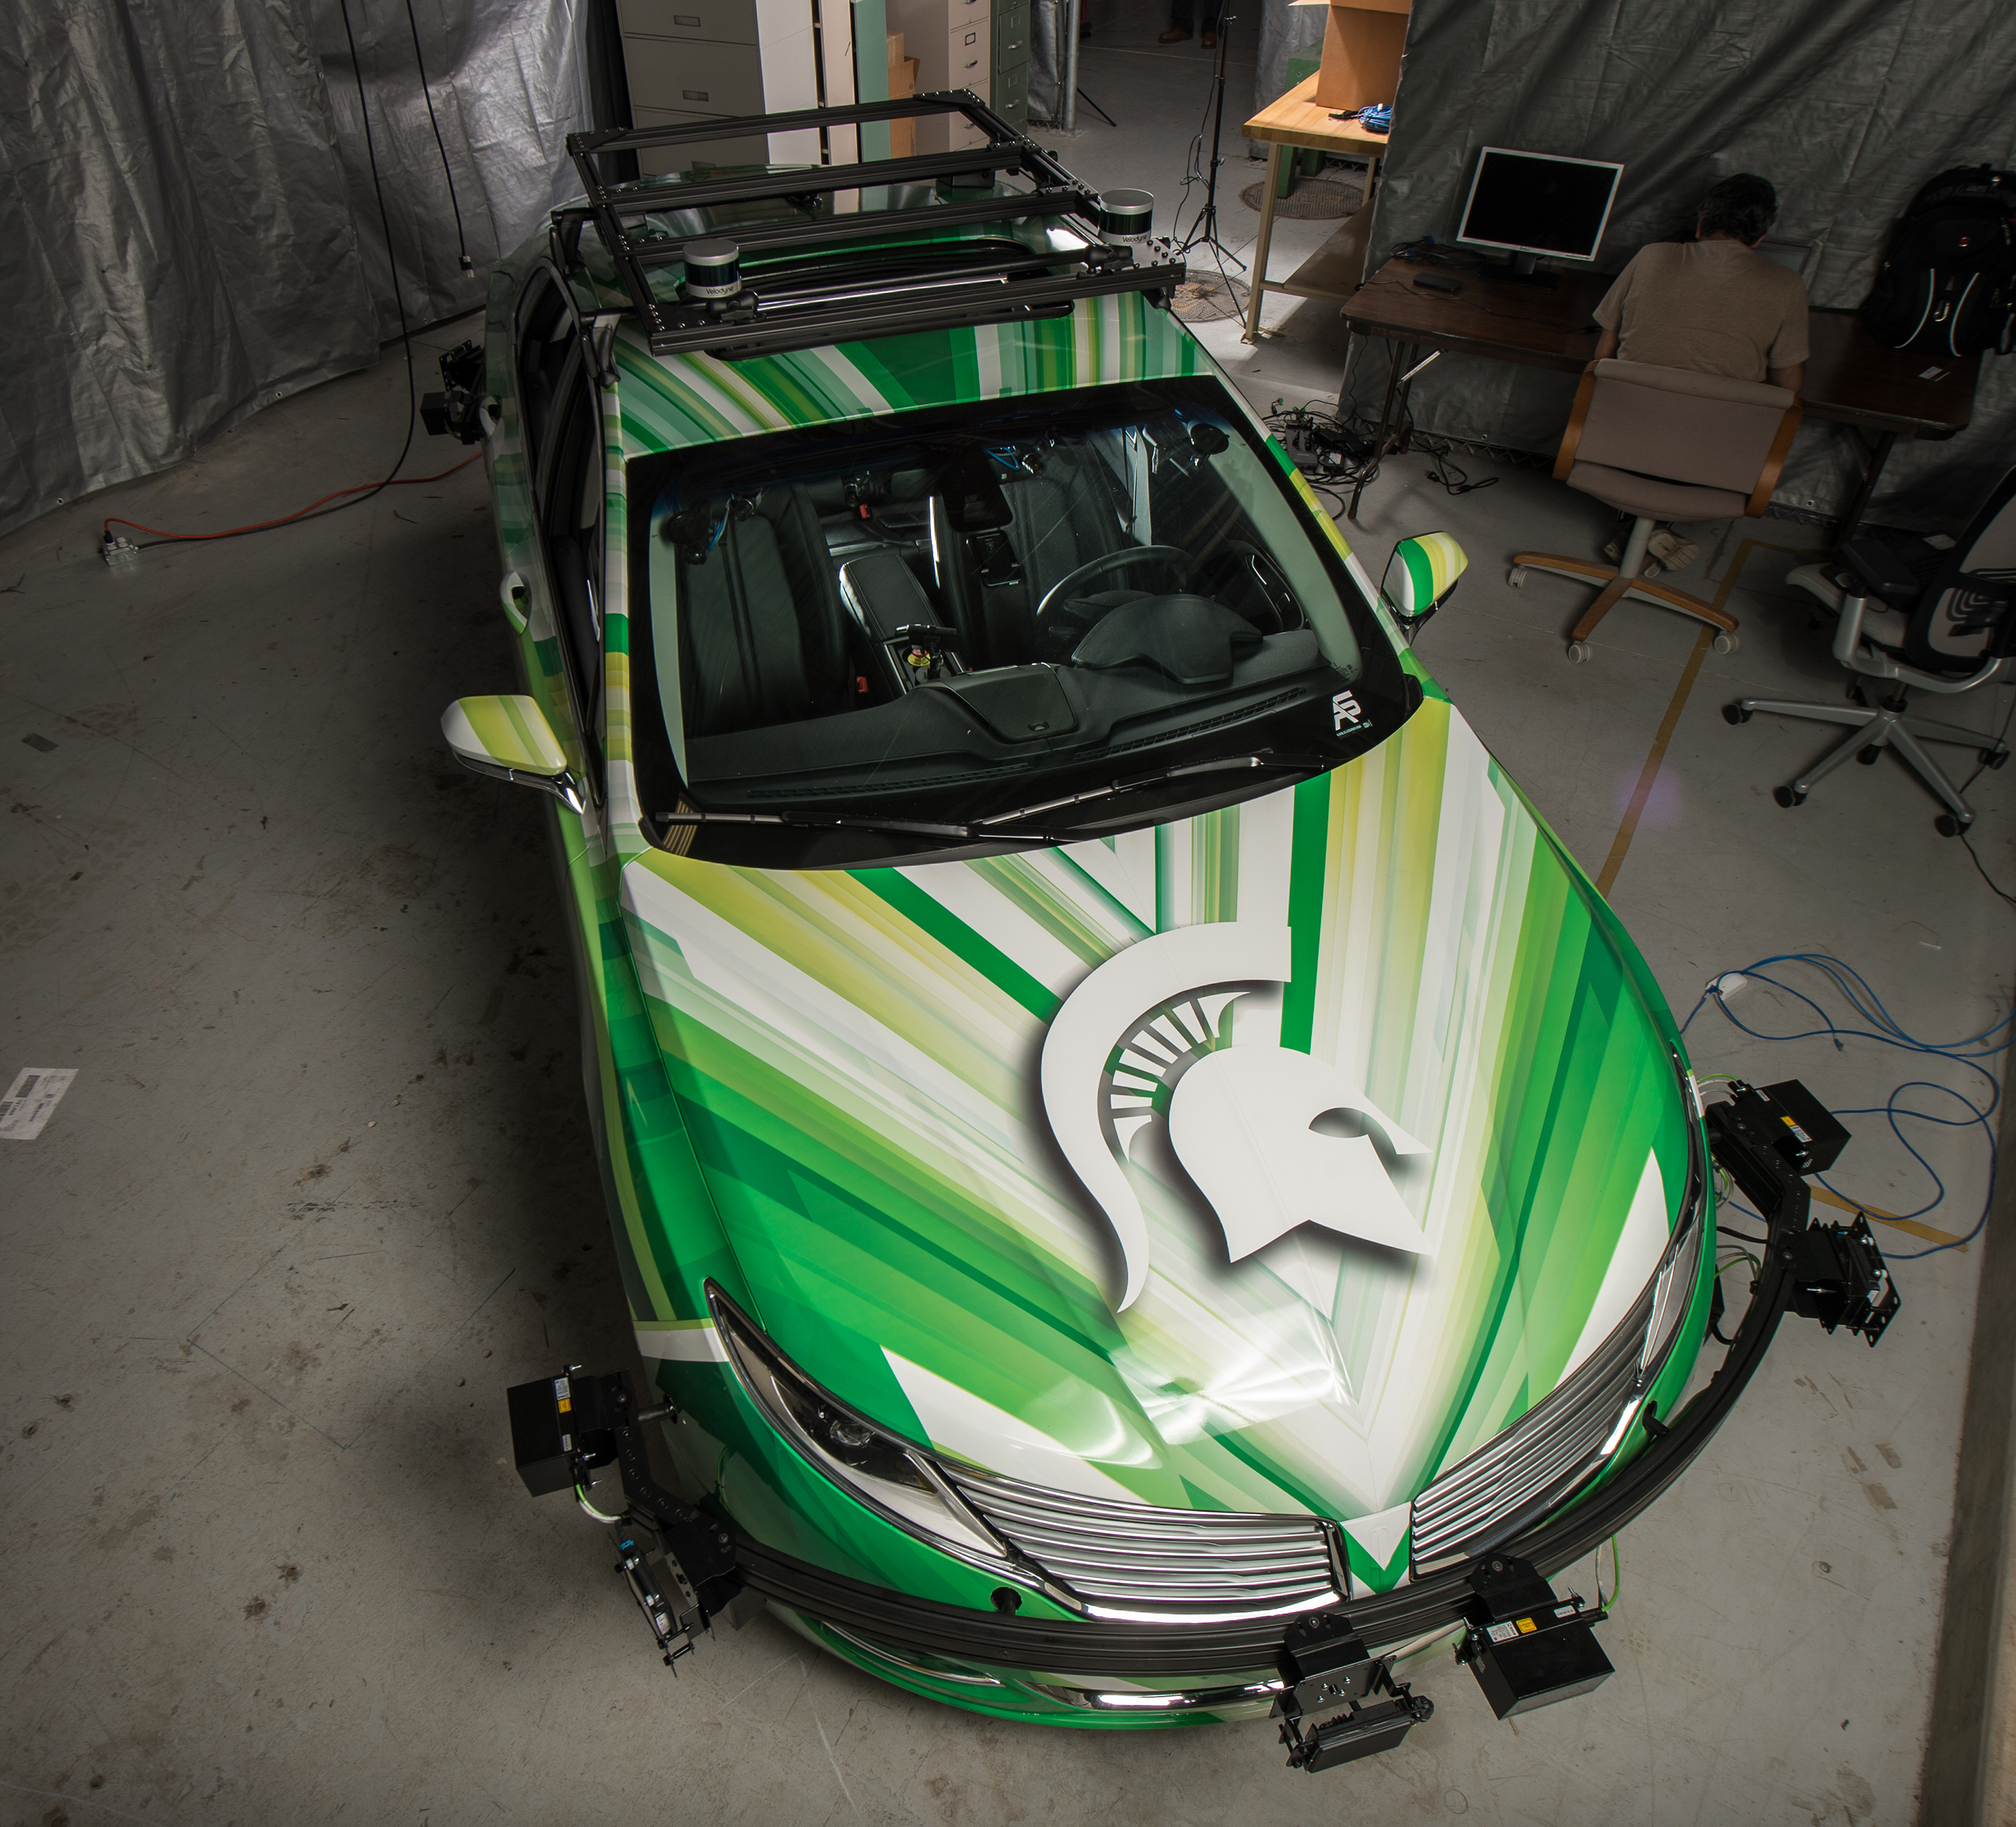
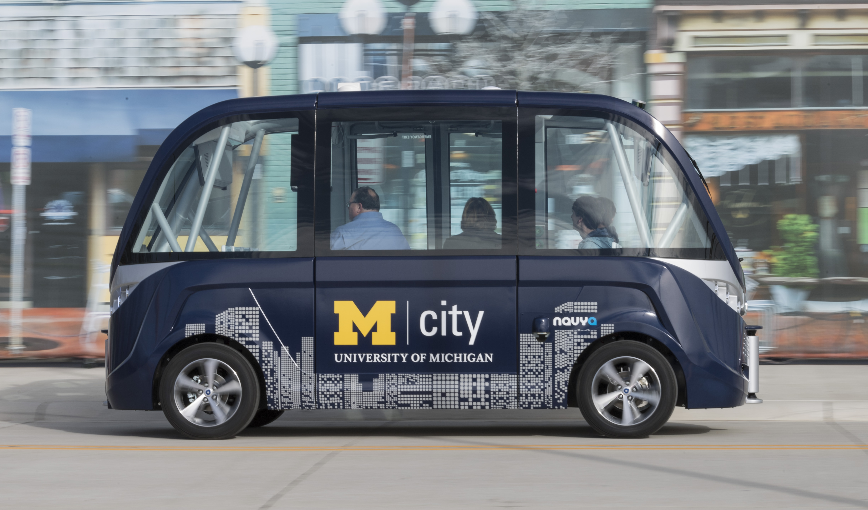
CAVs in Michigan
Home of the Auto Industry
All auto-makers actively investing in CAV technology
Public-Private Partnerships
Research rapidly moving into reality
U of M has been using autonomous shuttles for almost a year

Slide 4
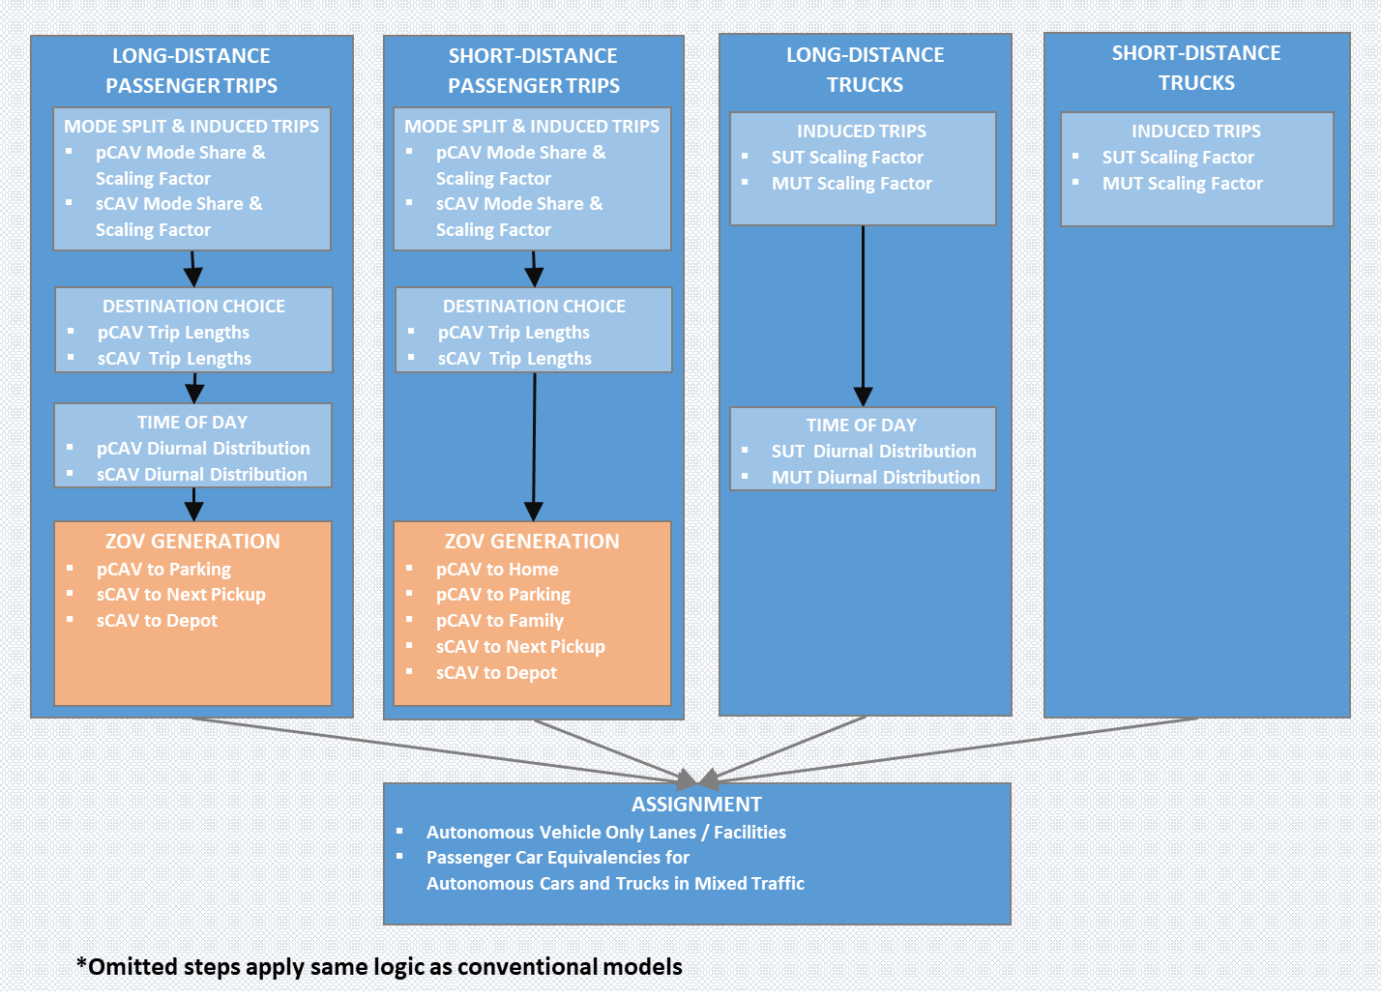
The Michigan CAV Framework

Slide 5


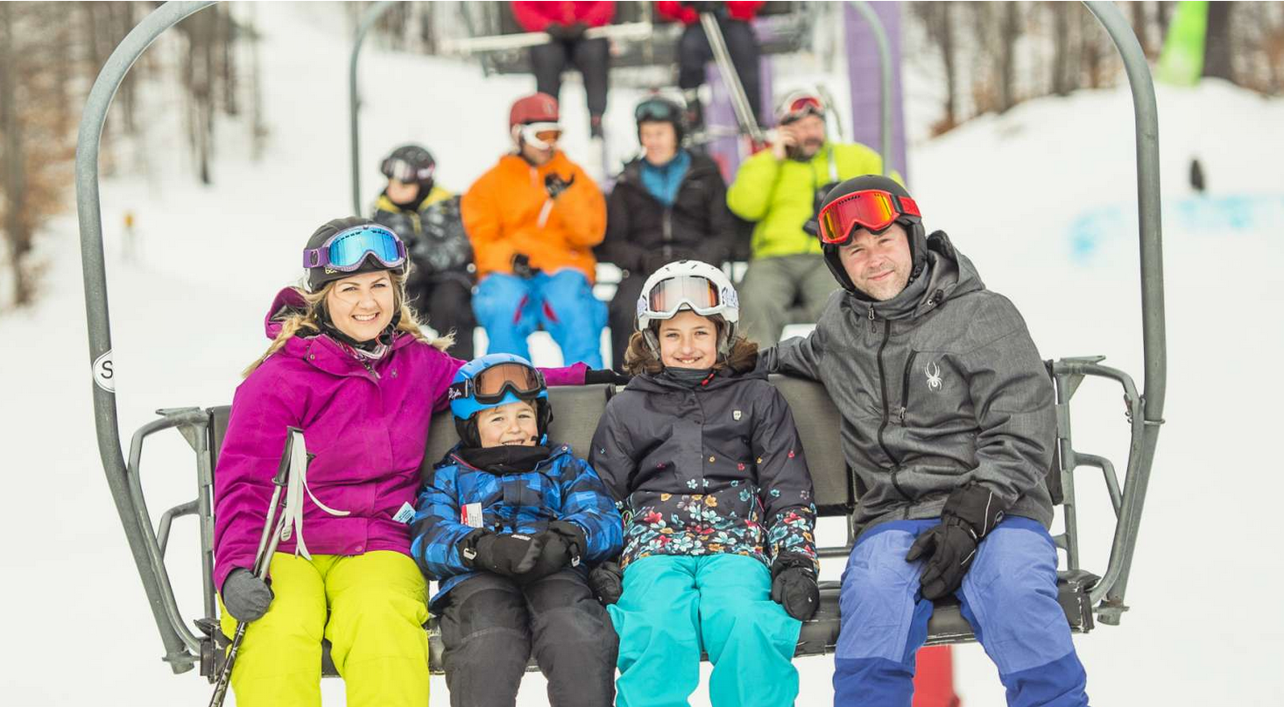
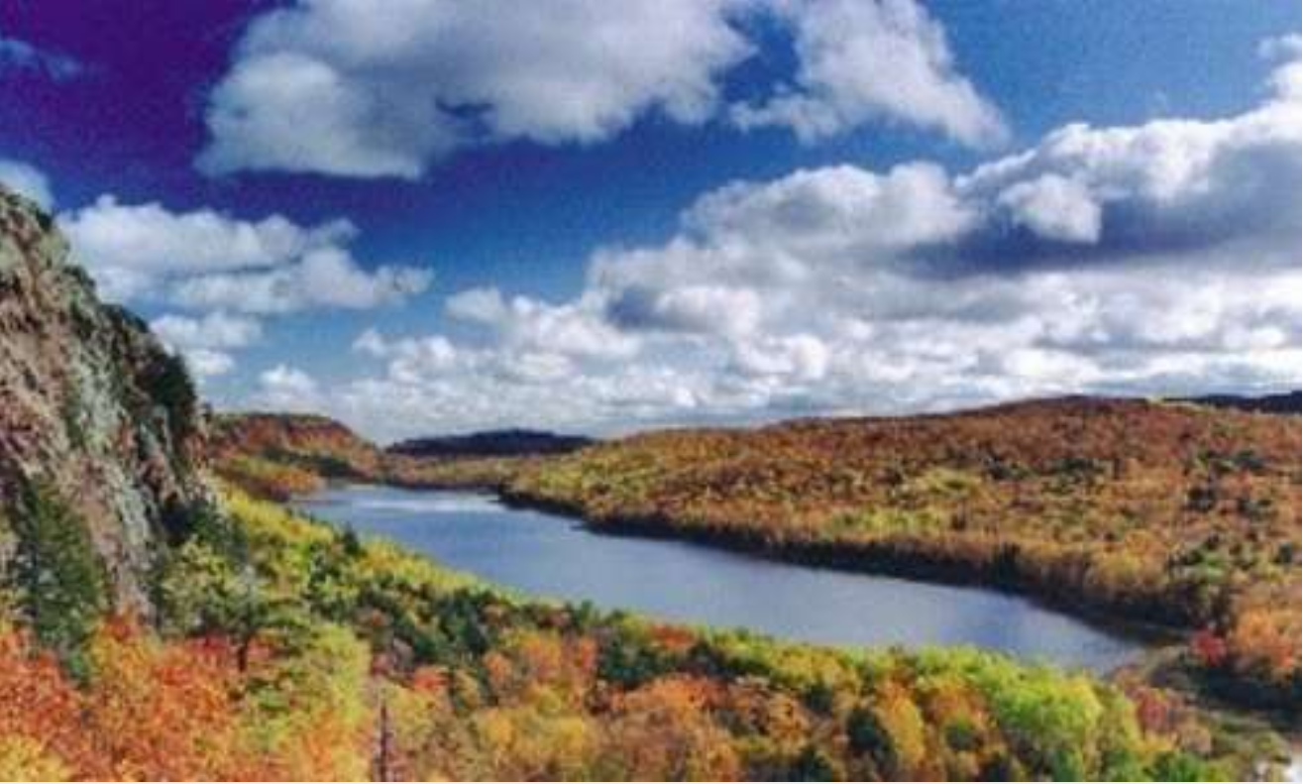
Michigan Tourism
Visitors injected $24.7 billion into Michigan economy in 2017
Which results in $2.7 billion in state tax revenue (compare to $1.2 billion gas tax revenue)
These figures have increased more than 25% since 2010

Slide 6
Model Design

Slide 7
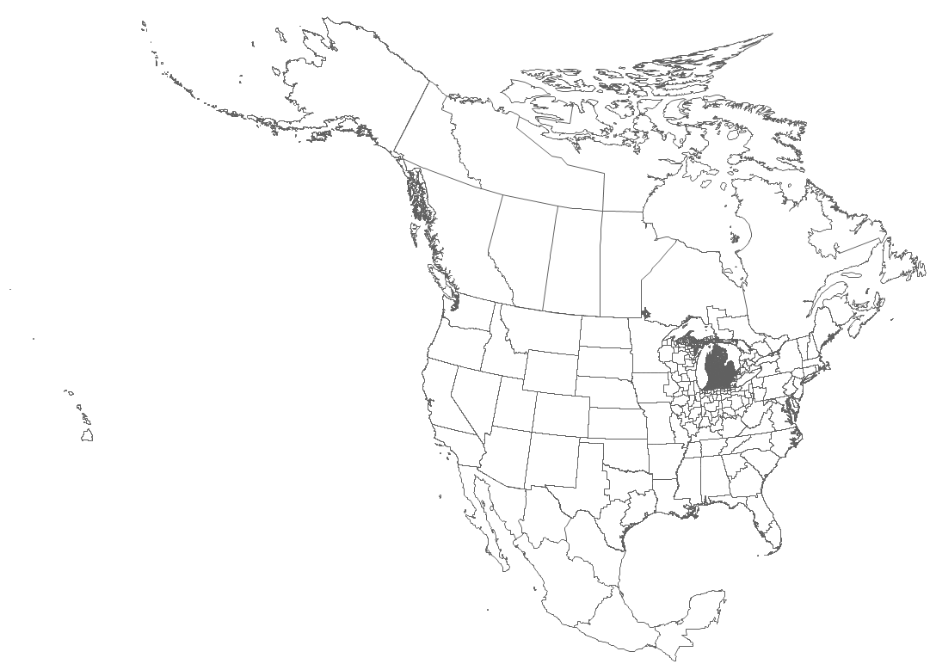
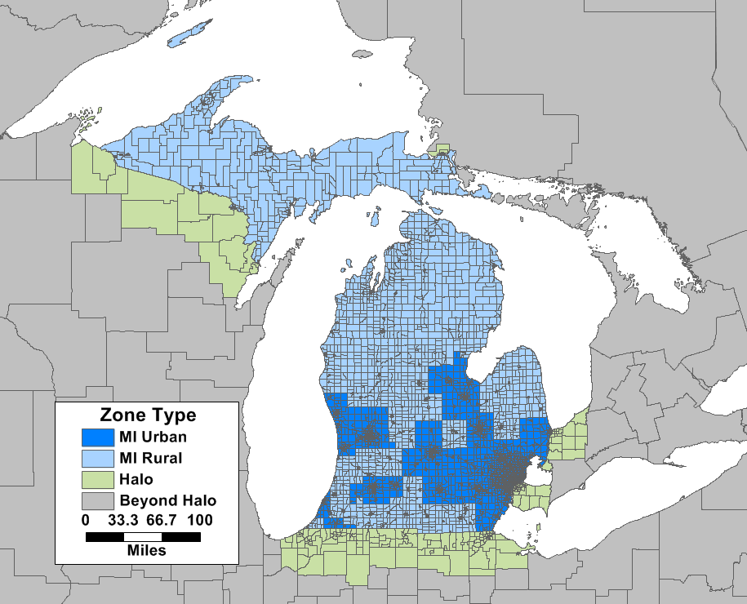
Model Scale and Boundaries
4,792 Zones
2,275 MI Urban
2,156 MI Rural
200 Halo
161 Beyond Halo

Slide 8
Passenger Demand Models
Short Distance
< 50 miles and near home
7 purposes on Work/Other Tour
Michigan + Halo residents only
Long Distance
> 50 miles and one end near home
4 purposes for MI + Halo residents
Single purpose for Other USA & Canada residents
Separate Auto and Airport Ground Access
Visitor
Both ends away from home
Linked to long-distance model
Single purpose

Slide 9
Advanced Trip-Based Framework
Household Synthesis
Trip Purposes by Tour Type in Short Distance Models
Model linkages (HB -> NHB & Long-Distance -> Visitor)
Long-Distance Trips
Visitor Trips
Trip Generation
Destination Choice
Trip Generation
Greater Michigan
Greater Michigan
Other
Other
Destination Choice

Slide 10
Seasonal Models
Three Periods
Typical / Fall Weekday
Summer Weekday
Summer Weekend
Approach
Summer and Fall models share the same code, design, and estimated parameters
Differences
Calibrated to different trip rates, lengths
Different observed base ODs for pivoting

Slide 11
Data Sources

Slide 12
Data Sources and Model Estimation
Source | Short | Long |  | Visitor Travel | Summer Update
 |  | MI | Other*
Daily HH Survey -227K Records | Main | Main |  | 2nd
Long-Distance Recall -17K Records |  | 2nd
Passive OD Data -July/Oct; Weekday/end (H,I,J) | 2nd | 2nd | Main | Main | Main
2017 NHTS |  | 2nd | 2nd |  | 2nd
*Also includes Canada ODs based on bordering crossing survey

Slide 13
AirSage Expansion

Slide 14
Passive OD Expansion
Network and AADT Counts
Raw AirSage
Scaling
OD Expansion Factors
Iterative Screenline Fitting
Parametric-Scaling
Address Trip Duration Bias
Final ODME

Slide 15
HH Survey and Expanded AirSage
 | Scaled AirSage** | Expanded AirSage | Household Survey
Daily Trips* | 18.7 M | 21.5 M | 21.4 M
Trip Distance* | 14.6 miles | 8.2 miles | 7.1 miles
*Resident, Internal, Non-Intrazonal Vehicle Trips
**Raw data scaled to have zero daily percent error in assignment

Slide 16
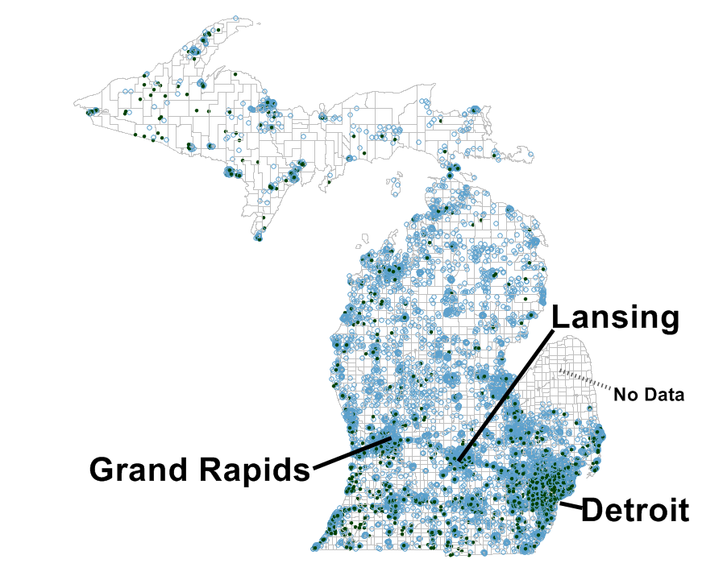
AirSage Long-Distance Attractions
Attractions
20 MI Resident
20 Not MI Resident
*only trips > 50 miles

Slide 17
Seasonal Factors from Passive Data

Slide 18
Seasonal Factor Estimation
Fall AirSage Expansion
Outputs used in:
Model Calibration
OD Pivoting
Traffic Counts
Expanded Fall
Raw Fall AirSage
Expansion Factors
Raw Summer AirSage
Expanded Summer
Summer AirSage Expansion

Slide 19
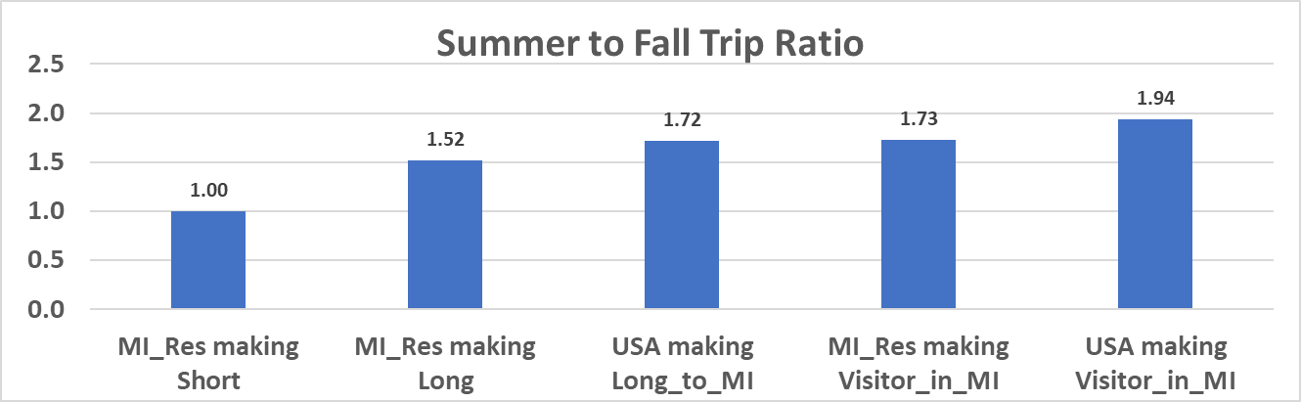
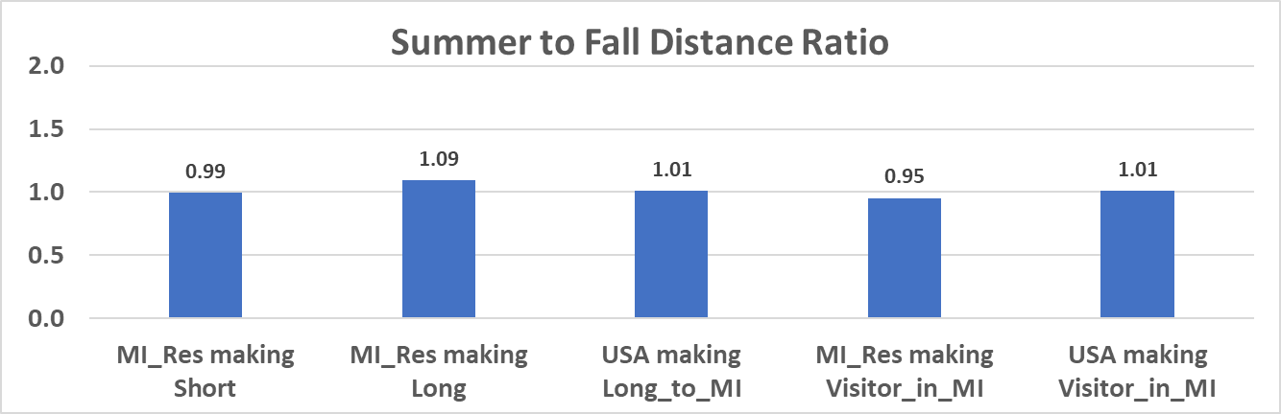
Summer / Fall Comparisons

Slide 20
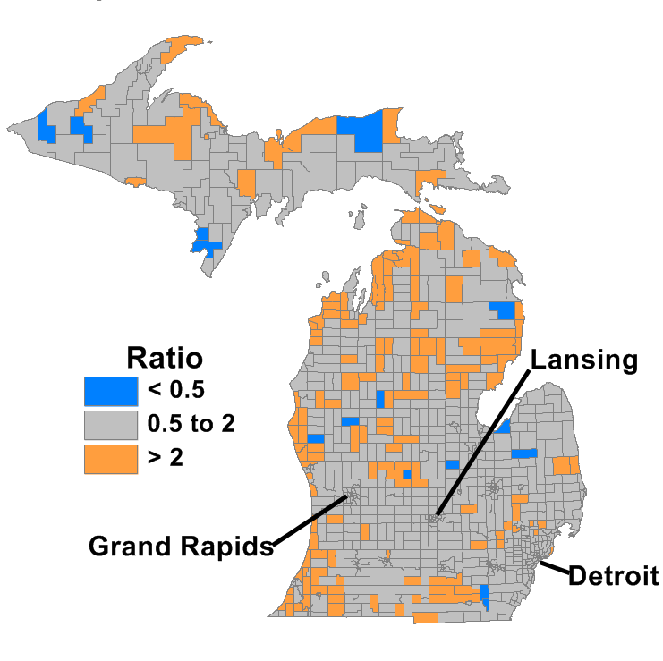
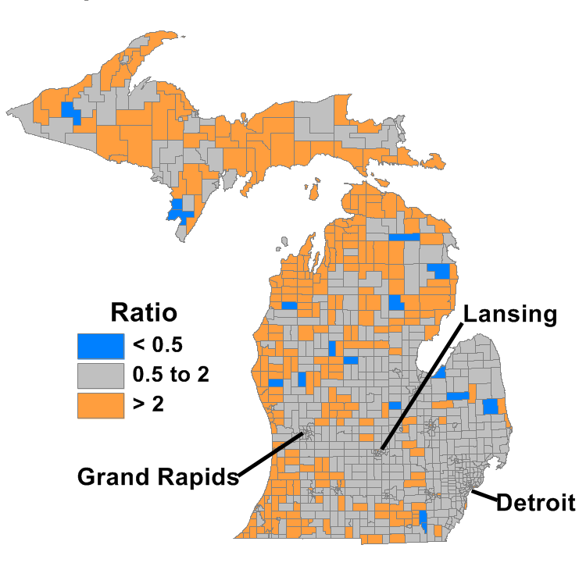
Observed Summer to Fall Ratio: Long Distance and Visitor Trips
Long-Distance Destinations
Visitor Trips

Slide 21
2017 NHTS Seasonal Trips

Slide 22
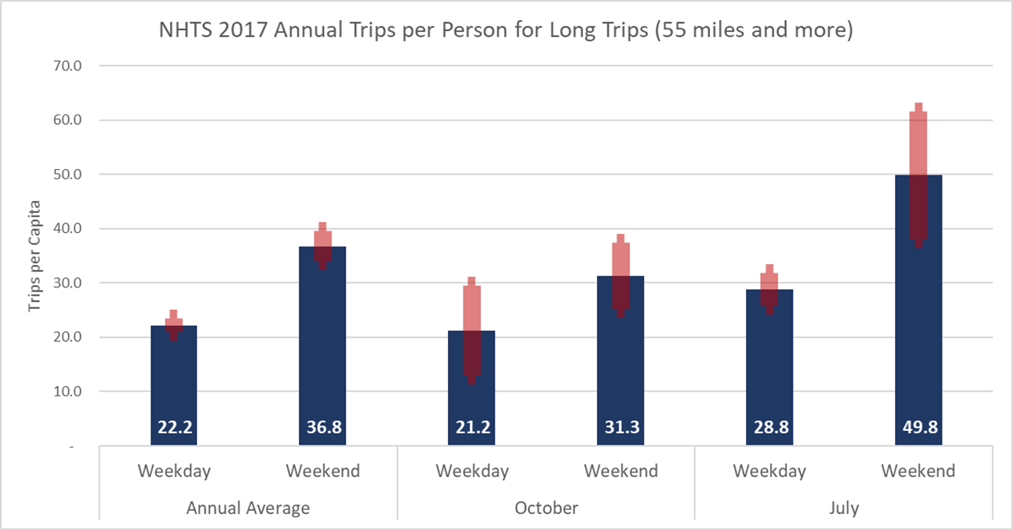
Person Trip Rates

Slide 23
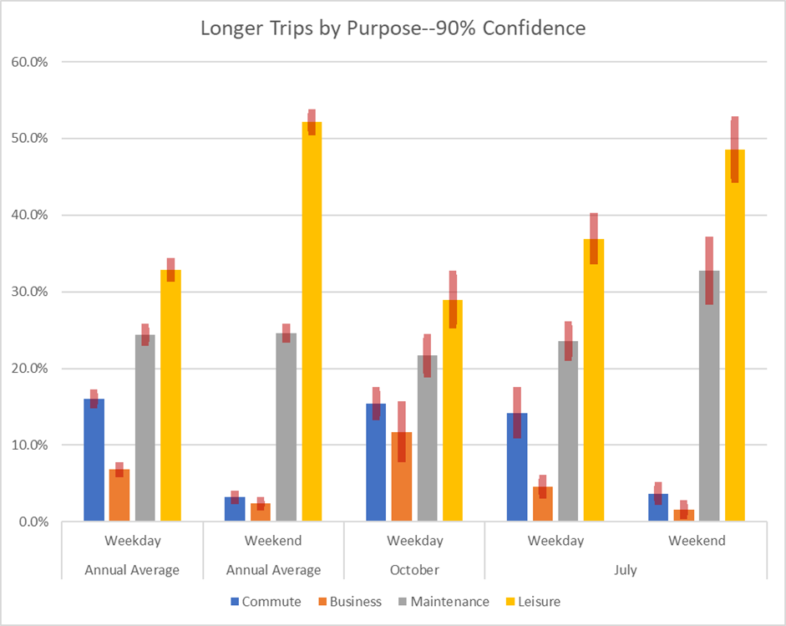
LD Person Trip Rates
Higher Weekend Leisure
Lower Weekend Commute and Business
Higher July Leisure
Lower July business

Slide 24
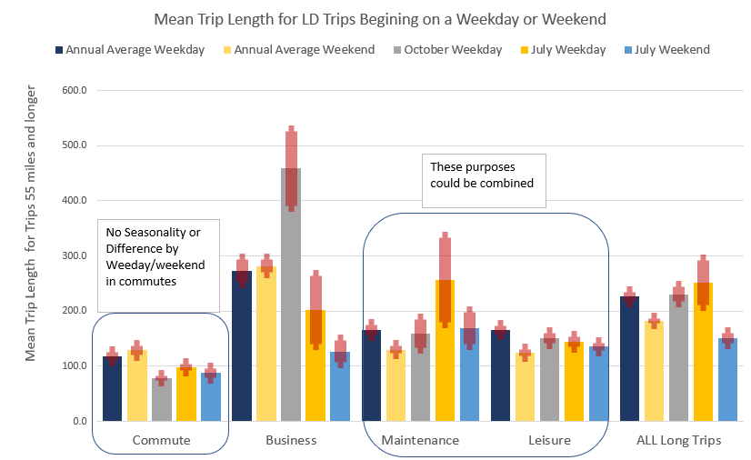
LD Trip Distances

Slide 25
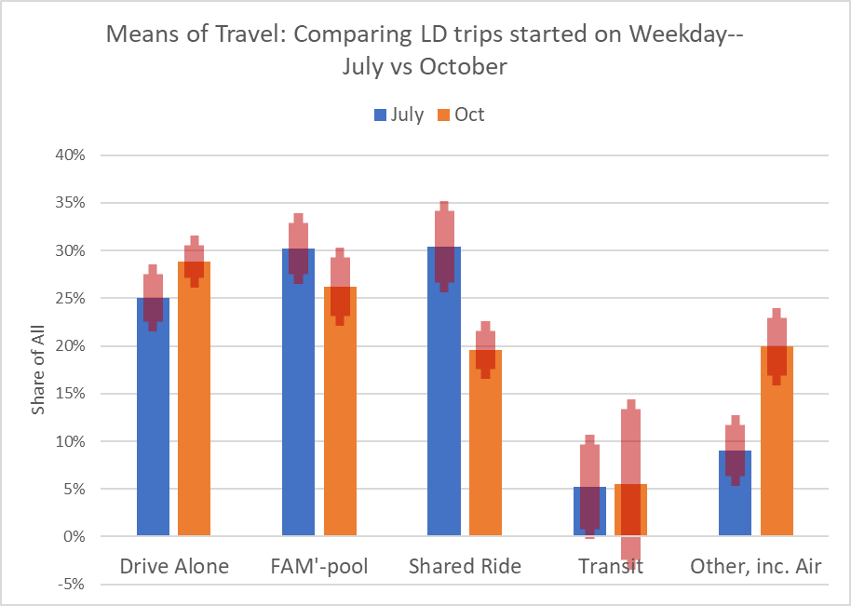
LD Mode Shares
Higher Summer Vehicle Occupancy

Slide 26
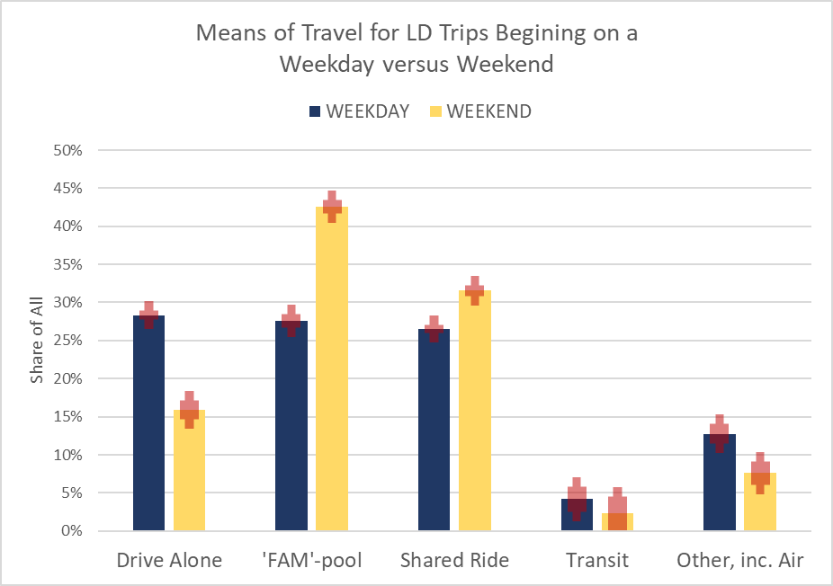
LD Weekday/Weekend Mode Shares
Higher weekday drive alone
Higher weekend HOV/fampool

Slide 27
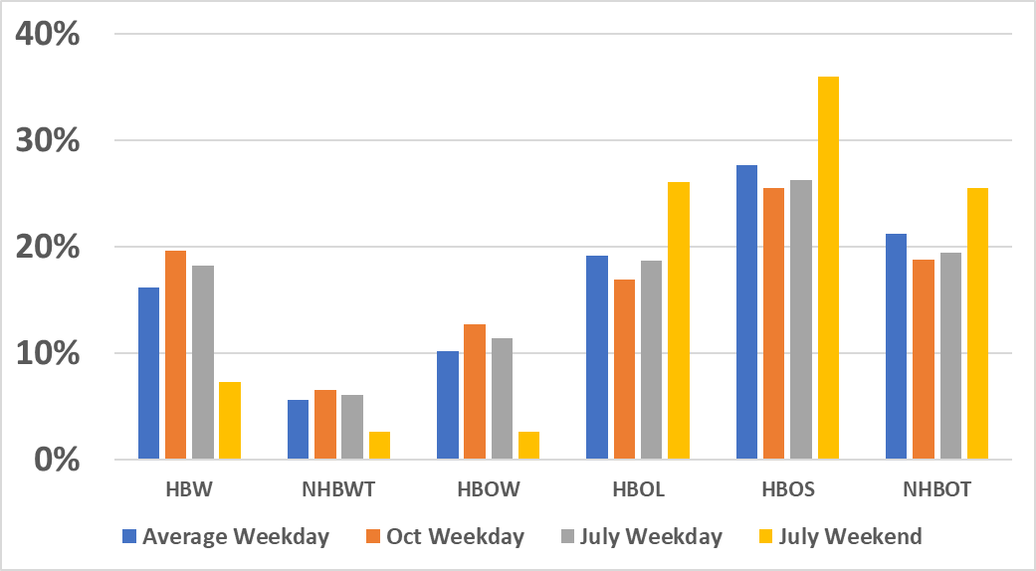
SD Trip Purpose Shares
NHBWT:
NHB on Work Tour
HBOW:
HBO on Work Tour
HBOL:
Long Duration HBO on Other Tour
HBOS:
Short Duration HBO on Other Tour
NHBOT:
NHB on Other Tour
Draft analysis
Reweighted After Dropping HBSCH (needs review)

Slide 28
Long Distance Models

Slide 29
Long-Distance Generation
 | Variable | Commute | Business | Main-tenance | Leisure
Agent | HH Workers | ▲ | ▲
 | HH Persons |  |  | ▲ | ▲
Demographic | Income | ▲ | ▲ | ▲ | ▲
 | Has Children | ▼ |  | ▼ | ▼
 | Has Senior |  |  | ▲ | ▲
Location | Urban | ▼ | ▼ | ▼ | ▼
 | Detroit | ▼ | ▼ | ▼ | ▼
 | Up Peninsula |  |  | ▲ | ▼

Slide 30
Attraction Variables in Destination Choice
 | Variable | Business | Commute | Main-tenance | Leisure
Employment | Accommodations | 120.8 | 0.0 | 27.9 | 75.5
 | Entertainment | 87.7 | 4.5 | 0.0 | 60.6
 | Retail and Dining | 25.1 | 2.1 | 35.1 | 7.1
 | Health & Social | 24.3 | 3.9 | 31.6 | 0.0
 | Office | 28.0 | 6.0 | 3.2 | 0.0
 | Government | 30.4 | 4.7 | 19.2 | 0.0
 | Other Emp | 1 | 1 | 1 | 0.0
Households | Households | 0.0 | 0.0 | 1.6 | 1.0
Amenities | Park Area | 0.0 | 0.0 | 0.0 | 2.1
 | Great Lakes (log area) | 0.0 | 0.0 | 0.0 | 0.0
 | Interior Lake (log area) | 0.0 | 0.0 | 0.0 | 368.6

Slide 31
Visitor Model

Slide 32
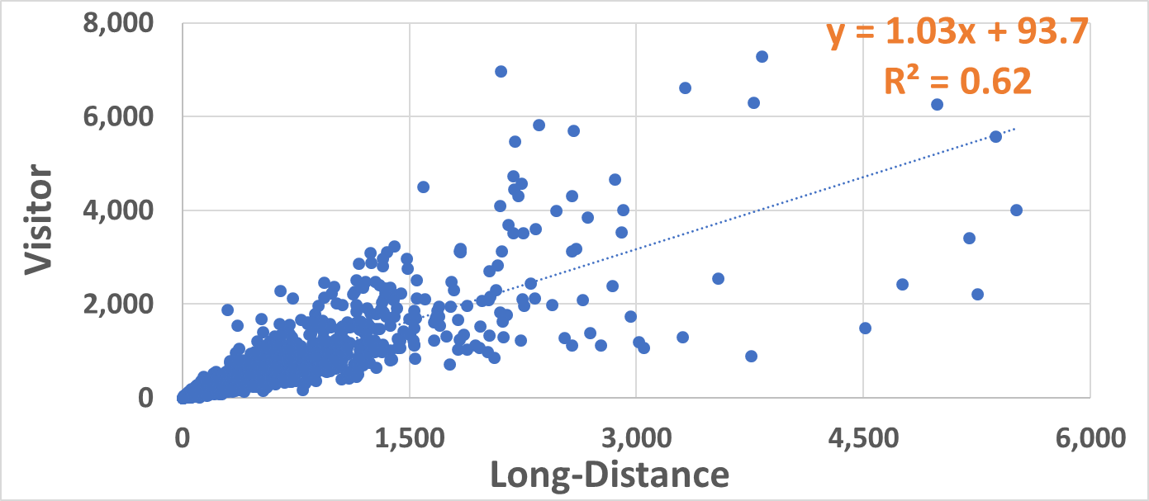
Visitor vs. Long-Distance Trips
Good Correlation
Not all visitor travel explained by long-distance
*AirSage Zones in MI excluding DTW

Slide 33
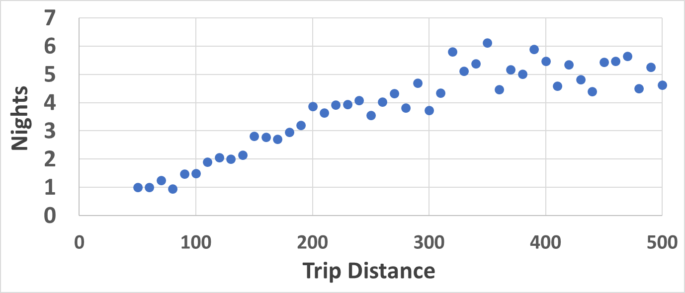
Average Trip Duration vs. Distance from Home
Longer Distance >>> Longer Duration
Longer Duration >>> More Visitor Trips (per LD)
From Recall Survey (which may favor longer duration trips)

Slide 34
Visitor Model
Distance | Variable | Coef.
< 125 Miles | Long Distance Trips | 1.922
 | Lake Area (sq miles) | 0.322
 | Park Area (sq miles) | 0.173
 | Retail Employment | 0.044
> 125 Miles | Long Distance Trips | 2.747
 | Lake Area (sq miles) | 4.857
 | Park Area (sq miles) | 3.276
 | Retail Employment | 0.255

Slide 35
Contacts
Vince Bernardin, Jr, PhD
Director of Travel Forecasting
Vince.Bernardin@rsginc.com
www.rsginc.com

