Slide 1
Eclipse Modeling
Andrew Rohne
November 13, 2020

Slide 2
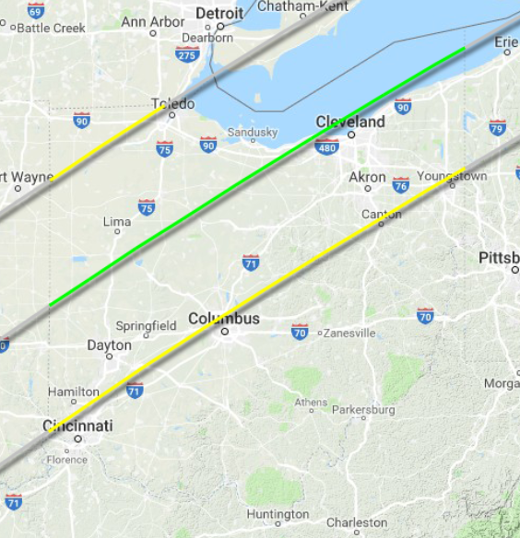
Eclipse 2024!
April 8, 2024
Enters State at 1:52 PM
Totality Begins: 3:08 PM
Totality Ends: 3:19 PM
Leaves State at 4:30 PM
Everything between the yellow lines is in totality

Slide 3

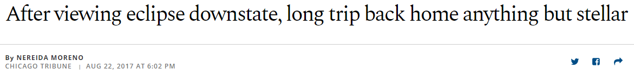
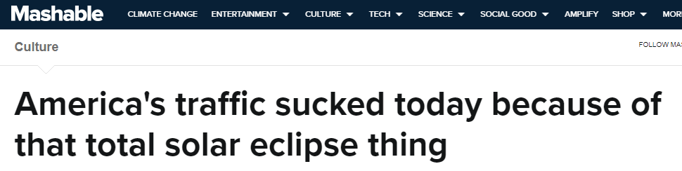
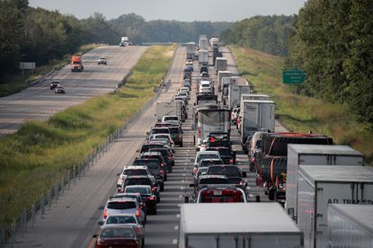
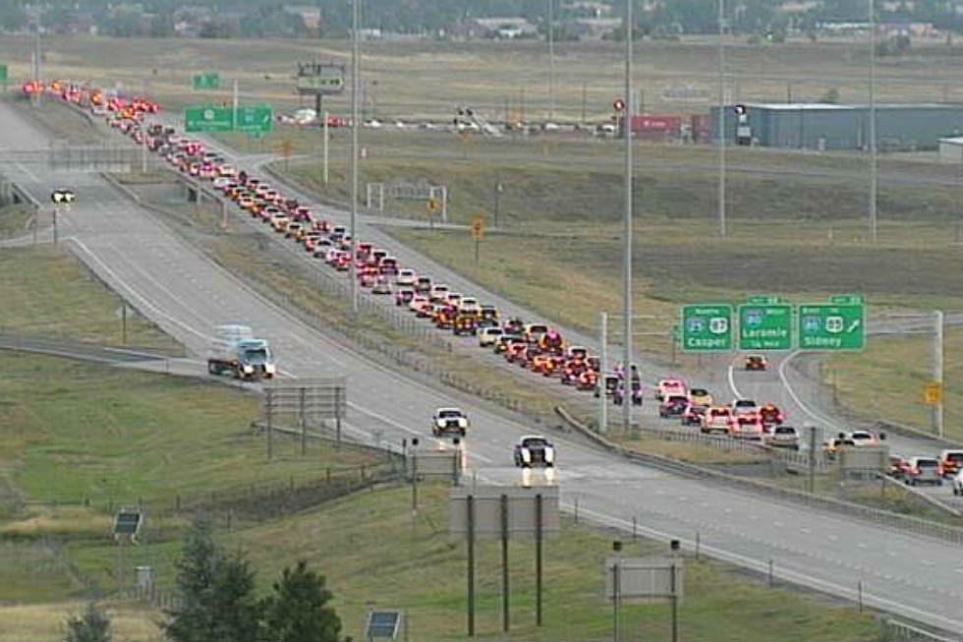
Why?

Slide 4

Learn from others’ mistakes!
Use Observed Passive Data from 2017 to Forecast Impacts on Ohio

Slide 5
Entire Project
Passive Data
?
Expansion
Local State Model
Model SEDATA
Expanded Trip Table
Traffic Counts
Trip Gen Models
Ohio STM
Just Starting
Phase I
Distribution Models
Application
Traffic Impacts on Ohio

Slide 6
Project Scope – Phase I
Evaluate Passive Data – Streetlight vs. rMerge
Evaluate Models to use for Expansion – Kentucky vs. Tennessee vs. rJourney National LD Passenger Model
Collect and Evaluate Traffic Counts (CDM Smith)

Slide 7
Passive Data Comparison

Slide 8
Disclaimer!
I have access to a deeper level of data with rMerge. Some of these comparisons may look a little biased because of that!
The Streetlight data came via the same interface that all ODOT and all Ohio MPOs have. When there were questions, I did reach out to Streetlight.
The data shown here is the data as-it-was in late 2019. RSG is continually improving processing algorithms, and we’d assume Streetlight is as well.

Slide 9
Data Sizes
Date | Number of Devices | Number of Trips | Trips per Observed Device
August 7, 2017 | 261,509 | 653,169 | 2.50
August 14, 2017 | 245,358 | 578,672 | 2.36
August 21, 2017 (Eclipse) | 244,699 | 612,155 | 2.50
August 28, 2017 | 196,038 | 528,157 | 2.69
rMerge
Date | Number of Devices | Approximate Trip Count | Trips per Observed Device
August 7, 2017 | 1,403,000 | 3,532,000 | 2.52
August 14, 2017 | 1,716,000 | 4,508,000 | 2.63
August 21, 2017 (Eclipse) | 1,671,000 | 4,585,000 | 2.74
August 28, 2017 | 1,565,000 | 4,089,000 | 2.61
Streetlight

Slide 10
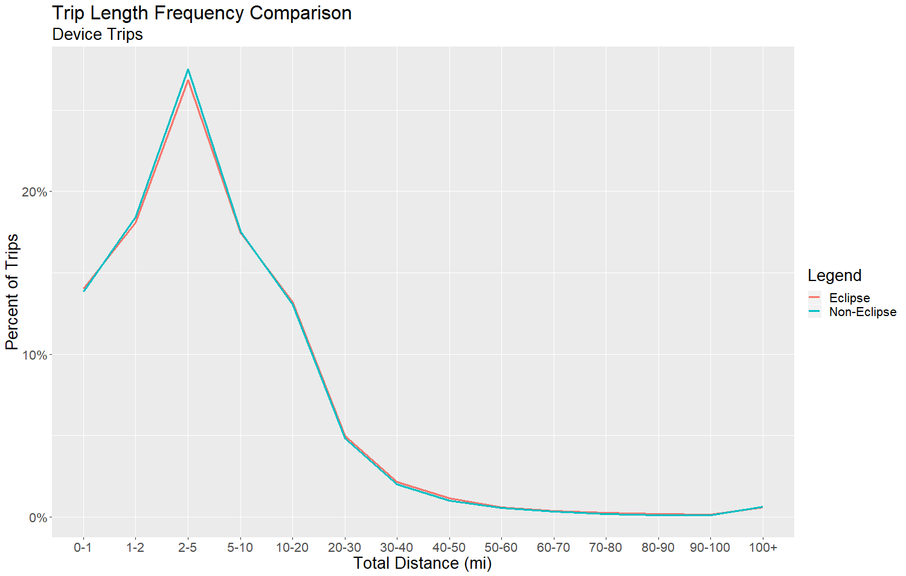
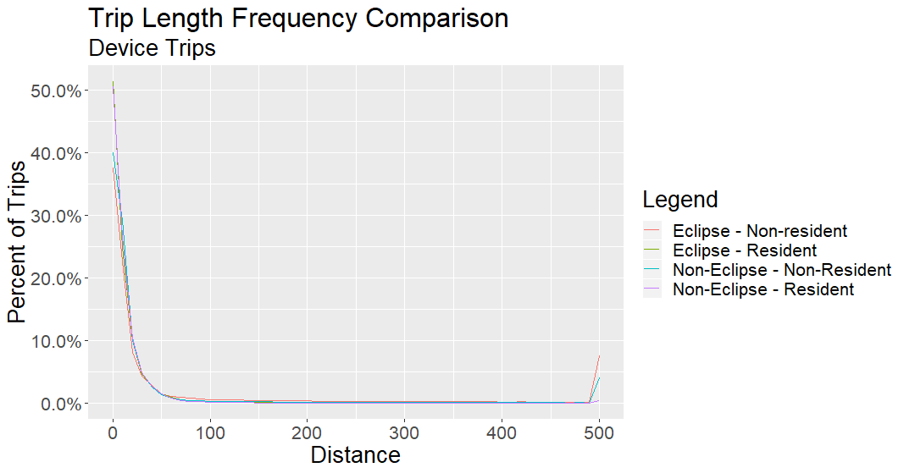
Trip Length Comparison
rMerge
Streetlight

Slide 11
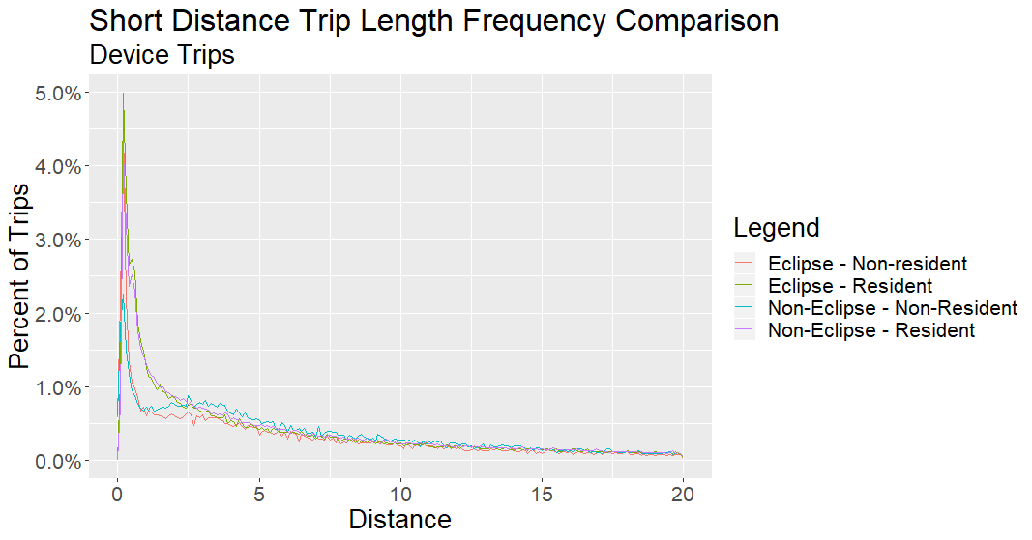
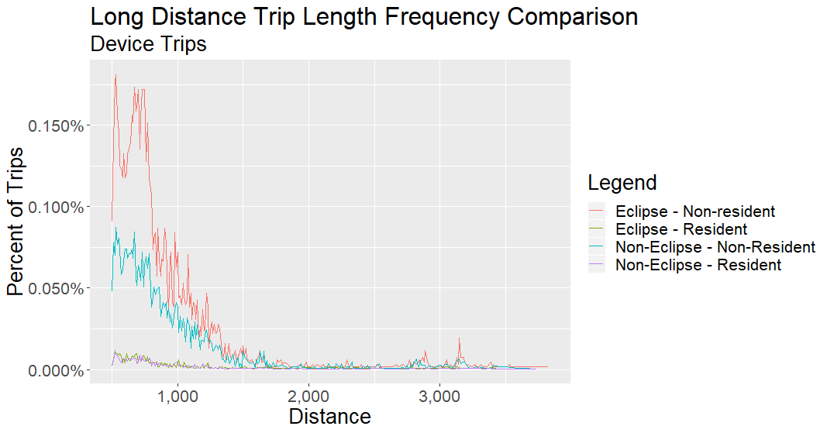
rMerge Trip Lengths – Short Trips and Long Trips
rMerge

Slide 12
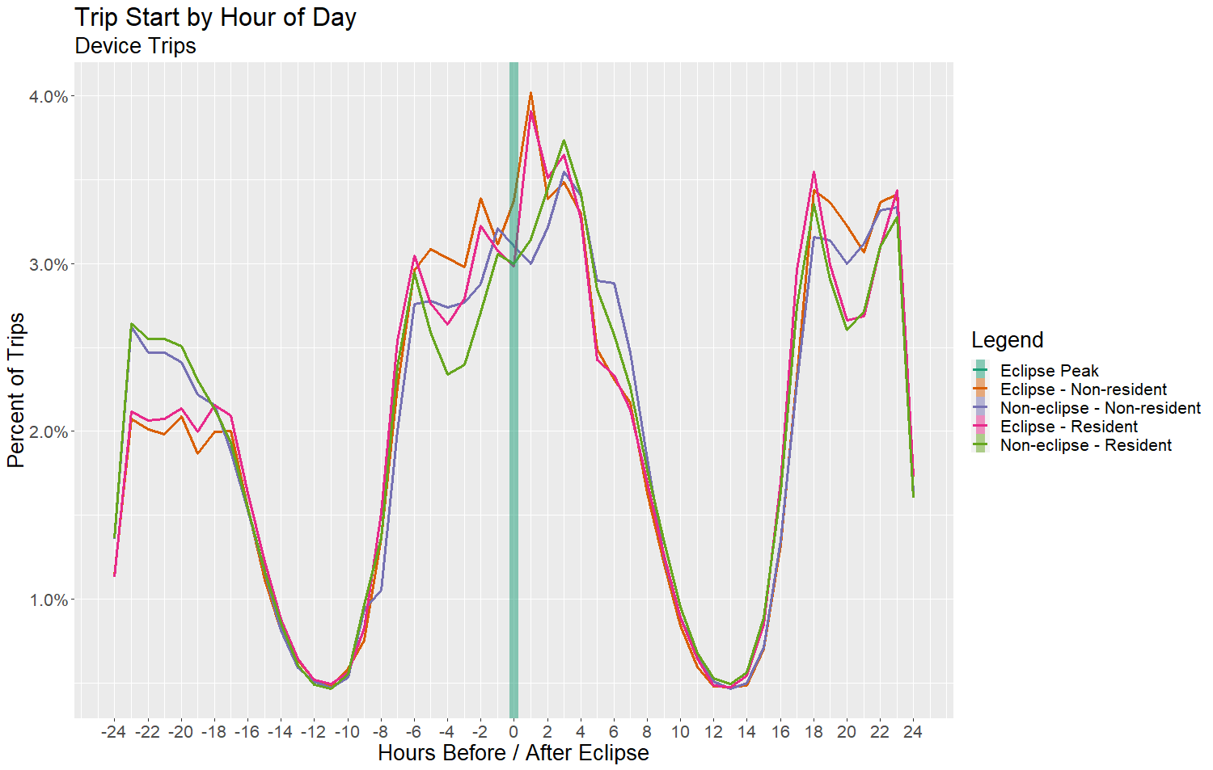
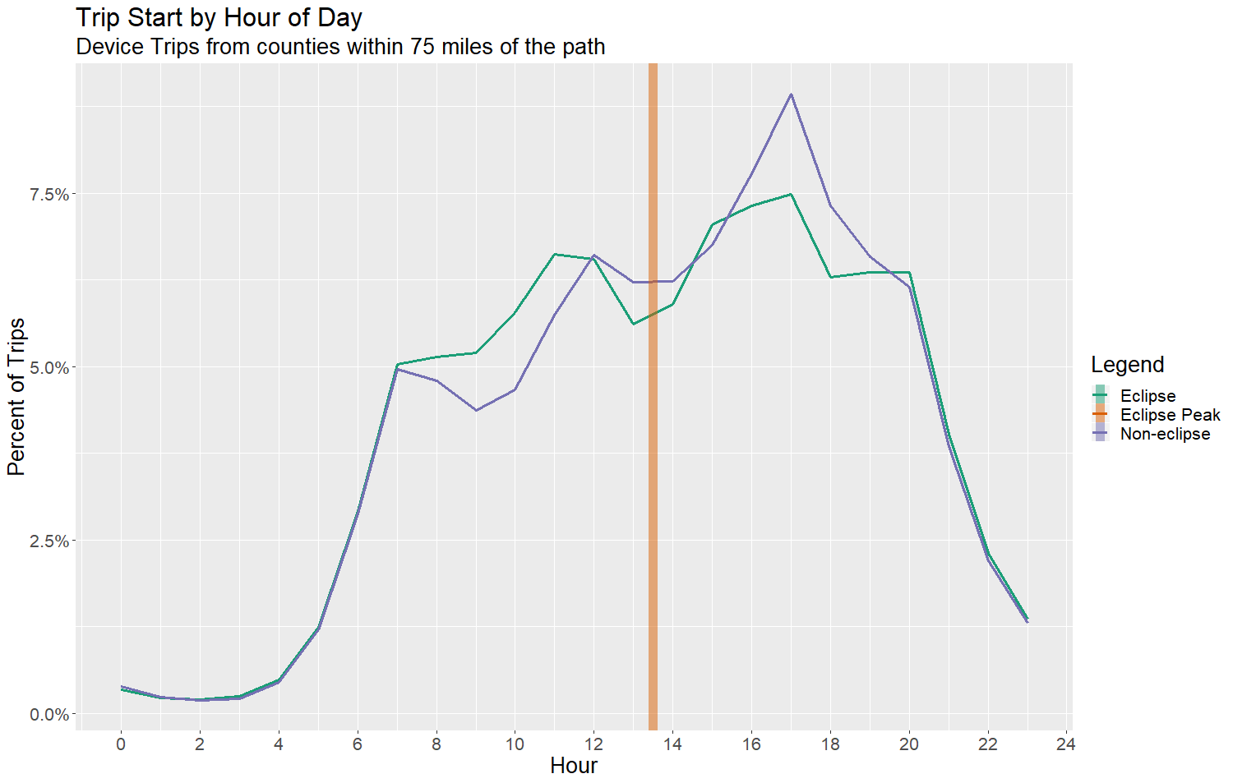
Trip Start Time
rMerge
Streetlight

Slide 13
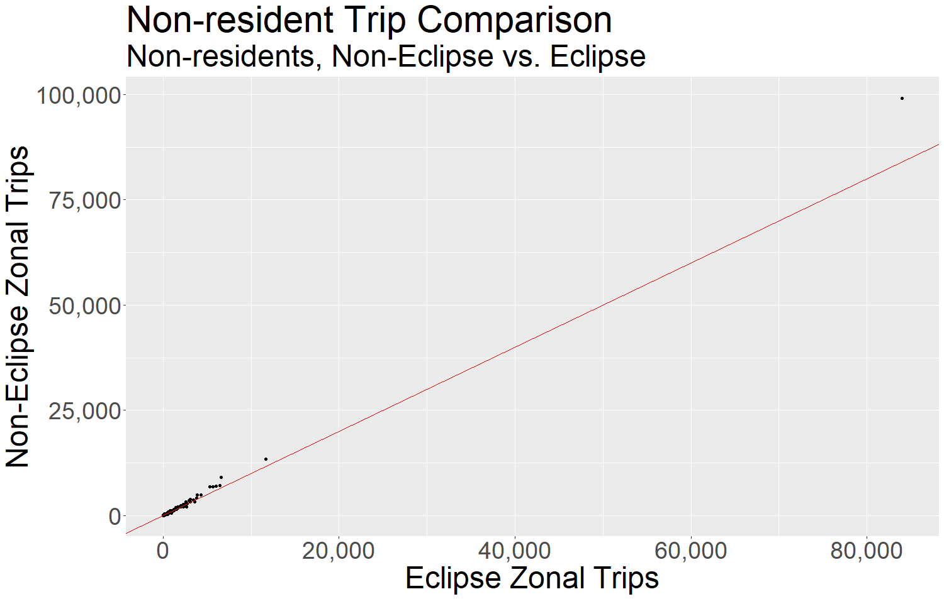
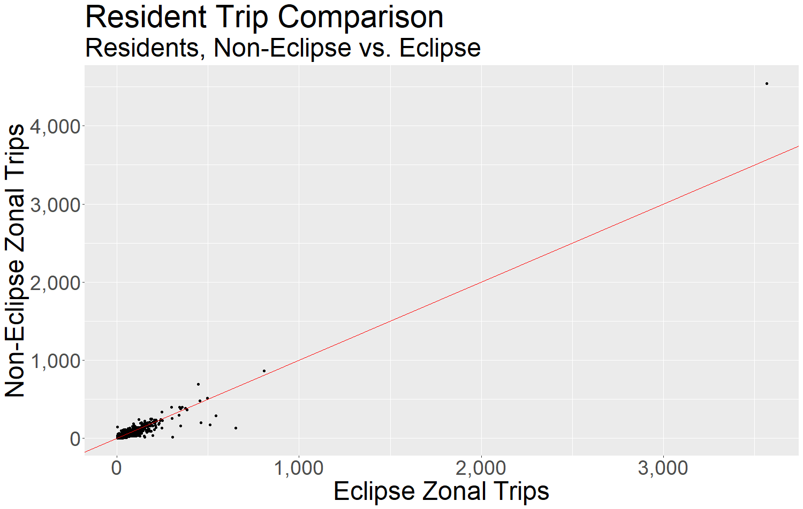
rMerge Trip Comparisons
rMerge

Slide 14
Streetlight AADT Estimates

Slide 15
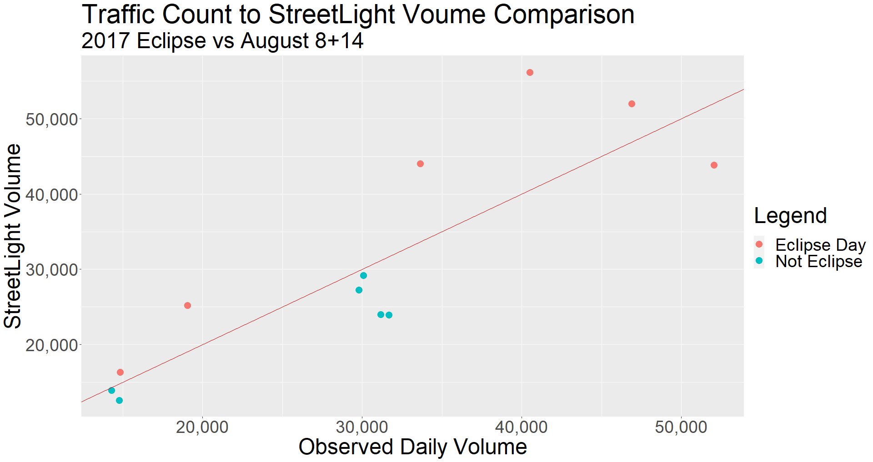
Streetlight AADT
Location | Average Day |  | Eclipse Day
 | AADT (KYTC) | Streetlight AADT | AADT (KYTC) | Streetlight AADT
I-65 N. of Elizabethtown NB | 31,662 | 23,918 | 52,035 | 43,866
I-65 N. of Elizabethtown SB | 31,166 | 24,003 | 46,899 | 52,011
I-65 N. of Bowling Green NB | 29,807 | 27,262 | 33,643 | 44,008
I-65 N. of Bowling Green SB | 30,088 | 29,162 | 40,514 | 56,179
I-75 S of Williamsburg NB | 14,781 | 12,605 | 19,043 | 25,207
I-75 S of Williamsburg SB | 14,307 | 13,909 | 14,831 | 16,361
Streetlight

Slide 16
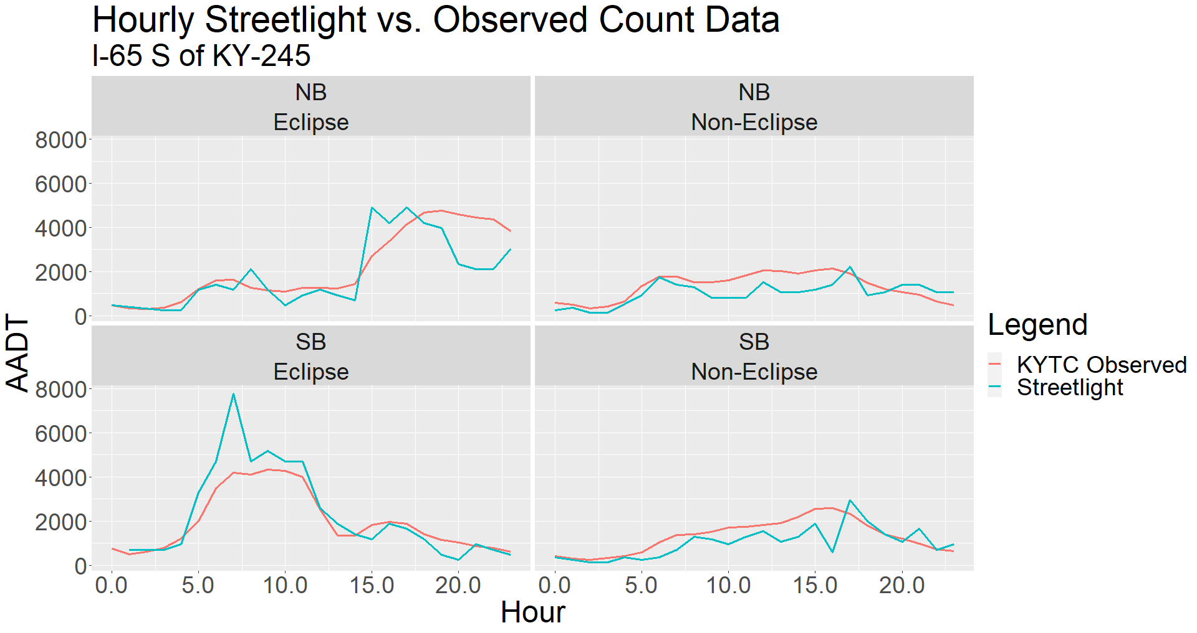
Streetlight AADT Comparison (hourly)
Streetlight

Slide 17
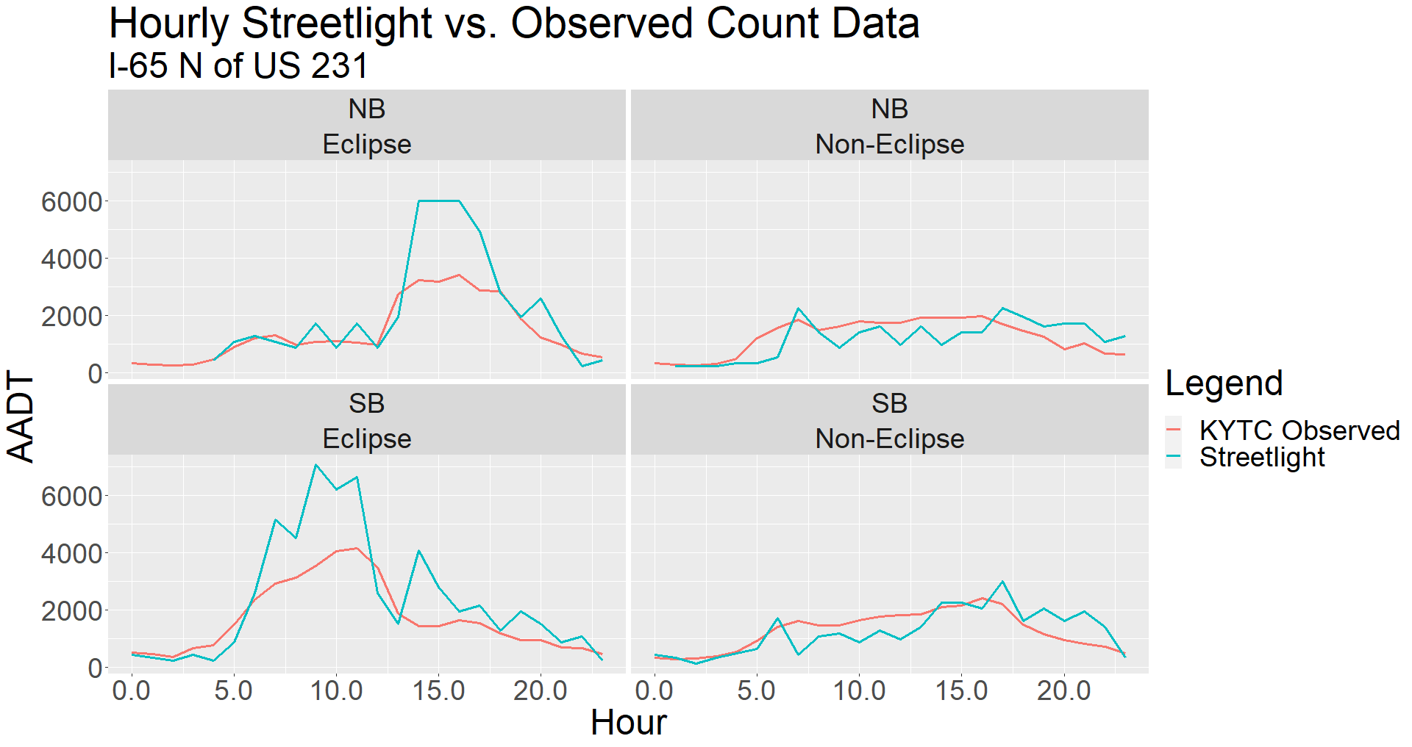
Streetlight AADT Comparison (hourly)
Streetlight

Slide 18
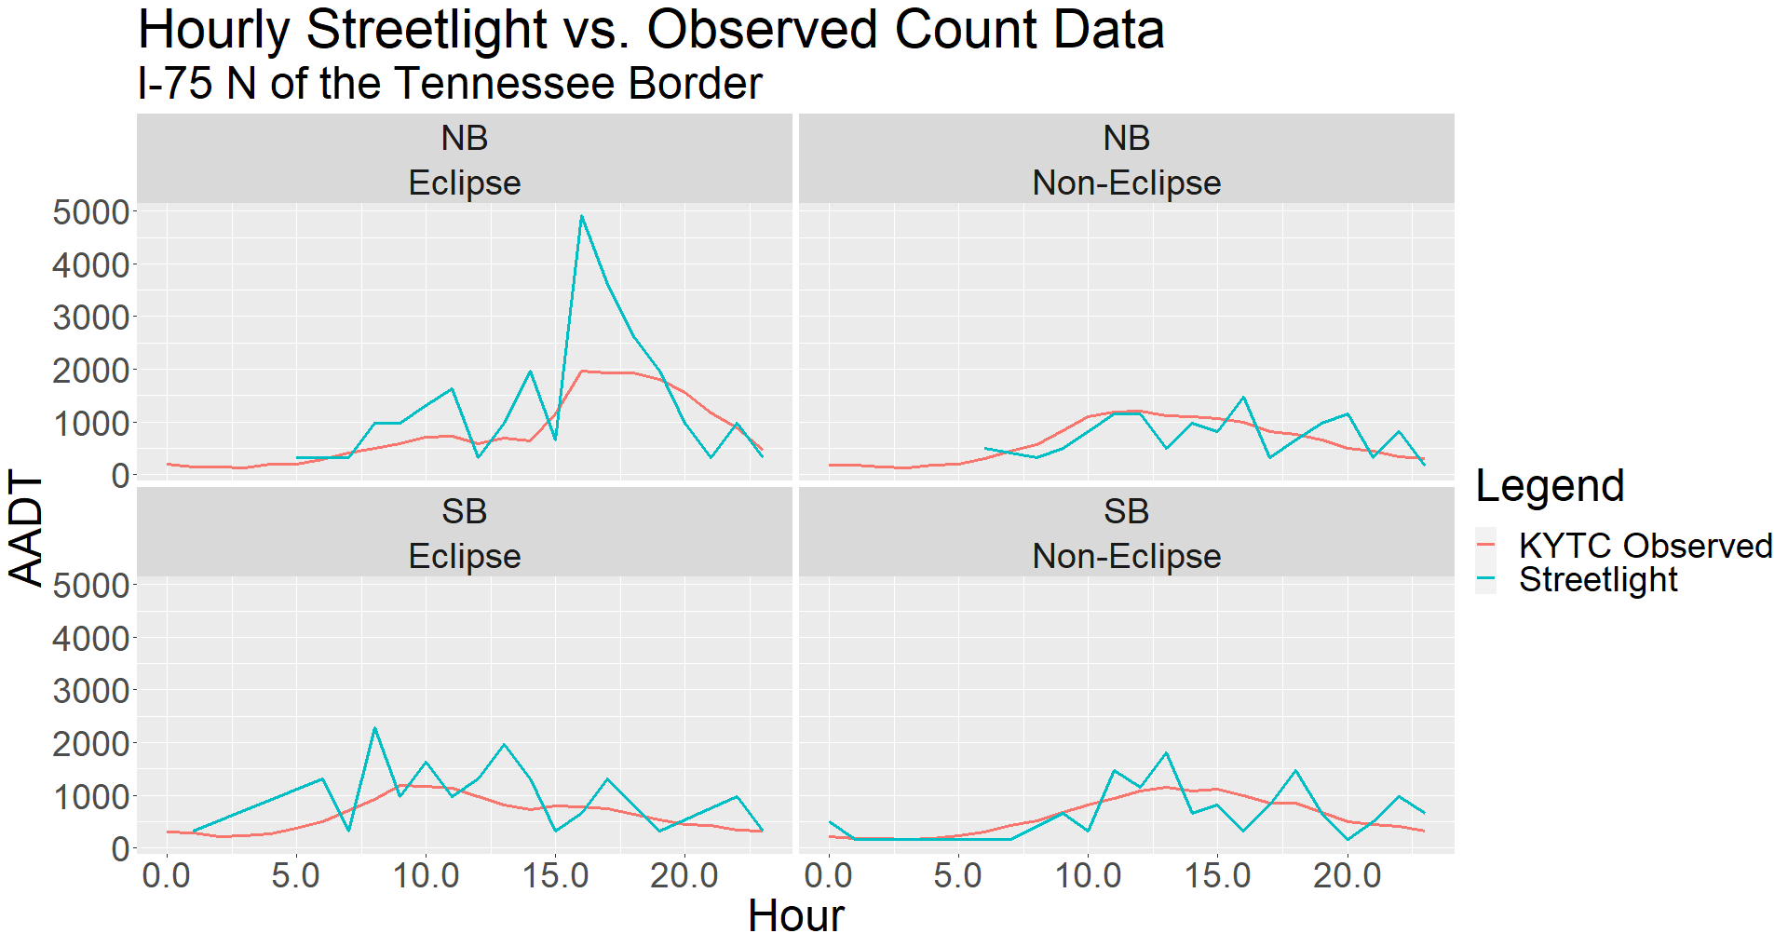
Streetlight AADT Comparison (hourly)
Streetlight

Slide 19
Truck Trips

Slide 20
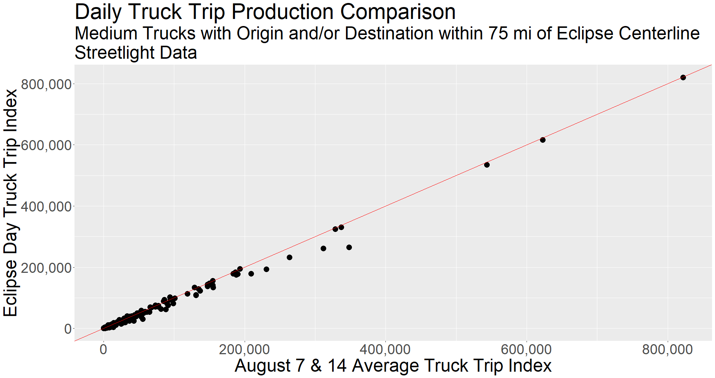
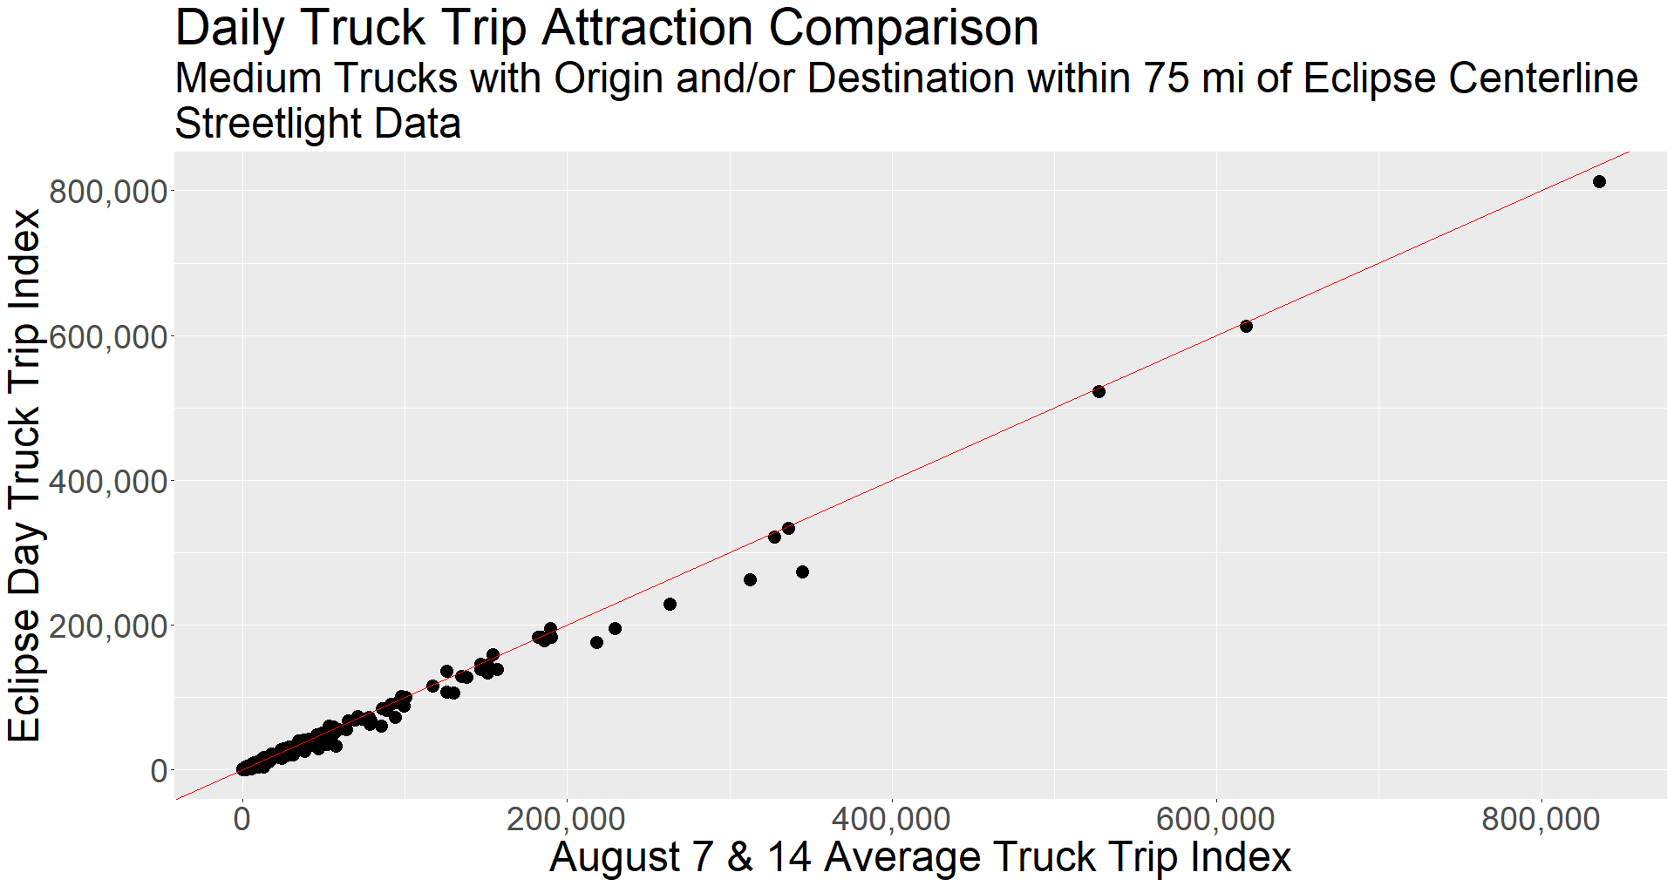
Medium Truck Trip Productions and Attractions
Streetlight

Slide 21
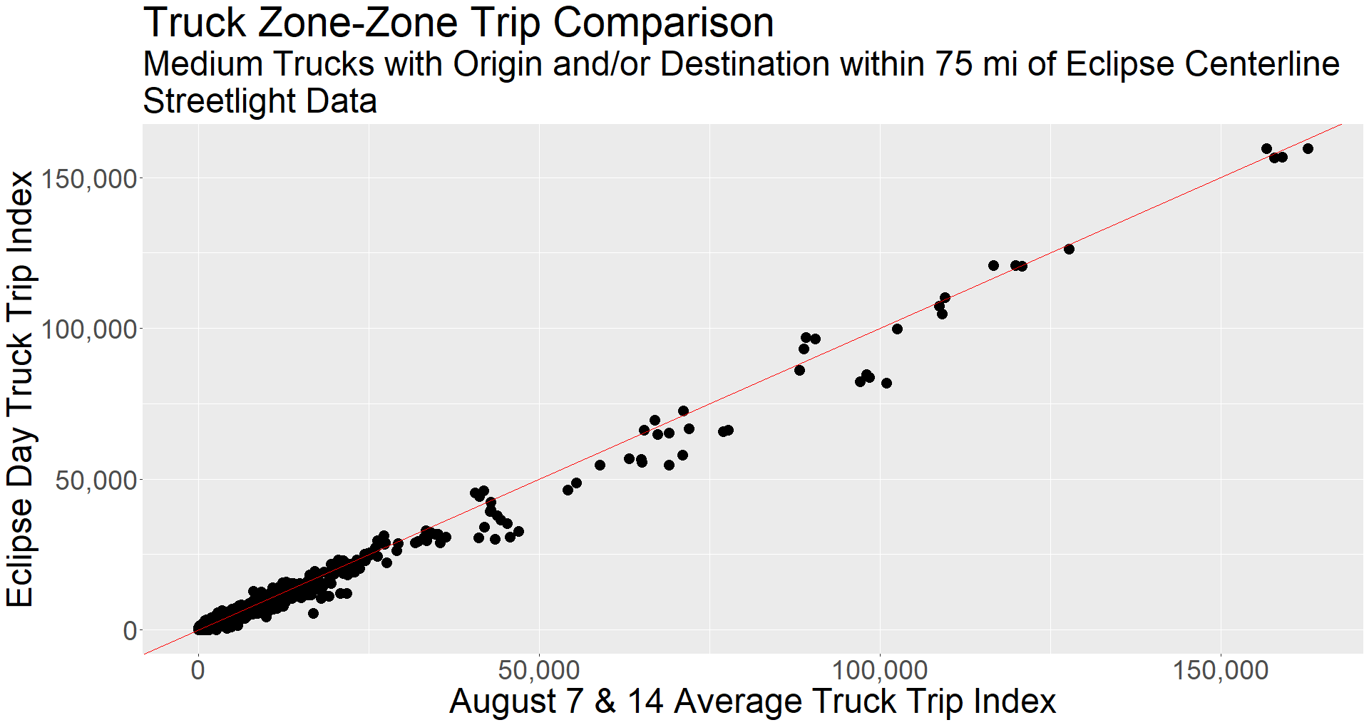
Zone-Zone Medium Truck Trips
Streetlight

Slide 22
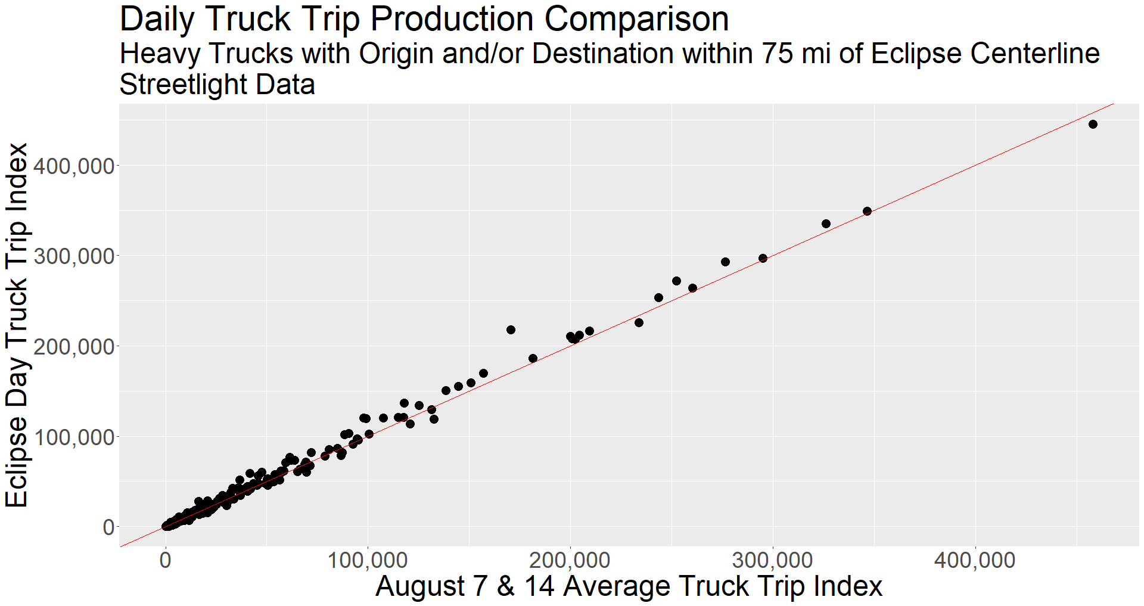
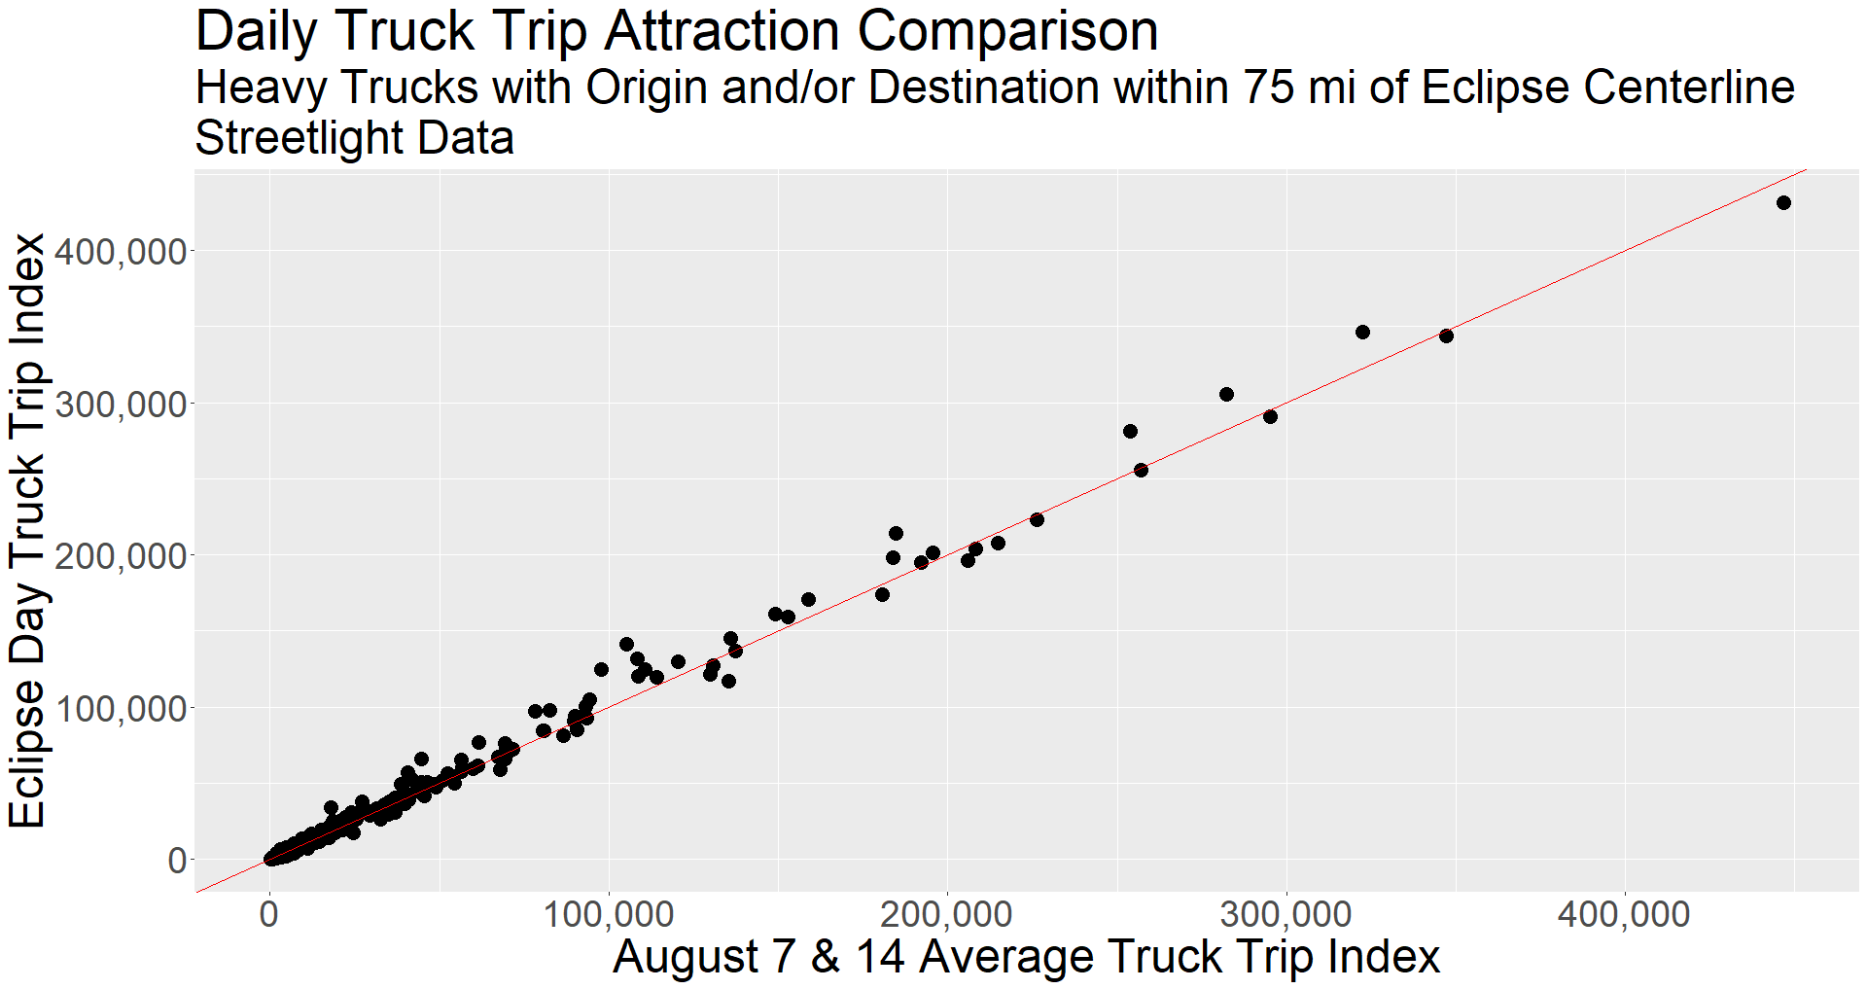
Heavy Truck Trip Productions and Attractions
Streetlight

Slide 23
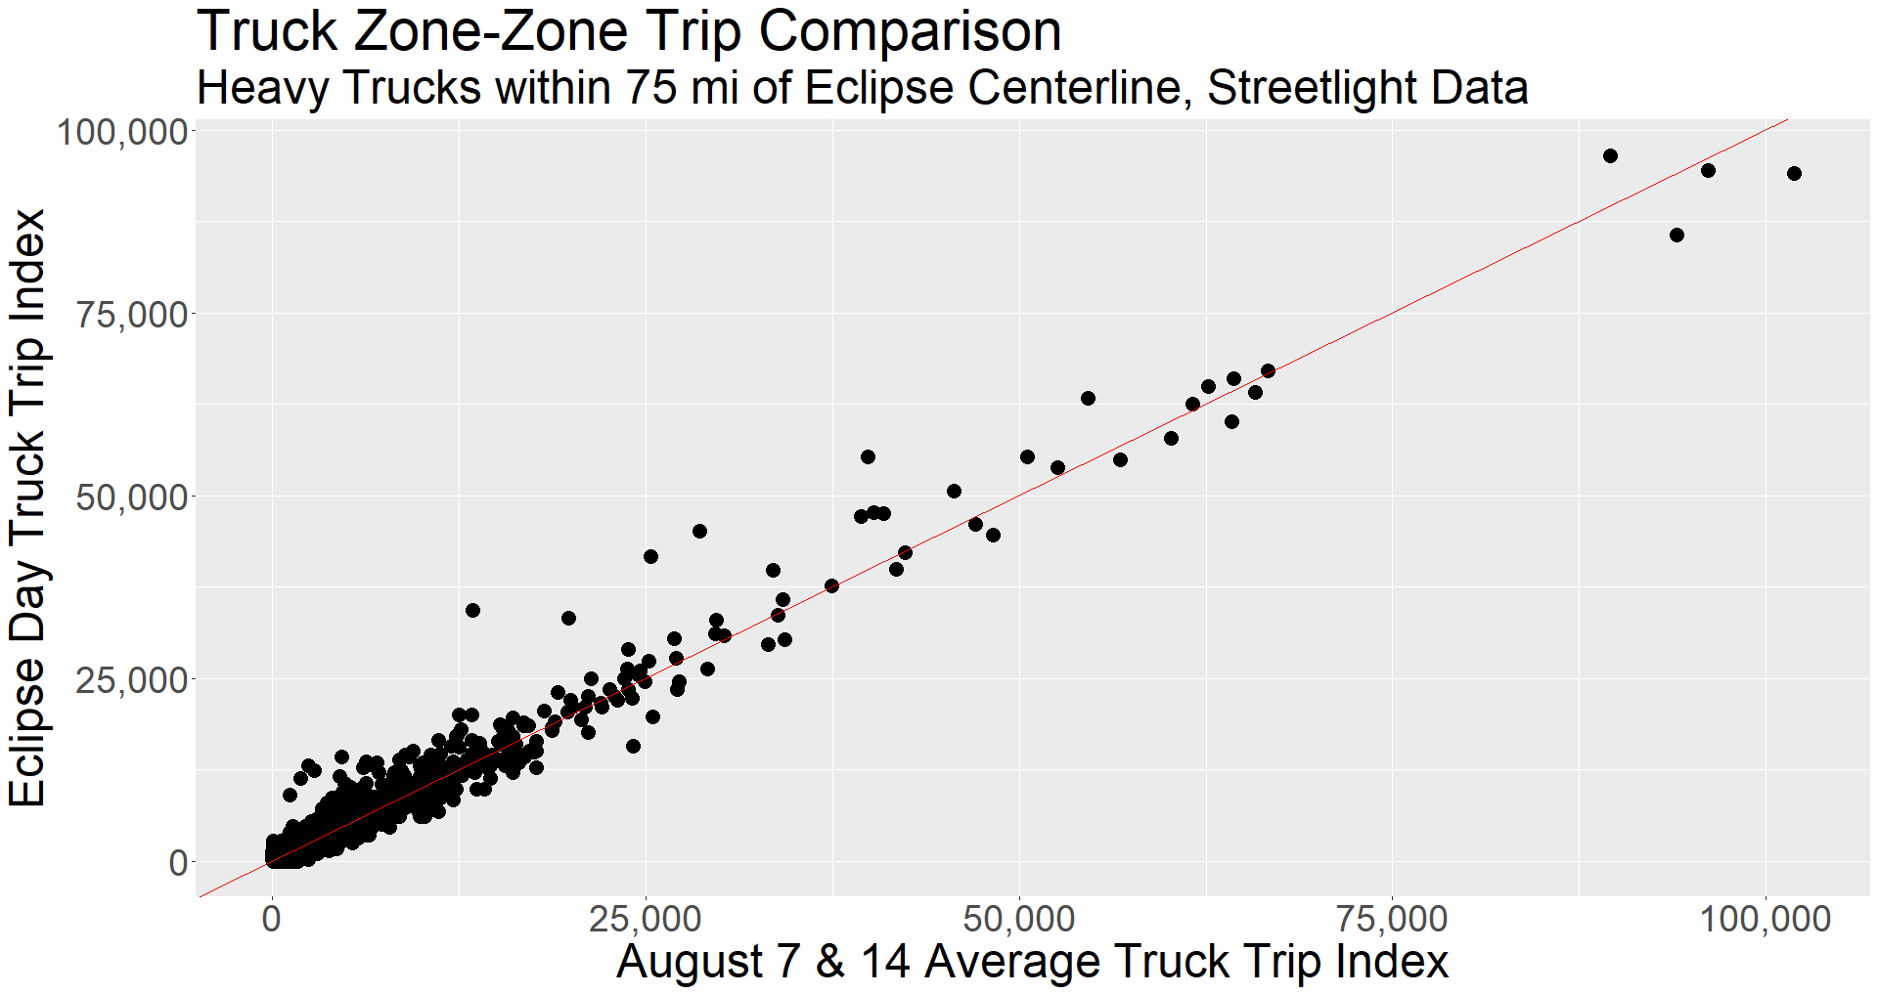
Zone-Zone Heavy Truck Trips
Streetlight

Slide 24
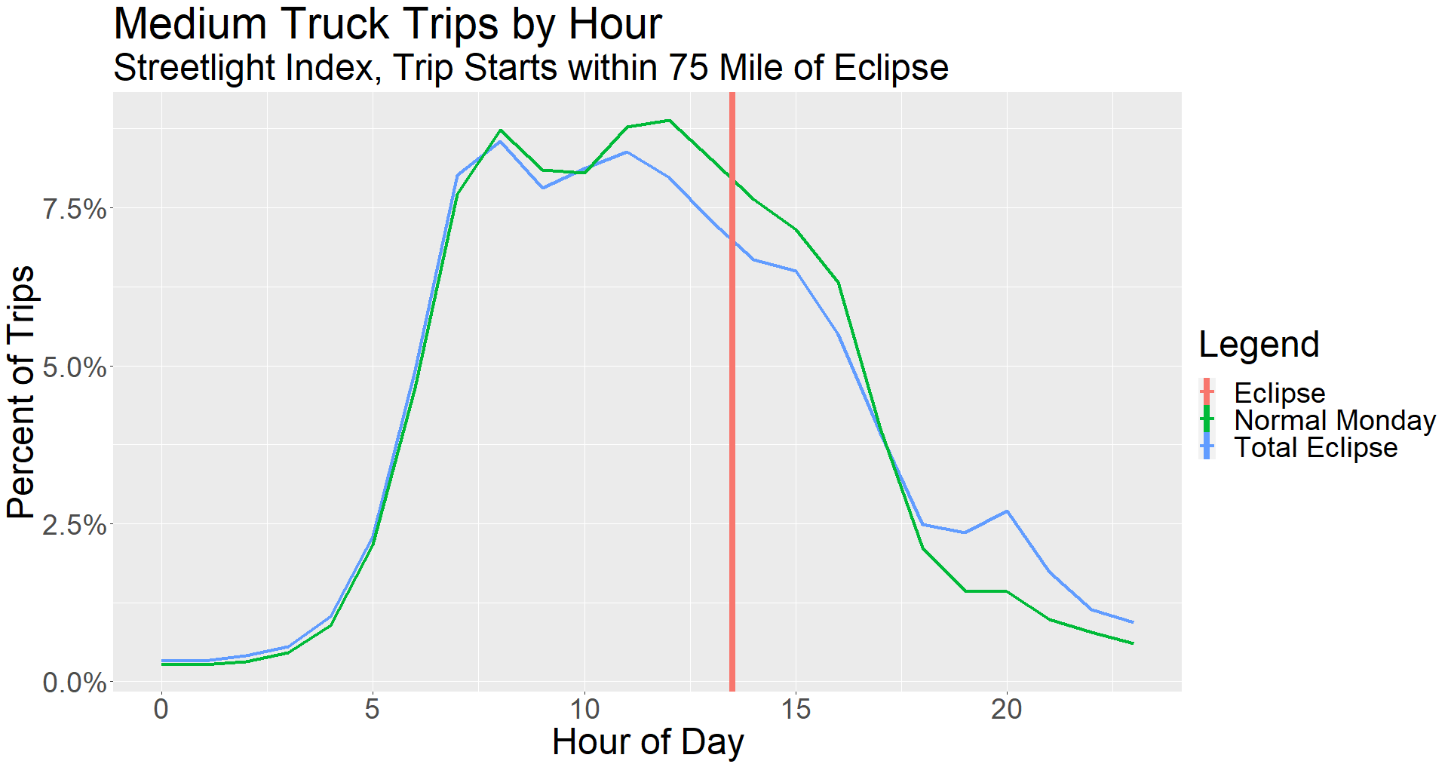
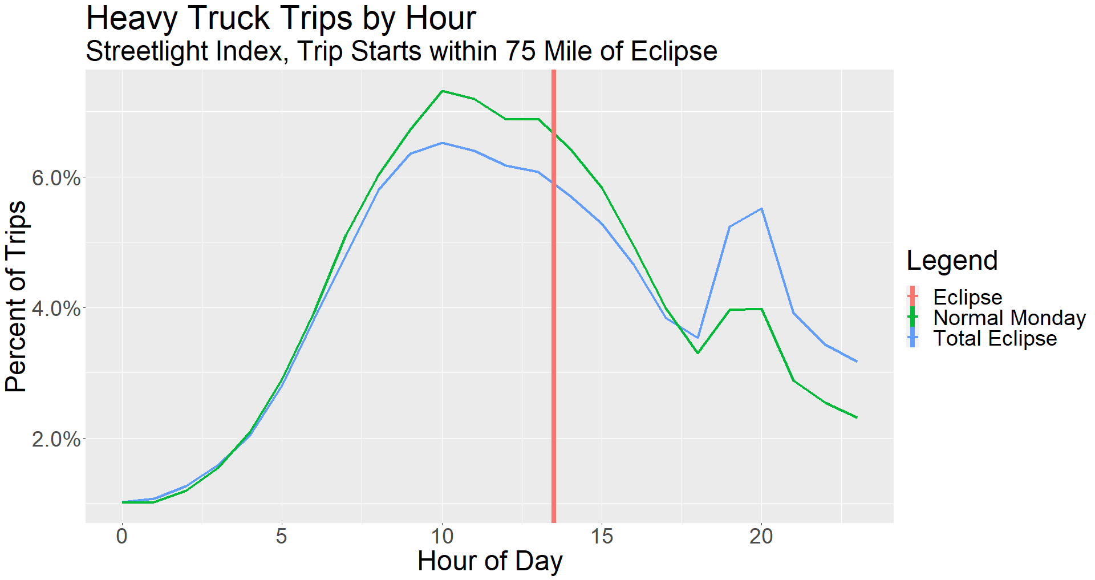
Truck Trips by Hour
Streetlight

Slide 25
Model Comparison

Slide 26
Three Models to Compare
Kentucky Statewide Model
Tennessee Statewide Model
National Passenger Long Distance Model
Not the same – models long distance trips, not all trips

Slide 27
Model Comparison Criteria
Base Year
Roadway Detail – CL miles in model
Zonal Detail – Average Zone Sizes
Expansion Requirements – Links with Counts
Goodness of fit starting point – %RMSE
The point of this: what model to start with for expansion?

Slide 28
Centerline Miles in Model
 | KY STM | TN STM | National PAX
Total CL Miles | 26,343 | 66,858 | 62,731

Slide 29
Zonal Detail in Model
 | KY STM | TN STM | National PAX
Number of Zones Within 75 mi of Path | 1,401 | 2,137 | 619 KY: 44 TN: 77
Average Zone Size - Entire Model (sq mi) | 504 | 509 | 904
Average Zone Size - In State (sq mi) | 9 | 13 | N/A
Average Zone Size - Within 75 mi of Path (sq mi) | 11 | 12 | 931 KY: 391 TN: 390
Total Zone Size Within 75 mi of Path (sq mi) | 15,591 | 26,428 | 576,291 KY: 17,198 TN: 30,045
Total Zone Size Within State (sq mi) | 40,387 | 42,139

Slide 30
Expansion and Evaluation
 | KY STM | TN STM | National PAX
N Links with Counts | 4,664 | 7,728 | 16,849
Sum of Counts | 15,815,851 | 58,616,500 | 347,733,569
%RMSE | 62% | 37% | 139%

Slide 31
Traffic Counts

Slide 32
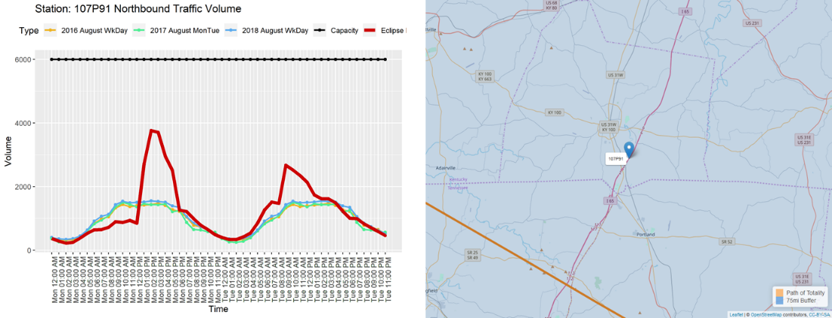
I-65 South of Bowling Green

Slide 33
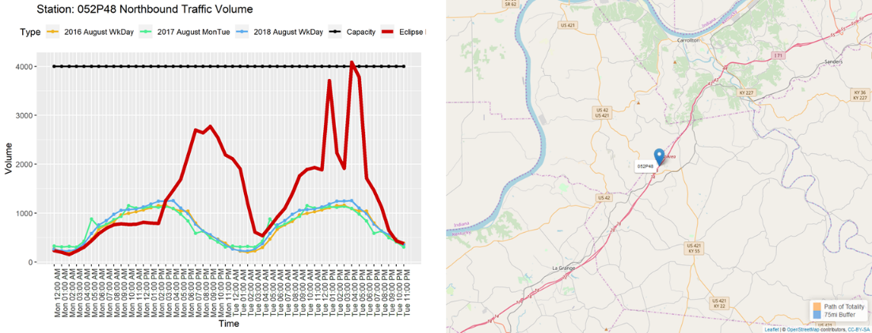
I-71 West of Carrollton

Slide 34
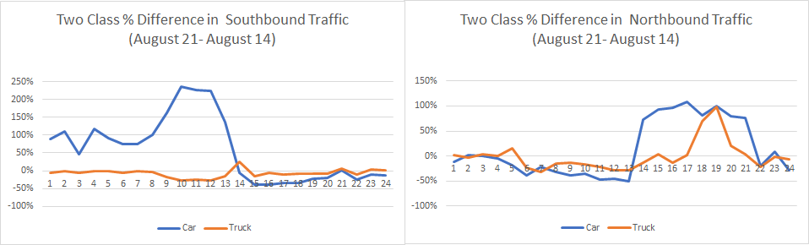
I-65 at Bowling Green Class Difference

Slide 35
Andrew Rohne
Senior Consultant
Andrew.Rohne@rsginc.com

