Slide 1
Imputing Light Commercial Vehicles from Big Data
Andrew Rohne – Ohio Travel Demand Model Users Group
September 11, 2020

Slide 2
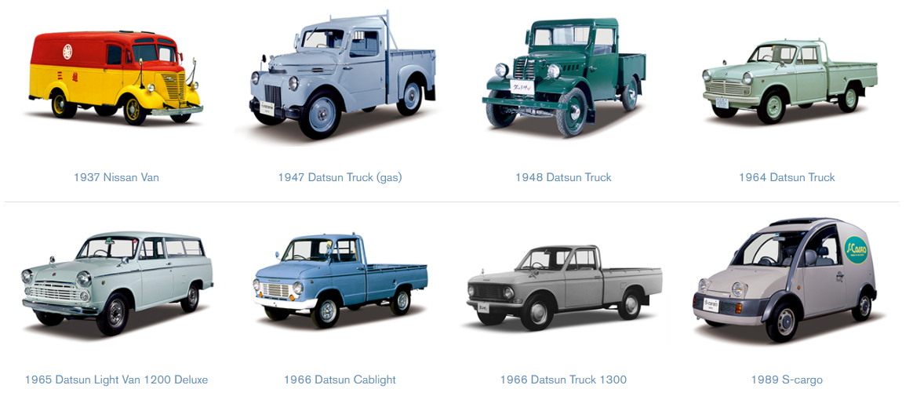
What is a Light Commercial Vehicle?
A non-commercial type of vehicle, like a car, van, or pickup truck used as a commercial vehicle. It may or may not be it’s only use.

Slide 3
Why do we care?
“Free Two-Day Shipping With Prime”
--Amazon, February 2005

Slide 4
Since Then…
PRE-COVID
Several other retailers added free delivery
Mostly 1 or 2 day, some same-day delivery
Drastically expanded food delivery options
Brick-and-mortar shopping options disappearing

Slide 5
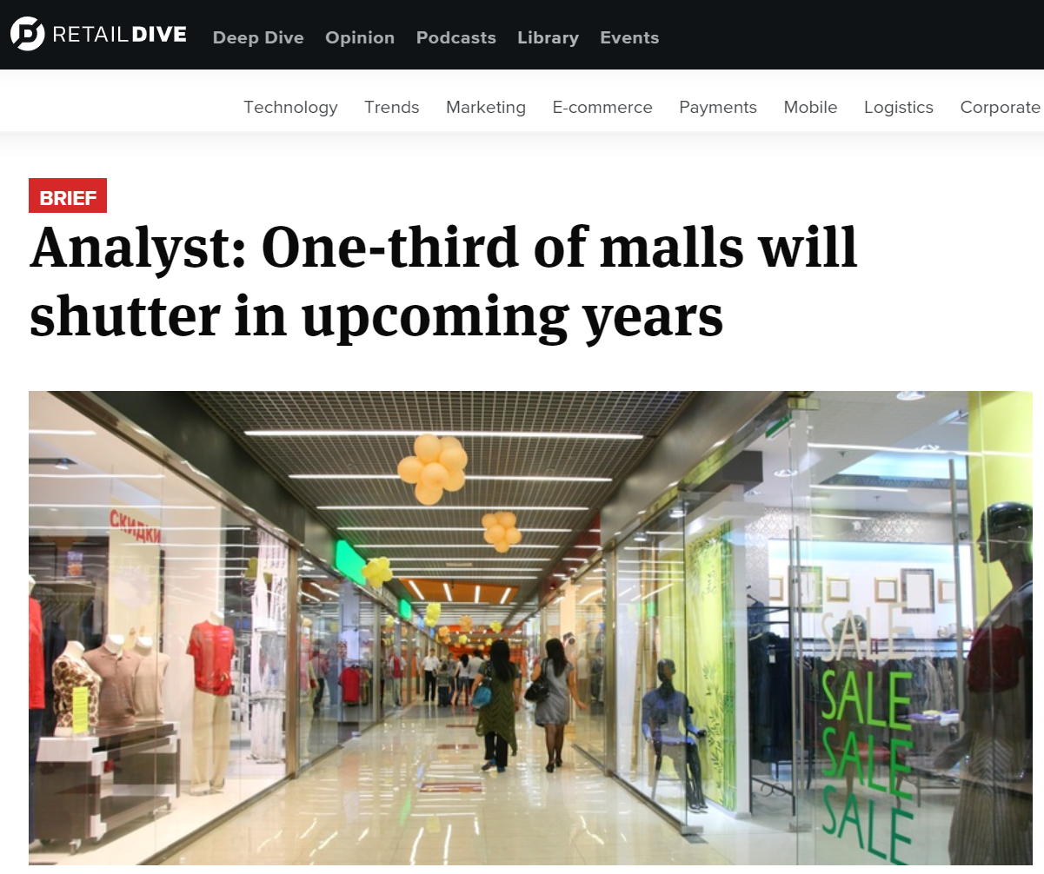
PRE-COVID
Retaildive.com, 5/13/2016
Notes:
Link: https://www.retaildive.com/news/analyst-one-third-of-malls-will-shutter-in-upcoming-years/419174/
In 2016, 3 of 7 malls in Cincinnati were visibly struggling (having crime issues and/or high vacancy) and a fourth was ‘on the brink’. The ‘on the brink’ has announced a pending foreclosure.

Slide 6
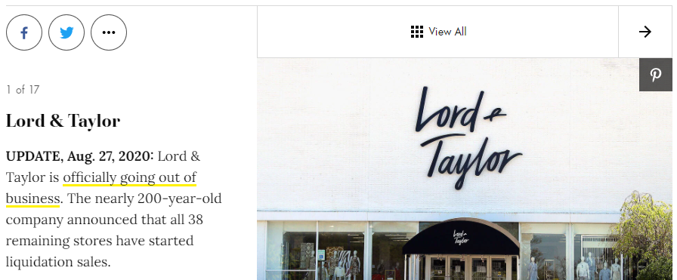
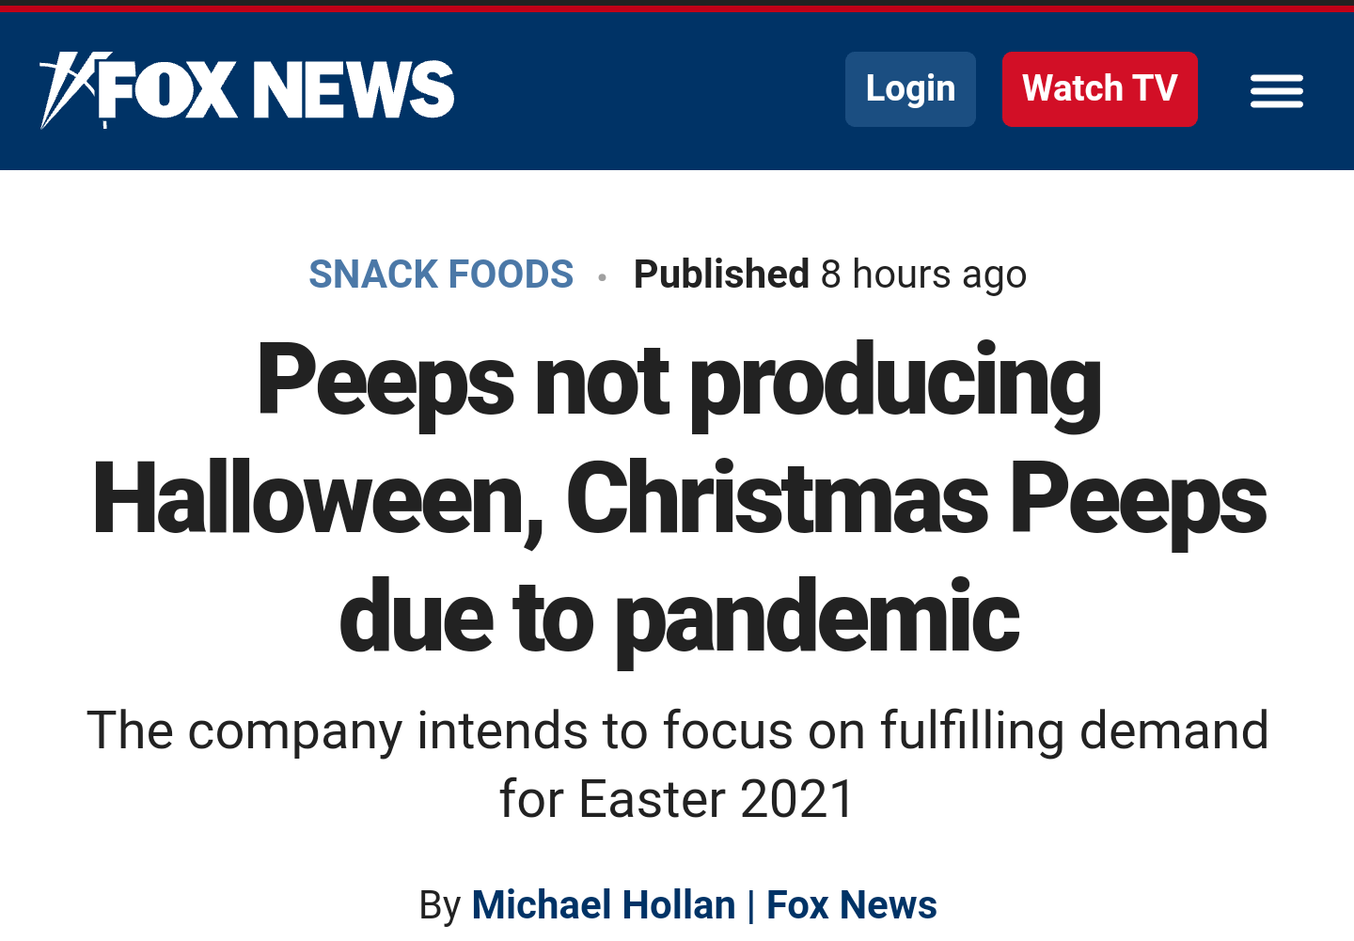



In The Last Six Months…
Many Store Closures
Supply Chain Issues
A Global Pandemic
Notes:
Store closures like Lord & Taylor and Pier One closed, and others like Men’s Wearhouse, California Pizza Kitchen, Neiman Marcus, New York and Company, Brooks Brothers, J. Crew, and JC Penny’s have filed for bankruptcy and are ‘on the ropes’

Slide 7
What’s Happening: The Data

Slide 8
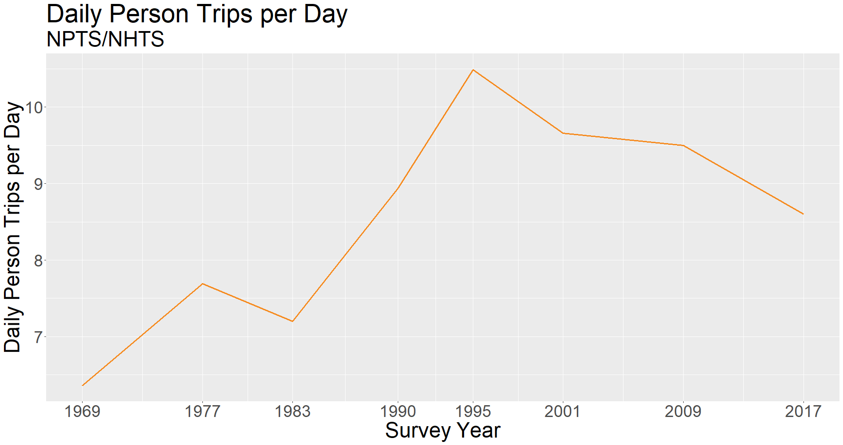
National Person Travel Survey
National HH Travel Survey
Notes:
Obviously, there are other reasons for the decline in person trips – aging (seniors are sometimes restricted from driving) and telecommuting are probably the top two that doesn’t include increased deliveries.

Slide 9
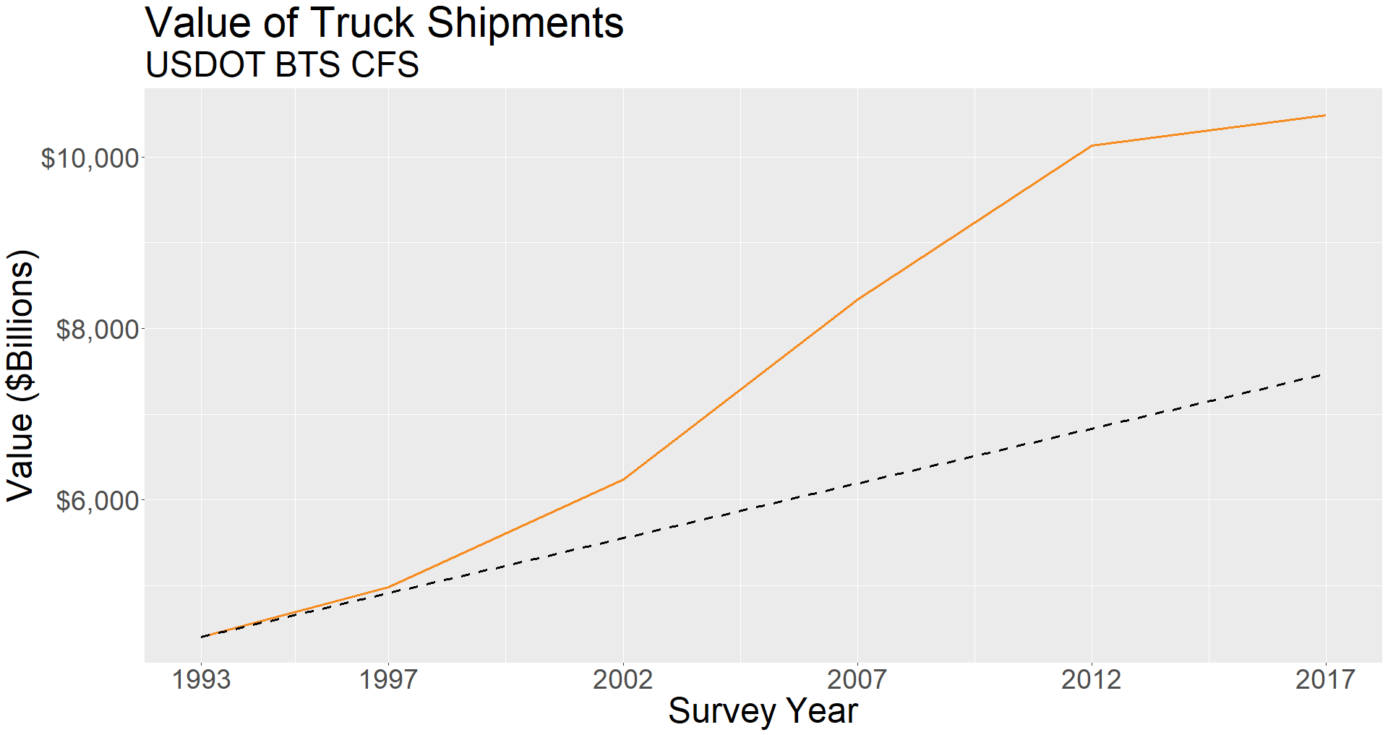
Inflation
Source: USDOT BTS – Commodity Flow Survey

Slide 10
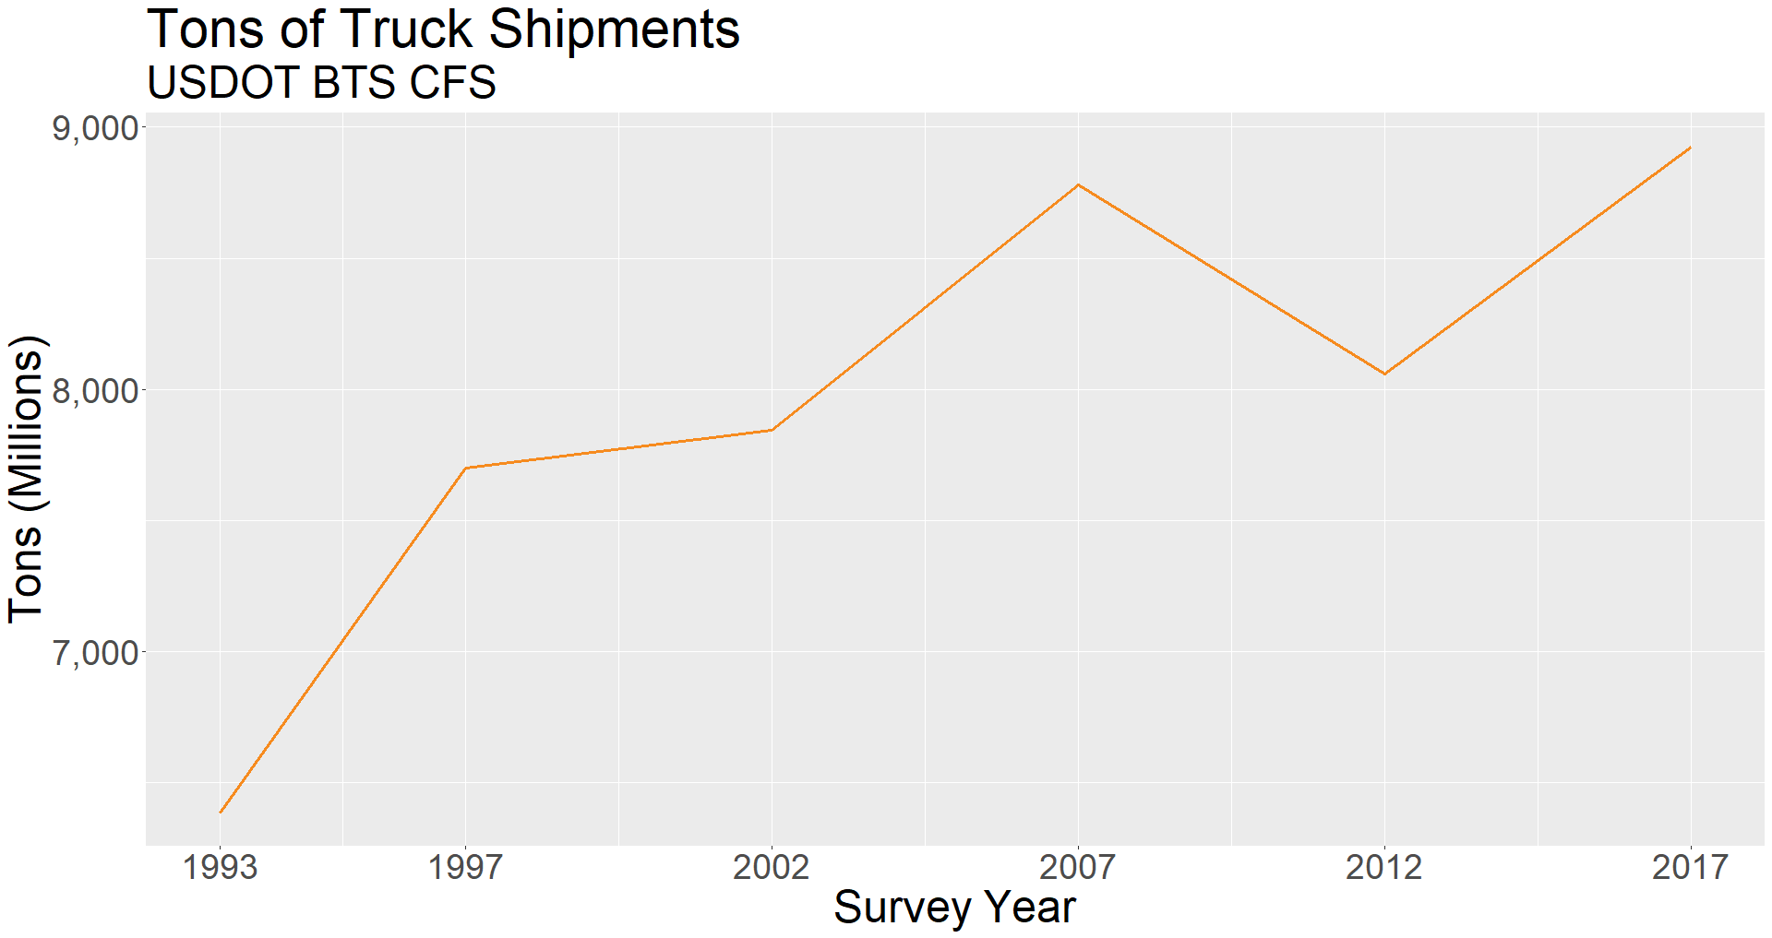
Source: USDOT BTS – Commodity Flow Survey

Slide 11
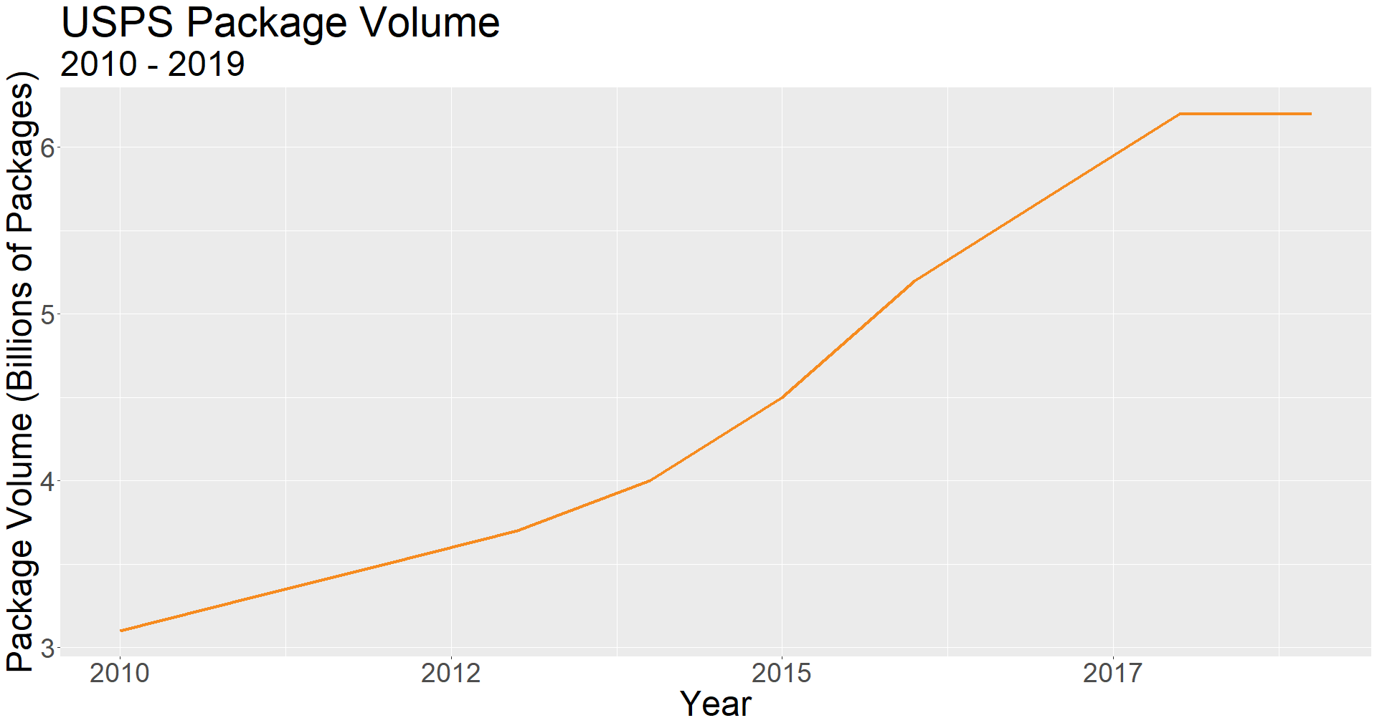

Slide 12
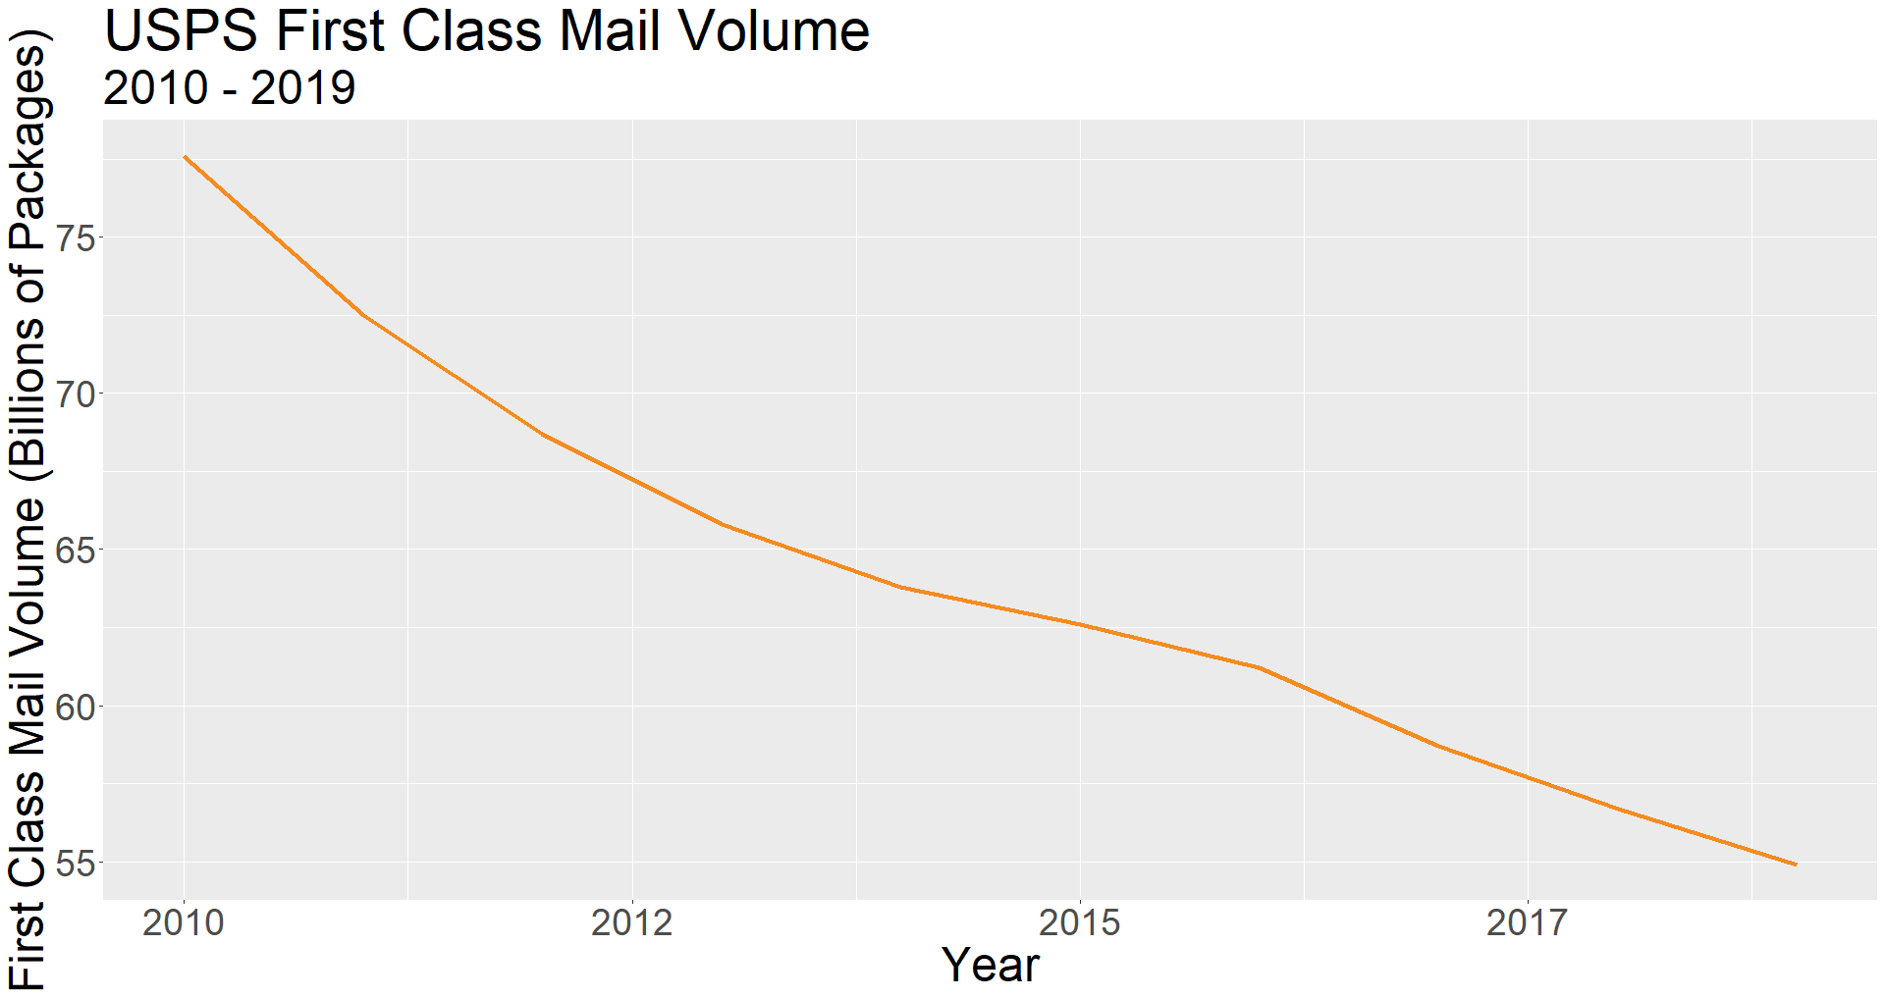

Slide 13
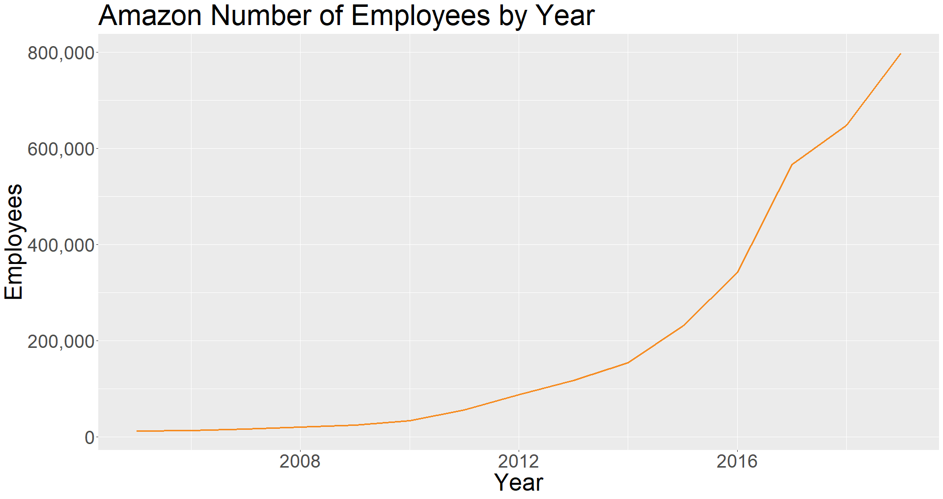
Source: https://www.macrotrends.net/stocks/charts/AMZN/amazon/number-of-employees

Slide 14
Data Considerations

Slide 15
Normal Data Inputs
Traffic Classification Counts
Most are classified with hoses
Trace Data – ATRI, Inrix
Processed O-D Data – rMerge, Streetlight
Surveys – behavioral data about deliveries
Frequently collected at establishments
Usually very small sample
Sampling usually trucks
Socioeconomic Data

Slide 16
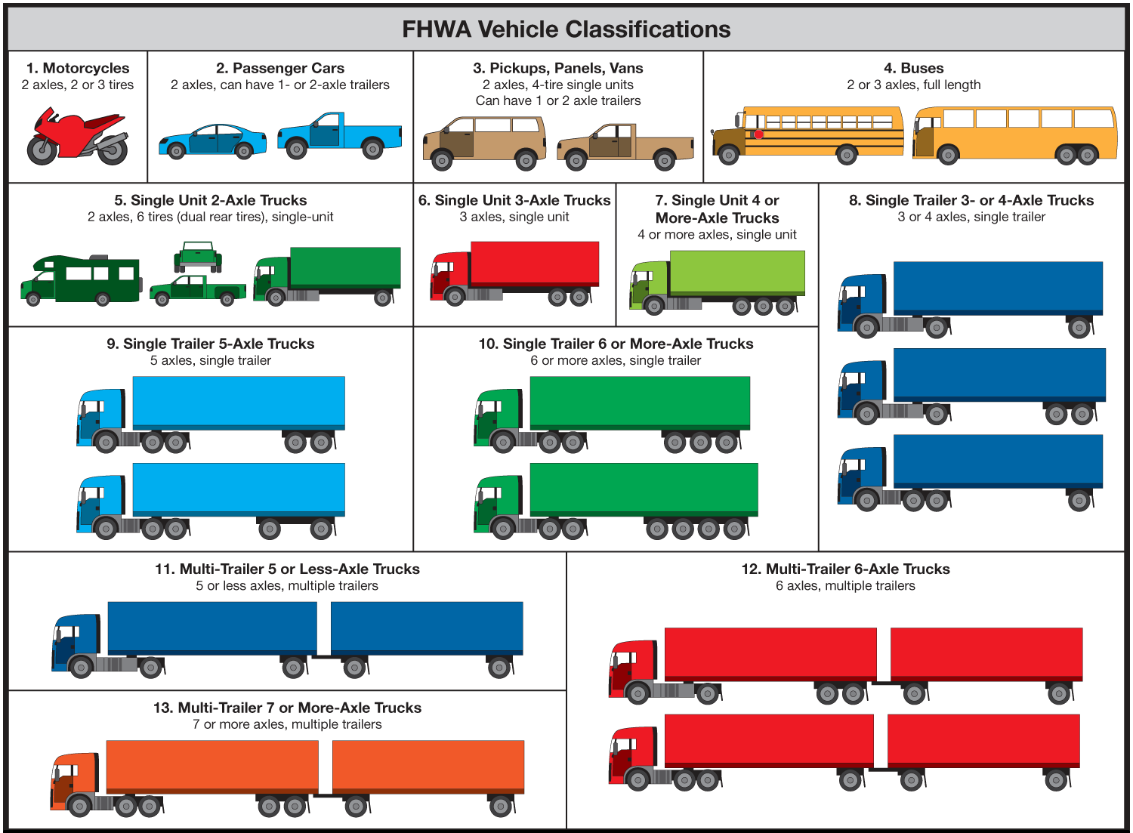

Slide 17
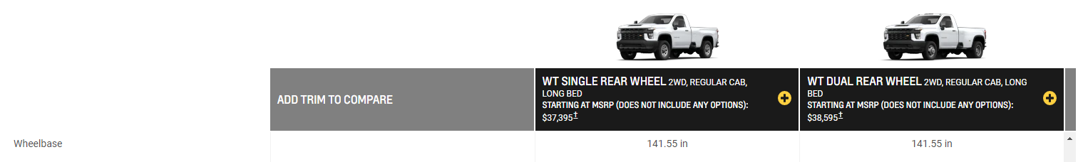
FHWA Class != Counted Class
Probably Class 3
(most class 2 vehicles are
108” – 122”)
Probably Class 3
Should be Class 5 (but how does the hose counter know it has two rear wheels?)
Pickups are increasingly common as personal household vehicles
Vans are decreasingly common as personal household vehicles

Slide 18
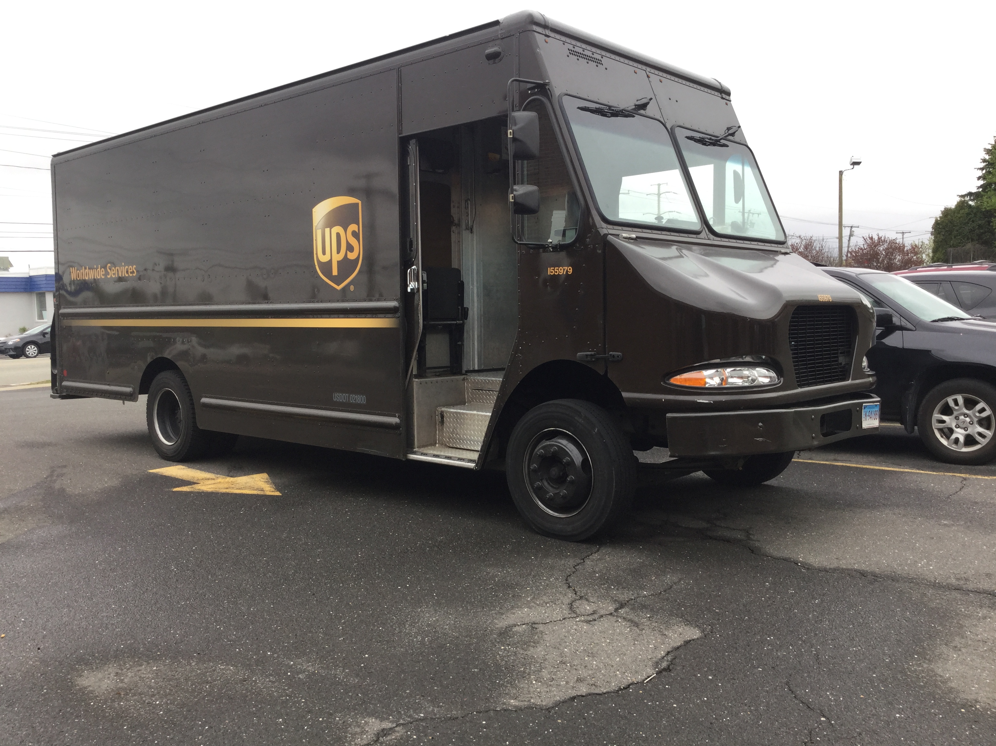
Normal Deliveries
Panel Truck
Class Counts: FHWA Class 5 (two-axle, 6 tire)
Class is mostly commercial vehicles
Notes:
We can discuss the accuracy of counters to the end of time but getting this type of vehicle somewhere in class 4-7 and have it considered a single-unit truck isn’t usually too much to ask of a counter.

Slide 19
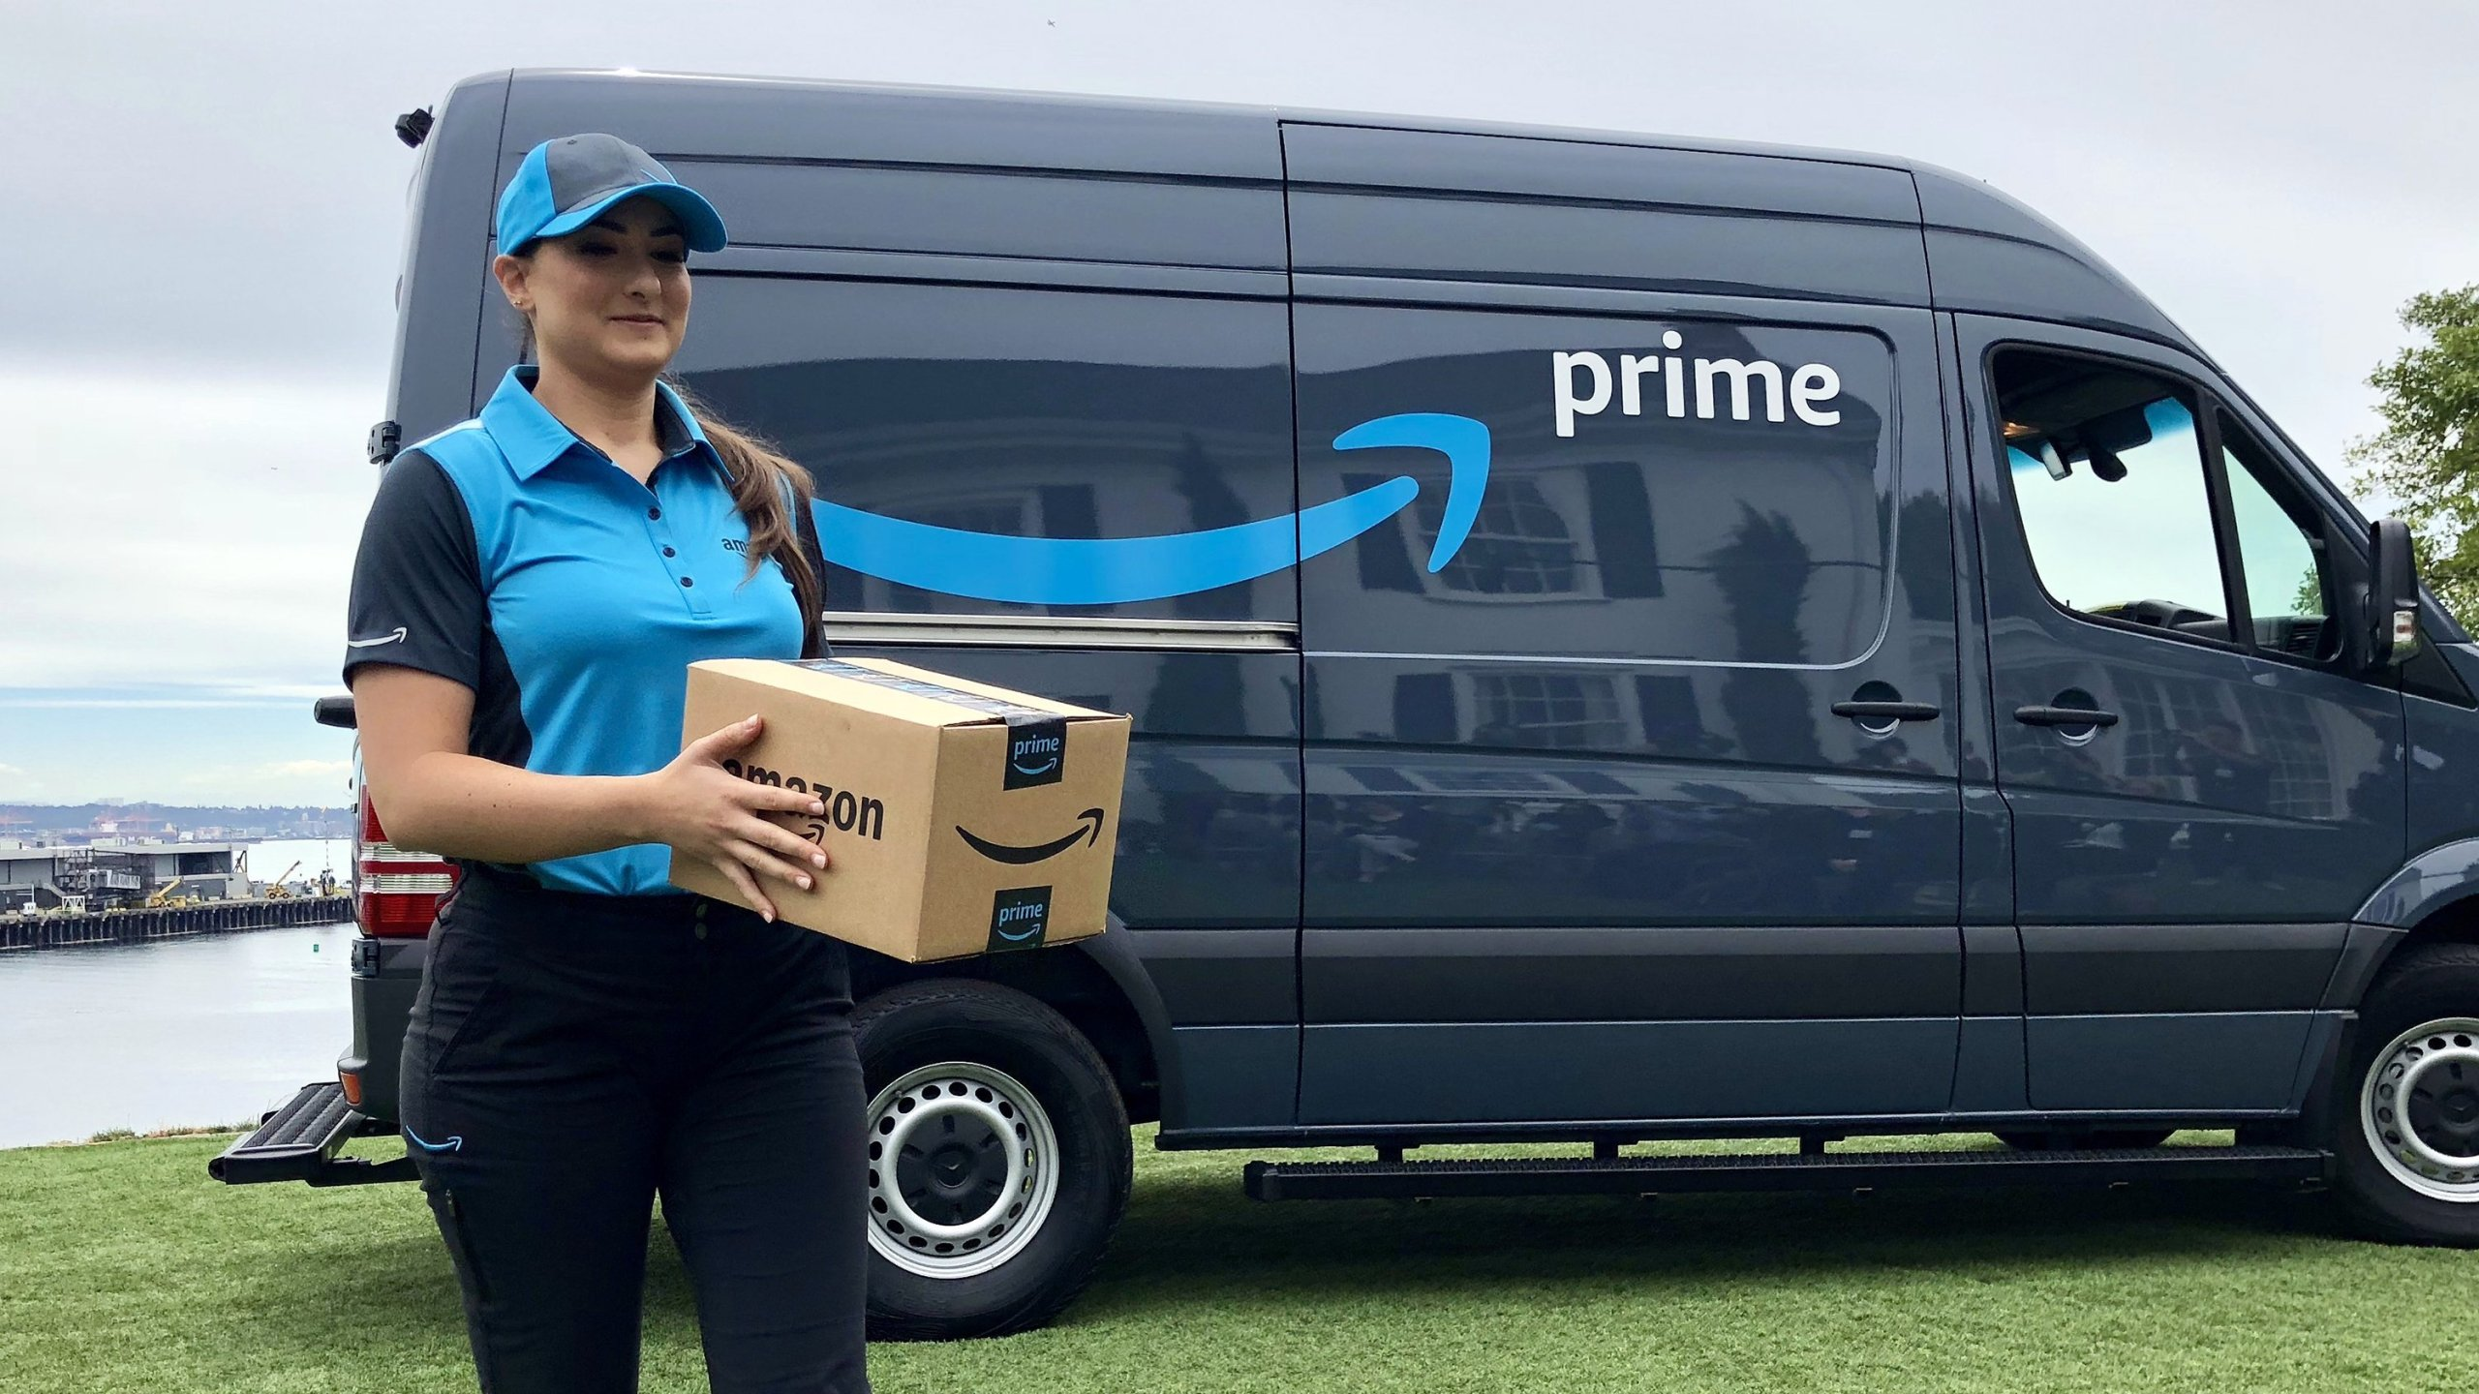
Amazon (and others) Normal Deliveries
Cargo Van
Class Counts: FHWA Class 3 (2 axle, 4 tire)
Class shared with the proliferation of pickups on the road!
We cannot rely on traffic counts for LCV numbers!

Slide 20
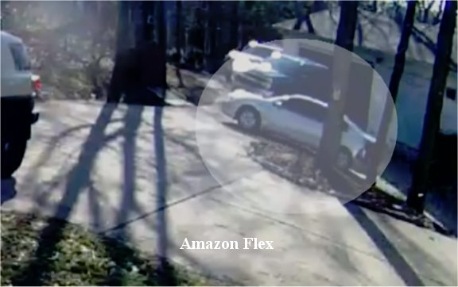
Flexible Delivery Options
During busy times (like Christmas season), these were the delivery vehicles…
We REALLY cannot rely on traffic counts for numbers!
Notes:
Also includes Uber, Lyft, Doordash, Grubhub, etc.
Note that the vehicle isn’t even marked, so even a cutting-edge visual system (like a camera paired with OpenCV and a convolutional neural network) isn’t going to identify these

Slide 21
Trace Data (ATRI, Inrix)
ATRI
Largely tractor-trailers
Some smaller trucks, not identified in the data
Inrix has some smaller vehicles
Samples in Toronto, Canada were too small to use
Samples in Washington, DC were good
LCV Difficult to expand because of traffic counts

Slide 22
OD Data – Cell Phone Location-Based Data
Location provided by apps on cell phones
List of apps too long to mention
Generally covers 5 - 10% of population
Input overlaps
Passengers
LCV
LBS DATA
Trucks

Slide 23






Passenger Apps

Slide 24
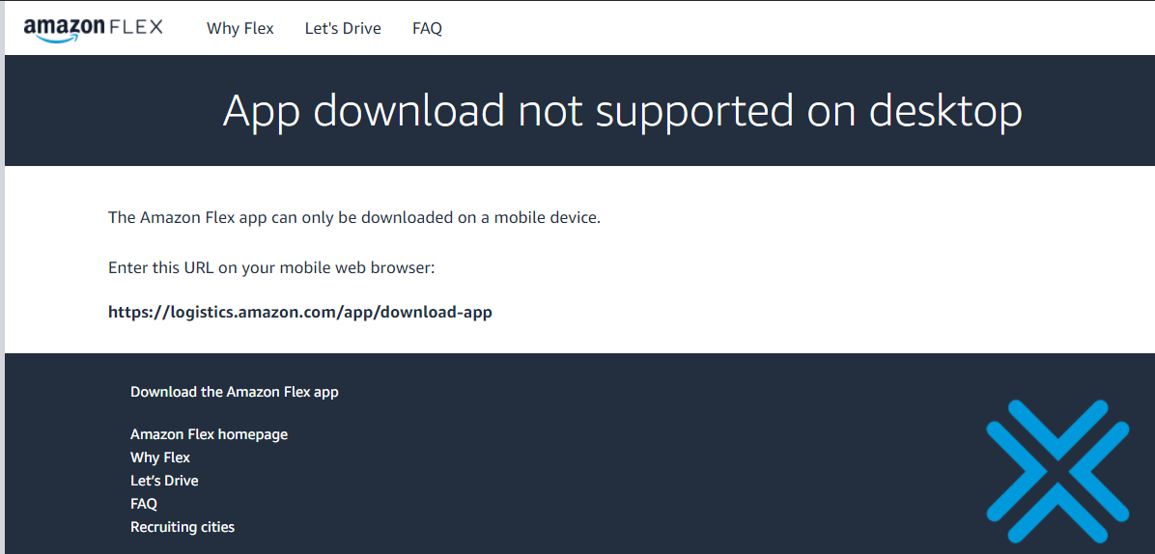

LCV Apps

Slide 25














Truck Apps

Slide 26
The Problem With Apps…
Not all apps report location
Weather, Social Media – highly likely
“Gig” apps – probably
Freight Terminal Apps – possibly not
We don’t know what app(s) reported location
rMerge: the data is aggregated before we get it
StreetLight: probably the same

Slide 27
Imputation Method (Version 1)

Slide 28
The Process in a Nutshell…
Trip List
Tours
Tours by Type
(Pax or Comm)
Depot Identification
LCV Tours by Tour Type
Process is specific to rMerge data

Slide 29
Trips to Tours
Use purpose info (HBW, HBNW, NHBW, NHBO) to determine tours
Group trips by tour id variable
Get number of stops, distance of tour, time of tour
Maintain resident vs. visitor

Slide 30
Tours by Vehicle Type
K-means Clustering Algorithm
Separate by resident and visitor
Used three criteria
N non-work stops on tour
N work stops on tour
N trips in tour
Checked device linking
Devices with more commercial tours ?
Didn’t work as well

Slide 31
Depot Identification Process
Data Preparation
Clean data
Collapse trace data to trips
Stop DBSCAN
ID Locations and Repeat Visits
Not all locations clustered
Develop Directed Graphs
Computes several metrics to identify relationship of stop to entire graph

Slide 32
Depot Identification Process
Train linear model based on a sample of trucks
Identify depots for each vehicle
Trained model applied to entire trip table
Cross-Vehicle DBSCAN
Identify shared depots

Slide 33
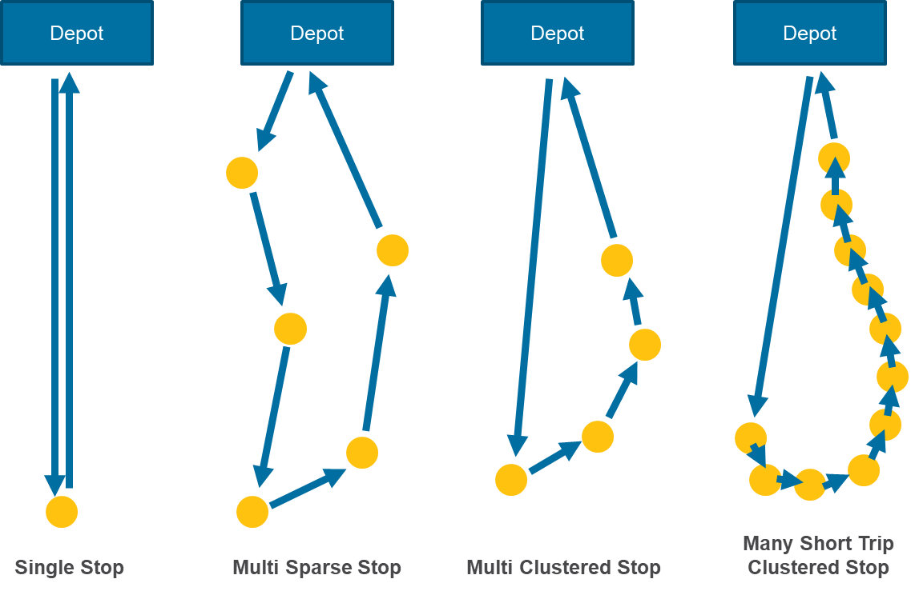
LCV & Truck Tours by Tour Type

Slide 34
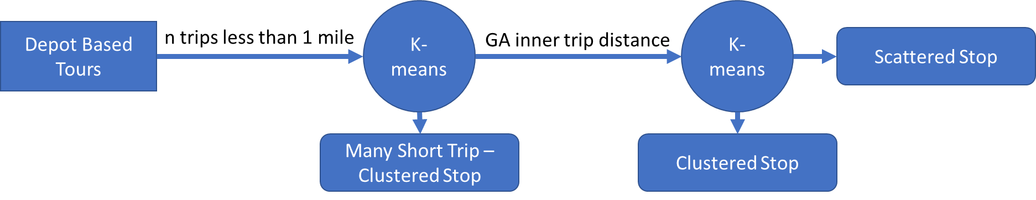
LCV & Truck Tours by Tour Type
Query out tours with no stop and one stop between depots
Remaining Tours through two K-Means Clusters

Slide 35

Geometric Average
 | Distance
Trip 1 | 45
Trip 2 | 8
Trip 3 | 4
Trip 4 | 3
Trip 5 | 15
Trip 6 | 15
Mean | 15.00
G Mean | 9.95
$$GA= \sqrt[n]{\prod{x}}$$

Slide 36
How Well Does This Work?
Indianapolis MPO Model Update In Progress
Model Should be functional in October
Model Should be validated by December 1, 2020
Potential Improvements
Wanted to do a better matching to ATRI data to check Truck vs. LCV in Commercial group
rMerge algorithms were updated since this work – much better home/work/other imputation now

Slide 37
Contacts
Andrew Rohne
Senior Consultant
Andrew.Rohne@rsginc.com
www.rsginc.com

