Slide 1
Interim Findings from NCHRP 08-110 Traffic Forecasting Accuracy Assessment Research
March 15, 2019
Greg Erhardt & Jawad Hoque
University of Kentucky
Dave Schmitt
Connetics Transportation Group

Slide 2
“The greatest knowledge gap in US travel demand modeling is the unknown accuracy of US urban road traffic forecasts.”
Hartgen, David T. “Hubris or Humility? Accuracy Issues for the next 50 Years of Travel Demand Modeling.” Transportation 40, no. 6 (2013): 1133–57.

Slide 3
Project Objectives
“The objective of this study is to develop a process to analyze and improve the accuracy, reliability, and utility of project-level traffic forecasts.”
-- NCHRP 08-110 RFP
Accuracy is how well the forecast estimates project outcomes.
Reliability is the likelihood that someone repeating the forecast will get the same result.
Utility is the degree to which the forecast informs a decision.

Slide 4
Dual Approaches and Dual Outcomes
 | Large-N Analysis | Deep Dive
Approach | Statistical analysis of a large sample of projects. | Detailed evaluation of one project.
Analysis Outcomes | What is the distribution of forecast errors? Can we detect bias in the forecasts? After adjusting for any bias, how precise are the forecasts? | What aspects of the forecasts can we identify as being inaccurate? If we had gotten those right, how much would it change the forecast?
Process Outcomes | What information should be archived from a forecast? What data should be collected about actual project outcomes?
 | Which measures should be reported in future Large-N studies? | Can we define a template for future Deep Dives?

Slide 5
Today’s Plan
Introduction
Data and Archiving
Large N Results
Deep Dive Results
Recommendations

Slide 6
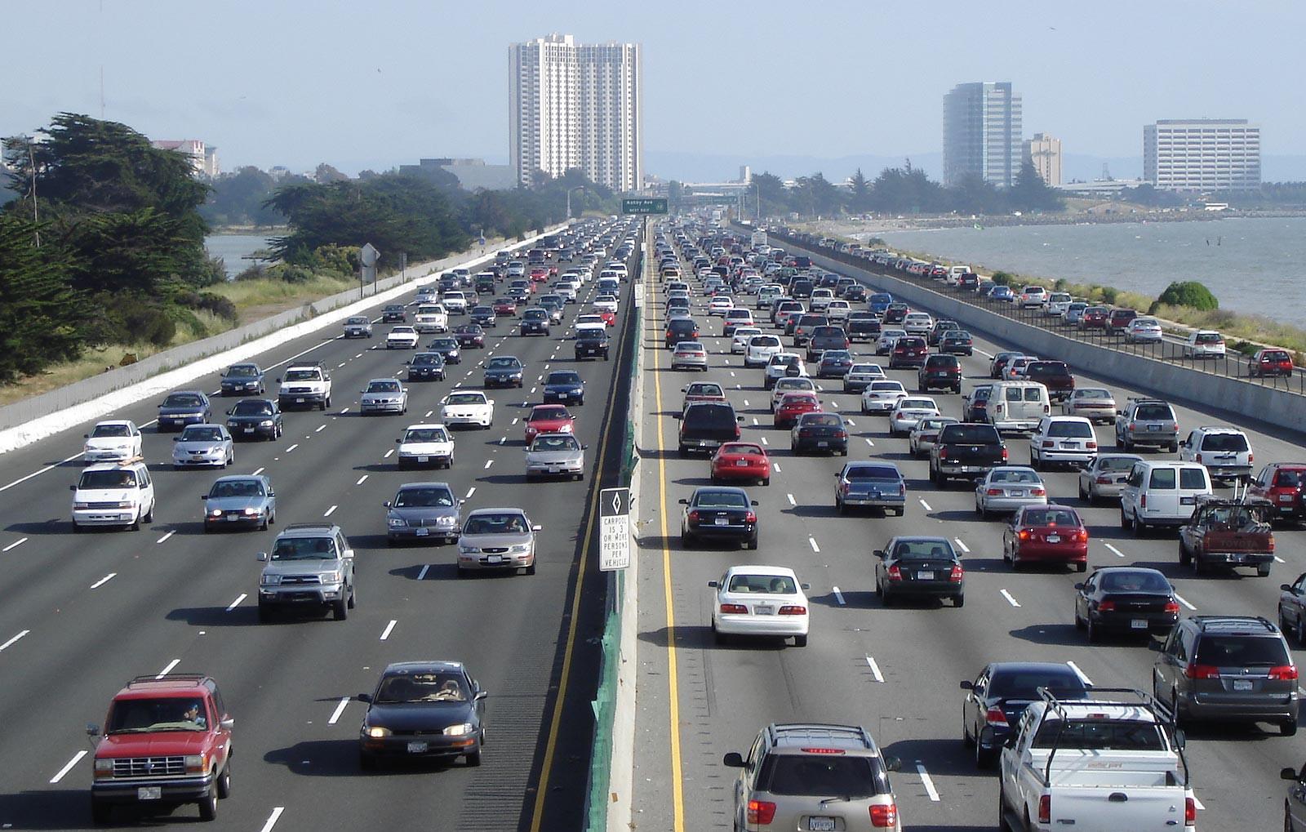
2. Data and Archiving

Slide 7
“The lack of availability for necessary data items is a general problem and probably the biggest limitation to advances in the field.”
Nicolaisen, Morten Skou, and Patrick Arthur Driscoll. “Ex-Post Evaluations of Demand Forecast Accuracy: A Literature Review.” Transport Reviews 34, no. 4 (2014): 540–57.

Slide 8
Forecast Accuracy Database
6 states: FL, MA, MI, MN, OH, WI + 4 European nations: DK, NO, SE, UK
Total: 2,300 projects, 16,000 segments
Open with Counts: 1,300 projects, 3,900 segments

Slide 9
Archive & Information System
Desired features:
Stable, long-term archiving
Ability to add reports or model files
Enable multiple users and data sharing
Private/local option
Mainstream and low-cost software
Standard data fields!

Slide 10
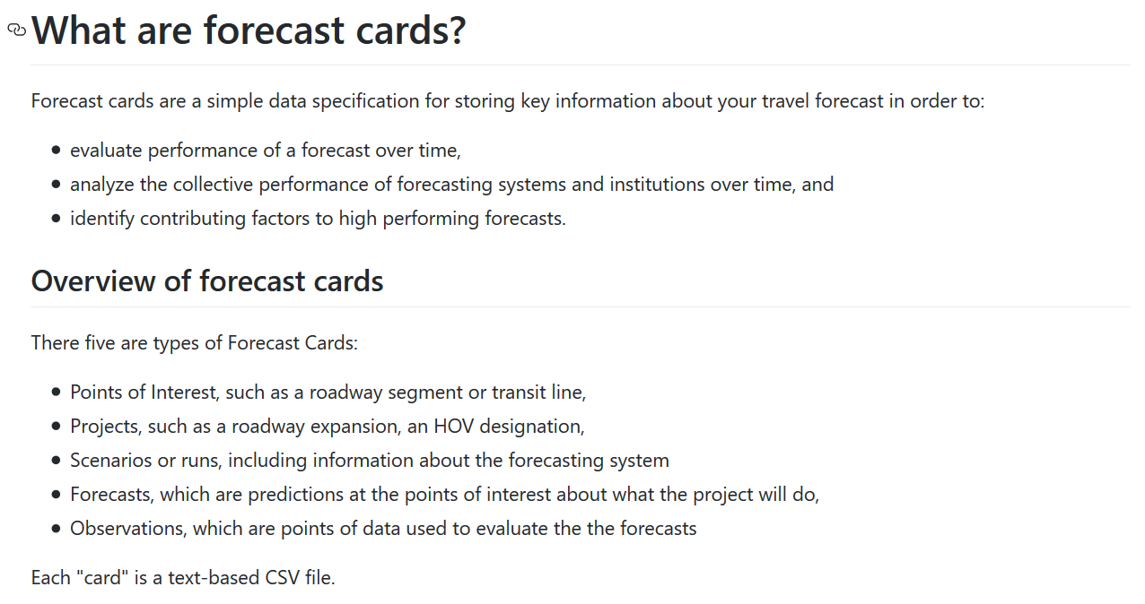
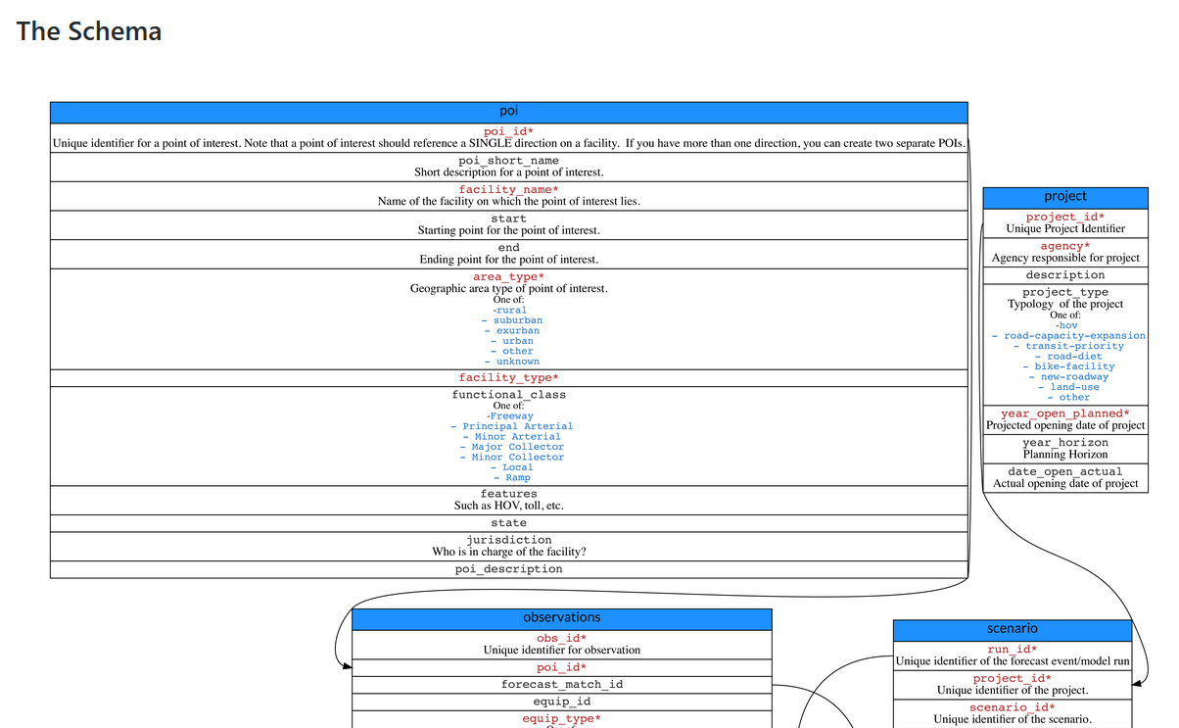
forecastcards
https://github.com/e-lo/forecastcards

Slide 11
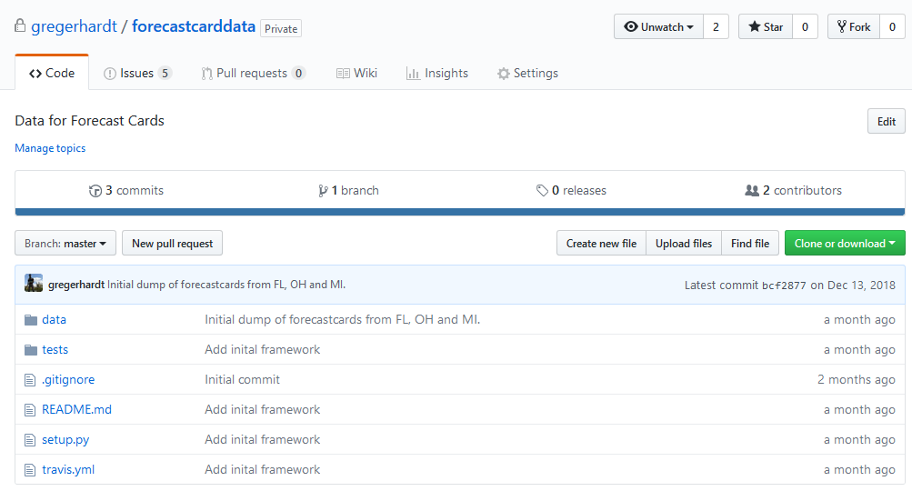
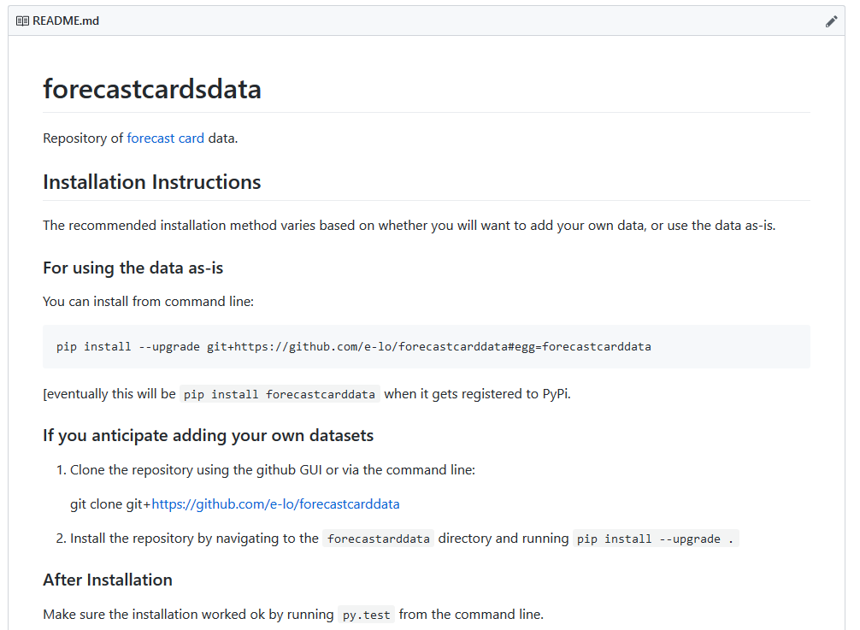
forecastcarddata
https://github.com/gregerhardt/forecastcarddata

Slide 12
3. Large N Analysis

Slide 13
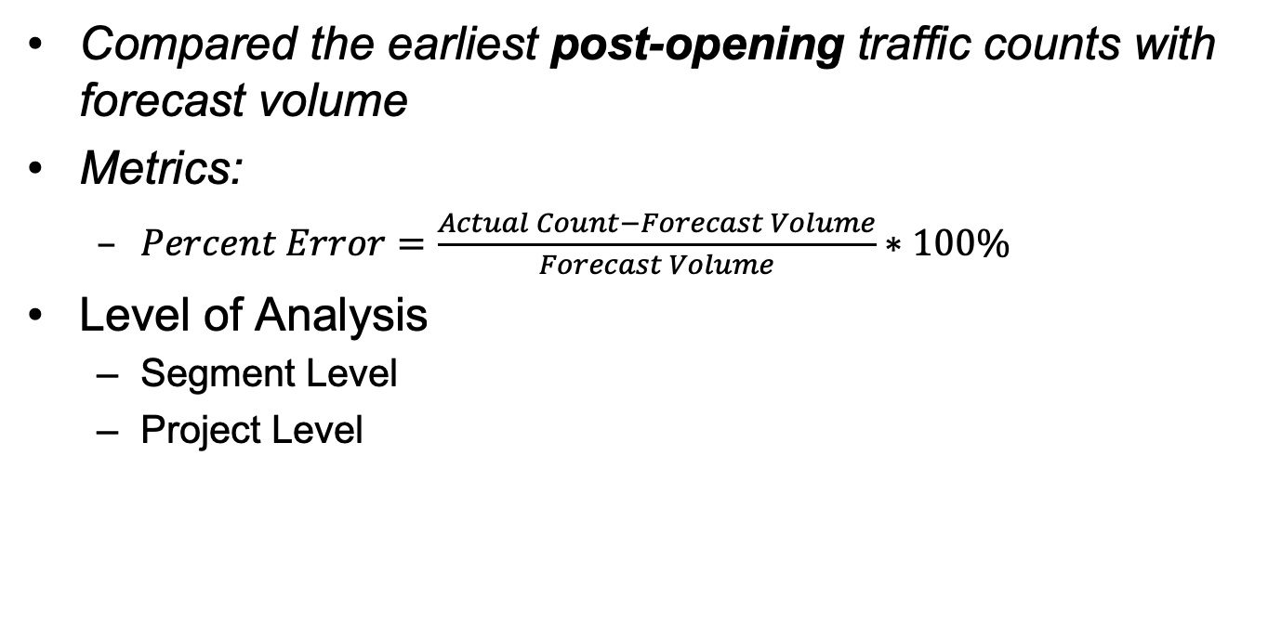
Large N Analysis
About the Methodology
Compared the earliest post-opening traffic counts with forecast volume
Metrics:
$\begin{aligned}Percent Error=\frac{Actual Count−Forecast Volume}{Forecast Volume}∗100\%\end{aligned}$
Level of Analysis
Segment Level
Project Level

Slide 14
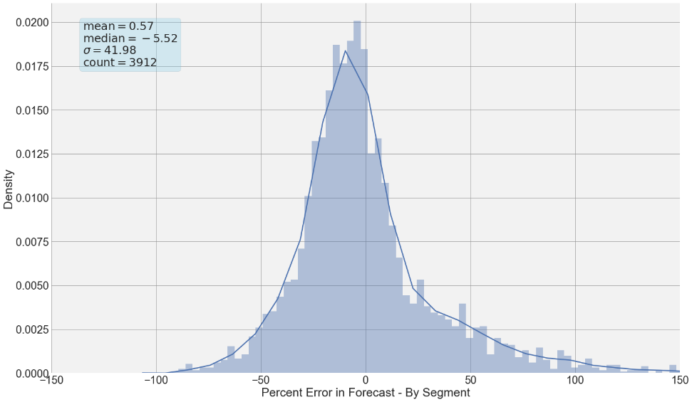
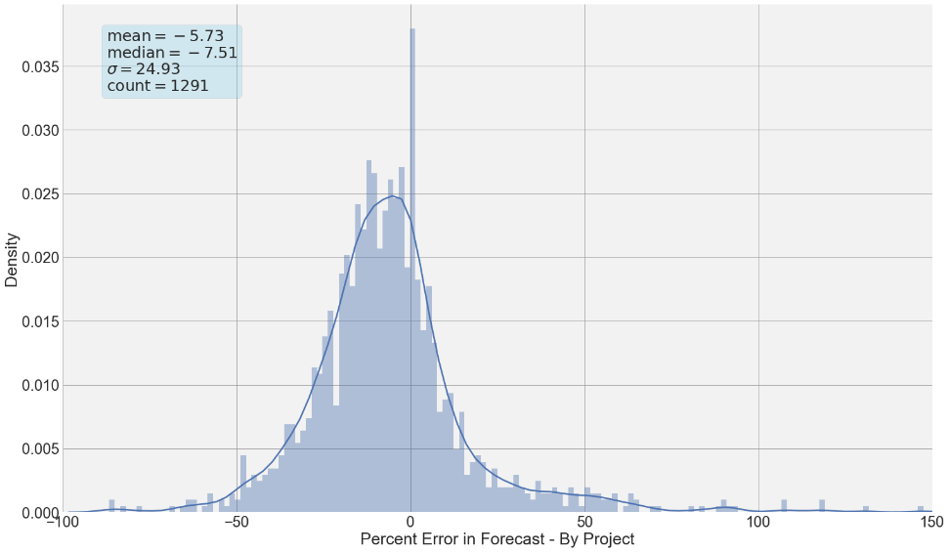
Overall Distribution
Segment Distribution
Project Distribution
Mean = 0.6%
Median = -5.5%
Std Dev = 42%
Count = 3912
MAPE = 25%
Mean = -5.7%
Median = -5.5%
Std Dev = 25%
Count = 1291
MAPE = 17%
Notes:
Talk about the level of analysis here. Will be touched upon later in next steps

Slide 15
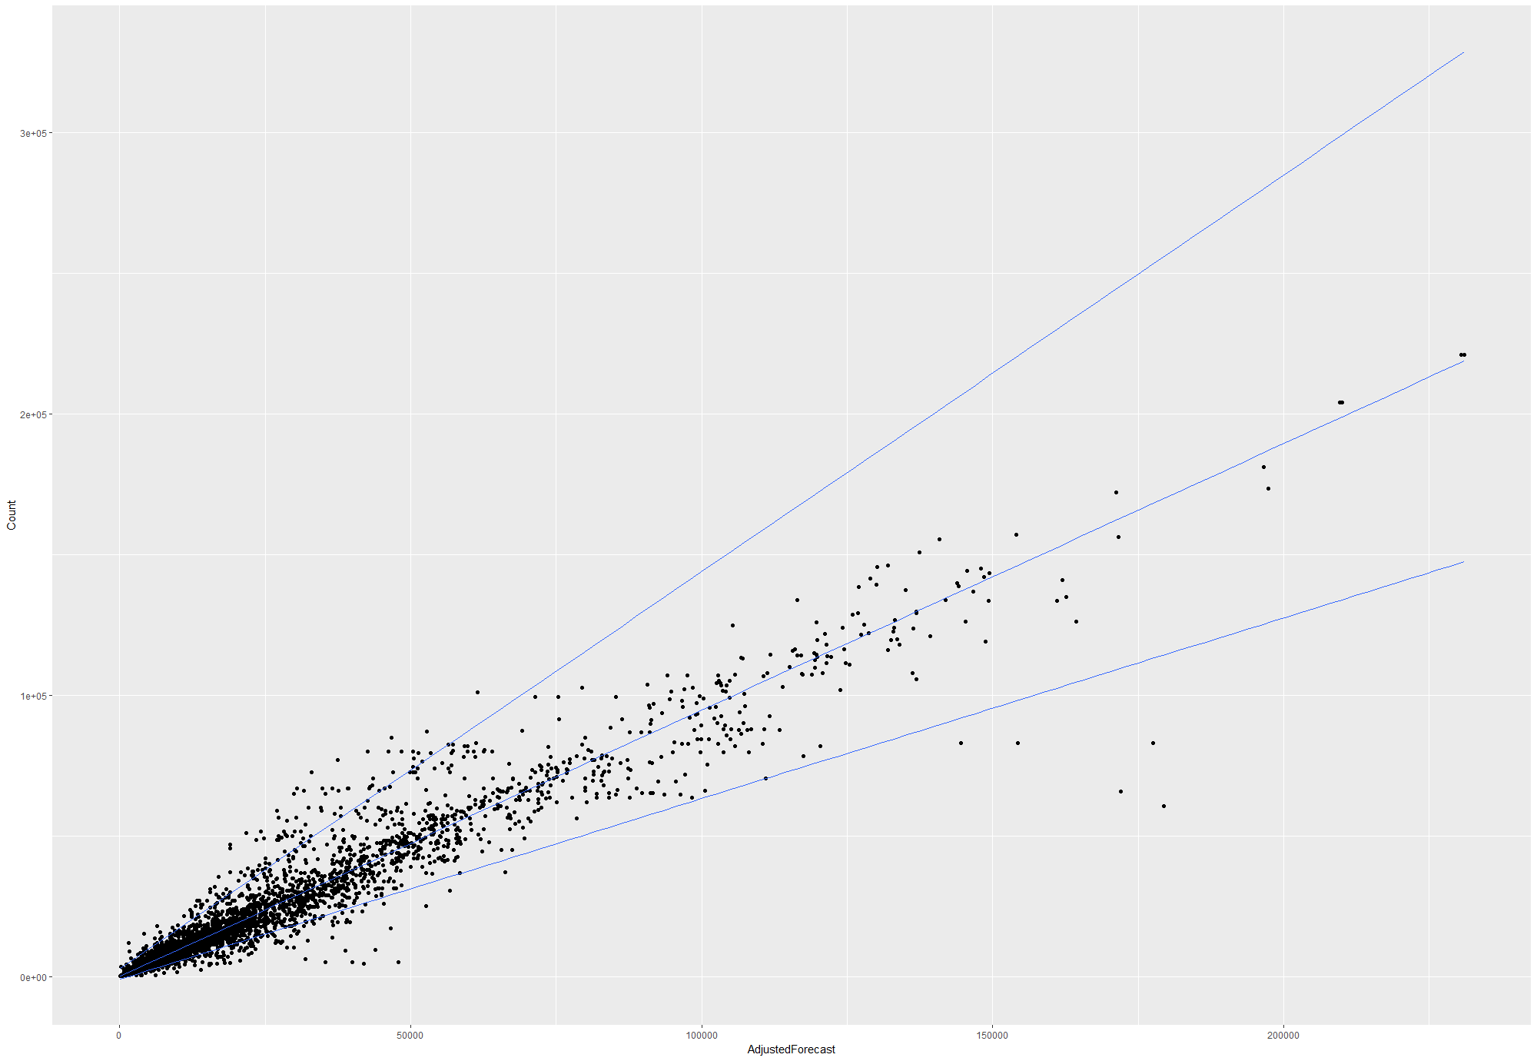
Estimating Uncertainty
Draw lines so 95% of dots are between the lines
Actual ADT
Forecast ADT

Slide 16



Estimating Uncertainty
To draw a line through the middle of the cloud, we use regression.
To draw a line along the edge of the cloud, we use quantile regression. It’s the same thing, but for a specific percentile instead of the mean.
$$A_{95th} =2940+1.42F+ε$$
$$A_{50th}= 37+0.94F+ε$$
$$A_{5th} =−826+0.62F+ε$$

Slide 17
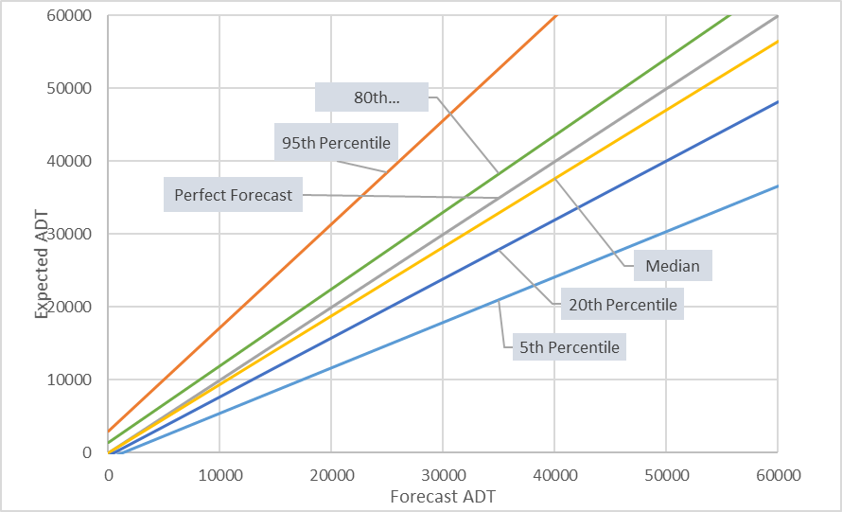
Quantile Regression Output

Slide 18
Large N Results
95% of forecasts reviewed are “accurate to within half of a lane.”
Traffic forecasts show a modest bias, with actual ADT about 6% lower than forecast ADT.
Traffic forecasts had a mean absolute percent error of 25% at the segment level and 17% at the project level.

Slide 19
Large N Results
Traffic forecasts are more accurate for:
Higher volume roads
Higher functional classes
Shorter time horizons
Travel models over traffic count trends
Opening years with unemployment rates close to the forecast year
More recent opening & forecast years

Slide 20
4. Deep Dive Results

Slide 21
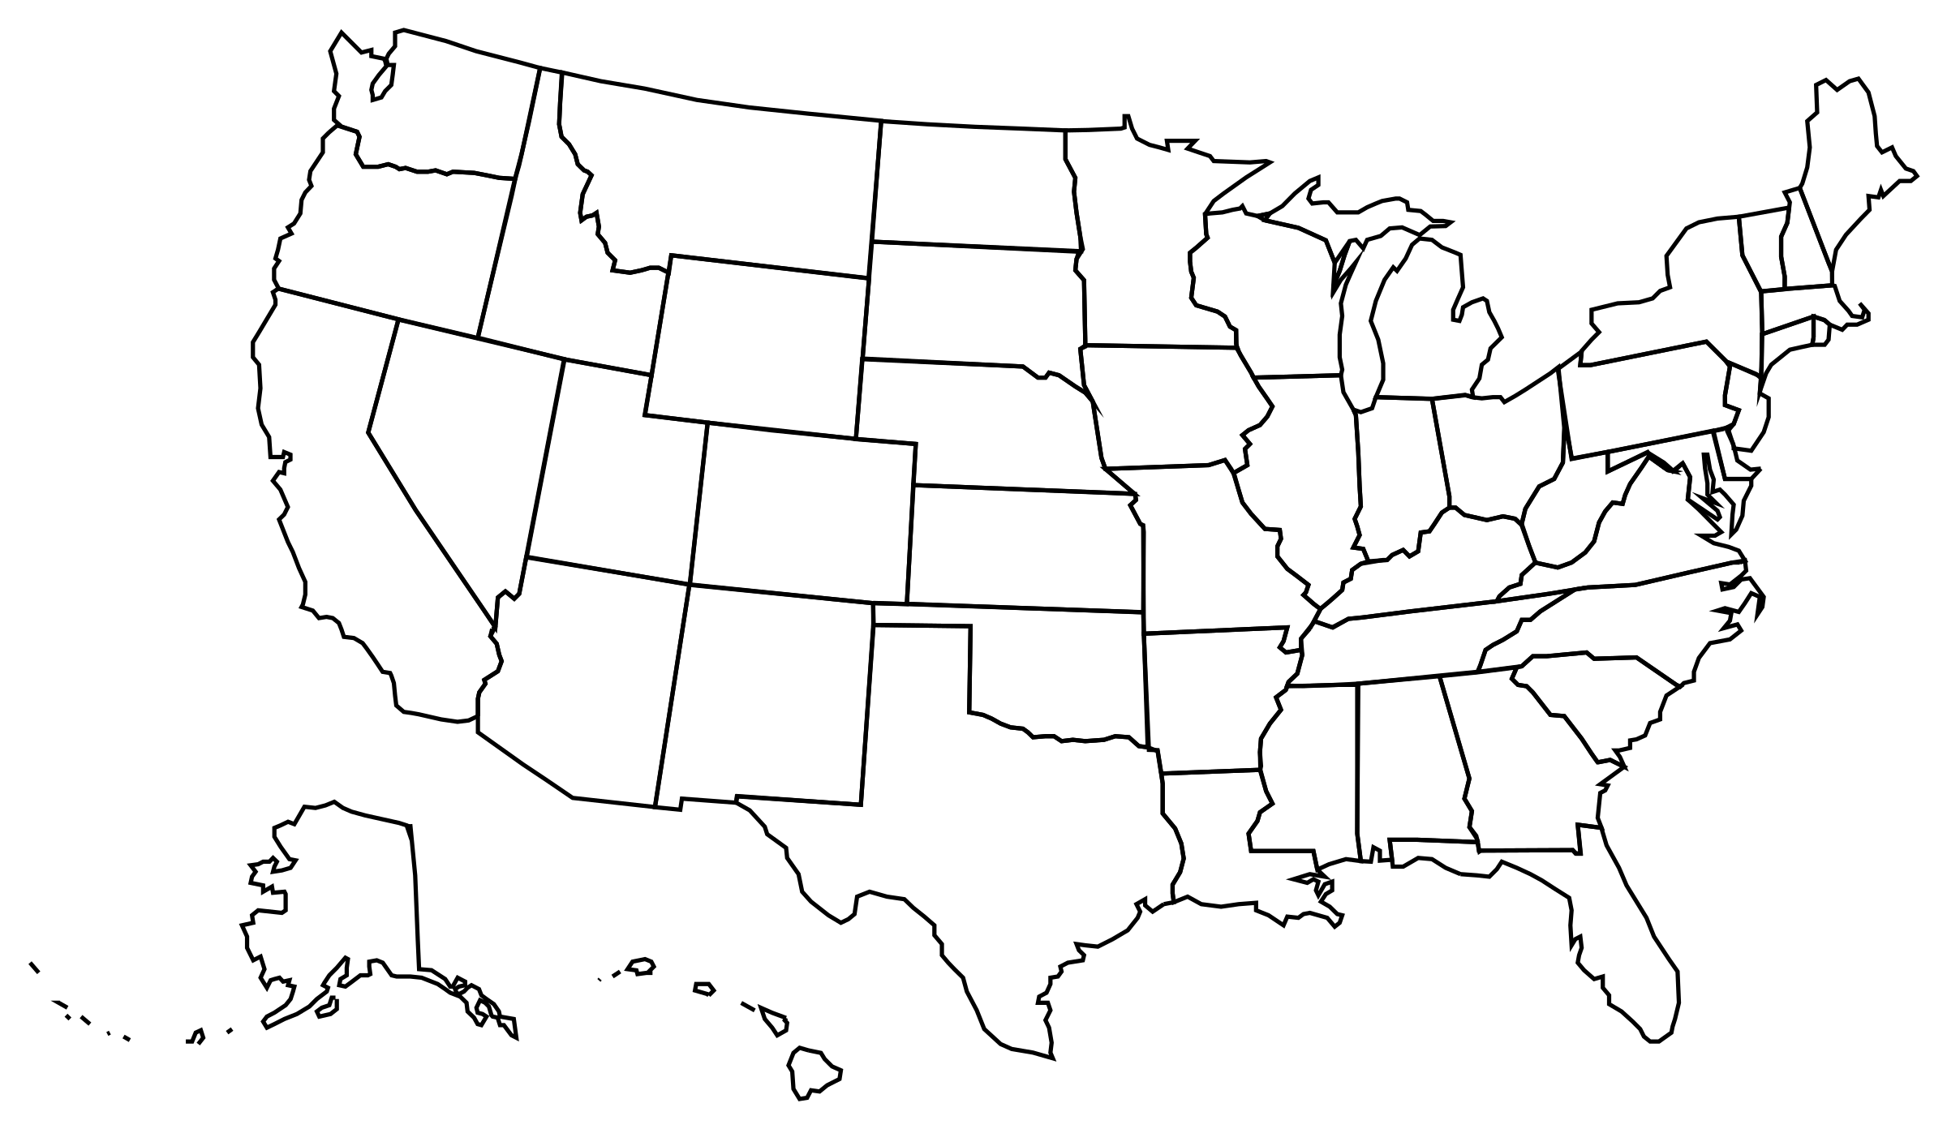
Deep Dives
Projects selected for Deep Dives
Eastown Road Extension Project, Lima, Ohio
Indian River Street Bridge Project, Palm City, Florida
Central Artery Tunnel, Boston, Massachusetts
Cynthiana Bypass, Cynthiana, Kentucky
South Bay Expressway, San Diego, California
US-41 (later renamed I-41), Brown County, Wisconsin

Slide 22

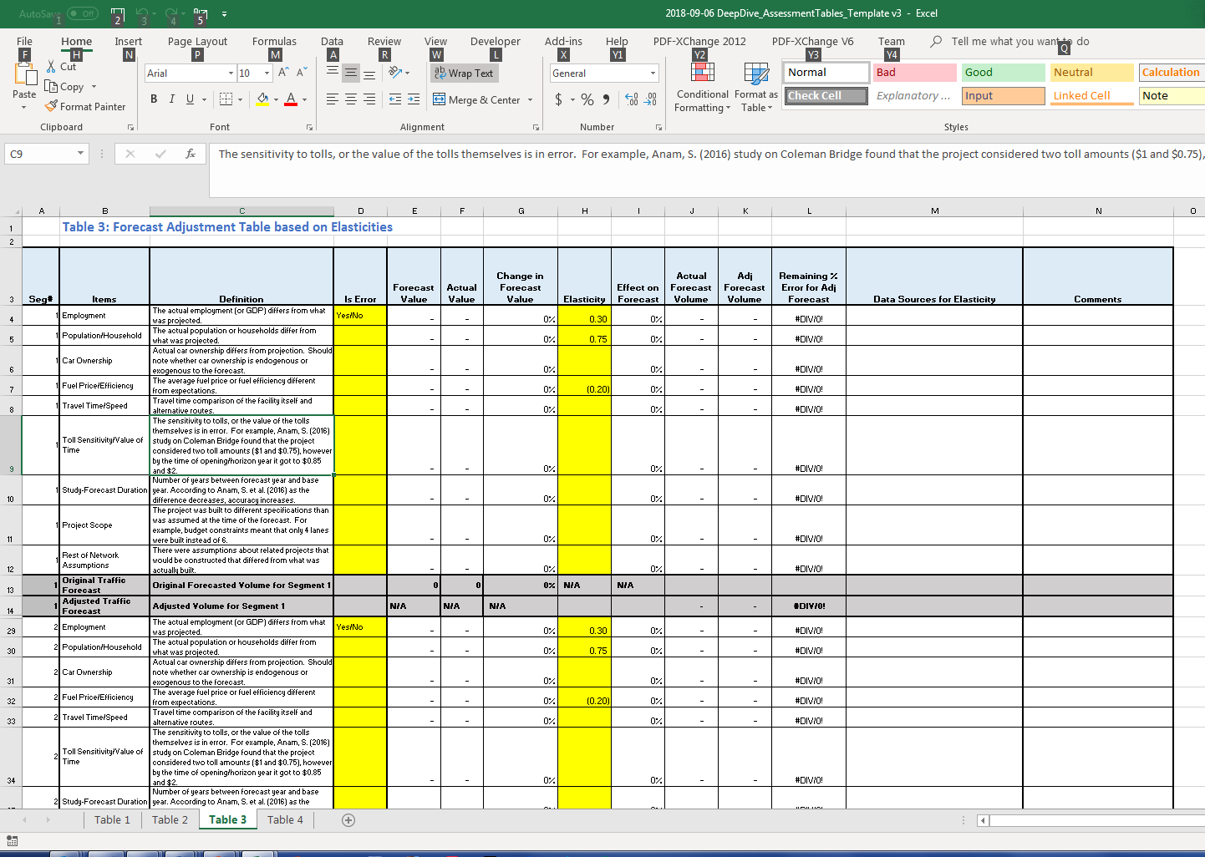
Deep Dive Methodology
Collect data:
Public Documents
Project Specific Documents
Model Runs
Investigate sources of errors as cited in previous research:
Employment, Population projections etc.
Adjust forecasts by elasticity analysis
Run the model with updated information

Slide 23
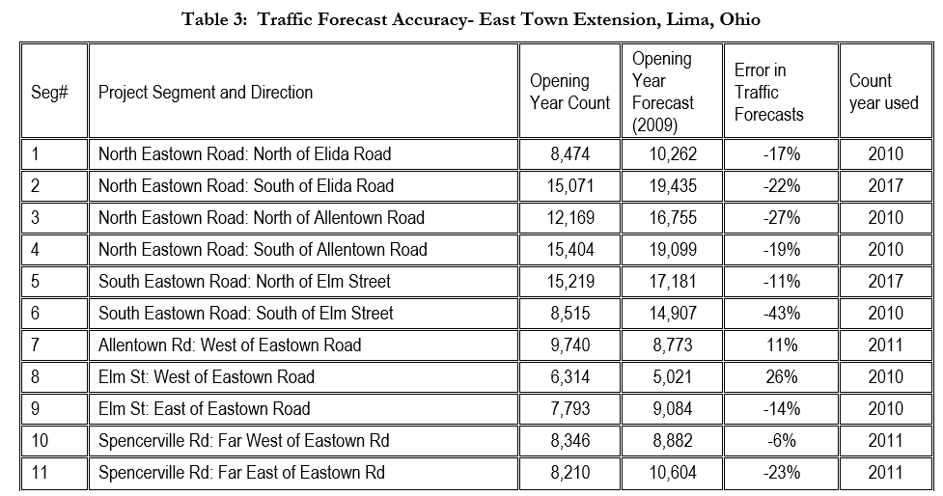
Step 1: Document forecast & actual volumes by segment

Slide 24
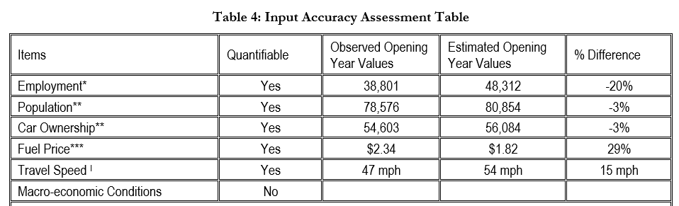
Step 2: Document forecast & actual values of inputs

Slide 25
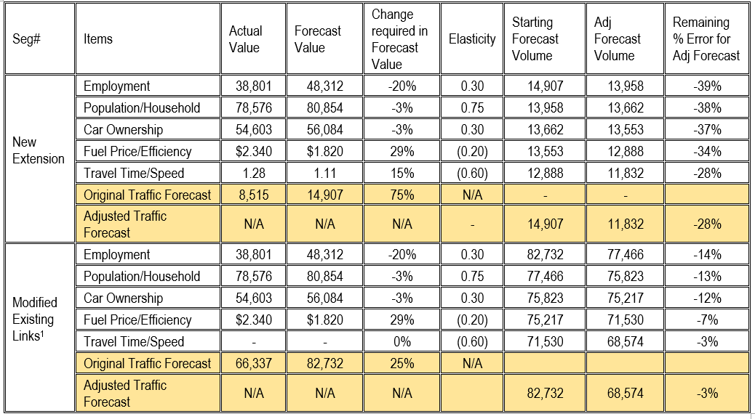
Step 3: Re-run models with corrected inputs or use elasticities to adjust

Slide 26
Deep Dives
Eastown Road Expansion Project
Employment, population, car ownership, fuel price, travel time are the identified sources of error.
Correcting input errors improved forecasts significantly.
Indian River Bridge Project
Base year validation was reasonable, but still an error of 60%
Very slight improvement after accounting for input errors (employment, population and fuel price)

Slide 27
Deep Dives
Central Artery/Tunnel Project
Accurate forecasts for a massive project with a long horizon, originally off by only 4% on existing links and 16% on new links.
Slight improvement in accuracy after correcting for input errors (employment, population and fuel price)
Cynthiana Bypass Project
External traffic projections (43% lower than forecast) major contributing factor
Correcting for external traffic projections reduced error significantly

Slide 28
Deep Dives
Southbay Expressway Project (toll road)
Contributing factors identified as recession just after opening, decrease in border crossing traffic and increase in toll.
Interstate 41 Project
Accuracy improved after correcting exogenous population forecast.
Relative lack of forecast documentation and unavailability of archived model

Slide 29
Deep Dives
General Conclusions
The reasons for forecast inaccuracy are diverse.
Employment, population and fuel price forecasts often contribute to forecast inaccuracy.
External traffic and travel speed assumptions also affect traffic forecasts.
Better archiving of models, better forecast documentation, and better validation are needed.

Slide 30
5. Recommendations

Slide 31
1. When forecasting
Use a travel model when accuracy is a concern, but don’t discount professional judgment.
Pay attention to the key travel markets associated with the project.
We hope future research will add to this list

Slide 32
2. Use QR models to get uncertainty windows
If the project were at the low/high end of the forecast range, would it change the decision?
No → Proceed
Yes → Consider if you’re ok with that risk

Slide 33
3. Archive your forecasts
Bronze: Record basic forecast information in a database
Silver: Bronze + document forecast in a semi-standardized report
Gold: Silver + make the forecast reproducible
Don’t forget data on actual outcomes.

Slide 34
4. Use the data to improve your model
Evaluate past forecasts to learn about weaknesses of existing model
Identify needed improvements
Test the ability of the new model to predict those project-level changes
Do the improvements help?
Estimate local quantile regression models
Is my range narrower than my peer’s?
We build models to predict change. We should evaluate them on their ability to do so.

Slide 35
Why?
Giving a range → more likely to be “right”
Archiving forecasts and data → Provides evidence for effectiveness of tools used
Data to improve models → Testing predictions is the foundation of science
Together, the goal is not only to improve forecasts, but to build credibility.

Slide 36

Questions & Discussion

Slide 37
Process Conclusions
Some transportation agencies started archiving their forecasts in recent years, and we are beginning to see the benefits.
Inconsistency because agencies used disparate sources of data limited our ability to draw conclusions.
The set of projects for which data are available is not a random sample of projects.

Slide 38
Process Conclusions
Project documentation is often insufficient to evaluate the sources of forecast error.
Evaluation of forecasts is most effective when archived model runs are available.
The best way to compare the accuracy of forecasting methods is by comparing multiple forecasts for the same project.
Don’t discount the value of professional judgment.

