Slide 1

Traffic Forecasting Trivia
Gregory Giaimo, PE
The Ohio Department of Transportation
Division of Planning
December 14, 2018

Slide 2
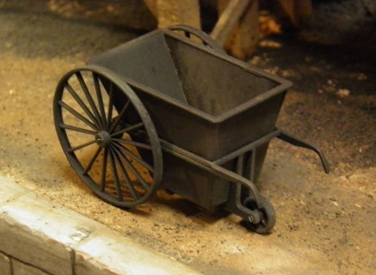
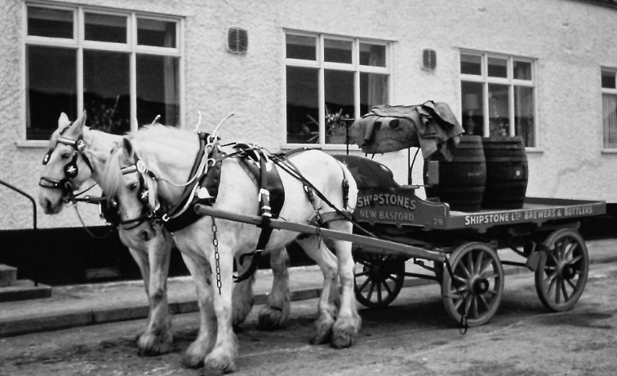
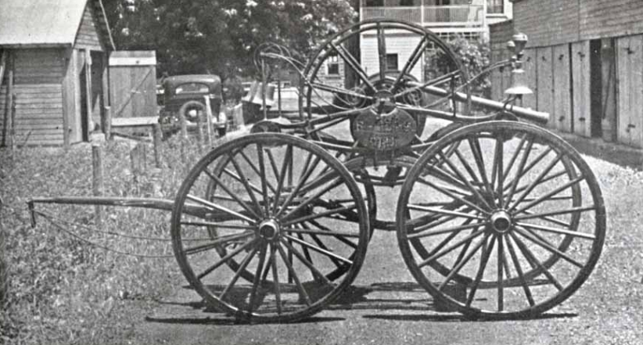
In what decade was the first traffic count taken in Ohio (bonus point for exact year)?
A: 1870’s (1873)
2nd Street Cincinnati
144 Coal Carts
961 Drays
429 Ox Teams
801 Horse Drawn Vehicles
2 One Engine Wagons
1 Hose Reel
2378 Total Vehicles
Coal Cart
Dray
Hose Reel

Slide 3
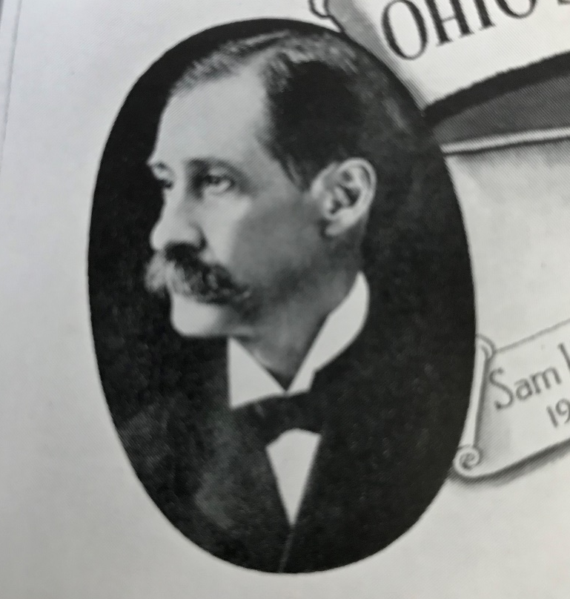
Who was named the Ohio State Highway Department’s first Director in 1904? (hint: similar to Texas)
A: Sam Houston

Slide 4
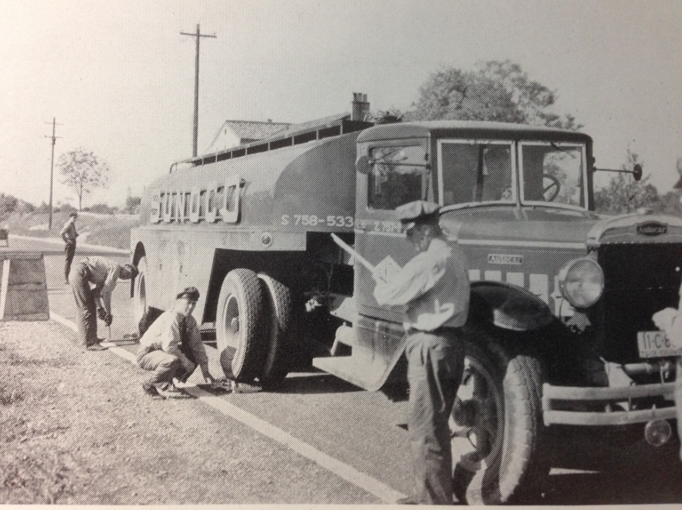
In what decade did the first traffic survey occur in Ohio? (bonus point for exact year)
A: 1920’s (1925)
354 roadside interview survey locations surveyed throughout year
Also 817 manual traffic count locations conducted by Boy Scouts

Slide 5
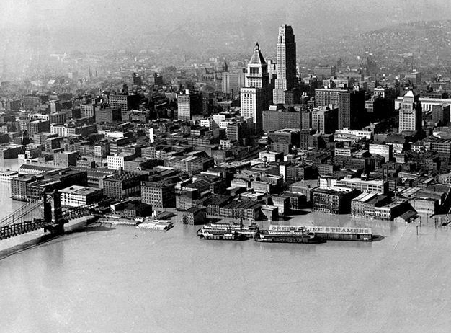
In what city was the first HH survey in Ohio conducted in 1945?
A: Cincinnati
There was also a big flood that year

Slide 6
What did Moore and Dantzig develop in 1957
A: Network routing algorithm
Developed for long distance phone routing
By 1960 had been adapted for traffic assignment in the first Bureau of Public Roads Urban Transportation Planning “Battery”
Early practitioners simply assigned survey developed OD to the network (1 step model)

Slide 7
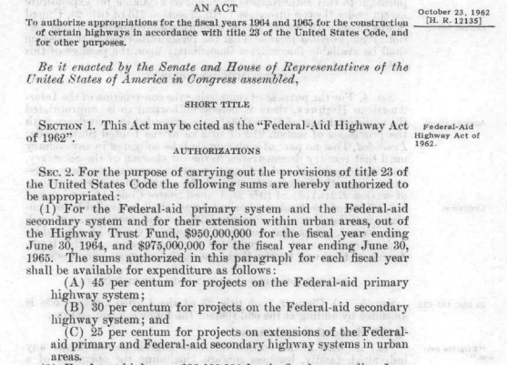
What was the year of the Federal-Aid Highway Act creating MPO’s?
A: 1962

Slide 8
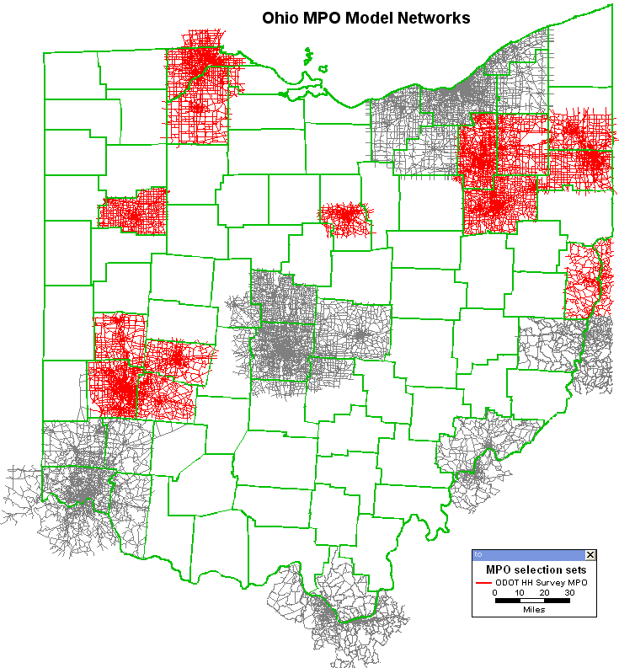
How many MPO’s did Ohio have that year?
A: 15
Originally referred to as transportation studies emphasizing their analytical role
Newark (LCATS) added via 1980 Census
Sandusky (ECRPC) added via 2000 Census

Slide 9
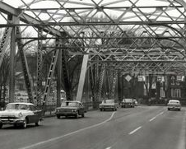
In 1964 a HH survey was conducted for this metro area which it was thought would soon be an MPO?
A: Zanesville
All new MPO areas were surveyed between 1963 and 1968 starting with Akron/Cleveland and ending with Dayton

Slide 10
What percent of households (within 5) was it originally recommended you survey in small metro areas?
The recommendation for the largest areas was 4%
Intent was to replicate the OD pattern of the area from the survey
Failed, assignment across the “Main Screen-line” resulted in adjustment factors near 2
Modern surveys obtain about 0.5% for updating model parameters only
But now we have “Big Data”
A: 12.5%

Slide 11
What year (within 3) was Technical Services created from the old Bureau of Planning Survey?
The same year as the creation of ODOT and demonstrates the transition away from survey based planning
A: 1972

Slide 12
What did ODOT previously refer to the nodes in networks as?
Mylar grid sheets were underlaid beneath paper to hand code networks before key punching changes into text files on the mainframe
It took a few days to get a plot back from the SOCC to see if you did it right
A: Grids

Slide 13
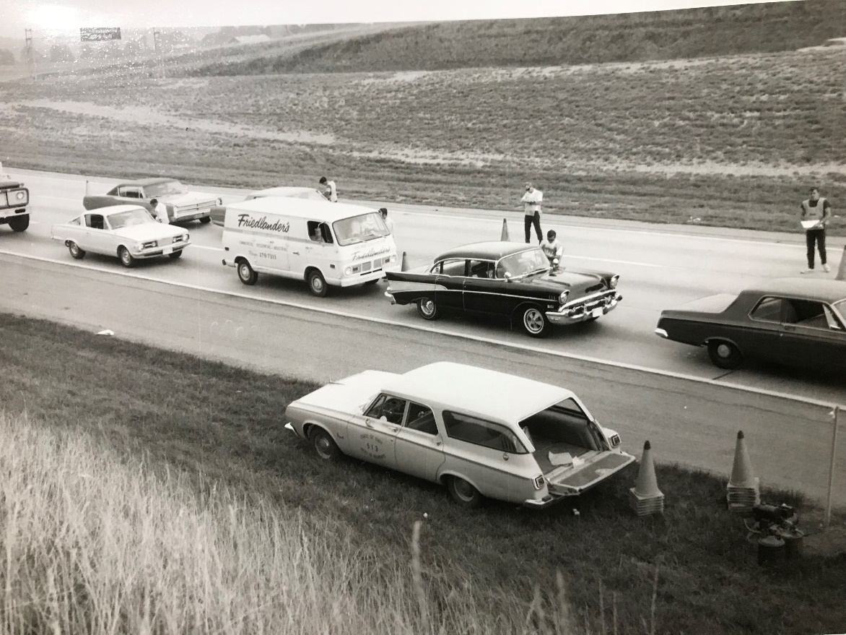
In what urban area was the last cordon survey of the “golden era” conducted in 1978?
A: Columbus
Planning Survey Bureau conducted hundreds of intercept surveys a year
There were several major incidents resulting in shutdown of the program

Slide 14
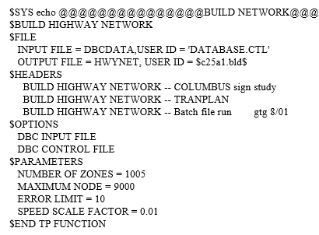
What Ohio urban area was the first to use microcomputer modeling software (Tranplan) around 1990?
A: Cleveland
ODOT followed up converting from Planpac/UTPS to Tranplan throughout the 1990’s

Slide 15
Following a slump in the 1980’s due to near completion of the Interstate, in 1992 what helped renew interest in travel modeling?
A: ISTEA (Intermodal Surface Transportation Efficiency Act)
Set the tone for a whole series of grandly named Federal transportation funding bills, none of which were nearly so impactful
The 1990 CAAA (Clean Air Act Amendments) were similarly important in reviving interest in modeling

Slide 16
Which MPO objected to ODOT only conducting a new roadside survey for the new MPO in Newark resulting in new cordon surveys for all MPO’s in the 1990’s? (bonus point for exact person)
A: AMATS (Ken Hanson)
A young Engineer 2 was put in charge of spending $7 million (a lot in the 90’s) hiring consultants to do it since no one else wanted to touch it

Slide 17
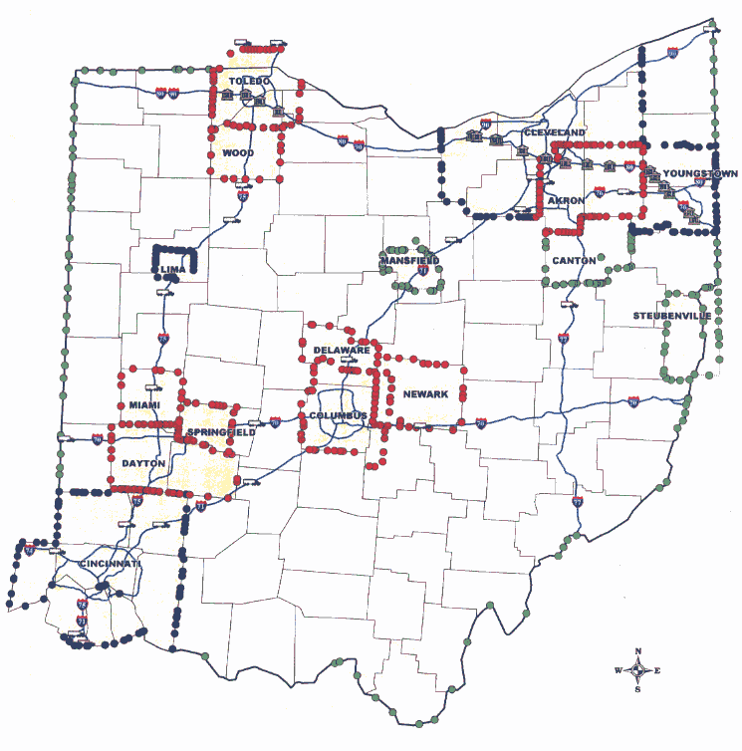
Approximately (nearest 100) how many roadside interview locations were surveyed in the 1990’s?
A: 700

Slide 18
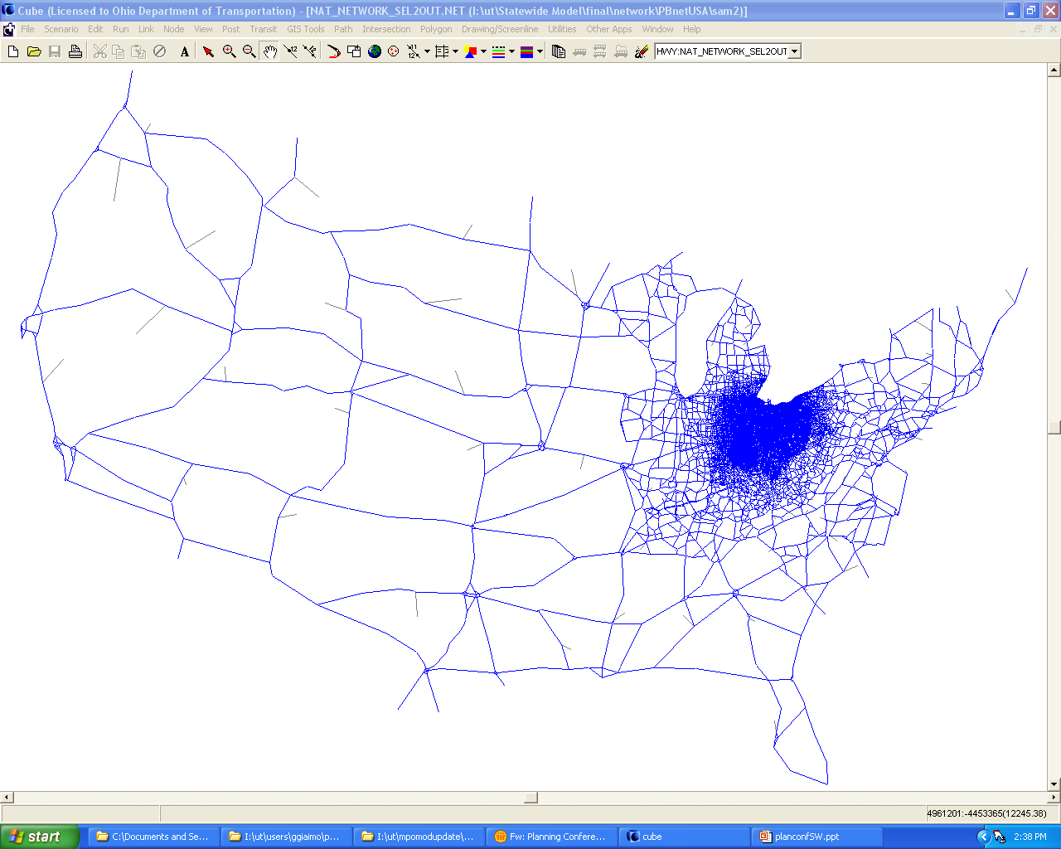
In what decade did Ohio statewide model development begin?
A: 1970’s
The first attempt used hundreds of cordon surveys to develop town by town trip generation rates, successful model begun in late 1990’s

Slide 19
Who developed the first capacity calculator to replace the old book (it was pretty thick) of capacity look up tables? (bonus point for specific person)
A: SCATS (Paul Jaeger)
Mark commented on the lack of cross street influences so Paul said do it better and I got tasked with it, first ODOT version based on 1985 HCM

Slide 20
Who decided to replace the Tranplan models with Cube?
A: OTDMUG
In 2000 a committee was formed
Dave Schmitt and I did most of the testing
MUG voted on it

Slide 21
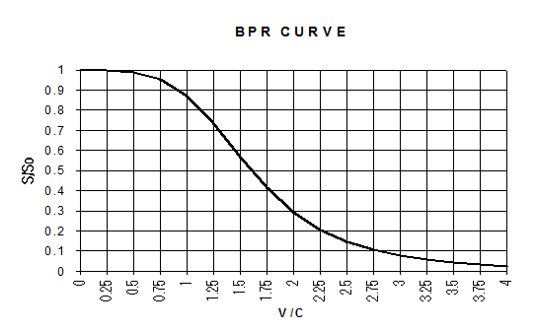
The capacity used in the original BPR curve was referred to as “practical capacity”, approximately what would the level of service be when practical capacity is approached?
A: C
The old assignment methodology was called 40/40/20 and required an LOS C capacity and speeds (formed as 1/3 peak + 2/3 off peak from floating car runs)

