Slide 1

Group 1 Lab 2 exercises and Assignment 2- Part 1
Thilanka Munasinghe
Data Analytics
ITWS-4600/ITWS-6600/MATP-4450/CSCI-4960
Group 1, Lab 2/Assignment2 – Part1, September 25th, 2020

Slide 2
Lab2- Part1: 2a, 2b
Do the BOTH ( Lab2a, Lab2b)
Lab2a. Measures of Central Tendency/Histograms/ Data Manipulation:
Lab2b. Regression
using EPI dataset

Slide 3
The Dataset(s)
http://aquarius.tw.rpi.edu/html/DA
See slides: Last week slides and in-class work as a reference.
Code fragments, i.e. they will not run as-is, on the following slides as.

Slide 4
Remember a few useful commands
head(<object>)
tail(<object>)
summary(<object>)

Slide 5
Generate the Histogram for EPI and DALY variables
Lab2a
Measures of Central Tendency:
Generate Central Tendency values for EPI variable
Generate Central Tendency values for DALY variable
EPI 2010 dataset
Generate the Histogram for EPI variable
Generate the Histogram for DALY variable

Slide 6
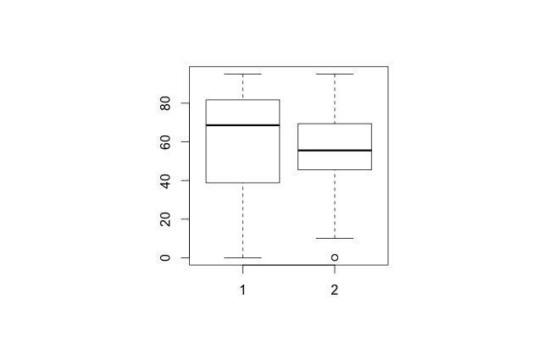
boxplot(ENVHEALTH,ECOSYSTEM)
(Generate the box plot)

Slide 7
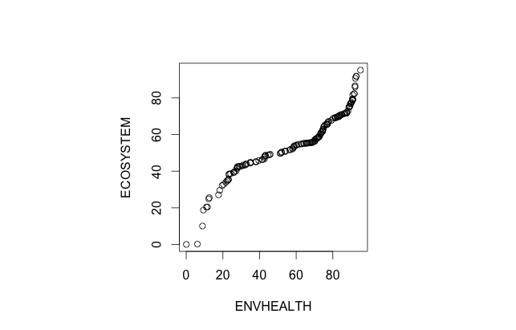
qqplot(ENVHEALTH,ECOSYSTEM)
(generate the Q-Q plot)…

Slide 8
2(b):Regression Exercises
Using the EPI (under /EPI on web) dataset find the single most important factor in increasing the EPI in a given region

Slide 9
Linear and least-squares
> EPI_data <- read.csv(”EPI_data.csv")
> attach(EPI_data);
> boxplot(ENVHEALTH,DALY,AIR_H,WATER_H)
> lmENVH<-lm(ENVHEALTH~DALY+AIR_H+WATER_H)
> lmENVH
> summary(lmENVH)
> cENVH<-coef(lmENVH)

Slide 10
Predict
> DALYNEW<-c(seq(5,95,5))
> AIR_HNEW<-c(seq(5,95,5))
> WATER_HNEW<-c(seq(5,95,5))
> NEW<-data.frame(DALYNEW,AIR_HNEW,WATER_HNEW)
> pENV<- predict(lmENVH,NEW,interval=“prediction”)
> cENV<- predict(lmENVH,NEW,interval=“confidence”)
NOTE: Read the documentation for the predict() function in R :
https://www.rdocumentation.org/packages/stats/versions/3.6.2/topics/predict.lm
Notes:
https://www.rdocumentation.org/packages/stats/versions/3.6.2/topics/predict.lm

Slide 11
Repeat for
AIR_E
CLIMATE

Slide 12
Due Dates:
Part 1 of the Assignment2 (Lab2 – Part 1) – given on 25th September 2020
Part 2 will be given on Monday September 28th, 2020 during the class.
Due Date: (Both Lab2-Part 1 & Lab2-Part 2 submit together): October 2nd , 2020, Friday by 11:59pm. Submit on LMS.

