Slide 1

Data and Information Resources, Role of Hypothesis, Exploration and Distributions
Thilanka Munasinghe
Data Analytics
ITWS-4600/ITWS-6600/MATP-4450/CSCI-4960 MGMT-4962/6962 BCBP 4960
Group 1 Module 3(a), ~ September 15th , 2020

Slide 2

Contents
Data sources
Cyber
Human
“Munging”
Exploring
Distributions…
Summaries
Visualization
Testing and evaluating the results (beginning)
Notes:
Data Munging = data manipulating

Slide 3
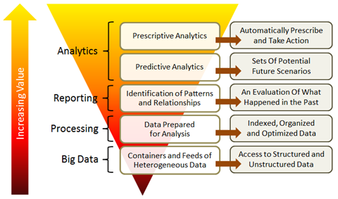
Lower layers in the Analytics Stack

Slide 4

“Cyber Data” …
Notes:
http://i.istockimg.com/file_thumbview_approve/9668319/2/stock-photo-9668319-stock-market-data.jpg
Cyber data – Stock market data ..

Slide 5
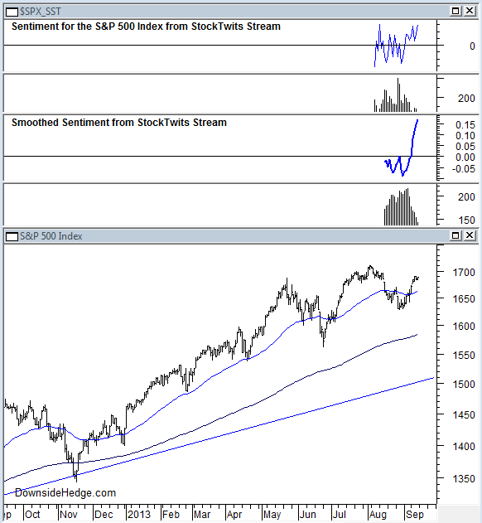
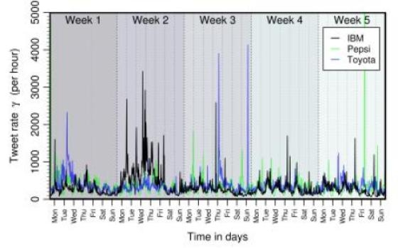
“Human Data” …
Notes:
http://images.sciencedaily.com/2013/10/131007151731-large.jpg
http://www.downsidehedge.com/wp-content/uploads/2013/09/130915StockTwitsSPX.png
Sentiment about the Stock market
What observations you can make,
Some clustering in peaks. Is it uniform ? Any patterns you see ?

Slide 6
Statistics Review – Probability
You have learned this in your Statistics class.

Slide 7
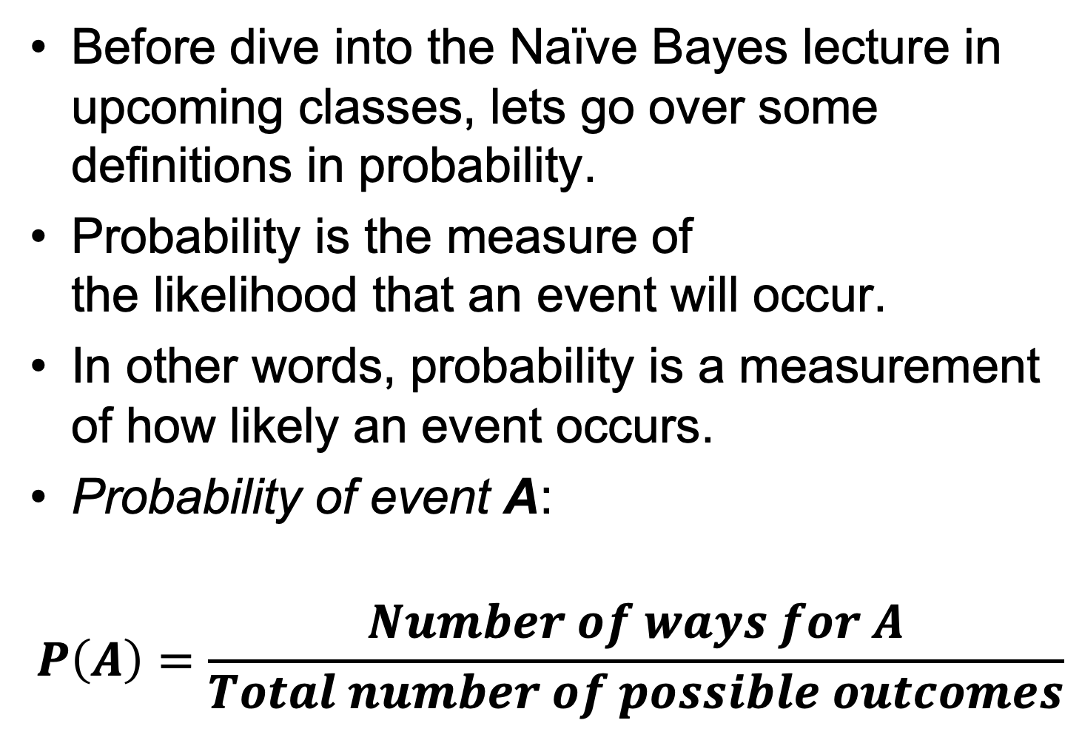
Probability …
Before dive into the Naïve Bayes lecture in upcoming classes, lets go over some definitions in probability.
Probability is the measure of the likelihood that an event will occur.
In other words, probability is a measurement of how likely an event occurs.
Probability of event A:
$$P\left(A\right)=\frac{Number of ways for A}{Total number of possible outcomes}$$
Reference: https://en.wikipedia.org/wiki/Probability
Notes:
https://en.wikipedia.org/wiki/Probability

Slide 8
Probability …
Before we do a deep dive, You should know/understand the two probability concepts:
1) Joint Probability
2) Conditional Probability
Reference: https://en.wikipedia.org/wiki/Probability
Notes:
https://en.wikipedia.org/wiki/Probability

Slide 9
Probability …
Joint Probability: specifies the probability of event A and event B occurring together.
Joint Probability A and B
P(A)
P(B)
P(A,B)
https://en.wikipedia.org/wiki/Joint_probability_distribution
Notes:
https://en.wikipedia.org/wiki/Probability
https://en.wikipedia.org/wiki/Joint_probability_distribution
Image/Photo Credit: https://pngtree.com/freepng/two-dice_1504759.html

Slide 10
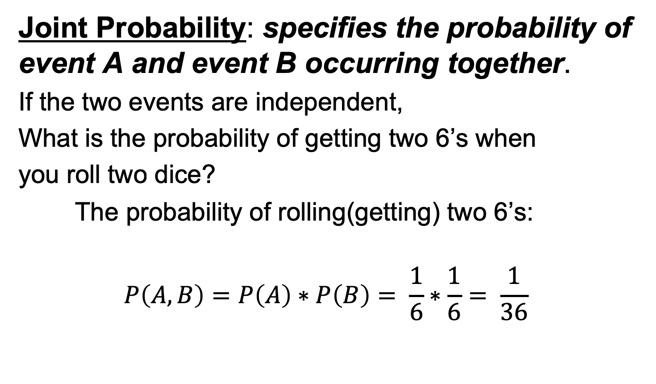
Probability …
Joint Probability: specifies the probability of event A and event B occurring together.
If the two events are independent,
What is the probability of getting two 6’s when
you roll two dice?
The probability of rolling(getting) two 6’s:
$$P\left(A,B\right)=P\left(A\right)∗P\left(B\right)= \frac{1}{6}∗\frac{1}{6}= \frac{1}{36}$$
https://en.wikipedia.org/wiki/Joint_probability_distribution
Image/Photo Credit: https://pngtree.com/freepng/two-dice_1504759.html
Notes:
https://en.wikipedia.org/wiki/Probability
https://en.wikipedia.org/wiki/Joint_probability_distribution
Image/Photo Credit: https://pngtree.com/freepng/two-dice_1504759.html

Slide 11

Probability …
Conditional Probability: probability of event A occurring, given that event B occurred.
$P\left(A | B\right)= \frac{P(A,B)}{P(B)}=$Probability of A, given B ; P(B)>0
P(A)
P(B)
P(A,B)
https://en.wikipedia.org/wiki/Conditional_probability
Notes:
Another way of saying this is event A is conditioned on event B.
The joint probability divided by probability of B
https://en.wikipedia.org/wiki/Probability
https://en.wikipedia.org/wiki/Conditional_probability

Slide 12
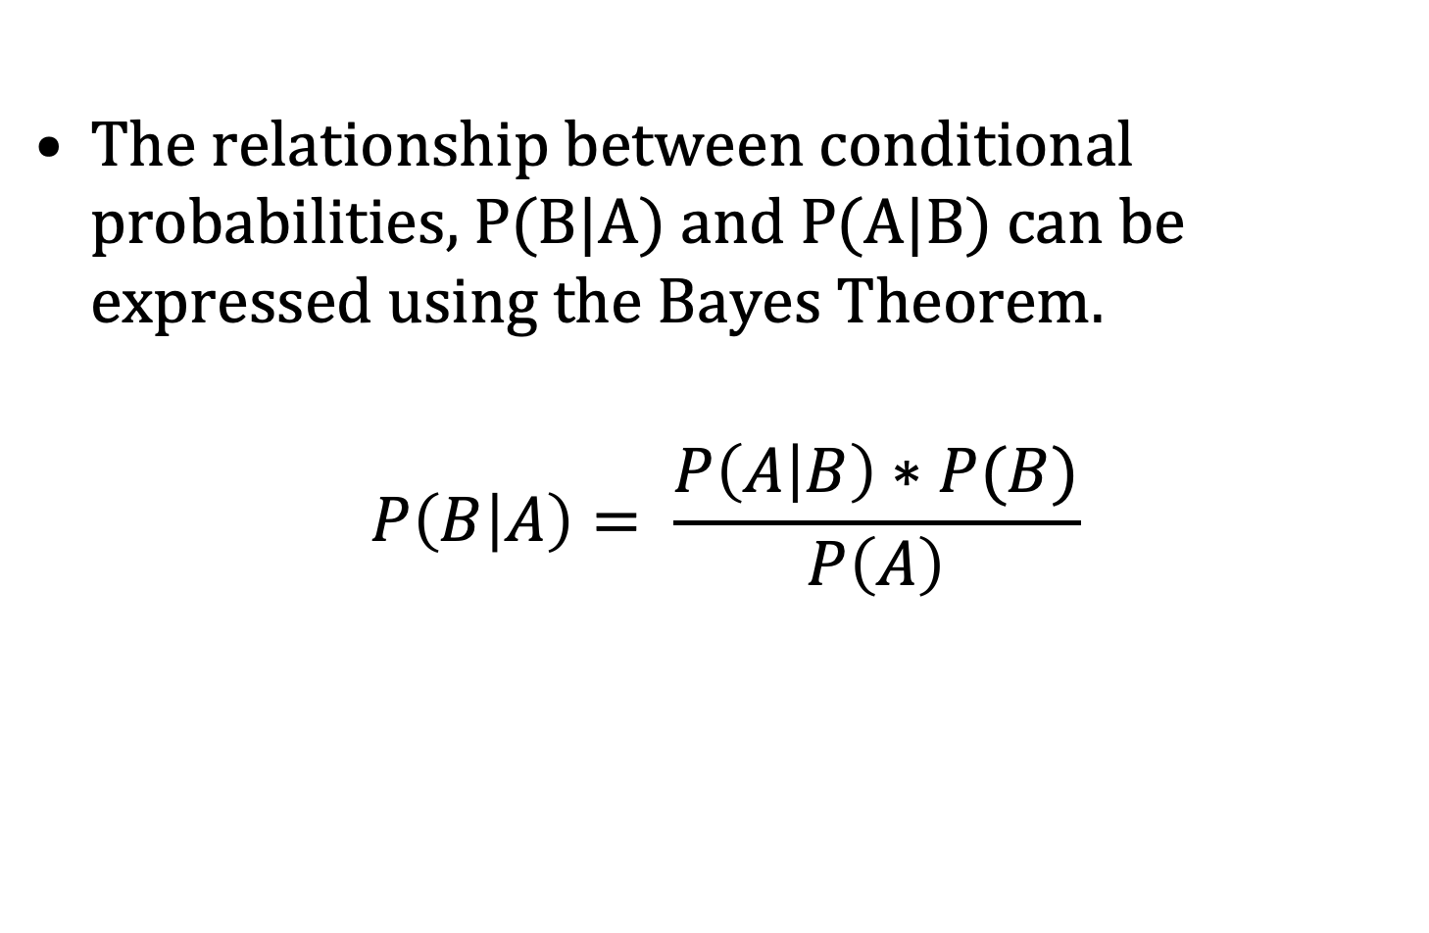
Bayes Theorem…
The relationship between conditional probabilities, P(B|A) and P(A|B) can be expressed using the Bayes Theorem.
$$P\left(B | A\right)= \frac{P\left(A | B\right)∗P(B)}{P\left(A\right)}$$
Reference: https://en.wikipedia.org/wiki/Bayes%27_theorem
Notes:
Bayes theorem express the relationship between probability of A given B and probability of B given A as stated in this equation.
https://en.wikipedia.org/wiki/Probability

Slide 13
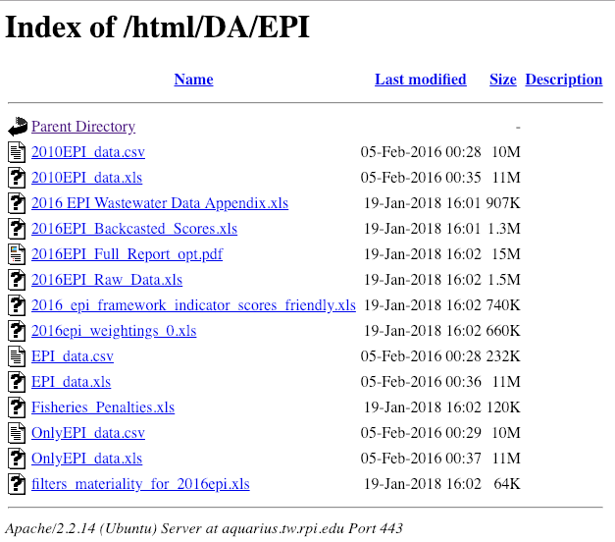
EPI data set from previous lecture…
https://aquarius.tw.rpi.edu/html/DA/EPI/

Slide 14
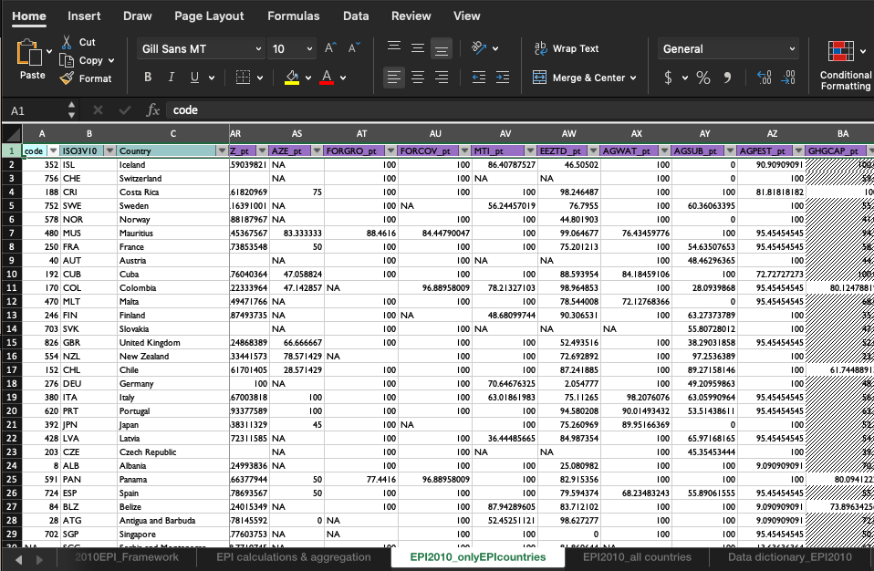
2010EPI_data.xls

Slide 15
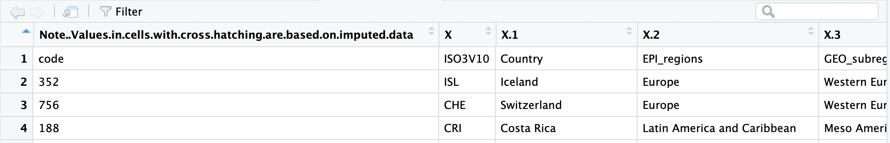
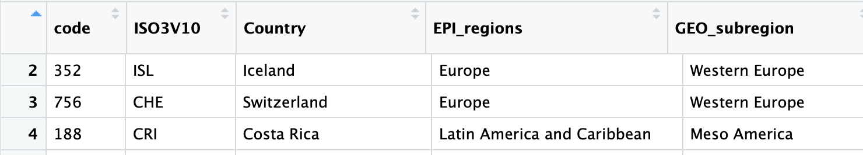
2010EPI dataset in R
Before:
We want this: Change the first row to be the header:

Slide 16
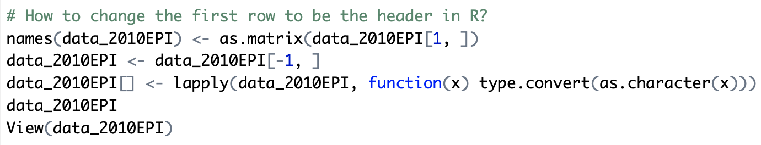
How to change the first row to be the header in 2010EPI ?
# How to change the first row to be the header in R?
names(data_2010EPI) <- as.matrix(data_2010EPI[1, ])
data_2010EPI <- data_2010EPI[-1, ]
data_2010EPI[] <- lapply(data_2010EPI, function(x) type.convert(as.character(x)))
data_2010EPI
View(data_2010EPI)

Slide 17
Data Prepared for Analysis = Munging
Missing values, null values, etc.
E.g. in the EPI_data – they use “--”
Most data applications provide built ins for these higher-order functions – in R “NA” is used and functions such as is.na(var), etc. provide powerful filtering options (we’ll cover these on next class)
Of course, different variables often are missing “different” values
In R – higher-order functions such as: Reduce, Filter, Map, Find, Position and Negate will become your enemies and then your friends: http://www.johnmyleswhite.com/notebook/2010/09/23/higher-order-functions-in-r/
Notes:
Plot the EPI data set
R is smart – R will not plot things can not be plotted. It will throw you an error.
NOTE: in EPI data set, when the values are missing it will show “ – --” two dashes .
NA = Not Available

Slide 18
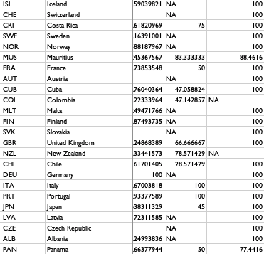
Explore the “Missing values” -- NA

Slide 19
Getting started – summarize data
Summary statistic
Ranges, “hinges”
Tukey’s five numbers
Look for a distribution match
Tests…for…
Normality – shapiro-wilks
and a p-value – what is the null hypothesis here?
> shapiro.test(EPI_data$EPI)
Shapiro-Wilk normality test
data: EPI_data$EPI
p-value = 0.1188
Notes:
When you start working with a dataset, you should always start with summarizing the data
Shapiro test for the normality
http://www.sthda.com/english/wiki/normality-test-in-r
https://www.dummies.com/programming/r/how-to-test-data-normality-in-a-formal-way-in-r/

Slide 20
Accept or Reject?
Reject the null hypothesis if the p-value is less than the level of significance.
You will fail to reject the null hypothesis if the p-value is greater than or equal to the level of significance.
Typical significance 0.05 (!)

Slide 21
Another variable in EPI
> shapiro.test(EPI_data$DALY)
Shapiro-Wilk normality test
data: EPI_data$DALY
W = 0.9365, p-value = 1.891e-07
Read: [1] https://en.wikipedia.org/wiki/Shapiro%E2%80%93Wilk_test
[2] http://www.sthda.com/english/wiki/normality-test-in-r
[3] https://www.dummies.com/programming/r/how-to-test-data- normality-in-a-formal-way-in-r/
[4] https://emilkirkegaard.dk/en/?p=4452

Slide 22
Distribution tests
most distributions have tests
Wilcoxon (Mann-Whitney)
Comparing populations
Two data samples are independent if they come from distinct populations and the samples do not affect each other. Using the Mann-Whitney-Wilcoxon Test, we can decide whether the population distributions are identical without assuming them to follow the normal distribution. http://www.r-tutor.com/elementary-statistics/non-parametric-methods/mann-whitney-wilcoxon-test
Kolmogorov-Smirnov (KS)
It got out of control when people realized they can name the test after themselves, v. someone else…
Notes:
https://en.wikipedia.org/wiki/Kolmogorov%E2%80%93Smirnov_test

Slide 23
Getting started – look at the data
Visually
What is the improvement in the understanding of the data as compared to the situation without visualization?
Which visualization techniques are suitable for one's data?
Scatter plot diagrams
Box plots (min, 1st quartile, median, 3rd quartile, max)
Stem and leaf plots
Frequency plots
Group Frequency Distributions plot
Cumulative Frequency plots
Distribution plots
Notes:
Do you improve your understanding about the data by using a visualization ? Better insights with visualizations ?
Example : Stock market data make more sense when you see the graph/plots rather than looking at the plain data on excel sheet
Like many tests, there are many visualization techniques that are useful for different types of data, examples boxplot, scatter plot, frequency plot etc …

Slide 24
Why visualization?
Reducing amount of data, quantization
Patterns
Features
Events
Trends
Irregularities
Leading to presentation of data, i.e. information products
Exit points for analysis
Notes:
Aims of having a visualization is to point out the “Patterns”, “Features”, “Trends”

Slide 25
Exploring the distribution
> summary(EPI) # stats
Min. 1st Qu. Median Mean 3rd Qu. Max. NA's
32.10 48.60 59.20 58.37 67.60 93.50 68
> boxplot(EPI)
> fivenum(EPI,na.rm=TRUE)
[1] 32.1 48.6 59.2 67.6 93.5
Tukey: min, lower hinge, median, upper hinge, max

Slide 26
Stem and leaf plot
> stem(EPI) # like-a histogram
The decimal point is 1 digit(s) to the right of the | - but the scale of the stem is 10… watch carefully..
3 | 234
3 | 66889
4 | 00011112222223344444
4 | 5555677788888999
5 | 0000111111111244444
5 | 55666677778888999999
6 | 000001111111222333344444
6 | 5555666666677778888889999999
7 | 000111233333334
7 | 5567888
8 | 11
8 | 669
9 | 4
Notes:
Stem here is 3 to 9
Quantitative way of looking at a histogram

Slide 27
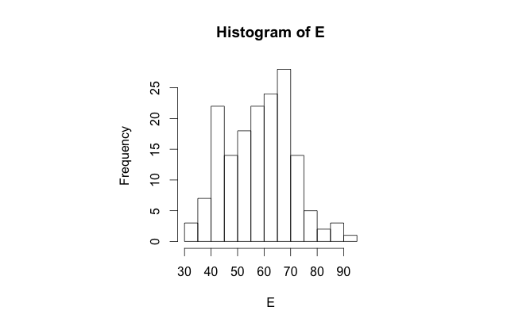
Grouped Frequency Distribution aka binning
> hist(EPI) #defaults
Notes:
Histogram with bins

Slide 28
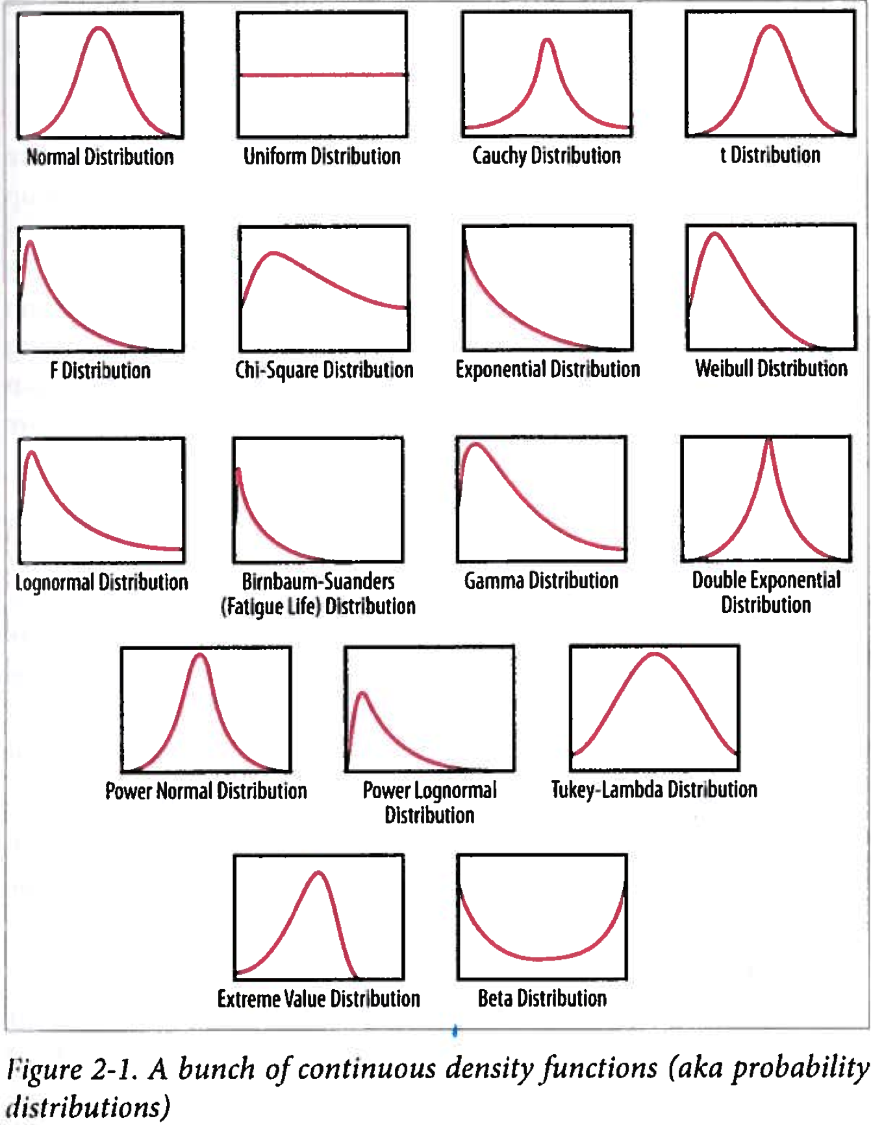
Distributions
Shape
Character
Parameter(s)
Which one fits?
Notes:
Another look at the distributions
First thing we do is we look at something partially look like our histogram
What distribution corresponds to the histogram

Slide 29
> hist(EPI, seq(30., 95., 1.0), prob=TRUE)
> lines (density(EPI,na.rm=TRUE,bw=1.))
> rug(EPI)
What is a rug plot ?
https://en.wikipedia.org/wiki/Rug_plot
Notes:
Here is an actual fragment of a R code of a Histogram.
Bins = 1
Probability density = True (using Probability density rather than the Frequencies)
Bandwidth = 1
Rug shows where the values are

Slide 30
> hist(EPI, seq(30., 95., 1.0), prob=TRUE)
> lines (density(EPI,na.rm=TRUE,bw=“SJ”))
Notes:
Bw = bandwidth
What is SJ mean ? You have to look it up …

Slide 31
Why are histograms so unsatisfying?
Notes:
Same histogram, with density smooth fit

Slide 32
> xn<-seq(30,95,1)
> qn<-dnorm(xn,mean=63, sd=5,log=FALSE)
> lines(xn,qn)
> lines(xn,.4*qn)
> ln<-dnorm(xn,mean=44, sd=5,log=FALSE)
> lines(xn,.26*ln)
Notes:
Ohh … there may be two distribution instead of one !
We are just exploring … ☺

Slide 33
Exploring the distribution
> summary(DALY) # stats
Min. 1st Qu. Median Mean 3rd Qu. Max. NA's
0.00 37.19 60.35 53.94 71.97 91.50 39
> fivenum(DALY,na.rm=TRUE)
[1] 0.000 36.955 60.350 72.320 91.500
EPI
DALY
Notes:
This is another variable called “DALY”
Box-plot two next to each other.

Slide 34
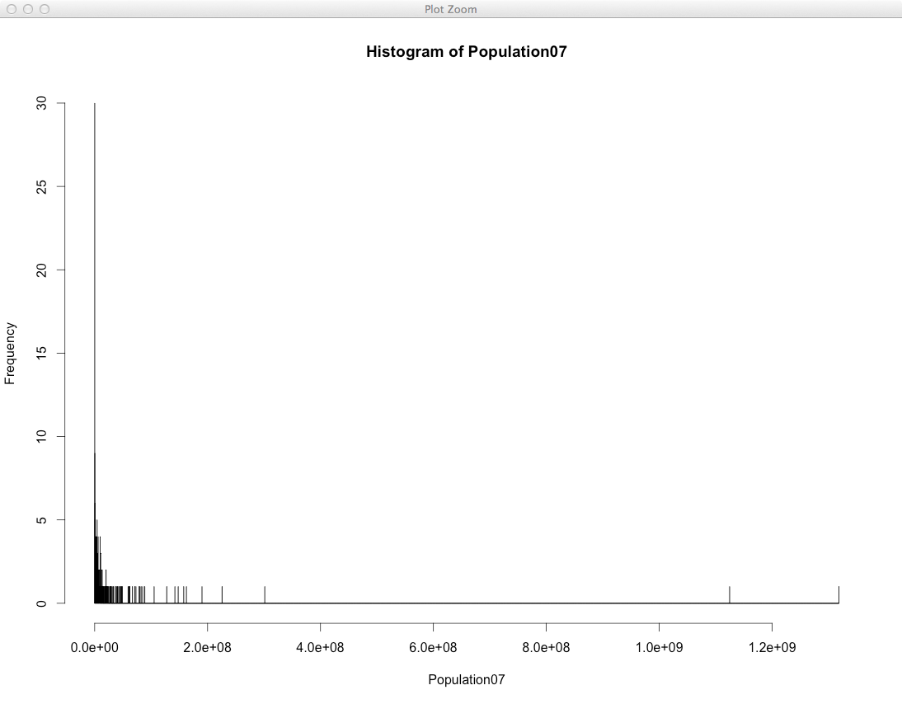

Slide 35
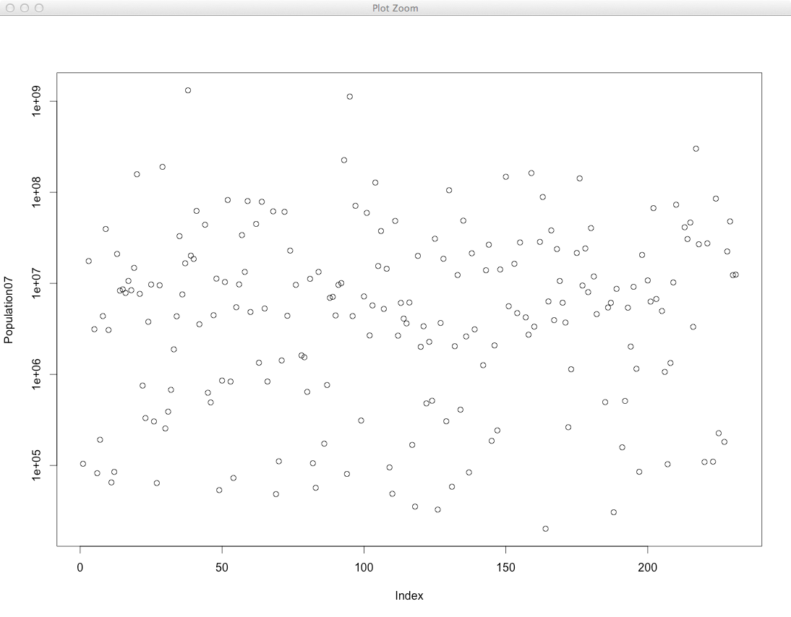
Notes:
Scatter plot.

Slide 36
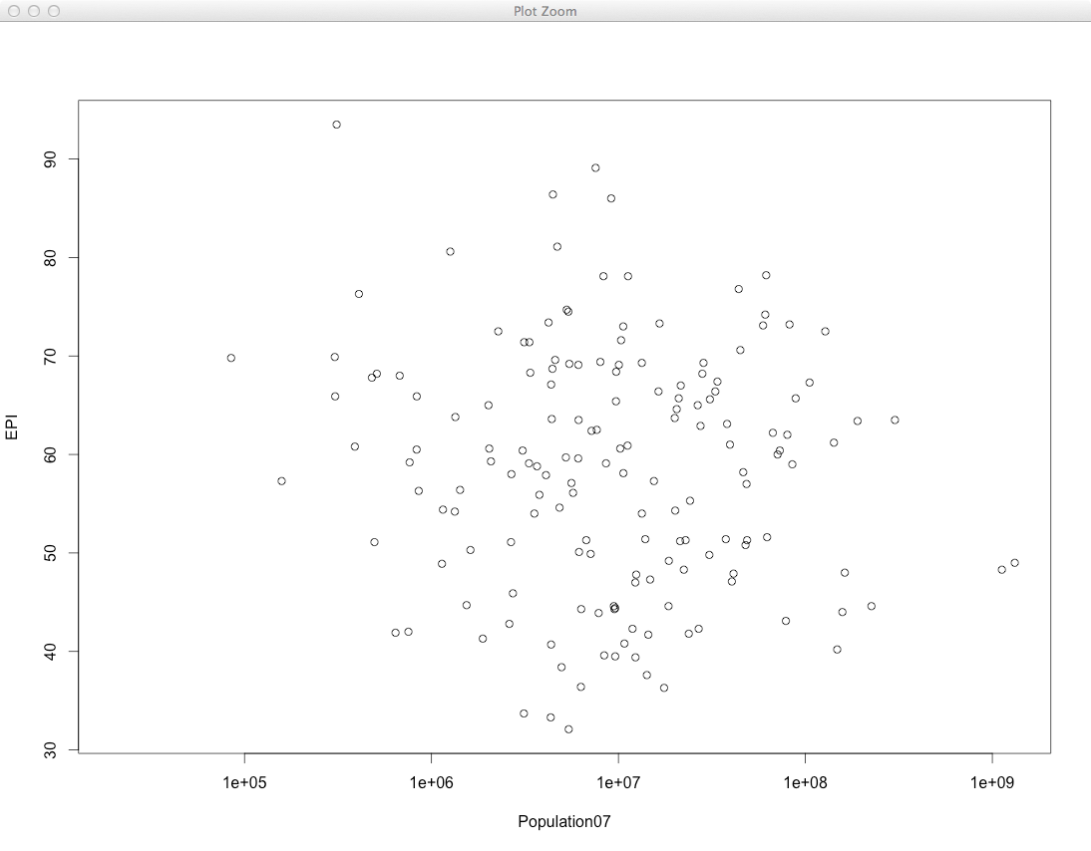

Slide 37
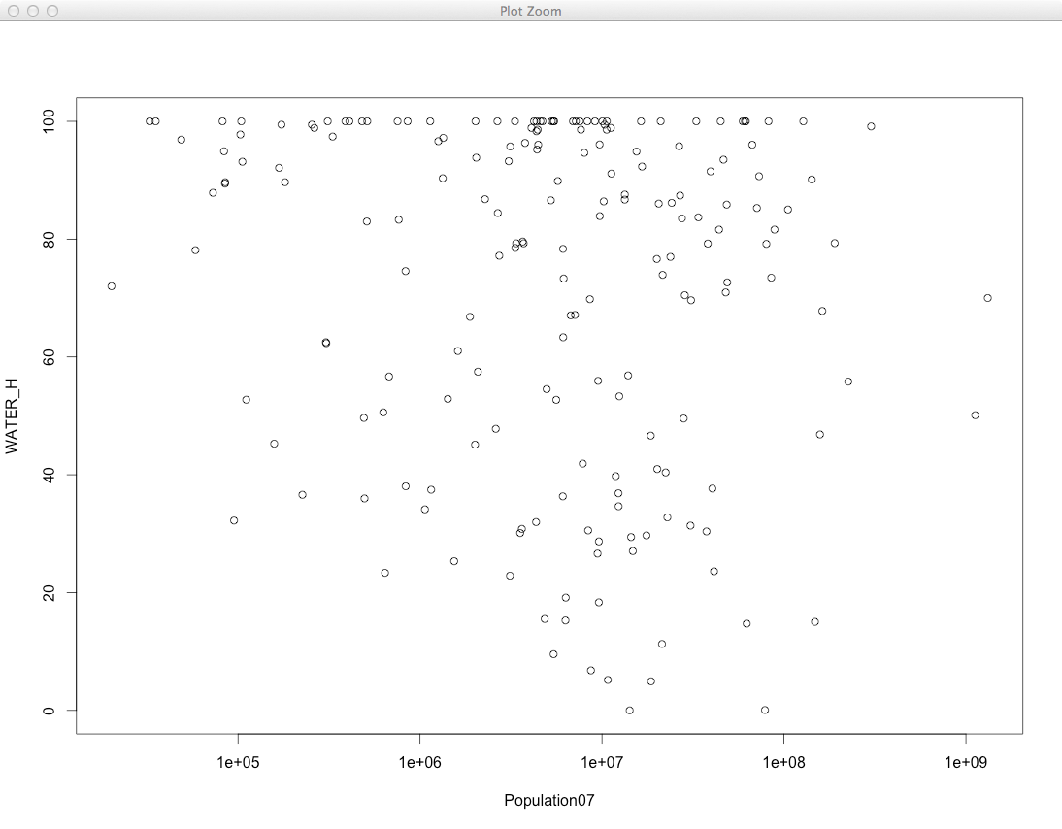

Slide 38
More munging
Bad values, outliers, corrupted entries, thresholds …
Noise reduction – low-pass filtering, binning
Modal filtering
REMEMBER: when you munge you MUST record what you did (and why) and save copies of pre- and post- operations…

Slide 39
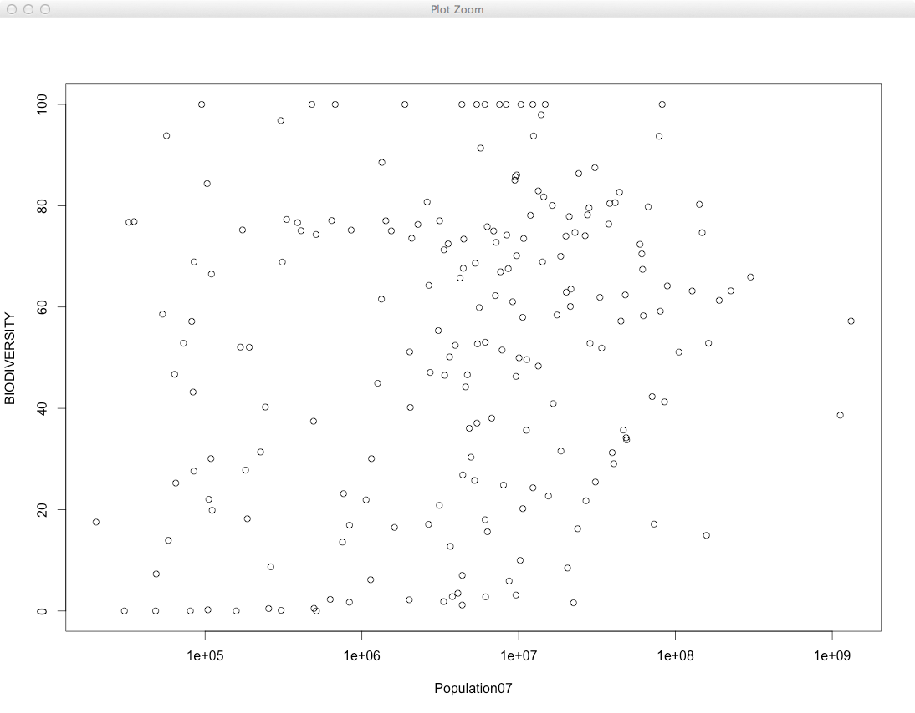

Slide 40
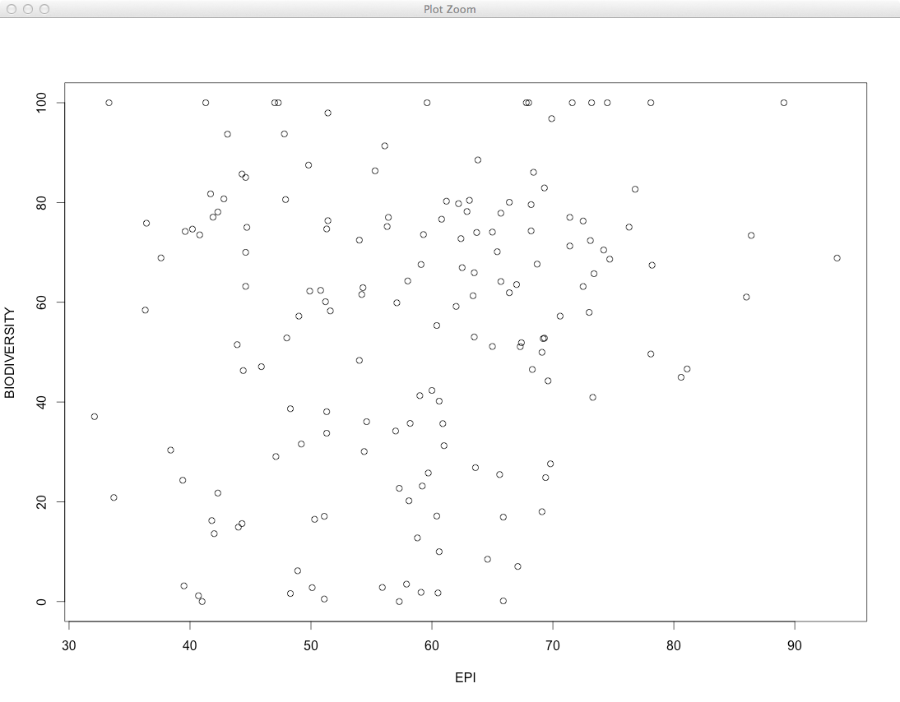

Slide 41
Populations within populations
In the EPI example:
Geographic regions (GEO_subregion)
EPI_regions
Eco-regions
Primary industry(ies)
Climate region
What would you do to start exploring?
Environmental Performance Index (EPI)
https://sedac.ciesin.columbia.edu/data/collection/epi
Notes:
Environmental Performance Index (EPI)
https://sedac.ciesin.columbia.edu/data/collection/epi

Slide 42
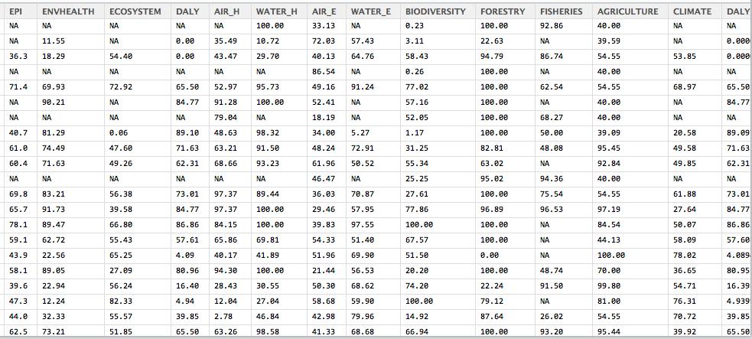

Slide 43
Or, a twist – n=1 but many attributes?
The item of interest in relation to its attributes

Slide 44
Summary: exploration
Going from preliminary to initial analysis…
Determining if there is one or more common distributions involved – i.e. parametric statistics (assumes or asserts a probability distribution)
Fitting that distribution -> provides a model!
Or NOT
A hybrid model or
Non-parametric (statistics) approaches are needed – more on this to come

Slide 45
Summary
Cyber and Human data; quality, uncertainty and bias – you will often spend a lot of time with the data
Distributions – the common and not-so common ones and how cyber and human data can have distinct distributions
How simple statistical distributions can mislead us
Populations and samples and how inferential statistics will lead us to model choices (no we have not actually done that yet in detail)
Munging toward exploratory analysis
Toward models!

Slide 46
Reminder: Lab1
Reminder to finish the last week Lab (Lab1)
R! ( how is your learning/coding in R going?) keep learning/coding…
Create the Github repository for this class if you have not created so far and share the Github repo URL with the TA

