Slide 1

More on Decision Trees Classification Trees, Regression Trees & Naïve Bayes
Thilanka Munasinghe
Data Analytics
ITWS-4600/ITWS-6600/MATP-4450/CSCI-4960
Group 2 Lab 3, October 2nd, 2020

Slide 2
Regression Tree example
We will be using the msleep dataset that comes under the ggplot2 packsge.
You need to install the following library packages first
library(rpart)
library(rpart.plot)

Slide 3
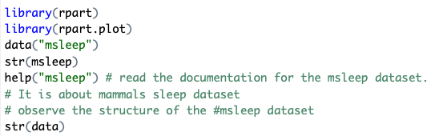
library(rpart)
library(rpart.plot)
data("msleep")
str(msleep)
help("msleep") # read the documentation for the msleep dataset.it is about mammals sleep dataset
# observe the structure of the #msleep dataset
str(data)

Slide 4
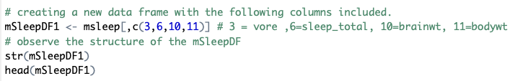
# creating a new data frame with the following columns included.
mSleepDF1 <- msleep[,c(3,6,10,11)] # 3 = vore ,6=sleep_total, 10=brainwt, 11=bodywt
# observe the structure of the mSleepDF
str(mSleepDF1)
head(mSleepDF1)

Slide 5
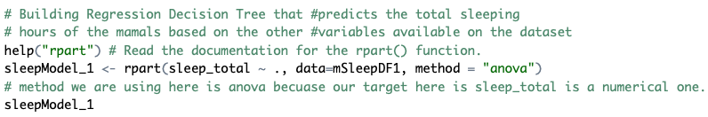
Building Regression Tree Model
# Building Regression Decision Tree that #predicts the total sleeping
# hours of the mamals based on the other #variables available on the dataset
help("rpart") # Read the documentation for the rpart() function.
sleepModel_1 <- rpart(sleep_total ~ ., data=mSleepDF1, method = "anova")
# method we are using here is anova becuase our target here is sleep_total is a numerical one.
sleepModel_1

Slide 6
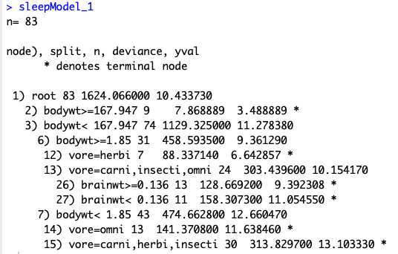
Interpretation
Root node has 83 samples
Branches
Leaf Node represented with *
We started with 83 observation that is why (n = 83 )

Slide 7
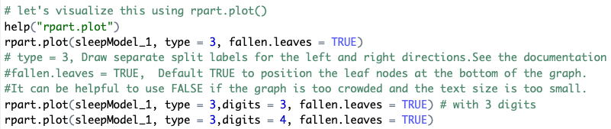
# let's visualize this using rpart.plot()
help("rpart.plot")
rpart.plot(sleepModel_1, type = 3, fallen.leaves = TRUE)
# type = 3, Draw separate split labels for the left and right directions. See the documentation
#fallen.leaves = TRUE, Default TRUE to position the leaf nodes at the bottom of the graph.
#It can be helpful to use FALSE if the graph is too crowded and the text size is too small.
rpart.plot(sleepModel_1, type = 3,digits = 3, fallen.leaves = TRUE) # with 3 digits
rpart.plot(sleepModel_1, type = 3,digits = 4, fallen.leaves = TRUE)

Slide 8
library(rpart)
library(rpart.plot)
data("msleep")
str(msleep)
help("msleep") # read the documentation for the msleep dataset.
# It is about mammal’s sleep dataset
# observe the structure of the #msleep dataset
str(data)
# creating a new data frame with the following columns included.
mSleepDF1 <- msleep[,c(3,6,10,11)] # 3 = vore ,6=sleep_total, 10=brainwt, 11=bodywt
# observe the structure of the mSleepDF
str(mSleepDF1)
head(mSleepDF1)
# Building Regression Decision Tree that #predicts the total sleeping
# hours of the mamals based on the other #variables available on the dataset
help("rpart") # Read the documentation for the rpart() function.
sleepModel_1 <- rpart(sleep_total ~ ., data=mSleepDF1, method = "anova")
# method we are using here is anova becuase our target here is sleep_total is a numerical one.
sleepModel_1
# let's visualize this using rpart.plot()
help("rpart.plot")
rpart.plot(sleepModel_1, type = 3, fallen.leaves = TRUE)
# type = 3, Draw separate split labels for the left and right directions.See the documentation
#fallen.leaves = TRUE, Default TRUE to position the leaf nodes at the bottom of the graph.
#It can be helpful to use FALSE if the graph is too crowded and the text size is too small.
rpart.plot(sleepModel_1, type = 3,digits = 3, fallen.leaves = TRUE) # with 3 digits
rpart.plot(sleepModel_1, type = 3,digits = 4, fallen.leaves = TRUE)

Slide 9
Ctree()
We will be building the classification tree using ctree() function.
Again, Iris dataset ! ☺

Slide 10
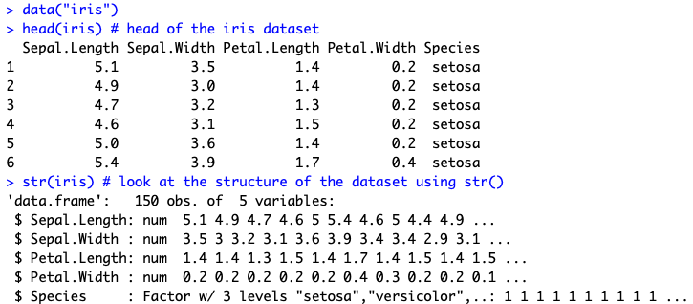
# instrall the C50 package
install.packages("C50")
require(C50)
# we will be using the iris dataset to do a #classfication
data("iris")
head(iris)
str(iris)
table(iris$Species)

Slide 11

It is important to set the seed in order to get the same randomly generated numbers when we run the model over and over.
# set the seed
set.seed(9850)
# generate random numbers
grn <-runif(nrow(iris))

Slide 12

# creating a randomized iris dataset , shuffling the dataset
# we use the order() function along with the #random numbers we generated.
irisrand <-iris[order(grn),]

Slide 13
# observe that rows are now randomly shuffled.
str(irisrand)
classificationmodel1 <-C5.0(irisrand[1:100,-5], irisrand[1:100,5])
classificationmodel1
summary(classificationmodel1)

Slide 14
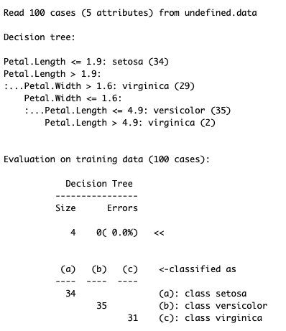
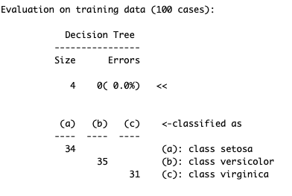
summary(classificationmodel1)

Slide 15
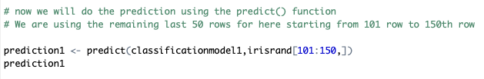
# now we will do the prediction using the #predict() function
# We are using the remaining last 50 rows for #here starting from 101 row to 150th row
prediction1 <- predict(classificationmodel1,irisrand[101:150,])
prediction1

Slide 16
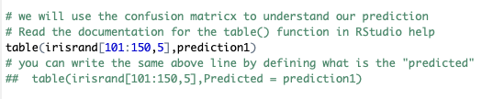
# we will use the confusion matrix to #understand our prediction
# Read the documentation for the table() function in RStudio help
table(irisrand[101:150,5],prediction1)
# you can write the same above line by defining what is the "predicted"
## table(irisrand[101:150,5],Predicted = prediction1)

Slide 17
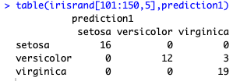
Interpretation
# we will use the confusion matrix to #understand our prediction
# Read the documentation for the table() #function in RStudio help
table(irisrand[101:150,5],prediction1)
Correctly predicted
16 of them Setosa
12 of them Versicolor
19 of them Verginica
Model predicted 47/50 correctly, however, there were 3 of them Incorrectly predicted.
(There were 3 versicolor species out of the 50 examples that the model incorrectly classified as virginica)

Slide 18
Plotting the ctree
# We can plot the classification model tree #using the plot() function
plot(classificationmodel1)

Slide 19
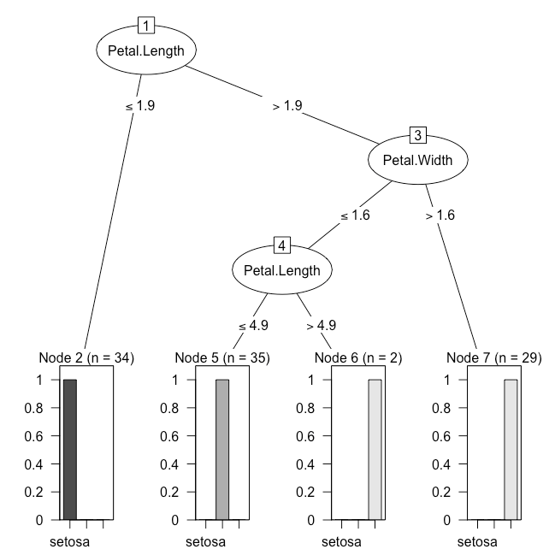

Slide 20
# install the C50 package
install.packages("C50")
# require(C50)
library(C50)
# we will be using the iris dataset to do a #classfication
data("iris")
head(iris) # head of the iris dataset
str(iris) # look at the structure of the dataset using str()
table(iris$Species) # using table() function we can look at the Species of Iris dataset column
# set the seed
set.seed(9850)
# generate random numbers
grn <-runif(nrow(iris))
# creating a randomized iris dataset , shuffling the dataset
# we use the order() function along with the #random numbers we generated.
irisrand <-iris[order(grn),]
# obsrve that rows are now randomly shuffled.
str(irisrand)
classificationmodel1 <-C5.0(irisrand[1:100,-5], irisrand[1:100,5])
classificationmodel1
summary(classificationmodel1)
# now we will do the prediction using the #predict() function
# We are using the remaining last 50 rows for #here starting from 101 row to 150th row
prediction1 <- predict(classificationmodel1,irisrand[101:150,])
prediction1
# we will use the confusion matrix to #understand our prediction
# Read the documentation for the table() function in RStudio help
table(irisrand[101:150,5],prediction1)
# you can write the same above line by defining what is the "predicted"
## table(irisrand[101:150,5],Predicted = prediction1)

Slide 21
rpart() and ctree()
Now you have used both rpart() and ctree() to generate the decision tree models.
Make sure to read the documentation of ctree()
https://www.rdocumentation.org/packages/partykit/versions/1.2-3/topics/ctree

Slide 22
Also go over the NaiveBayes Classifier example I shared in the lecture (code is in the next slide)
Read the documentation of the Packages e1071 and C50 during your spare time, it will be very handy/useful down the road
Documentation of the Package e1071
https://cran.r-project.org/web/packages/e1071/e1071.pdf
Documentation of the Package C50
https://cran.r-project.org/web/packages/C50/C50.pdf

Slide 23
Digging into iris
## Call the NaiveBayes Classifier Package e1071, which auto calls the Class package ##
library("e1071")
classifier<-naiveBayes(iris[,1:4], iris[,5])
table(predict(classifier, iris[,-5]), iris[,5], dnn=list('predicted','actual'))
classifier$apriori
classifier$tables$Petal.Length
plot(function(x) dnorm(x, 1.462, 0.1736640), 0, 8, col="red", main="Petal length distribution for the 3 different species")
curve(dnorm(x, 4.260, 0.4699110), add=TRUE, col="blue")
curve(dnorm(x, 5.552, 0.5518947 ), add=TRUE, col = "green")
Standard Deviation
mean
Notes:
From where did I get the “mean” and ”SD” numbers ? I calculated the meand and SD for each iris type

Slide 24
Now, go over and explore on remaining R scripts that are given in the website (group2: https://aquarius.tw.rpi.edu/html/DA/group2/).
You are asked to Explore, Inspect the code/scripts in the Rstudio environment and get familiar with those scripts.
As you are working on those given scripts, your goal is to understand the R functions that are available in those scripts by using the help() function in RStudio and searching the web.

Slide 25
Scripts – work through these
See in folder group2/ Lab3
Go over the following scrips,
Lab3_ctree1.R
Lab3_ctree2.R
Lab3_ctree3.R
script fragments in R available on the web site:
(aquarius.tw.rpi.edu/html/DA)
you are allowed to work in small groups (virtually) and discuss.

Slide 26
Dataset Check-In
Mandatory One-on-One with the instructor today to check-in your dataset (Dataset Documentation), if you have not met with instructor last Tuesday, you must meet with the instructor during the lab time.
Reminder: Assignment 2 (Lab2) is due today 10/02/2020.
Assignment 3 is due on 10/09/2020
Assignment 5: Individual student presentations will take place during the class time on 10/13 and 10/16

