Slide 1

How fast does my cat eat
Andrew Updegrove
CSCI 6350 Data Science

Slide 2
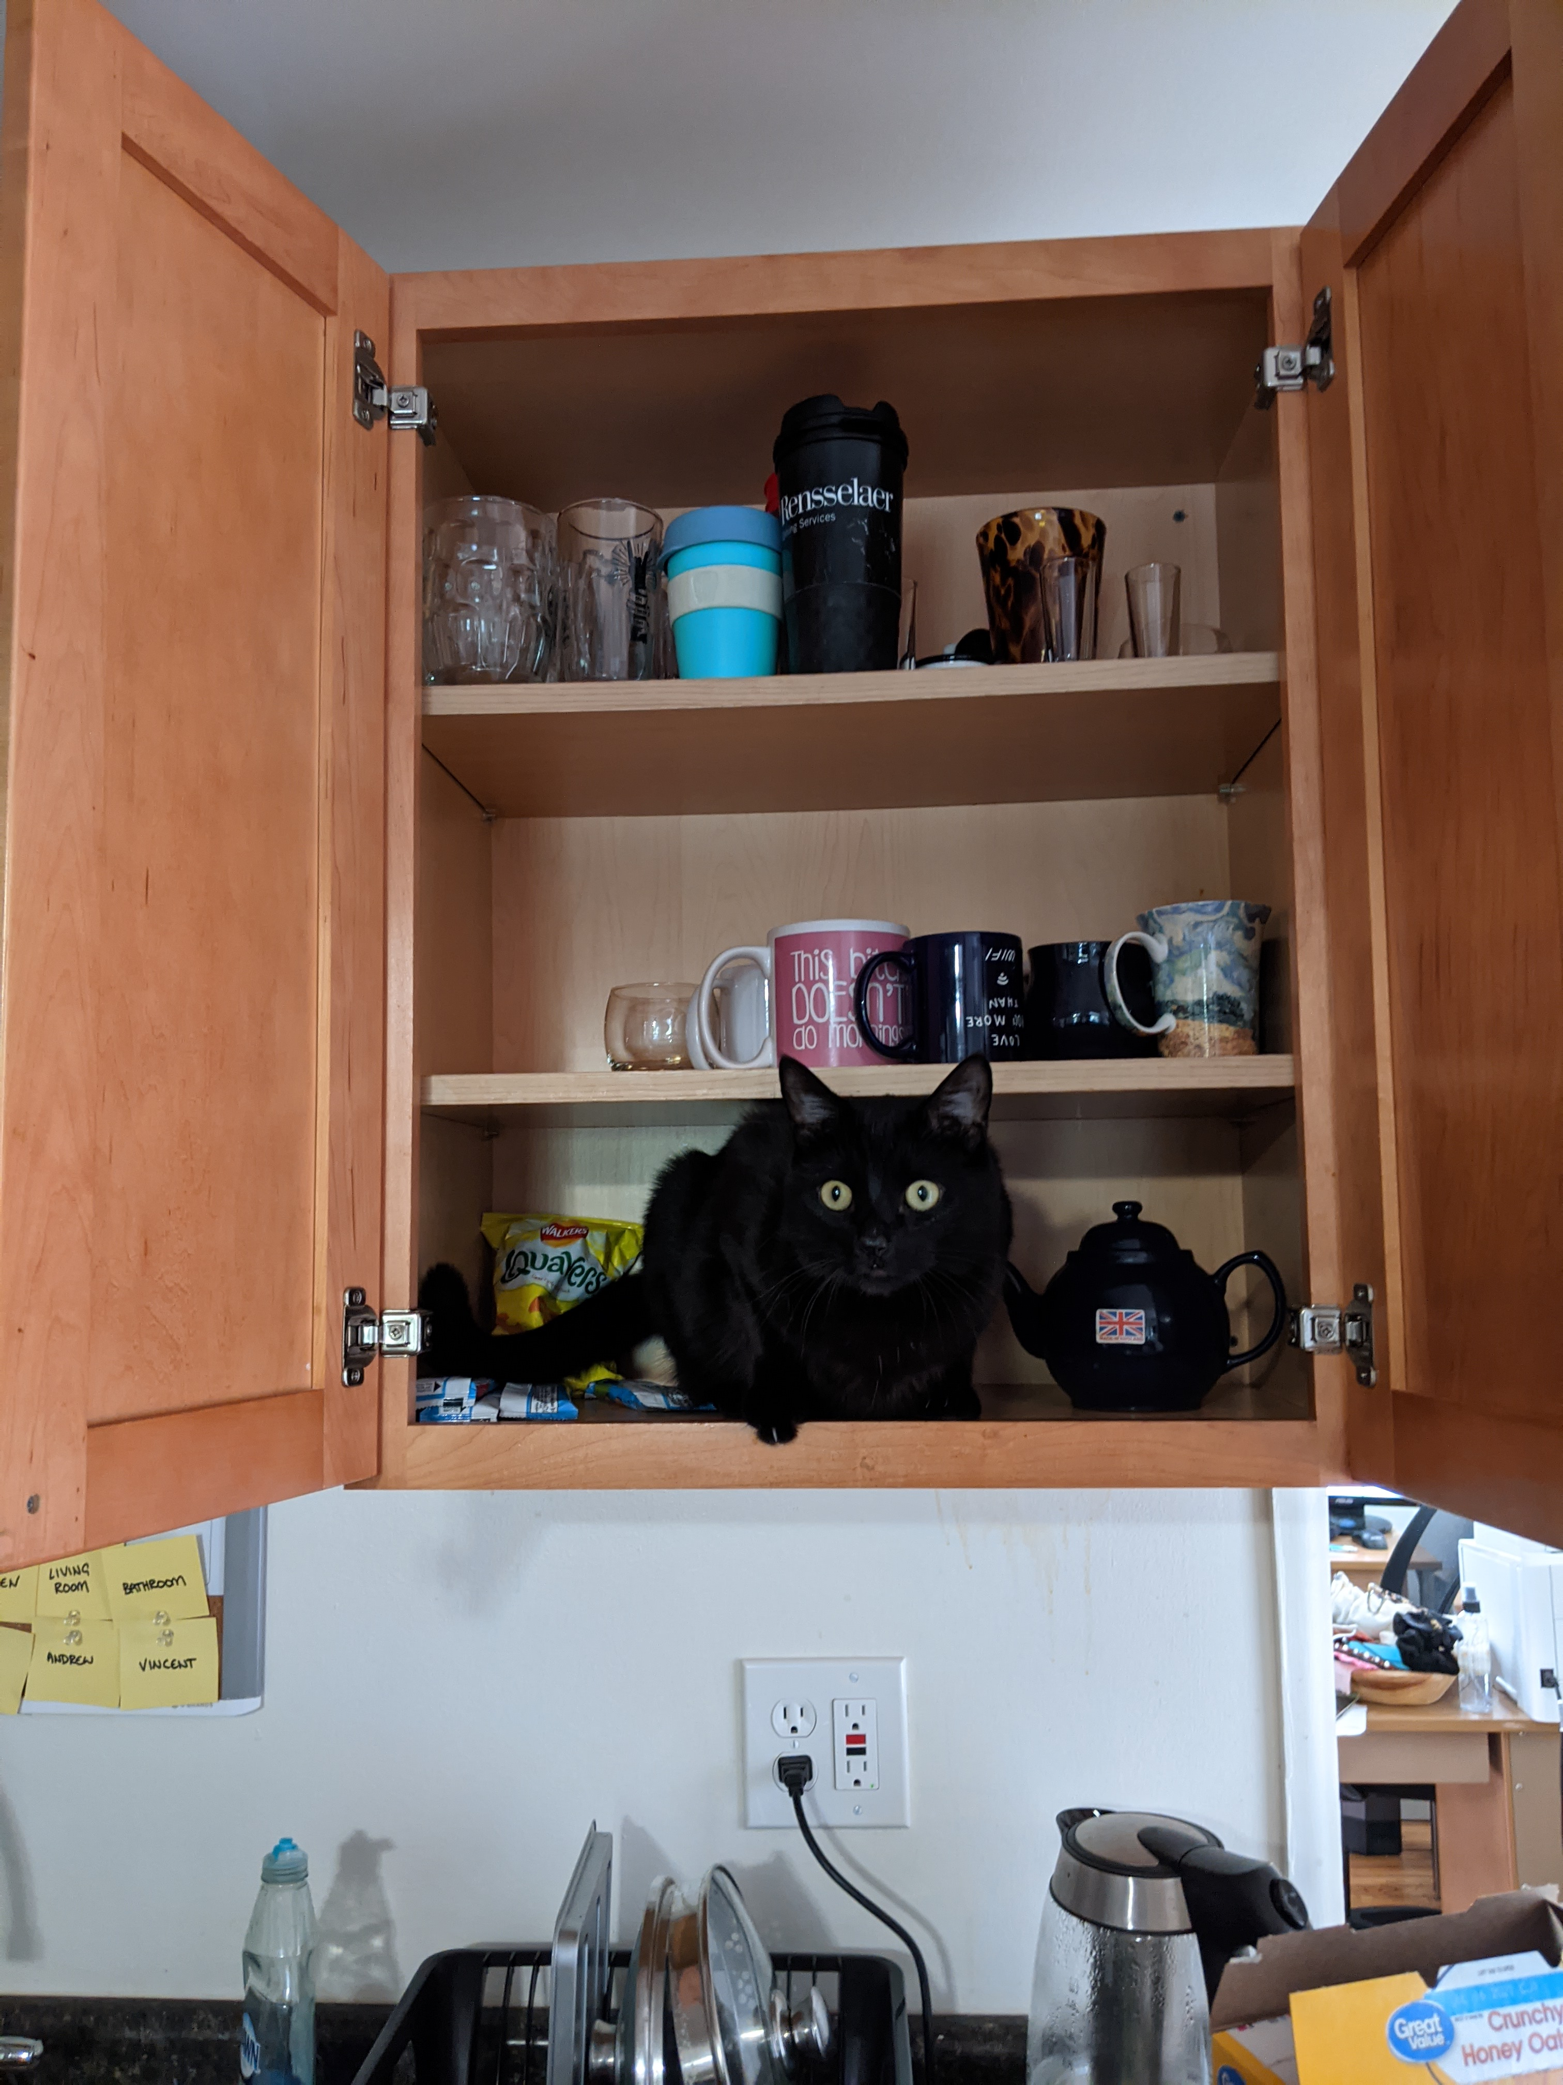
The goal & about My Cat
My cat, Zuko, was raised with black labs
Have to feed him wet and dry food to stop him from eating bad things
Does Zuko eat faster in the morning or at night?

Slide 3
The Process
Feed one tablespoon of dry food, twice a day and record how long it takes him to eat it
Modes of collection: measurement and observation
Problem: Zuko sometimes wouldn’t finish
Data was recorded into excel (or my phone when it was too early in the morning to turn on my computer)

Slide 4
The Data
Recorded the data, the time of day, time taken to eat, which meal he was being fed, who recorded the data and any notes I had to potentially explain outlier
Metadata and data format was put in the headers
Date (YYYY-MM-DD) | Time Recording Started (24-hr time) | Time taken to eat MM:SS | Meal | Recorded by: | Notes
9/17/2020 | 18:31 | 01:54.8 | Dinner | Andrew
9/18/2020 | 7:23 | 02:07.3 | Breakfast | Andrew
9/19/2020 | 10:27 | 02:09.1 | Breakfast | Andrew | Didn't finish. Switched to wet food
9/19/2020 | 18:24 | 02:25.4 | Dinner | Andrew
9/20/2020 | 10:17 | 01:51.7 | Breakfast | Andrew
9/20/2020 | 19:02 | 02:34.7 | Dinner | Andrew
Data Collection Sample

