Slide 1

Voice Scoring
Andrew Updegrove

Slide 2
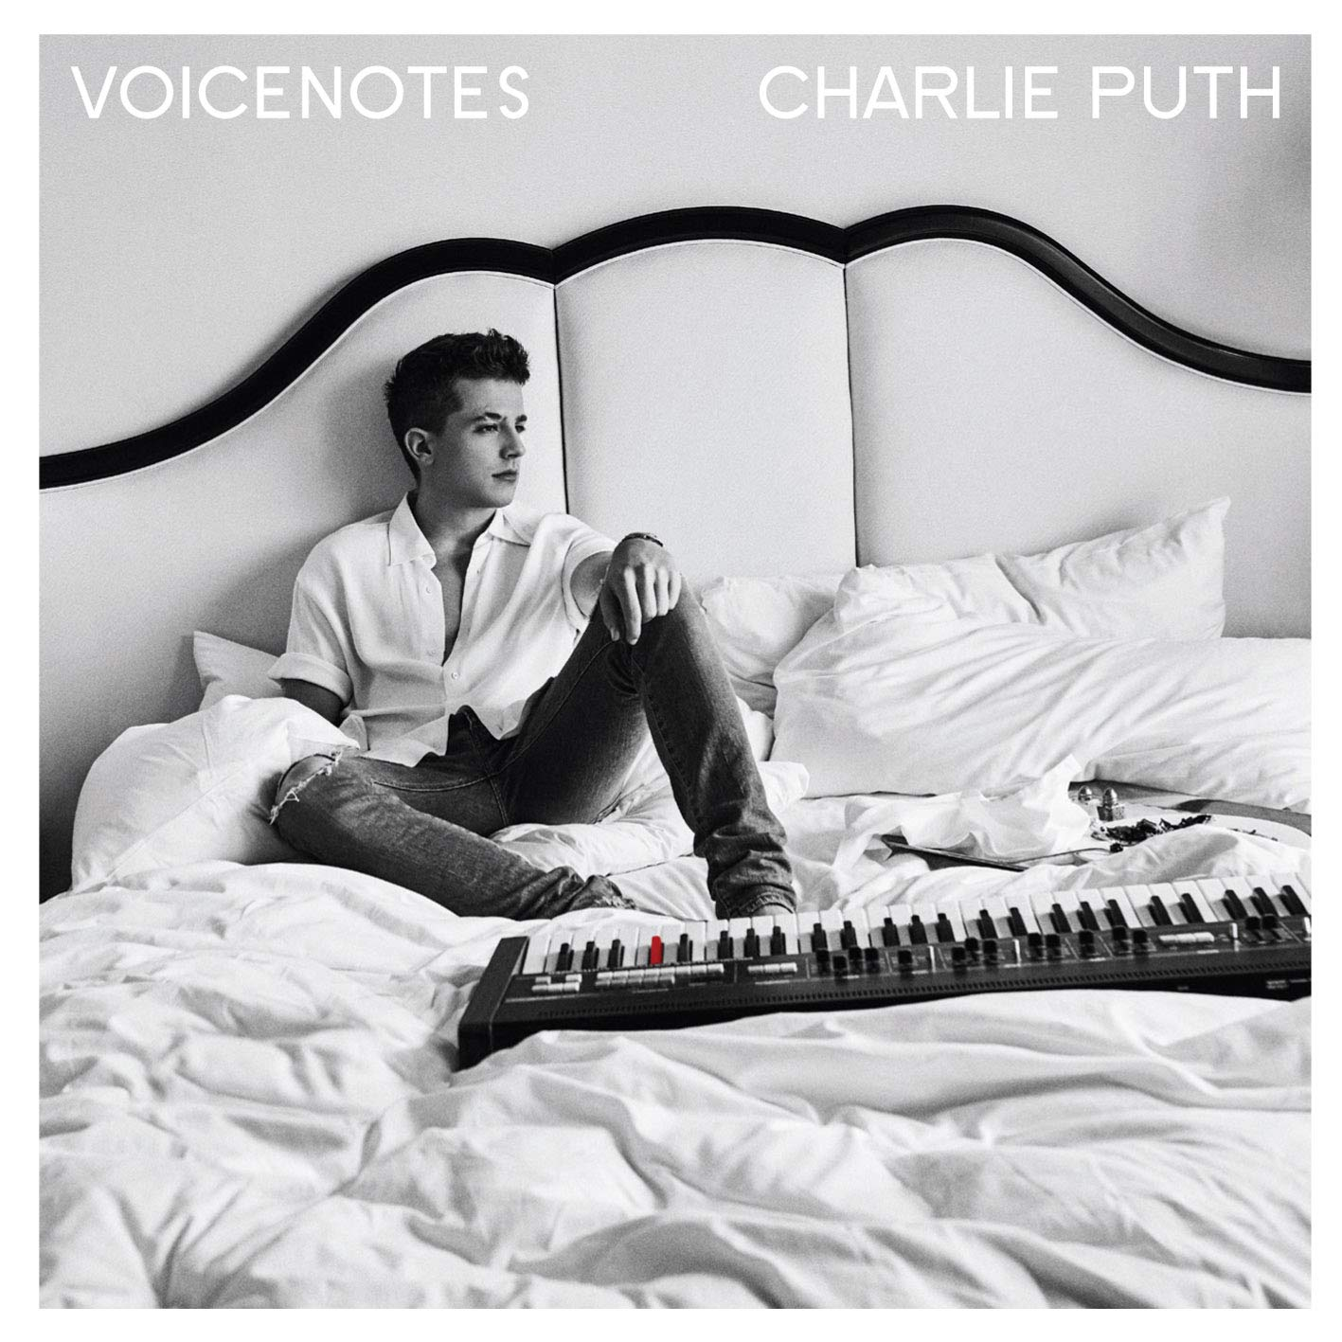
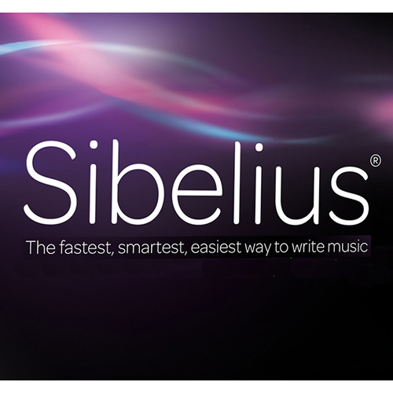

Project Inspiration
Charlie Puth’s album, Voicenotes
Friend who sings well but can’t compose

Slide 3
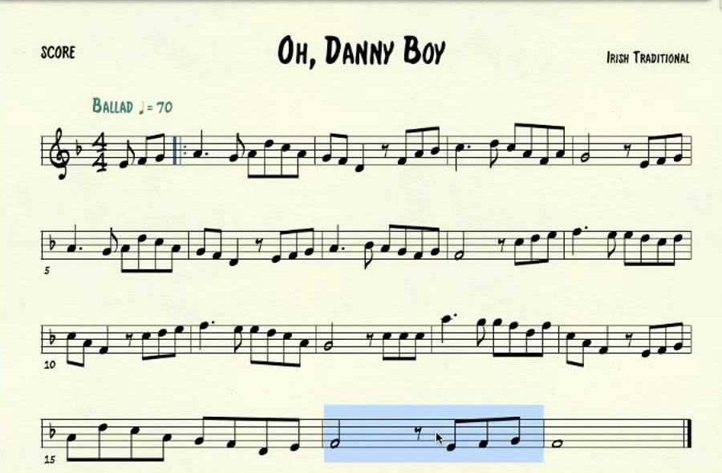
Project Overview
Phone app where the user sings a musical line and the app notates it
Multiple lines can be recorded
Potential for orchestral composition
App will choose the note values based on user input
User can sing the line at tempo
Based on duration ratio and user specification of first note duration, app will create correct rhythm
Lines will then have midi playback
User can select what instrument they want on the line
Maybe allow for original playback, but only at original pace (not messing with granular synthesis)
Not going to be a full fledged scoring software

Slide 4
Problem Areas
Current:
Finding when a note terminates (issue with software library)
Consistency of accurate pitch detection
Foreseeable:
Visual scoring
Is it something that I want to include?
If so lots of work

Slide 5
Demonstration

Slide 6
Next Steps
Adding midi playback
Writing the software like I mean it
Writing actual classes and structures to hold he appropriate info
Web audio for long run working out
STK might have pitch detection buried in it
Instead of midi bleeps in bloops have good way to export to common file type, music xml
So that finale and sib can import it

