Slide 1
Threats and Attacks
Principles of Information Security, 2nd Edition
Notes:
THREATS TO INFORMATION SECURITY
To make sound decisions about information security, create policies, and enforce them, management must be informed of the various kinds of threats facing the organization, its applications, data and information systems.
A threat is an object, person, or other entity that represents a constant danger to an asset.
To better understand the numerous threats facing the organization, a categorization scheme has been developed allowing us to group threats by their respective activities.
By examining each threat category in turn, management can most effectively protect its information through policy, education and training, and technology controls.

Slide 2
Learning Objectives
Upon completion of this material, you should be able to:
Identify and understand the threats posed to information security
Identify and understand the more common attacks associated with those threats
Principles of Information Security, 2nd Edition
Notes:
Learning Objectives:
Upon completion of this chapter, you should be able to:
Understand the business need for information security.
Understand a successful information security program is the responsibility of an organization’s general management and IT management.
Understand the threats posed to information security and the more common attacks associated with those threats.
Differentiate threats to information systems from attacks against information systems.

Slide 3
Threats
Threat: an object, person, or other entity that represents a constant danger to an asset
Management must be informed of the different threats facing the organization
By examining each threat category, management effectively protects information through policy, education, training, and technology controls
Principles of Information Security, 2nd Edition
Notes:
THREATS TO INFORMATION SECURITY
To make sound decisions about information security, create policies, and enforce them, management must be informed of the various kinds of threats facing the organization, its applications, data and information systems.
A threat is an object, person, or other entity that represents a constant danger to an asset.
To better understand the numerous threats facing the organization, a categorization scheme has been developed allowing us to group threats by their respective activities.
By examining each threat category in turn, management can most effectively protect its information through policy, education and training, and technology controls.

Slide 4
Threats (continued)
The 2004 Computer Security Institute (CSI)/Federal Bureau of Investigation (FBI) survey found:
  79 percent of organizations reported cyber security breaches within the last 12 months
  54 percent of those organizations reported financial losses totaling over $141 million
Principles of Information Security, 2nd Edition
Notes:
THREATS TO INFORMATION SECURITY
The 2002 Computer Security Institute/Federal Bureau of Investigation (CSI/FBI) survey on Computer Crime and Security Survey found:
90% of organizations responding, primarily large corporations and government agencies, detected computer security breaches within the last year.
80% of these organizations lost money to computer breaches, totaling over $455,848,000 up from $377,828,700 reported in 2001.
The number of attacks that came across the Internet rose from 70% in 2001 to 74% in 2002.
Only 34% of organizations reported their attacks to law enforcement.

Slide 5
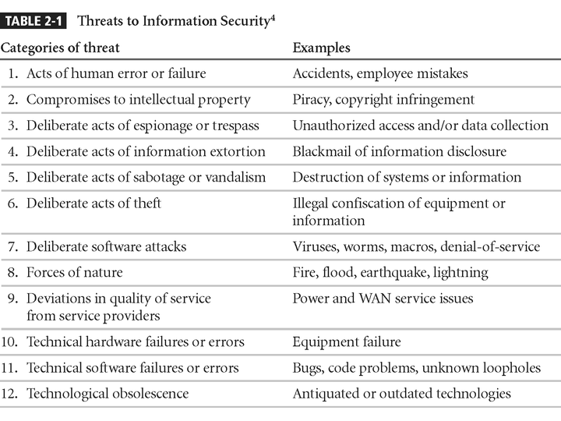
Threats to Information Security
Principles of Information Security, 2nd Edition
Notes:
1. Potential Acts of Human Error or Failure
2. Compromises to Intellectual Property
3. Deliberate Acts of Espionage or Trespass
4. Deliberate Acts of Information Extortion
5. Deliberate Acts of Sabotage or Vandalism
6. Deliberate Acts of Theft
7. Deliberate Software Attacks
8. Forces of Nature
9. Potential Deviations in Quality of Service from Service Providers
10. Technical Hardware Failures or Errors
11. Technical Software Failures or Errors
12. Technological Obsolescence

Slide 6
Acts of Human Error or Failure
Includes acts performed without malicious intent
Causes include:
  Inexperience
  Improper training
  Incorrect assumptions
Employees are among the greatest threats to an organization’s data
Principles of Information Security, 2nd Edition
Notes:
Potential Acts of Human Error or Failure
This category includes the possibility of acts performed without intent or malicious purpose by an individual who is an employee of an organization.
Inexperience, improper training, the making of incorrect assumptions, and other circumstances can cause problems.
Employees constitute one of the greatest threats to information security, as the individuals closest to the organizational data.
Employee mistakes can easily lead to the following: revelation of classified data, entry of erroneous data, accidental deletion or modification of data, storage of data in unprotected areas, and failure to protect information.
Many threats can be prevented with controls, ranging from simple procedures, such as requiring the user to type a critical command twice, to more complex procedures, such as the verification of commands by a second party.

Slide 7
Acts of Human Error or Failure (continued)
Employee mistakes can easily lead to:
  Revelation of classified data
  Entry of erroneous data
  Accidental data deletion or modification
  Data storage in unprotected areas
  Failure to protect information
Many of these threats can be prevented with controls
Principles of Information Security, 2nd Edition
Notes:
Potential Acts of Human Error or Failure
This category includes the possibility of acts performed without intent or malicious purpose by an individual who is an employee of an organization.
Inexperience, improper training, the making of incorrect assumptions, and other circumstances can cause problems.
Employees constitute one of the greatest threats to information security, as the individuals closest to the organizational data.
Employee mistakes can easily lead to the following: revelation of classified data, entry of erroneous data, accidental deletion or modification of data, storage of data in unprotected areas, and failure to protect information.
Many threats can be prevented with controls, ranging from simple procedures, such as requiring the user to type a critical command twice, to more complex procedures, such as the verification of commands by a second party.

Slide 8
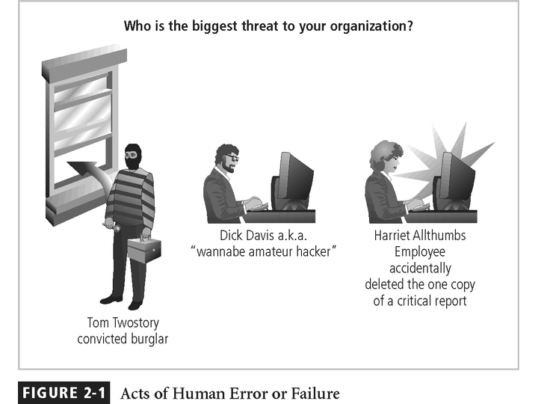
Figure 2-1 – Acts of Human Error or Failure
Principles of Information Security, 2nd Edition

Slide 9
Deliberate Acts of Espionage or Trespass
Access of protected information by unauthorized individuals
Competitive intelligence (legal) vs. industrial
espionage (illegal)
Shoulder surfing occurs anywhere a person accesses confidential information
Controls let trespassers know they are encroaching on organization’s cyberspace
Hackers uses skill, guile, or fraud to bypass controls protecting others’ information
Principles of Information Security, 2nd Edition
Notes:
Deliberate Acts of Espionage or Trespass
This threat represents a well-known and broad category of electronic and human activities that breach the confidentiality of information.
When an unauthorized individual gains access to the information an organization is trying to protect, that act is categorized as a deliberate act of espionage or trespass.
When information gatherers employ techniques that cross the threshold of what is legal and/or ethical, they enter the world of industrial espionage.
Instances of shoulder surfing occur at computer terminals, desks, ATM machines, public phones, or other places where a person is accessing confidential information.
Deliberate Acts of Espionage or Trespass
The threat of Trespass can lead to unauthorized, real or virtual actions that enable information gatherers to enter premises or systems they have not been authorized to enter.
Controls are sometimes implemented to mark the boundaries of an organization’s virtual territory.
These boundaries give notice to trespassers that they are encroaching on the organization’s cyberspace.
The classic perpetrator of deliberate acts of espionage or trespass is the hacker.
In the gritty world of reality, a hacker uses skill, guile, or fraud to attempt to bypass the controls placed around information that is the property of someone else. The hacker frequently spends long hours examining the types and structures of the targeted systems.

Slide 10
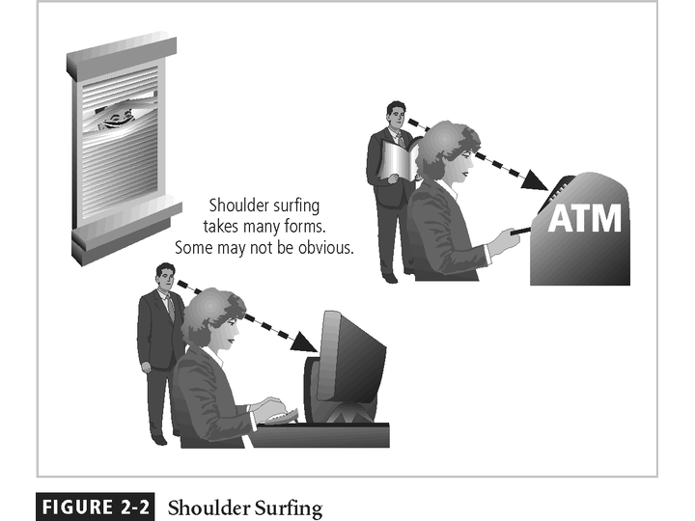
Principles of Information Security, 2nd Edition

Slide 11
Deliberate Acts of Theft
Illegal taking of another’s physical, electronic, or intellectual property
Physical theft is controlled relatively easily
Electronic theft is more complex problem; evidence of crime not readily apparent
Principles of Information Security, 2nd Edition
Notes:
Deliberate Acts of Theft
Theft is the illegal taking of another’s property. Within an organization, that property can be physical, electronic, or intellectual.
The value of information suffers when it is copied and taken away without the owner’s knowledge.
Physical theft can be controlled quite easily. A wide variety of measures can be used from simple locked doors, to trained security personnel, and the installation of alarm systems.
Electronic theft, however, is a more complex problem to manage and control. Organizations may not even know it has occurred.

Slide 12
Deliberate Software Attacks
Malicious software (malware) designed to damage, destroy, or deny service to target systems
Includes viruses, worms, Trojan horses, logic bombs, back doors, and denial-of-services attacks
Principles of Information Security, 2nd Edition
Notes:
Deliberate Software Attacks
Deliberate software attacks occur when an individual or group designs software to attack an unsuspecting system. Most of this software is referred to as malicious code or malicious software, or sometimes malware.
These software components or programs are designed to damage, destroy, or deny service to the target systems.
Some of the more common instances of malicious code are viruses and worms, Trojan horses, logic-bombs, back doors, and denial-of-services attacks.
Computer viruses are segments of code that perform malicious actions.
This code behaves very much like a virus pathogen attacking animals and plants, using the cell’s own replication machinery to propagate and attack.
The code attaches itself to the existing program and takes control of that program’s access to the targeted computer.
The virus-controlled target program then carries out the virus’s plan, by replicating itself into additional targeted systems.
The macro virus is embedded in the automatically executing macro code, common in office productivity software like word processors, spread sheets, and database applications.
The boot virus, infects the key operating systems files located in a computer’s boot sector.
Worms - malicious programs that replicate themselves constantly without requiring another program to provide a safe environment for replication. Worms can continue replicating themselves until they completely fill available resources, such as memory, hard drive space, and network bandwidth.
Trojan horses - software programs that hide their true nature, and reveal their designed behavior only when activated. Trojan horses are frequently disguised as helpful, interesting or necessary pieces of software, such as readme.exe files often included with shareware or freeware packages.
Back door or Trap door - A virus or worm can have a payload that installs a back door or trap door component in a system. This allows the attacker to access the system at will with special privileges.
Polymorphism - A threat that changes its apparent shape over time, representing a new threat not detectable by techniques that are looking for a pre-configured signature. These threats actually evolve variations in size and appearance to elude detection by anti-virus software programs, making detection more of a challenge.
Virus and Worm Hoaxes - As frustrating as viruses and worms are, perhaps more time and money is spent on resolving virus hoaxes. Well-meaning people spread the viruses and worms when they send e-mails warning of fictitious or virus laden threats.

Slide 13
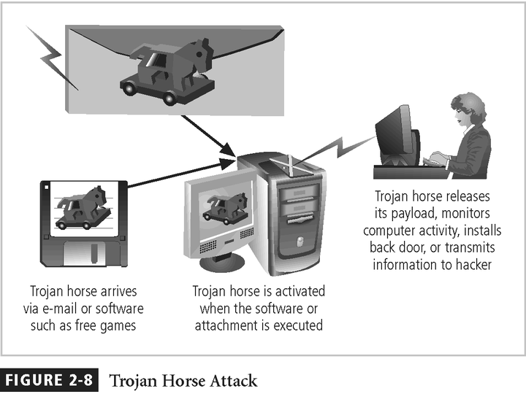
Principles of Information Security, 2nd Edition

Slide 14
Forces of Nature
Forces of nature are among the most dangerous threats
Disrupt not only individual lives, but also storage, transmission, and use of information
Organizations must implement controls to limit damage and prepare contingency plans for continued operations
Principles of Information Security, 2nd Edition
Notes:
Forces of Nature
Forces of nature, force majeure, or acts of God pose the most dangerous threats, because they are unexpected and can occur with very little warning.
These threats can disrupt not only the lives of individuals, but also the storage, transmission, and use of information.
These include fire, flood, earthquake, and lightning as well as volcanic eruption and insect infestation.
Since it is not possible to avoid many of these threats, management must implement controls to limit damage and also prepare contingency plans for continued operations.

Slide 15
Deviations in Quality of Service
Includes situations where products or services not delivered as expected
Information system depends on many interdependent support systems
Internet service, communications, and power irregularities dramatically affect availability of information and systems
Principles of Information Security, 2nd Edition
Notes:
Potential Deviations in Quality of Service by Service Providers
This category represents situations in which a product or services are not delivered to the organization as expected.
The organization’s information system depends on the successful operation of many inter-dependent support systems including, power grids, telecom networks, parts suppliers, service vendors, and even the janitorial staff and garbage haulers.
Internet service, communications, and power irregularities are three sets of service issues that dramatically affect the availability of information and systems.

Slide 16
Internet Service Issues
Internet service provider (ISP) failures can considerably undermine availability of information
Outsourced Web hosting provider assumes responsibility for all Internet services as well as hardware and Web site operating system software
Principles of Information Security, 2nd Edition
Notes:
Internet Service Issues
For organizations that rely heavily on the Internet and the Web to support continued operations, the threat of the potential loss of Internet service can lead to considerable loss in the availability of information.
Many organizations have sales staff and telecommuters working at remote locations.
When an organization places its web servers in the care of a Web Hosting provider, that outsourcer assumes responsibility for all Internet Services as well as for the hardware and operating system software used to operate the web site.

Slide 17
Attacks
Act or action that exploits vulnerability (i.e., an identified weakness) in controlled system
Accomplished by threat agent which damages or steals organization’s information
Principles of Information Security, 2nd Edition
Notes:
ATTACKS
An attack is the deliberate act that exploits vulnerability.
It is accomplished by a threat-agent to damage or steal an organization’s information or physical asset.
An exploit is a technique to compromise a system. Vulnerability is an identified weakness of a controlled system whose controls are not present or are no longer effective. An attack is then the use of an exploit to achieve the compromise of a controlled system.

Slide 18
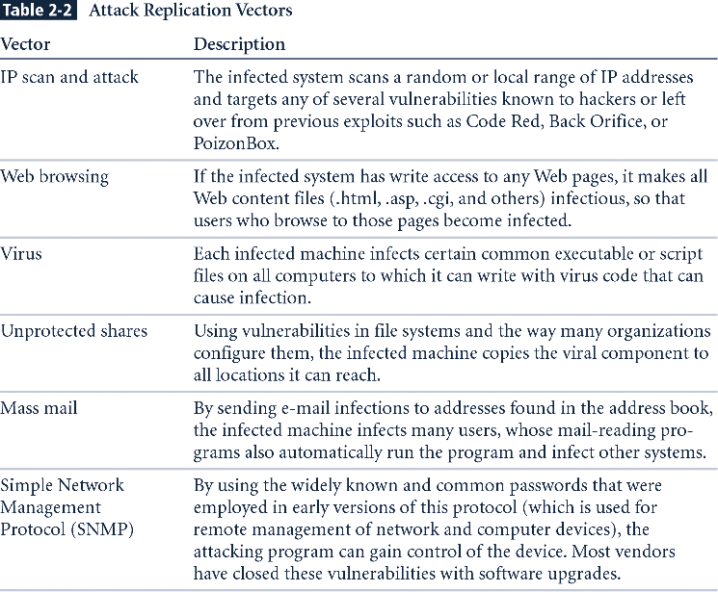
Table 2-2 - Attack Replication Vectors
New Table
Principles of Information Security, 2nd Edition

Slide 19
Attacks (continued)
Malicious code: includes execution of viruses, worms, Trojan horses, and active Web scripts with intent to destroy or steal information
Back door: gaining access to system or network using known or previously unknown/newly discovered access mechanism
Principles of Information Security, 2nd Edition
Notes:
Malicious Code
This kind of attack includes the execution of viruses, worms, Trojan horses, and active web scripts with the intent to destroy or steal information.
The state of the art in attacking systems in 2002 is the multi-vector worm.
These attack programs use up to six known attack vectors to exploit a variety of vulnerabilities in commonly found information system devices.

Slide 20
Attacks (continued)
Password crack: attempting to reverse calculate a password
Brute force: trying every possible combination of options of a password
Dictionary: selects specific accounts to attack and uses commonly used passwords (i.e., the dictionary) to guide guesses
Principles of Information Security, 2nd Edition
Notes:
Attack Descriptions
Back Doors - Using a known or previously unknown and newly discovered access mechanism, an attacker can gain access to a system or network resource.
Password Crack - Attempting to reverse calculate a password.
Brute Force - The application of computing and network resources to try every possible combination of options of a password.
Dictionary - The dictionary password attack narrows the field by selecting specific accounts to attack and uses a list of commonly used passwords (the dictionary) to guess with.

Slide 21
Attacks (continued)
Spoofing: technique used to gain unauthorized access; intruder assumes a trusted IP address
Man-in-the-middle: attacker monitors network packets, modifies them, and inserts them back into network
Spam: unsolicited commercial e-mail; more a nuisance than an attack, though is emerging as a vector for some attacks
Principles of Information Security, 2nd Edition
Notes:
Attack Descriptions
Spoofing - a technique used to gain unauthorized access to computers, whereby the intruder sends messages to a computer with an IP address indicating that the message is coming from a trusted host.
Man-in-the-Middle - In the man-in-the-middle or TCP hijacking attack, an attacker sniffs packets from the network, modifies them, and inserts them back into the network.
Spam - unsolicited commercial e-mail. While many consider Spam a nuisance rather than an attack, it is emerging as a vector for some attacks.

Slide 22
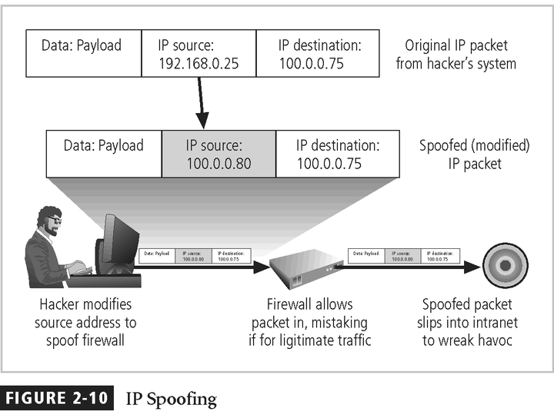
Principles of Information Security, 2nd Edition

Slide 23
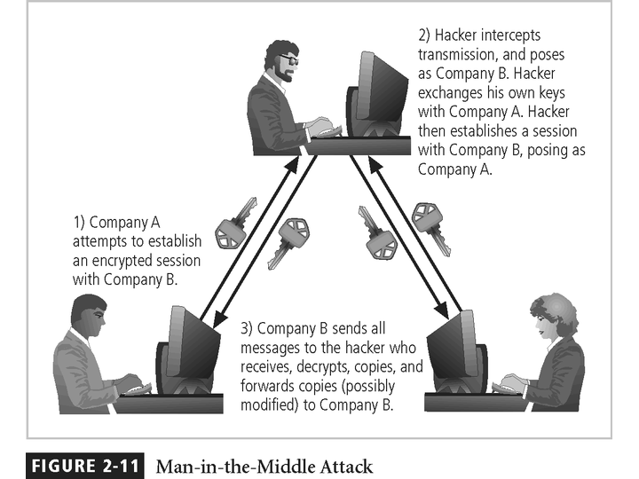
Figure 2-11 - Man-in-the-Middle
Principles of Information Security, 2nd Edition

Slide 24
Attacks (continued)
Mail bombing: also a DoS; attacker routes large quantities of e-mail to target
Sniffers: program or device that monitors data traveling over network; can be used both for legitimate purposes and for stealing information from a network
Social engineering: using social skills to convince people to reveal access credentials or other valuable information to attacker
Principles of Information Security, 2nd Edition
Notes:
Attack Descriptions
Mail-bombing - Another form of e-mail attack that is also a DoS, in which an attacker routes large quantities of e-mail to the target.
Sniffers - a program and/or device that can monitor data traveling over a network. Sniffers can be used both for legitimate network management functions and for stealing information from a network.
Social Engineering - Within the context of information security, the process of using social skills to convince people to reveal access credentials or other valuable information to the attacker.

Slide 25
Attacks (continued)
Buffer overflow: application error occurring when more data is sent to a buffer than can be handled
Timing attack: relatively new; works by exploring contents of a Web browser’s cache to create malicious cookie
Principles of Information Security, 2nd Edition
Notes:
Attack Descriptions
Buffer Overflow - an application error that occurs when more data is sent to a buffer than it can handle. When the buffer overflows, the attacker can make the target system execute instructions, or the attacker can take advantage of some other unintended consequence of the failure.
Timing Attack - relatively new, works by exploring the contents of a web browser’s cache. This could allow the designer to collect information on access to password-protected sites. Another attack by the same name involves attempting to intercept cryptographic elements to determine keys and encryption algorithms.

Slide 26
Attacks (continued)
Denial-of-service (DoS): attacker sends large number of connection or information requests to a target
  Target system cannot handle successfully along with other, legitimate service requests
  May result in system crash or inability to perform
  ordinary functions
Distributed denial-of-service (DDoS): coordinated stream of requests is launched against target from many locations simultaneously
Principles of Information Security, 2nd Edition
Notes:
Attack Descriptions
Denial-of-service (DoS) - the attacker sends a large number of connection or information requests to a target. So many requests are made that the target system cannot handle them successfully along with other, legitimate requests for service. This may result in a system crash, or merely an inability to perform ordinary functions.
Distributed Denial-of-service (DDoS) - an attack in which a coordinated stream of requests is launched against a target from many locations at the same time.

Slide 27
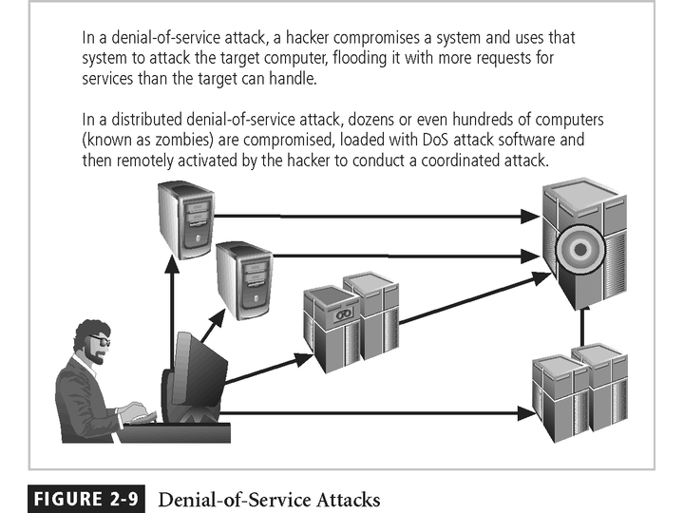
Figure 2-9 - Denial-of-Service Attacks
Principles of Information Security, 2nd Edition

Slide 28
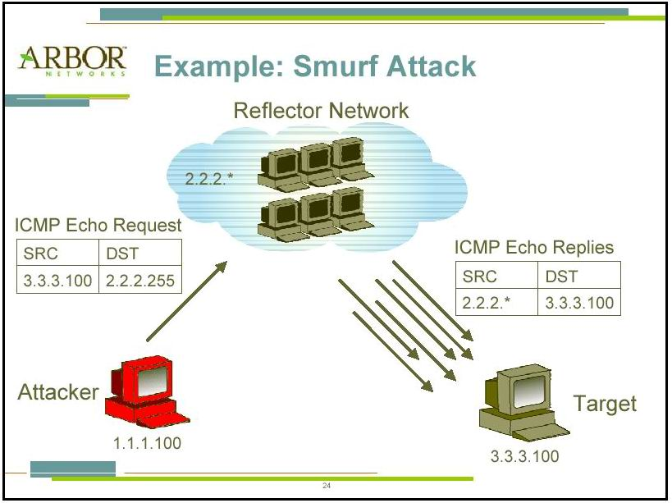
CSE551 Handout on DDoS and Worm

Slide 29
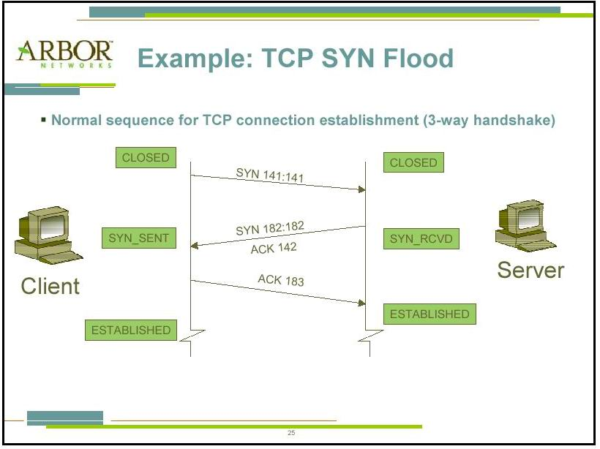
CSE551 Handout on DDoS and Worm

Slide 30
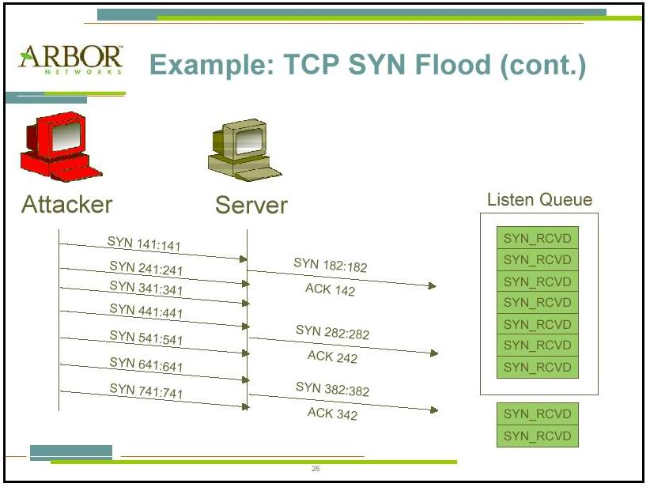
CSE551 Handout on DDoS and Worm

Slide 31
What Makes DDoS Attacks Possible?
Internet was designed with functionality & not security in mind
Internet security is highly interdependent
Internet resources are limited
Power of many is greater than power of a few
CSE551 Handout on DDoS and Worm

Slide 32
Summary
Threat: object, person, or other entity representing a constant danger to an asset
Attack: a deliberate act that exploits vulnerability
Principles of Information Security, 2nd Edition

