Slide 1
Firewalls and VPNs
Principles of Information Security, 2nd Edition
Notes:
THREATS TO INFORMATION SECURITY
To make sound decisions about information security, create policies, and enforce them, management must be informed of the various kinds of threats facing the organization, its applications, data and information systems.
A threat is an object, person, or other entity that represents a constant danger to an asset.
To better understand the numerous threats facing the organization, a categorization scheme has been developed allowing us to group threats by their respective activities.
By examining each threat category in turn, management can most effectively protect its information through policy, education and training, and technology controls.

Slide 2
Learning Objectives
Upon completion of this material, you should be able to:
Understand firewall technology and the various approaches to firewall implementation
Describe the technology that enables the use of Virtual Private Networks
Principles of Information Security, 2nd Edition
Notes:
Learning Objectives
Upon completion of this material, you should be able to:
Understand the role of physical design in the implementation of a comprehensive security program
Understand firewall technology and the various approaches to firewall implementation
Identify the various approaches to remote and dial-up access protection—that is, how these connection methods can be controlled to assure confidentiality of information, and the authentication and authorization of users
Understand content filtering technology
Describe the technology that enables the use of Virtual Private Networks

Slide 3
Firewalls
Prevent specific types of information from moving between the outside world (untrusted network) and the inside world (trusted network)
May be separate computer system; a software service running on existing router or server; or a separate network containing supporting devices
A Roadmap
  Firewall categorization
  Firewall configuration and management
Principles of Information Security, 2nd Edition
Notes:
Firewalls
A firewall prevents specific types of information from moving between the outside world, known as the untrusted network, and the inside world, known as the trusted network.
The firewall may be a separate computer system, a software service running on an existing router or server, or a separate network containing a number of supporting devices.

Slide 4
Firewall Categorization
Processing mode
Development era
Intended deployment structure
Architectural implementation
Principles of Information Security, 2nd Edition
Notes:
Firewall Categorization Methods
Firewalls can be categorized by:
processing mode,
development era, or
intended structure.

Slide 5
Firewalls Categorized by Processing Modes
Packet filtering
Application gateways
Circuit gateways
MAC layer firewalls
Hybrids
Principles of Information Security, 2nd Edition
Notes:
Firewall Categorization Methods
Firewalls can be categorized by:
processing mode,
development era, or
intended structure.

Slide 6
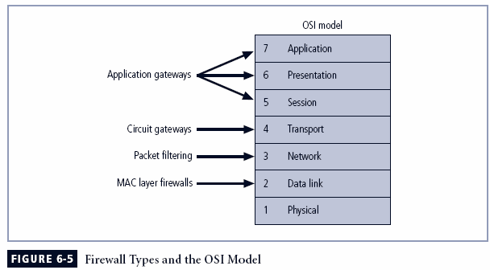
Principles of Information Security, 2nd Edition

Slide 7
Packet Filtering
Packet filtering firewalls examine header information of data packets
Most often based on combination of:
  Internet Protocol (IP) source and destination address
  Direction (inbound or outbound)
  Transmission Control Protocol (TCP) or User Datagram Protocol (UDP) source and destination port requests
Simple firewall models enforce rules designed to prohibit packets with certain addresses or partial addresses
Principles of Information Security, 2nd Edition
Notes:
Packet Filtering
Packet filtering firewalls examine the header information of data packets that come into a network.
The restrictions most commonly implemented are based on a combination of:
Internet Protocol (IP) source and destination address
Direction (inbound or outbound)
Transmission Control Protocol (TCP) or User Datagram Protocol (UDP) source and destination port requests
Simple firewall models examine one aspect of the packet header: the destination and source address. They enforce address restrictions, rules designed to prohibit packets with certain addresses or partial addresses from passing through the device.
They accomplish this through access control lists (ACLs), which are created and modified by the firewall administrators.
There are three subsets of packet filtering firewalls:
Static Filtering
Dynamic Filtering
Stateful Inspection
Static filtering requires that the filtering rules governing how the firewall decides which packets are allowed and which are denied are developed and installed.
Dynamic filtering allows the firewall to react to an emergent event and update or create rules to deal with the event.
While static filtering firewalls allow entire sets of one type of packet to enter in response to authorized requests, the dynamic packet filtering firewall allows only a particular packet with a particular source, destination, and port address to enter through the firewall.
Stateful inspection firewalls, or stateful firewalls, keep track of each network connection between internal and external systems using a state table, which tracks the state and context of each packet in the conversation by recording which station sent what packet and when.
Whereas simple packet filtering firewalls only allow or deny certain packets based on their address, a stateful firewall can block incoming packets that are not responses to internal requests.
The primary disadvantage of this type of firewall is the additional processing required to manage and verify packets against the state table, which can leave the system vulnerable to a DoS or DDoS attack.

Slide 8
Packet Filtering (continued)
Three subsets of packet filtering firewalls:
  Static filtering: requires that filtering rules governing how the firewall decides which packets are allowed and which are denied are developed and installed
  Dynamic filtering: allows firewall to react to emergent event and update or create rules to deal with event
  Stateful inspection: firewalls that keep track of each network connection between internal and external systems using a state table
Principles of Information Security, 2nd Edition

Slide 9
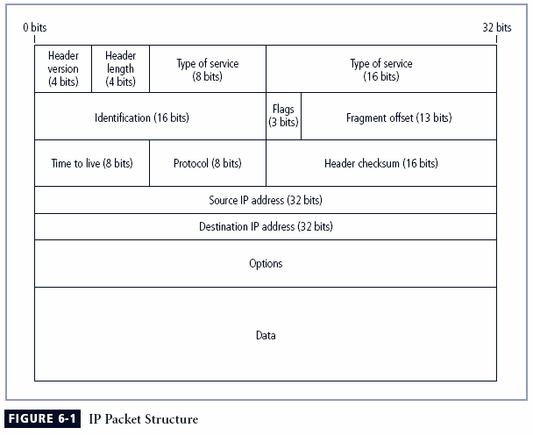
Principles of Information Security, 2nd Edition

Slide 10
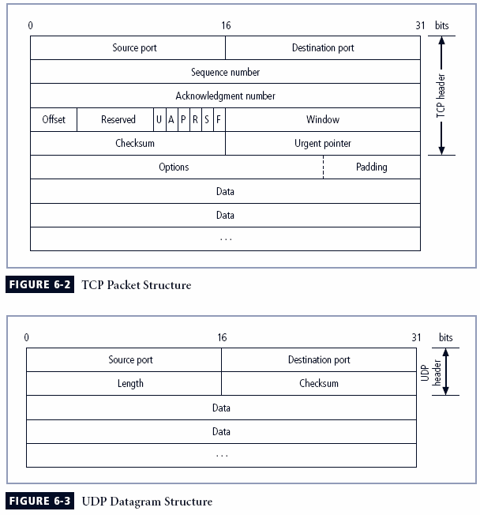
Principles of Information Security, 2nd Edition

Slide 11
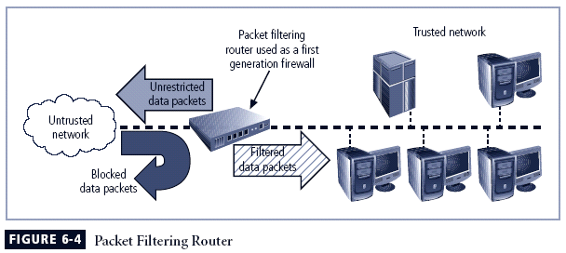
Principles of Information Security, 2nd Edition

Slide 12
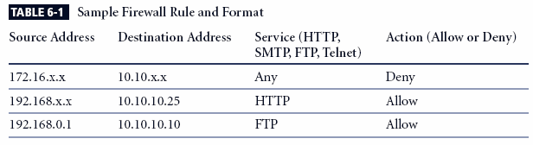
Principles of Information Security, 2nd Edition

Slide 13
Application Gateways
Frequently installed on a dedicated computer; also known as a proxy server
Since proxy server is often placed in unsecured area of the network (e.g., DMZ), it is exposed to higher levels of risk from less trusted networks
Additional filtering routers can be implemented behind the proxy server, further protecting internal systems
Principles of Information Security, 2nd Edition
Notes:
Application Gateways
The application gateway, application-level firewall or application firewall, is frequently installed on a dedicated computer, separate from the filtering router, but is commonly used in conjunction with a filtering router.
The application firewall is also known as a proxy server, since it runs special software that acts as a proxy for a service request.
Since the proxy server is often placed in an unsecured area of the network or is placed in the DMZ it, rather than the Web server, is exposed to the higher levels of risk from the less trusted networks.
Additional filtering routers can be implemented behind the proxy server, limiting access to the more secure internal system, and thereby further protecting internal systems.

Slide 14
Circuit Gateways
Circuit gateway firewall operates at transport layer
Like filtering firewalls, do not usually look at data traffic flowing between two networks, but prevent direct connections between one network and another
Accomplished by creating tunnels connecting specific processes or systems on each side of the firewall, and allow only authorized traffic in the tunnels
Principles of Information Security, 2nd Edition
Notes:
Circuit Gateways
The circuit gateway firewall operates at the transport layer.
Connections are authorized based on addresses.
Like filtering firewalls, circuit gateway firewalls do not usually look at data traffic flowing between one network and another, but they do prevent direct connections between one network and another.
They accomplish this by creating tunnels connecting specific processes or systems on each side of the firewall, and then allow only authorized traffic, such as a specific type of TCP connection for only authorized users, in these tunnels.

Slide 15
MAC Layer Firewalls
Designed to operate at the media access control layer of OSI network model
Able to consider specific host computer’s identity in its filtering decisions
MAC addresses of specific host computers are linked to access control list (ACL) entries that identify specific types of packets that can be sent to each host; all other traffic is blocked
Principles of Information Security, 2nd Edition
Notes:
MAC Layer Firewalls
While not as well known or widely referenced as the firewall approaches above, MAC layer firewalls are designed to operate at the media access control layer of the OSI network model.
This gives these firewalls the ability to consider the specific host computer’s identity in its filtering decisions.
Using this approach, the MAC addresses of specific host computers are linked to ACL entries that identify the specific types of packets that can be sent to each host, and all other traffic is blocked.

Slide 16
Hybrid Firewalls
Combine elements of other types of firewalls; i.e., elements of packet filtering and proxy services, or of packet filtering and circuit gateways
Alternately, may consist of two separate firewall devices; each a separate firewall system, but are connected to work in tandem
Principles of Information Security, 2nd Edition
Notes:
Hybrid Firewalls
Hybrid firewalls combine the elements of other types of firewalls—that is, the elements of packet filtering and proxy services, or of packet filtering and circuit gateways.
Alternately, a hybrid firewall system may actually consist of two separate firewall devices; each is a separate firewall system, but they are connected so that they work in tandem.

Slide 17
Firewalls Categorized by Development Era
First generation: static packet filtering firewalls
Second generation: application-level firewalls or proxy servers
Third generation: stateful inspection firewalls
Fourth generation: dynamic packet filtering firewalls; allow only packets with particular source, destination and port addresses to enter
Fifth generation: kernel proxies; specialized form working under kernel of Windows NT
Principles of Information Security, 2nd Edition
Notes:
First generation firewalls are static packet filtering firewalls and filter packets according to their headers as the packets travel to and from the organization’s networks.
Second generation firewalls are application-level firewalls or proxy servers — dedicated systems that are separate from the filtering router and that provide intermediate services for requestors.
Third generation firewalls are stateful inspection firewalls, and monitor network connections between internal and external systems using state tables.
Fourth generation firewalls are dynamic packet filtering firewalls and allow only a particular packet with a particular source, destination, and port address to enter.
Fifth generation firewalls are kernel proxy and are a specialized form that works under the Windows NT Executive, which is the kernel of Windows NT.

Slide 18
Firewalls Categorized by Deployment Structure
Most firewalls are appliances: stand-alone, self-contained systems
Commercial-grade firewall system consists of firewall application software running on general-purpose computer
Small office/home office (SOHO) or residential-grade firewalls, aka broadband gateways or DSL/cable modem routers, connect user’s local area network or a specific computer system to Internetworking device
Residential-grade firewall software is installed directly on the user’s system
Principles of Information Security, 2nd Edition

Slide 19
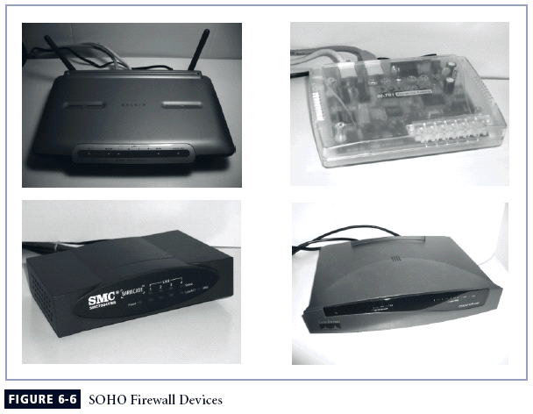
Principles of Information Security, 2nd Edition

Slide 20
Firewalls Categorized by Architectural Implementation
Firewall devices can be configured in a number of network connection architectures
Four common architectural implementations of firewalls:
  Packet filtering routers
  Screened host firewalls
  Dual-homed firewalls
  Screened subnet firewalls
Principles of Information Security, 2nd Edition
Notes:
Firewall Architectures
Each of the firewall devices noted earlier can be configured in a number of network connection architectures.
The firewall configuration that works best for a particular organization depends on three factors: the objectives of the network, the organization’s ability to develop and implement the architectures, and the budget available for the function.
Although literally hundreds of variations exist, there are four common architectural implementations of firewalls:
packet filtering routers,
screened host firewalls,
dual-homed firewalls, and
screened subnet firewalls.
Packet Filtering Routers
Most organizations with an Internet connection have a router as the interface to the Internet at the perimeter. Many of these routers can be configured to reject packets that the organization does not allow into the network.
The drawbacks to this type of system include a lack of auditing and strong authentication and the complexity of the access control lists used to filter the packets can grow and degrade network performance.

Slide 21
Packet Filtering Routers
Most organizations with Internet connection have a router serving as interface to Internet
Many of these routers can be configured to reject packets that organization does not allow into network
Drawbacks include a lack of auditing and strong authentication
Principles of Information Security, 2nd Edition
Notes:
Packet Filtering Routers
Most organizations with an Internet connection have a router as the interface to the Internet at the perimeter. Many of these routers can be configured to reject packets that the organization does not allow into the network.
The drawbacks to this type of system include a lack of auditing and strong authentication and the complexity of the access control lists used to filter the packets can grow and degrade network performance.

Slide 22
Principles of Information Security, 2nd Edition

Slide 23
Screened Host Firewalls
Combines packet filtering router with separate, dedicated firewall such as an application proxy server
Allows router to pre-screen packets to minimize traffic/load on internal proxy
Separate host is often referred to as bastion host; can be rich target for external attacks, and should be very thoroughly secured
Principles of Information Security, 2nd Edition
Notes:
Screened Host Firewalls
This architecture combines the packet filtering router with a separate, dedicated firewall, such as an application proxy server, allowing the router to prescreen packets to minimize the network traffic and load on the internal proxy.
The application proxy examines an application layer protocol and performs the proxy services.
This separate host is often referred to as a bastion host or sacrificial host; it can be a rich target for external attacks, and should be very thoroughly secured.

Slide 24
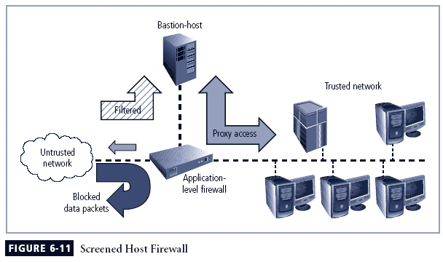
Principles of Information Security, 2nd Edition

Slide 25
Dual-Homed Host Firewalls
Bastion host contains two network interface cards (NICs): one connected to external network, one connected to internal network
Implementation of this architecture often makes use of network address translation (NAT), creating another barrier to intrusion from external attackers
Principles of Information Security, 2nd Edition
Notes:
Dual-Homed Host Firewalls
With this approach the bastion host contains two NICs: one connected to the external network, and one connected to the internal network, providing an additional layer of protection by requiring all traffic to go through the firewall to move between the internal and external networks.
Implementation of this architecture often makes use of NAT - mapping assigned IP addresses to special ranges of non-routable internal IP addresses, creating yet another barrier to intrusion from external attackers.

Slide 26
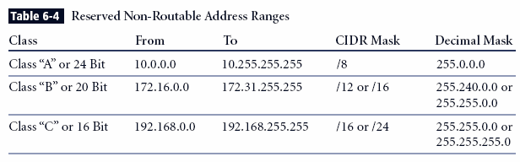
Principles of Information Security, 2nd Edition

Slide 27
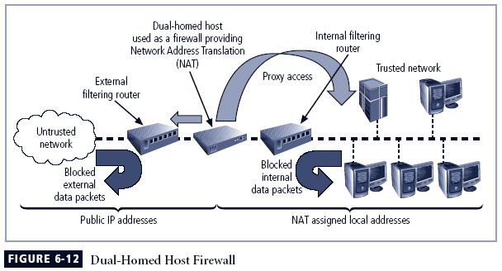
Principles of Information Security, 2nd Edition

Slide 28
Screened Subnet Firewalls (with DMZ)
Dominant architecture used today is the screened subnet firewall
Commonly consists of two or more internal bastion hosts behind packet filtering router, with each host protecting trusted network:
  Connections from outside (untrusted network) routed through external filtering router
  Connections from outside (untrusted network) are routed into and out of routing firewall to separate network segment known as DMZ
  Connections into trusted internal network allowed only from DMZ bastion host servers
Principles of Information Security, 2nd Edition
Notes:
Screened Subnet Firewalls (with DMZ)
The dominant architecture used today, the screened subnet firewall provides a DMZ, which could be a dedicated port on the firewall device linking a single bastion host, or it can be connected to a screened subnet.
A common arrangement finds the subnet firewall consisting of two or more internal bastion hosts behind a packet filtering router, with each host protecting the trusted network:
Connections from the outside or untrusted network are routed through an external filtering router.
Connections from the outside or untrusted network are routed into—and then out of—a routing firewall to the separate network segment known as the DMZ.
Connections into the trusted internal network are allowed only from the DMZ bastion host servers.
The screened subnet is an entire network segment that performs two functions:
it protects the DMZ systems and information from outside threats by providing a network of intermediate security; and
it protects the internal networks by limiting how external connections can gain access to internal systems.
DMZs can also create extranets - segments of the DMZ where additional authentication and authorization controls are put into place to provide services that are not available to the general public.

Slide 29
Screened Subnet Firewalls (with DMZ)
(continued)
Screened subnet performs two functions:
  Protects DMZ systems and information from outside threats
  Protects the internal networks by limiting how external connections can gain access to internal systems
Another facet of DMZs: extranets
Principles of Information Security, 2nd Edition

Slide 30
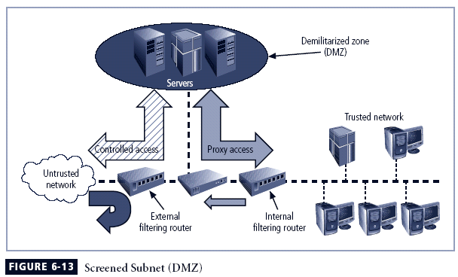
Principles of Information Security, 2nd Edition

Slide 31
Selecting the Right Firewall
When selecting firewall, consider a number of factors:
  What firewall offers right balance between protection and cost for needs of organization?
  What features are included in base price and which are not?
  Ease of setup and configuration? How accessible are staff technicians who can configure the firewall?
  Can firewall adapt to organization’s growing network?
Second most important issue is cost
Principles of Information Security, 2nd Edition
Notes:
Selecting the Right Firewall
When selecting the best firewall for an organization, you should consider a number of factors. The most important of these is the extent to which the firewall design provides the desired protection:
What type of firewall technology offers the right balance between protection and cost for the needs of the organization?
What features are included in the base price? What features are available at extra cost? Are all cost factors known?
How easy is it to set up and configure the firewall? How accessible are the staff technicians who can competently configure the firewall?
Can the candidate firewall adapt to the growing network in the target organization?
The second most important issue is cost.

Slide 32
Configuring and Managing Firewalls
Each firewall device must have own set of configuration rules regulating its actions
Firewall policy configuration is usually complex and difficult
Configuring firewall policies both an art and a science
When security rules conflict with the performance of business, security often loses
Principles of Information Security, 2nd Edition
Notes:
Configuring and Managing Firewalls
Good policy and practice dictates that each firewall device, whether a filtering router, bastion host, or other firewall implementation, must have its own set of configuration rules that regulate its actions.
The configuration of firewall policies can be complex and difficult.
Configuring firewall policies is as much an art as a science. Each configuration rule must be carefully crafted, debugged, tested, and sorted.
When configuring firewalls, keep one thing in mind: when security rules conflict with the performance of business, security often loses.

Slide 33
Best Practices for Firewalls
All traffic from trusted network is allowed out
Firewall device never directly accessed from public network
Simple Mail Transport Protocol (SMTP) data allowed to pass through firewall
Internet Control Message Protocol (ICMP) data denied
Telnet access to internal servers should be blocked
When Web services offered outside firewall, HTTP traffic should be denied from reaching internal networks
Principles of Information Security, 2nd Edition
Notes:
Best Practices for Firewalls
All traffic from the trusted network is allowed out.
The firewall device is never directly accessible from the public network.
SMTP data is allowed to pass through the firewall, but should be routed to a well-configured SMTP gateway to filter and route messaging traffic securely.
All ICMP data should be denied.
Telnet access to all internal servers from the public networks should be blocked.
When Web services are offered outside the firewall, HTTP traffic should be denied from reaching your internal networks through the use of some form of proxy access or DMZ architecture.

Slide 34
Firewall Rules
Operate by examining data packets and performing comparison with predetermined logical rules
Logic based on set of guidelines most commonly referred to as firewall rules, rule base, or firewall logic
Most firewalls use packet header information to determine whether specific packet should be allowed or denied
Principles of Information Security, 2nd Edition
Notes:
Firewall Rules
Firewalls operate by examining a data packet and performing a comparison with some predetermined logical rules.
This logical set is most commonly referred to as firewall rules, rule base, or firewall logic.
Most firewalls use packet header information to determine whether a specific packet should be allowed to pass through or should be dropped.

Slide 35
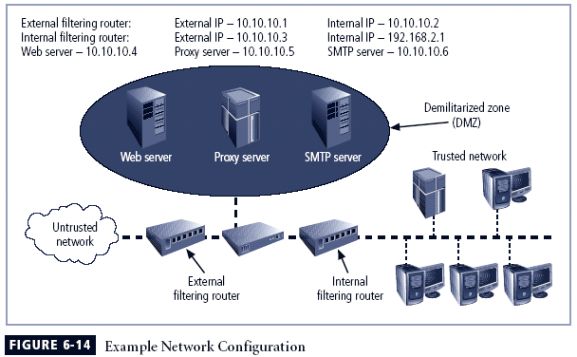
Principles of Information Security, 2nd Edition

Slide 36
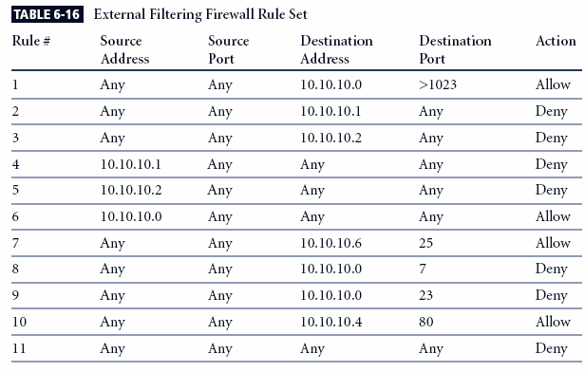
Principles of Information Security, 2nd Edition
Notes:
(For Notes Page)
Note that the rule allowing responses to internal communications comes first (appearing in Table 6-16 as Rule #1), followed by the four rules prohibiting direct communications to or from the firewall (Rules #2-5 in Table 6-16). After this comes the rule stating that all outgoing internal communications are allowed, followed by the rules governing access to the SMTP server, and denial of Ping, Telnet access, and access to the HTTP server. If heavy traffic to the HTTP server is expected, move the HTTP server rule closer to the top (for example, into the position of Rule #2), which would expedite rule processing for external communications. The final rule in Table 6-16 denies any other types of communications.

Slide 37
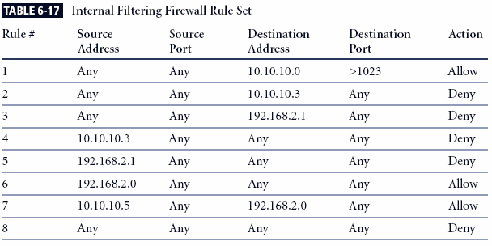
Principles of Information Security, 2nd Edition
Notes:
(For Notes Page)
Note the similarities and differences in the two rule sets. The internal filtering router/firewall rule set, shown in Table 6-17, has to both protect against traffic to and allow traffic from the internal network (192.168.2.0). Most of the rules in Table 6-17 are similar to those in Table 6-16: allowing responses to internal communications (Rule #1); denying communications to/from the firewall itself (Rules #2-5); and allowing all outbound internal traffic (Rule #6). Note that there is no permissible traffic from the DMZ systems, except as in Rule #1. Why isn’t there a comparable rule for the 192.168.2.1 subnet? Because this is an unrouteable network, external communications are handled by the NAT server, which maps internal (192.168.2.0) addresses to external (10.10.10.0) addresses. This prevents a hacker from compromising one of the internal boxes and accessing the internal network with it. The exception is the proxy server (Rule #7 in Table 6-17), which should be very carefully configured. If the organization does not need the proxy server, as in cases where all externally accessible services are provided from machines in the DMZ, then Rule #7 is not needed. Note that there are no Ping and Telnet rules in Table 6-17. This is because the external firewall filters these external requests out. The last rule, Rule #8, provides cleanup.

Slide 38
Virtual Private Networks (VPNs)
Private and secure network connection between systems; uses data communication capability of unsecured and public network
Securely extends organization’s internal network connections to remote locations beyond trusted network
Principles of Information Security, 2nd Edition
Notes:
Virtual Private Networks (VPNs)
A VPN is a private and secure network connection between systems that uses the data communication capability of an unsecured and public network.
VPNs are commonly used to extend securely an organization’s internal network connections to remote locations beyond the trusted network.
The VPNC defines three VPN technologies:
A trusted VPN, or VPN, uses leased circuits from a service provider and conducts packet switching over these leased circuits.
Secure VPNs use security protocols and encrypt traffic transmitted across unsecured public networks like the Internet.
A hybrid VPN combines the two, providing encrypted transmissions (as in secure VPN) over some or all of a trusted VPN network.
A VPN that proposes to offer a secure and reliable capability while relying on public networks must address:
Encapsulation of incoming and outgoing data, wherein the native protocol of the client is embedded within the frames of a protocol that can be routed over the public network as well as be usable by the server network environment.
Encryption of incoming and outgoing data to keep the data contents private while in transit over the public network but usable by the client and server computers and/or the local networks on both ends of the VPN connection.
Authentication of the remote computer and, perhaps, the remote user as well. Authentication and the subsequent authorization of the user to perform specific actions are predicated on accurate and reliable identification of the remote system and/or user.

Slide 39
Virtual Private Networks (VPNs) (continued)
VPN must accomplish:
  Encapsulation of incoming and outgoing data
  Encryption of incoming and outgoing data
  Authentication of remote computer and (perhaps) remote user as well
Two working modes:
  Transport mode
  Tunnel mode
Principles of Information Security, 2nd Edition
Notes:
Virtual Private Networks (VPNs)
A VPN is a private and secure network connection between systems that uses the data communication capability of an unsecured and public network.
VPNs are commonly used to extend securely an organization’s internal network connections to remote locations beyond the trusted network.
The VPNC defines three VPN technologies:
A trusted VPN, or VPN, uses leased circuits from a service provider and conducts packet switching over these leased circuits.
Secure VPNs use security protocols and encrypt traffic transmitted across unsecured public networks like the Internet.
A hybrid VPN combines the two, providing encrypted transmissions (as in secure VPN) over some or all of a trusted VPN network.
A VPN that proposes to offer a secure and reliable capability while relying on public networks must address:
Encapsulation of incoming and outgoing data, wherein the native protocol of the client is embedded within the frames of a protocol that can be routed over the public network as well as be usable by the server network environment.
Encryption of incoming and outgoing data to keep the data contents private while in transit over the public network but usable by the client and server computers and/or the local networks on both ends of the VPN connection.
Authentication of the remote computer and, perhaps, the remote user as well. Authentication and the subsequent authorization of the user to perform specific actions are predicated on accurate and reliable identification of the remote system and/or user.

Slide 40
Transport Mode
Data within IP packet is encrypted, but header information is not
Allows user to establish secure link directly with remote host, encrypting only data contents of packet
Two popular uses:
  End-to-end transport of encrypted data
  Remote access worker connects to office network over Internet by connecting to a VPN server on the perimeter
Principles of Information Security, 2nd Edition
Notes:
Transport Mode
In transport mode, the data within an IP packet is encrypted, but the header information is not. This allows the user to establish a secure link directly with the remote host, encrypting only the data contents of the packet.
There are two popular uses for transport mode VPNs.
The end-to-end transport of encrypted data. In this model, two end users can communicate directly, encrypting and decrypting their communications as needed. Each machine acts as the end node VPN server and client.
A remote access worker or teleworker connects to an office network over the Internet by connecting to a VPN server on the perimeter.

Slide 41
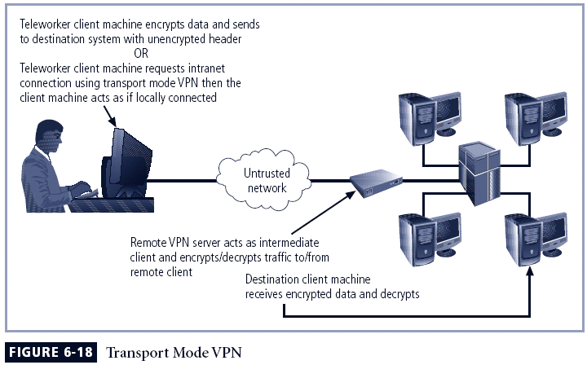
Principles of Information Security, 2nd Edition

Slide 42
Tunnel Mode
Organization establishes two perimeter tunnel servers
These servers act as encryption points, encrypting all traffic that will traverse unsecured network
Primary benefit to this model is that an intercepted packet reveals nothing about true destination system
Example of tunnel mode VPN: Microsoft’s Internet Security and Acceleration (ISA) Server
Principles of Information Security, 2nd Edition
Notes:
Tunnel Mode
In tunnel mode, the organization establishes two perimeter tunnel servers. These servers serve as the encryption points, encrypting all traffic that will traverse an unsecured network.
In tunnel mode, the entire client packet is encrypted and added as the data portion of a packet addressed from one tunneling server and to another. The receiving server decrypts the packet and sends it to the final address.
The primary benefit to this model is that an intercepted packet reveals nothing about the true destination system.

Slide 43
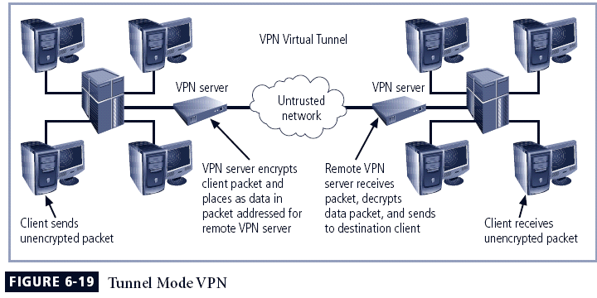
Principles of Information Security, 2nd Edition

Slide 44
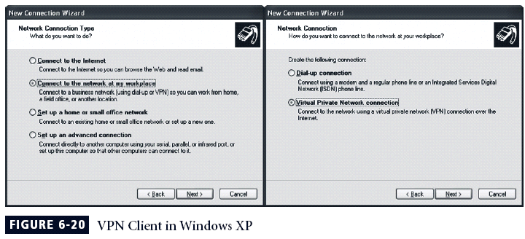
Principles of Information Security, 2nd Edition

Slide 45
Summary
Firewall technology
  Four methods for categorization
  Firewall configuration and management
Virtual Private Networks
  Two modes
Principles of Information Security, 2nd Edition

Slide 46
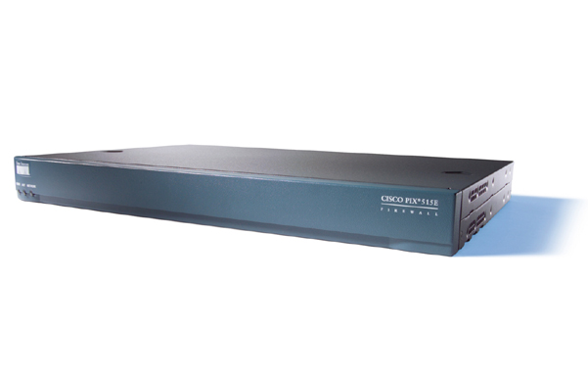
Case Studies on
Cisco PIX Firewalls

Slide 47
Acknowledgement
The contents of this lecture come from the following links:
  https://www.cisco.com/en/US/docs/security/pix/pix30/user/guide/pixugint.html
  http://faculty.valenciacollege.edu/wyousif/CCNA/Students_presentations/Fall_02/Cisco%20PIX%20515E%20Firewall.ppt
  http://cs3.calstatela.edu/~egean/cs581/lecture-notes/malik/Chapter%208%20PIX%20Firewall.ppt
  http://sce.uhcl.edu/yang/teaching/csci5234WebSecurityFall2011/Pix%20presentation.ppt

Slide 48
Overview
Introduction
Adaptive Security Algorithm
Multiple Interfaces and Security Levels
Address Translation
Configurations
Working on TCP and UDP Transmissions
Other Features

Slide 49
What a PIX Firewall can do?
Cisco PIX firewall is a “hardware” firewall, a network layer firewall.
Cisco PIX firewall series: 501, 506e, 515e, 525 and 535.
Protect one or more perimeter networks
Allows you to implement security policies for connection to and from the inside network

Slide 50
Adaptive Security Algorithm (ASA)
Allows one way connections (inside to outside) without an explicit configuration for each internal system and application
Always in operation
No packets can traverse the PIX Firewall without a connection and state
All ICMP packets are denied unless specifically permitted

Slide 51
Multiple Interfaces and Security Levels
All PIX Firewalls provide at least two interfaces
Each interface is assigned a security level from 0 to 100
  Security level 100 usually assigned to interface connected to the inside private network
  Security level 0 usually assigned to outside public interface
By default, traffic can flow from a higher security level to a lower security level provided that a NAT (xlate) is built for the source IP address
Connections from lower security interface to a higher security interface must be explicitly permitted via ACL or conduit

Slide 52
Address Translation
Network Address Translation (NAT)
  NAT must be set up in order to pass traffic between any two interfaces
  Works by substituting or translating host addresses on one interface with a global address associated with another interface
Port Address Translation (PAT)
  Uses port remapping which allows a single valid IP address translation for up to 64,000 active objects
  Does not work with multimedia applications that have an inbound data stream different from the outgoing control path

Slide 53
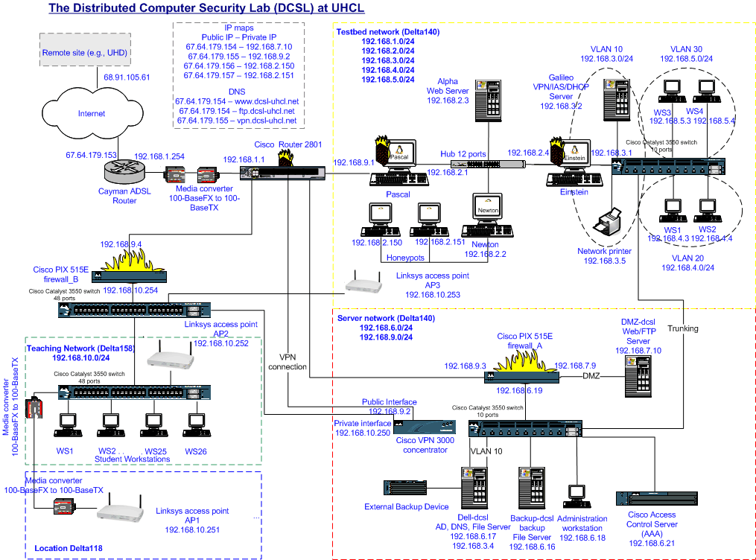
PIX firewall Configurations

Slide 54
PIX Firewall Configurations (Con't)
How to access PIX firewall
  Access via Telnet port
  Access via Console port
General capabilities of PIX 515e
  Up to 6 Ethernet interfaces
  128,000 simultaneous connections
  170 Mbps clear text throughput
  11Mbps DES throughput

Slide 55
PIX Firewall Configurations (Con't)
Nameif command
  nameif ethernet0 outside security0
  nameif ethernet1 inside security100
  nameif ethernet2 dmz security 80
Interface command
  interface ethernet0 auto
  interface ethenet1 100full
Ip address command
  ip address outside 192.168.9.4 255.255.255.0
  ip address inside 192.168.10.254 255.255.255.0

Slide 56
PIX Firewall Configurations (Con't)
Route command
  route outside 0.0.0.0 0.0.0.0 192.168.9.254 1
  route outside 192.168.6.0 255.255.255.0 192.168.9.3 1
Static command
  static (inside,outside) 192.168.10.0 192.168.10.0 netmask 255.255.255.0
Conduit command
  conduit permit icmp 192.168.10.0 255.255.255.0 any
  conduit permit udp host 192.168.6.21 eq 1645 host 192.168.10.251

Slide 57
PIX Configurations
See Cisco PIX Firewall and VPN configuration guide

Slide 58
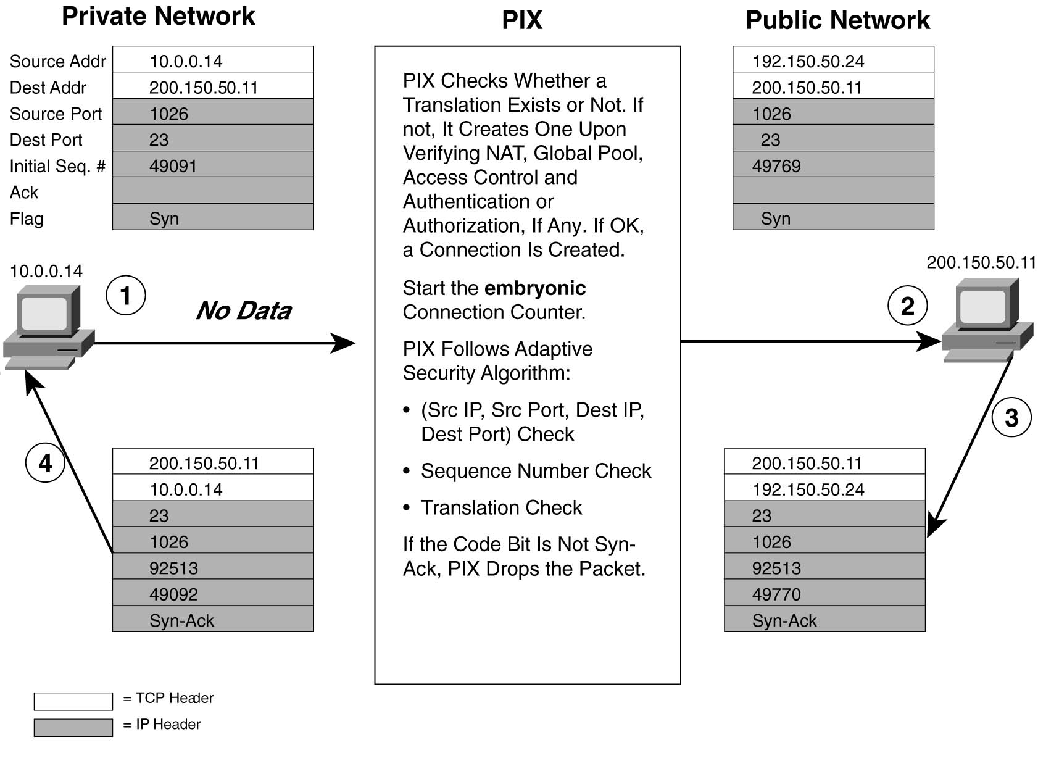
TCP Connection Setup

Slide 59
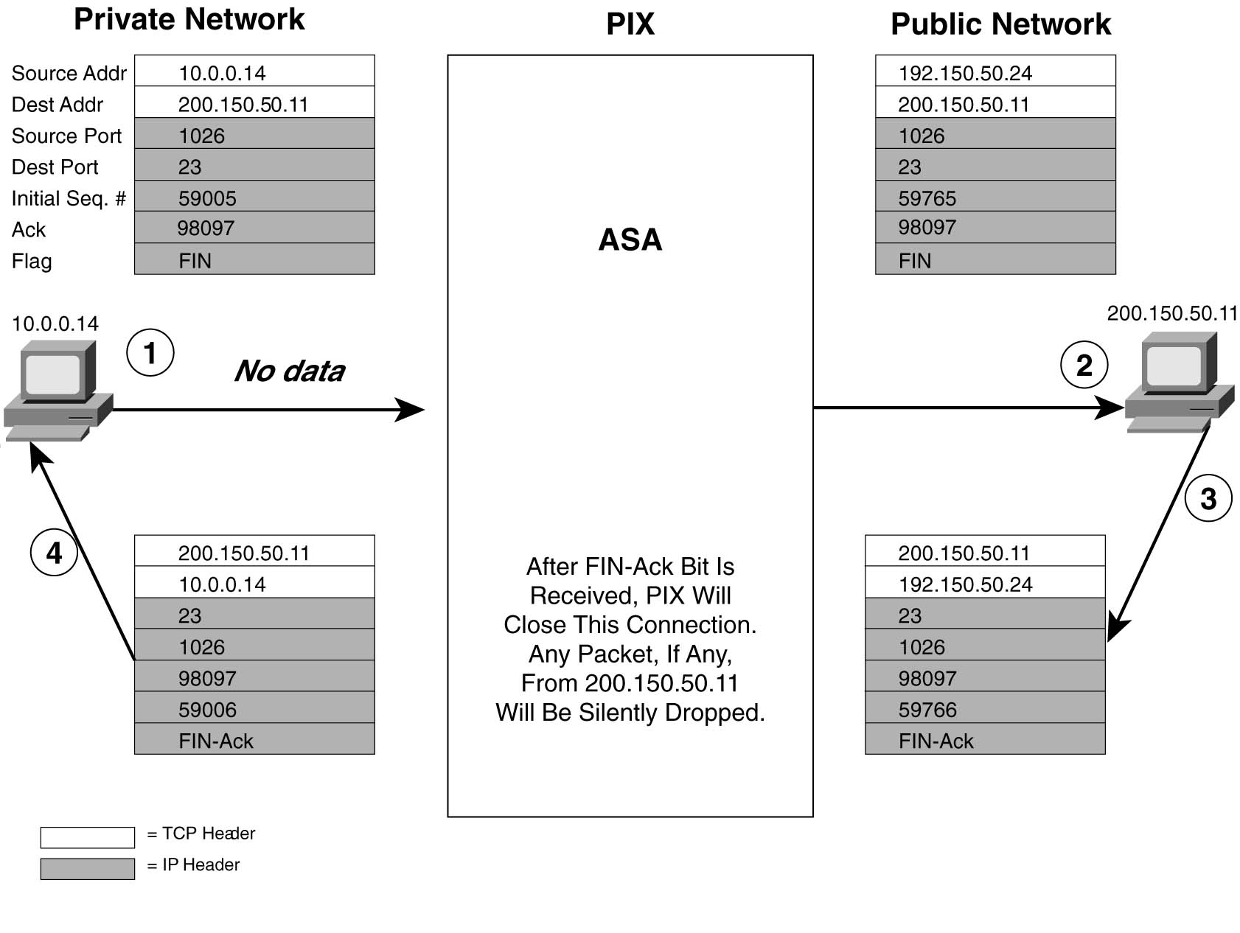
TCP Connection Teardown

Slide 60
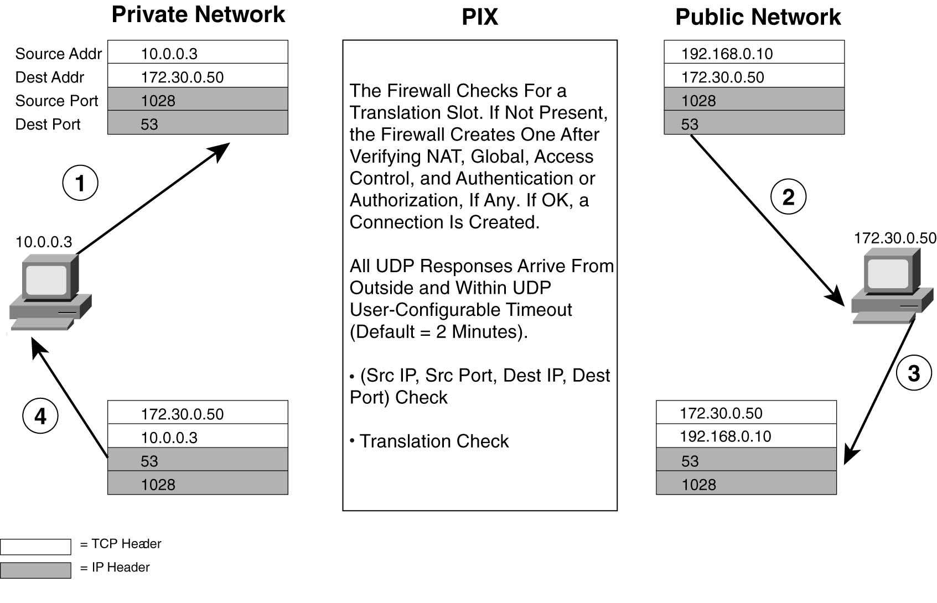
UDP Transmission

Slide 61
Other Features of PIX
Cut-Through Proxy
  Unique feature of a PIX Firewall
  Allows user-based authentication of inbound or outbound connections
  A PIX Firewall uses cut-through proxy to authenticate a connection and then allow traffic to flow quickly and directly
Can act as an inline IDS and also have VPN functions
Can provide stateful failover to a redundant PIX
Application awareness implement via “fixup” commands

Slide 62
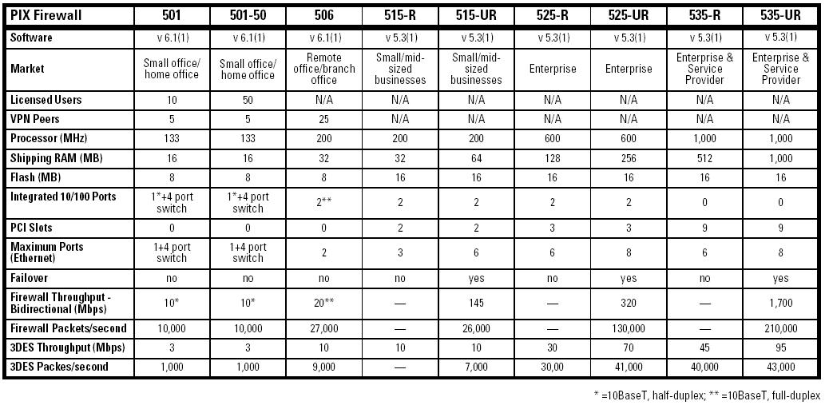
PIX Firewall Comparisons

Slide 63
PIX 500 Series Firewall Price Listing
Model | Price
501 | $509.08
501-50 | $847.55
506E | $1,212.37
515-R | $2,516.58
515-UR | $6,099.63
525-R | $10,499.40
525-UR | $13,553.90
535-R | $30,981.52
535-UR | $48,825.46
(Prices compiled from CDW and MicroWarehouse)

