Slide 1
KV-PIMple
PIM-aware KV-cache Allocation for LLM Decode
Kiet Vu
9/15/26

Slide 2
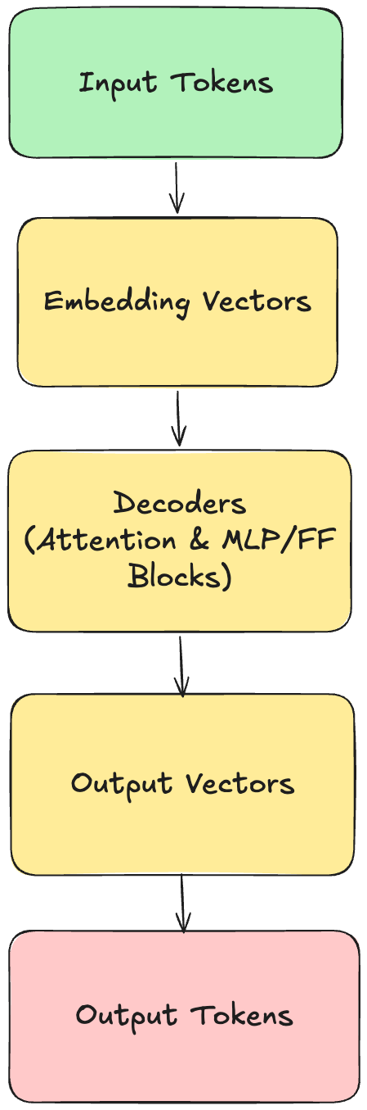
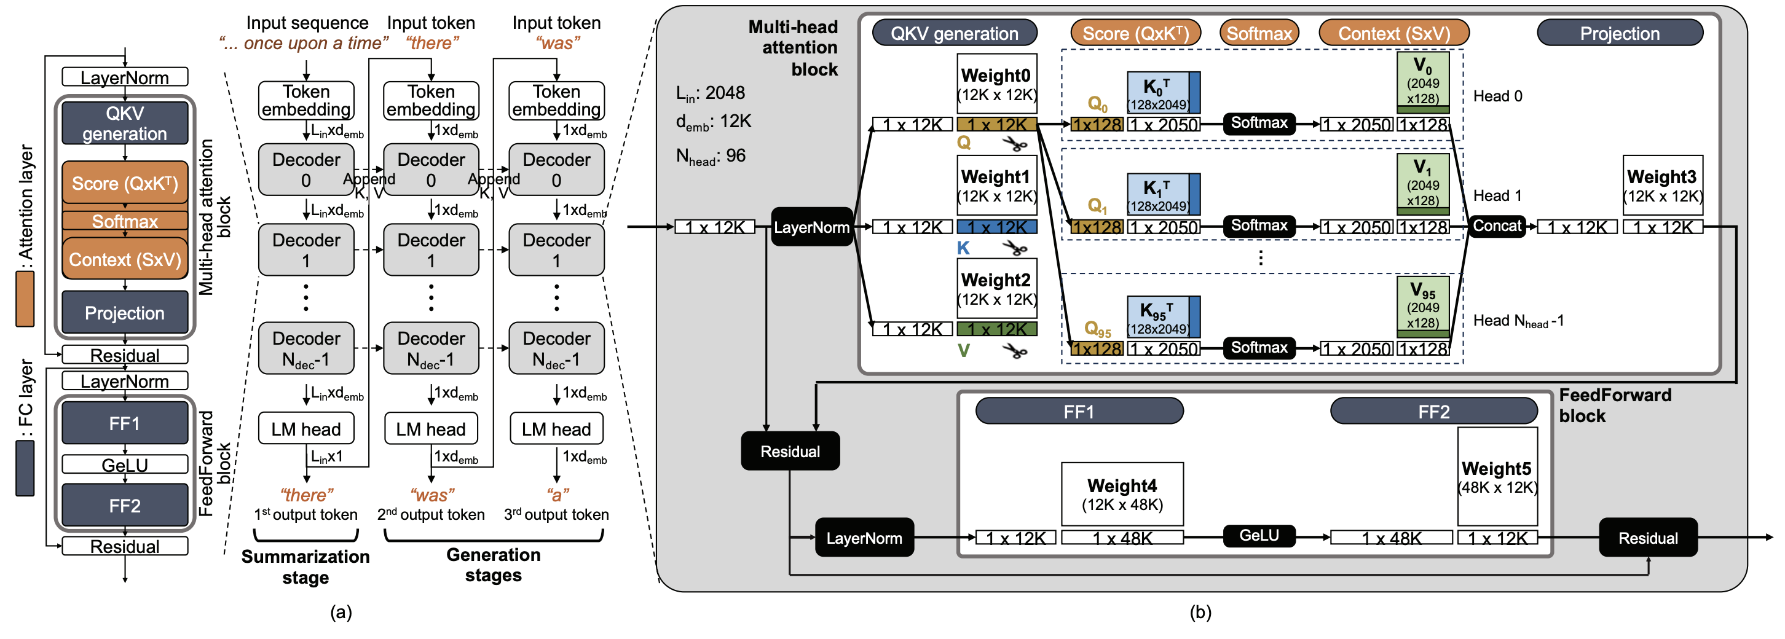
Background:
Prefill: The attention layers produce K (key) Q (query) V (value), with KV containing the context of previous tokens
Decode: scores Q against all past K -> weights -> weighted sum of V
KV cache: instead of recalculating the 2 matrices again per output token -> store them -> main usage of GPU memory (excluding weights) -> trade compute-bound for memory-bound (wide margin)
Problem: The cache grows unpredictably since output length is unknown & memory fragmentation -> reserve & waste memory space

Slide 3
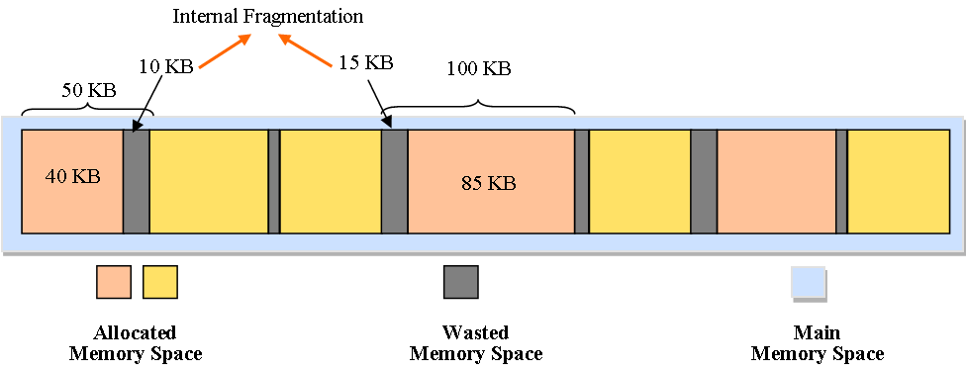
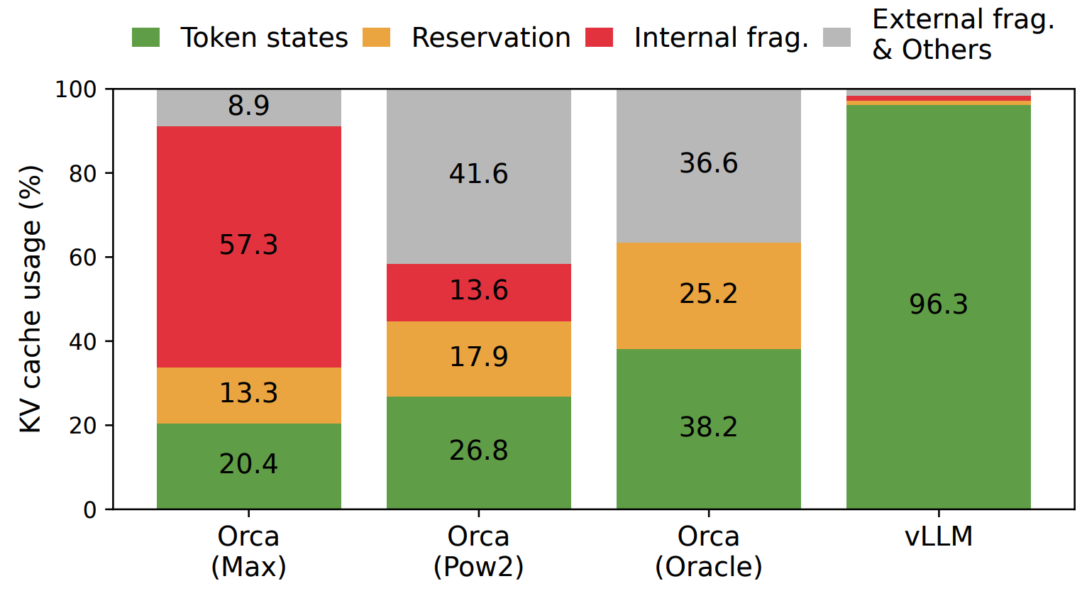
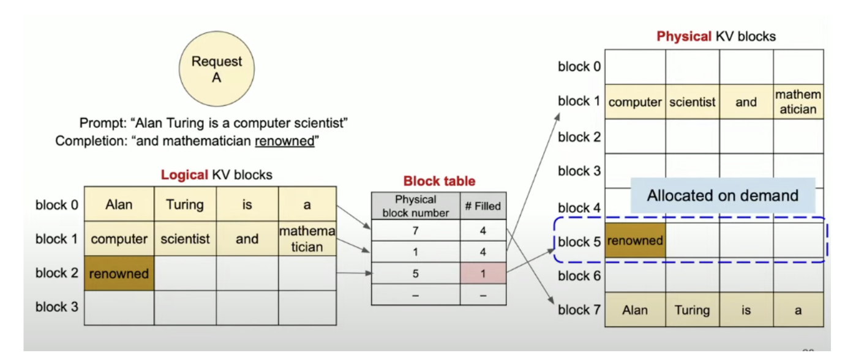
Background:
Problem: Memory Fragmentation
Solution: vLLM & PagedAttention
PagedAttention: Borrows virtual memory & paging from OS memory management
Prefix sharing: identical prefixes point at the same physical block, copy-on-write on divergence

Slide 4
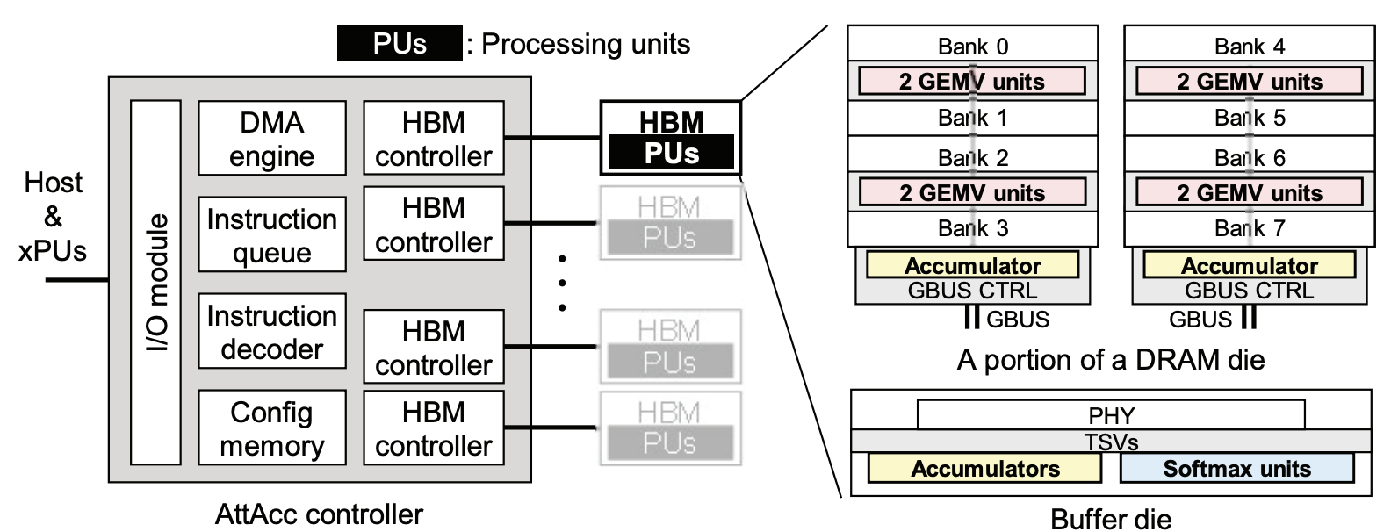
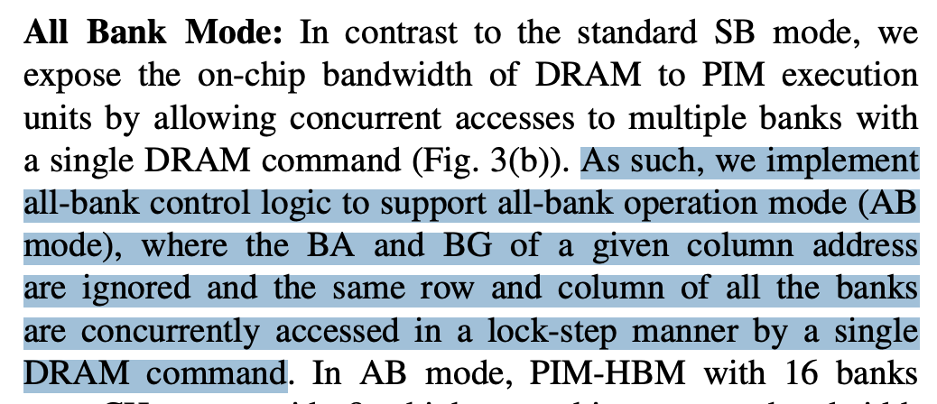
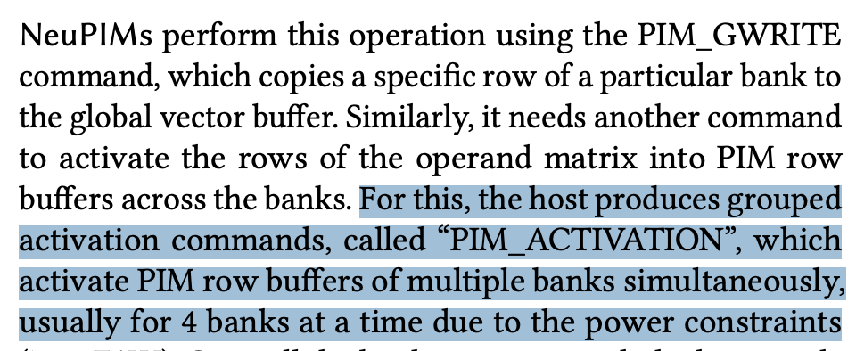
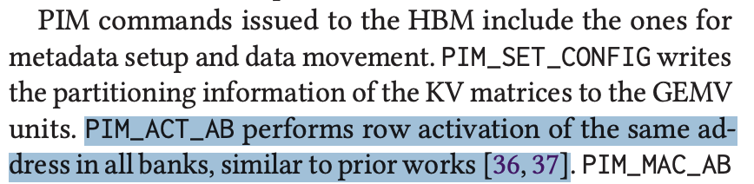
Background:
Persisting Problem: Memory Bandwidth
Solution: processing-in-memory (PIM) -> take advantage of the internal bandwidth by doing Attention inside the banks
- All bank ops: activate the same row index in all banks of a channel, then broadcast one command -> bank parallelism
- However, this only works if the data sits at matching row indices across banks (row group), which most PIM papers assume
- Gap: Most papers just assume the layout
NeuPIMs |ASPLOS ‘24
Samsung HBM2-PIM & Aquabolt-XL | Hot Chips 33
AttAcc!| ASPLOS ‘24

Slide 5
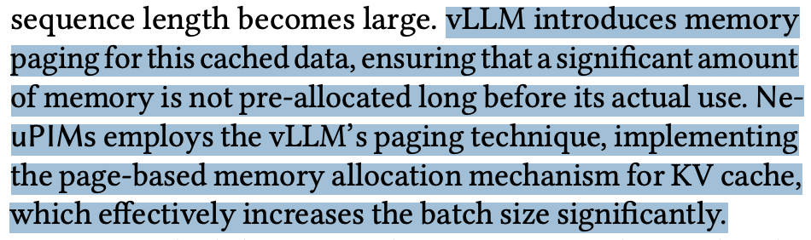
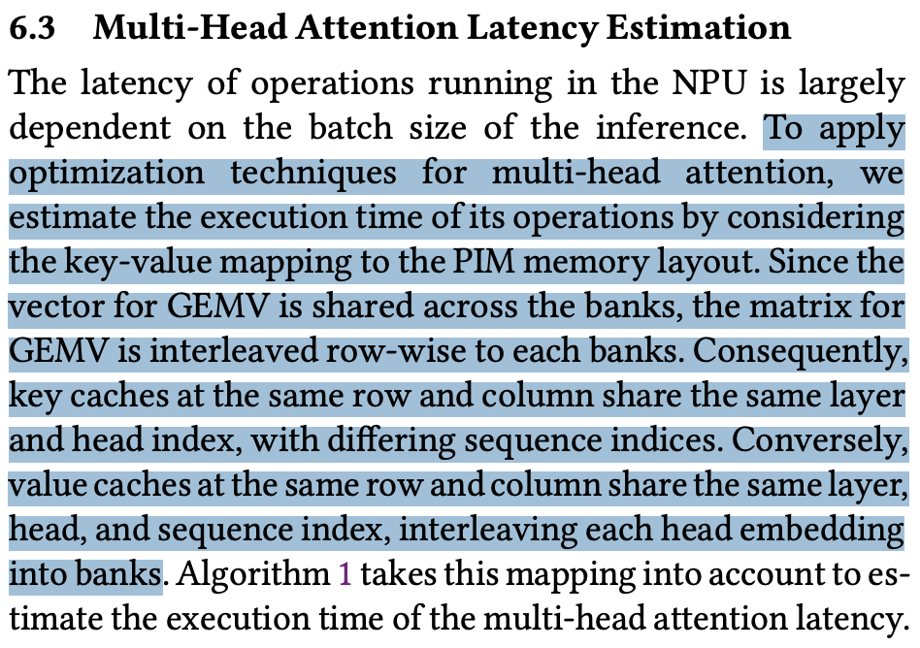
NeuPIMs
PROS:
They use a technique close to vLLM PagedAttention, but they modify their allocator to ensure row alignment
The allocator is a per-channel FIFO of row indices, with no region bookkeeping and no degraded fallback path
Pages are whole row groups (keys every 32 tokens, values every 512 -> aligned by construction
CONS:
Heavy internal fragmentation: 52.9% of used KV is reserved but empty on their own ShareGPT traces compared to 2.4% for vLLM's 16-token blocks -> happens when a request is smaller than the page size (no degrade path)
Each request is pinned to one channel -> one channel can fill up while others have room, so they need load balancing
Keys and values grow differently (every 32 vs every 512 tokens) -> so each request's memory use steps unevenly
Not a drop-in for vLLM -> coarser prefix sharing and copy-on-write (only work at 32/512-token granularity)
Use vLLM Paging Technique
Use their own algorithm for row alignment

Slide 6
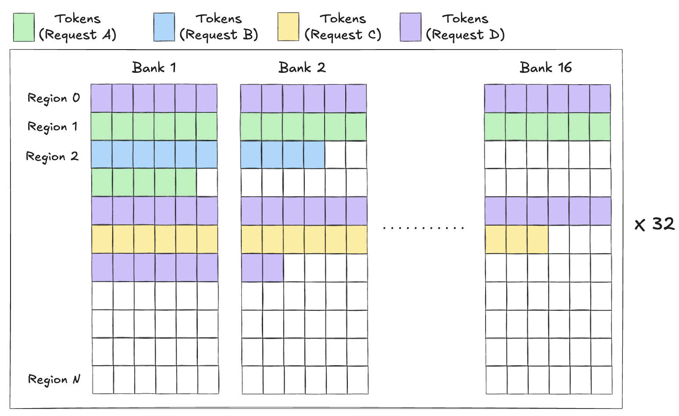
KV-PIMple: PIM-aware KV-cache Allocation
The Fix
Bounded contiguity: Turn the pool into regions, which holds #_blocks that fills one row-group across all channels
Fill a region in order, claim another only when it's full. A sequence’s regions can be scattered
region_size = row_size x banks x channels
= 1 KB x 16 x 32 = 512 KB
token_size = KV_matrices x n_kv_heads x head_dim x precision
= 2 x 8 x 128 x 2 (fp16) = 4096 B = 4 KB/layer
#_tokens_per_region = 512 KB / 4 KB = 128 tokens
#_blocks_per_region = 128 tokens / 16 tokens = 8 blocks
When no free region is available, we fall back to filling blocks to partial regions -> degrades to baseline behavior
Runtime allocation: #_blocks_per_region derived at startup from DRAM geometry and model shape
We pick the lowest free slot from that sequence's region heap, and the lowest empty region when it fills
row = floor(blockID / #_blocks_per_region)

Slide 7
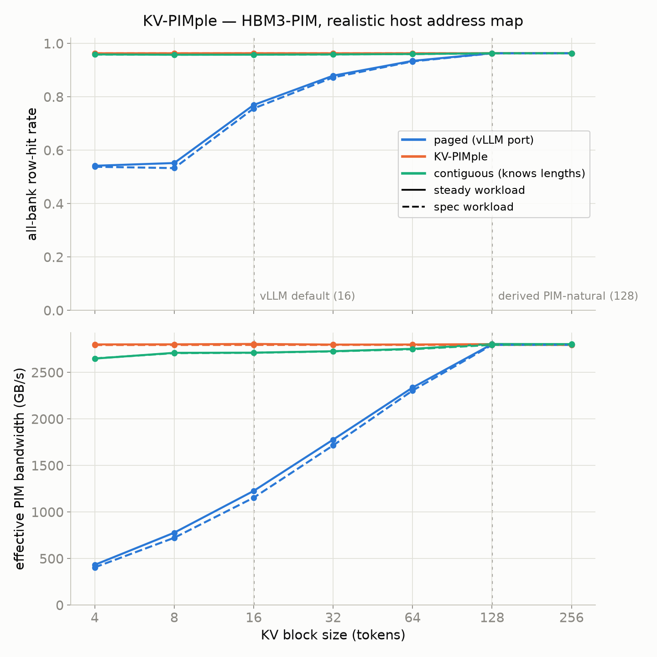
KV-PIMple: PIM-aware KV-cache Allocation
Measurements
At the standard 16-token block, KV-PIMple raises the row-hit rate from 0.77 to 0.96 and effective bandwidth from 1226 to 2805 GB/s -> 2.3×
At 4-token blocks the gap widens to 6.5×. Under speculative decoding it is 2.4×
However, at 128 tokens every allocator scores the same since a 128-token block is exactly one aligned region
Nevertheless, using 128-token blocks gives up the fine-grained packing of paging. With 16-token blocks and PIM-aware allocator we keep the packing and get the same result

Slide 8
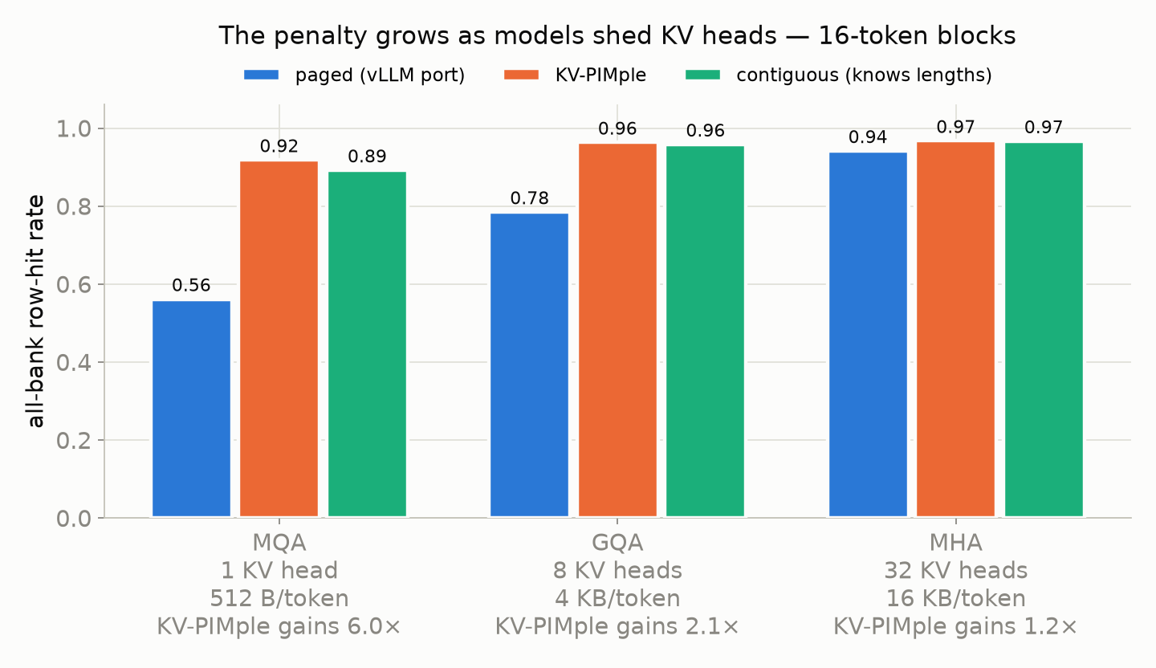
KV-PIMple: PIM-aware KV-cache Allocation
Model Configs
Token Size & Model Heads:
Token size increases proportionally with the number of heads
As token size increases, block size (bytes) also increases, occupying more rows across banks –> filling regions -> row-hit rate increases
However, since memory storage is a constraint, we can’t just increase everything naively
*The gains here are PIM bandwidth

Slide 9
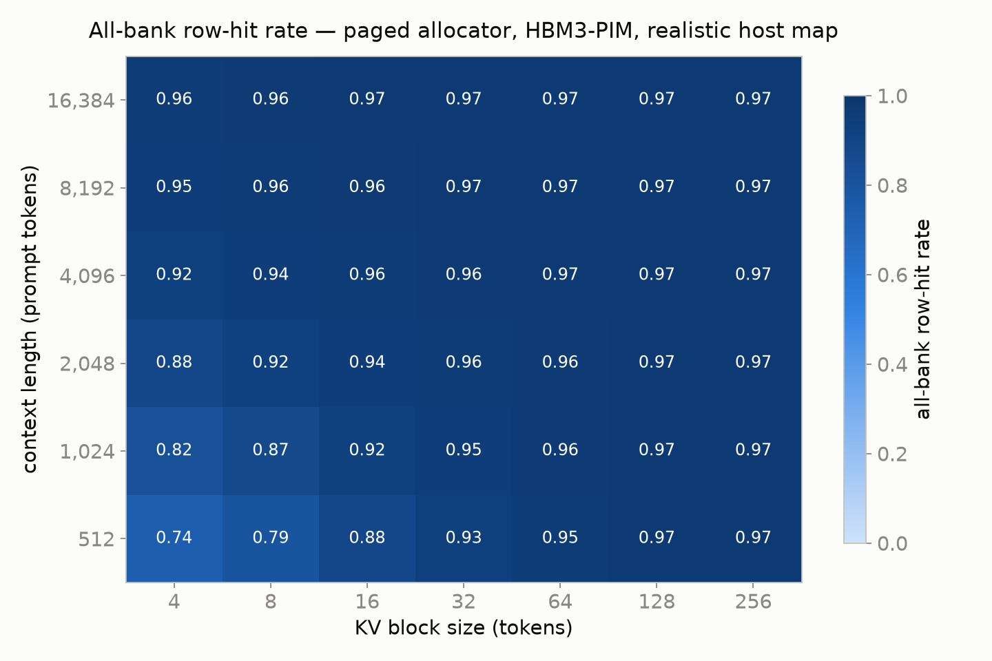
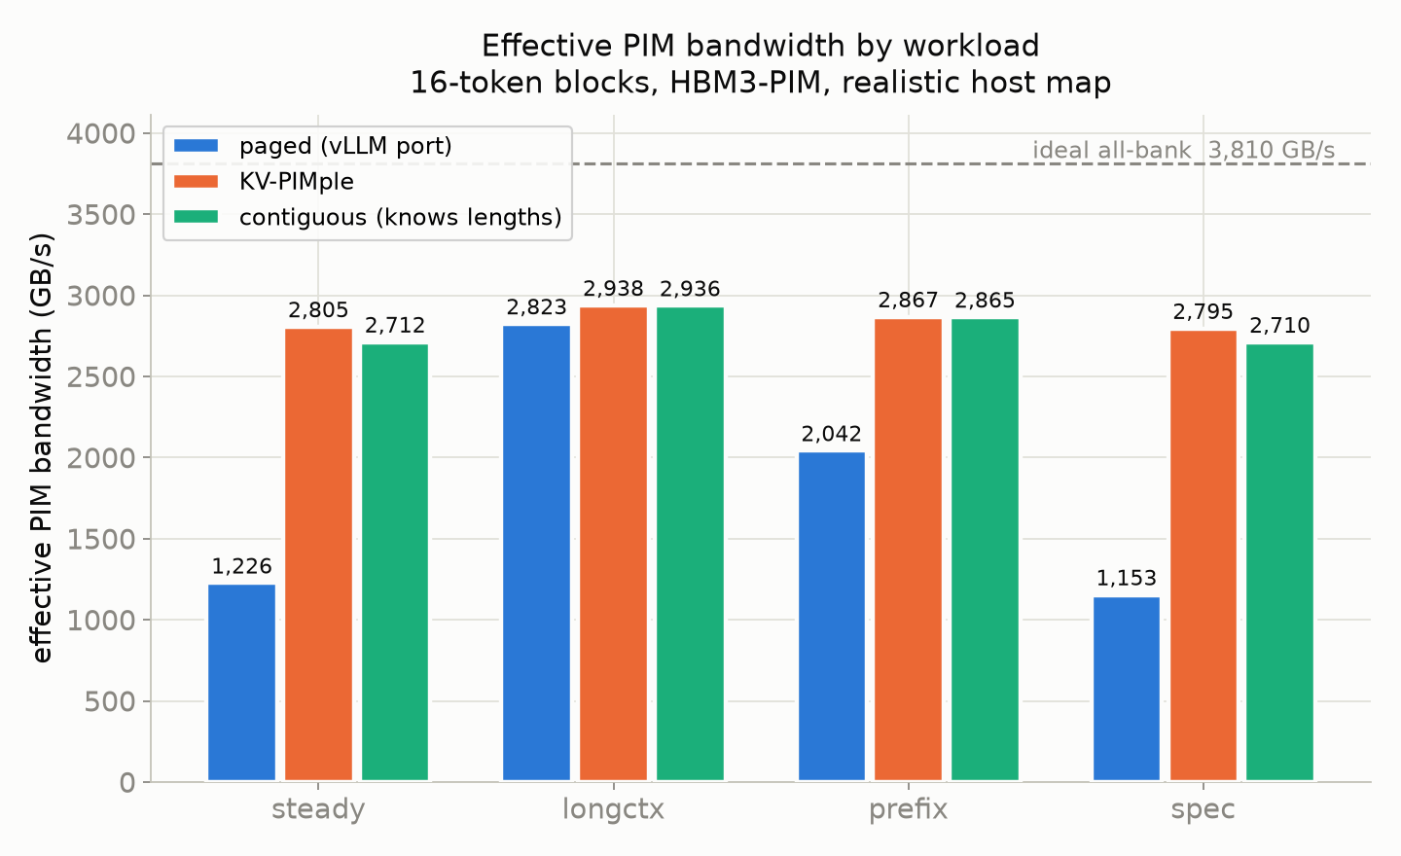
KV-PIMple: PIM-aware KV-cache Allocation
Workload
Workload:
Row-hit rate grows with context length & block size (caps at near 0.97)
If we just naively increase block size:
- Internal fragmentation
- Prefix sharing gets coarser

Slide 10
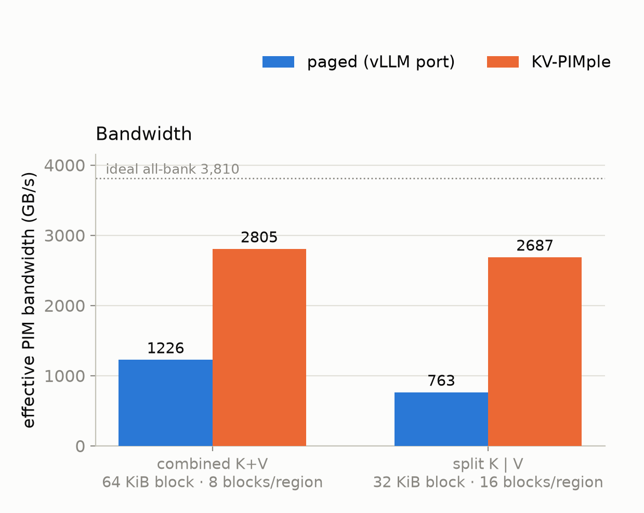

KV-PIMple: PIM-aware KV-cache Allocation
KV Tensor Layout
KV-PIMple: 4 KB/token -> 64 KB block -> 8 blocks fill a row
vLLM: K and V stay in separate tensors -> each sees half the bytes -> 32 KB block -> 16 blocks fill a row
Smaller block per tensor -> a row activation covers half as many reads
Paged pays one activation per block either way -> row-hit 0.77 -> 0.55
KV-PIMple still fills a whole row before moving on -> row-hit 0.96 -> 0.96 (at the 0.969 ceiling)
Bandwidth gain therefore widens: 2.3× -> 3.5×
Note: Every measurement before/after this slide were run on 64 KB blocks

Slide 11
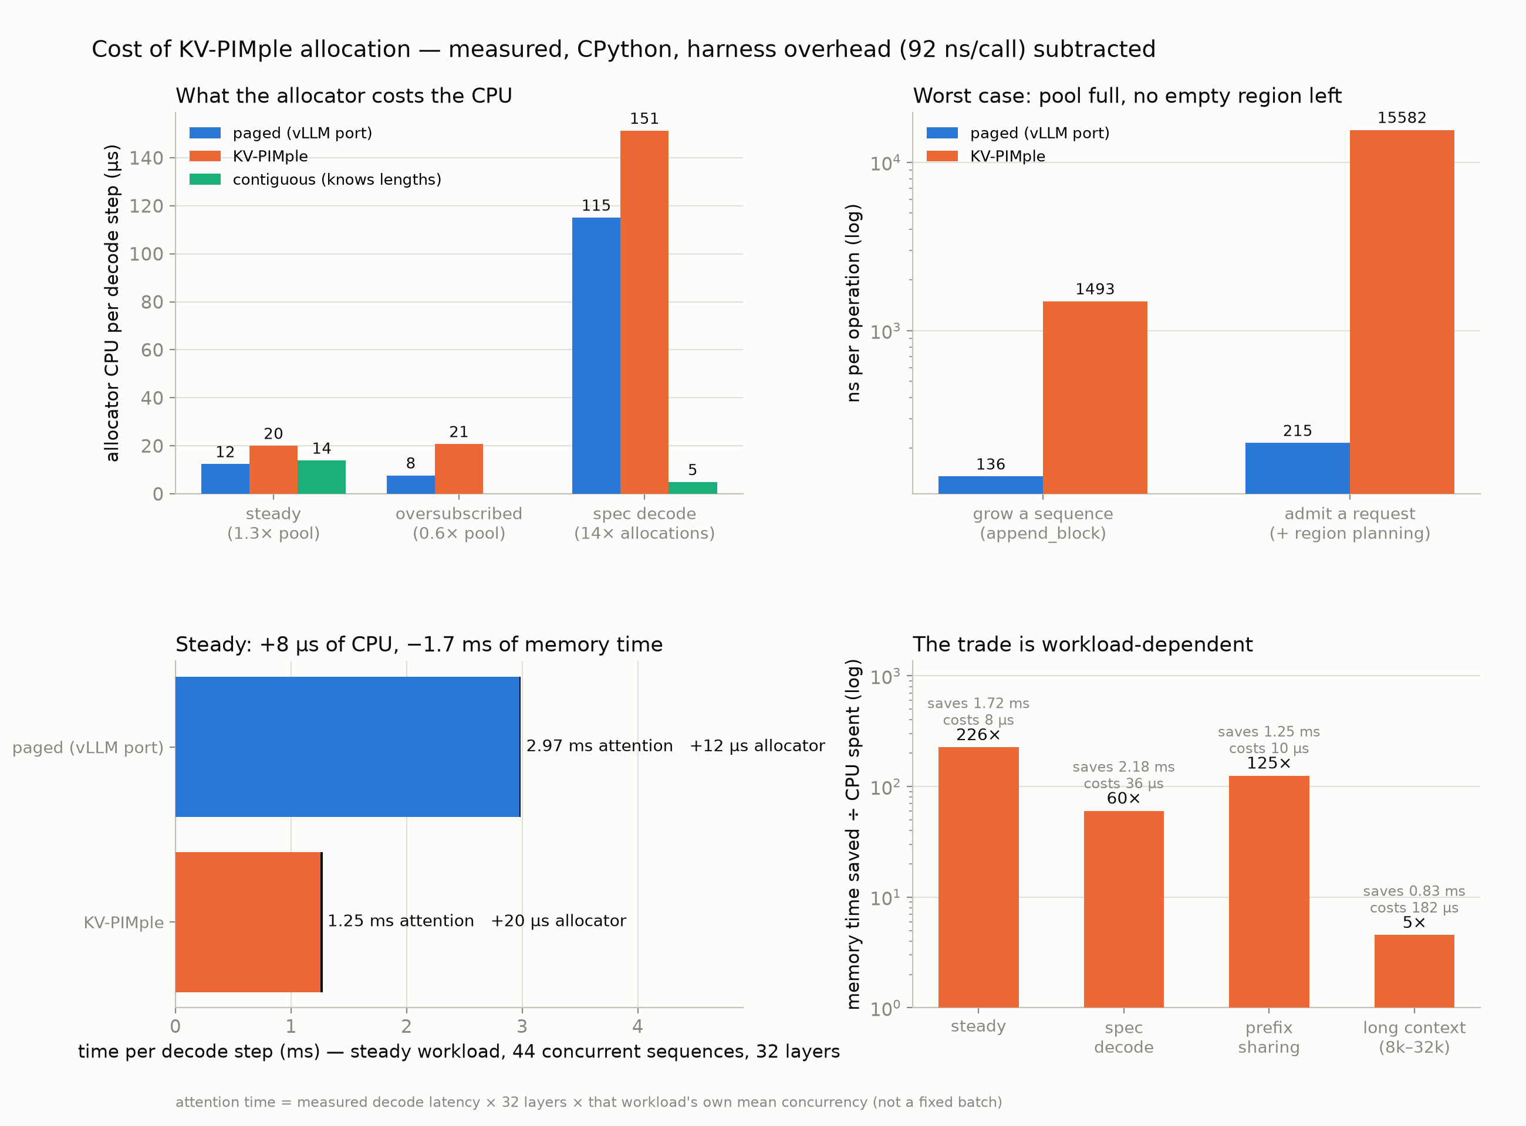
KV-PIMple: PIM-aware KV-cache Allocation
Cost of Implementations
vLLM pops any block off a free list (one operation). We pop the lowest free slot from that sequence's region heap, and the lowest empty region when it fills -> ordered structures instead of a single list
Headroom: an empty region is almost always available
Oversubscribed: no region is ever empty -> falls back to scanning all regions
Speculative decoding: each round forks 4 draft branches, keeps one and frees the rest -> churn-dominated: 110 allocations/step vs. 6 in steady
Worst case per operation: the admission cost is best-fit region planning, which sorts every region and is droppable (measured as a no-op)
Memory: region bookkeeping is 70 KiB vs vLLM's 113 KiB free list -> no memory cost
The trade: Increase CPU time per decode step to gain memory time. Benefit-to-cost runs from 226× on steady down to 5× on long context
Cost and trade-offs of KV-PIMple compared to plain Paging

Slide 12
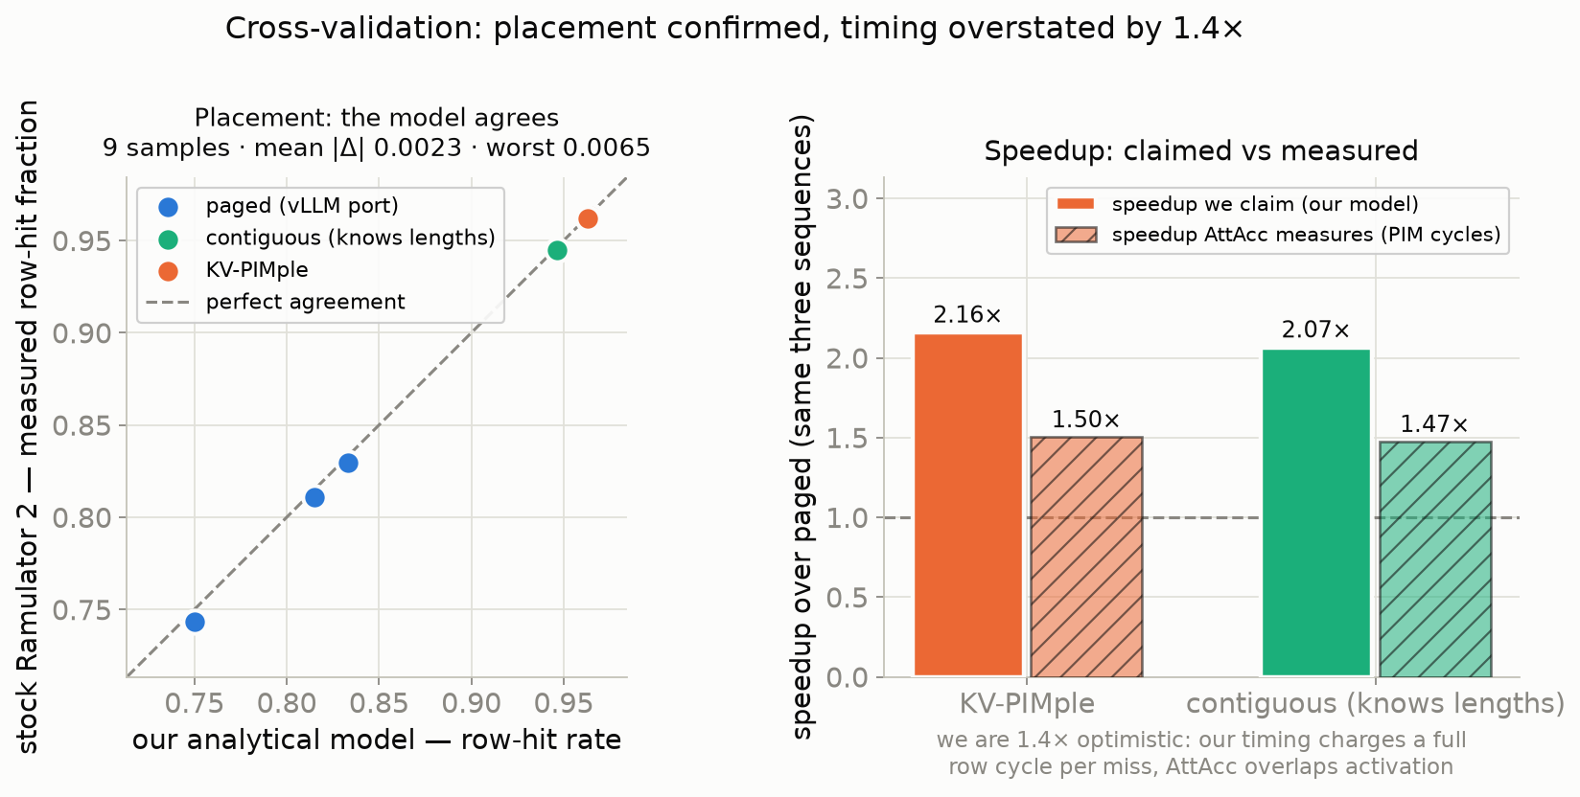
KV-PIMple: PIM-aware KV-cache Allocation
Validation Against Other Simulators
KV-PIMple_sim generates memory traces -> run inside Ramulator & AttAcc

Slide 13
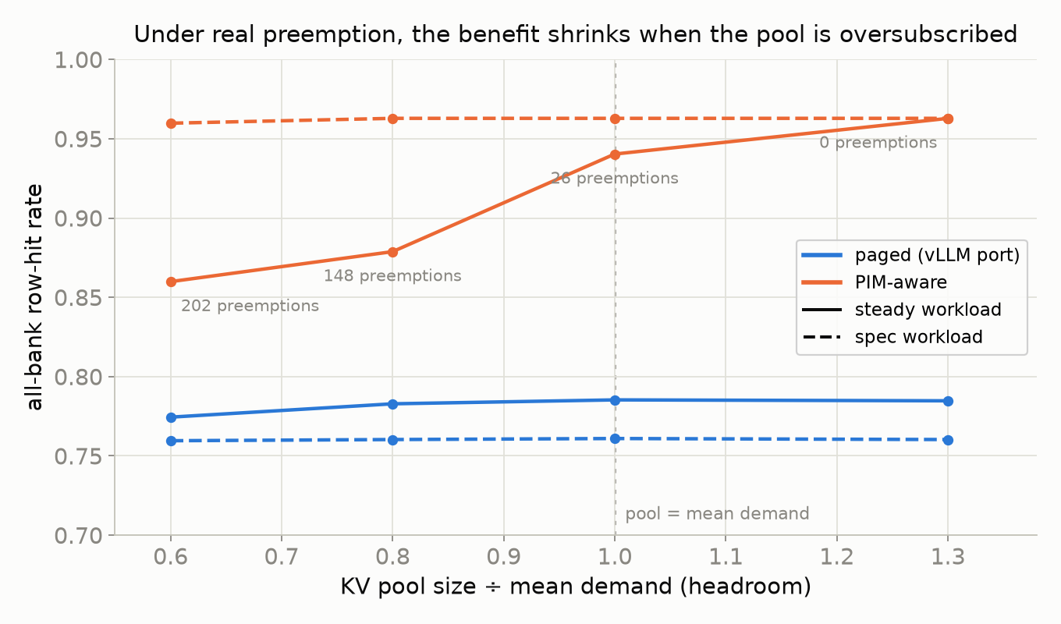
KV-PIMple: PIM-aware KV-cache Allocation
Gaps & Challenges
Preemption: Benefits shrink when the memory pool is oversubscribed -> 2.3× to 1.38× -> still above the baseline
Long Context: thousands of tokens per request (which is normal) then the plain Paged allocator easily reaches 95%+ row-hit rate
Too many heads: #_heads is proportional to the token size -> saturate the regions -> row hit -> our advantages shrink
Timing overstated compared to AttAcc
vLLM: KV-PIMple DID NOT run vLLM directly since I can’t afford the time & resources for that. KV-PIMple just modeled vLLM’s allocation policy and measure 1 representative layer
KV-PIMple only measured where the KV go, not the writes themselves
Speculative workload survives since the requests finish too fast to be evicted

Slide 14
KV-PIMple: PIM-aware KV-cache Allocation
Gaps & Challenges
It turns out that this idea is not new!
1. Static PIM Layout (AttAcc, NeuPIMs, Pimba, L3,...)
2. Dynamic PIM layout:
LoL-PIM/PIMphony: Their chunk is the same object as our region. The constant differs with geometry (1 MB here), and their chunk belongs to one request, with no mentioning of degrading in case of a busy server. Also, there is no mention of prefix-sharing support
BlockPIM: per-block greedy placement across channels, so a request isn't pinned to one channel. Block size derived as banks × row / bytes-per-token (256 tokens in their HBM3 config) so one block = one all-bank op -> same idea, at per-channel granularity. However, since BlockPIM grows the block to the hardware-natural size instead of using vLLM 16-token block, the granularity becomes coarser -> internal fragmentation
3. Sparsity:
STARC: Row ordering for sparsity (dropping calculations on KV pairs that contribute negligibly to the final distribution)

Slide 15
KV-PIMple: PIM-aware KV-cache Allocation
Gaps & Challenges
4. Concurrent:
PATTON (Sep 10th, 2026): The work closest to mine. Their hierarchy is:
  Order-0: one 32 B burst in every bank of a channel -> same as my all-bank burst (S = 32 B × 16 banks)
  Order-1: one vLLM 16-token block, bound to an exact channel-bank-row-column address
  Order-2: a request-owned group of 16 blocks inside a key or value row set -> same as my region. But theirs is a fixed 16 blocks per group (N_O1p2 = 16) while mine is derived from geometry
  Placement order: same spread across channels first, then pack row
  Granularity: same finding, where without bounded O-2 group, Under capacity pressure (>250K live tokens), KV cache hit rate collapses from 82.09% to 30.30% -> coarse aligned reservations cost memory
  Same staging trick: write unfinished data somewhere temporarily, then copy them into a row-aligned space later. They use this for half-filled blocks, while KV-PIMple uses it for speculative decoding

Slide 16
KV-PIMple: PIM-aware KV-cache Allocation
What Stands
Still, KV-PIMple:
Measured the baseline (plain vLLM on PIM), while PATTON only measured 4 allocators they mentioned (NeuPIMs, AttAcc, BlockPIM, PIMphony)
Explained the reason why the units have the size they do, while PATTON used a fixed constant, stating that the performance is best at that config
Measured vLLM preemption-by-recompute (2.13× -> 1.38×), reorder window, batch size, spec decoding with copy-on-write,...
While they:
Cover gaps I have, like the write path and KV asymmetry, prefix caching, and real engine integration
Have different hardware
Have probably more thorough testing than I did

Slide 17
KV-PIMple: PIM-aware KV-cache Allocation
Fun Fact
KV is my initial. KV also means Key/Value
PIMple rhymes with simple, which is the point. All I did was changing the policy on top of an already-existed allocator
PIMple also literally means pimple, since I’m an adolescence and still have many pimples

Slide 18
References
[1] Yongchan Jung, Shafayat Mowla Anik, Byeong Kil Lee, and Jeeho Ryoo. 2026. RH+: Row-Hit-Optimized Scheduling for PIM-based LLM Inference. arXiv:2606.05511 [cs.ET]. https://arxiv.org/abs/2606.05511
[2] Haocong Luo, Yahya Can Tuğrul, F. Nisa Bostancı, Ataberk Olgun, A. Giray Yağlıkçı, and Onur Mutlu. 2023. Ramulator 2.0: A Modern, Modular, and Extensible DRAM Simulator. arXiv:2308.11030 [cs.AR]. https://arxiv.org/abs/2308.11030
[3] SAFARI Research Group. 2023. Ramulator 2.0 (source code). https://github.com/CMU-SAFARI/ramulator2
[4] Jaehyun Park, Jaewan Choi, Kwanhee Kyung, Michael Jaemin Kim, Yongsuk Kwon, Nam Sung Kim, and Jung Ho Ahn. 2024. AttAcc! Unleashing the Power of PIM for Batched Transformer-based Generative Model Inference. In ASPLOS '24, Vol. 2. ACM, 103–119. https://doi.org/10.1145/3620665.3640422
[5] SCALE Lab, Seoul National University. 2024. AttAcc Simulator (source code). https://github.com/scale-snu/attacc_simulator
[6] Sukhan Lee, Shin-haeng Kang, Jaehoon Lee, et al. 2021. Hardware Architecture and Software Stack for PIM Based on Commercial DRAM Technology. In ISCA '21. IEEE, 43–56. https://doi.org/10.1109/ISCA52012.2021.00013

Slide 19
References
[7] vLLM Project. 2023. vLLM (source code). https://github.com/vllm-project/vllm
[8] Woosuk Kwon, Zhuohan Li, Siyuan Zhuang, Ying Sheng, Lianmin Zheng, Cody Hao Yu, Joseph E. Gonzalez, Hao Zhang, and Ion Stoica. 2023. Efficient Memory Management for Large Language Model Serving with PagedAttention. https://arxiv.org/pdf/2309.06180
[9] Guseul Heo, Sangyeop Lee, Jaehong Cho, Hyunmin Choi, Sanghyeon Lee, Hyungkyu Ham, Gwangsun Kim, Divya Mahajan, and Jongse Park. 2024. NeuPIMs: NPU-PIM Heterogeneous Acceleration for Batched LLM Inferencing. In ASPLOS '24, Vol. 3. ACM, 722–737. https://doi.org/10.1145/3620666.3651380
[10] CASYS Lab, KAIST. 2024. NeuPIMs Simulator (source code). https://github.com/casys-kaist/NeuPIMs
[11] Hyucksung Kwon, Kyungmo Koo, Janghyeon Kim, et al. 2024. PIMphony: Overcoming Bandwidth and Capacity Inefficiency in PIM-based Long-Context LLM Inference System. https://arxiv.org/abs/2412.20166
[12] Qingyuan Liu, Liyan Chen, Yanning Yang, Haocheng Wang, Dong Du, Zhigang Mao, Naifeng Jing, Yubin Xia, and Haibo Chen. 2025. L3: DIMM-PIM Integrated Architecture and Coordination for Scalable Long-Context LLM Inference https://arxiv.org/abs/2504.17584

Slide 20
References
[13] Zehao Fan, Garrett Gagnon, Zhenyu Liu, and Liu Liu. 2025. Sparse Attention Remapping with Clustering for Efficient LLM Decoding on PIM. https://arxiv.org/abs/2505.05772
[14] Zhichun Li, Jun Zhou, Xueqi Li, and Ninghui Sun. 2025. BlockPIM: Optimizing Memory Management for PIM-enabled Long-Context LLM Inference. In DAC '25. IEEE, 1–7. https://doi.org/10.1109/dac63849.2025.11133193
[15] Corey Lammie, Hadjer Benmeziane, William Andrew Simon, and Irem Boybat. 2026. On Design Principles for Efficient Heterogeneous DRAM-PIM-GPU Systems. https://arxiv.org/abs/2608.04169
[18] Hangyeol Kim, Sanghyun Lee, Teokkyu Suh, and Joo-Young Kim. 2026. PATTON: Enabling Commodity PIM for Production LLM Serving. https://arxiv.org/abs/2609.11392

Slide 21
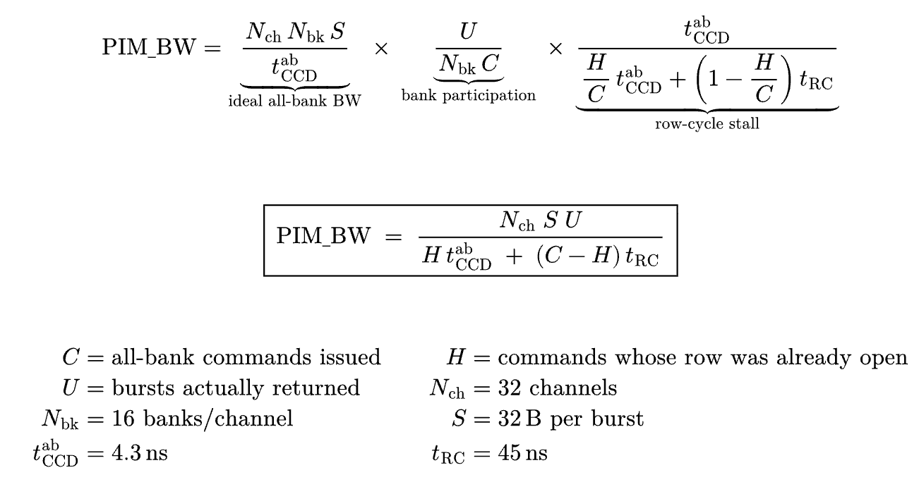
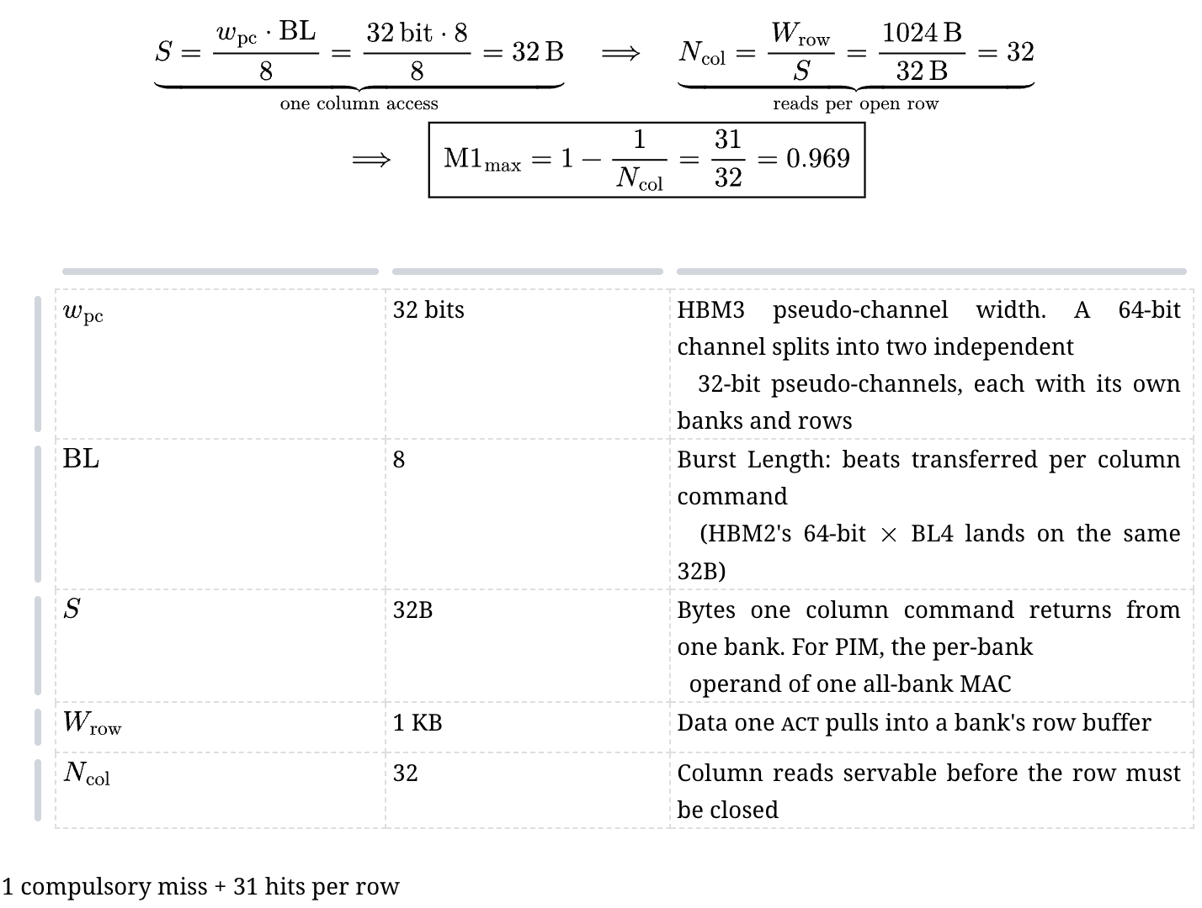
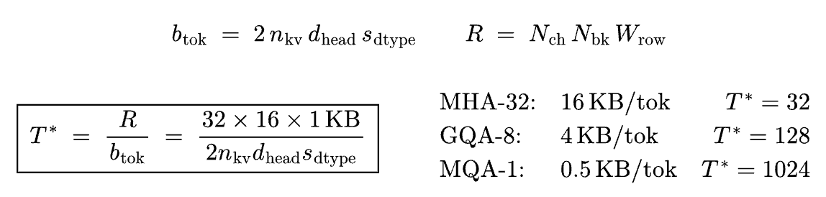
Equations
Relations between row-hit rate & bandwidth
Row-hit rate ceiling
Token & block size calculation

Slide 22
Thank You

