Slide 1

CI / CD
Value To The Business
Andrew Wasef

Slide 2
Presentation Content
CI/CD OVERVIEW
BENEFITS OF CI/CD

Slide 3
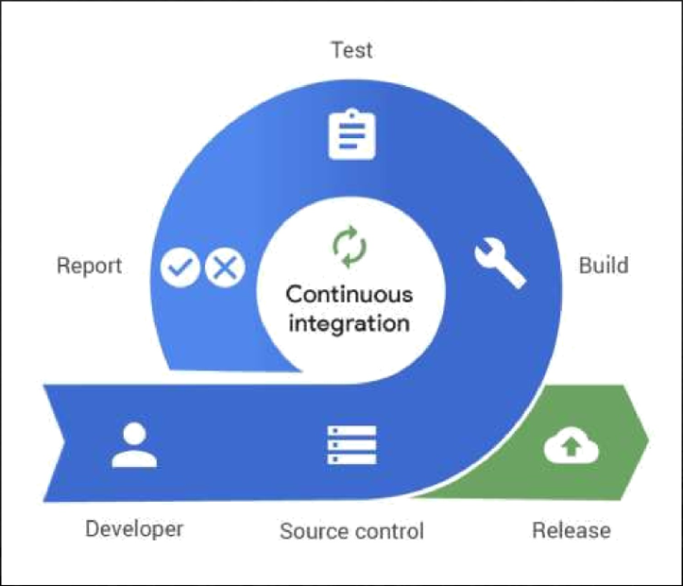
Continuous Integration “CI”: The practice of merging all developers' working copies to shared mainline several times a day. It's the process of "Making". Everything related to the code ﬁts here, and it all culminates in the ultimate goal of CI: a high-quality, deployable artifact!

Slide 4
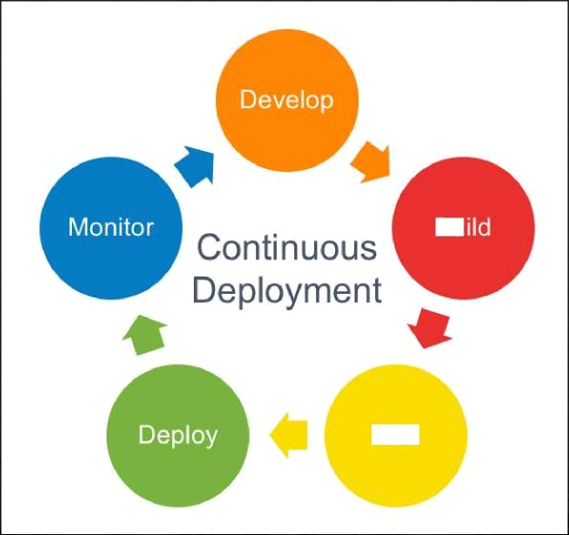

Continuous Deployment “CD”: A software engineering approach in which the value is delivered frequently through automated deployments. Everything related to deploying the artifact ﬁts here. It's the process of "Moving" the artifact from the shelf to the spotlight
Bu

Slide 5
Automate Infrastructure Creation and clean up: Eliminating human errors and avoid unnecessary cost of unused or invalid infrastructure Faster to production: By automating the pipeline to production this way, we can deploy features as soon as created which will help increase revenue Automated Rollback Triggered by Job Failure: Automate the process of rolling back and cleaning any infrastructure left which would help in reducing cost and lower down time Catch Compile Errors After Merge: Discover errors as soon as the developer make his commit which will help reduce the time of developers and reduce cost Catch Unit Test Failures: Unit tests are not neglected with CICD which will increase code quality and catch errors early before production which would decrease cost Automated Smoke Tests: Automate smoke test after deployment and automatic rollback in case of failure which will decrease downtime and reduce cost
Beneﬁts of CI/CD

