Slide 1
CS4770 - Group F
Milestone 1 Project Status
Notes:
“La ingeniería de eq de fases comprende la aplicación del conocimiento fenomenológico del comportamiento de sistemas homogéneos y multifásicos, y su predicción mediante herramientas termodinámicas, con la finalidad de contribuir al desarrollo de procesos químicos. El diseño del equilibrio de fases es un nexo entre los requerimiento de un dado proceso y las actividades académicas de medición y modelado de datos experimentales.
[…] Esta disponibilidad (de simuladores computacionales) hace necesario estudiarla, con la finalidad de alcanzar un uso más fehaciente y efectivo de éstos, a través del desarrollo de criterios generales que faciliten la comprensión del potencial y limitaciones del proceso químico.”
Pereda, tesis doctoral, PLAPIQUI/UNS 2003, pp 4.1.

Slide 2

Current Status
SRS Revision 1 complete
Group organization and role assignment complete
A testing database and server has been implemented
UI/UX design in progress

Slide 3
SRS
What is provided in the SRS?
  Introduction
    Purpose
    Intended Audience
    Scope
    Definitions
    References
    Overview
  Specific
  Requirements
    Functional requirements
    External interface
    requirements
    Non-functional
    requirements
  System use case
    Diagram
    Description

Slide 5
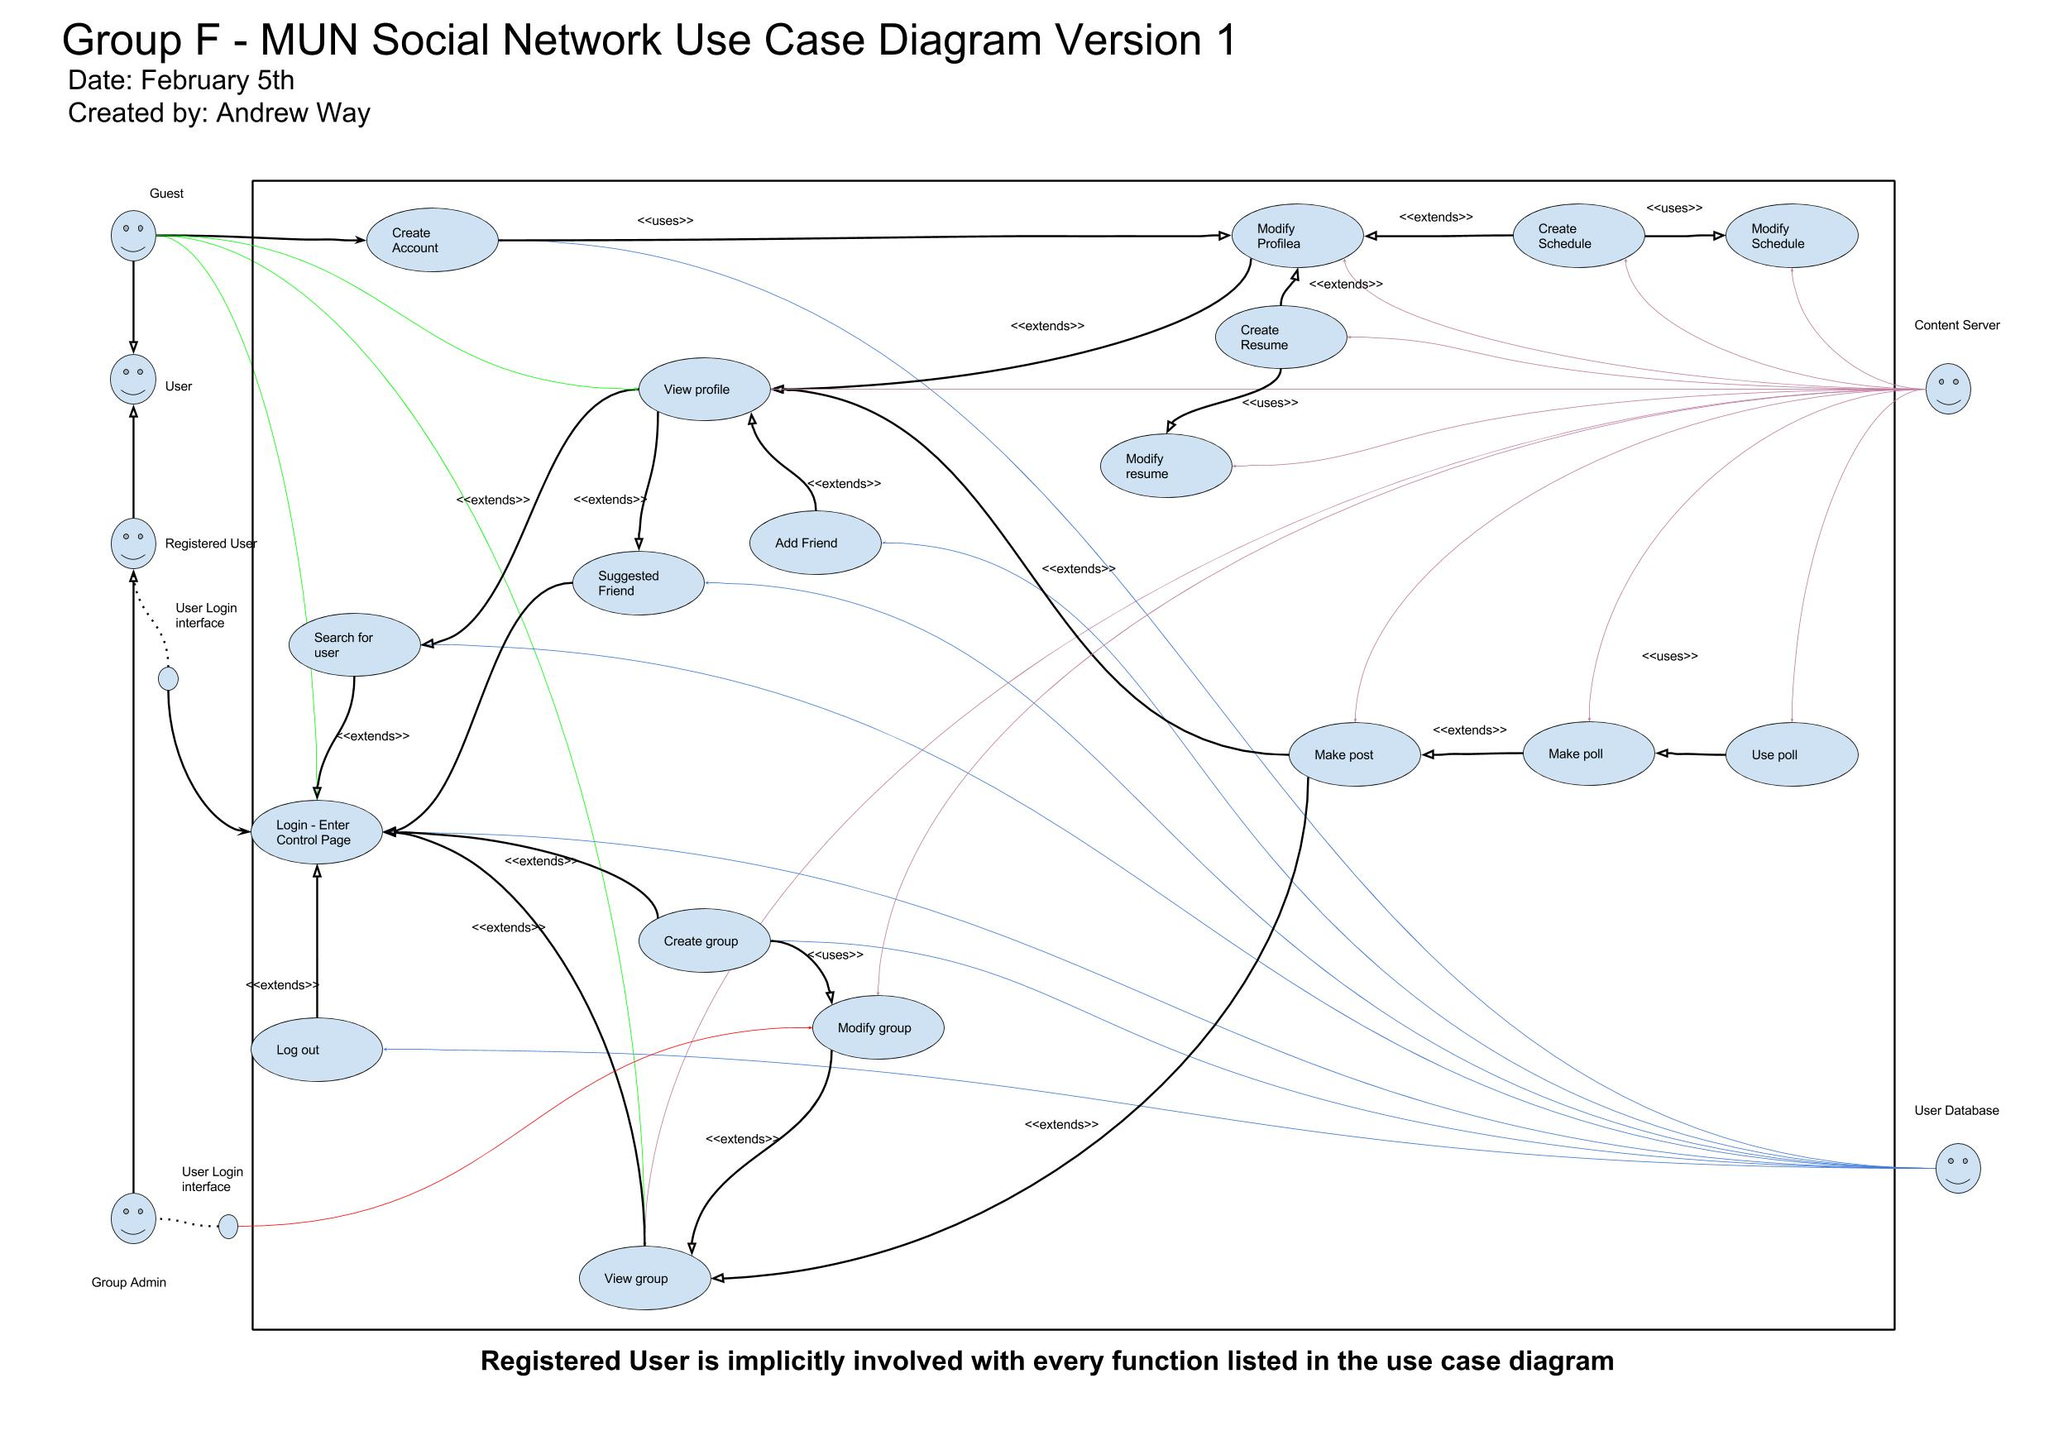

Slide 6
Use Case UC0: Create Account
Scope: Website Homepage
Level: user-goal
Primary Actor: Guest
Stakeholders and Interests:
User - needs an account to access the system
Administrator - Authentication is required so that other users cannot abuse the system
Preconditions: User has a mun email with no prior account attached
Postconditions: User account is created
Trigger: Site visitor clicks on registration button
Main Success Scenario:
1. User accesses site
2. User to start a new account
3. User types in their MUN email ID
4. User enters a password.
5. System sends a confirmation email to confirm successful creation and validation
Extensions:
2a. User uploads profile picture

Slide 7
Team organization
Each member is assigned a specific role
Roles were determined by questionnaire
Intended communication paths between roles
Group leader is the central communications path

Slide 8
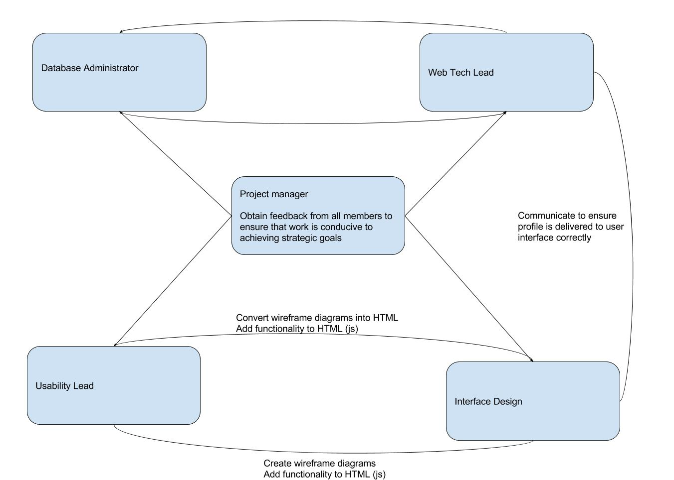

Slide 9
Testing environment
Server and database are deploy-able
Server currently features most of the node modules that will support the server when live
Provides everyone a testing platform as the application is developed

Slide 10
UI/UX
Simplify website building through templates
Sub templating with Hogan
Wireframe design pattern

Slide 11
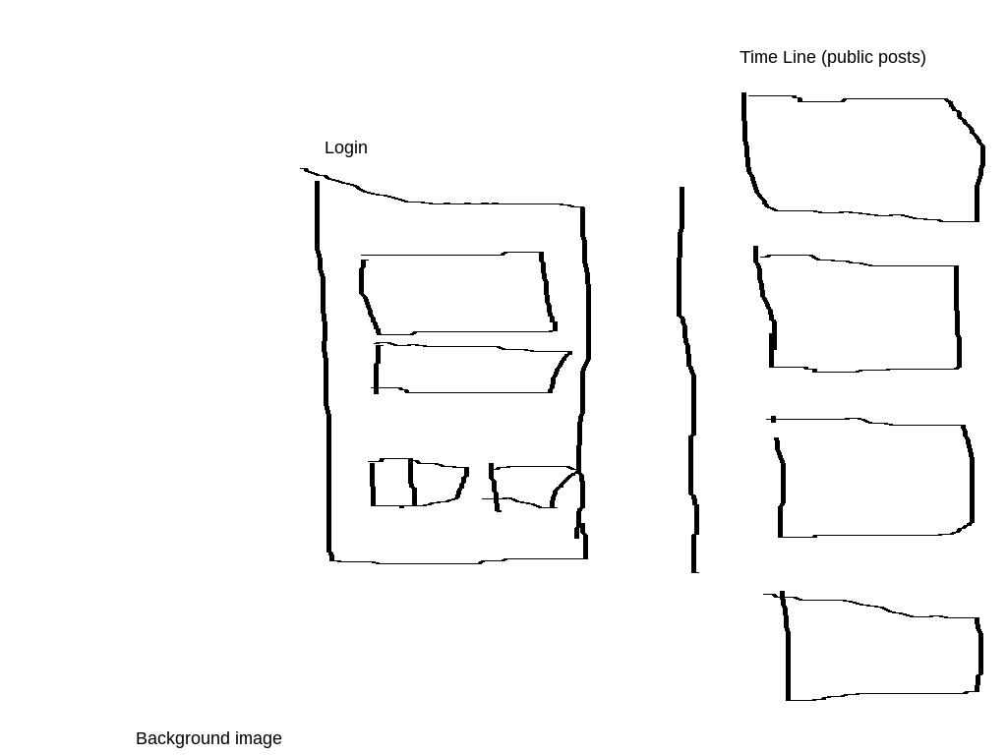
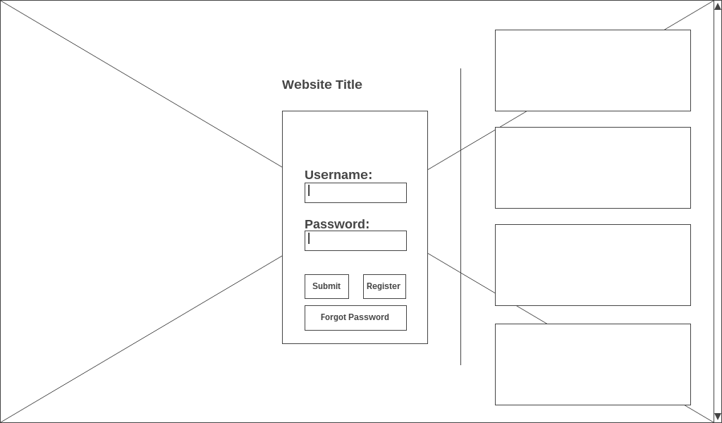
Wireframe workflow
Photoshop
Code

